Slide 1
Section 10.4
Addition and Subtraction with Radicals

Slide 2
Definition: Like Radicals
Like radicals have the same index and radicand, or they can be simplified so that they have the same index and radicand.

Slide 3
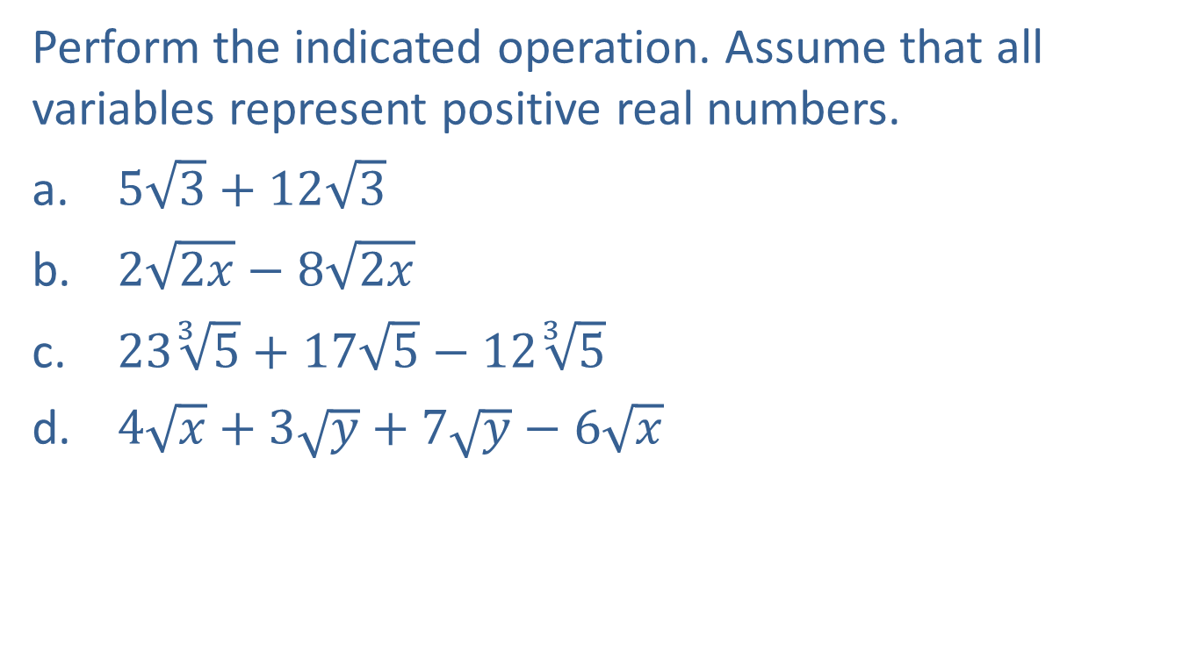
Example 1: Adding and Subtracting Radicals
Perform the indicated operation. Assume that all variables represent positive real numbers.
$5\sqrt{3}+12\sqrt{3}$
$2\sqrt{2x}−8\sqrt{2x}$
$23\sqrt[3]{5}+17\sqrt{5}−12\sqrt[3]{5}$
$4\sqrt{x}+3\sqrt{y}+7\sqrt{y}−6\sqrt{x}$

Slide 4

Example 1: Adding and Subtracting Radicals (cont.)
Solution
$5\sqrt{3}+12\sqrt{3}=\left(5+12\right)\sqrt{3}$
$=17\sqrt{3}$
$2\sqrt{2x}−8\sqrt{2x}=\left(2−8\right)\sqrt{2x}$
$=−6\sqrt{2x}$

Slide 5
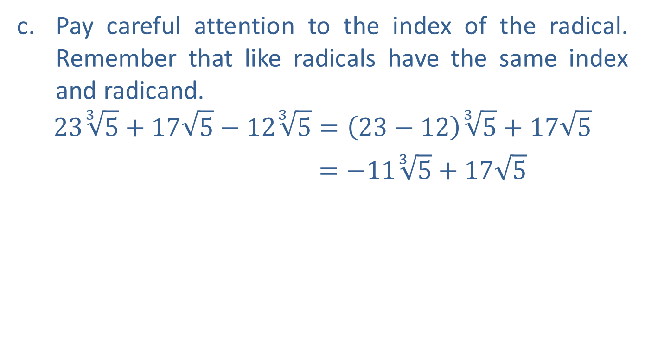
Example 1: Adding and Subtracting Radicals (cont.)
Pay careful attention to the index of the radical. Remember that like radicals have the same index and radicand.
$$23\sqrt[3]{5}+17\sqrt{5}−12\sqrt[3]{5}=\left(23−12\right)\sqrt[3]{5}+17\sqrt{5}$$
$=−11\sqrt[3]{5}+17\sqrt{5}$

Slide 6
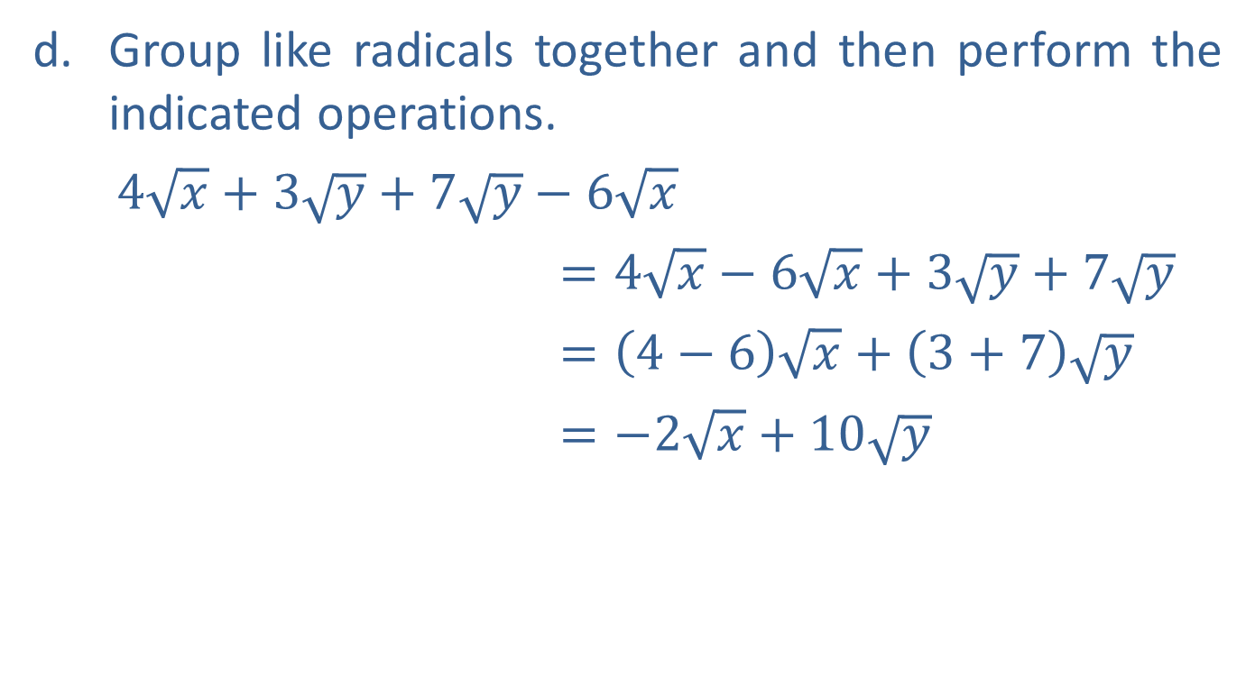
Example 1: Adding and Subtracting Radicals (cont.)
Group like radicals together and then perform the indicated operations.
$4\sqrt{x}+3\sqrt{y}+7\sqrt{y}−6\sqrt{x}$
$=4\sqrt{x}−6\sqrt{x}+3\sqrt{y}+7\sqrt{y}$
$=\left(4−6\right)\sqrt{x}+\left(3+7\right)\sqrt{y}$
$=−2\sqrt{x}+10\sqrt{y}$

Slide 7
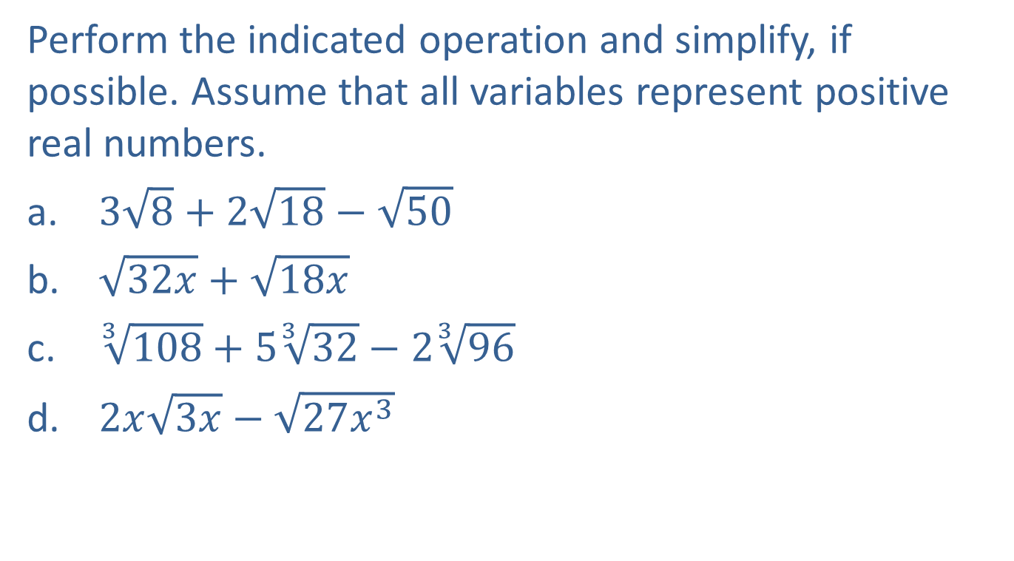
Example 2: Adding and Subtracting Radicals
Perform the indicated operation and simplify, if possible. Assume that all variables represent positive real numbers.
$3\sqrt{8}+2\sqrt{18}−\sqrt{50}$
$\sqrt{32x}+\sqrt{18x}$
$\sqrt[3]{108}+5\sqrt[3]{32}−2\sqrt[3]{96}$
$2x\sqrt{3x}−\sqrt{27x^{3}}$

Slide 8
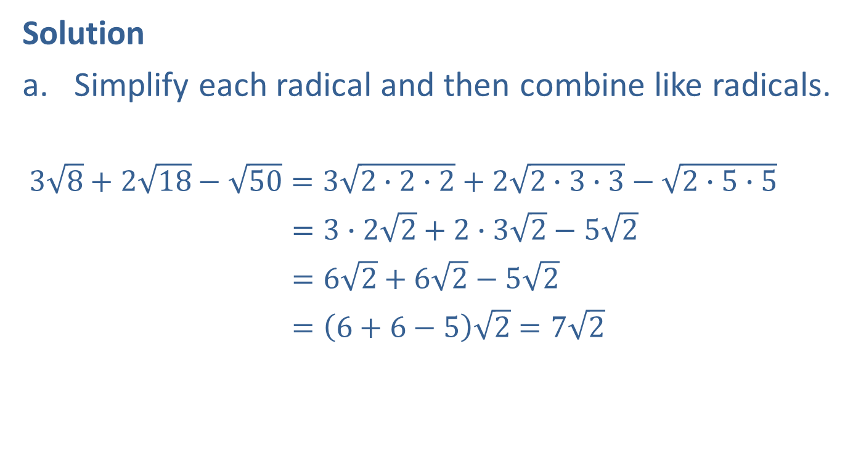
Example 2: Adding and Subtracting Radicals (cont.)
Solution
Simplify each radical and then combine like radicals.
$3\sqrt{8}+2\sqrt{18}−\sqrt{50}=3\sqrt{2∙2∙2}+2\sqrt{2∙3∙3}−\sqrt{2∙5∙5}$
$=3∙2\sqrt{2}+2∙3\sqrt{2}−5\sqrt{2}$
$=6\sqrt{2}+6\sqrt{2}−5\sqrt{2}$
$=\left(6+6−5\right)\sqrt{2}=7\sqrt{2}$

Slide 9

Example 2: Adding and Subtracting Radicals (cont.)
$\sqrt{32x}+\sqrt{18x}=\sqrt{2∙4∙4∙x}+\sqrt{2∙3∙3∙x}$
$=4\sqrt{2x}+3\sqrt{2x}$
$=\left(4+3\right)\sqrt{2x}=7\sqrt{2x}$

Slide 10
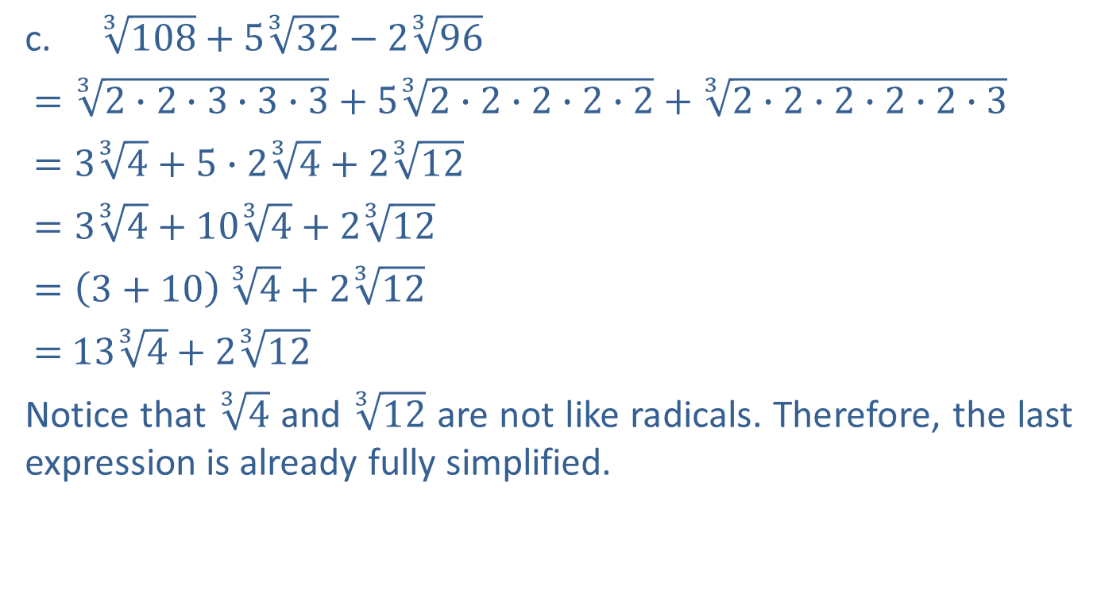
Example 2: Adding and Subtracting Radicals (cont.)
$\sqrt[3]{108}+5\sqrt[3]{32}−2\sqrt[3]{96}$
$=\sqrt[3]{2∙2∙3∙3∙3}+5\sqrt[3]{2∙2∙2∙2∙2}+\sqrt[3]{2∙2∙2∙2∙2∙3}$
$=3\sqrt[3]{4}+5∙2\sqrt[3]{4}+2\sqrt[3]{12}$
$=3\sqrt[3]{4}+10\sqrt[3]{4}+2\sqrt[3]{12}$
$=\left(3+10\right)$ $\sqrt[3]{4}+2\sqrt[3]{12}$
$=$ $13\sqrt[3]{4}+2\sqrt[3]{12}$
Notice that $\sqrt[3]{4}$ and $\sqrt[3]{12}$ are not like radicals. Therefore, the last expression is already fully simplified.

Slide 11

Example 2: Adding and Subtracting Radicals (cont.)
$2x\sqrt{3x}−\sqrt{27x^{3}}=$ $2x\sqrt{3∙x}−\sqrt{3∙3∙3∙x∙x∙x}$
$=2x\sqrt{3x}−3x\sqrt{3x}=−x\sqrt{3x}$

Slide 12
Completion Example 3: Adding and Subtracting with Radicals
Perform the indicated operations and simplify, if possible. Assume that all variables represent positive real numbers.
Solution
3 + 5 − 1
7
1 + 8
4 + 3
9
7

