Slide 1
Section 1.2
Prime Factorization and Least Common Multiple

Slide 2
Definition: Prime Number
A prime number is a counting number greater than 1 that has exactly two different factors (or divisors), namely itself and 1.

Slide 3
Definition: Composite Number
A composite number is a counting number with more than two different factors (or divisors).

Slide 4
Example 1: Determining Prime Numbers
The following numbers are prime numbers because each has exactly two different factors, 1 and itself.
2: 2 has exactly two different factors, 1 and 2.
3: 3 has exactly two different factors, 1 and 3.
11: 11 has exactly two different factors, 1 and 11.
29: 29 has exactly two different factors, 1 and 29.

Slide 5
Example 2: Determining Composite Numbers
The following numbers are composite.
15: 1, 3, 5, and 15 are all factors of 15.
39: 1, 3, 13, and 39 are all factors of 39.
49: 1, 7, and 49 are all factors of 49.
51: 1, 3, 17, and 51 are all factors of 51.

Slide 6
Definition: Even and Odd Whole Numbers
If a whole number is divisible by 2, it is even.
If a whole number is not divisible by 2, it is odd.

Slide 7
Procedure: Finding the Prime Factorization of a Composite Number
1. Factor the composite number into any two factors.
2. Factor each factor that is not prime into two more factors.
3. Continue this process until all factors are prime.
The prime factorization is the product of all the prime factors.

Slide 8
Note
You may have studied quick tests for divisibility by 2, 3, 4, 5, 6, 9, and 10 in a previous course in mathematics. For example, a number is divisible by 2, and therefore even, if the units digit is 0, 2, 4, 6, or 8. We will make reference to some of these tests for divisibility in the examples. See the end of this section for a brief review of this helpful topic.

Slide 9
Example 3: Finding the Prime Factorization of a Number
Find the prime factorization of 90.
Solution
Since the units digit is 0, we know that 10 is a factor.
9 and 10 can both be factored so that each factor is a prime number. This is the prime factorization.

Slide 10
Example 3: Finding the Prime Factorization of a Number (cont.)
Or
Notice that the final prime factorization was the same in both factor trees even though the first pair of factors was different.
3 is prime, but 30 is not.
10 is not prime.
All factors are prime.

Slide 11

Example 3: Finding the Prime Factorization of a Number (cont.)
Since multiplication is commutative, the order of the factors is not important. What is important is that all the factors are prime. Writing the factors in order, we can write $90=2∙3∙$3 $∙$5 or, with exponents, $90=2∙3^{2}∙5$.

Slide 12

Example 4: Finding the Prime Factorization of a Number
Find the prime factorization of each number.
a. $65$ b. $−72$ c. $294$
Solution
5 is a factor because the units digit is 5. Since both 5 and 13 are prime, 5 ⋅ 13 is the prime factorization.
9 is a factor because the sum of the digits is 9

Slide 13
Example 4: Finding the Prime Factorization of a Number (cont.)
2 is a factor because the units digits is even.
3 is a factor of 147 because the sum of the digits is divisible by 3.
Prime factorization
Using exponents

Slide 14
Example 4: Finding the Prime Factorization of a Number (cont.)
If we begin with the product 294 = 6 ⋅ 49, we see that the prime factorization is the same.

Slide 15
Definition: Least Common Multiple (LCM)
The least common multiple (LCM) of two (or more) counting numbers is the smallest number that is a multiple of each of these numbers.

Slide 16
Procedure: Finding the LCM of a Set of Counting Numbers
1. Find the prime factorization of each number.
2. List the prime factors that appear in any one of the prime factorizations.
3. Find the product of these primes using each prime the most number of times it appears in any one of the prime factorizations.

Slide 17
Example 5: Finding the Least Common Multiple (LCM)
Find the LCM of 8, 10, and 30.
Solution
Step 1: Prime factorizations:
8 = 2 ⋅ 2 ⋅ 2 Three 2s
10 = 2 ⋅ 5 One 2, one 5
30 = 2 ⋅ 3 ⋅ 5 One 2, one 3, one 5
Step 2: 2, 3, and 5 are the prime factors.

Slide 18
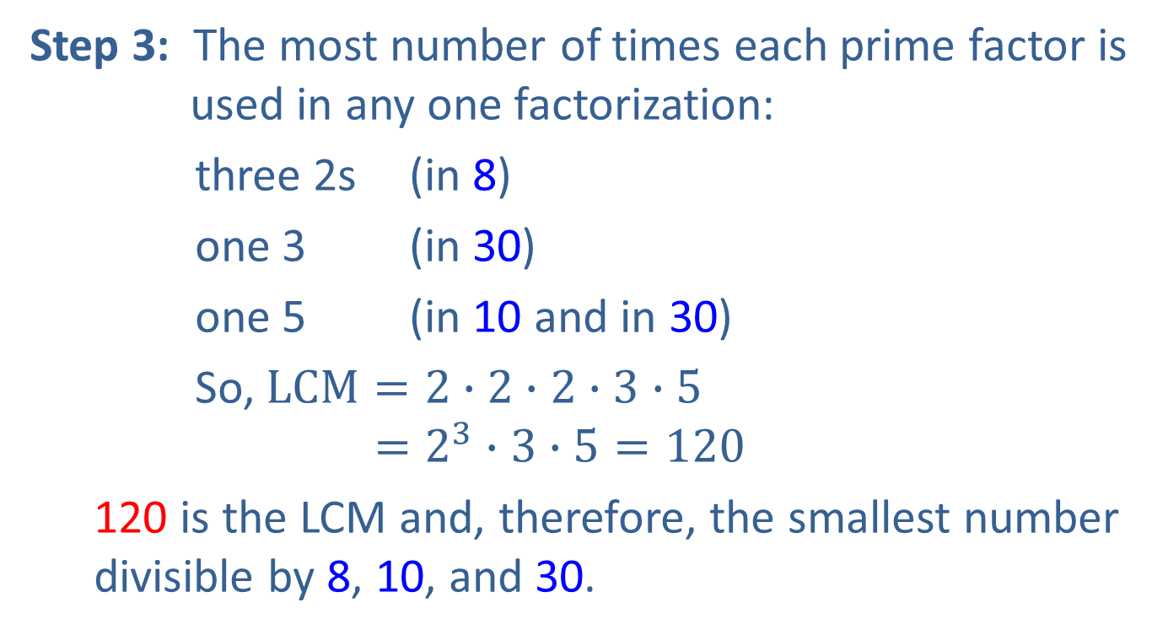
Example 5: Finding the Least Common Multiple (LCM) (cont.)
Step 3: The most number of times each prime factor is used in any one factorization:
three 2s (in 8)
one 3 (in 30)
one 5 (in 10 and in 30)
So, $LCM=2∙2∙2∙3∙5$ $$=2^{3}∙3∙5=120$$
120 is the LCM and, therefore, the smallest number divisible by 8, 10, and 30.

Slide 19
Example 6: Finding the Least Common Multiple (LCM)
Find the LCM of 27, 30, 35, and 42.
Solution
Step 1: Prime factorizations:
27 = 3 ⋅ 3 ⋅ 3 Three 3s
30 = 2 ⋅ 3 ⋅ 5 One 2, one 3, one 5
35 = 5 ⋅ 7 One 5, one 7
42 = 2 ⋅ 3 ⋅ 7 One 2, one 3, one 7
Step 2: 2, 3, 5, and 7 are the prime factors.

Slide 20
Example 6: Finding the Least Common Multiple (LCM) (cont.)
Step 3: The most number of times each prime factor appears in any one factorization:
one 2 (in 30 and in 42)
three 3s (in 27)
one 5 (in 30 and in 35)
one 7 (in 35 and in 42)
LCM = 2 ⋅ 3 ⋅ 3 ⋅ 3 ⋅ 5 ⋅ 7
= 2 ⋅ 3³ ⋅ 5 ⋅ 7 = 1890
1890 is the smallest number divisible by all four of the numbers 27, 30, 35, and 42.

Slide 21
Procedures: Tests for Divisibility
A number is divisible
By 2: if the units digit is 0, 2, 4, 6, or 8.
By 3: if the sum of the digits is divisible by 3.
By 4: if the number formed by the last two digits is divisible by 4.
By 5: if the units digit is 0 or 5.
By 6: if the number is divisible by both 2 and 3.
By 9: if the sum of the digits is divisible by 9.
By 10: if the units digit is 0.

