Slide 1
Section 1.1
Exponents and Order of Operations with Integers

Slide 2
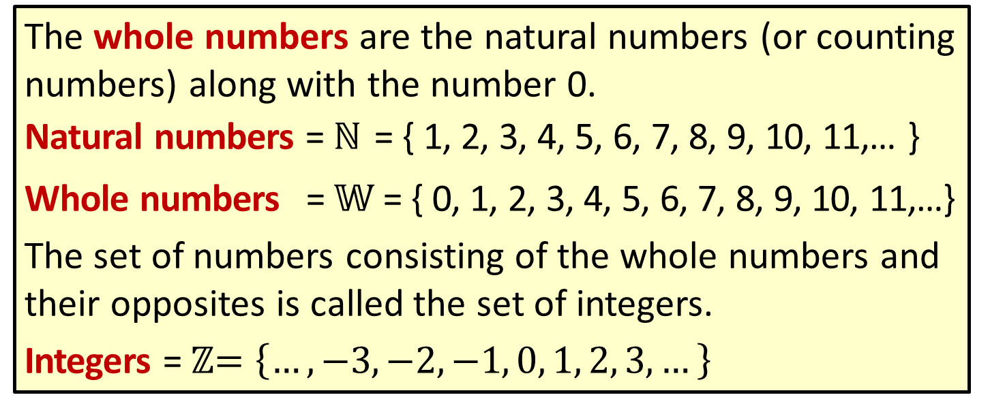
Definition: Types of Numbers
The whole numbers are the natural numbers (or counting numbers) along with the number 0.
Natural numbers = ℕ = { 1, 2, 3, 4, 5, 6, 7, 8, 9, 10, 11,… }
Whole numbers = 𝕎 = { 0, 1, 2, 3, 4, 5, 6, 7, 8, 9, 10, 11,…}
The set of numbers consisting of the whole numbers and their opposites is called the set of integers.
Integers = ℤ$=\left\{…,−3,−2,−1, 0, 1, 2, 3,…\right\}$

Slide 3
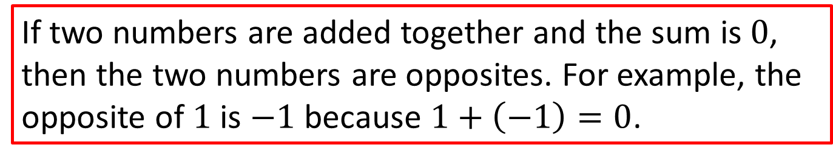
Note
If two numbers are added together and the sum is $0$, then the two numbers are opposites. For example, the opposite of $1$ is $−1$ because $1+\left(−1\right)=0$.

Slide 4
Definition: Variable
A variable is a symbol (generally a letter of the alphabet) that is used to represent an unknown number or any one of several numbers.

Slide 5
Definition: Exponent and Base
A whole number n is an exponent if it is used to tell how many times another whole number a is used as a factor. The repeated factor a is called the base of the exponent. Symbolically,
exponent
base

Slide 6
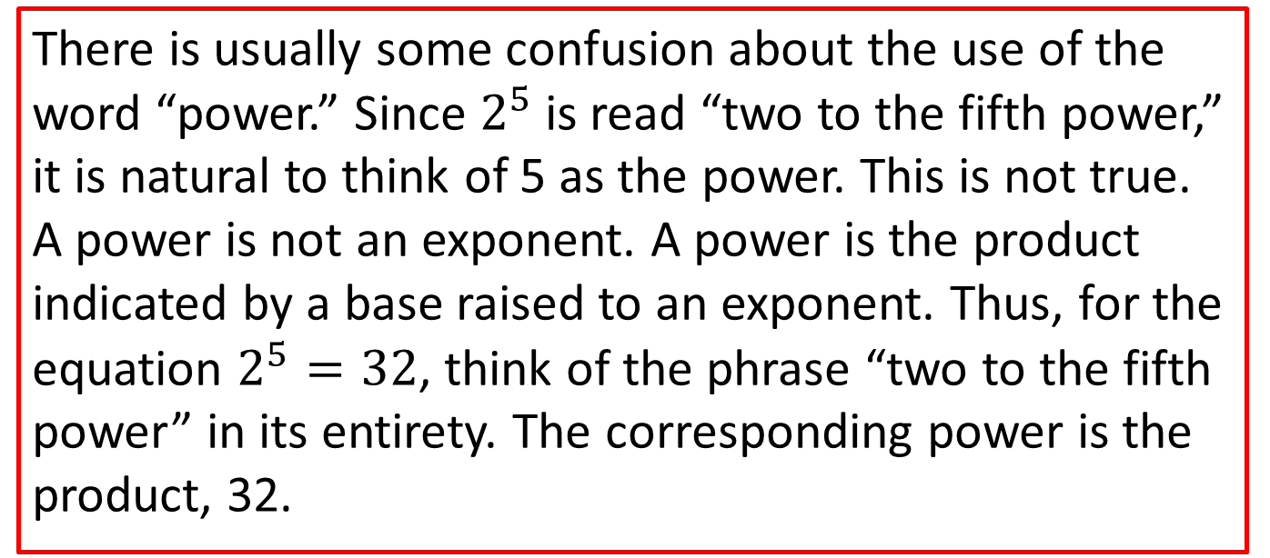
Note
There is usually some confusion about the use of the word “power.” Since $2^{5}$ is read “two to the fifth power,” it is natural to think of 5 as the power. This is not true. A power is not an exponent. A power is the product indicated by a base raised to an exponent. Thus, for the equation $2^{5}=32$, think of the phrase “two to the fifth power” in its entirety. The corresponding power is the product, 32.

Slide 7
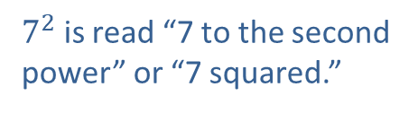
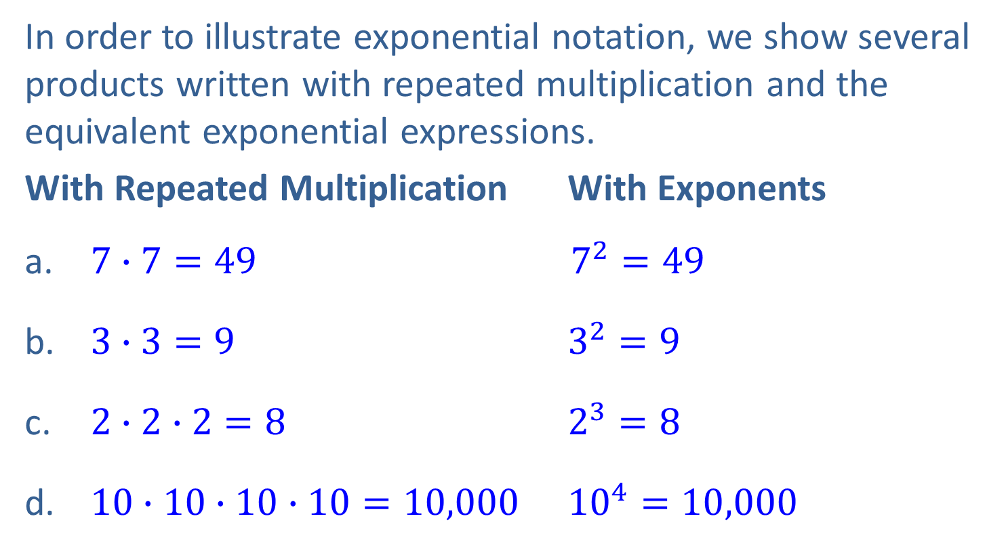
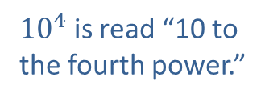
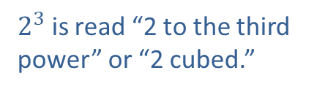

Example 1: Writing Expressions Using Exponents
In order to illustrate exponential notation, we show several products written with repeated multiplication and the equivalent exponential expressions.
With Repeated Multiplication With Exponents
$7∙7=49$ $7^{2}=49$
$3∙3=9$ $3^{2}=9$
$2∙2∙2=8$ $2^{3}=8$
$10∙10∙10∙10=10,000$ ${10}^{4}=10,000$
$7^{2}$ is read “7 to the second power” or “7 squared.”
$3^{2}$ is read “3 to the second power” or “3 squared.”
$2^{3}$ is read “2 to the third power” or “2 cubed.”
${10}^{4}$ is read “10 to the fourth power.”

Slide 8
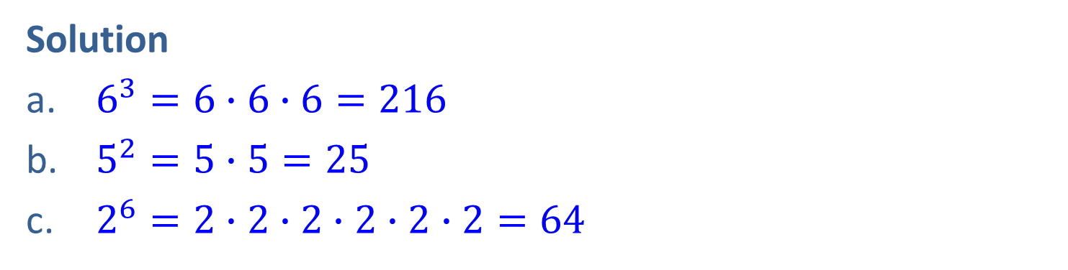
Example 2: Evaluating Exponential Expressions
Evaluate each exponential expression.
a. 6³
b. 5²
c. 2⁶
Solution
$6^{3}=6∙6∙6=216$
$5^{2}=5∙5=25$
$2^{6}=2∙2∙2∙2∙2∙2=64$

Slide 9
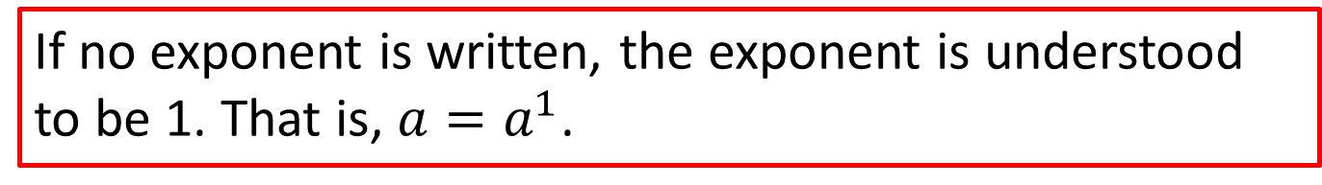
Note
If no exponent is written, the exponent is understood to be 1. That is, $a=a^{1}$.

Slide 10
Common Error
Wrong Solution Correct Solution
Do not multiply the base times the exponent.
Do multiply the base times itself.
INCORRECT
INCORRECT
CORRECT
CORRECT

Slide 11
Procedure: Rules for Order of Operations
Simplify within grouping symbols, such as parentheses ( ), brackets [ ], braces { }, or absolute value bars | |. (If there are more than one pair of grouping symbols, start with the innermost grouping symbols.)
Evaluate any exponential expressions.
Moving from left to right, perform any multiplication or division in the order in which it appears.
Moving from left to right, perform any addition or subtraction in the order in which it appears.

Slide 12

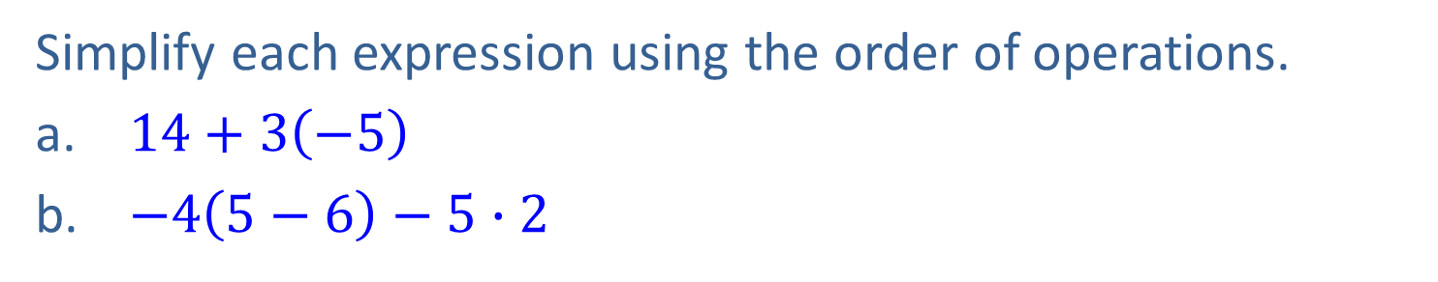
Example 3: Using the Order of Operations with Integers
Simplify each expression using the order of operations.
$14+3\left(−5\right)$
$−4\left(5−6\right)−5∙2$
Solution
$14+3\left(−5\right)=14+\left(−15\right)$
$=−1$
$−4\left(5−6\right)−5∙2=−4\left(−1\right)−5∙2$
$=4−5∙2$
$=4−10$
$=−6$

Slide 13
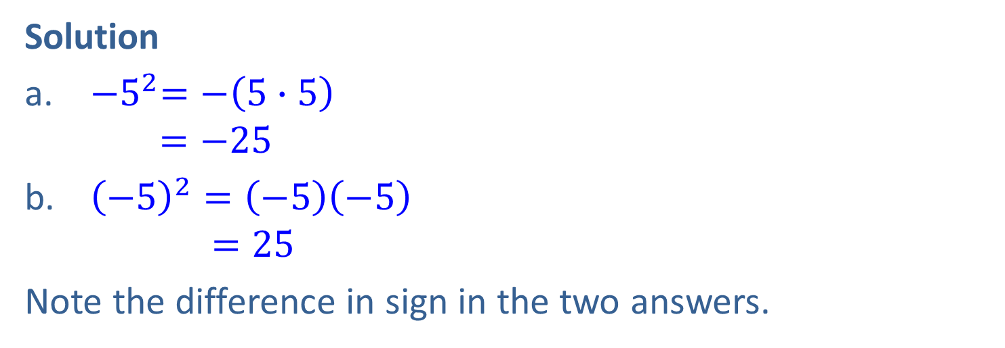
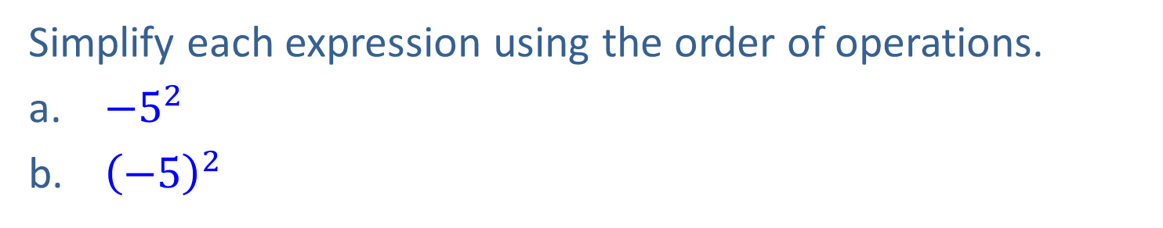
Example 4: Using the Order of Operations with Integers
Simplify each expression using the order of operations.
${−5}^{2}$
${\left(−5\right)}^{2}$
Solution
${−5}^{2}=−\left(5∙5\right)$
$=−25$
${\left(−5\right)}^{2}=\left(−5\right)\left(−5\right)$
$=25$
Note the difference in sign in the two answers.

Slide 14
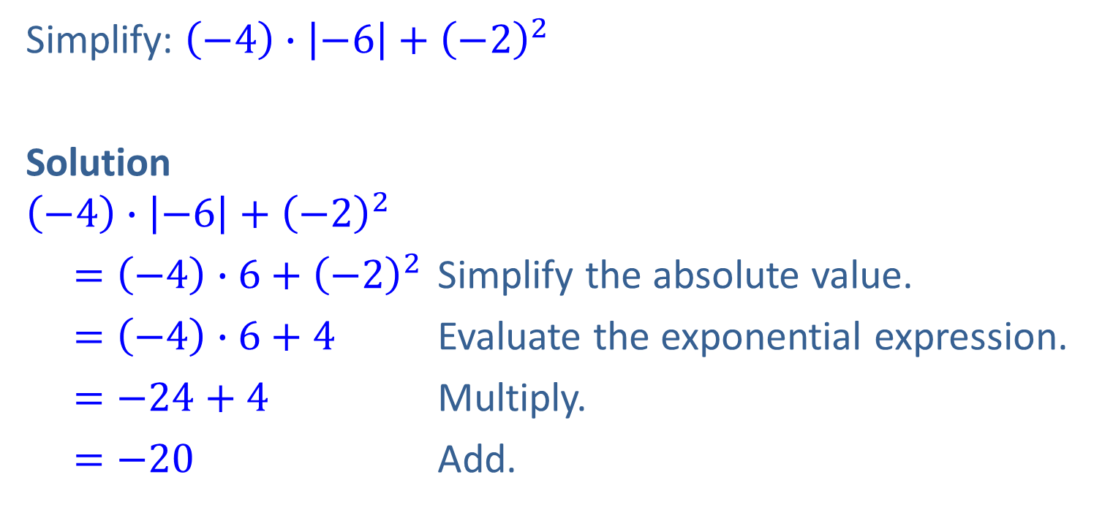
Example 5: Using the Order of Operations with Integers
Simplify: $\left(−4\right)∙\left|−6\right|+{\left(−2\right)}^{2}$
Solution
$$\left(−4\right)∙\left|−6\right|+{\left(−2\right)}^{2}$$
$=\left(−4\right)∙6+{\left(−2\right)}^{2}$ Simplify the absolute value.
$=\left(−4\right)∙6+4$ Evaluate the exponential expression.
$=−24+4$ Multiply.
$=−20$ Add.

Slide 15
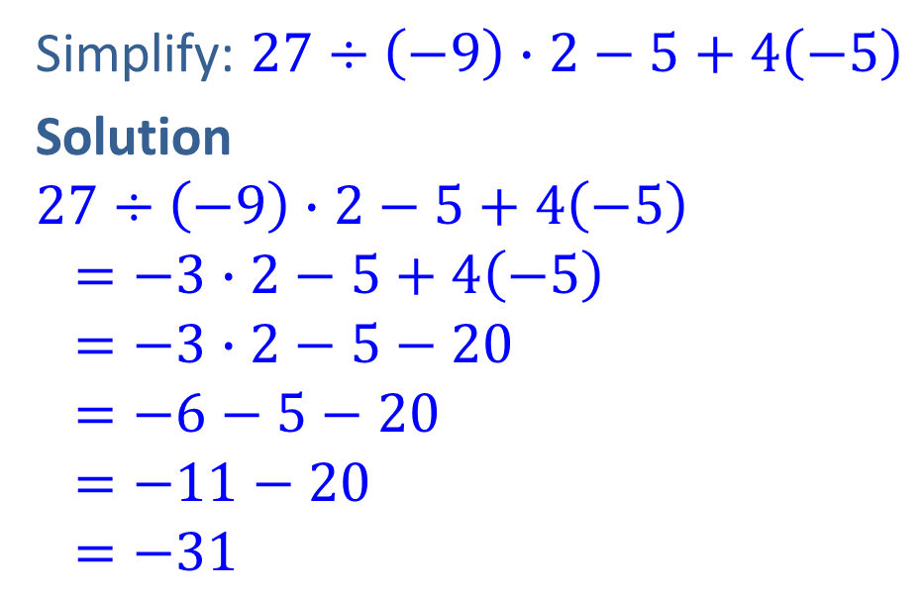
Example 6: Using the Order of Operations with Integers
Simplify: $27÷\left(−9\right)∙2−5+4\left(−5\right)$
Solution
$$27÷\left(−9\right)∙2−5+4\left(−5\right) \\ =−3∙2−5+4\left(−5\right)$$
$$=−3∙2−5−20$$
$$=−6−5−20$$
$$=−11−20 \\ =−31$$
Divide.
Multiply.
Multiply.
Add. Remember we are adding negative numbers.
Add.

Slide 16
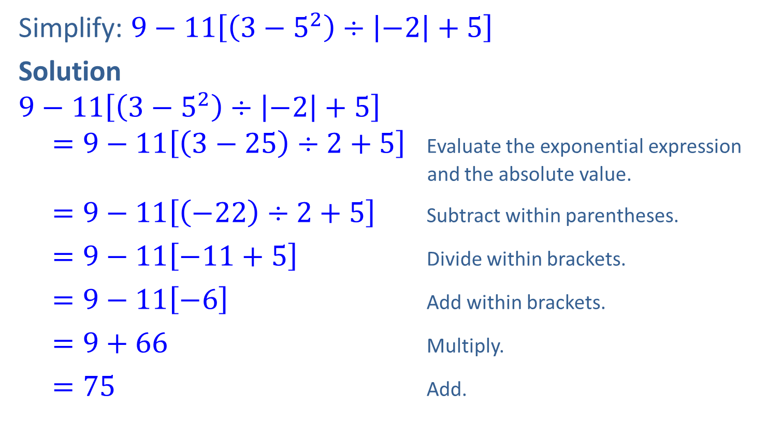
Example 7: Using the Order of Operations with Integers
Simplify: $9−11\left[\left(3−5^{2}\right)÷\left|−2\right|+5\right]$
Solution
$$9−11\left[\left(3−5^{2}\right)÷\left|−2\right|+5\right]$$
$=9−11\left[\left(3−25\right)÷2+5\right]$ Evaluate the exponential expression
and the absolute value.
$=9−11\left[\left(−22\right)÷2+5\right]$ Subtract within parentheses.
$=9−11\left[−11+5\right]$ Divide within brackets.
$=9−11\left[−6\right]$ Add within brackets.
$=9+66$ Multiply.
$=75$ Add.

Slide 17




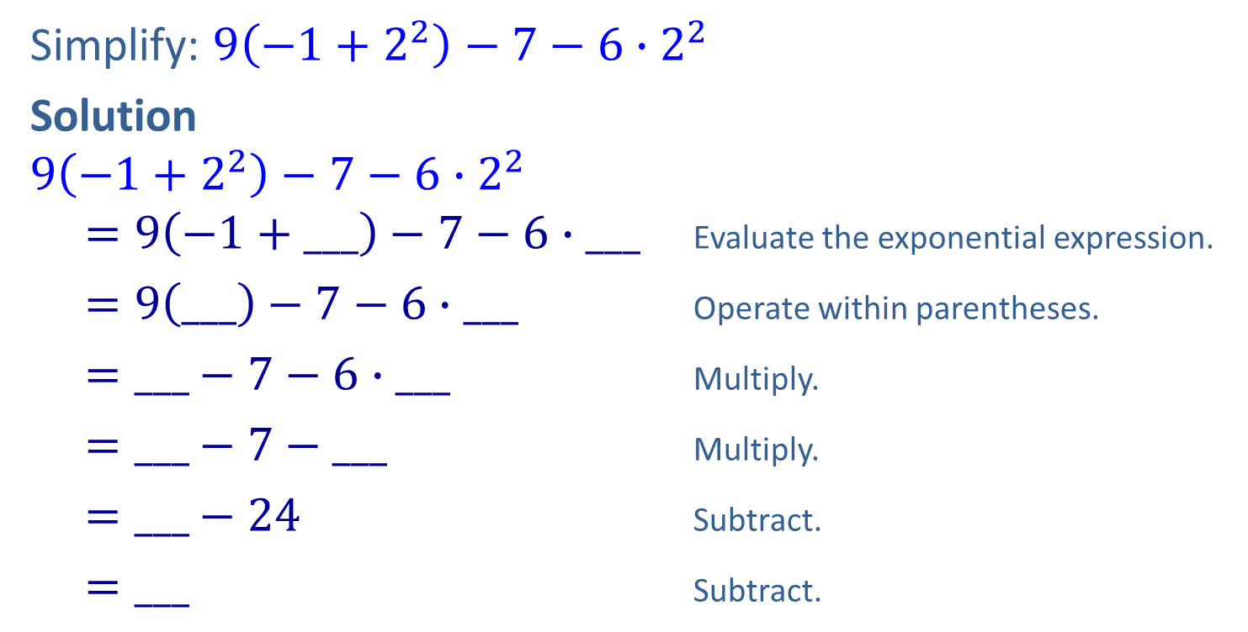






Completion Example 8: Using the Order of Operations with Integers
Simplify: $9\left(−1+2^{2}\right)−7−6∙2^{2}$
Solution
$$9\left(−1+2^{2}\right)−7−6∙2^{2}$$
$=9\left(−1+___\right)−7−6∙___$ Evaluate the exponential expression.
$=9\left(___\right)−7−6∙___$ Operate within parentheses.
$=___−7−6∙___$ Multiply.
$=___−7−___$ Multiply.
$=___−24$ Subtract.
$=___$ Subtract.
$$4$$
$$4$$
$$3$$
$$4$$
$2$7
$$4$$
$2$7
$2$4
$2$0
$$−4$$

Slide 18
Procedure: Finding the Average of a Set of Numbers
Find the sum of the given set of numbers.
Divide this sum by the number of numbers in the set. This quotient is called the average of the given set of numbers.

Slide 19
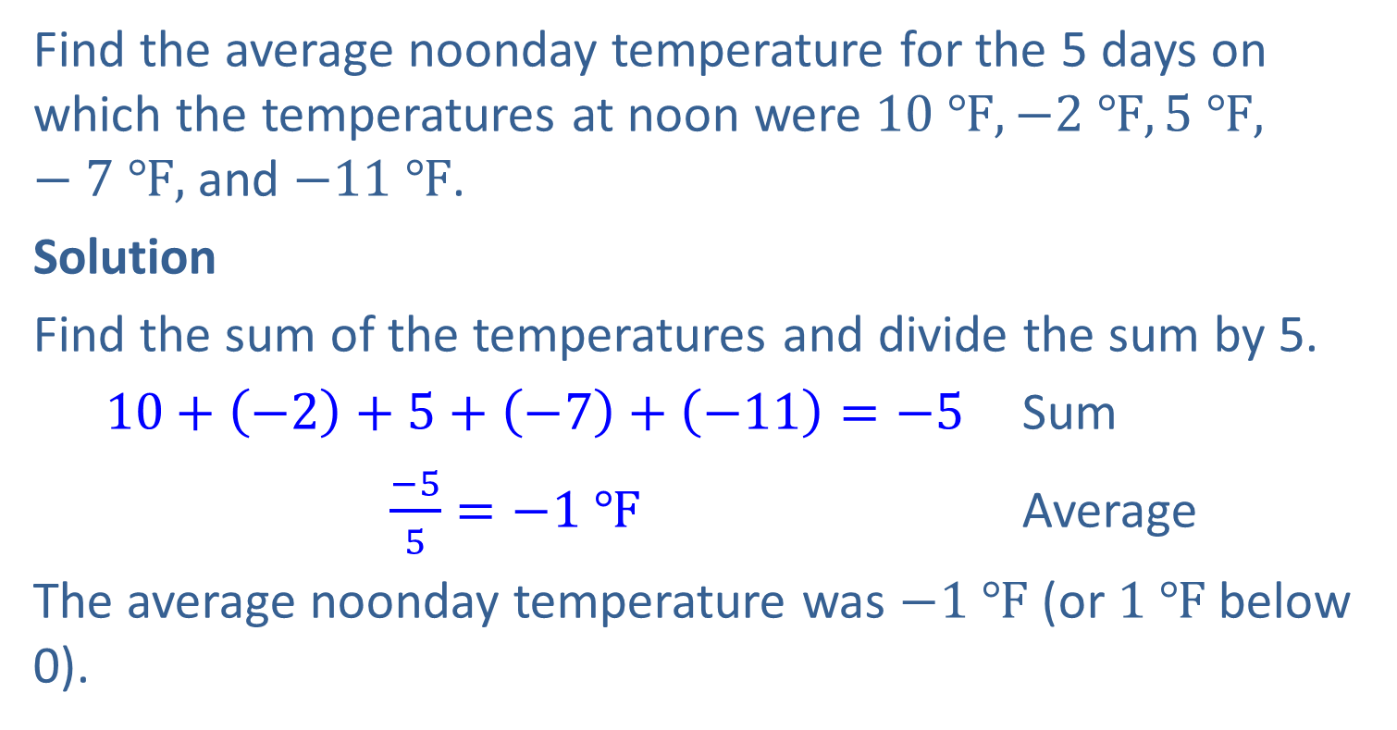
Example 9: Application: Calculating an Average
Find the average noonday temperature for the 5 days on which the temperatures at noon were $10 ℉, −2 ℉, 5 ℉,$ $−7 ℉,$ and $−11 ℉$.
Solution
Find the sum of the temperatures and divide the sum by 5.
$10+\left(−2\right)+5+\left(−7\right)+\left(−11\right)=−5$ Sum
$\frac{−5}{5}=−1 ℉$ Average
The average noonday temperature was $−1 ℉$ (or $1 ℉$ below 0).

Slide 20
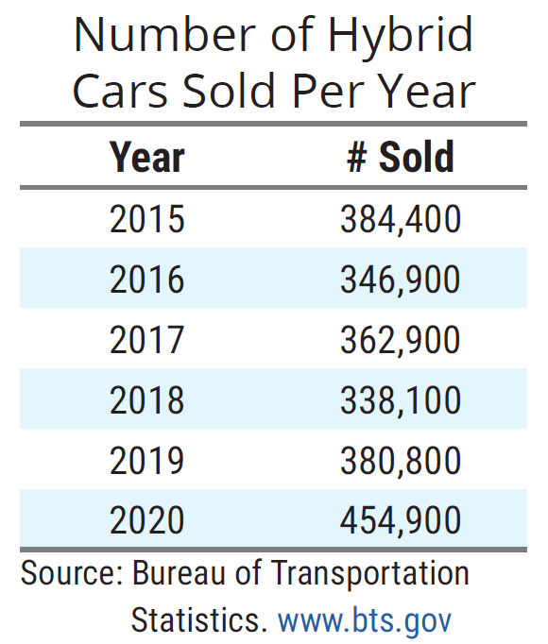
Example 10: Application: Calculating an Average
The table below shows the number of hybrid cars sold in the United States from the year 2015 to 2020.
What year had the highest number of hybrid car sales? How many cars were sold that year?

Slide 21
Example 10: Application: Calculating an Average (cont.)
What year had the highest number of hybrid car sales? How many cars were sold that year?
What year had the lowest number of hybrid car sales? How many cars were sold in that year?
Find the average number of car sales per year over the 6-year period.
Solution
From the table, we can see that 2020 had the highest number of hybrid car sales with 454,900 cars sold.

Slide 22
Example 10: Application: Calculating an Average (cont.)
From the table, we can see that 2018 had the lowest number of hybrid car sales with 338,100 cars sold.
In order to find the average number of cars sold per year over the past 6 years, find the sum of yearly sales and divide by 6.

Slide 23
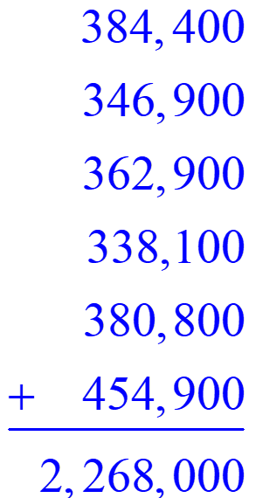
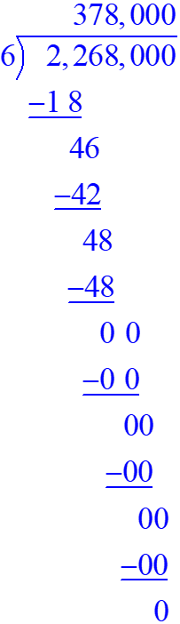
Example 10: Application: Calculating an Average (cont.)
Average sales
The average hybrid sales per year over the 6-year period was 378,000 cars.

