Slide 1
Section 9.4
Other Forms of Sampling

Slide 2
Other Forms of Sampling
Random sampling is an effective means of obtaining a sample that is representative of the population. As we discussed previously, acquiring an exact sampling frame for the population under study is a requirement for simple random sampling, a requirement which can be time-consuming and expensive. There are other sampling strategies that are designed to reduce the cost of sampling or add control to the sampling procedure. These techniques can be categorized as probability samples or non-probability samples.

Slide 3
Other Forms of Sampling (cont.)
Probability samples enable an analyst to determine the probable errors that an estimator might generate. Essentially, they allow the analyst a known degree of confidence in their estimation method. All of statistical inference relies on probability sampling.

Slide 4
Non-Probability Samples
Non-probability samples are convenient means of obtaining sample data. If data from a non-probability sample is used to estimate a population parameter, there is no statistical theory that helps define the potential error of the estimate, and hence no statement about an estimate’s reliability can be made. Non-probability samples come in several forms.

Slide 5
Definition: Non-probability Sample
A non-probability sample is a convenient sample used to estimate a population parameter in which no statement about the estimate’s reliability can be made.

Slide 6
Definition: Judgment Sample
A judgment sample is a sample in which the observations are selected by an expert in the field and not picked at random.

Slide 7
Non-Probability Samples (cont.)
One of the common uses of judgment samples is in auditing. When auditing a company’s accounts receivable, an auditor may use a judgment sample to verify the accounts outstanding. The quality of the sample data is related to the competence of the expert. If the expert is good at what he or she does, this type of sampling can produce reasonable representations of the population and correspondingly good estimates of the population parameters.
Another type of non-probability sample is the convenience sample.

Slide 8
Definition: Convenience Sample
A convenience sample is a sample of observations that are easily obtained and not random.

Slide 9
Non-Probability Samples (cont.)
As the name implies, a convenience sample is nothing more than a convenient group of observations. For example, the students in your statistics class would be a convenience sample of students in your college. Although convenience samples could be representative of the population, they tend to possess more bias than other forms of sampling. Consider your statistics class. It is likely that the class is dominated by some particular group of majors and has a disproportionate number of sophomores and juniors.

Slide 10
Non-Probability Samples (cont.)
Despite their shortcomings, convenience samples are convenient, and certainly a convenient sample is often better than no sample at all.
There are two disadvantages to using a convenience sample. First, it is difficult to determine how representative the sample is of the population, or if it is representative at all. Secondly, even though the convenience sample may not be representative of the population, statistical methods are often applied.

Slide 11
Non-Probability Samples (cont.)
Since it is not a probability sample, the results will lack validity and are questionable.
The worst forms of non-probability samples are the voluntary or self-selected samples. Those samples were discussed in Section 9.1.

Slide 12

Systematic Sampling
One type of sampling technique, the systematic sample, chooses a starting point and selects every $k$^{th} member of the population. Systematic samples are considered probability samples.

Slide 13
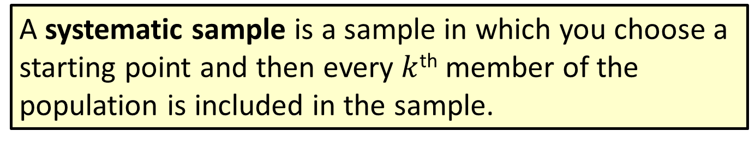
Definition: Systematic Sample
A systematic sample is a sample in which you choose a starting point and then every $k$^{th} member of the population is included in the sample.

Slide 14

Systematic Sampling (cont.)
For example, suppose a sample of 1000 names is to be selected from a mailing list that contains 80,000 names. If every 80th person in the mailing list is selected for inclusion in the sample, the result will be a sample of 1000 names. If the names are in random order, then the systematic sample will produce a random sample. Systematic samples are regularly used in sampling mailing lists.

Slide 15

Systematic Sampling (cont.)
They are also used in controlling production quality. Production-oriented quality control plans frequently call for the inspection (sample) of every $k$^{th} item on an assembly line. If you are studying pest populations in an agricultural setting you might use a systematic sample and inspect the pest population on every 10th plant in a row of plants.

Slide 16
Cluster Sampling
Although simple random sampling may be feasible, the traveling cost required to obtain the sample information may be prohibitive. Suppose McDonald’s wishes to perform quality control inspection on its franchises. If a random sample of 500 is drawn from the nearly 38,000 McDonald’s scattered throughout the world, the quality inspection team could be in for quite a bit of traveling. Instead of selecting the stores individually, suppose we divide the world into 200 regions.

Slide 17
Cluster Sampling (cont.)
Then we could select 20 of these regions and inspect every store in the region. This technique is called cluster sampling. Using this technique, an inspector would be required to travel much less and a substantial reduction in cost would result. Cluster sampling is considered a form of probability sampling.

Slide 18
Cluster Sampling (cont.)
Clusters are not always geographic. Suppose you were interested in soliciting student opinion regarding bookstore prices. If everyone in your college had a 9 am class, one reasonable method of clustering would be to use each class as a cluster. Randomly select a set of clusters (classes) and interview each member of the selected cluster. The selection of clusters depends greatly on the population and variables of interest.

Slide 19
Definition: Cluster Sampling
Cluster sampling involves dividing the population into clusters, and randomly selecting a sample of clusters to represent the population. Cluster sampling is used when “natural” groupings are evident in the population.

Slide 20
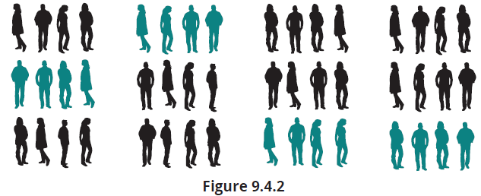
Cluster Sampling (cont.)
Cluster sampling can be as effective as simple random sampling if the clusters are as heterogeneous as the population. Unfortunately, clusters are almost never as diverse as the population.

Slide 21
Cluster Sampling (cont.)
If the clusters are geographic, people in the same geographic area tend to be less diverse than the population. If the clusters are not heterogeneous, cluster sampling is less efficient than simple random sampling for a given sample size. Generally, smaller cluster sizes will result in more representative samples.
In simple random sampling, constructing the sampling frame is frequently cumbersome. Cluster sampling simplifies the task, since the initial frame is composed only of clusters.

Slide 22
Cluster Sampling (cont.)
Only those clusters selected as part of the sample must be completely enumerated and sampled.
Cluster sampling is a good alternative to simple random sampling when the population’s geographic area is spread out over a large area or when the sampling frame for a simple random sample is difficult to construct.

Slide 23
Stratified Sampling
The fundamental goal of sampling is to obtain a sample that is representative of the population. Representative means that the characteristics of the population are proportionally represented in the sample. For example, if a population contained 60% of persons with brown eyes and 30% with blood type A, then it would be desirable for the sample to have 60% of persons with brown eyes and 30% with blood type A. Simple random samples make no guarantees regarding the constituency of the sample.

Slide 24
Stratified Sampling (cont.)
If a random sample could be taken such that it was assured that the population characteristics were properly represented, the resulting samples would tend to be more representative of the population. This is precisely the objective of stratified sampling.

Slide 25
Definition: Stratified Sampling
In stratified sampling, the population is divided into strata, which are subpopulations. A stratum (singular) can be any identifiable characteristic that can be used to classify the population. If the population consists of people, then strata could be sex, income, political party, religion, education, race, age, or location.

Slide 26
Stratified Sampling (cont.)
For instance, to draw a stratified sample of 40 students from a college of 50,000 students with 5000 seniors, 10,000 juniors, 15,000 sophomores, and 20,000 freshmen, the proportions in the sample should match the proportions in the population for the sample to be representative of the population. Therefore, for a sample of size 40 there should be 4 seniors (1/10 of 40), 8 juniors (1/5 of 40), 12 sophomores (3/10 of 40), and 16 freshmen (2/5 of 40) included in the sample.

Slide 27
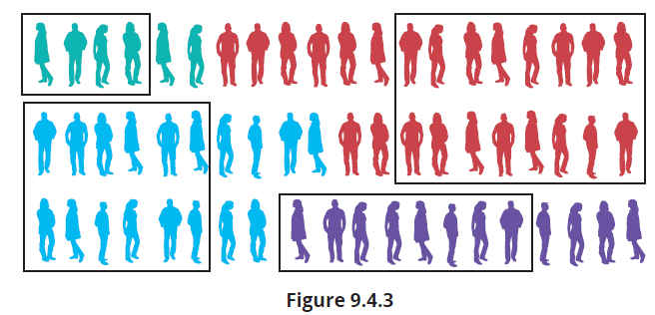
Stratified Sampling (cont.)
In summary, stratified sampling can provide greater accuracy if the population is heterogeneous, and subpopulations (or strata) of the population can be identified that are relatively homogeneous.

Slide 28
Example 9.4.1: Determining a Stratified Sample of Voters
In Mount Pleasant, South Carolina a new park referendum was being voted on to determine the proportion of people who would support an increase in property taxes over fifteen years to build new ballfields, tennis courts, and update old fields and facilities. Using the following voting age groups and proportion in the population for each age group, describe how you would form a sample of size 20 to survey at the next city council meeting to get an idea of the support for the referendum.

Slide 29
Example 9.4.1: Determining a Stratified Sample of Voters (cont.)
Identify the population.
Identify the strata.
Calculate the sample size per stratum.
How would you select a random sample of size 20 at the next city council meeting?
Percentage of Voter Population by Age Group
Age Group | Percentage
18 - 30 years | 40%
31 - 50 years | 30%
51 years and older | 30%

Slide 30
Example 9.4.1: Determining a Stratified Sample of Voters (cont.)
Solution
The population in this scenario is the voter population in Mount Pleasant, South Carolina.
The strata are the individual age groups in the voter population in Mount Pleasant.
To calculate the sample size needed from each stratum we multiply the percentage from each age group by the total desired sample size of 20. From the 18 - 30 year-old age group, we would select 20(0.40) = 8 people for the sample. From the 31 - 50 year-old age group, we would select 20(0.30) = 6 people for the sample. Finally, from the 51 years and older age group we would also select 20(0.30) = 6 people for the sample.

Slide 31
Example 9.4.1: Determining a Stratified Sample of Voters (cont.)
To select a representative sample of 20 at the next city council meeting, randomly select 8 members from the 18 - 30 year-old age group, 6 members from the 31 - 50 year-old age group, and 6 members that are 51 years and older and ask them whether they support the referendum.

