Slide 1
Section 9.3
The Distribution of the Sample Proportion

Slide 2
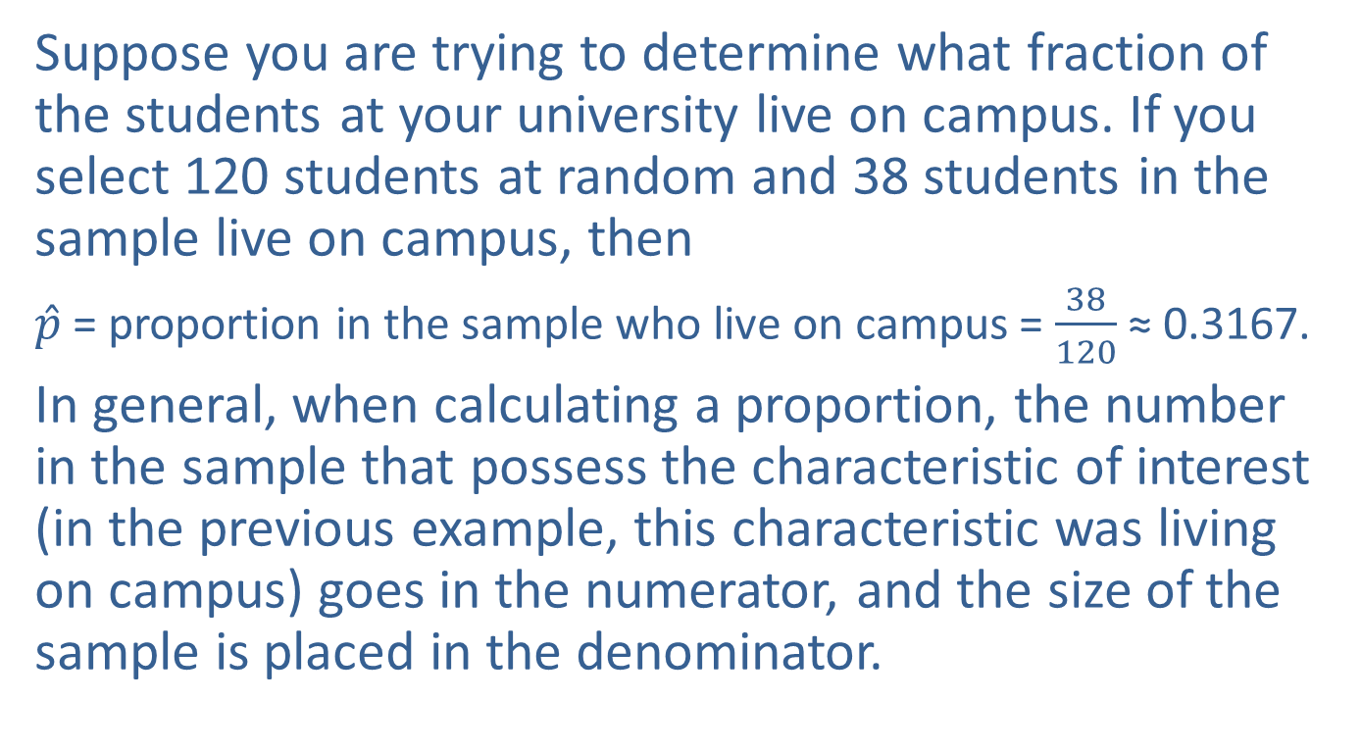
Determining the Sample Proportion
Suppose you are trying to determine what fraction of the students at your university live on campus. If you select 120 students at random and 38 students in the sample live on campus, then
$\hat{p}$ = proportion in the sample who live on campus = $\frac{38}{120}$ ≈ 0.3167.
In general, when calculating a proportion, the number in the sample that possess the characteristic of interest (in the previous example, this characteristic was living on campus) goes in the numerator, and the size of the sample is placed in the denominator.

Slide 3
Note
$\hat{p}$ is pronounced $p$-hat.

Slide 4
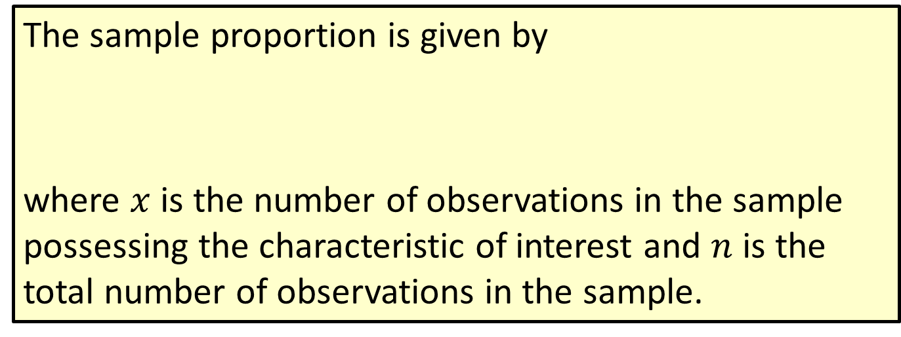
Formula: Sample Proportion
The sample proportion is given by
where $x$ is the number of observations in the sample possessing the characteristic of interest and $n$ is the total number of observations in the sample.

Slide 5
Determining the Sample Proportion (cont.)
Just as the sample mean was a good estimate of the population mean, the sample proportion is a good estimate of the population proportion. And just as the sample mean varied depending on the sample selected, the sample proportion varies depending on the selected sample.

Slide 6
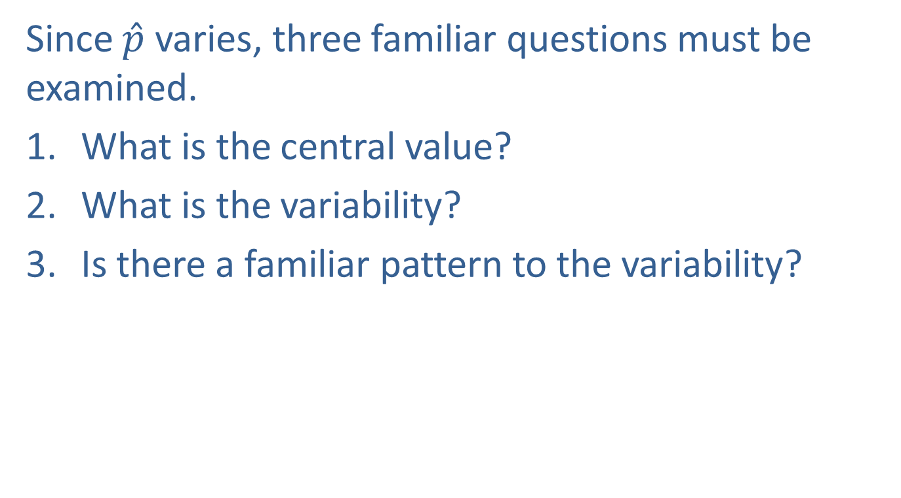
Determining the Sample Proportion (cont.)
Since $\hat{p}$ varies, three familiar questions must be examined.
What is the central value?
What is the variability?
Is there a familiar pattern to the variability?

Slide 7
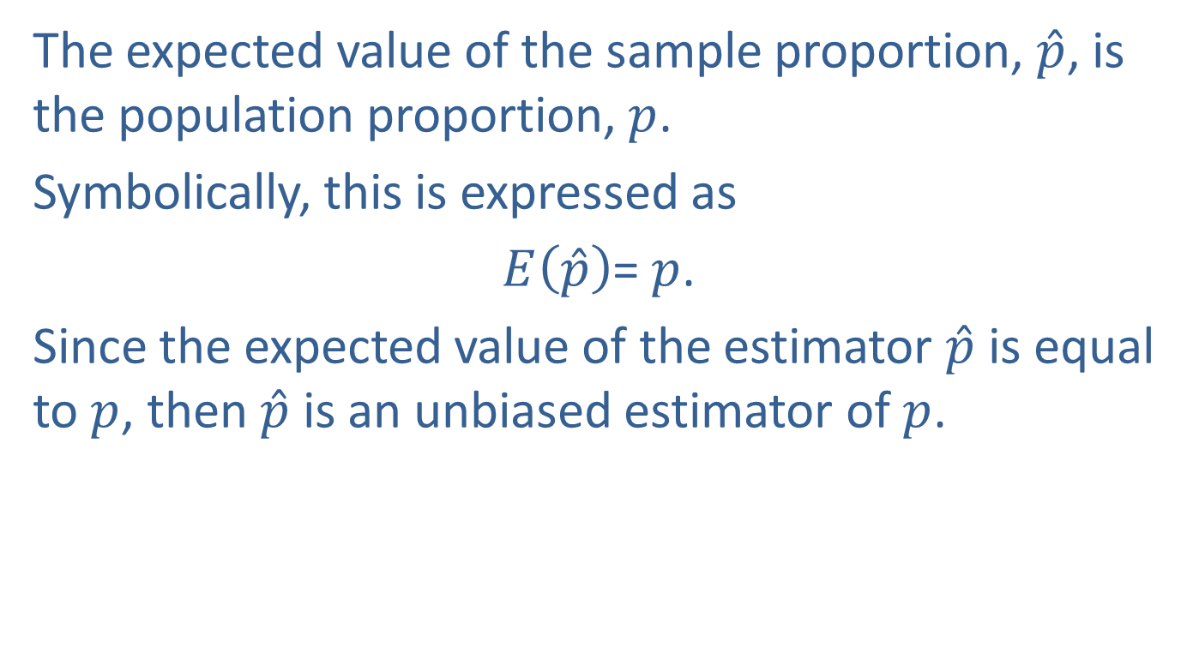

What is the Central Value of $\hat{p}$?
The expected value of the sample proportion, $\hat{p}$, is the population proportion, $p$.
Symbolically, this is expressed as
$E\left(\hat{p}\right)$= $p$.
Since the expected value of the estimator $\hat{p}$ is equal to $p$, then $\hat{p}$ is an unbiased estimator of $p$.

Slide 8
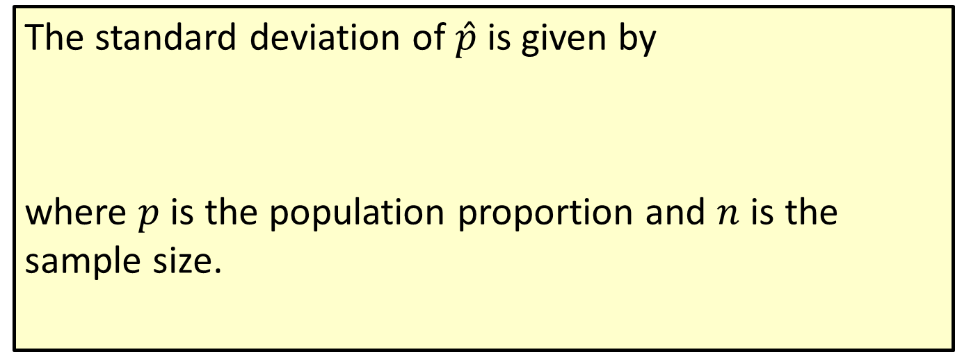
Formula: Standard Deviation of the Sample Proportion
The standard deviation of $\hat{p}$is given by
where $p$ is the population proportion and $n$ is the sample size.

Slide 9
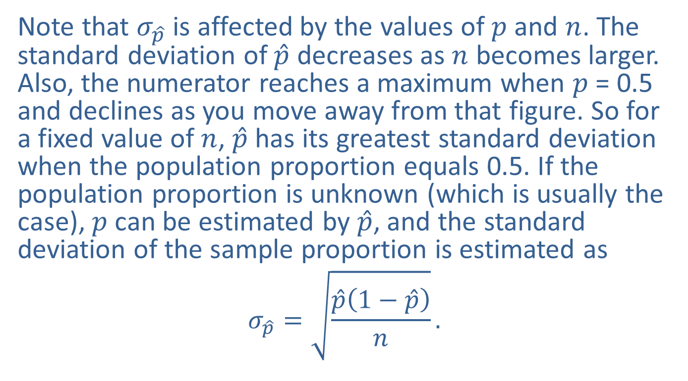

What is the Variability of $\hat{p}$?
Note that $σ_{\hat{p}}$ is affected by the values of $p$ and $n$. The standard deviation of $\hat{p}$ decreases as $n$ becomes larger. Also, the numerator reaches a maximum when $p$ = 0.5 and declines as you move away from that figure. So for a fixed value of $n$, $\hat{p}$ has its greatest standard deviation when the population proportion equals 0.5. If the population proportion is unknown (which is usually the case), $p$ can be estimated by $\hat{p}$, and the standard deviation of the sample proportion is estimated as
$$σ_{\hat{p}}=\sqrt{\frac{\hat{p}\left(1−\hat{p}\right)}{n}}.$$

Slide 10
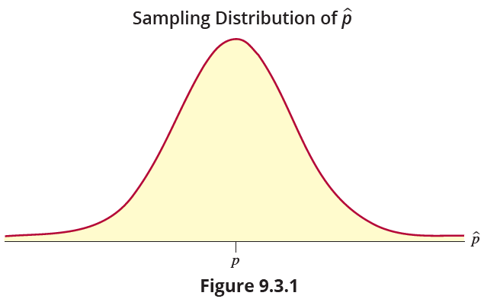


Is There a Familiar Pattern to the Variability of $\hat{p}$?
The sampling distribution of $\hat{p}$ approaches normality as $n$ becomes sufficiently large, as illustrated in Figure 9.3.1. The sample size is generally considered “sufficiently large” if $np$ $≥$ 10 and $n(1 − p) ≥ 10$.

Slide 11


Is There a Familiar Pattern to the Variability of $\hat{p}$? (cont.)
The sampling distribution of $\hat{p}$ is summarized below for both finite and infinite populations.

Slide 12
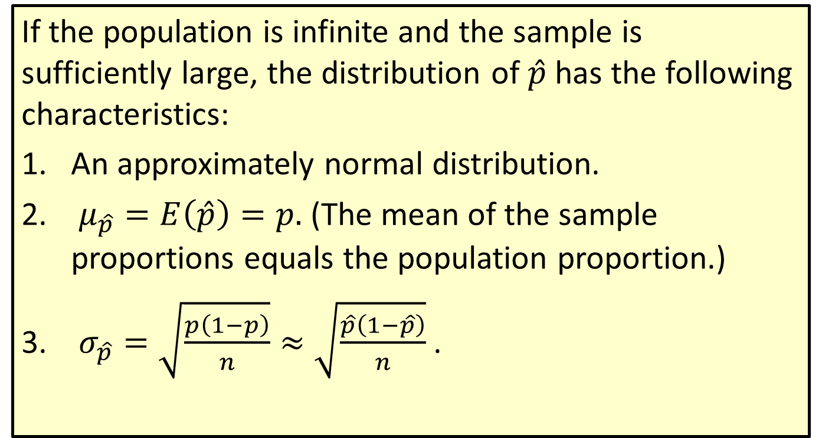
Definition: Sampling Distribution of the Sample Proportion
If the population is infinite and the sample is sufficiently large, the distribution of $\hat{p}$has the following characteristics:
An approximately normal distribution.
$μ_{\hat{p}}=E\left(\hat{p}\right)=p.$ (The mean of the sample proportions equals the population proportion.)
$σ_{\hat{p}}=\sqrt{\frac{p\left(1−p\right)}{n}}≈$ $\sqrt{\frac{\hat{p}\left(1−\hat{p}\right)}{n}}$.

Slide 13
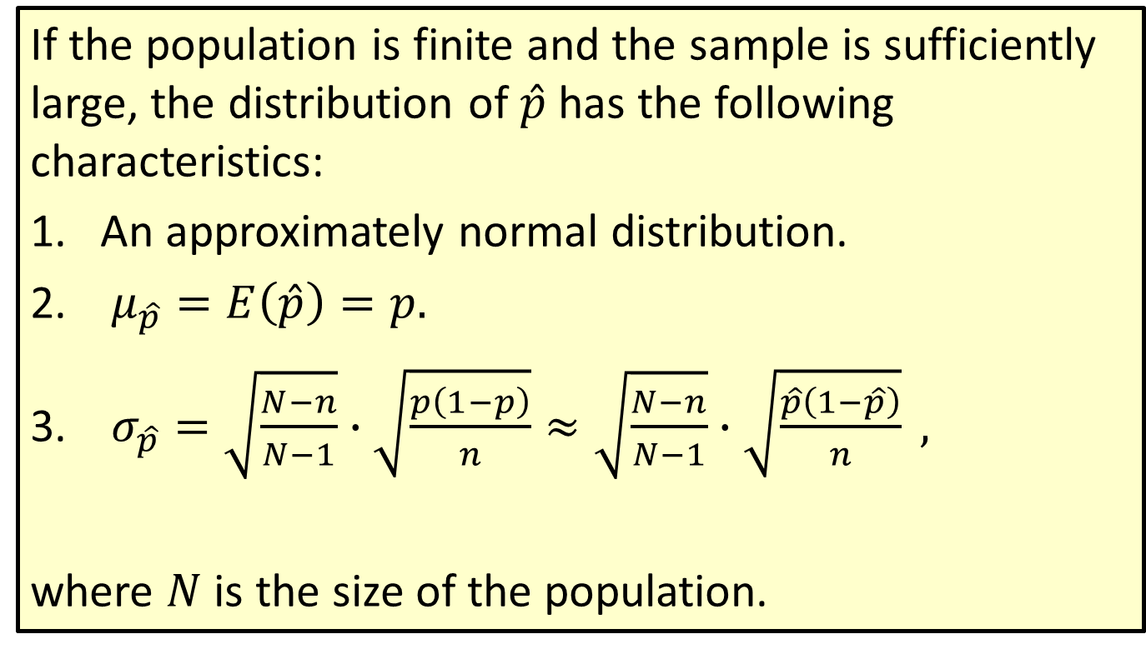
Definition: Sampling Distribution of the Sample Proportion (cont.)
If the population is finite and the sample is sufficiently large, the distribution of $\hat{p}$has the following characteristics:
An approximately normal distribution.
$μ_{\hat{p}}=E\left(\hat{p}\right)=p.$
$σ_{\hat{p}}=\sqrt{\frac{N−n}{N−1}}∙\sqrt{\frac{p\left(1−p\right)}{n}}≈\sqrt{\frac{N−n}{N−1}}∙\sqrt{\frac{\hat{p}\left(1−\hat{p}\right)}{n}} ,$
where $N$ is the size of the population.

Slide 14

Is There a Familiar Pattern to the Variability of $\hat{p}$? (cont.)
Since $\hat{p}$ is a good estimator of $p$, one of the natural questions to ask is, can limits be established for the error in estimation? Since the sampling distribution of $\hat{p}$ is known, probabilities for various errors of estimation can be determined.

Slide 15
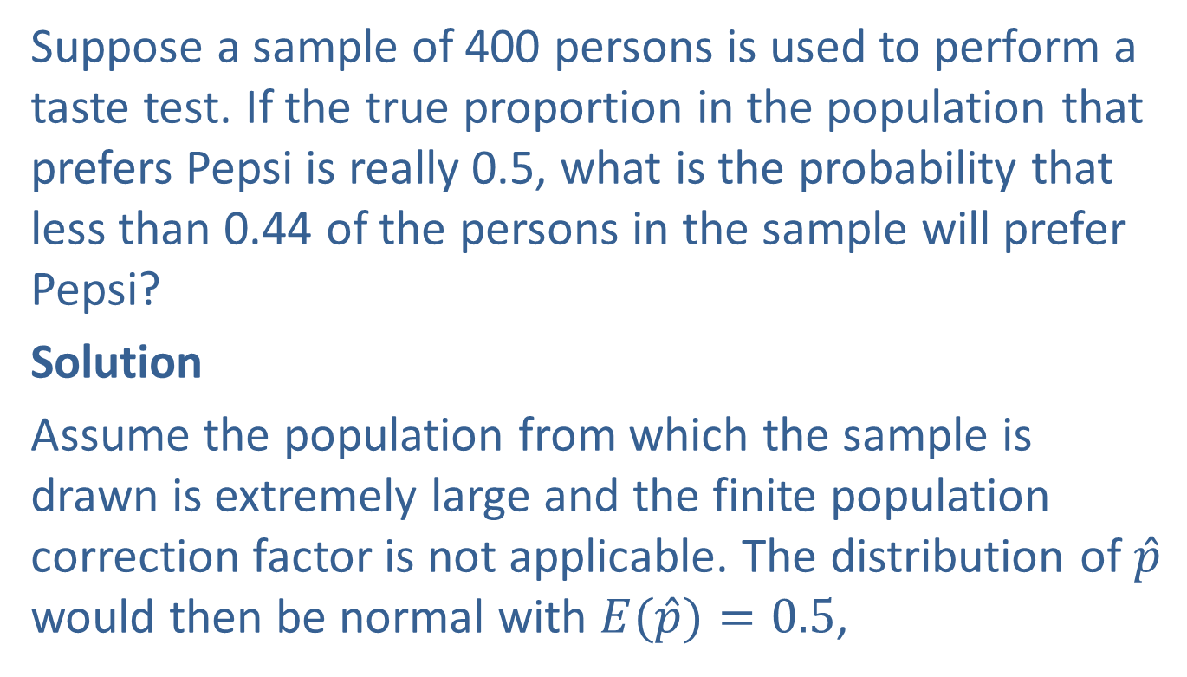
Example 9.3.1: Calculating a Probability for the Proportion Who Prefer Pepsi
Suppose a sample of 400 persons is used to perform a taste test. If the true proportion in the population that prefers Pepsi is really 0.5, what is the probability that less than 0.44 of the persons in the sample will prefer Pepsi?
Solution
Assume the population from which the sample is drawn is extremely large and the finite population correction factor is not applicable. The distribution of $\hat{p}$ would then be normal with $E(\hat{p})=0.5$,

Slide 16
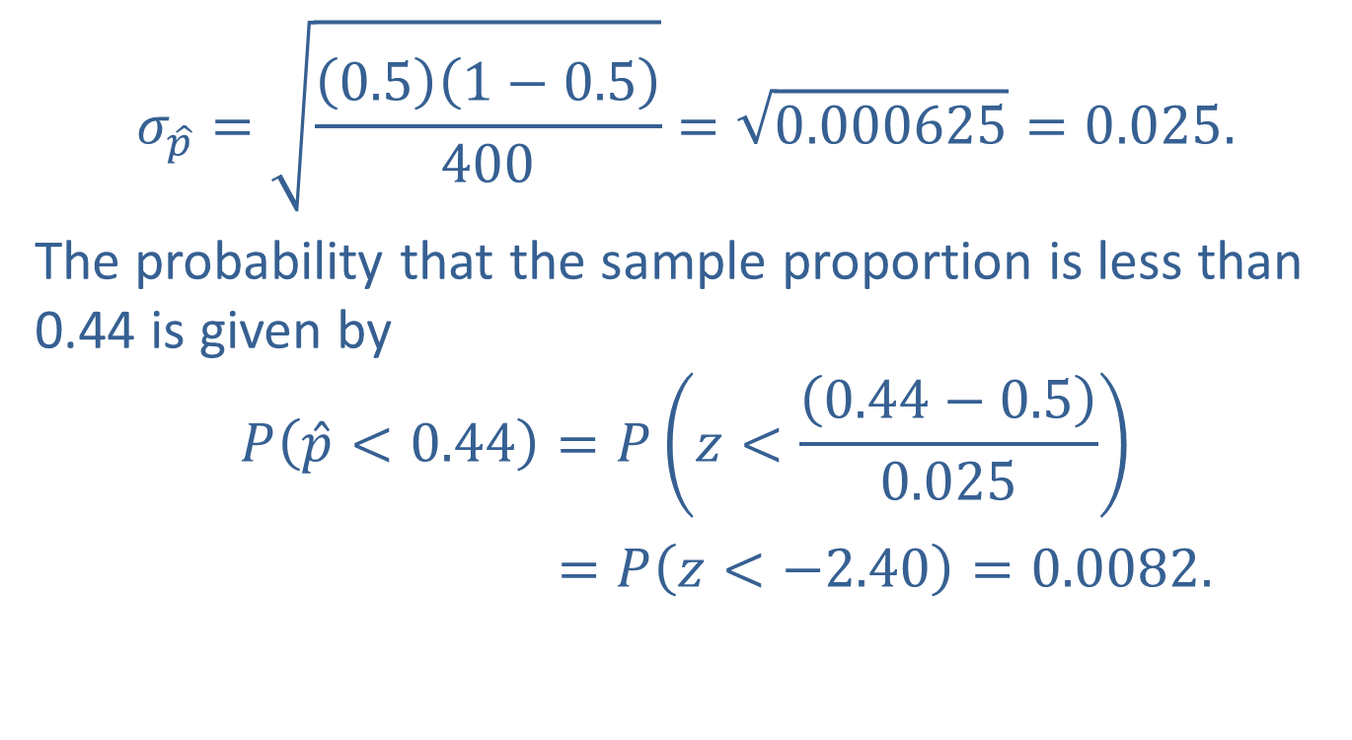
Example 9.3.1: Calculating a Probability for the Proportion Who Prefer Pepsi (cont.)
$$σ_{\hat{p}}=\sqrt{\frac{\left(0.5\right)\left(1−0.5\right)}{400}}=\sqrt{0.000625}=0.025.$$
The probability that the sample proportion is less than 0.44 is given by
$$P\left(\hat{p}<0.44\right)=P\left(z<\frac{\left(0.44−0.5\right)}{0.025}\right)$$
$=P\left(z<−2.40\right)=0.0082.$

Slide 17
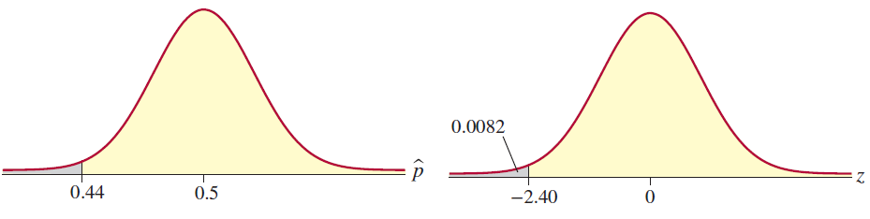
Example 9.3.1: Calculating a Probability for the Proportion Who Prefer Pepsi (cont.)

Slide 18
Example 9.3.1: Calculating a Probability for the Proportion Who Prefer Pepsi (cont.)
With the information we have developed thus far we can begin to draw conclusions (make inferences). If the true fraction of people in the population who prefer Pepsi is really 0.5, it is extremely unlikely (0.0082 is less than 1 in 100) to observe a sample proportion as low as 0.44. Suppose that you had to make a decision as to whether cola drinkers were indifferent between Pepsi and Coke. If they were indifferent, the fraction who prefer Pepsi should be around 0.5.

Slide 19
Example 9.3.1: Calculating a Probability for the Proportion Who Prefer Pepsi (cont.)
If you used a sample of 400 people and observed a sample proportion of 0.438 that preferred Pepsi, which of the conclusions would you believe?
The indifference hypothesis
Conclusion A: Cola drinkers are indifferent between Pepsi and Coke. Stated another way, the proportion of persons that favor Pepsi is about 0.5.
The difference hypothesis
Conclusion B: Cola drinkers are not indifferent between Pepsi and Coke.

Slide 20
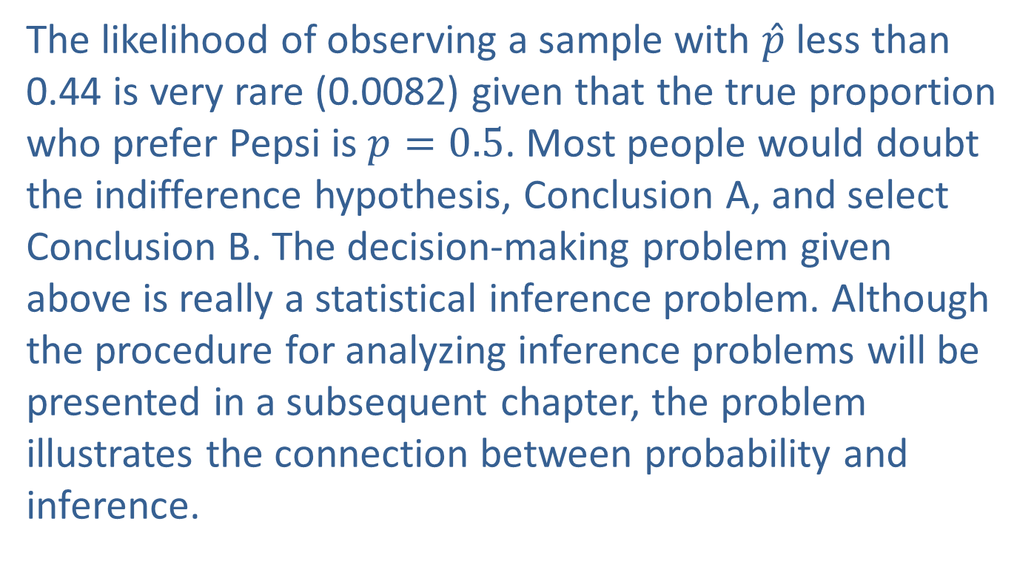
Example 9.3.1: Calculating a Probability for the Proportion Who Prefer Pepsi (cont.)
The likelihood of observing a sample with $\hat{p}$ less than 0.44 is very rare (0.0082) given that the true proportion who prefer Pepsi is $p=0.5$. Most people would doubt the indifference hypothesis, Conclusion A, and select Conclusion B. The decision-making problem given above is really a statistical inference problem. Although the procedure for analyzing inference problems will be presented in a subsequent chapter, the problem illustrates the connection between probability and inference.

Slide 21
Example 9.3.1: Calculating a Probability for the Proportion Who Prefer Pepsi (cont.)
To reach a decision (make the inference) we used the fact that if the true proportion is really 0.5, a proportion below 0.44 is highly improbable for a sample of size 400.

Slide 22
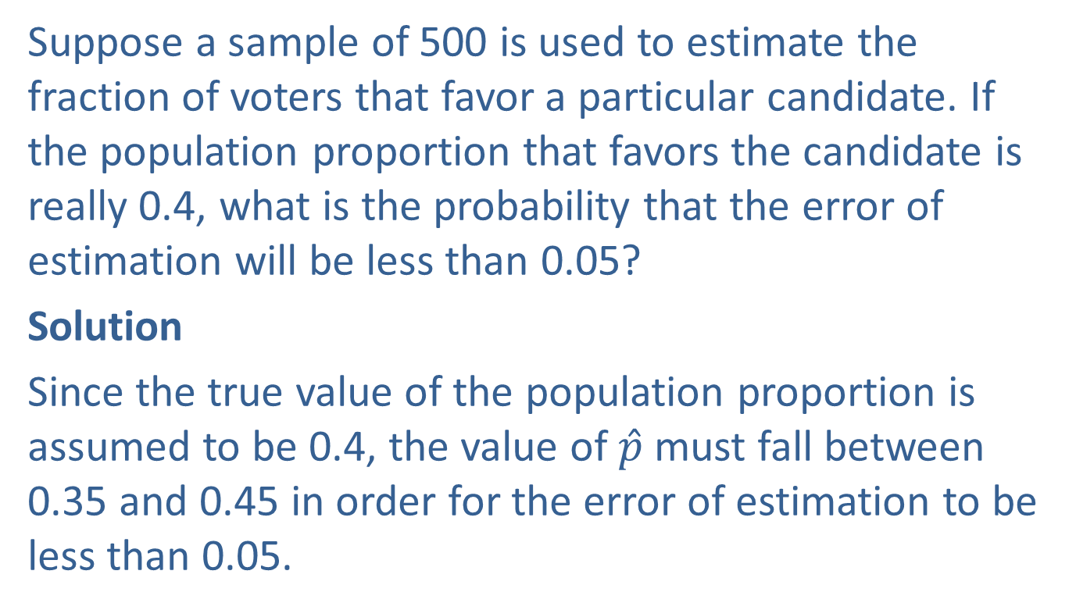
Example 9.3.2: Calculating a Probability Concerning the Error of Estimation
Suppose a sample of 500 is used to estimate the fraction of voters that favor a particular candidate. If the population proportion that favors the candidate is really 0.4, what is the probability that the error of estimation will be less than 0.05?
Solution
Since the true value of the population proportion is assumed to be 0.4, the value of $\hat{p}$ must fall between 0.35 and 0.45 in order for the error of estimation to be less than 0.05.

Slide 23
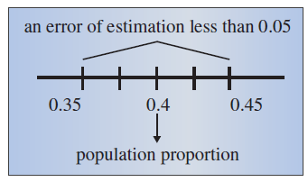
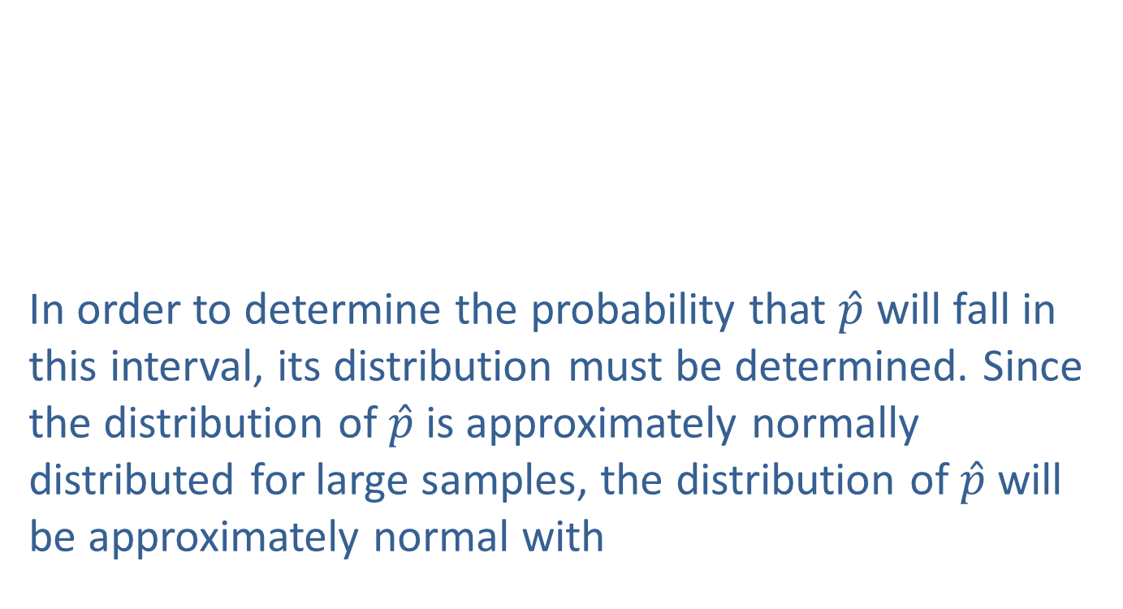
Example 9.3.2: Calculating a Probability Concerning the Error of Estimation (cont.)
In order to determine the probability that $\hat{p}$ will fall in this interval, its distribution must be determined. Since the distribution of $\hat{p}$ is approximately normally distributed for large samples, the distribution of $\hat{p}$ will be approximately normal with

Slide 24
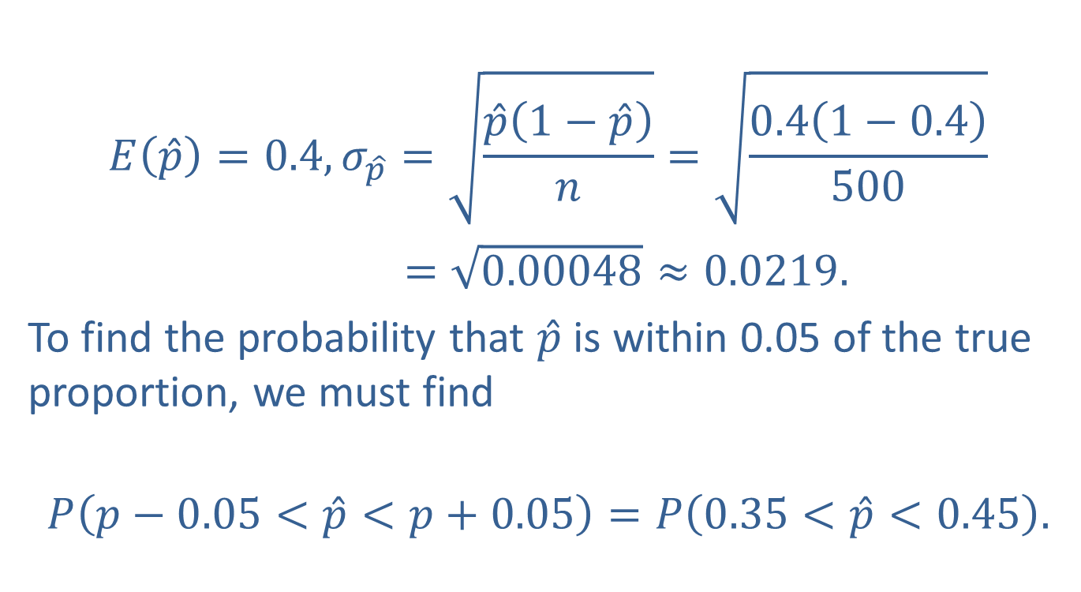
Example 9.3.2: Calculating a Probability Concerning the Error of Estimation (cont.)
$$E\left(\hat{p}\right)=0.4, σ_{\hat{p}}=\sqrt{\frac{\hat{p}\left(1−\hat{p}\right)}{n}}=\sqrt{\frac{0.4\left(1−0.4\right)}{500}}$$
$=\sqrt{0.00048}≈0.0219.$
To find the probability that $\hat{p}$ is within 0.05 of the true proportion, we must find
$$P\left(p−0.05<\hat{p}<p+0.05\right)=P\left(0.35<\hat{p}<0.45\right).$$

Slide 25
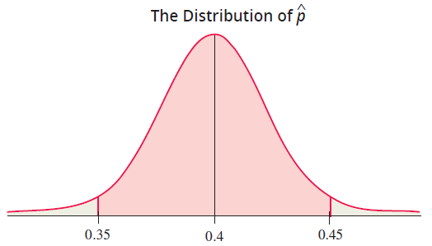
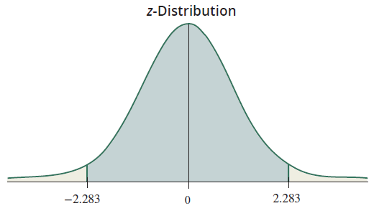
Example 9.3.2: Calculating a Probability Concerning the Error of Estimation (cont.)
Using the $z$-transformation,

Slide 26
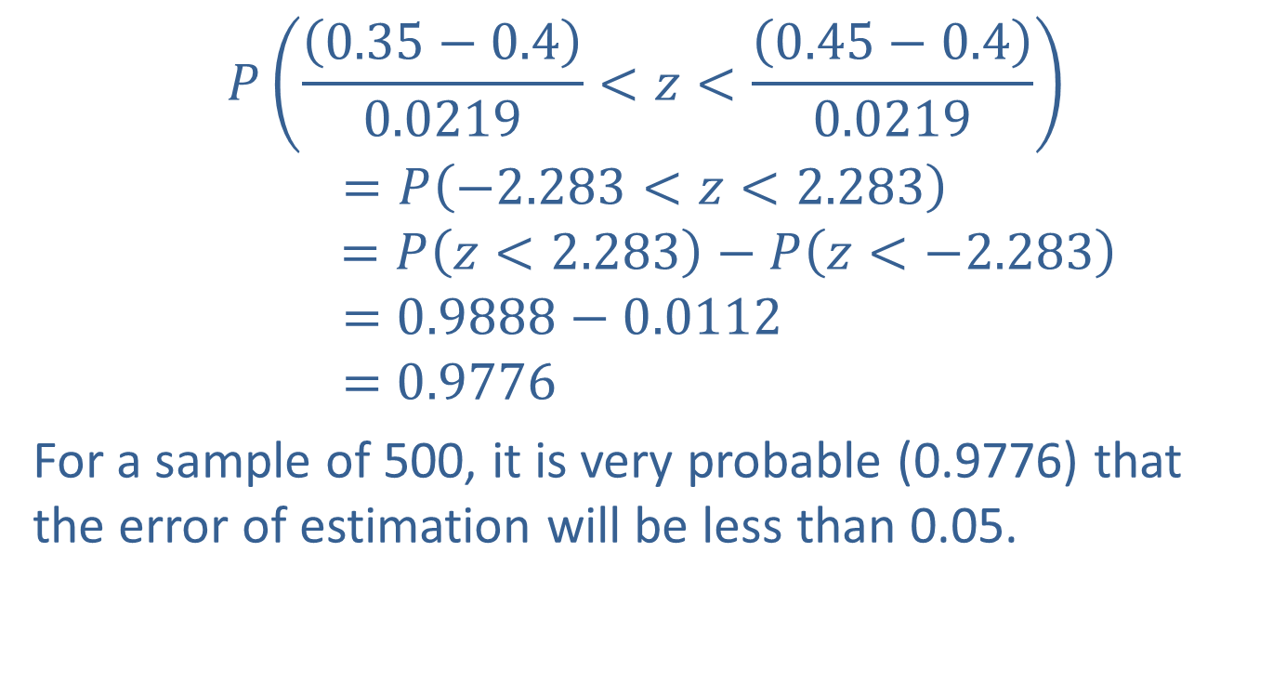
Example 9.3.2: Calculating a Probability Concerning the Error of Estimation (cont.)
$$P\left(\frac{\left(0.35−0.4\right)}{0.0219}<z<\frac{\left(0.45−0.4\right)}{0.0219}\right)$$
$$=P\left(−2.283<z<2.283\right)$$
$$=P\left(z<2.283\right)−P\left(z<−2.283\right)$$
$$=0.9888−0.0112$$
$$=0.9776$$
For a sample of 500, it is very probable (0.9776) that the error of estimation will be less than 0.05.

