Slide 1
Section 9.2
The Distribution of the Sample Mean and the Central Limit Theorem

Slide 2
The Distribution of the Sample Mean and the Central Limit Theorem
Sample means vary because sample data vary from sample to sample. As an illustration, suppose that the quality control department wished to determine the average diameter of a shipment of valves that are used in the manufacture of respirators. Since measuring these valves is very time consuming, the quality control group has decided to select two from a batch of six. Suppose that the actual widths of the six valves are given in Table 9.2.1.

Slide 3
The Distribution of the Sample Mean and the Central Limit Theorem (cont.)
Table 9.2.1 - Valve Measurements
Valve | Diameter (cm)
A | 0.124
B | 0.136
C | 0.201
D | 0.144
E | 0.138
F | 0.147

Slide 4
The Distribution of the Sample Mean and the Central Limit Theorem (cont.)
It is important to realize that the above set of data constitutes a population. The mean diameter of the population in Table 9.2.1 is approximately equal to 0.1483 cm and the population standard deviation is 0.02465 cm.
Both of these measures are considered population parameters. The diameters given in Table 9.2.1 are not known by the quality control group when the shipment arrives.

Slide 5
The Distribution of the Sample Mean and the Central Limit Theorem (cont.)
Their job is to estimate the population average using a sample estimate, in this case using the sample mean from a sample of size two.
How many different samples of size two can be drawn? Assuming no replacement, there would be 15 possible samples of size two if order does not matter. A list of all possible samples and the resulting means is given in Table 9.2.2.

Slide 6
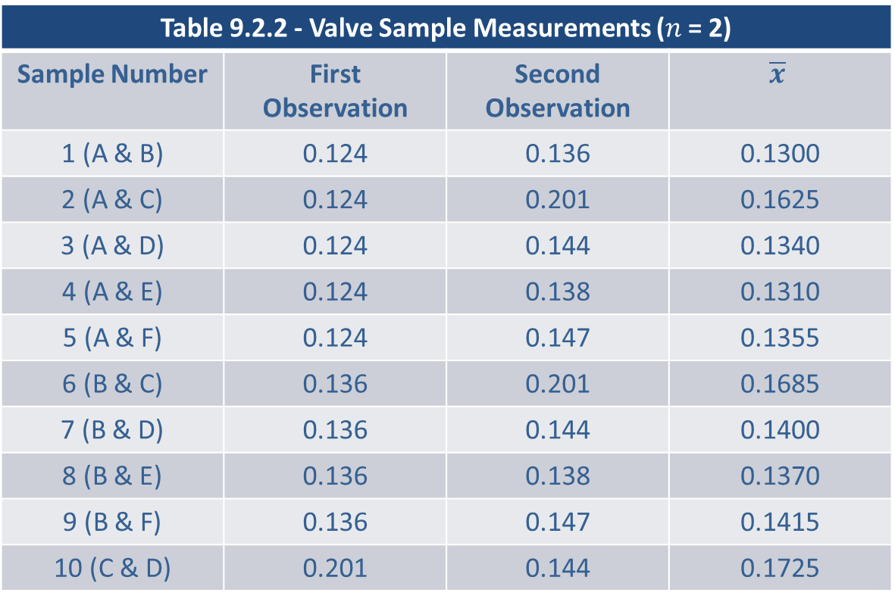
The Distribution of the Sample Mean and the Central Limit Theorem (cont.)
Table 9.2.2 - Valve Sample Measurements ($n$ = 2)
Sample Number | First Observation | Second Observation | $$\overline{x}$$
1 (A & B) | 0.124 | 0.136 | 0.1300
2 (A & C) | 0.124 | 0.201 | 0.1625
3 (A & D) | 0.124 | 0.144 | 0.1340
4 (A & E) | 0.124 | 0.138 | 0.1310
5 (A & F) | 0.124 | 0.147 | 0.1355
6 (B & C) | 0.136 | 0.201 | 0.1685
7 (B & D) | 0.136 | 0.144 | 0.1400
8 (B & E) | 0.136 | 0.138 | 0.1370
9 (B & F) | 0.136 | 0.147 | 0.1415
10 (C & D) | 0.201 | 0.144 | 0.1725

Slide 7
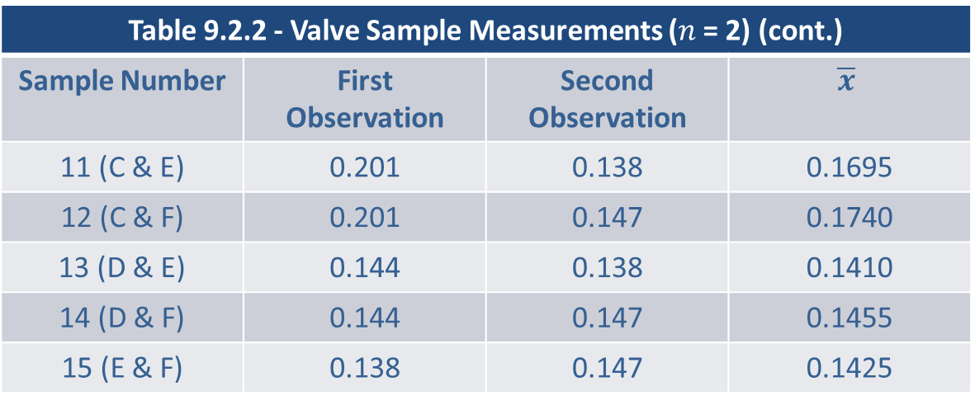
The Distribution of the Sample Mean and the Central Limit Theorem (cont.)
Table 9.2.2 - Valve Sample Measurements ($n$ = 2) (cont.)
Sample Number | First Observation | Second Observation | $$\overline{x}$$
11 (C & E) | 0.201 | 0.138 | 0.1695
12 (C & F) | 0.201 | 0.147 | 0.1740
13 (D & E) | 0.144 | 0.138 | 0.1410
14 (D & F) | 0.144 | 0.147 | 0.1455
15 (E & F) | 0.138 | 0.147 | 0.1425

Slide 8
The Distribution of the Sample Mean and the Central Limit Theorem (cont.)
The sample means in Table 9.2.2 vary and when something varies there are at least three questions to ask:
What is the central value of the variable?
What is the variability of the variable?
Is there a familiar pattern (distribution) to the variability?

Slide 9
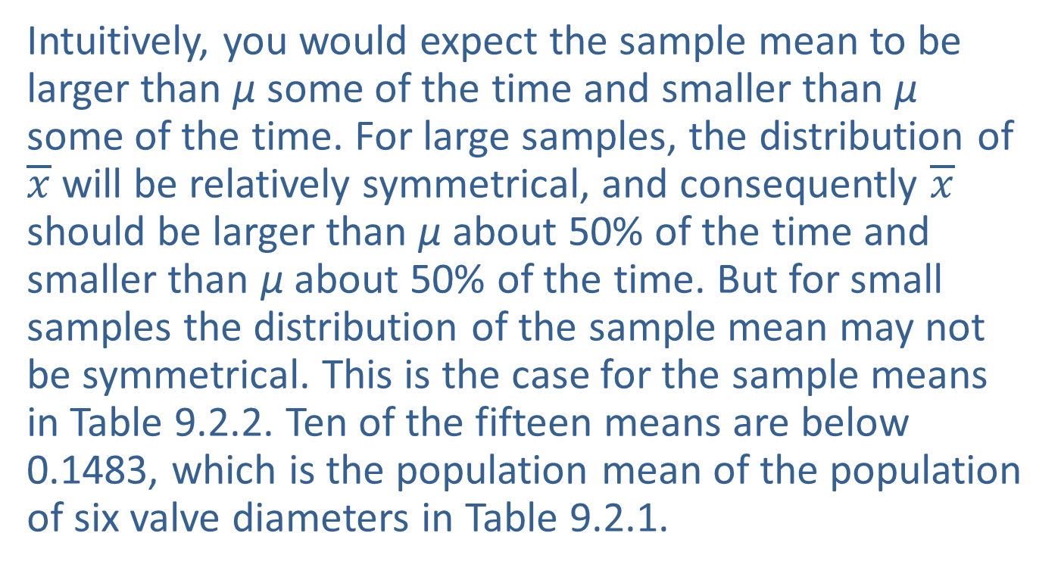

What is the Central Value of $\overline{x}$?
Intuitively, you would expect the sample mean to be larger than µ some of the time and smaller than µ some of the time. For large samples, the distribution of $\overline{x}$will be relatively symmetrical, and consequently $\overline{x}$ should be larger than µ about 50% of the time and smaller than µ about 50% of the time. But for small samples the distribution of the sample mean may not be symmetrical. This is the case for the sample means in Table 9.2.2. Ten of the fifteen means are below 0.1483, which is the population mean of the population of six valve diameters in Table 9.2.1.

Slide 10
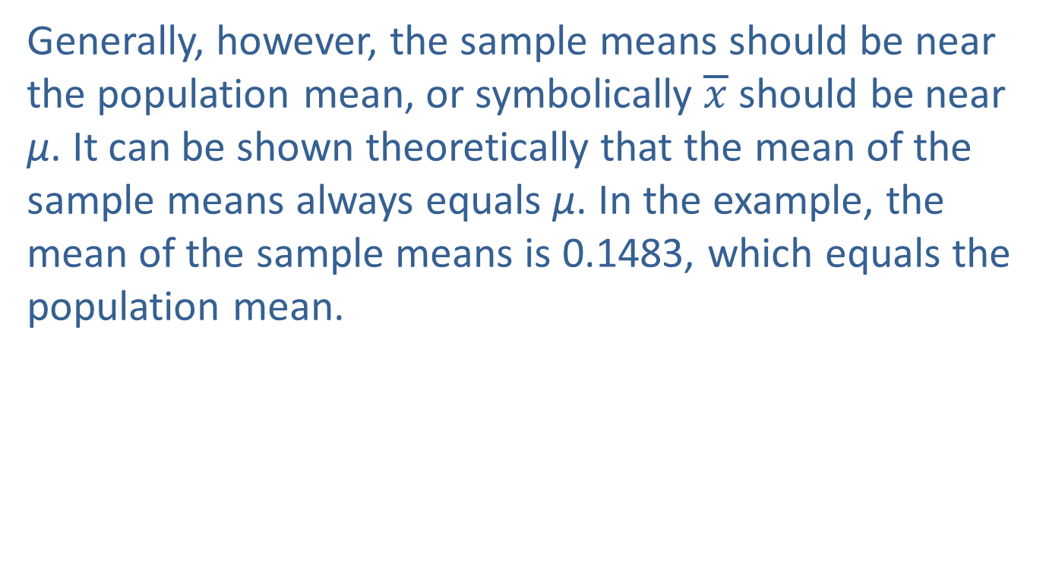

What is the Central Value of $\overline{x}$? (cont.)
Generally, however, the sample means should be near the population mean, or symbolically $\overline{x}$ should be near µ. It can be shown theoretically that the mean of the sample means always equals µ. In the example, the mean of the sample means is 0.1483, which equals the population mean.

Slide 11
Definition: Unbiased
If the average value of an estimator equals the population parameter being estimated, the estimator is said to be unbiased.

Slide 12
Note
The sample median is an unbiased estimator of the population median if the distribution of the population is symmetric.

Slide 13
What is the Central Value of $\overline{x}$? (cont.)
Estimators are similar to marksmen. When you shoot, you want to hit what you are shooting at. When you estimate, you want to get as close as possible to the population characteristic you are estimating. But, bullets do not always land exactly where the marksman aims. If the gun sights are properly adjusted, then the shots will be dispersed around the middle of the target area.

Slide 14
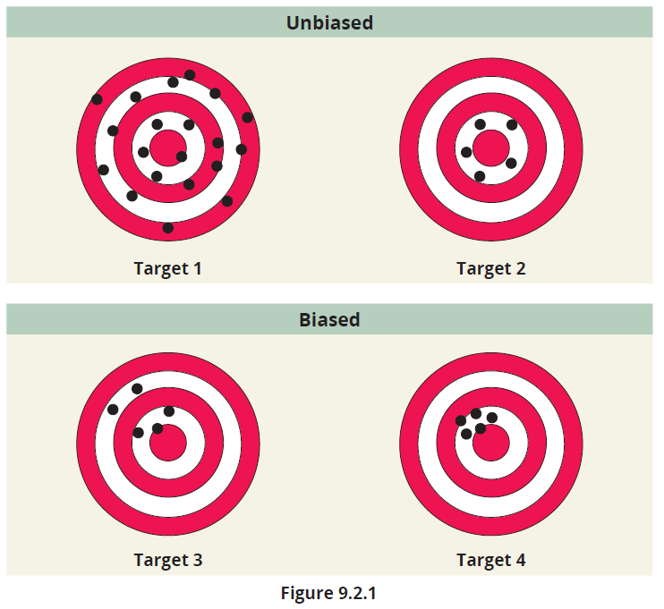
What is the Central Value of $\overline{x}$? (cont.)

Slide 15
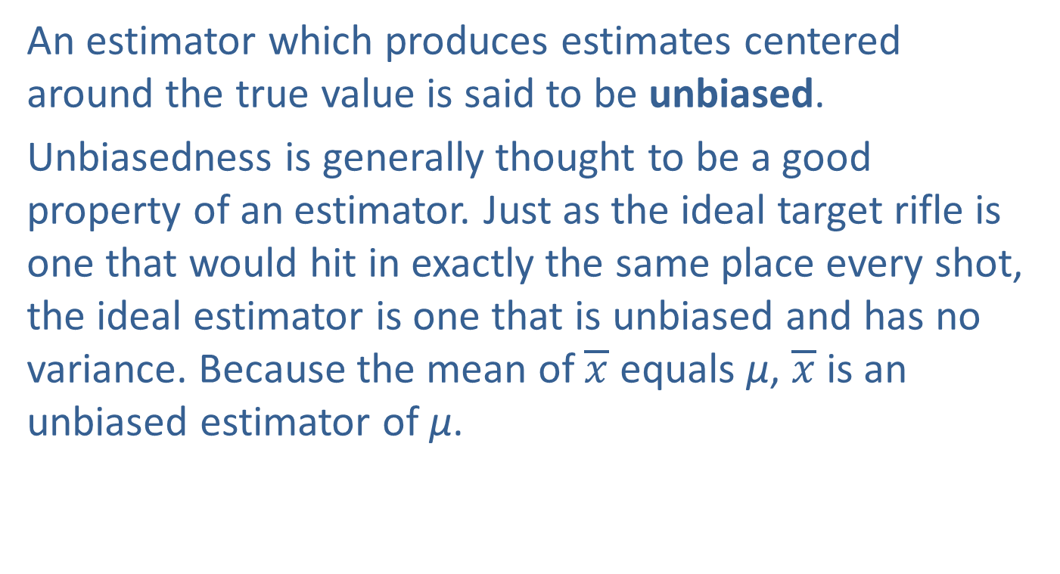
What is the Central Value of $\overline{x}$? (cont.)
An estimator which produces estimates centered around the true value is said to be unbiased.
Unbiasedness is generally thought to be a good property of an estimator. Just as the ideal target rifle is one that would hit in exactly the same place every shot, the ideal estimator is one that is unbiased and has no variance. Because the mean of $\overline{x}$ equals µ, $\overline{x}$is an unbiased estimator of µ.

Slide 16
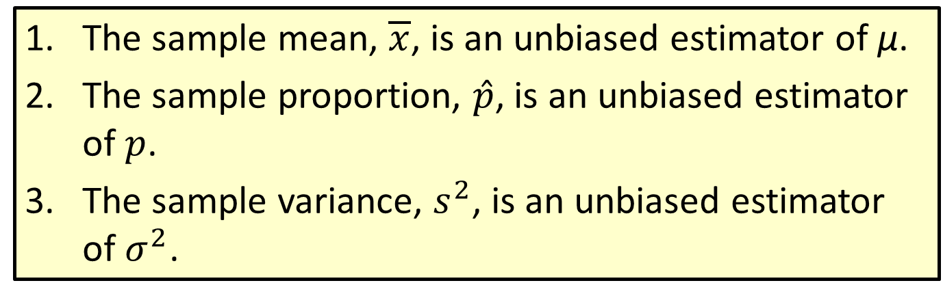
Properties: Unbiased Estimators
The sample mean, $\overline{x}$, is an unbiased estimator of µ.
The sample proportion, $\hat{p}$, is an unbiased estimator of $p$.
The sample variance, $s^{2}$, is an unbiased estimator of $σ^{2}$.

Slide 17
What is the Central Value of $\overline{x}$? (cont.)
If an estimator is unbiased, its variability determines its reliability. If an unbiased estimator is extremely variable, then the individual estimates it produces may not be as close to the parameter being estimated as estimates produced by a biased estimator. Such is the case when you compare Target 4 (biased) to the unbiased Target 1.

Slide 18

What is the Variability of $\overline{x}$?
The variability of an estimator reveals a great deal about the quality of that estimator. In order to assess how well the sample mean estimates the population mean, the variance of the sample means must be determined.

Slide 19
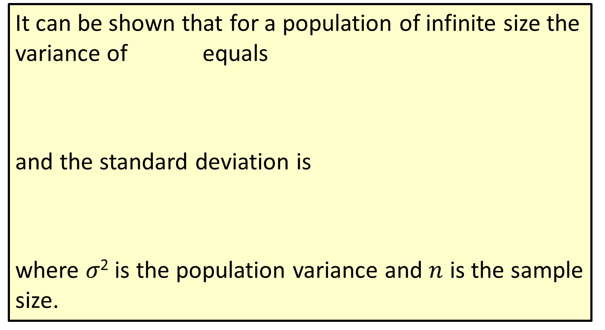
Formula: Variance and Standard Deviation of the Sample Mean: Infinite Population
It can be shown that for a population of infinite size the variance of equals
and the standard deviation is
where 𝜎² is the population variance and $n$ is the sample size.

Slide 20
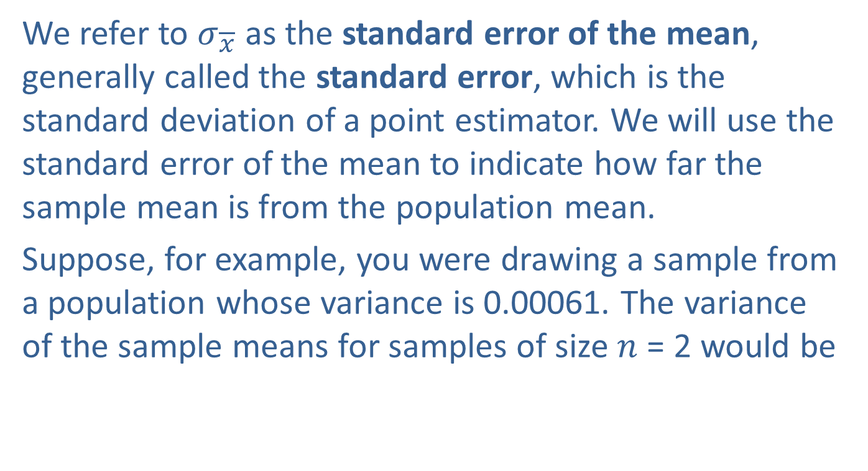

What is the Variability of $\overline{x}$? (cont.)
We refer to $σ_{\overline{x}}$ as the standard error of the mean, generally called the standard error, which is the standard deviation of a point estimator. We will use the standard error of the mean to indicate how far the sample mean is from the population mean.
Suppose, for example, you were drawing a sample from a population whose variance is 0.00061. The variance of the sample means for samples of size $n$ = 2 would be

Slide 21
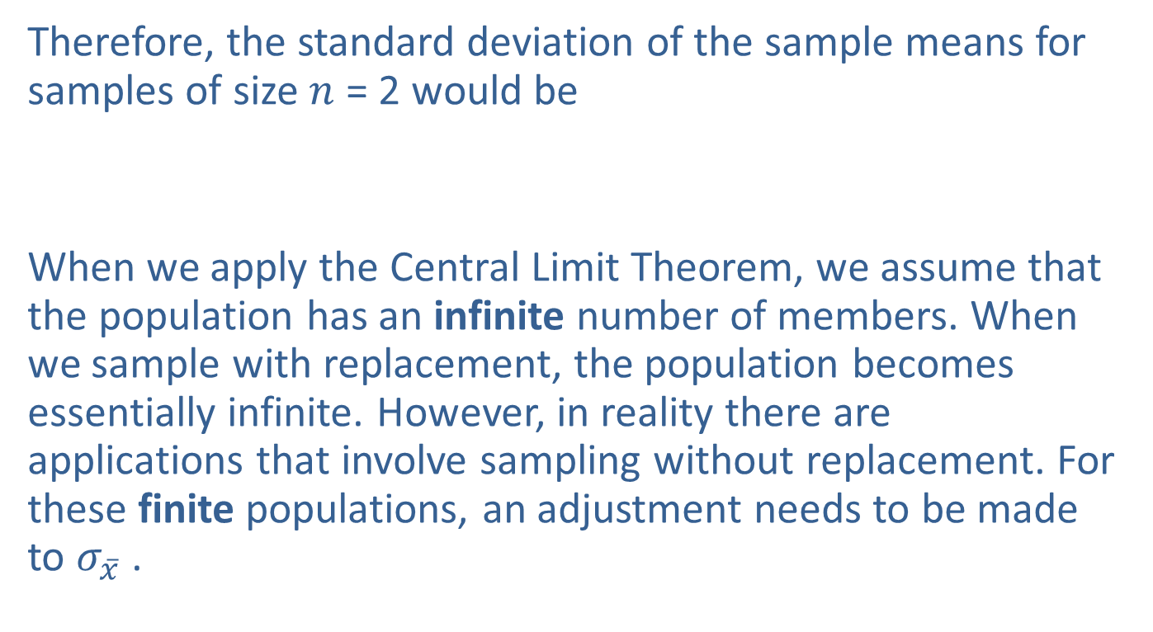
What is the Variability of $\overline{x}$? (cont.)
Therefore, the standard deviation of the sample means for samples of size $n$ = 2 would be
When we apply the Central Limit Theorem, we assume that the population has an infinite number of members. When we sample with replacement, the population becomes essentially infinite. However, in reality there are applications that involve sampling without replacement. For these finite populations, an adjustment needs to be made to $σ_{\overline{x}}$ .

Slide 22

What is the Variability of $\overline{x}$? (cont.)
If the population is finite, as in Table 9.2.1, then the finite population correction factor $\left(\frac{N−n}{N−1}\right)$ must be applied to the calculation of the variance of the sample mean.

Slide 23
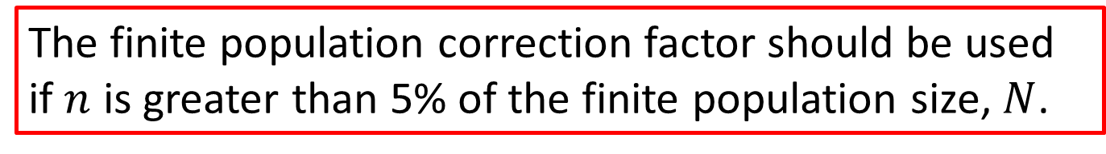
Note
The finite population correction factor should be used if $n$ is greater than 5% of the finite population size, $N$.

Slide 24
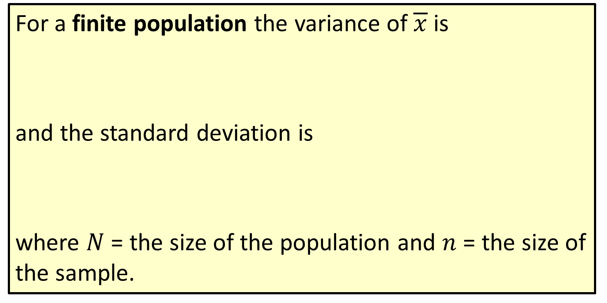
Formula: Variance and Standard Deviation of the Sample Mean: Finite Population
For a finite population the variance of $\overline{x}$is
and the standard deviation is
where $N$ = the size of the population and $n$ = the size of the sample.

Slide 25
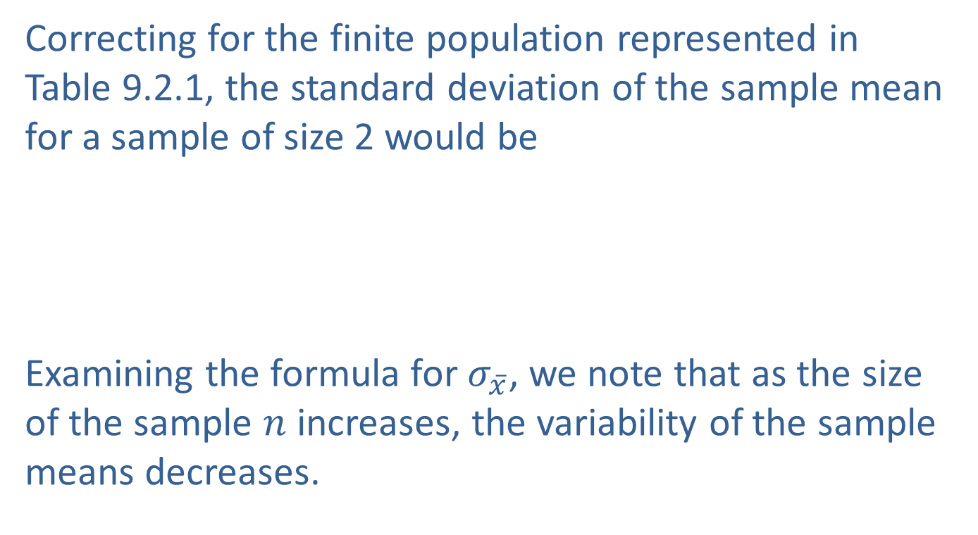
What is the Variability of $\overline{x}$? (cont.)
Correcting for the finite population represented in Table 9.2.1, the standard deviation of the sample mean for a sample of size 2 would be
Examining the formula for $σ_{\overline{x}}$, we note that as the size of the sample $n$ increases, the variability of the sample means decreases.

Slide 26
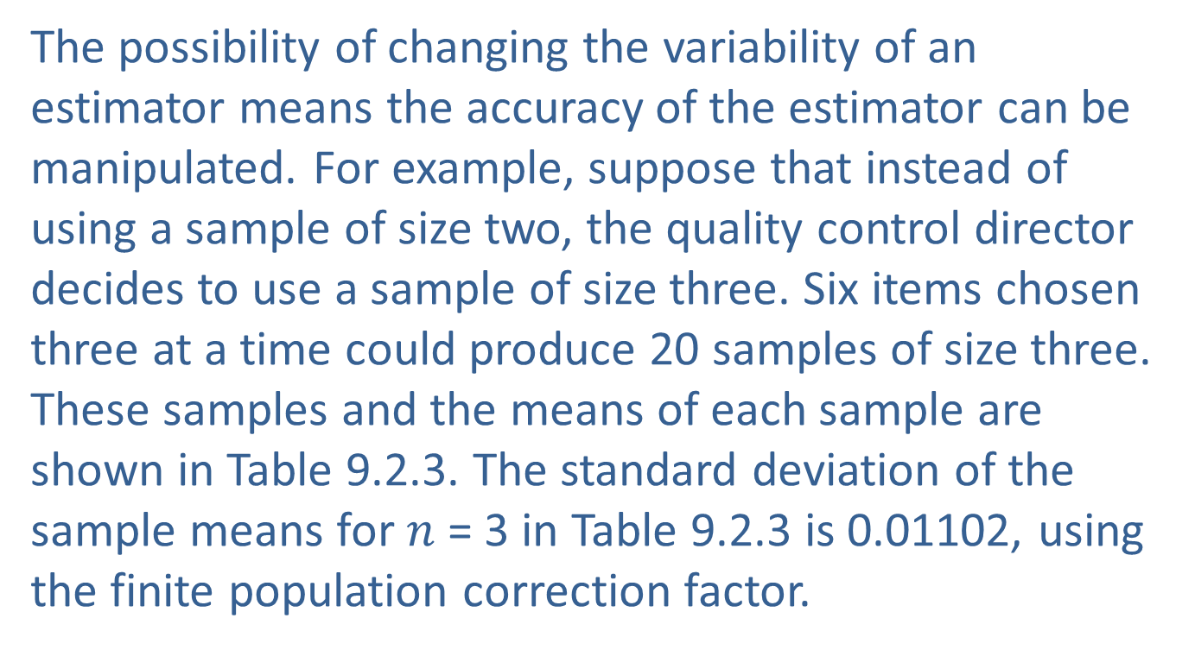
What is the Variability of $\overline{x}$? (cont.)
The possibility of changing the variability of an estimator means the accuracy of the estimator can be manipulated. For example, suppose that instead of using a sample of size two, the quality control director decides to use a sample of size three. Six items chosen three at a time could produce 20 samples of size three. These samples and the means of each sample are shown in Table 9.2.3. The standard deviation of the sample means for $n$ = 3 in Table 9.2.3 is 0.01102, using the finite population correction factor.

Slide 27
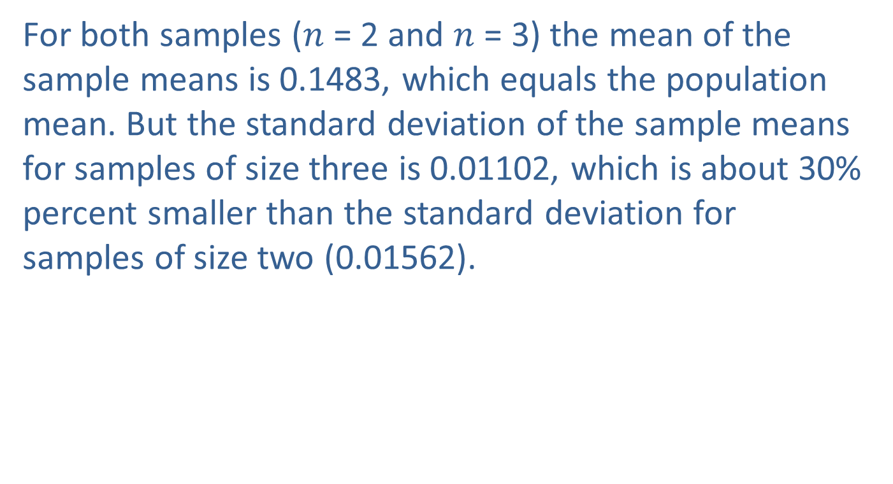
What is the Variability of $\overline{x}$? (cont.)
For both samples ($n$ = 2 and $n$ = 3) the mean of the sample means is 0.1483, which equals the population mean. But the standard deviation of the sample means for samples of size three is 0.01102, which is about 30% percent smaller than the standard deviation for samples of size two (0.01562).

Slide 28
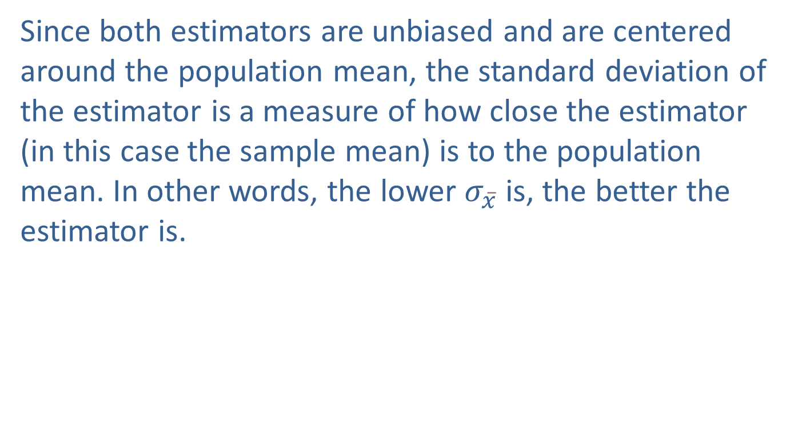
What is the Variability of $\overline{x}$? (cont.)
Since both estimators are unbiased and are centered around the population mean, the standard deviation of the estimator is a measure of how close the estimator (in this case the sample mean) is to the population mean. In other words, the lower $σ_{\overline{x}}$ is, the better the estimator is.

Slide 29
Critical Thinking
Question: Do you think the sample range is an unbiased or biased estimator?
Answer: The range is a biased estimator as most samples will not include the minimum or maximum values in the population. This means the sample range is expected to be less than the population range.

Slide 30
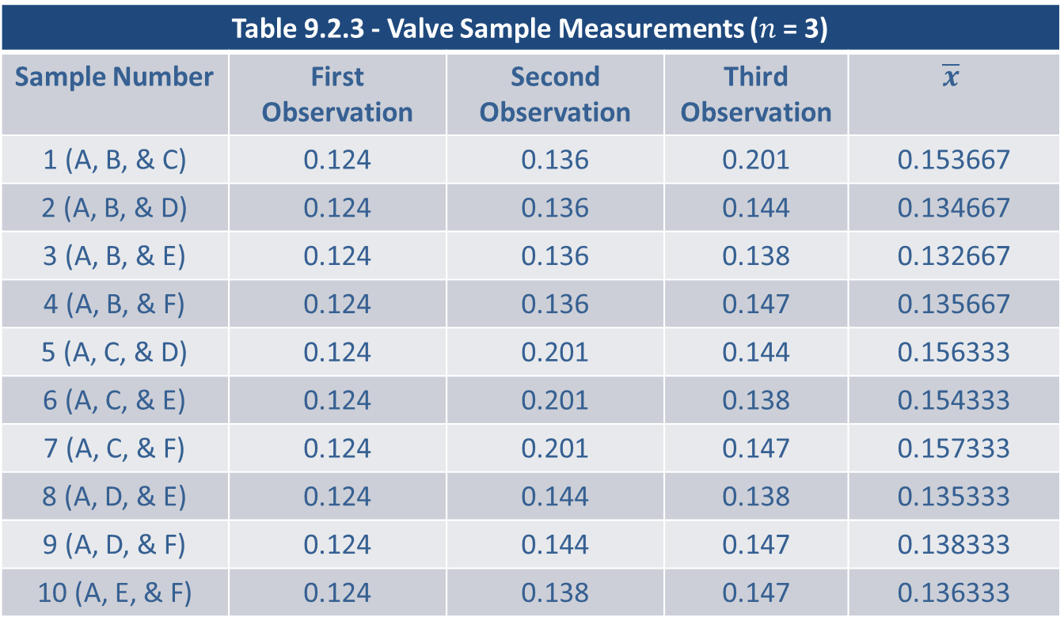
What is the Variability of $\overline{x}$? (cont.)
Table 9.2.3 - Valve Sample Measurements ($n$ = 3)
Sample Number | First Observation | Second Observation | Third Observation | $$\overline{x}$$
1 (A, B, & C) | 0.124 | 0.136 | 0.201 | 0.153667
2 (A, B, & D) | 0.124 | 0.136 | 0.144 | 0.134667
3 (A, B, & E) | 0.124 | 0.136 | 0.138 | 0.132667
4 (A, B, & F) | 0.124 | 0.136 | 0.147 | 0.135667
5 (A, C, & D) | 0.124 | 0.201 | 0.144 | 0.156333
6 (A, C, & E) | 0.124 | 0.201 | 0.138 | 0.154333
7 (A, C, & F) | 0.124 | 0.201 | 0.147 | 0.157333
8 (A, D, & E) | 0.124 | 0.144 | 0.138 | 0.135333
9 (A, D, & F) | 0.124 | 0.144 | 0.147 | 0.138333
10 (A, E, & F) | 0.124 | 0.138 | 0.147 | 0.136333

Slide 31
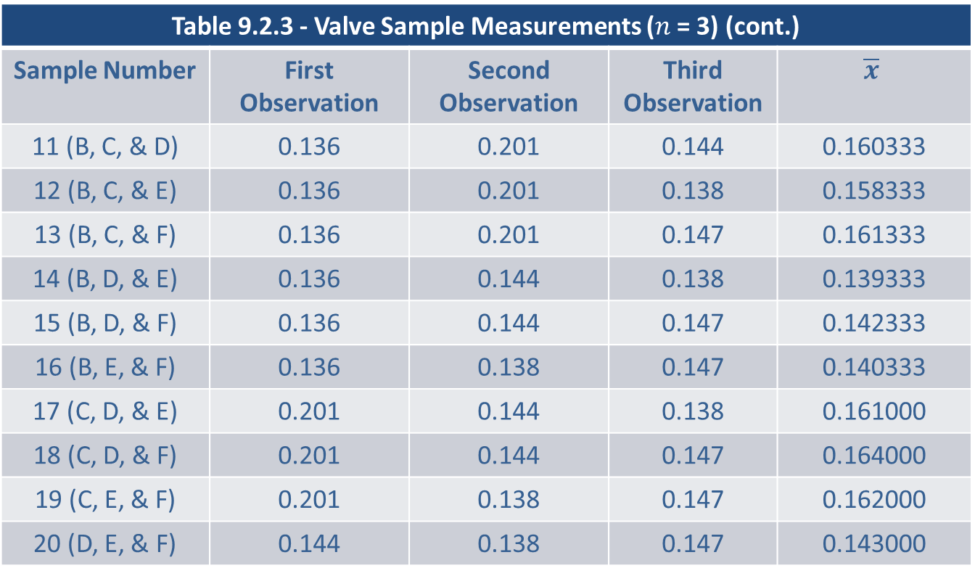
What is the Variability of $\overline{x}$? (cont.)
Table 9.2.3 - Valve Sample Measurements ($n$ = 3) (cont.)
Sample Number | First Observation | Second Observation | Third Observation | $$\overline{x}$$
11 (B, C, & D) | 0.136 | 0.201 | 0.144 | 0.160333
12 (B, C, & E) | 0.136 | 0.201 | 0.138 | 0.158333
13 (B, C, & F) | 0.136 | 0.201 | 0.147 | 0.161333
14 (B, D, & E) | 0.136 | 0.144 | 0.138 | 0.139333
15 (B, D, & F) | 0.136 | 0.144 | 0.147 | 0.142333
16 (B, E, & F) | 0.136 | 0.138 | 0.147 | 0.140333
17 (C, D, & E) | 0.201 | 0.144 | 0.138 | 0.161000
18 (C, D, & F) | 0.201 | 0.144 | 0.147 | 0.164000
19 (C, E, & F) | 0.201 | 0.138 | 0.147 | 0.162000
20 (D, E, & F) | 0.144 | 0.138 | 0.147 | 0.143000

Slide 32
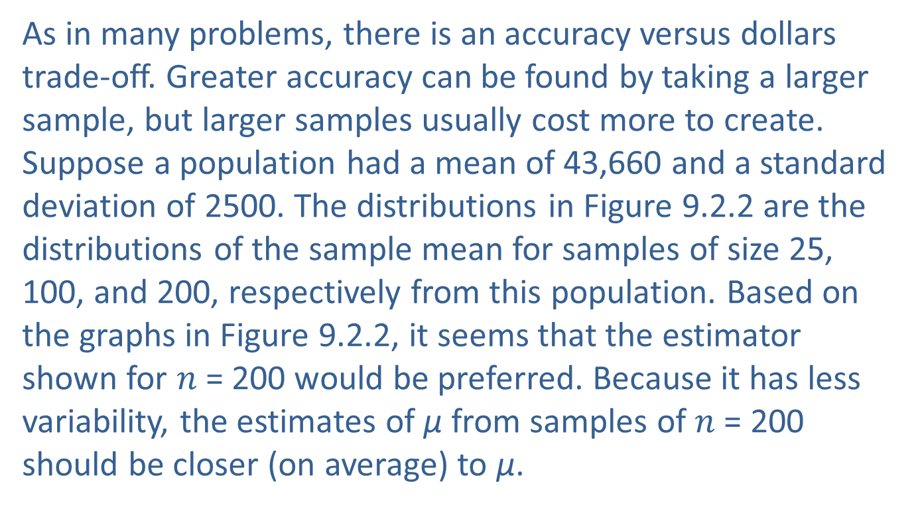
What is the Variability of ? (cont.)
As in many problems, there is an accuracy versus dollars trade-off. Greater accuracy can be found by taking a larger sample, but larger samples usually cost more to create. Suppose a population had a mean of 43,660 and a standard deviation of 2500. The distributions in Figure 9.2.2 are the distributions of the sample mean for samples of size 25, 100, and 200, respectively from this population. Based on the graphs in Figure 9.2.2, it seems that the estimator shown for $n$ = 200 would be preferred. Because it has less variability, the estimates of µ from samples of $n$ = 200 should be closer (on average) to µ.

Slide 33
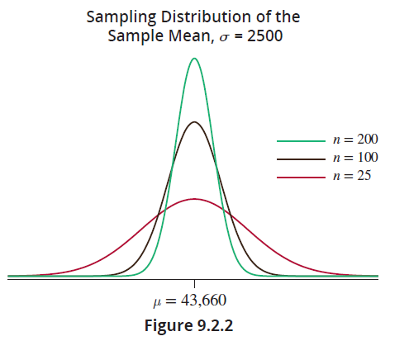
What is the Variability of ? (cont.)

Slide 34
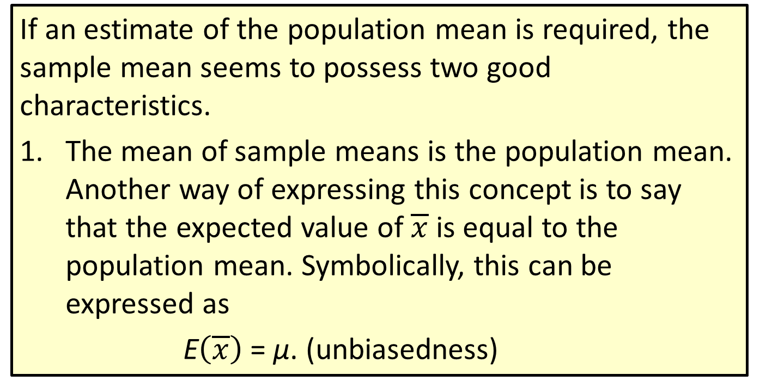
Properties: Characteristics of the Sample Mean
If an estimate of the population mean is required, the sample mean seems to possess two good characteristics.
The mean of sample means is the population mean. Another way of expressing this concept is to say that the expected value of $\overline{x}$is equal to the population mean. Symbolically, this can be expressed as
E$\left(\overline{x}\right)$ = µ. (unbiasedness)

Slide 35
Properties: Characteristics of the Sample Mean (cont.)
If the sample size is increased, the variability of the sample mean decreases. This implies that the quality of the estimator tends to improve as the sample size increases

Slide 36
What is the Variability of ? (cont.)
The second characteristic has an important consequence for estimating a population characteristic. By choosing a sufficiently large sample size, an estimate can be obtained with some specified level of accuracy. Being able to predetermine the accuracy of an estimate is an important topic in statistics and will be discussed in the next chapter.

Slide 37
Is There a Familiar Pattern to the Variability?
The Central Limit Theorem is a very important theorem which summarizes the distribution of the sample mean. The distribution of the sample mean becomes closer to a normal distribution as the sample size becomes larger, regardless of the shape of the population from which the sample is drawn.
The most important feature of the Central Limit Theorem is that it can be applied to any population. Because the theorem does not have any distributional assumptions, it is widely applicable and is one of the cornerstones of statistical inference.

Slide 38
Is There a Familiar Pattern to the Variability? (cont.)
Many of the statistical techniques discussed in subsequent chapters will have their theoretical basis in this theorem.

Slide 39
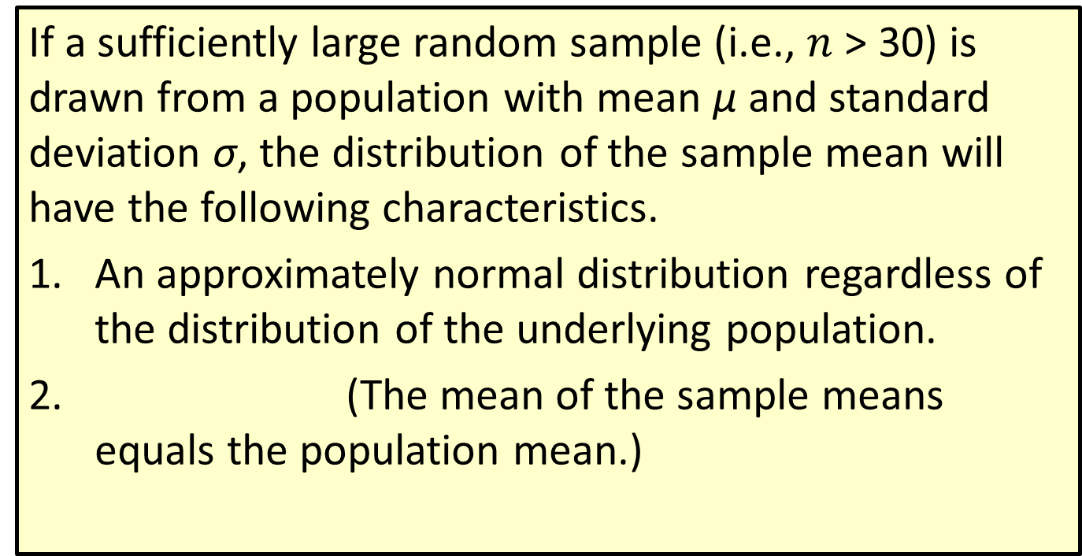
Definition: The Central Limit Theorem
If a sufficiently large random sample (i.e., $n$ > 30) is drawn from a population with mean µ and standard deviation σ, the distribution of the sample mean will have the following characteristics.
An approximately normal distribution regardless of the distribution of the underlying population.
(The mean of the sample means equals the population mean.)

Slide 40
Definition: The Central Limit Theorem (cont.)
(The standard deviation of the sample means equals the standard deviation of the population divided by the square root of the sample size.)

Slide 41
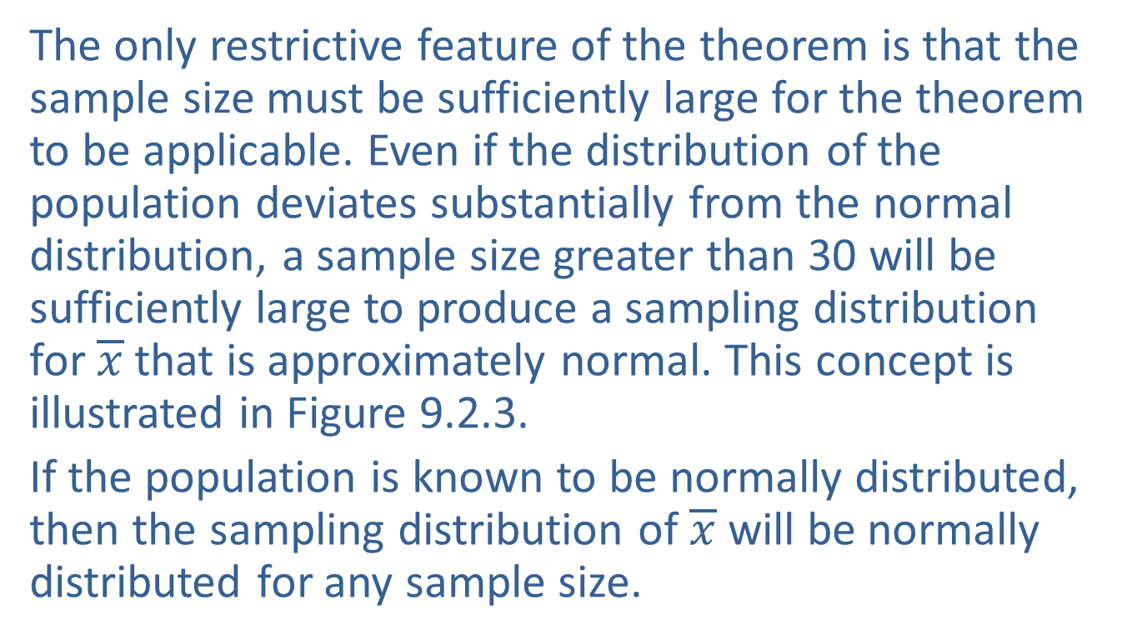
Is There a Familiar Pattern to the Variability? (cont.)
The only restrictive feature of the theorem is that the sample size must be sufficiently large for the theorem to be applicable. Even if the distribution of the population deviates substantially from the normal distribution, a sample size greater than 30 will be sufficiently large to produce a sampling distribution for $\overline{x}$that is approximately normal. This concept is illustrated in Figure 9.2.3.
If the population is known to be normally distributed, then the sampling distribution of $\overline{x}$will be normally distributed for any sample size.

Slide 42

Is There a Familiar Pattern to the Variability? (cont.)
Once we have determined the sample size is sufficiently large, we can use the $z$-transformation we studied in Chapter 8 to calculate probabilities about the random variable $\overline{x}$. We can adapt the $z$-transformation to the random variable $\overline{x}$ as follows.

Slide 43
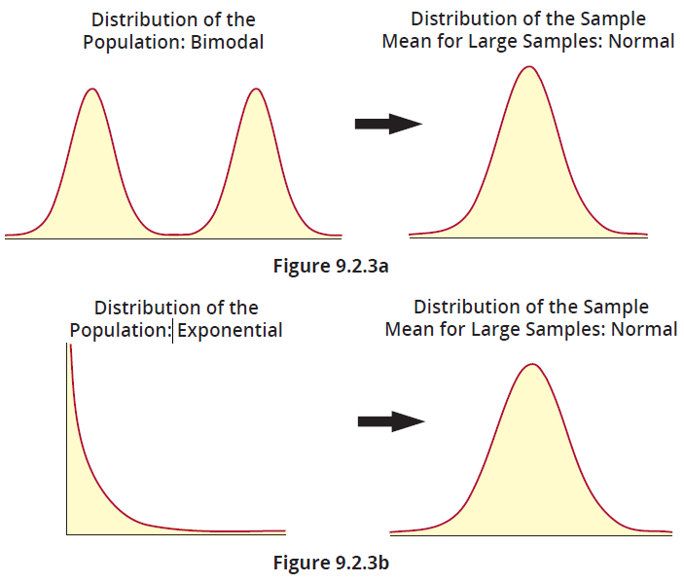
Is There a Familiar Pattern to the Variability? (cont.)

Slide 44
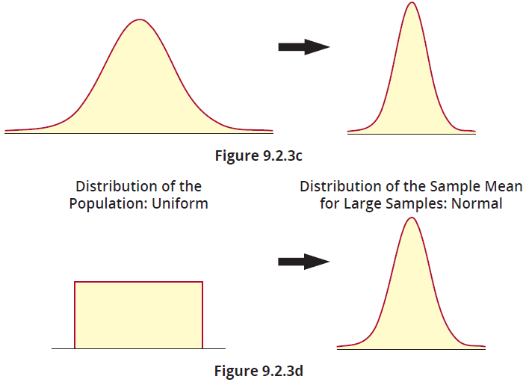
Is There a Familiar Pattern to the Variability? (cont.)

Slide 45
Example 9.2.1: Applying the Central Limit Theorem to a Skewed Population Distribution
The United States Geological Survey (USGS) has an internet repository of data related to earthquakes that occur around the world. Notice that the histogram of the population of 134 “significant” earthquakes from 2022 does not have a shape that resembles a normal distribution, but rather is skewed left. A histogram and table of summary statistics for the population data is shown below.

Slide 46
Example 9.2.1: Applying the Central Limit Theorem to a Skewed Population Distribution (cont.)
Magnitude of Significant Earthquakes in 2022
Mean | 5.7440
Median | 6.1000
Mode | 6.3000
Standard Deviation | 1.1046
N | 134

Slide 47
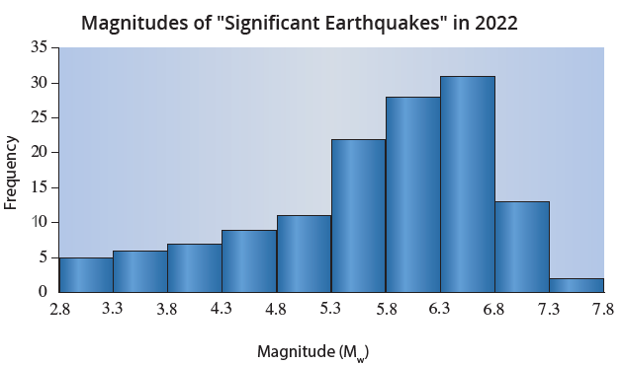
Example 9.2.1: Applying the Central Limit Theorem to a Skewed Population Distribution (cont.)

Slide 48
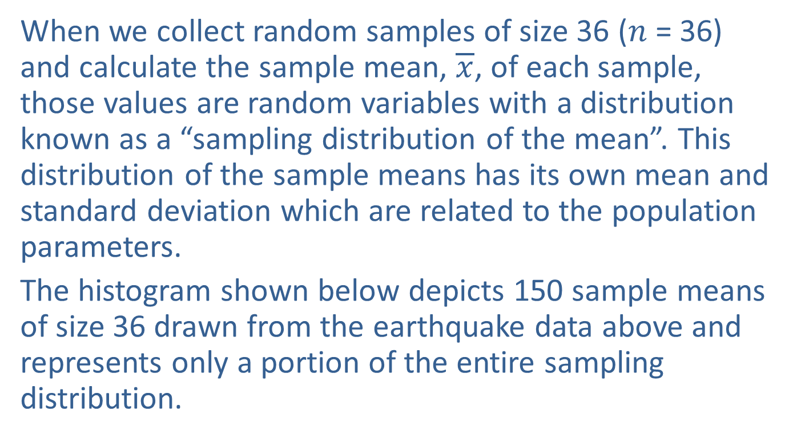
Example 9.2.1: Applying the Central Limit Theorem to a Skewed Population Distribution (cont.)
When we collect random samples of size 36 ($n$ = 36) and calculate the sample mean, $\overline{x}$, of each sample, those values are random variables with a distribution known as a “sampling distribution of the mean”. This distribution of the sample means has its own mean and standard deviation which are related to the population parameters.
The histogram shown below depicts 150 sample means of size 36 drawn from the earthquake data above and represents only a portion of the entire sampling distribution.

Slide 49
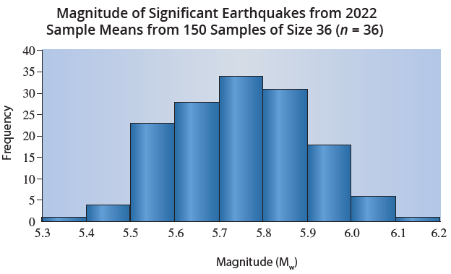
Example 9.2.1: Applying the Central Limit Theorem to a Skewed Population Distribution (cont.)
Describe the shape and visually estimate the center of the histogram of 150 sample means of size 36 for the magnitudes of significant earthquakes in 2022.

Slide 50
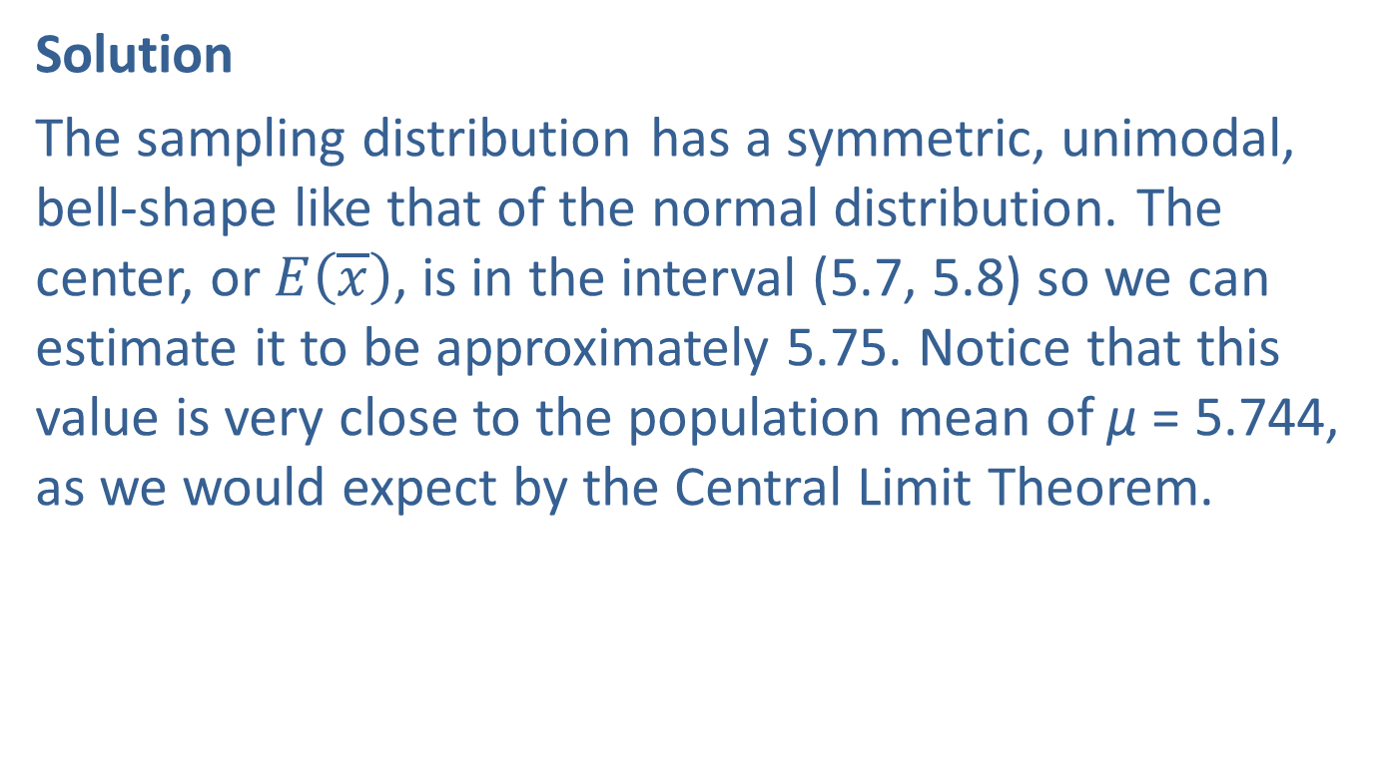
Example 9.2.1: Applying the Central Limit Theorem to a Skewed Population Distribution (cont.)
Solution
The sampling distribution has a symmetric, unimodal, bell-shape like that of the normal distribution. The center, or $E\left(\overline{x}\right)$, is in the interval (5.7, 5.8) so we can estimate it to be approximately 5.75. Notice that this value is very close to the population mean of µ = 5.744, as we would expect by the Central Limit Theorem.

Slide 51
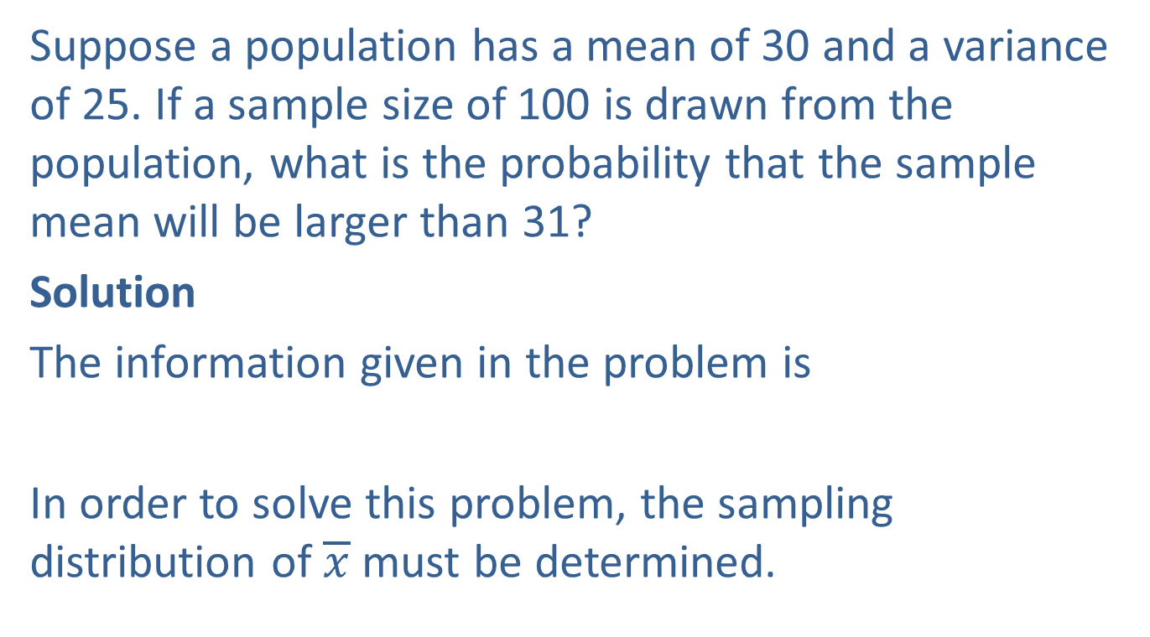
Example 9.2.2: Calculating a Probability Using the Central Limit Theorem
Suppose a population has a mean of 30 and a variance of 25. If a sample size of 100 is drawn from the population, what is the probability that the sample mean will be larger than 31?
Solution
The information given in the problem is
In order to solve this problem, the sampling distribution of $\overline{x}$ must be determined.

Slide 52
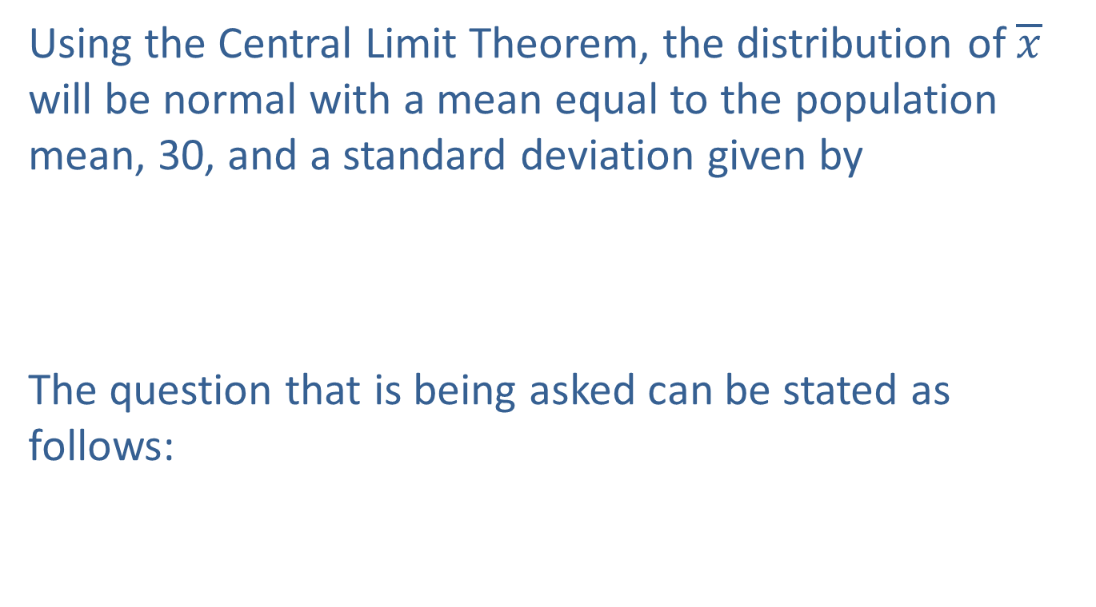
Example 9.2.2: Calculating a Probability Using the Central Limit Theorem (cont.)
Using the Central Limit Theorem, the distribution of $\overline{x}$ will be normal with a mean equal to the population mean, 30, and a standard deviation given by
The question that is being asked can be stated as follows:

Slide 53

Example 9.2.2: Calculating a Probability Using the Central Limit Theorem (cont.)
Since $\overline{x}$ is a normal random variable, the probability that $\overline{x}$ is greater than 31 is determined using a
$z$-transformation. The objective is to find the area under the normal curve corresponding to an $\overline{x}$ greater than 31.

Slide 54
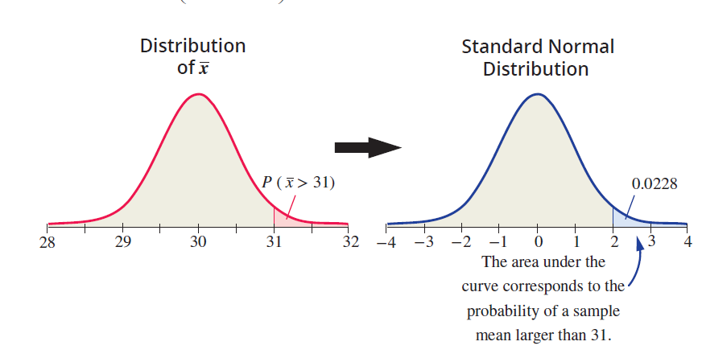
Example 9.2.2: Calculating a Probability Using the Central Limit Theorem (cont.)

Slide 55
Example 9.2.3: Using the Error of Estimation to Calculate a Probability
Consider the same scenario as in Example 9.2.2 except that the mean is unknown. If the sample mean is used as an estimate of the population mean, what is the probability that the sample mean will be in error by at most one unit from the true mean?
Solution
The concept of using a statistic to estimate a population parameter introduces the concept of the error of estimation (also referred to as sampling error or estimation error).

Slide 56
Definition: Error of Estimation
In general, the error of estimation is the difference between a sample statistic and the parameter that it is estimating.

Slide 57
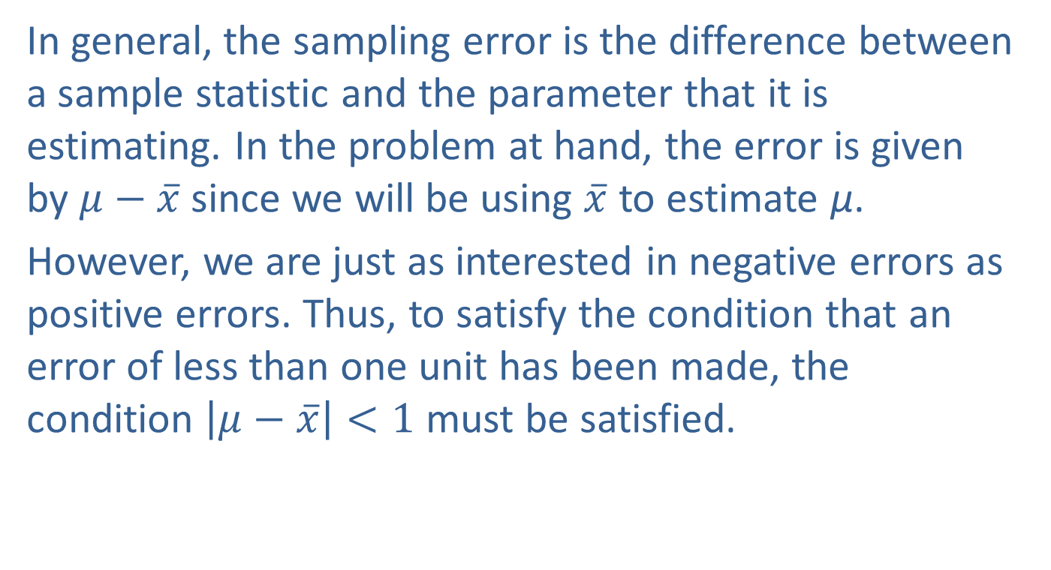
Example 9.2.3: Using the Error of Estimation to Calculate a Probability (cont.)
In general, the sampling error is the difference between a sample statistic and the parameter that it is estimating. In the problem at hand, the error is given by $μ−\overline{x}$ since we will be using $\overline{x}$ to estimate µ.
However, we are just as interested in negative errors as positive errors. Thus, to satisfy the condition that an error of less than one unit has been made, the condition $\left|μ−\overline{x}\right|<1$ must be satisfied.

Slide 58
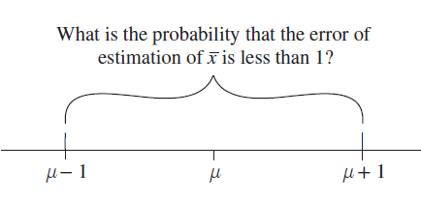


Example 9.2.3: Using the Error of Estimation to Calculate a Probability (cont.)
An interesting and almost magical phenomenon happens when we use the $z$-transformation.
Since $σ_{\overline{x}}=0.5.$

Slide 59
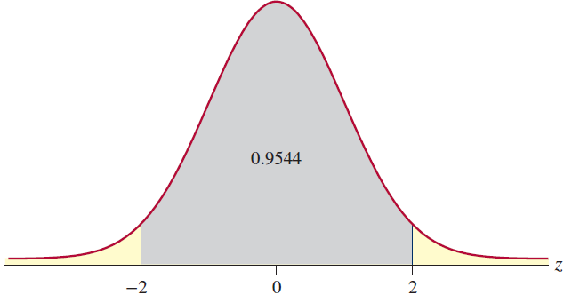
Example 9.2.3: Using the Error of Estimation to Calculate a Probability (cont.)
For a sample of 100, It is very probable (0.9544) that the error of estimation will be less than 1 unit.

