Slide 1
Section 8.6
Approximation to the Binomial Distribution

Slide 2
The Binomial Distribution
Calculating binomial probabilities can be quite time consuming if n is large. For example, suppose that you intend to sample 2000 subjects for a marketing research survey. If 50 percent of the population believes your product is superior to the competition’s, what is the probability of obtaining 600 or fewer subjects who believe your company’s product is superior?

Slide 3
The Binomial Distribution (cont.)
Determining the appropriate probability using the binomial distribution would require the calculation of 601 individual probabilities, many of which would have extremely large combinations such as the following.
Computing this and the other 600 similar calculations would be a formidable task. The normal distribution is useful in approximating binomial probabilities. The larger the binomial parameter, n, the more accurate the approximation.

Slide 4
The Binomial Distribution (cont.)
Determining the probability described above using the normal approximation is trivial in comparison to calculating the exact probability using the binomial.
Recall that the normal distribution is a function of two parameters, the mean and the standard deviation. Thus, if the normal distribution is used to approximate the binomial distribution, it seems reasonable that the mean and standard deviation of the normal should be the same as the mean and standard deviation of the binomial that is being approximated. Specifically, let

Slide 5
The Binomial Distribution (cont.)
To approximate a binomial with n = 20 and p = 0.5 would require a normal distribution with

Slide 6
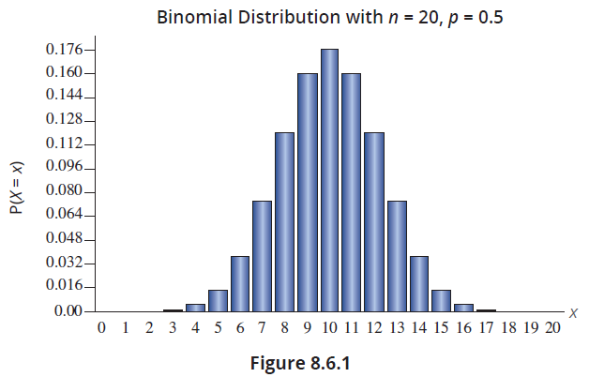
The Binomial Distribution (cont.)
In this example, the shapes of the distributions are quite similar and consequently the approximation will be good. This is illustrated in Figures 8.6.1 and 8.6.2.

Slide 7
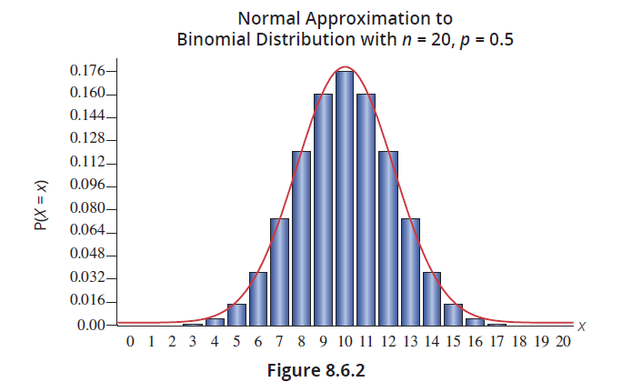
The Binomial Distribution (cont.)

Slide 8
The Binomial Distribution (cont.)
So, when should the normal distribution be used to approximate the binomial distribution? Generally, the approximation is reasonable when the mean of the binomial, np, is greater than or equal to 5 and n(1 – p) is greater than or equal to 5. The approximation becomes quite good when np is greater than or equal to 10 and n(1 – p) is greater than or equal to 10.
The normal approximation to the binomial can be improved by using continuity correction.

Slide 9
Definition: Continuity Correction
Continuity correction is used when a discrete distribution is approximated using a continuous distribution. To apply continuity correction, subtract or add 0.5 (depending on the question at hand) to a selected value in order to find the desired probability.

Slide 10
The Binomial Distribution (cont.)
Suppose that you wished to determine the probability that a binomial random variable (n = 20 and p = 0.5) is equal to 5. Recall that for a continuous random variable X, the probability that X is equal to some specific value is zero since there is no area under the curve for a single point, say X = 5. Therefore, to approximate the probability would require finding the area under the curve of a normal random variable Y between 4.5 and 5.5.

Slide 11
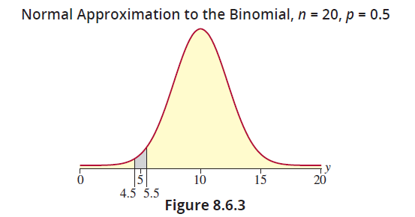
The Binomial Distribution (cont.)

Slide 12
The Binomial Distribution (cont.)
Using Continuity Correction
Problem Statement | Area (Probability)
At least 5 (includes 5 and above) | Find the area to the right of 4.5
More than 5 (doesn’t include 5) | Find the area to the right of 5.5
At most 5 (includes 5 and below) | Find the area to the left of 5.5
Less than 5 (doesn’t include 5) | Find the area to the left of 4.5
Exactly 5 | Find the area between 4.5 and 5.5
The continuity correction should be used whenever the normal distribution is used to approximate the binomial distribution. The following examples will illustrate how to approximate the binomial distribution using the normal distribution with continuity correction.

Slide 13
Example 8.6.1: Using a Normal Distribution to Approximate a Binomial Probability
Verify that the normal distribution can be used to approximate the binomial when n = 20 and p = 0.5.
Use a normal random variable (Y) to approximate the probability that a binomial random variable (X) is 5 or less.
Using a normal distribution to approximate, find the probability that X is greater than 4.

Slide 14
Example 8.6.1: Using a Normal Distribution to Approximate a Binomial Probability (cont.)
Solution
Since np = 10 and n(1 – p) = 10, the normal distribution can be used to approximate the binomial probability.
This implies finding the area of the rectangles for 0, 1, 2, 3, 4, and 5.

Slide 15
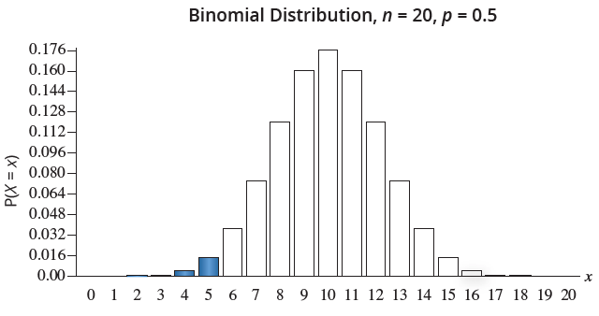
Example 8.6.1: Using a Normal Distribution to Approximate a Binomial Probability (cont.)

Slide 16
Note
The method of approximating the binomial with the normal distribution was developed in the 18th century before something like a calculator existed. Now it is practical to find the true probabilities using technology. However, it is still important to understand the normal approximation concept as we will use this idea later in Section 11.5.

Slide 17
Example 8.6.1: Using a Normal Distribution to Approximate a Binomial Probability (cont.)
Instead of using the normal approximation P(Y ≤ 5), use the continuity correction P(Y ≤ 5.5) in order to accumulate all of the probabilities under the normal curve that correspond to the region X ≤ 5.
To use the normal approximation the mean and standard deviation of the binomial must be calculated.

Slide 18
Example 8.6.1: Using a Normal Distribution to Approximate a Binomial Probability (cont.)
Using the normal random variable Y with a mean of 10 and a standard deviation of 2.2361 to approximate the binomial using continuity correction,

Slide 19
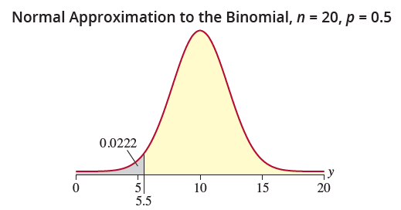
Example 8.6.1: Using a Normal Distribution to Approximate a Binomial Probability (cont.)
Thus, the probability that the binomial random variable is 5 or less is approximately 0.0222.

Slide 20
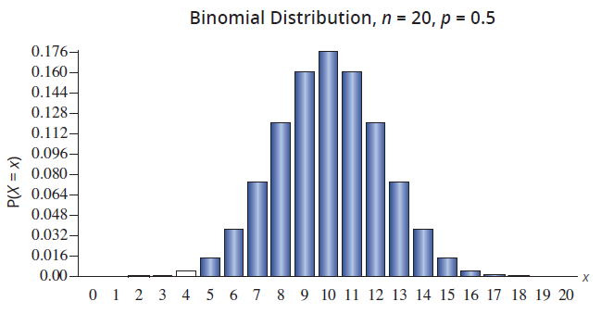
Example 8.6.1: Using a Normal Distribution to Approximate a Binomial Probability (cont.)

Slide 21
Example 8.6.1: Using a Normal Distribution to Approximate a Binomial Probability (cont.)
We are interested in the probability that a binomial random variable, X, is greater than 4. Since this is a discrete distribution, the probability that X is greater than 4 is equal to the probability that X is greater than or equal to 5. Thus, when using the normal approximation, we need to apply continuity correction and consider the probability that the normal random variable is greater than or equal to 4.5.

Slide 22
Example 8.6.1: Using a Normal Distribution to Approximate a Binomial Probability (cont.)
Using the normal random variable Y with a mean of 10 and a standard deviation of 2.2361 to approximate the binomial using continuity correction,

Slide 23
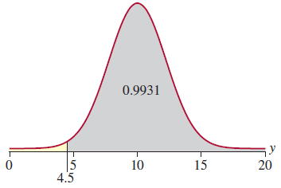
Example 8.6.1: Using a Normal Distribution to Approximate a Binomial Probability (cont.)
Normal Approximation to the Binomial, n = 20, p = 0.5
Thus, the probability that the binomial random variable is greater than 4 is 0.9931.

Slide 24
Example 8.6.2: Using a Normal Distribution to Approximate a Binomial Probability about Campaign Awareness
An advertising agency hired on behalf of a college’s development office conducted an ad campaign aimed at making alumni aware of their new capital campaign. Upon completion of the new campaign, the agency claimed that 20% of alumni in the state were aware of the new campaign. To validate the claim of the agency, the development office surveyed 1000 alumni in the state and found that 150 were aware of the campaign. Assuming that the ad agency’s claim is true, what is the probability that no more than 150 of the alumni in the random sample were aware of the new campaign?

Slide 25
Example 8.6.2: Using a Normal Distribution to Approximate a Binomial Probability about Campaign Awareness (cont.)
Solution
Let X = the number of alumni that were aware of the campaign.
X is a binomial random variable with n = 1000 and p = 0.20.
So, np = 200 and n(1 – p) = 800. Therefore, the normal distribution is appropriate to use as an approximation to the binomial distribution.
The mean is μ = np = 200 and the standard deviation is

Slide 26
Example 8.6.2: Using a Normal Distribution to Approximate a Binomial Probability about Campaign Awareness (cont.)
We are interested in the probability that no more than 150 of the alumni in the sample were aware of the campaign, or P(X ≤ 150). However, since we are using the normal distribution to approximate the binomial, continuity correction must be applied.
Let Y be a normally distributed random variable with a mean of 200 and a standard deviation of 12.6491. Applying continuity correction, we are interested in the following probability.

Slide 27
Example 8.6.2: Using a Normal Distribution to Approximate a Binomial Probability about Campaign Awareness (cont.)
Thus, if the marketing agency’s claim is true, the probability that 150 or fewer alumni are aware of the campaign is practically zero. This would lead the development office to believe that the agency’s claim is false.

Slide 28
Note
The z-value −3.91 is not listed in the tables given in Appendix A. However, using technology such as a calculator or computer software, it can be calculated that the actual probability is approximately 0.000046.

Slide 29
Example 8.6.3: Using a Normal Distribution to Approximate a Binomial Probability About Restaurant No-Shows
A popular restaurant near a college campus accepts 200 reservations on Saturdays, often the day of a home football game. Given that many of the reservations are made weeks in advance of game day, the restaurant expects that about eight percent will be no-shows. What is the probability that the restaurant will have no more than 20 no-shows on the next Saturday of a football weekend?

Slide 30
Example 8.6.3: Using a Normal Distribution to Approximate a Binomial Probability About Restaurant No-Shows (cont.)
Solution
Let X = the number of no-shows.
X is a binomial random variable with n = 200 and p = 0.08.
Since np = 16 and n(1 – p) = 184 are both greater than 10, the normal distribution can be used to approximate the binomial probability.
For the binomial, μ = np = 16 and

Slide 31
Example 8.6.3: Using a Normal Distribution to Approximate a Binomial Probability About Restaurant No-Shows (cont.)
Using the normal random variable Y with a mean of 16 and a standard deviation of 3.8367 to approximate the binomial without continuity correction results in
Using continuity correction,

Slide 32
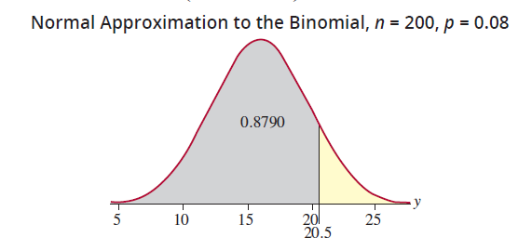
Example 8.6.3: Using a Normal Distribution to Approximate a Binomial Probability About Restaurant No-Shows (cont.)
Thus, using the normal approximation and continuity correction, the probability that the restaurant will have no more than 20 no-shows is 0.8790.

Slide 33
Example 8.6.3: Using a Normal Distribution to Approximate a Binomial Probability About Restaurant No-Shows (cont.)
Notice that the continuity correction has a significant impact on the accuracy of the approximation. Using the binomial distribution, the exact probability is 0.8775.

