Slide 1
Section 8.5
Assessing Normality

Slide 2
Assessing Normality
Many of the statistical tests that are discussed in this book require that the data be a simple random sample from a population that has a normal distribution, or is at least approximately normal. If a histogram of the data is symmetric and bell-shaped, we can assume normality. However, the shape of a histogram can be hard to determine with a small sample of data. Therefore, we need additional ways to assess normality. One of these alternative methods is called a normal probability plot (or normal quantile plot).

Slide 3
Definition: Normal Probability Plot
A normal probability plot is a graph that plots the observed data (x) versus the normal score (y). The normal score is the expected z-score of the data values, assuming the data are normally distributed. The expected z-score of an observation depends on the number of observations in the data set, n.

Slide 4
Procedure: Assessing Normality
Graphically confirm the distribution of the sample data.
If there are enough data values to draw a histogram, then the histogram of the data must follow a bell-shaped curve, or a “normal curve”. If the shape of the histogram differs drastically from a bell shape, then we conclude that the data are not drawn from a normal distribution.

Slide 5
Procedure: Assessing Normality (cont.)
For small data sets (n ≤ 30), construct a normal probability plot. If the points on the normal probability plot do not follow a linear pattern, or if there is a systematic pattern that is not linear, then we conclude that the data are not drawn from a normal distribution.

Slide 6
Procedure: Assessing Normality (cont.)
Inspect the histogram or normal probability plot for outliers.
The data must have no more than one outlier present. A single outlier could be the result of an error or some chance variation. However, since even a single outlier may affect results, we must reject normality if there are two or more outliers. A method to detect outliers was described in Section 4.3. Box plots of the data can also be used to detect outliers.

Slide 7
Assessing Normality (cont.)
The construction of a normal probability plot can be a tedious process if done by hand; however, there are several software programs that make the process much easier. In general, the steps for constructing a normal probability plot manually are as follows.

Slide 8
Procedure: Constructing a Normal Probability Plot
Sort the data values so they are arranged from smallest to largest, and assign a rank to each value with 1 corresponding to the smallest value and n corresponding to the largest value.
Once sorted, compute the percentile occupied by each value using the formula
where i is the rank and n is the total number of data points.

Slide 9
Procedure: Constructing a Normal Probability Plot (cont.)
Using the percentile computed in the previous step, find the corresponding z-value or z-score.
Create a scatter plot with the observed values on the horizontal axis, and the corresponding expected z-scores on the vertical axis.

Slide 10
Example 8.5.1: Assessing the Normality of Student Ages
Suppose a tech company is offering computer-programming courses to the local community, and the courses are open to all ages. One of the course sections has 10 students enrolled with the ages shown below. Is there evidence to support the belief that the ages come from a normally distributed population?
Ages of Students Enrolled in the Course
20 | 32 | 14 | 23 | 27 | 23 | 29 | 24 | 23 | 19

Slide 11
Example 8.5.1: Assessing the Normality of Student Ages (cont.)
Solution
Since our data set is small, constructing a histogram will not tell us much about the distribution of the data. In order to get a better understanding of the shape of our data, we need to construct a normal probability plot. Usually, we would use a software application to construct a normal probability plot since the process can become tedious for large data sets. However, it is beneficial to understand how the process is carried out by hand. Since we are assessing a small data set, we will demonstrate the calculations below.

Slide 12
Example 8.5.1: Assessing the Normality of Student Ages (cont.)
Steps 1–3
Sort the data values so they are arranged from smallest to largest, and assign a rank to each value.
Compute the percentile occupied by each value. For example, the value 20, which has rank 3, occupies the 25th percentile.

Slide 13
Example 8.5.1: Assessing the Normality of Student Ages (cont.)
Using the percentiles computed in the previous step, find the corresponding z-scores using technology.
Age | Rank | Percentile | z-score
14 | 1 | 0.05 | ─1.645
19 | 2 | 0.15 | ─1.036
20 | 3 | 0.25 | ─0.674
23 | 4 | 0.35 | ─0.385
23 | 5 | 0.45 | ─0.126
23 | 6 | 0.55 | 0.126
24 | 7 | 0.65 | 0.385
27 | 8 | 0.75 | 0.674
29 | 9 | 0.85 | 1.036
32 | 10 | 0.95 | 1.645

Slide 14
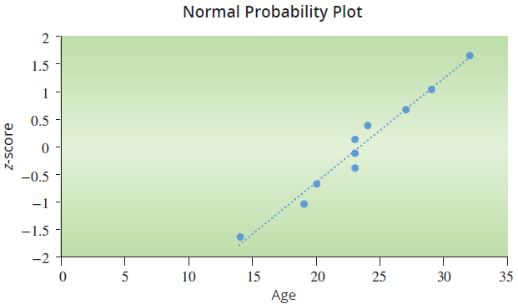
Example 8.5.1: Assessing the Normality of Student Ages (cont.)
Step 4
We create a scatter plot with ages on the horizontal axis and the corresponding z-scores on the vertical axis. This can be done by hand, or using a software application.

Slide 15
Example 8.5.1: Assessing the Normality of Student Ages (cont.)
As we can see from the normal probability plot, the data points roughly follow a linear pattern. We cannot detect any outliers (any points very far removed from the majority on the plot). Therefore, we can conclude that the ages of students enrolled in the course come from a normally distributed population.

Slide 16
Example 8.5.2: Assessing the Normality of Housefly Wing Lengths
Biostatisticians Dr. Robert R. Sokal and Dr. F. James Rohlf published a text titled Biometry which focused on the use of statistical methods in biological research. Within that book, there was a data set regarding the wing lengths of houseflies in tenths of a millimeter. The length values are shown in the following table sorted from smallest to largest.

Slide 17
Example 8.5.2: Assessing the Normality of Housefly Wing Lengths (cont.)
Check whether the data are approximately normally distributed.
Housefly Wing Lengths (tenths of a mm)
36 | 41 | 42 | 43 | 45 | 46 | 47 | 48 | 49 | 51
37 | 41 | 42 | 44 | 45 | 46 | 47 | 48 | 49 | 51
38 | 41 | 42 | 44 | 45 | 46 | 47 | 48 | 49 | 51
38 | 41 | 43 | 44 | 45 | 46 | 47 | 48 | 49 | 51
39 | 41 | 43 | 44 | 45 | 46 | 47 | 48 | 50 | 52
39 | 41 | 43 | 44 | 45 | 46 | 47 | 48 | 50 | 52
40 | 42 | 43 | 44 | 45 | 46 | 47 | 48 | 50 | 53
40 | 42 | 43 | 44 | 45 | 46 | 47 | 49 | 50 | 53
40 | 42 | 43 | 44 | 45 | 46 | 47 | 49 | 50 | 54
40 | 42 | 43 | 44 | 45 | 46 | 48 | 49 | 50 | 55

Slide 18
Note
The housefly population exceeds the human population 17:1.

Slide 19
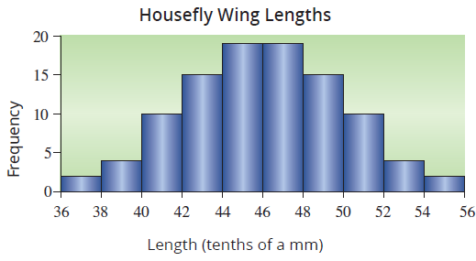
Example 8.5.2: Assessing the Normality of Housefly Wing Lengths (cont.)
Solution
As the sample size is reasonably large, we start by creating a histogram so we can check to see if the distribution is symmetrical and bell-shaped.

Slide 20
Example 8.5.2: Assessing the Normality of Housefly Wing Lengths (cont.)
Based on the histogram, we can assume the population is normally distributed.
By examining the beginning and end of the list of sorted data points, and also by examining the histogram, we find that there are no discernable outliers in the data set.
We are able to conclude that the population is normally distributed. With this knowledge, we can perform further statistical analysis using methods tailored to normally distributed populations.

Slide 21
Example 8.5.3: Assessing the Normality of Bill-Length Ratios
Dr. Thomas W. Schoener assembled a data set containing the bill-length ratios of several hundred different bird species. The bill-length ratio is the ratio of the largest bill to the smallest bill measured in each population (in each species). For example, if a certain species had a bill-length ratio of 1.23, that means that the largest bill measured within that species was 1.23 times larger than the smallest bill measured within that species. Is there evidence to support the belief that bill-length ratio is normally distributed?

Slide 22
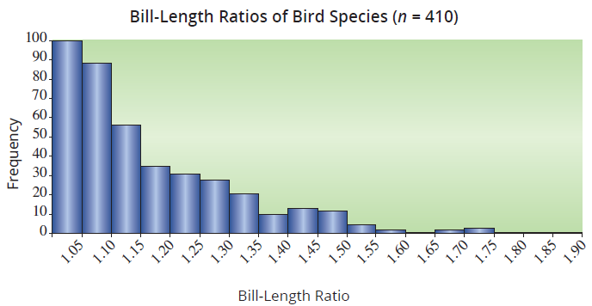
Example 8.5.3: Assessing the Normality of Bill-Length Ratios (cont.)
Clearly, the histogram does not have a bell shape, so we would reject the belief that bill-length ratio is normally distributed.

Slide 23
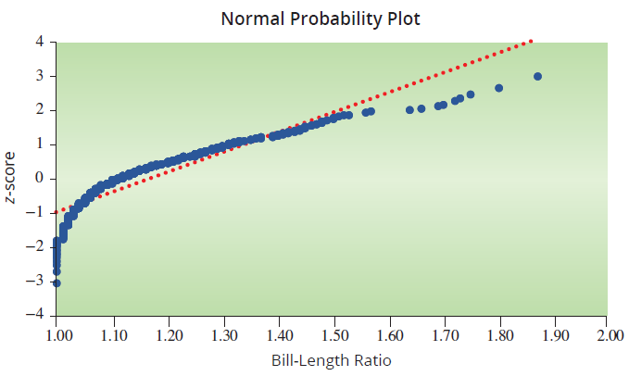
Example 8.5.3: Assessing the Normality of Bill-Length Ratios (cont.)
Though the data set is large, let’s examine what the normal probability plot looks like for this data.

Slide 24
Example 8.5.3: Assessing the Normality of Bill-Length Ratios (cont.)
From the graph, we can see that the plotted points do not follow a linear trend. This particular pattern indicates that the data are skewed right and not normally distributed, confirming what we observed in the histogram.

