Slide 1
Section 8.4
Applications of the Normal Distribution

Slide 2
Applications of the Normal Distribution
Most normal distributions of real data do not have a mean of zero and standard deviation of one. However, we can perform a transformation to standardize any normal random variable into a standard normal distribution.

Slide 3
Formula: Standardizing a Normal Random Variable
The following formula can transform any normal random variable into a standard normal random variable, z:
where x is a normal random variable with mean μ and standard deviation σ.

Slide 4
Applications of the Normal Distribution (cont.)
If we look at the individual pieces, exactly how the transformation works is not very mysterious. First, the numerator centers the z-distribution around zero. By subtracting the mean of the random variable from each data value, the mean of the resulting random variable will be zero. A short example illustrates the point.

Slide 5
Applications of the Normal Distribution (cont.)
Suppose that a population contained the following data values shown in Table 8.4.1.
Table 8.4.1 - Deviations from the Mean
x | x─µ
1
5
6
12
Mean = 6 | Mean = 0

Slide 6
Applications of the Normal Distribution (cont.)
The data has a mean of six. If six is subtracted from each of the data values, the resulting deviations are shown in the second column of the table. The deviations have a mean of zero. Essentially the location of the data set has been shifted to zero. The interrelationship of the data points to one another has not changed. Try this experiment on larger sets of data to convince yourself that subtracting the mean from each value of a data set will produce a data set that always has a mean of zero.

Slide 7
Applications of the Normal Distribution (cont.)
Table 8.4.2 - Standardizing the Data
Data | Formula | Value of z
1
5
6
12
6 | Mean | 0
3.9370 | Standard Deviation | 1

Slide 8
Applications of the Normal Distribution (cont.)
The standard deviation of the data is approximately 3.9370. Let’s standardize each data value (see Table 8.4.2). The resulting z-values indicate how far the data values in Table 8.4.1 are from the mean, measured in standard deviation units. The first row of Table 8.4.2 shows that the data value 1 is –1.27 standard deviation units from the mean. The mean and standard deviation of the transformed values in Table 8.4.2 are zero and one, respectively.

Slide 9
Applications of the Normal Distribution (cont.)
You can verify that the mean and standard deviation of the z-scores are actually zero and one. Compute the population standard deviation rather than the sample standard deviation (divide by n instead of n – 1 in the standard deviation formula).
Now that we have seen how to convert any normal random variable into a standard normal random variable, let’s apply it.

Slide 10
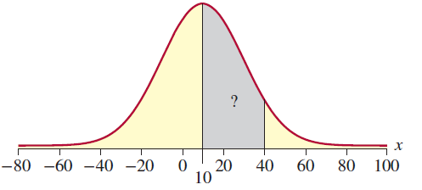
Example 8.4.1: Determining a Probability Using the Standard Normal Distribution
Find the probability that a normal random variable X with a mean of 10 and a standard deviation of 20 will lie between 10 and 40.

Slide 11
Example 8.4.1: Determining a Probability Using the Standard Normal Distribution (cont.)
Solution
Standardizing the random variable X yields the following.

Slide 12
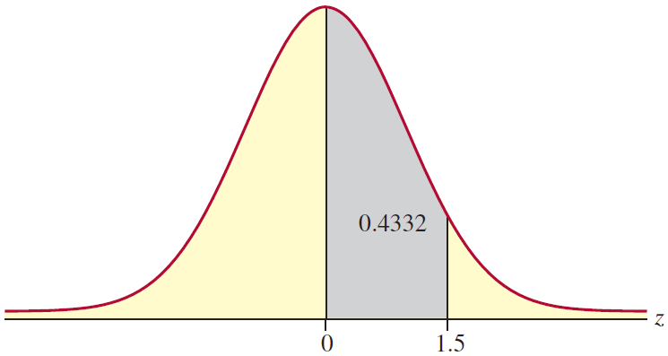
Example 8.4.1: Determining a Probability Using the Standard Normal Distribution (cont.)
Once the problem has been converted to a problem involving z, the appropriate probability can be determined from the standard normal tables in Appendix A. From Table C,

Slide 13
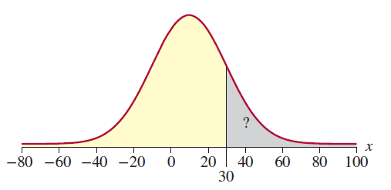
Example 8.4.2: Determining a Probability Using the Standard Normal Distribution
Find the probability that a normal random variable with a mean of 10 and standard deviation of 20 will be greater than 30.

Slide 14
Example 8.4.2: Determining a Probability Using the Standard Normal Distribution (cont.)
Solution
Standardizing the random variable, we have the following.

Slide 15
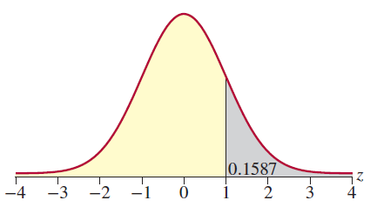
Example 8.4.2: Determining a Probability Using the Standard Normal Distribution (cont.)
Note that the x-value of 30 transformed into the z-value of 1. In other words, 30 is one standard deviation away from the mean.

Slide 16
Example 8.4.3: Determining the Probability of Exceeding a Test Score Using the Standard Normal Distribution
Suppose that a national testing service gives a test in which the results are normally distributed with a mean of 400 and a standard deviation of 100. If you score a 644 on the test, what percentage of the students taking the test exceeded your score?
Solution
Let X = a student’s score on the test.

Slide 17
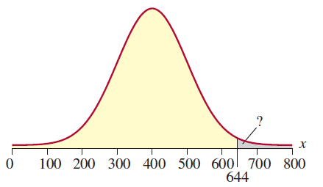
Example 8.4.3: Determining the Probability of Exceeding a Test Score Using the Standard Normal Distribution (cont.)
The first step is to standardize the random variable.

Slide 18
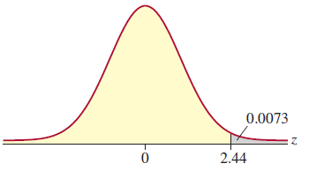
Example 8.4.3: Determining the Probability of Exceeding a Test Score Using the Standard Normal Distribution (cont.)
Thus, only 0.73% of the students scored higher than your score of 644.

Slide 19
Example 8.4.4: Determining the Probability of a Purchase Total Using the Standard Normal Distribution
Suppose that for 132 shoppers making a purchase at a clothing store, the total each shopper will spend follows a normal distribution with a mean of $234 and a standard deviation of $94. What is the probability that the next purchase total will be between $100 and $150?
Solution
Let X = the purchase total. We are interested in the probability that x is between $100 and $150. Writing this probability statement and then standardizing the random variable x, we have the following.

Slide 20
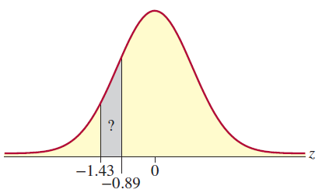
Example 8.4.4: Determining the Probability of a Purchase Total Using the Standard Normal Distribution (cont.)

Slide 21
Example 8.4.4: Determining the Probability of a Purchase Total Using the Standard Normal Distribution (cont.)
To find the probability that z is between −1.43 and −0.89, we will need to find the probability that z is less than −0.89 and subtract the probability that z is less than −1.43. Using Table A in Appendix A, we have the following.
Thus, there is approximately an 11% chance that the purchase will be between $100 and $150.

Slide 22
Finding Values of a Normally Distributed Random Variable
In the previous section, we were asked for the value of z corresponding to an area under the normal curve, but a question could ask for the value of a normally distributed random variable X associated with some specified probability. Recall that the steps for finding the area under a normal curve when given a value of x are as follows.
Use the values of the mean and standard deviation to convert the value of x to a z-value.

Slide 23
Finding Values of a Normally Distributed Random Variable (cont.)
Use the z-value to find the area under the standard normal curve.
When we want to find the value of a normally distributed random variable x given the area under a normal curve, we use the steps in reverse. First, we will rearrange the z-score formula, using algebra to solve for x, as shown

Slide 24
Finding Values of a Normally Distributed Random Variable (cont.)
So Using this altered formula, the steps are as follows.
Use the given area under the standard normal curve to find the corresponding value of z.
Use the values of z, the mean, and the standard deviation to find the value of the random variable x by using the formula

Slide 25
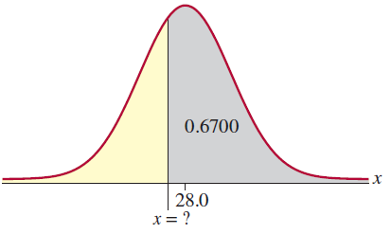
Example 8.4.5: Determining the z-Value that Corresponds to an Area Under the Standard Normal Distribution
If a normal distribution has a mean of 28.0 and a standard deviation of 2.5, what is the value of the random variable X that has an area to its right equal to 0.6700?
Solution
Remember that we need to use the steps in reverse. Begin by using the given area to find the value of z.

Slide 26
Example 8.4.5: Determining the z-Value that Corresponds to an Area Under the Standard Normal Distribution (cont.)
Since we know that the area to the right of x is 0.6700, we also know the area to the left of x is 1 − 0.6700 = 0.3300. Using Table A in Appendix A, we find the z-value corresponding to this area is z = −0.44. The final step is to use this z-score, along with the given values of the mean and standard deviation, to solve for x. Substituting these values into the formula for x we have the following.

Slide 27
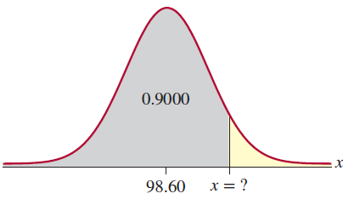
Example 8.4.6: Determining the Body Temperature that Corresponds to a Specific Percentile
The body temperatures of adults are normally distributed with a mean of 98.60 °F and a standard deviation of 0.73°F. What temperature represents the 90th percentile?
Solution
In order to determine the temperature that represents the 90th percentile, we first need to find the z-value that represents the 90th percentile.

Slide 28
Example 8.4.6: Determining the Body Temperature that Corresponds to a Specific Percentile (cont.)
Using technology, we determine this value to be z ≈ 1.281552. Once we have the value of z, we can substitute into the formula given above to find x.
Thus, a temperature of approximately 99.54 °F represents the 90th percentile.

