Slide 1
Section 8.3
The Standard Normal Distribution

Slide 2
The Standard Normal Distribution
Given that the normal distribution is a function of two continuous parameters, 𝜇 and σ, there are an infinite number of combinations for 𝜇 and σ, and thus an infinite number of normal distributions. The standard normal distribution in Figure 8.3.1 is a special version of the normal distribution. This distribution provides a basis for computing probabilities for all normal distributions.

Slide 3
Definition: Standard Normal Distribution
The standard normal distribution is a normal distribution with a mean of zero and a standard deviation of one.
μ = 0 and σ = 1

Slide 4
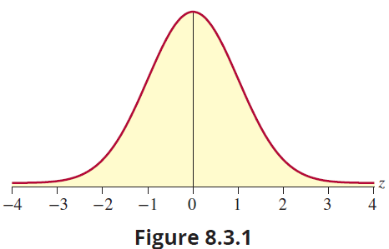
The Standard Normal Distribution (cont.)

Slide 5
The Standard Normal Distribution (cont.)
The technique used to translate any normal random variable into a standard normal random variable is called a z-transformation (or “standardizing” the random variable) and was discussed earlier in Chapter 4. Because the z-transformation gives the standard normal unique status among normals, the standard normal is also referred to as the z-distribution.

Slide 6
The Standard Normal Distribution (cont.)
Tables A, B, and C in Appendix A contain probability calculations for various areas under the standard normal curve. Specifically, Tables A and B provide the probability that a standard normal random variable will be less than a specified value. Table C provides the probability that a standard normal random variable will be between 0 and a specified value. For example, to compute the probability that a standard normal random variable will be less than 1 (see Figure 8.3.2), look up the value 1.00 in Table B. The table value of

Slide 7
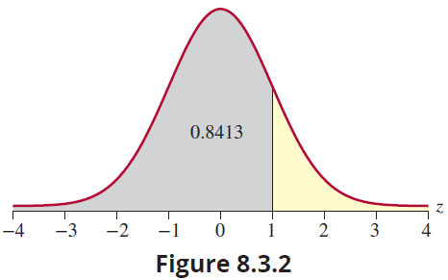
The Standard Normal Distribution (cont.)
0.8413 is the area under the curve between negative infinity and 1, which is also the probability that the random variable will assume a value in that interval.

Slide 8
The Standard Normal Distribution (cont.)
To compute the probability that a standard normal random variable will be between 0 and 1 (see Figure 8.3.3), look up the value 1.00 in Table C. The table value of 0.3413 is the area under the curve between 0 and 1, which is also the probability that the random variable will assume a value in that interval.

Slide 9
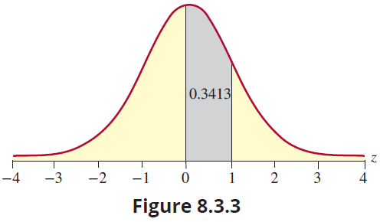
The Standard Normal Distribution (cont.)

Slide 10
The Standard Normal Distribution (cont.)
The z-distribution will be used throughout the remainder of this text. Thus, it is important to comprehend the use of the standard normal tables in the determination of probabilities for a variety of problems. Because of the manner in which the table is constructed, some types of problems will require manipulation of the table values.

Slide 11
Example 8.3.1: Computing a Probability Using the Standard Normal Distribution
Compute the probability that a standard normal random variable is less than 1.27.
Solution
Drawing a picture—even when the problem is rather simple—is a good idea. Remember that the probability is represented by the area under the standard normal curve.

Slide 12
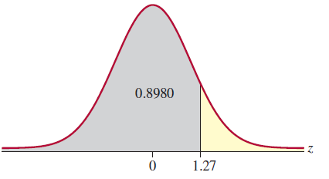
Example 8.3.1: Computing a Probability Using the Standard Normal Distribution (cont.)
Determining the area under the standard normal curve to the left of a particular value requires little effort since the tables are constructed to give the cumulative probabilities. That is, the table gives probabilities that the random variable z is less than (or less than or equal to) some value (i.e., P (z<z₀) where z₀ is the number of standard deviations

Slide 13
Example 8.3.1: Computing a Probability Using the Standard Normal Distribution (cont.)
above or below the mean). In this case, the construction of Table B exactly matches the kind of interval we are examining. Thus, merely looking up the value corresponding to 1.27 in the table is sufficient to obtain the probability.

Slide 14
Example 8.3.1: Computing a Probability Using the Standard Normal Distribution (cont.)
z | 0.00 | 0.01 | ... | 0.06 | 0.07
0.0 | 0.5000 | 0.5040 | 0.5239 |  | 0.5279 0.5675 0.8790
0.1 | 0.5398 | 0.5438 | 0.5636
1.1 | 0.8643 | 0.8665 | 0.8770
1.2 | 0.8849 | 0.8869 | 0.8962 |  | 0.8980
1.3 | 0.9032 | 0.9049 | 0.9131 |  | 0.9147

Slide 15
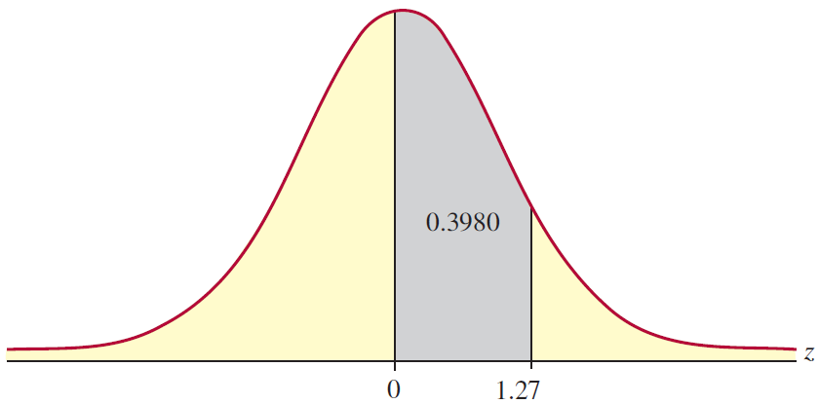
Example 8.3.2: Computing a Probability Using the Standard Normal Distribution
Compute the probability that a standard normal random variable is between 0 and 1.27.
Solution
First, draw a picture.

Slide 16
Example 8.3.2: Computing a Probability Using the Standard Normal Distribution (cont.)
To determine the area under the standard normal curve requires little effort. Table C is constructed to give the probability between 0 and some value of z. In this case, the table’s construction exactly matches the kind of interval you are examining. Thus, merely looking up the value corresponding to 1.27 in the table is sufficient to obtain the probability.
P(0 < z < 1.27) = 0.3980

Slide 17
Example 8.3.3: Determining a Probability Using the Standard Normal Distribution
Determine the probability that a standard normal random variable is greater than 1.37.
Solution
Again, draw a picture first. Because Table B gives us cumulative probabilities, we can find the probability that z is less than 1.37 and then subtract this probability from 1, yielding the probability that z is greater than 1.37. Thus, the probability is 1 − 0.9147 = 0.0853.

Slide 18
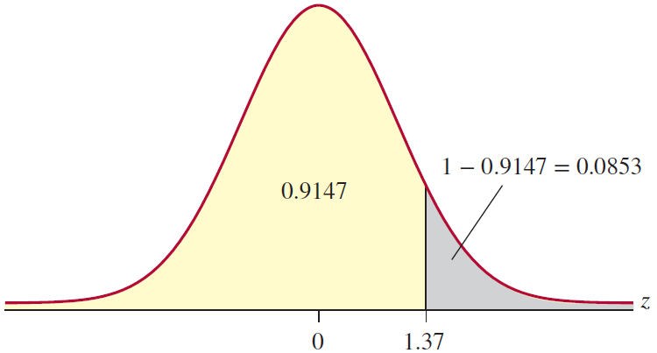
Example 8.3.3: Determining a Probability Using the Standard Normal Distribution (cont.)
Alternately, we can look up z = −1.37 in Table A and using the symmetry of the normal, the probability of being greater than 1.37 is the same as the probability of being less than −1.37, which is 0.0853.

Slide 19
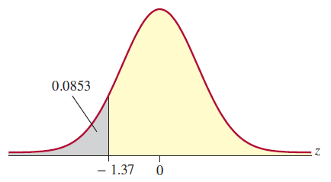
Example 8.3.3: Determining a Probability Using the Standard Normal Distribution (cont.)

Slide 20
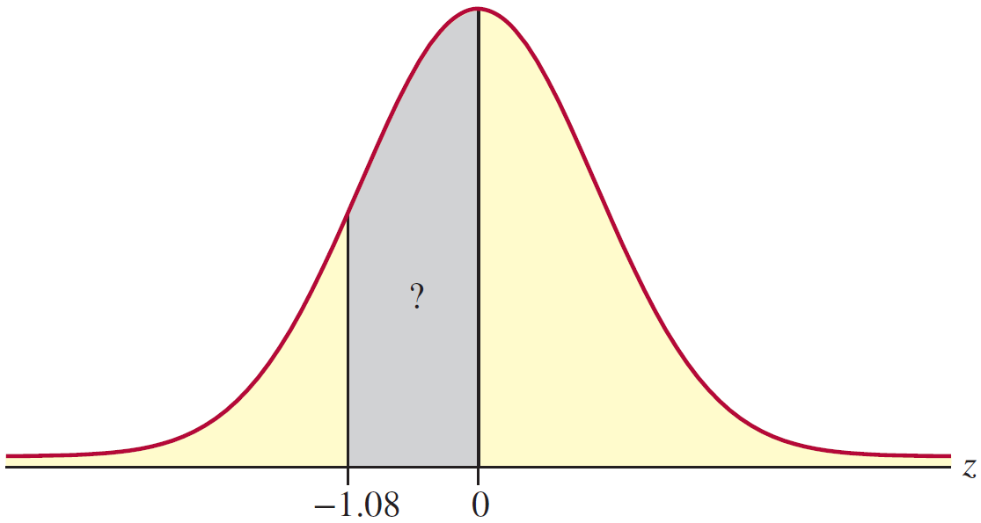
Example 8.3.4: Determining a Probability Using the Standard Normal Distribution
Determine the probability that a standard normal random variable is between −1.08 and 0.
Solution
First draw a picture.

Slide 21
Example 8.3.4: Determining a Probability Using the Standard Normal Distribution (cont.)
In this case we cannot simply look up the value in Table C, because the value we want to find (−1.08) is not given in the table. However, since the normal distribution is symmetric, the probability that the random variable is between −1.08 and 0 is equal to the probability the random variable is between 0 and 1.08.

Slide 22
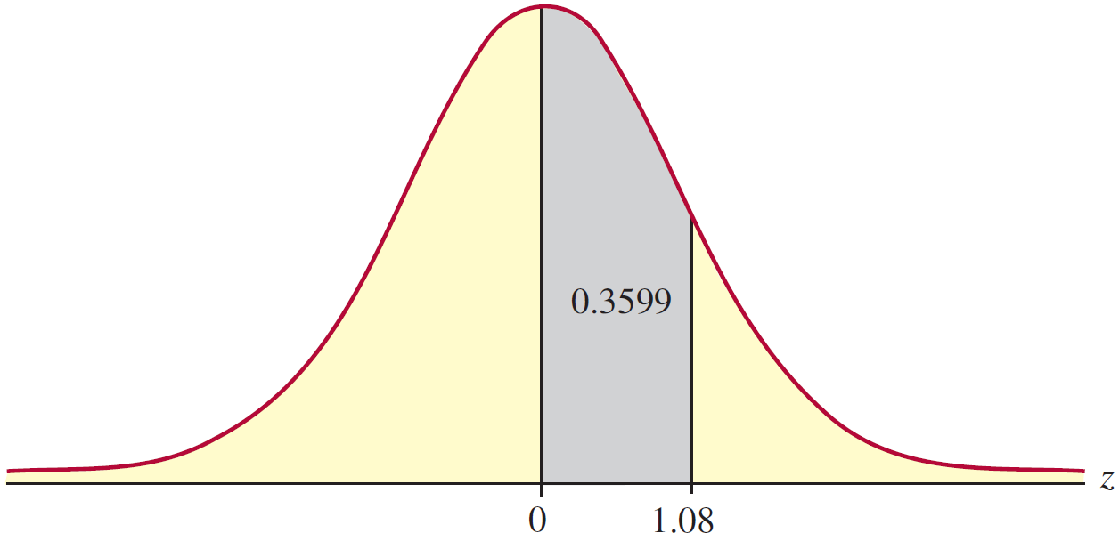
Example 8.3.4: Determining a Probability Using the Standard Normal Distribution (cont.)
Using Table C, the area under the curve between 0 and 1.08 is 0.3599. Because of symmetry, the area between −1.08 and 0 is also 0.3599. Thus,
P(−1.08 < z < 0) = 0.3599.

Slide 23
Example 8.3.4: Determining a Probability Using the Standard Normal Distribution (cont.)
There is an alternate way to find this probability using Table A. Understanding that the table gives us cumulative probabilities, if we find the probability that z is less than 0 and then subtract the probability that z is less than –1.08, we will get the probability that z is between –1.08 and 0.
Because the standard normal distribution is symmetric and the total area under the curve is equal to 1, we know that the probability that z is less than 0 is equal to 0.5 (since 0 is the mean or the central value).

Slide 24
Example 8.3.4: Determining a Probability Using the Standard Normal Distribution (cont.)
We can find P( z < −1.08) to be 0.1401 from looking up −1.08 in Appendix A, Table A. Thus, to find the area between −1.08 and 0 we subtract the area to the left of −1.08 from 0.5 as follows.

Slide 25
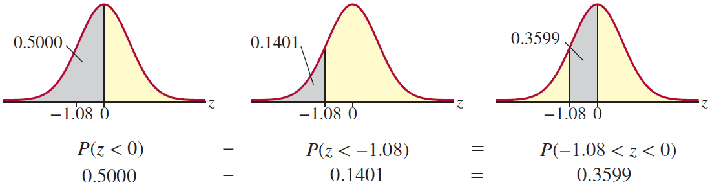
Example 8.3.4: Determining a Probability Using the Standard Normal Distribution (cont.)

Slide 26
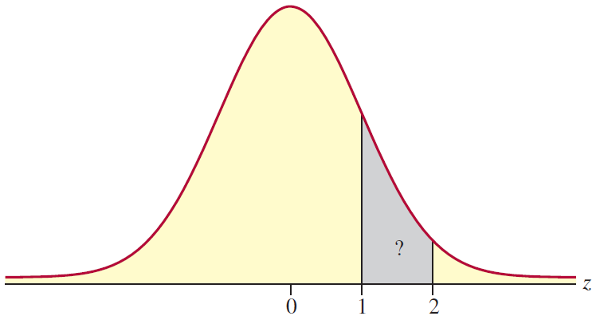
Example 8.3.5: Determining a Probability Using the Standard Normal Distribution
What is the probability that a standard normal random variable will be between 1 and 2?
Solution
A picture will be helpful in calculating this probability.

Slide 27
Example 8.3.5: Determining a Probability Using the Standard Normal Distribution (cont.)
Because Table B gives us cumulative probabilities, we can find the probability that z is less than 2 and then subtract the probability that z is less than 1, yielding the probability that z is between 1 and 2. Thus, we have the following. The figure below illustrates the areas involved in this calculation.

Slide 28
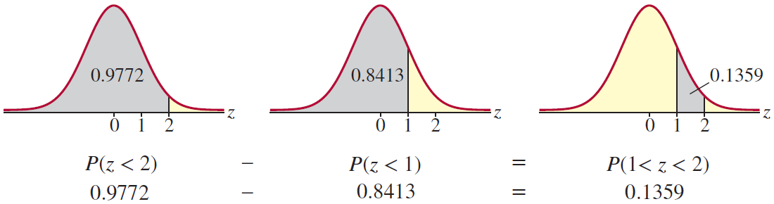
Example 8.3.5: Determining a Probability Using the Standard Normal Distribution (cont.)
Again, drawing the picture proves to be invaluable in this example.

Slide 29
Example 8.3.6: Determining the z-Value that Corresponds to an Area Under the Standard Normal Distribution
Given that z is a standard normal random variable, find the value of z for each situation.
The area to the left of z is 0.9147.
The area between 0 and z is 0.3665.
The area to the left of z is 0.1469.
The area to the right of z is 0.7967.

Slide 30
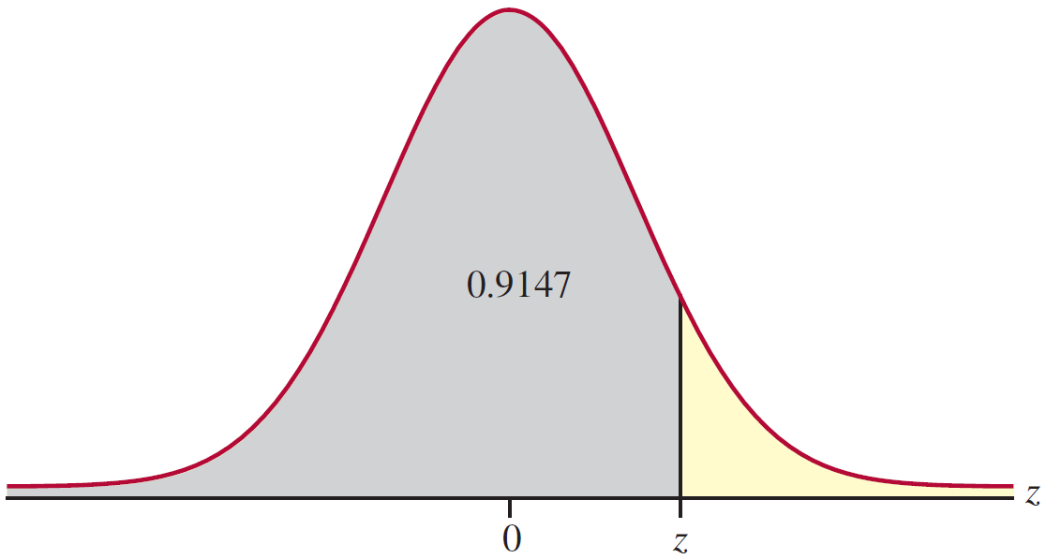
Example 8.3.6: Determining the z-Value that Corresponds to an Area Under the Standard Normal Distribution (cont.)
Solution
First, draw a picture.

Slide 31
Example 8.3.6: Determining the z-Value that Corresponds to an Area Under the Standard Normal Distribution (cont.)
Note that this problem is slightly different from the previous one. In Example 8.3.5, you were asked to find a probability, given that you know the value of z. In this example, you are given a probability and asked to find the corresponding value of z. Recall that Table A and Table B in Appendix A give you the cumulative probability of the area less than some value of z.
Since the value of z shown in the figure above is positive (greater than 0), look in the body of Table B and find the probability value 0.9147.

Slide 32
Example 8.3.6: Determining the z-Value that Corresponds to an Area Under the Standard Normal Distribution (cont.)
Once you’ve found the value (the probability), determine the corresponding value of z. In this case, the value of z is 1.37. So,
P(z < 1.37) = 0.9147
and the value of z is 1.37 with the area to the left of it being 0.9147.

Slide 33

Example 8.3.6: Determining the z-Value that Corresponds to an Area Under the Standard Normal Distribution (cont.)
Again, draw a picture.
Recall that Table C gives us cumulative probabilities from 0 to z. Therefore, find 0.3665 in the body of Table C and locate the corresponding value of z. In this case,

Slide 34
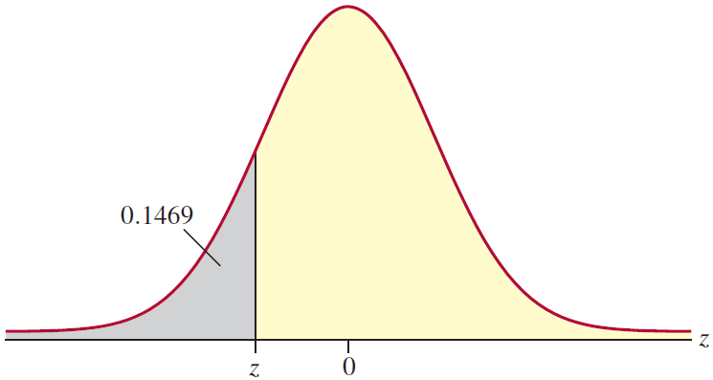
Example 8.3.6: Determining the z-Value that Corresponds to an Area Under the Standard Normal Distribution (cont.)
P(0 < z < 1.11) = 0.3665.
So, the value of z corresponding to an area of 0.3665 between 0 and z is z = 1.11.
Just as in parts a. and b., a picture can be helpful.

Slide 35
Example 8.3.6: Determining the z-Value that Corresponds to an Area Under the Standard Normal Distribution (cont.)
Please note that the value of z is to the left of 0. Thus, the value of z is going to be negative. Note that the area to the left of z represents the cumulative probability (in the above figure). So, to find the value of z, we only need to find 0.1469 in the body of Appendix A, Table A. The value of z with the area 0.1469 to the left of it is −1.05. That is, P(z < −1.05) = 0.1469.

Slide 36
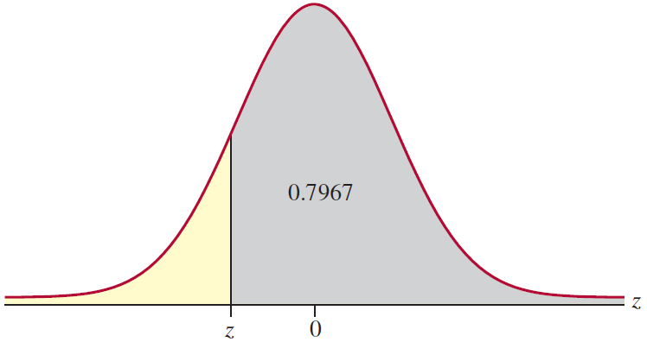
Example 8.3.6: Determining the z-Value that Corresponds to an Area Under the Standard Normal Distribution (cont.)
Once again, a picture can be very helpful.
Note that from the picture, we have the area to the right of z. However, we know that the total area under the curve is 1.

Slide 37
Example 8.3.6: Determining the z-Value that Corresponds to an Area Under the Standard Normal Distribution (cont.)
Thus, if the area to the right of z is 0.7967, then the area to the left of z is 1 − 0.7967 = 0.2033. From the picture, it is clear that if we find 0.2033 in the body of Appendix A, Table A, the corresponding value of z is the value we are interested in. This value of z is −0.83. Therefore, the value of z with the area 0.7967 to the right is −0.83.

