Slide 1
Section 8.2
The Normal Distribution

Slide 2
The Normal Distribution
The normal distribution, also called the Gaussian distribution, was named after Carl Gauss who published a work in 1833 describing the mathematical definition of the distribution. Gauss developed this distribution to describe the error in predicting the orbits of planets.
Normal distributions are all bell-shaped, but the bells come in various shapes and sizes. Since all normal distributions are symmetric, the mean, mode, and median are all equal.

Slide 3
The Normal Distribution (cont.)
Although normally distributed random variables can range in value from minus infinity to positive infinity, values that are a great distance from the mean rarely occur.

Slide 4
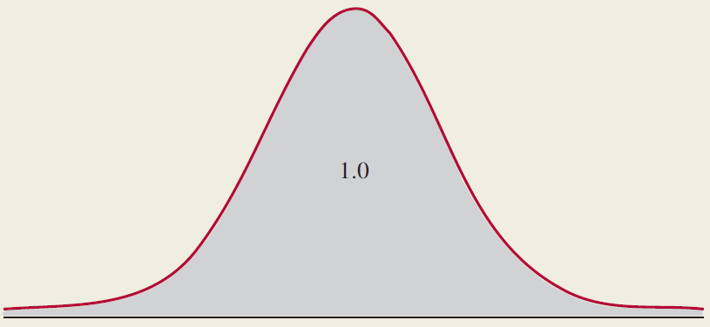
Properties: Properties of the Normal Distribution
The total area under any normal curve equals one.

Slide 5
Properties: Properties of the Normal Distribution (cont.)
Within a fixed number of standard deviations from the mean, all normal distributions contain the same proportion of their probability.
The probability of a normal random variable being in a specified interval corresponds to the area under the curve bounded by that interval.

Slide 6
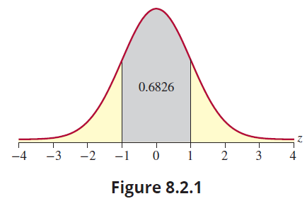
The Normal Distribution (cont.)
In Figure 8.2.1, the shaded area represents the probability of being within of the mean. Regardless of the shape of the normal distribution, the area under the curve and the probability of being within one standard deviation of the mean equals 0.6826.

Slide 7
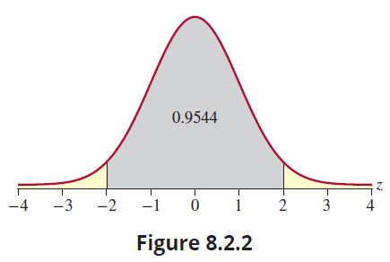
The Normal Distribution (cont.)
Figure 8.2.2 illustrates the area under the curve within two standard deviations of the mean. The probability of being within of the mean equals 0.9544 for every normal distribution.

Slide 8
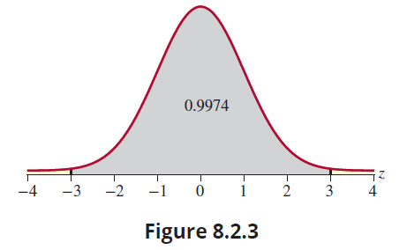
The Normal Distribution (cont.)
Figure 8.2.3 illustrates the area under the curve within three standard deviations of the mean. As you can see, virtually all the area under the curve is within three standard deviations of the mean. The probability of being within of the mean equals 0.9974.

Slide 9
The Normal Distribution (cont.)
Not all bell-shaped distributions are normal distributions, however the empirical rule given in Chapter 4 is based on the normal distribution. If you round the probabilities in the previous paragraphs you will obtain the probabilities expressed in the empirical rule. For bell-shaped distributions in general, about 68% of the data will be within 1 standard deviation of the mean, and about 95% of the data will be within two standard deviations of the mean.

Slide 10
The Normal Distribution (cont.)
A number of non-normal random variables with bell shapes will be introduced in later chapters. In fact, the word normal can be somewhat misleading. The name suggests that the distribution is a fact of nature. It is not. However, many variables seem to possess a shape that resembles the normal distribution.
Like other theoretical distributions, a normal distribution is completely defined by its probability density function.

Slide 11
Note
See Section 8.3 for a description of the z-distribution.

Slide 12
Formula: Normal Probability Density Function
The normal probability density function is given by the following
where μ is the mean and σ is the standard deviation of the population distribution.

Slide 13
The Normal Distribution (cont.)
At first glance, this function does not look very normal! The distribution has two parameters, 𝜇 and σ, which are the mean and standard deviation, respectively. The mean defines the location and the standard deviation determines the dispersion. Figure 8.2.4 illustrates several normal distributions with identical standard deviations. The only difference in the distributions is the central location, the mean.

Slide 14
Caution
Although a normal distribution has a bell shape, a bell shape does not imply a normal distribution.

Slide 15
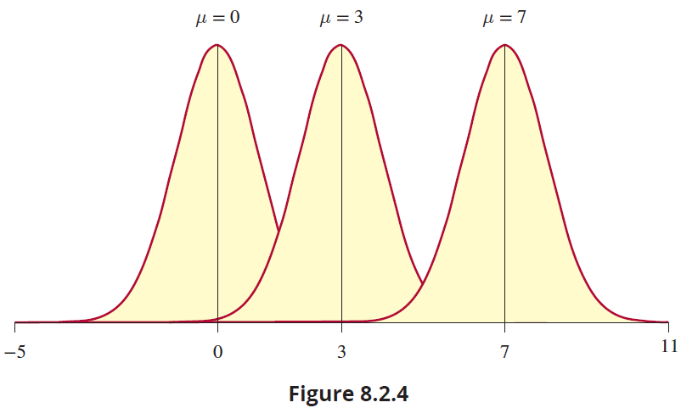
The Normal Distribution (cont.)

Slide 16
The Normal Distribution (cont.)
In Figure 8.2.5, there are several distributions with identical means, but with different standard deviations. Changing the standard deviation parameter can have rather significant effects on the shape of the distribution.

Slide 17
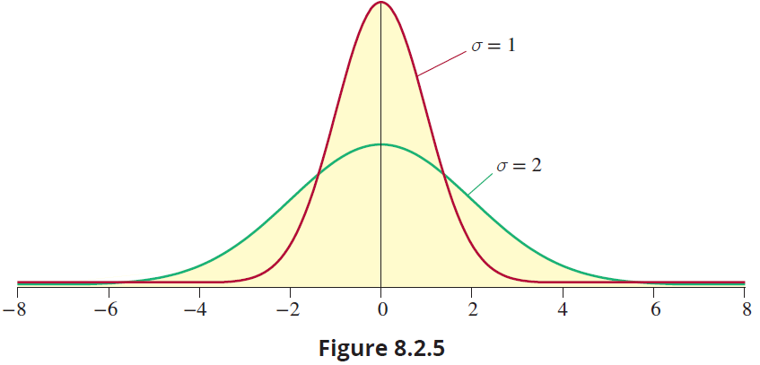
The Normal Distribution (cont.)

Slide 18
Looking at Data from Normal Distributions
The normal distribution is a theoretical construct with a bell shape. Therefore, it would not be unreasonable to expect empirical data drawn from a normal population to exhibit the bell-shaped characteristic. In two small samples taken from a normal population, shown in Figures 8.2.6 and 8.2.7, the data does show a faint resemblance of a bell shape. But as you can see, the shapes of the histograms developed from these small samples are somewhat unpredictable, even though the bell-shaped pattern is to some extent apparent.

Slide 19
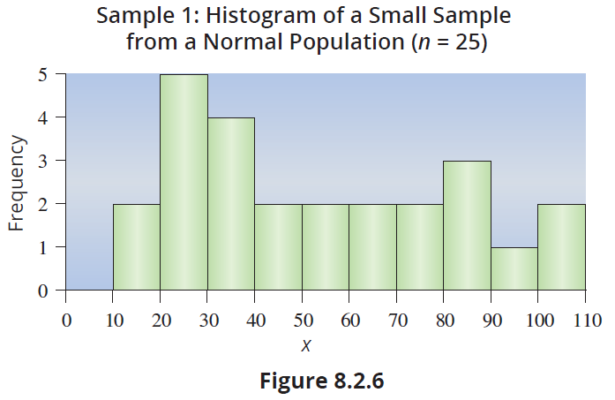
Looking at Data from Normal Distributions (cont.)

Slide 20
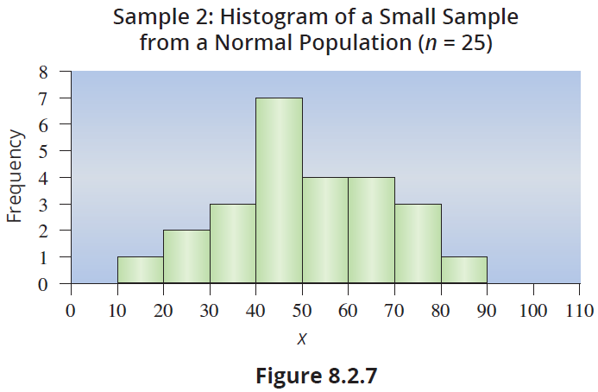
Looking at Data from Normal Distributions (cont.)

Slide 21
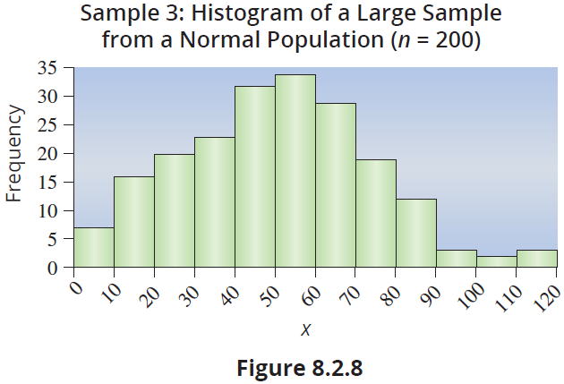
Looking at Data from Normal Distributions (cont.)
For large samples, the representation of the bell curve is usually more visible. While the large sample (n = 200) certainly is not a perfect bell curve, it is recognizable (see Figure 8.2.8).

Slide 22
Note
There is a lesson called Name that Distribution in the appendix of the courseware that provides practice in recognizing a probability model from sample data.

Slide 23
Looking at Data from Normal Distributions (cont.)
Using the probability density to determine the probability of some interval would be complicated. Fortunately, there is an easier way. A special normal distribution, called the standard normal, can be used to determine probabilities for any normal random variable. The standard normal distribution will be discussed in Section 8.3.

