Slide 1
Section 8.1
The Uniform Distribution

Slide 2
The Uniform Distribution
Continuous random variables do not have probability distribution functions. Instead they have probability density functions, which are denoted by f(x). The probability density function for the uniform random variable, its expected value (mean), and its standard deviation are given below. The parameters of the probability density function are the minimum and maximum values of the random variable and are referred to as a and b, respectively.

Slide 3
Formula: Uniform Probability Density Function
The uniform probability density function is given by
The mean and standard deviation are given by the following expressions.

Slide 4
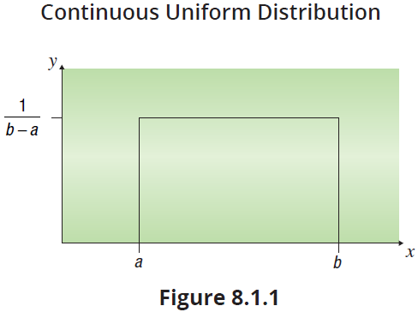
The Uniform Distribution (cont.)
For the continuous uniform distribution, the probability density is spread out over some range from a to b, as shown in Figure 8.1.1.

Slide 5
Example 8.1.1: Determining Probability, Expected Value, and Standard Deviation of a Continuous Uniform Probability Density Function
The fire department records how long it takes each of its trucks to reach the scene of a fire. Suppose that the distribution of arrival times is uniform with the minimum time being 2 minutes and the maximum 15 minutes. Let X equal the time it takes a truck to arrive at the scene of a fire after being called.
a. What is the probability that a truck will reach a fire scene within 5 to 10 minutes?
b. What is the expected time until arrival of the fire truck?

Slide 6
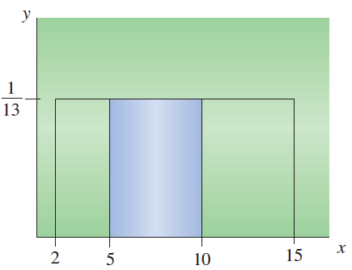
Example 8.1.1: Determining Probability, Expected Value, and Standard Deviation of a Continuous Uniform Probability Density Function (cont.)
c. What is the standard deviation of truck arrival times?
Solution
a. For the uniform distribution, the probability is simply calculated using the formula for the area of a rectangle.

Slide 7
Example 8.1.1: Determining Probability, Expected Value, and Standard Deviation of a Continuous Uniform Probability Density Function (cont.)
Area = Height ⋅ Width
and
therefore

Slide 8
Example 8.1.1: Determining Probability, Expected Value, and Standard Deviation of a Continuous Uniform Probability Density Function (cont.)
The expected value of a continuous uniform random variable is given by
Therefore, the expected time until arrival of the fire truck is 8.5 minutes.

Slide 9
Example 8.1.1: Determining Probability, Expected Value, and Standard Deviation of a Continuous Uniform Probability Density Function (cont.)
The standard deviation of a continuous uniform random variable is given by
Therefore, the standard deviation of truck arrival times is approximately 3.753 minutes.

Slide 10
The Uniform Distribution (cont.)
While the density function for the uniform distribution has a flat top, a histogram of data from a uniformly distributed random process may not be so perfectly flat. Suppose that we generated 100 observations from a random process that was uniformly distributed on the interval 2 to 15. For this sample, the frequency of each category is not identical (see Figure 8.1.2).

Slide 11
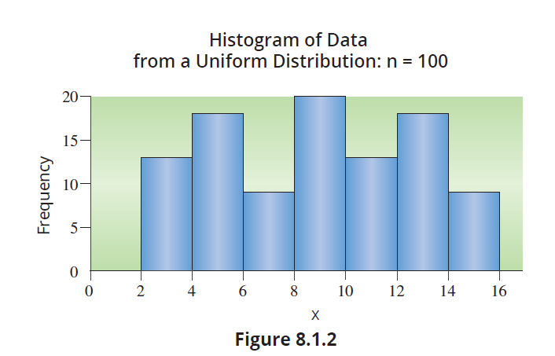
The Uniform Distribution (cont.)

Slide 12
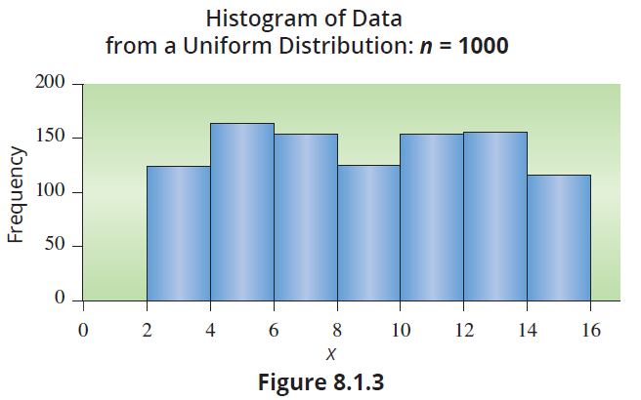
The Uniform Distribution (cont.)
However, if we were to generate 1000 observations, the distribution would likely begin to level (see Figure 8.1.3).

Slide 13
The Uniform Distribution (cont.)
This idea is similar to the law of large numbers we discussed in Chapter 6 which states that a relative probability approaches the classical probability when enough trials are done. In the case of a random variable’s probability distribution, a larger sample size should produce a distributional shape closer to the expected shape.

