Slide 1
Section 7.5
The Poisson Distribution

Slide 2
The Poisson Distribution
The binomial random variable requires a fixed number of repetitions of the experiment, where the outcomes are either successes or failures. The Poisson distribution is similar to the binomial in that the random variable represents a count of the total number of successes. The major difference between the two distributions is that the Poisson does not have a fixed number of trials. Instead, the Poisson uses a fixed interval of time or space in which the number of successes is recorded. Thus, there is no theoretical

Slide 3
The Poisson Distribution (cont.)
constraint on the maximum number of successes, although the likelihood of observing a large number of successes is usually low.
The word success in the Poisson context can sometimes take on rather morbid connotations. Many phenomena that have been observed to follow the distribution are associated with violence and carnage. For example, the randomness exhibited by the number of airplane crashes, oil tanker spills, and car accidents in some fixed period of time seems to conform to the randomness described by a Poisson random variable.

Slide 4
The Poisson Distribution (cont.)
Fortunately, not all applications are so bleak. In business environments a great many variables seem to follow a pattern of randomness similar to that described by the Poisson distribution. One of the Poisson’s principal areas of use in business is the analysis of waiting lines. Other random phenomena, such as airplane arrivals, trucks arriving at a loading dock, users logging on to a computer system, the number of defects in a given surface area, the number of earthquakes in a fixed period of time, or the

Slide 5
The Poisson Distribution (cont.)
number of patients arriving at an emergency room on a given day, can be modeled with a Poisson distribution. These variables are often of interest in determining personnel requirements, inventories, and quality control.

Slide 6
Definition: Poisson Random Variable
In order to qualify as a Poisson random variable an experiment must meet two conditions.
Successes occur one at a time. That is, two or more successes cannot occur at exactly the same point in time or at exactly the same point in space.
The occurrence of a success in any interval is independent of the occurrence of a success in any other interval.

Slide 7
The Poisson Distribution (cont.)
If these two conditions are met, it can be proven that the random variable for the number of successes follows the Poisson probability distribution function.

Slide 8
Formula: Poisson Probability Distribution Function
The Poisson probability distribution function is given by
Where
e = 2.71828…, and
λ = the mean number of successes per unit of time or space.

Slide 9
The Poisson Distribution (cont.)
The Poisson distribution has only one parameter, , pronounced lambda. One peculiar feature of the distribution is that the variance of the distribution is equal to the mean. That is, and .
Tables for the Poisson distribution are found in Appendix A, Table F. The tables give P(X = x) for particular values of x and λ. Probabilities of a Poisson random variable can also be found using technology such as Microsoft Excel, Minitab, and many calculators.

Slide 10
The Poisson Distribution (cont.)
The shape of the Poisson distribution varies dramatically with the parameter λ. If λ is small, say 0.3, then the corresponding distribution is found in Table 7.5.1 and displayed in Figure 7.5.1

Slide 11
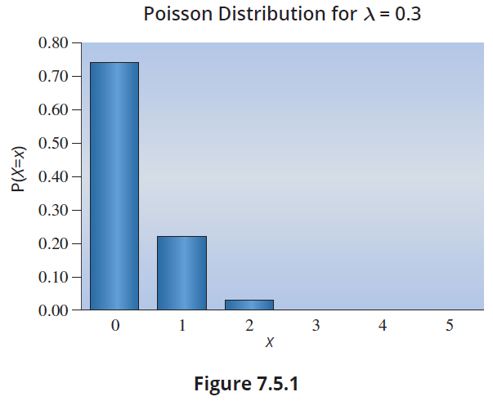
The Poisson Distribution (cont.)
Table 7.5.1 λ = 0.3
x | P(X = x)
0 | 0.7408
1 | 0.2222
2 | 0.0333
3 | 0.0033
4 | 0.0003
5 | 0.0000

Slide 12
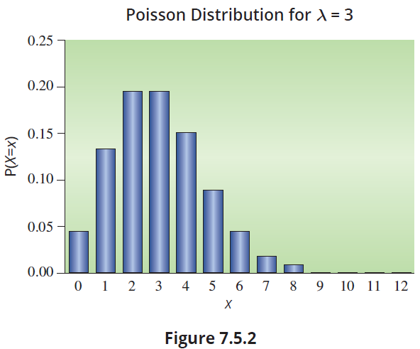
The Poisson Distribution (cont.)
As λ increases to 3 (see Table 7.5.2), the distribution exhibits a mound shape with skewness as shown in Figure 7.5.2.

Slide 13
The Poisson Distribution (cont.)
Table 7.5.2 = 3
x | P(X = x)
0 | 0.0498
1 | 0.1494
2 | 0.2240
3 | 0.2240
4 | 0.1680
5 | 0.1008
6 | 0.0504
7 | 0.0216
8 | 0.0081
9 | 0.0027
10 | 0.0008
11 | 0.0002
12 | 0.0001

Slide 14
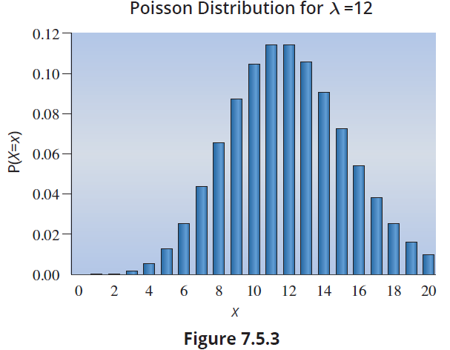
The Poisson Distribution (cont.)
As λ becomes even larger, say λ = 12, the distribution begins to closely resemble a bell-shaped distribution as shown in Figure 7.5.3.

Slide 15
Poisson Random Variables for Time
Most Poisson applications relate to the number of occurrences of some event in a specific duration of time.

Slide 16
Example 7.5.1: Determining Probabilities Using the Poisson Distribution
Suppose a bank has one automatic teller machine. Customers arrive at the machine at a rate of 20 per hour and according to a Poisson pattern.
What is the probability that no one will arrive in a 15-minute interval?
What is the probability that in a 15-minute period at least 3 persons will use the automated teller machines?

Slide 17
Example 7.5.1: Determining Probabilities Using the Poisson Distribution (cont.)
Solution
Let X = the number of arrivals in a 15-minute period.
This problem contains one of the standard techniques used in working with Poisson random variables, that is, translating the arrival rate to correspond to the desired time interval. In this problem, the rate is given at 20 per hour which
corresponds to a rate of 5 per

Slide 18
Example 7.5.1: Determining Probabilities Using the Poisson Distribution (cont.)
Thus, λ = 5 and the desired probability is
The probability could also have been found directly by using the table in Appendix A or technology.

Slide 19
Example 7.5.1: Determining Probabilities Using the Poisson Distribution (cont.)
To find the probability that in a 15-minute period at least 3 persons will use the automated teller machines, we are interested in .
(using the Poisson table)
(answers using technology may vary slightly)

Slide 20
Poisson Random Variables for Length or Space
Instead of counting the number of successes in a time interval, there are a number of applications of the Poisson that measure the number of successes in some area or length. The average number of successes in the area or length will define the parameter of the Poisson random variable.

Slide 21
Example 7.5.2: Determining a Probability Using the Poisson Distribution
The telephone company is considering purchasing optical cable from Optica, Inc. The company wishes to replace approximately 100,000 feet of conventional cable with optical fiber. Since optical fiber is very difficult to repair, it is important that the number of optical cable defects are minimized. Optica claims that on average there is one defect per 200,000 feet of cable. What is the probability that the replaced cable will contain no defects?

Slide 22
Example 7.5.2: Determining a Probability Using the Poisson Distribution (cont.)
Solution
Let X = the number of defects in 100,000 feet of optical cable.
Based on previous experience, we assume that the number of defects is approximated by a Poisson distribution with Poisson parameter λ computed as follows.
Using the tables provided in Appendix A, Table F,
(the average number of defects per 100,000 feet of cable)

