Slide 1
Section 7.4
The Binomial Distribution

Slide 2
The Binomial Distribution
The binomial distribution arises from experiments with repeated two-outcome trials, where only one of the outcomes is counted. The binomial probability model is used in biology, microbiology, infectious disease, veterinary medicine, evolutionary biology, genetics, and seismology research.
Experiments using the binomial probability model are also rather common in the business world. For example, in market research a survey respondent (a trial) will either recognize a company’s brand or will not.

Slide 3
The Binomial Distribution (cont.)
The number of respondents that recognize the brand out of a fixed sample size is a count that may be modeled as a binomial random variable.
Some examples of binomial random variables include:
Genetic traits such as the number of left-handed persons in a sample of 200 unrelated people or the number of long winged (allele “L”) fruit flies in a population of 300 fruit flies.
The number of correct guesses out of 20 True or False questions when you randomly choose an answer.

Slide 4
The Binomial Distribution (cont.)
In microbiology, consider a sample of 50 bacterial cells that can be classified as either wild type (WT) or mutant (M). If the probability of a WT cell is p, what is the probability distribution for the number of WT cells in the sample?
Experiments are required to meet several conditions in order to qualify as a binomial experiment.

Slide 5
Definition: Binomial Experiment
A binomial experiment is a random experiment which satisfies all of the following conditions.
There are only two outcomes on each trial of the experiment. (One of the outcomes is usually referred to as a success, and the other as a failure.)
The experiment consists of n identical trials as described in condition 1.

Slide 6
Definition: Binomial Experiment (cont.)
The probability of success on any one trial is denoted by p and does not change from trial to trial. (Note: The probability of a failure is 1 ─ p and also does not change from trial to trial.)
The trials are independent.
The binomial random variable is the count of the number of successes in n trials.

Slide 7
The Binomial Distribution (cont.)
A binomial random variable is formed by counting the number of successes in n trials of an experiment with two outcomes. One of the simplest of binomial random variables is produced by tossing a coin.

Slide 8
Example 7.4.1: Identifying a Binomial Random Variable
Toss a coin four times and record the number of heads. Is the number of heads in four tosses a binomial random variable?
Solution
There are only two outcomes, heads or not heads.
The experiment will consist of four tosses of a coin. (Hence, n = 4.)
The probability of getting a head (success) is
and does not change from trial to trial.
(Hence, p = .)

Slide 9
Example 7.4.1: Identifying a Binomial Random Variable (cont.)
The outcome of one toss will not affect other tosses.
The variable of interest is the count of the number of heads in four tosses.
All the conditions of a binomial experiment are met, so the number of heads in four tosses of a coin is a binomial random variable. The probability distribution for this experiment is given in the following table.

Slide 10
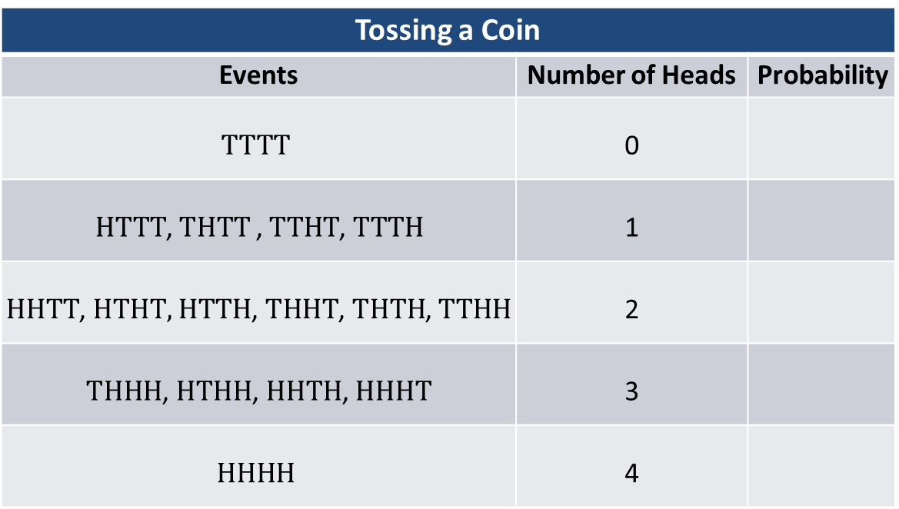
Example 7.4.1: Identifying a Binomial Random Variable (cont.)
Tossing a Coin
Events | Number of Heads | Probability
$$TTTT$$ | 0
$HTTT$,$THTT$ , $TTHT$, $TTTH$ | 1
$HHTT$, $HTHT,$ $HTTH$, $THHT$, $THTH$, $TTHH$ | 2
$THHH$, $HTHH$, $HHTH$, $HHHT$ | 3
$$HHHH$$ | 4

Slide 11
Binomial Probability Distribution Function
The probability distribution could be derived using classical methods described in the previous chapter. To derive the binomial distribution by listing the simple events is unnecessarily tedious (see Example 7.4.1). Instead of tossing the coin four times, suppose the coin is tossed ten times in the experiment. The number of outcomes for an experiment with ten tosses would be 1024, and an experiment with twenty tosses would require listing a staggering 1,048,576 outcomes.

Slide 12
Binomial Probability Distribution Function (cont.)
Fortunately, there is a far simpler method of obtaining the probability distribution. The binomial probability distribution function provides a relatively simple method of calculating binomial probabilities.
To calculate a binomial probability, the parameters of the distribution (n and p), as well as the value of the random variable, must be specified.

Slide 13
Formula: Binomial Probability Distribution Function
The binomial probability distribution function is
Where represents the number of possible combinations of n objects taken x at a time (without replacement) and is given by

Slide 14
Formula: Binomial Probability Distribution Function (cont.)
where n! = n(n − 1)(n − 2)∙∙∙2⋅1 and 0!=1;
n = the number of trials,
p = the probability of a success, and
x = the number of successes in n trials.

Slide 15
Note
An alternate notation often used is

Slide 16
Binomial Probability Distribution Function (cont.)
To calculate a binomial probability, the parameters of the distribution (n and p), as well as the value of the random variable, must be specified. For example, to determine the probability of three heads in four tosses of a coin, you would substitute the values x = 3, n = 4, and p = into the binomial probability distribution function as follows.

Slide 17
Binomial Probability Distribution Function (cont.)
Since,
The probability that two heads would be tossed would be computed in a similar manner.

Slide 18
Binomial Probability Distribution Function (cont.)
The complete distribution can be computed by substituting the remaining values of the random variable into the probability distribution function.

Slide 19
Binomial Probability Distribution Function (cont.)
The coin toss is a classical binomial experiment easily related to the rules of a binomial experiment. In many instances the relationship of an experiment to the binomial definition is not as clear.
Table 7.4.1 - Tossing a Coin
Number of Heads | 0 | 1 | 2 | 3 | 4
Probability

Slide 20
Example 7.4.2: Constructing the Probability Distribution for a Binomial Random Variable
Roll a single six-sided die four times and record the number of sixes observed. Does the number of sixes rolled in four tosses of a die meet the conditions required of a binomial random variable? Construct the probability distribution for this experiment.
Solution
The experiment either produces a six or not, and thus satisfies the two-outcome requirement. (At first glance, there appears to be a problem.

Slide 21
Example 7.4.2: Constructing the Probability Distribution for a Binomial Random Variable (cont.)
There are six sides to a die and there would appear to be six possible outcomes rather than the two required for a single trial of a binomial experiment.)
The experiment is repeated four times. Hence, the number of trials equals four (n = 4).
The probability of getting a six, a success, is (This probability assumes that the die is fair.)
The probability remains constant from trial to trial. (One roll of the die does not affect other rolls.)

Slide 22
Example 7.4.2: Constructing the Probability Distribution for a Binomial Random Variable (cont.)
If X is the “number” of sixes in four rolls, then it has a binomial distribution.
To obtain the probability distribution for X, use the binomial probability distribution function with parameters n = 4 and

Slide 23
Example 7.4.2: Constructing the Probability Distribution for a Binomial Random Variable (cont.)

Slide 24
Example 7.4.2: Constructing the Probability Distribution for a Binomial Random Variable (cont.)
Throwing a Die
x | 0 | 1 | 2 | 3 | 4
Probability | 0.4823 | 0.3858 | 0.1157 | 0.0154 | 0.0008
The calculations required to produce the distribution were reasonably simple in this case. However, if there had been forty cases rather than four, the determination of the probabilities would have been rather burdensome, at best. Binomial tables containing a large collection of binomial distributions have been constructed in order to avoid tedious calculations. These tables are found in Appendix A, Table E.

Slide 25
Example 7.4.3: Constructing the Probability Distribution for the Number of Profitable Leases
The US Land Management Office regularly holds a lottery for the lease of government lands. Your company has won the rights to twelve leases. Historically, about 10% of these lands possess sufficient oil reserves for profitable operation. Construct the distribution for the number of leases that will be profitable. What is the probability that at least one of the leases will be profitable?

Slide 26
Example 7.4.3: Constructing the Probability Distribution for the Number of Profitable Leases (cont.)
Solution
Instead of laboriously computing the distribution, use the binomial tables in Appendix A, Table E.
Binomial Table n = 12, p = 0.10
x | P(X = x) | x | P(X = x)
0 | 0.2824 | 7 | 0.0000
1 | 0.3766 | 8 | 0.0000
2 | 0.2301 | 9 | 0.0000
3 | 0.0852 | 10 | 0.0000
4 | 0.0213 | 11 | 0.0000
5 | 0.0038 | 12 | 0.0000
6 | 0.0005

Slide 27
Example 7.4.3: Constructing the Probability Distribution for the Number of Profitable Leases (cont.)
The binomial parameters are n = 12 and p = 0.10. Let X equal the number of profitable leases. The table above shows the binomial distribution for X. Note that the probabilities for 7 through 12 are given as 0.0000. This does not mean that the probability is 0, because it is possible that seven or more of the leases could be profitable, albeit a rather small probability. (The probability, however, is so small that it is not significant in the fourth decimal place.)

Slide 28
Example 7.4.3: Constructing the Probability Distribution for the Number of Profitable Leases (cont.)
The probability that none of the leases will be profitable is equal to the probability that X = 0, which is 0.2824. Hence, the probability that at least one of the leases will be profitable is one minus the probability that none of the leases will be profitable or 1 ─ 0.2824 = 0.7176.

Slide 29
Example 7.4.4: Determining a Probability Using the Binomial Distribution
A department store has decided to interview a random sample of ten customers to determine if they should modify their return policy. The company believes that 70% of the customers will approve the change and 30% will not approve the change. Using the probabilities given, what is the probability that at least three of the ten customers will approve the change in the return policy?
Solution
Instead of laboriously computing the distribution, use the binomial tables in Appendix A, Table E. A portion of Appendix A, Table E can be found in the following table.

Slide 30
Example 7.4.4: Determining a Probability Using the Binomial Distribution (cont.)
Note that the table, which shows the cumulative distribution for X, is for a sample size of n = 10. Suppose that we let X equal the number of customers that will approve the change.

Slide 31
Example 7.4.4: Determining a Probability Using the Binomial Distribution (cont.)
Cumulative Binomial Probabilities
n | x | 0.1 | 0.2 | 0.3 | 0.4 | 0.5 | 0.6 | 0.7 | 0.8 | 0.9
10 | 0 | 0.3487 | 0.1704 | 0.0282 | 0.0060 | 0.0010 | 0.0001 | 0.0000 | 0.0000 | 0.0000
 | 1 | 0.7361 | 0.3758 | 0.1493 | 0.0464 | 0.0107 | 0.0017 | 0.0001 | 0.0000 | 0.0000
 | 2 | 0.9298 | 0.6778 | 0.3828 | 0.1673 | 0.0547 | 0.0123 | 0.0016 | 0.0001 | 0.0000
 | 3 | 0.9872 | 0.8791 | 0.6496 | 0.3823 | 0.1719 | 0.0548 | 0.0106 | 0.0009 | 0.0000
 | 4 | 0.9984 | 0.9672 | 0.8497 | 0.6331 | 0.3770 | 0.1662 | 0.0473 | 0.0064 | 0.0001
 | 5 | 0.9999 | 0.9936 | 0.9527 | 0.8338 | 0.6230 | 0.3669 | 0.1503 | 0.0328 | 0.0016
 | 6 | 1.0000 | 0.9991 | 0.9894 | 0.9452 | 0.8281 | 0.6177 | 0.3504 | 0.1209 | 0.0128
 | 7 | 1.0000 | 0.9999 | 0.9984 | 0.9877 | 0.9453 | 0.8327 | 0.6172 | 0.3222 | 0.0702
 | 8 | 1.0000 | 1.0000 | 0.9999 | 0.9983 | 0.9893 | 0.9536 | 0.8507 | 0.6242 | 0.2639
 | 9 | 1.0000 | 1.0000 | 1.0000 | 0.9999 | 0.9990 | 0.9940 | 0.9718 | 0.8926 | 0.6513
 | 10 | 1.0000 | 1.0000 | 1.0000 | 1.0000 | 1.0000 | 1.0000 | 1.0000 | 1.0000 | 1.0000

Slide 32
Example 7.4.4: Determining a Probability Using the Binomial Distribution (cont.)
With n = 10 and p = 0.7 the probability that at least three customers will approve the change is equal to 1 ─ P(X ≤ 2) = 1 ─ 0.0016 = 0.9984. Therefore, it’s almost certain that at least three customers will approve the change in the return policy.

Slide 33
Note
P(X ≤ 2) can be read directly from the table. To find the probability, locate 0.7 at the top of the table (i.e., p = 0.7), then find 2 (under n = 10), and find the intersection between 2 and 0.7 in the table to yield 0.0016.

Slide 34
Example 7.4.5: Determining a Probability Using the Binomial Distribution
According to a recent national poll, about 40% of Americans believe in ghosts. Assuming this percentage is accurate, if 20 people were randomly selected and asked if they believed in ghosts, what is the probability that 12 or more would say they do?
Solution
For this problem n = 20, p = 0.4, and x ranges from 12 to 20. So, nine probabilities must be computed and added together to answer the question.

Slide 35
Example 7.4.5: Determining a Probability Using the Binomial Distribution (cont.)
This could be done using the binomial probability distribution function, but it would be cumbersome. Instead, use one of the binomial tables in Appendix A. Table E contains binomial probabilities for each value of x where p ranges from 0.1 to 0.9 and n ranges from 1 to 20.

Slide 36
Example 7.4.5: Determining a Probability Using the Binomial Distribution (cont.)
To determine the answer, find the following individual probabilities in Table E and add them together.

Slide 37
Example 7.4.5: Determining a Probability Using the Binomial Distribution (cont.)
Alternately, use the cumulative binomial probability table (Table E) to find the cumulative probability where x = 11, n = 20, and p = 0.4, and subtract this probability from 1.
Technology such as Microsoft Excel can also be used to obtain the probability. Note that if the value of p does not appear in the tables, then you must use technology or the binomial probability distribution function to determine the probability.

Slide 38
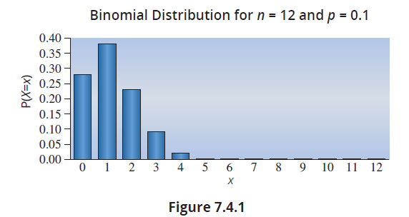
The Shape of a Binomial Distribution
Binomial distributions have taken various shapes in the previous problems. The shape of the distribution depends upon the parameters n and p. If p is small, the distribution tends to be skewed with a tail on the right, (i.e., there are more successes when x is smaller) as is the case in Example 7.4.3 (see Figure 7.4.1).

Slide 39
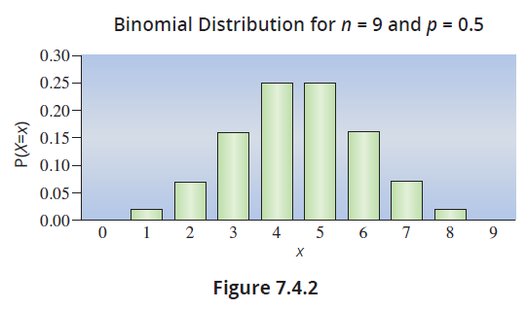
The Shape of a Binomial Distribution (cont.)
If p is near 0.5, the distribution is symmetrical. The graph in Figure 7.4.2 displays the probabilities for n = 9 and p = 0.5.

Slide 40
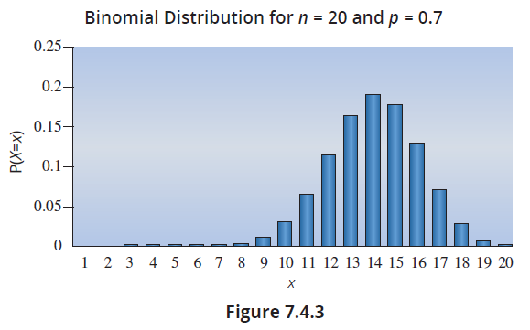
The Shape of a Binomial Distribution (cont.)
If p is large, the distribution tends to be skewed with a long tail on the left (i.e., there are more successes when x is larger). The graph in Figure 7.4.3 displays the binomial probabilities for n = 20 and p = 0.7.

Slide 41
Formula: Expected Value of a Binomial Random Variable
The expected value of a binomial random variable can be computed using the expression
μ = E(X) = np,
where n and p are the parameters of the binomial distribution.

Slide 42
Formula: Variance and Standard Deviation of a Binomial Random Variable
To find the variance of a binomial random variable, use the expression
Therefore, the standard deviation of a binomial random variable is given by

Slide 43
Example 7.4.6: Computing the Expected Value and Variance of a Binomial Random Variable
Compute the expected value and the variance of the number of profitable leases in Example 7.4.3.
Solution
Since the random variable is binomial, we can use the formulas above. Since n = 12 and p = 0.1, the expected value is given by the following expression.

Slide 44
Example 7.4.6: Computing the Expected Value and Variance of a Binomial Random Variable (cont.)
The variance is
which implies that the standard deviation is
Thus, if groups of 12 oil leases were purchased with the same probability of success (0.1 probability of a profitable lease), then the average number of profitable leases per group of 12 would be 1.2 and the standard deviation would be 1.039 leases.

