Slide 1
Section 7.2
Expected Value and Variance

Slide 2
Definition: Expected Value
The expected value of a discrete random variable X is the mean of the random variable X. It is denoted E(X) and is given by computing the following expression
where

Slide 3
Example 7.2.1: Determining the Expected Number of Wins for a Racehorse
The following table shows the probability distribution of the number of wins for a racehorse in a year.
Determine the expected number of wins per year for the horse.
Number of Wins, x | 0 | 1 | 2 | 3 | 4
p(x) | 0.2 | 0.1 | 0.3 | 0.2 | 0.2

Slide 4
Example 7.2.1: Determining the Expected Number of Wins for a Racehorse (cont.)
Solution
Use the expected value formula to calculate the expected number of wins by forming a third column of the table as follows.

Slide 5
Example 7.2.1: Determining the Expected Number of Wins for a Racehorse (cont.)
Calculating a Racehorse’s Expected Number of Wins per Year
x | p( x ) | x∙p( x )
0 | 0.2 | 0
1 | 0.1 | 0.1
2 | 0.3 | 0.6
3 | 0.2 | 0.6
4 | 0.2 | 0.8
Total |  | E(X) = 2.1
In the long run, the expected number of wins per year from this distribution should average about 2.1.

Slide 6
Example 7.2.2: Comparing Alternatives Using Expected Values
Suppose you are confronted with two investment alternatives that possess uncertain outcomes described by the probability distributions given in the table below. Which option should you choose?
Solution

Slide 7
Example 7.2.2: Comparing Alternatives Using Expected Values (cont.)
Investment Alternatives
Option A |  | Option B
Profit (Dollars) | Probability | Profit (Dollars) | Probability
─2000 | 0.2 | ─3000 | 0.2
0 | 0.1 | ─1000 | 0.1
1000 | 0.3 | 2000 | 0.2
2000 | 0.3 | 3000 | 0.3
4000 | 0.1 | 4000 | 0.2

Slide 8
Example 7.2.2: Comparing Alternatives Using Expected Values (cont.)
Because of the randomness of the profit variable, it is difficult to evaluate the investments by merely eyeballing the two distributions. However, by calculating the expected values of the two alternatives, the information in each distribution is condensed to a single value. This value characterizes the center of the distribution and facilitates comparison. The expected values of Options A and B are $900 and $1400, respectively.

Slide 9
Example 7.2.2: Comparing Alternatives Using Expected Values (cont.)
Thus, in the long run Option B would be $500 more profitable. The phrase in the long run is a significant qualifier. It means that under repeated investments with the same profit and probability structure, you would receive an average profit of $1400 from Option B. But on any one investment in Option B, you may lose as much as $3000 or make as much as $4000.

Slide 10
Definition: Variance and Standard Deviation of a Discrete Random Variable
The variance of a discrete random variable X is given by the following formula.
The standard deviation of a discrete random variable X is therefore,

Slide 11
Note
Sometimes it is easier to compute the variance of a discrete random variable using the computational formula
Both formulas are equivalent.

Slide 12
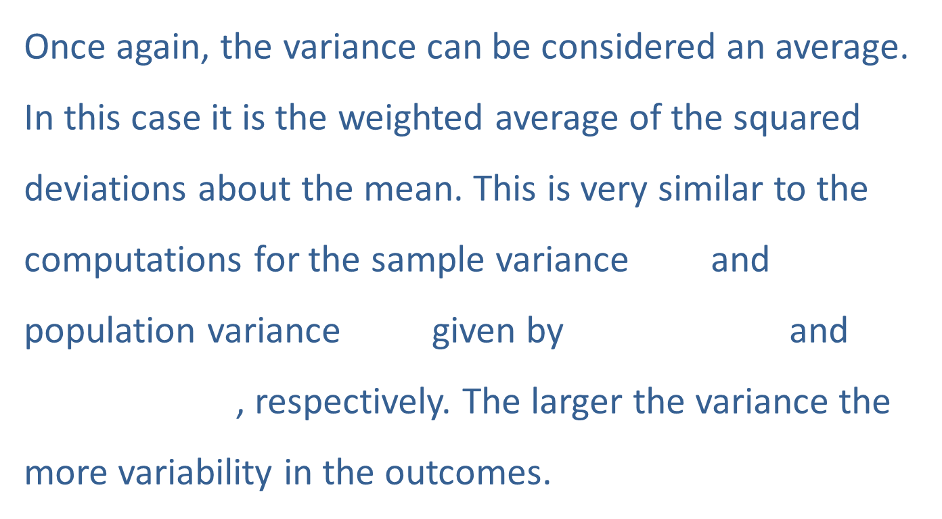
Variance of a Discrete Random Variable
Once again, the variance can be considered an average. In this case it is the weighted average of the squared deviations about the mean. This is very similar to the computations for the sample variance and population variance given by and , respectively. The larger the variance the more variability in the outcomes.

Slide 13
Note
Recall that n is the size of the sample and N is the size of the population.

Slide 14
Example 7.2.3: Determining the Variance of a Random Variable
The process for determining the variances for the random variables described in Example 7.2.2 is given in the tables below.

Slide 15
Example 7.2.3: Determining the Variance of a Random Variable (cont.)
Solution
Variance of Option A
Option A |  | Option B
Profit (Dollars) | Probability
─2000 | 0.2
0 | 0.1
1000 | 0.3
2000 | 0.3
4000 | 0.1
 | Total

Slide 16
Example 7.2.3: Determining the Variance of a Random Variable (cont.)
The standard deviation is computed by taking the square root of the variance. In this instance, the standard deviation of Option A is given by

Slide 17
Example 7.2.3: Determining the Variance of a Random Variable (cont.)
The standard deviation of Option B is given by
Standard Deviation =
Variance of Option B
Option B |  | Option B
Profit (Dollars) | Probability
─3000 | 0.2
─1000 | 0.1
2000 | 0.2
3000 | 0.3
4000 | 0.2
 | Total

