Slide 1
Section 7.1
Types of Random Variables and Probability Distributions

Slide 2
Definition: Random Variable
A random variable is a numerical outcome of a random process.

Slide 3
Definition: Probability Distribution
A probability distribution is a model which describes a specific kind of random process. It maps each value the random variable can assume to a probability.

Slide 4
Definition: Discrete Random Variable
A discrete random variable is a random variable which has a countable number of possible outcomes.
When describing a discrete random variable, you should do the following.
State the variable.
List all of the possible values of the variable.
Determine the probabilities of these values.

Slide 5
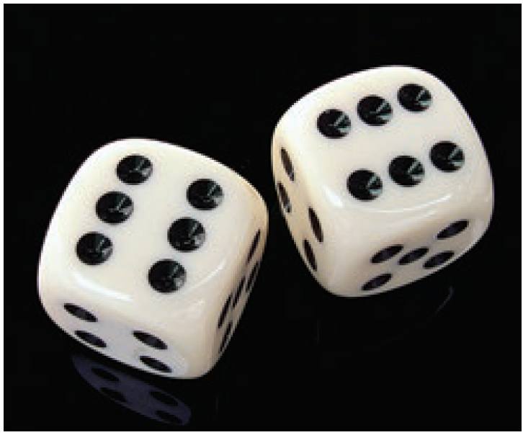
Example 7.1.1: Identifying Random Variables
Random Phenomenon: Toss a die and observe the outcome of the toss.
Identify the random variable: X = the outcome of the toss of a die.
Range of values: Integers between 1 and 6, inclusive.

Slide 6
Example 7.1.1: Identifying Random Variables (cont.)
Probability distribution: The outcomes of the toss of a die and their probabilities are given below. The probabilities are deduced using the classical method and the assumption of a fair die.
Tossing a Die
x | 1 | 2 | 3 | 4 | 5 | 6
P(X=x) | 1 6 | 1 6 | 1 6 | 1 6 | 1 6 | 1 6

Slide 7
Note
For discrete random variables, probability distributions are described by probability mass functions.

Slide 8
Example 7.1.2: Identifying Random Variables
Random Phenomenon: The number of defective integrated circuits received in a batch of 1000. Each outcome of the random variable is a numerical measure whose range of values is given below.
Identify the random variable: X = the number of defective integrated circuits in a batch of 1000.
Range of values: Integers between 0 and 1000, inclusive, where N = 1000. If symbols were chosen to represent the values they could be given as x₁= 0, x₂= 1, …, x_{N+1}= 1000.
Probability distribution: Unknown.

Slide 9
Example 7.1.3: Identifying Random Variables
Random Phenomenon: The head nurse of the pediatric division of the Sisters of Mercy Hospital is trying to determine the capacity requirement for the nursery. She realizes that the number of babies born at the hospital each day is a random variable. She will have to develop a description of the randomness in order to develop her plan.
Identify the random variable: X = the number of babies born at Sisters of Mercy Hospital each day.

Slide 10
Example 7.1.3: Identifying Random Variables (cont.)
Range of values: Integers from 0 to some large positive number.
Probability distribution: Unknown, but could be estimated using the relative frequency idea from Section 6.1 in conjunction with historical data on hospital births at Sisters of Mercy.

Slide 11
Definition: Continuous Random Variable
A continuous random variable is a random variable that can assume any value on a continuous segment(s) of the real number line.

Slide 12
Example 7.1.4: Identifying Random Variables
Random Phenomenon: A local restaurant has an express policy that states that lunch will be served within 15 minutes of ordering, or it will be free. Obviously, the restaurant is keenly interested in not giving away its product and in delivering on its promise of a timely lunch. But the length of time to prepare each meal varies because of the difference in preparation times of each dish, the load on the kitchen, and the experience of the chefs and waitresses.

Slide 13
Example 7.1.4: Identifying Random Variables (cont.)
Since time is measured on a continuous scale and the variability of meal preparation is not predictable, the time between ordering and receiving a meal is considered to be a continuous random variable.
Identify the random variable: X = the time between ordering a meal and receiving it.
Range of values: From 0 to ∞ (infinity). Note that X is measured on a continuous scale.
Probability density: Unknown, but could be approximated empirically using historical data.

Slide 14
Note
For continuous random variables, we specify probabilities with probability density functions.

Slide 15
Definition: Discrete Probability Distribution
A discrete probability distribution consists of all possible values of the discrete random variable along with their associated probabilities.
Discrete probability distributions always have two characteristics.
The sum of all of the probabilities must equal 1.
The probability of any value must be between 0 and 1, inclusively.

Slide 16
Empirical Probability Distributions
If there are sufficient observations, an empirical probability distribution can be established for a discrete random variable. To create an empirical probability distribution for a discrete random variable, list the values the random variable can assume and observe the relative frequency of each unique data value in the observed data. Then create a table relating the two.

Slide 17
Example 7.1.5: Using Empiricism to Determine a Probability Distribution for Hospital Admissions
To help define staffing needs during the past year, a hospital has tracked the number of patients admitted on Wednesdays. Find the empirical probability distribution of the number of admitted patients on Wednesdays.
Let X = the number of admitted patients on Wednesday.

Slide 18
Example 7.1.5: Using Empiricism to Determine a Probability Distribution for Hospital Admissions (cont.)
Step 1: List the range of values for the random variable.
Range of X = {1,2,3,4,5,6,7,8,9,10,11}
Hospital Admissions |  |  |  |  |  | Hospital Admissions
5 | 5 | 6 | 4 | 7 | 6 | 9 | 6 | 8 | 7 | 5 | 5 | 6
11 | 3 | 8 | 8 | 7 | 2 | 5 | 7 | 5 | 4 | 6 | 6 | 4
4 | 6 | 3 | 9 | 9 | 5 | 6 | 7 | 10 | 7 | 1 | 10 | 7
8 | 8 | 6 | 4 | 6 | 8 | 2 | 8 | 7 | 3 | 6 | 4 | 6

Slide 19
Example 7.1.5: Using Empiricism to Determine a Probability Distribution for Hospital Admissions (cont.)
Step 2: Compute the relative frequency of each possible value the random variable can assume.
P(X=1) = P(X=2) = P(X=3) = P(X=4) =
P(X=5) = P(X=6) = P(X=7) = P(X=8) =
P(X=9) = P(X=10) = P(X=11) =

Slide 20
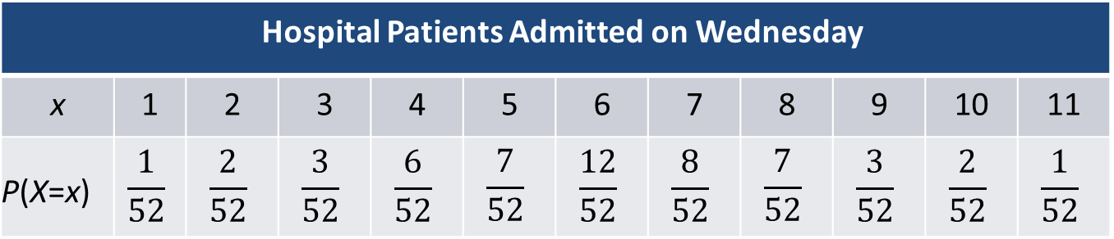
Example 7.1.5: Using Empiricism to Determine a Probability Distribution for Hospital Admissions (cont.)
Step 3: Make a table associating each value of the random variable with its relative frequency. This table is an empirical probability distribution.
Letting the data describe a probability distribution using relative frequency is empiricism at work.
Hospital Patients Admitted on Wednesday |  |  |  |  |  | Hospital Admissions
x | 1 | 2 | 3 | 4 | 5 | 6 | 7 | 8 | 9 | 10 | 11
P(X=x) | $$\frac{1}{52}$$ | $$\frac{2}{52}$$ | $$\frac{3}{52}$$ | $$\frac{6}{52}$$ | $$\frac{7}{52}$$ | $$\frac{12}{52}$$ | $$\frac{8}{52}$$ | $$\frac{7}{52}$$ | $$\frac{3}{52}$$ | $$\frac{2}{52}$$ | $$\frac{1}{52}$$

Slide 21
Definition: Probability Distribution Function
A function that assigns probabilities to each value of a random variable is called a probability distribution function.

Slide 22
Example 7.1.6: Using Deduction to Determine the Probability Distribution of Three Coin Tosses
Consider the random phenomenon of tossing a coin three times and counting the number of heads. What is the probability distribution for the number of heads observed in three tosses of a coin?
Solution
The random variable is X = the number of heads in three tosses of a coin. The probabilities can be deduced using the classical approach to probability and are
given in the table below.

Slide 23
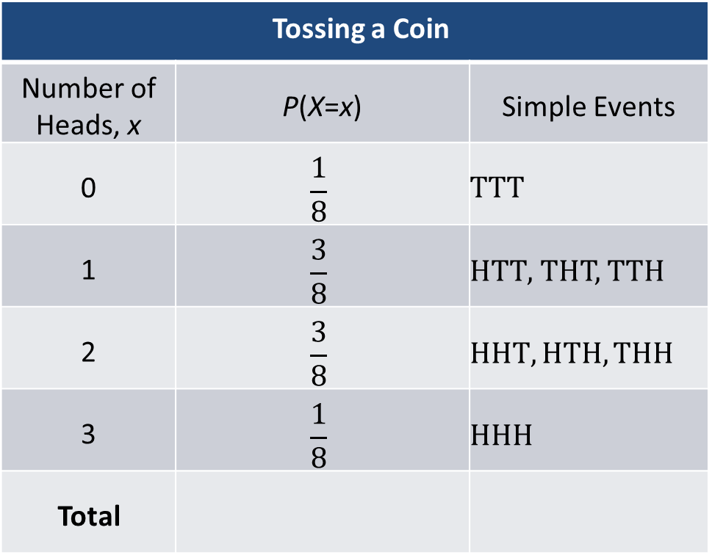
Example 7.1.6: Using Deduction to Determine the Probability Distribution of Three Coin Tosses (cont.)
Tossing a Coin
Number of Heads, x | P(X=x) | Simple Events
0 | $$\frac{1}{8}$$ | $$TTT$$
1 | $$\frac{3}{8}$$ | $HTT$, THT, TTH
2 | $$\frac{3}{8}$$ | $$HHT, HTH, THH$$
3 | $$\frac{1}{8}$$ | $$HHH$$
Total

Slide 24
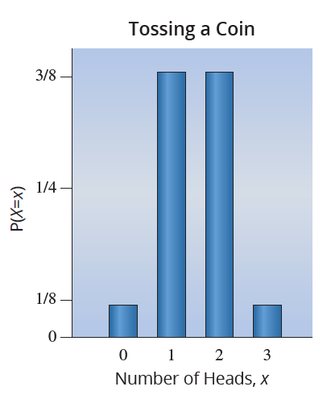
Example 7.1.6: Using Deduction to Determine the Probability Distribution of Three Coin Tosses (cont.)

Slide 25
Example 7.1.7: Probabilistic Modeling of the Number of Rolls Needed to Obtain a 1 on a Single Die
Suppose you are playing a game and just need to roll a one to move into the last space on the board and win. This scenario has the characteristics of a well-known discrete probability distribution, named the Geometric distribution, with the following probability distribution function.

Slide 26
Example 7.1.7: Probabilistic Modeling of the Number of Rolls Needed to Obtain a 1 on a Single Die (cont.)
We assign the random variable, X, as the number of rolls of a single 6-sided die needed until the face with one dot (pip) on it appears. While theoretically the range of the random variable is infinite, we know from experience that the desired outcome is likely to occur within a reasonable number of attempts. The table below shows the start of the probability distribution of X with p = 1/6.

Slide 27
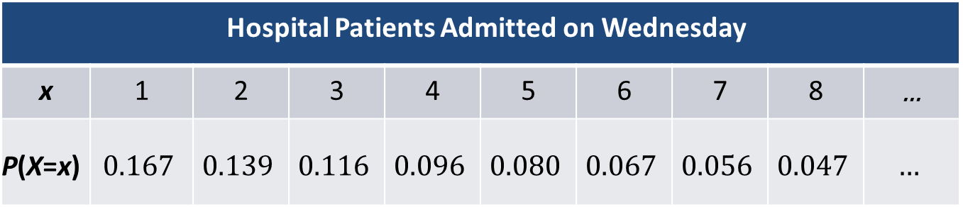
Example 7.1.7: Probabilistic Modeling of the Number of Rolls Needed to Obtain a 1 on a Single Die (cont.)
What is the probability that it will take less than four rolls of the die to win the game?
Hospital Patients Admitted on Wednesday |  |  |  |  |  | Hospital Admissions
x | 1 | 2 | 3 | 4 | 5 | 6 | 7 | 8 | ...
P(X=x) | $$0.167$$ | $$0.139$$ | $$0.116$$ | $$0.096$$ | $$0.080$$ | $$0.067$$ | $$0.056$$ | $$0.047$$ | $$…$$

Slide 28
Example 7.1.7: Probabilistic Modeling of the Number of Rolls Needed to Obtain a 1 on a Single Die (cont.)
Solution

Slide 29
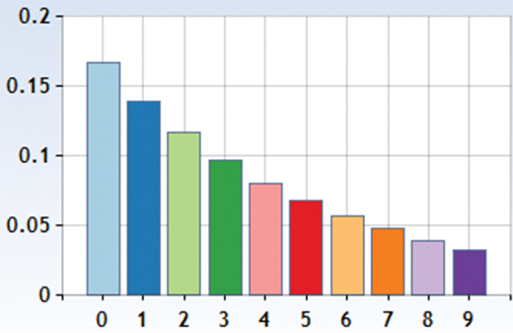
The Geometric Distribution
The geometric probability distribution is often used to model the number of attempts until the first success in a sequence of independent and identically distributed trials in which there is a fixed probability for success, p, in every attempt.

Slide 30
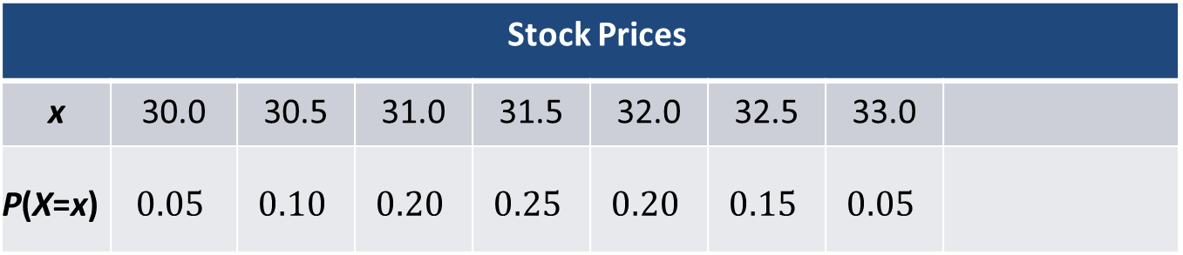
Example 7.1.8: Understanding and Using the Probability Distribution of a Stock Price
An investor has decided that she will purchase a stock if there is at least a 50% chance that the price of the stock will be more than $32 in thirty days. Assuming the price of the stock 30 days from now is described in the table below, should the investor purchase the stock?
Stock Prices |  |  |  |  |  | Hospital Admissions
x | 30.0 | 30.5 | 31.0 | 31.5 | 32.0 | 32.5 | 33.0
P(X=x) | $$0.05$$ | $$0.10$$ | $$0.20$$ | $$0.25$$ | $$0.20$$ | $$0.15$$ | $$0.05$$

Slide 31
Example 7.1.8: Understanding and Using the Probability Distribution of a Stock Price (cont.)
The random variable is: X = the price of a stock 30 days hence.
Based on the probability distribution, the probability that the stock price will be more than $32 in thirty days is calculated as follows.
Since the probability that the price of the stock will be more than $32 in thirty days is only 20%, the investor should not purchase the stock.

Slide 32
Using Functions to Create Discrete Probability Distributions
If a probability distribution is defined by a mathematical function, then the function is called a probability distribution function, or more simply a probability model. We are going to discuss several probability models in this chapter. Let’s consider a simple probability model.

Slide 33
Example 7.1.9: Evaluating a Probability Distribution Given as a Function
The following function is a discrete probability distribution function.
Summarize the probability distribution for this function.

Slide 34
Example 7.1.9: Evaluating a Probability Distribution Given as a Function (cont.)
Solution
To determine the probability for a value, use the value as the argument to the function. For example, to determine the probability that X = 3, compute
The probability that X = 4 can be calculated similarly.

Slide 35
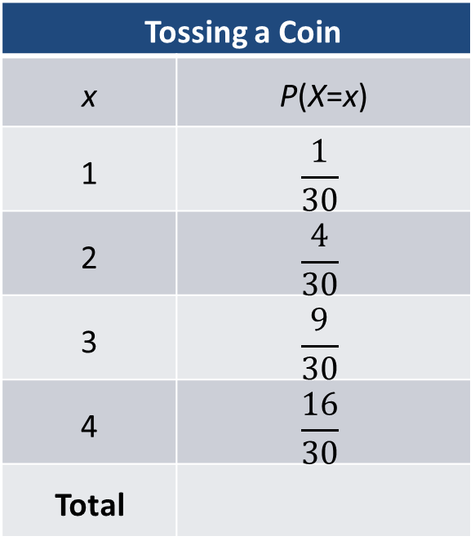
Example 7.1.9: Evaluating a Probability Distribution Given as a Function (cont.)
The resulting probability distribution is summarized in the table below
Tossing a Coin
x | P(X=x)
1 | $$\frac{1}{30}$$
2 | $$\frac{4}{30}$$
3 | $$\frac{9}{30}$$
4 | $$\frac{16}{30}$$
Total

Slide 36
Example 7.1.9: Evaluating a Probability Distribution Given as a Function (cont.)
Note that the distribution possesses the essential properties of all probability distributions; that is, the probabilities sum to one, and all the probabilities are between 0 and 1.

Slide 37
Continuous Probability Distributions
Continuous random variables also have probability distributions. We often describe their probability distributions using an equation or graph rather than a table since it is impossible to list all of the values in the range of a continuous random variable. They will be the subject of the next chapter.

