Slide 1
Section 6.4
Combinations and Permutations

Slide 2
Combinations and Permutations
To compute certain probabilities, such as the probability of having winning numbers in the state lottery, requires the ability to count the number of possible outcomes for a given experiment or a sequence of experiments.
However, often it is impractical to list out all the possibilities. Therefore, we will develop some techniques to facilitate counting.

Slide 3
Procedure: The Fundamental Counting Principle
E₁ is an event with n₁ possible outcomes and E₂ is an event with n₂ possible outcomes. The number of ways the events can occur in sequence is n₁⋅ n₂. This principle can be applied for any number of events occurring in sequence.

Slide 4
Example 6.4.1: Using the Fundamental Counting Principle to Count the Number of Tomato Plots Needed for an Experiment
An agricultural research center is designing an experiment to determine the effects of soil type, fertilizer, and plant spacing on tomato yield. The plan calls for four soil types, three types of fertilizer, and four different spacings between plants. The plan also includes replication of each combination of fertilizer, soil type, and plant spacing five times. How many different plots of tomatoes will be needed to conduct the experiment?

Slide 5
Example 6.4.1: Using the Fundamental Counting Principle to Count the Number of Tomato Plots Needed for an Experiment (cont.)
Solution

Slide 6
Example 6.4.2: Using the Fundamental Counting Principle to Count License Plates
Standard passenger license plates in the state of Illinois consist of two letters (excluding I and O) followed by five numbers beginning with a non-zero digit. How many license plates are possible?
Solution
There are 24 letters possible for each of the first two letters. There are nine digits possible for the first number and then ten digits possible for the last four numbers. Therefore, we have:

Slide 7
Example 6.4.2: Using the Fundamental Counting Principle to Count License Plates (cont.)

Slide 8
Example 6.4.3: Using the Fundamental Counting Principle to Count Arrangements
You have a stack of 5 textbooks: English, History, Statistics, Geology, and Psychology. How many ways can you arrange these textbooks on a shelf?
Solution
Because you can put each book on the bookshelf only once, you have five possible choices for the first book. Similarly, there are four possible choices for the second book, three possible choices for the third book, two possible choices for the fourth book and only one book left for the fifth book.

Slide 9
Example 6.4.3: Using the Fundamental Counting Principle to Count Arrangements (cont.)
Using the Fundamental Counting Principle, we have

Slide 10
Permutations
The product 5 ⋅ 4 ⋅ 3 ⋅ 2 ⋅ 1 in the previous example is a special type of product called a factorial. Factorials occur so frequently that they have their own notation as follows.

Slide 11
Formula: Factorial
Suppose n is a positive whole number. Then,
n! = n ⋅ (n−1) ⋅ (n−2) ⋅… ⋅ 3 ⋅ 2 ⋅ 1.
Note: 0! = 1 by definition.

Slide 12
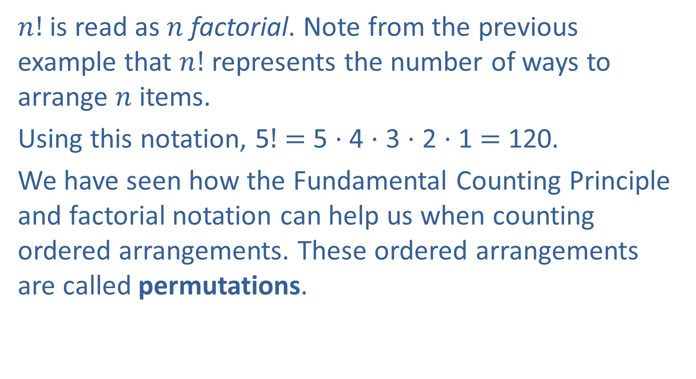
Permutations (cont.)
$n!$ is read as $n$ factorial. Note from the previous example that $n!$ represents the number of ways to arrange $n$ items.
Using this notation, 5$!$ $=$ 5 ⋅ 4 ⋅ 3 ⋅ 2 ⋅ 1 $=$ 120.
We have seen how the Fundamental Counting Principle and factorial notation can help us when counting ordered arrangements. These ordered arrangements are called permutations.

Slide 13
Definition: Permutation
A permutation is a specific order or arrangement of objects in a set. There are n! permutations of n unique objects.

Slide 14
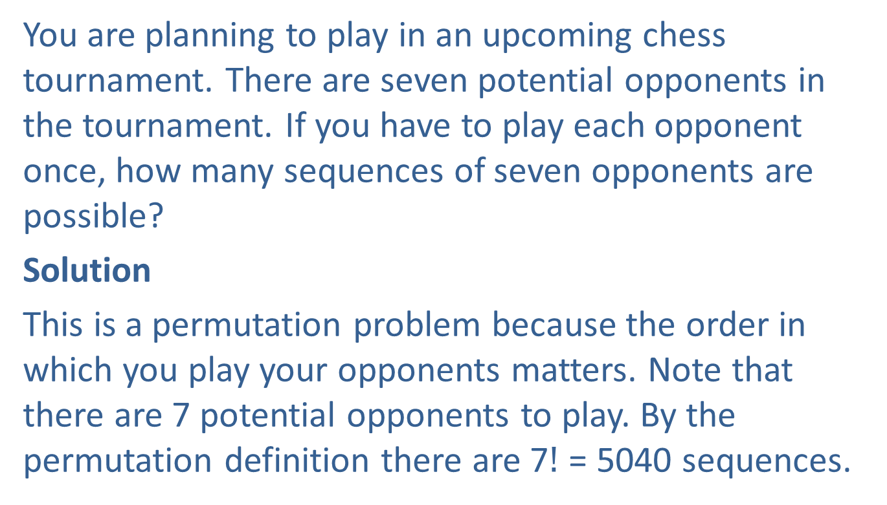
Example 6.4.4: Using Permutations to Find the Number of Different Sequences
You are planning to play in an upcoming chess tournament. There are seven potential opponents in the tournament. If you have to play each opponent once, how many sequences of seven opponents are possible?
Solution
This is a permutation problem because the order in which you play your opponents matters. Note that there are 7 potential opponents to play. By the permutation definition there are 7$!$ = 5040 sequences.

Slide 15
Permutations (cont.)
There are times when not all objects in a set will be used for a permutation problem. Consider the following example.

Slide 16
Example 6.4.5: Using Permutations to Find the Number of Different Codes
At a local fast food restaurant, the door to the kitchen is secured by a five button lock, labeled 1, 2, 3, 4, 5. To open the door, the correct three digit code must be pushed, but each button can only be pushed once. How many different codes are possible?
Solution
This is a permutation problem of 5 objects, but we are selecting only 3 at a time. There are 5 buttons available for the first character in the code, 4 for the second and 3 for the third. Therefore, there are
5 ⋅ 4 ⋅ 3 = 60 possible codes.

Slide 17
Permutations (cont.)
In the previous example, we had a permutation of 5 objects selecting 3 at a time. In general,

Slide 18
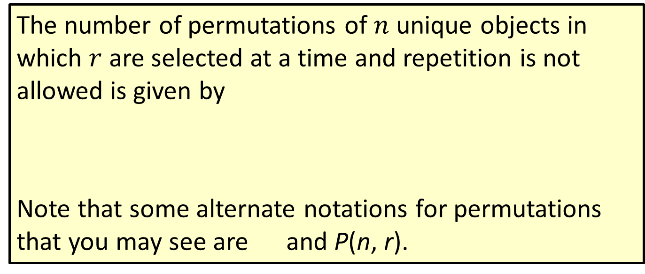
Formula: Permutation
The number of permutations of $n$ unique objects in which $r$ are selected at a time and repetition is not allowed is given by
Note that some alternate notations for permutations that you may see are and P(n, r).

Slide 19
Example 6.4.6: Using Permutations to Find Ways to Finish a Horse Race
Seven horses are entered in the Kentucky Derby. How many ways can they finish in first, second, and third place?
Solution
Because we have seven horses and the order (first, second, third) is important, we need to find the number of permutations of 7 objects selecting 3 at a time.

Slide 20
Permutations (cont.)
There are times when we are interested in finding the number of permutations where some of the objects are duplicates. For instance, consider the word EYE.
If we interchange the two E’s, the resulting permutation is not distinguishable from the original. To count the number of distinguishable permutations, we need the following formula.

Slide 21
Formula: Distinguishable Permutations
If given n objects, with n₁ alike, n₂ alike, … , n_{k} alike, then the number of distinguishable permutations of all n objects is

Slide 22
Example 6.4.7: Finding the Number of Distinguishable Permutations
How many distinguishable permutations can be made from the word Mississippi?
Solution
There are 11 letters in the word Mississippi, one M, four I’s, four S’s, and two P’s. So there are,
distinguishable permutations of the letters in Mississippi.

Slide 23
Combinations
We have just looked at counting where order or arrangement mattered. But there are many situations, such as a winning lottery number, where the order is not important. If we want a count where the order is not important, then we have a combination problem.

Slide 24
Definition: Combinations
A combination is a collection or grouping of objects where the order is not important.

Slide 25
Combinations (cont.)
The number of combinations of the n objects selecting k at a time can be found as follows.

Slide 26
Formula: Combinations
The number of combinations of n unique objects selecting r at a time and repetition is not allowed is given by
Note that some alternate notations for combinations that you may see are and C(n, r).

Slide 27
Example 6.4.8: Using Combinations to Find the Probability of Winning the Lottery
In South Carolina’s Palmetto Cash 5 lottery, a player selects five different numbers from 1 to 38 (inclusive). If the numbers selected match the player’s numbers in any order, the player wins.
What is the total number of winning combinations?
What is the probability of winning?

Slide 28
Example 6.4.8: Using Combinations to Find the Probability of Winning the Lottery (cont.)
Solution
Because we have 38 unique numbers and 5 will be selected at a time, we have:
The probability of winning with any one combination is

Slide 29
Combinations (cont.)
It is important to remember that permutations are used when order is important, and combinations are used when order is not important.

Slide 30
Combinations (cont.)
Concept |  | Formula
Fundamental Counting Principle | If one event has n₁ outcomes and another event has n₂ outcomes, the number of ways the events can occur in sequence is the product of n₁ and n₂. (This principle can be applied for any number of events occurring in sequence.) | n₁⋅ n₂
Factorial | n! is the product of each of the positive whole numbers from 1 to n. | n! = n (n−1) (n−2) ∙∙∙ (3) (2) (1)

Slide 31
Combinations (cont.)
Concept |  | Formula
Combination | A collection or grouping of objects where order is not important. | The number of combinations of n unique objects selecting r at a time and repetition is not allowed is given by the following formula.

Slide 32
Combinations (cont.)
Concept |  | Formula
Permutation | A specific order or arrangement of objects. | The number of arrangements for n objects when order is important is given by n factorial: n!.
 | The number of permutations of n unique objects selecting r at a time and repetition is not allowed.
 | Given n objects with n₁ alike, n₂ alike, …, n_{k} alike, then the number of distinguishable permutations is given by the formula to the right.

