Slide 1
Section 6.3
Multiplication Rules for Probability

Slide 2
Multiplication Rules for Probability
Researchers often want to examine a limited portion of the sample space. For example, consider the question of whether cigarette smoking harms those that are indirectly exposed to the smoke. Suppose that 3% of women who do not smoke die of cancer. However, if a nonsmoking woman is married to a smoking husband (not to be confused with a husband who is on fire), the probability of dying of cancer is 0.08 or 8%. This probability is a conditional probability, because the sample space is being limited by some condition – in this case, limited to only wives of smoking husbands.

Slide 3
Multiplication Rules for Probability (cont.)
In this instance, the dramatic effect of a smoking husband on cancer rates is readily evident.

Slide 4
Multiplication Rules for Probability (cont.)
Similarly, the results from a market survey indicate that 39% of the customers surveyed believe a product is of high quality. However, if the analysis is limited to only women, 54% of women surveyed believe the product is of high quality. Based on the survey, it appears that women have a much higher regard for the company’s product than men. The difference in attitude would probably be something that could affect how the company spends its marketing dollars.
To compute a conditional probability, apply the following rule.

Slide 5
Definition: Conditional Probability
The probability that an event will occur given that some other event has already occurred or is certain to occur, is a conditional probability.

Slide 6
Definition: Probability Law 9: Conditional Probability
The conditional probability of event A occurring, given that event B has already occurred is
The notation P(A|B) is read as the probability of A given the occurrence of B. The vertical bar within a probability statement will always mean given.

Slide 7
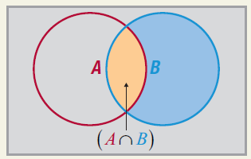
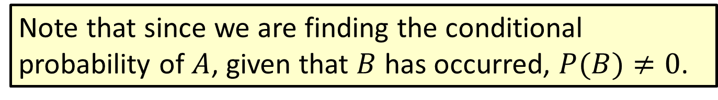
Definition: Probability Law 9: Conditional Probability (cont.)
Note that since we are finding the conditional probability of $A$, given that $B$ has occurred, $P(B)≠0$.

Slide 8

Multiplication Rules for Probability (cont.)
The events $A$ and $B$ can be reversed in the preceding rule to compute $P(B|A)$. It would be very unlikely that $P(A|B)$ equals $P(B|A)$.

Slide 9
Example 6.3.1: Calculating a Conditional Probability
Suppose a marketing research firm has used the internet to conduct a survey of consumers to test a new product. The results of the survey are reflected in the following cross tabulation indicating the number of respondents that liked the product, the number that did not like the product, and the number that were undecided.
Market Research Survey
Age | Like | Not Like | Undecided | Total
18–34 | 213 | 197 | 103 | 513
35–50 | 193 | 184 | 67 | 444
Over 50 | 144 | 219 | 83 | 446
Total | 550 | 600 | 253 | 1403

Slide 10
Example 6.3.1: Calculating a Conditional Probability (cont.)
If an individual is between 35 and 50 years old, what is the probability that he or she will like the product?
Solution
Let the events
A = {like the product},
and
B = {age between 35 and 50}.
Then the desired probability can be formulated as

Slide 11
Example 6.3.1: Calculating a Conditional Probability (cont.)
The P(A∩B) is called a joint probability since it is the probability of the occurrence of more than one event. To compute the P(A∩B) use the empirical approach; that is,

Slide 12
Example 6.3.1: Calculating a Conditional Probability (cont.)
Similarly, P(B) can be computed as
Consequently, P(A|B) is
Note that this answer could have also been obtained by simply dividing 193 by 444.

Slide 13
Example 6.3.2: Calculating Conditional Probabilities
Out of 300 applicants for a job, 212 are college graduates. Of the college graduate job applicants, 110 have served in the military.
What is the probability that a randomly chosen applicant has served in the military, given that they are a college graduate?
If 152 of the applicants have served in the military, what is the probability that a randomly chosen applicant is a college graduate, given that the applicant has served in the military?

Slide 14
Example 6.3.2: Calculating Conditional Probabilities (cont.)
Solution
The question asks for P(military service|college graduate). Thus, in order to use the formula for conditional probability, we need to find P(college graduate and military service) and P(collage graduate). There are 300 applicants total, so the probability of choosing an applicant who is a college graduate and has served in the military is

Slide 15
Example 6.3.2: Calculating Conditional Probabilities (cont.)
Similarly, the probability of choosing a college graduate applicant is Thus, we calculate the conditional probability as follows.

Slide 16
Example 6.3.2: Calculating Conditional Probabilities (cont.)
For this question we want to determine P(college graduate|military service). We know from part a. that the probability of choosing one of the 300 applicants who is a college graduate and has served in the military is Also, we know that the probability that a randomly chosen applicant has served in the military is Using the formula for conditional probability, we have the following.

Slide 17
Example 6.3.2: Calculating Conditional Probabilities (cont.)
As you can see, P(A|B) is not necessarily the same as
P(B|A).

Slide 18
Multiplication Rules for Probability (cont.)
An extremely important concept in statistical analysis is independence. It describes a special kind of relationship between two events. Two events are said to be independent if knowledge of one event does not provide information of the other event’s occurrence. In other words, the occurrence of one event does not affect the occurrence of another event if the events are independent.

Slide 19
Example 6.3.3: Determining the Independence of Events
Conduct the experiment of rolling a fair die two times. Consider the two events
A = {rolling a six on the first roll of a fair die}, and
B = {rolling a four on the second roll of a fair die}.
Are these two events independent?
Solution
Since knowledge of the outcome of the first roll does not help one make an inference about the outcome of the second roll, the two events are independent.

Slide 20
Multiplication Rules for Probability (cont.)
Symbolically the idea of independence is expressed in the following definition.

Slide 21
Definition: Independent Events
Two events are said to be independent if the occurrence of one event does not affect the occurrence of the other event.

Slide 22
Definition: Independent
Two events, A and B, are independent if and only if

Slide 23
Multiplication Rules for Probability (cont.)
In many cases, regarding the independence of two events, intuition and common sense will lead you to the correct determination. There are situations in which independence can only be discovered by formal application of the definition.

Slide 24
Definition: Dependent Events
Two events are said to be dependent if the occurrence of one event does affect the occurrence of the other event.

Slide 25
Definition: Probability Law 10: Multiplication Rule for Independent Events
If two events, A and B, are independent, then
If n events, A₁, A₂, ..., A_{n}, are independent, then

Slide 26
Multiplication Rules for Probability (cont.)
The above multiplication rule for independent events is sometimes called the product rule. The rule simply states that the probability of the joint occurrence of mutually independent events is the product of their probabilities.

Slide 27
Example 6.3.4: Finding the Probability of Independent Events
A coin is flipped and a fair six-sided die is rolled. Find the probability of getting a head on the coin and an even number on the die.
Use a tree diagram to find the probability.
Use Probability Law 10 to find the probability.
Solution
The tree diagram for flipping a coin and rolling a fair die is given in the margin. Note that there are 12 equally likely outcomes.

Slide 28
Example 6.3.4: Finding the Probability of Independent Events (cont.)
The three outcomes outlined in red are those where the coin toss results in a head and the roll of the die results in a 2, 4, or 6, an even number. The probability is therefore
Since the event of tossing a coin is independent of the event of rolling a fair die, we can use Probability Law 10 and multiply the probabilities of the two events together.

Slide 29
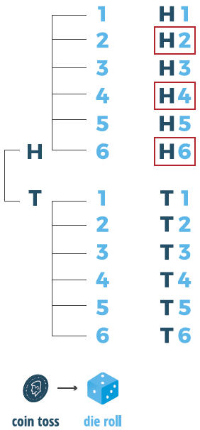
Example 6.3.4: Finding the Probability of Independent Events (cont.)

Slide 30
Multiplication Rules for Probability (cont.)
Notice that regardless of the approach you take to find the solution, you get the same result. In the next example we will look at an extension to three events.

Slide 31
Example 6.3.5: Finding the Probability of Independent Events
A coin is flipped, a six-sided die is rolled, and a card is drawn from a standard deck of 52 cards. Find the probability of getting a tail on the coin, a five on the die, and a jack of clubs from the deck of cards.
Solution
Since the three events (flipping a coin, rolling a die, and selecting a card) are independent, we can use the product rule.
We know the following.

Slide 32
Example 6.3.5: Finding the Probability of Independent Events (cont.)
Therefore, we can compute the probability as follows.
P(tail on coin ∩ five on die ∩ jack of clubs) = P(tail on coin ) · P(five on die) · P(jack of clubs)
So the probability of getting tails on the coin, rolling a five, and then selecting the jack of clubs is about 0.0016.

Slide 33
Example 6.3.6: Finding the Probability of Independent Events
Choose two cards from a standard deck, replacing the first card and shuffling before choosing the second one. What is the probability of choosing a king and then a queen?
Solution
Because the first card is replaced before the second card is drawn, the probability of the second event occurring is not affected by the outcome of the first event. That is, the two events are independent. Therefore, we can compute the probability using the product rule as follows.

Slide 34
Example 6.3.6: Finding the Probability of Independent Events (cont.)

Slide 35
Example 6.3.7: Using the Probability of Independent Events in a Court Case
This is an actual case that stirred up quite a controversy.
People vs. Collins (1968)
On June 18, 1964, at about 11:30 AM, Mrs. Juanita Brooks was assaulted and robbed while walking through an alley in the San Pedro area of Los Angeles. Mrs. Brooks described her assailant as a young woman with a blond pony tail. At about the same time, John Bass was watering his lawn and witnessed the assault. He described the assailant as a Caucasian woman with dark-blond hair.

Slide 36
Example 6.3.7: Using the Probability of Independent Events in a Court Case (cont.)
As she ran from the alley she jumped into a yellow automobile driven by a black man with a mustache and a beard.
Several days later the police arrested two individuals based on the descriptions provided by the assailant and the witness. The two suspects were eventually charged with the crime. During the trial the prosecution called a professor of mathematics to testify. The prosecutor set forth the following probabilities for the characteristics of the assailants.

Slide 37
Example 6.3.7: Using the Probability of Independent Events in a Court Case (cont.)
Assailant Characteristics Data
Characteristic | Probability
Yellow automobile | 0.10
Man with mustache | 0.25
Girl with ponytail | 0.10
Girl with blonde hair | 0.33
Black man with beard | 0.10
Interracial couple in a car | 0.001
How did the prosecution use these probabilities to argue its case?

Slide 38
Example 6.3.7: Using the Probability of Independent Events in a Court Case (cont.)
Solution
If the events are assumed to be independent, then the product rule can be used to determine the likelihood of observing their joint occurrence.
P(Yellow automobile ∩ Man with mustache ∩ Girl with ponytail ∩ Girl with blond hair ∩ Black man with beard ∩ Interracial couple in car)
= (0.10)(0.25)(0.10)(0.33)(0.10)(0.001)
= 0.0000000825

Slide 39
Example 6.3.7: Using the Probability of Independent Events in a Court Case (cont.)
Based on the product rule, the mathematician testified that there was about a 1 in 12 million chance that a couple selected at random would possess these characteristics. The prosecution added that the probability was the chance that “any other couple possessed the distinctive characteristics of the defendants.” The jury convicted the defendants. On appeal, the Supreme Court of California reversed the decision, based on two main points.

Slide 40
Example 6.3.7: Using the Probability of Independent Events in a Court Case (cont.)
First there was no proof offered that the probabilities used in the probability calculation were correct and there was no evidence that the events were independent. Second, the prosecution’s evidence pertaining to a randomly selected couple was not pertinent to the problem of the existence of any other couple possessing the same characteristics.

Slide 41
Example 6.3.8: Calculating the Probability of Defective Work
In a production process, a product is assembled by using four different independent parts (A, B, C, and D). In order for the product to operate properly, each part must be free of defects. The probabilities of the parts being defect-free are given by P(A) = 0.9, P(B) = 0.7, P(C) = 0.8, and P(D) = 0.9.
What is the probability that all four parts are defective?
What is the probability that the product does not work?

Slide 42
Example 6.3.8: Calculating the Probability of Defective Work (cont.)
Solution
For all parts to have defects, we need to find the probability of the intersection of the complement for each of the parts. That is,
P(all four parts have defects) = P(A^{c} ∩ B^{c} ∩ C^{c} ∩ D^{c}).
Since each part operates independently of the others, the probability that all four parts are defective is the product of the probability of each of the part’s complement.

Slide 43
Example 6.3.8: Calculating the Probability of Defective Work (cont.)
Thus, the probability that all four parts have defects is 0.0006, or 0.06%.
The probability that the product does not work is the probability that at least one of the parts does not work (since each part must be free of defects for the product to work).

Slide 44
Example 6.3.8: Calculating the Probability of Defective Work (cont.)
Thus, there is nearly a 55% chance that the product will
not work.

Slide 45
Multiplication Rules for Probability (cont.)
What does it mean if two events are not independent? One obvious response is to say that they are dependent, a term that is just as much a part of statistical vocabulary as independent. If events are dependent, they are related; the nature of the relationship and whether the relationship can be used for predictive purposes are problems often examined by statisticians.
When two events are not independent, then the occurrence of one influences the occurrence of the other.

Slide 46
Multiplication Rules for Probability (cont.)
For example, consider drawing two cards from a standard card deck without replacement, which means that the first card is not replaced in the deck before the second card is drawn. When a multistage experiment is performed without replacement, the outcome from the first stage affects the occurrence of the second, and so forth. The events are not independent. Instead, they are said to be dependent. To compute the probability of dependent events occurring, we still multiply the probabilities, but we must take into account the outcome of the first stage when determining the probability of the second event occurring.

Slide 47
Example 6.3.9: Calculating the Probability of Dependent Events
What is the probability of drawing a king and then a queen from a standard deck if the cards are drawn without replacement?
Solution
This situation is essentially the same as drawing two cards at the same time from the deck. Let’s think of this experiment as having two stages for ease in calculation. We start by first determining the probability of drawing a king from the deck.

Slide 48
Example 6.3.9: Calculating the Probability of Dependent Events (cont.)
Since there are 4 kings in a deck of 52 cards, this probability is
What is the probability of now drawing a queen? Since we are holding a king in our hand, there are still 4 queens left in the deck, but there are only 51 cards left to choose from in the deck. Therefore, the probability of drawing a queen, given we have already drawn a king and we did not place the king back in the deck before drawing our second card, is calculated as

Slide 49
Example 6.3.9: Calculating the Probability of Dependent Events (cont.)
We can now find the probability of drawing a king and a queen, without replacement, by multiplying the two probabilities together.
P(king and queen, without replacement)
= P(king) ⋅ P(queen | king)

Slide 50
Multiplication Rules for Probability (cont.)
Notice that this value is slightly different than the value we obtained in Example 6.3.6 where we drew the cards with replacement. There is a slightly higher probability of drawing a king and then a queen if the king is not placed back into the deck before the second draw. This example helps us to develop a formula for calculating the probability of dependent events.

Slide 51
Definition: Probability Law 11: Multiplication Rule for Dependent Events
If two events, A and B, are dependent, then

Slide 52
Example 6.3.10: Calculating the Probability of Dependent Events
Texas Hold’em is a popular variation of the card game of poker. The game consists of two cards being dealt face down to each player, and then five community cards (CCs) being dealt face up in the center of the table which can be used by all players. The object of the game is to create the best five-card hand using any combination of the two private cards and the five community cards. (See the rules for Texas Hold’em below.)

Slide 53

Example 6.3.10: Calculating the Probability of Dependent Events (cont.)
In a game of Texas Hold’em a poker player is trying to decide whether to call a bet after the “flop.” The “flop” was the jack of spades, eight of hearts, and six of spades.
Only two players are playing. One player’s “private cards” are the K♠ and 9♠ (king and nine of spades). The opponent goes all in and shows her cards: A♠ and A♦ (ace of spades and ace of diamonds). What is the probability that neither of the next two community cards will be spades?

Slide 54
Example 6.3.10: Calculating the Probability of Dependent Events (cont.)
Solution
Since we know what cards the other player holds, we know that there are 45 unknown cards remaining in the deck.
(number of cards in the deck originally) − (number of CCs currently displayed) − (your two cards) − (opponent’s two cards) = 52 − 3 −2 −2 = 45
Once the “flop” is displayed, the player has exact information on 7 of the 52 cards.

Slide 55
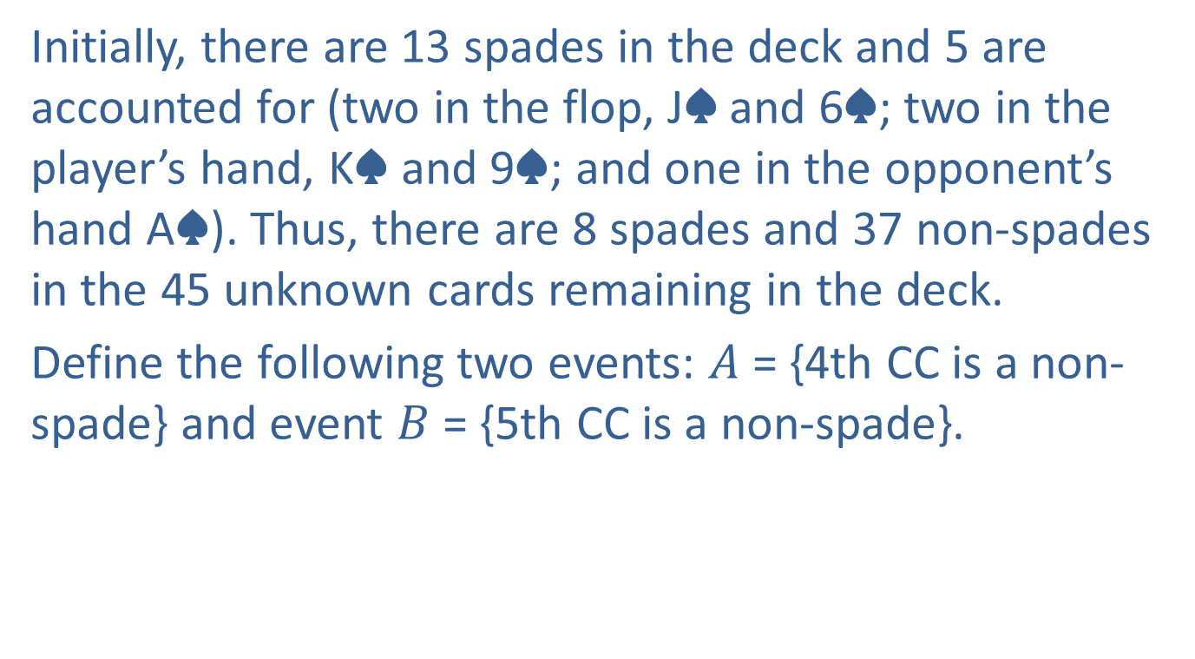
Example 6.3.10: Calculating the Probability of Dependent Events (cont.)
Initially, there are 13 spades in the deck and 5 are accounted for (two in the flop, J♠ and 6♠; two in the player’s hand, K♠ and 9♠; and one in the opponent’s hand A♠). Thus, there are 8 spades and 37 non-spades in the 45 unknown cards remaining in the deck.
Define the following two events: $A$ = {4th CC is a non-spade} and event $B$ = {5th CC is a non-spade}.

Slide 56
Example 6.3.10: Calculating the Probability of Dependent Events (cont.)
These two events are not independent; therefore, the probability of no spades is:

Slide 57
Example 6.3.10: Calculating the Probability of Dependent Events (cont.)

Slide 58
Example 6.3.10: Calculating the Probability of Dependent Events (cont.)
Therefore,
There is approximately a 67.27% chance of getting non-spades in the next two CCs. Would you call her bet?

Slide 59
Texas Hold’em
Here is a brief overview of how the game is played.
The game begins with each player being dealt two cards face down, which are called “hole cards” or “pocket cards.”
The first round of betting begins with the player to the left of the dealer, who has the option to “call” (match the current bet), “raise” (increase the current bet), or “fold” (discard their hand and end their participation in the current hand). All of the bets throughout the rounds comprise the “pot.”

Slide 60
Texas Hold’em (cont.)
After the first round of betting, three community cards are dealt face up in the center of the table, which are called the “flop.” These cards can be used by all players to make their best five-card hand.
A second round of betting takes place, beginning with the player to the left of the dealer.
A fourth community card is dealt face up in the center of the table, which is called the “turn.”
A third round of betting takes place, beginning with the player to the left of the dealer.

Slide 61
Texas Hold’em (cont.)
A fifth and final community card is dealt face up in the center of the table, which is called the “river.”
A final round of betting takes place, beginning with the player to the left of the dealer.
If more than one player is still in the hand after the final betting round, the players reveal their hole cards and the player with the best five-card hand wins the “pot.”

