Slide 1
Section 6.2
Addition Rules for Probability

Slide 2
Addition Rules for Probability
Interpreting probabilities using the classical approach is a good way of thinking about the basic probability principles. In this section we will discuss certain laws that probabilities must obey, regardless of how probability is defined.

Slide 3
Definition: Probability Law 1
A probability of zero means the event cannot happen. (For example, the probability of observing three heads in two tosses of a coin is zero.)

Slide 4
Definition: Probability Law 2
A probability of one means the event must happen. (For example, if we toss a coin, the probability of getting either a head or tail is one.)

Slide 5
Definition: Probability Law 3
All probabilities must be between zero and one inclusively. The closer the probability is to 1, the more likely the event. The closer the probability is to 0, the less likely the event. For an event A this is expressed as follows.

Slide 6
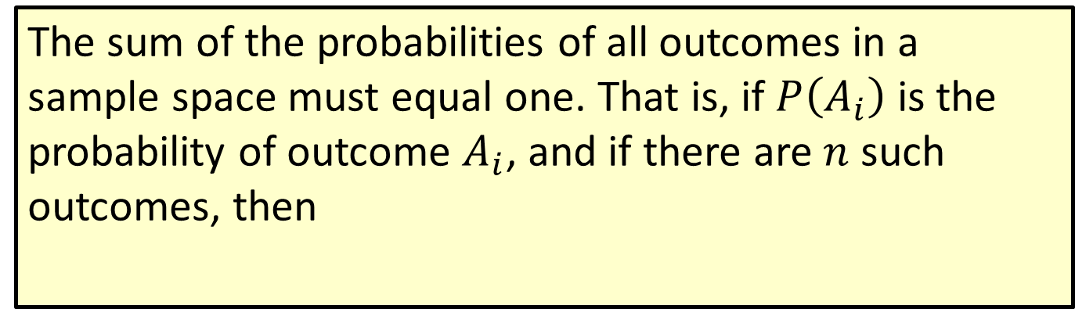
Definition: Probability Law 4
The sum of the probabilities of all outcomes in a sample space must equal one. That is, if $P\left(A_{i}\right)$ is the probability of outcome $A_{i}$, and if there are $n$ such outcomes, then

Slide 7
Addition Rules for Probability (cont.)
There are a number of rules concerning the relationships between events that are useful in determining probabilities.

Slide 8
Definition: Compound event
A compound event is an event that is defined by combining two or more events.

Slide 9
Addition Rules for Probability (cont.)
Suppose that the marketing director of Sports Illustrated believed that anyone who possessed an income greater than $50,000 or subscribed to more than one other sports magazine could potentially be a good prospect for a direct mail marketing campaign.

Slide 10
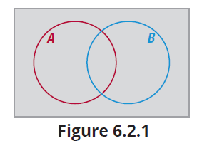
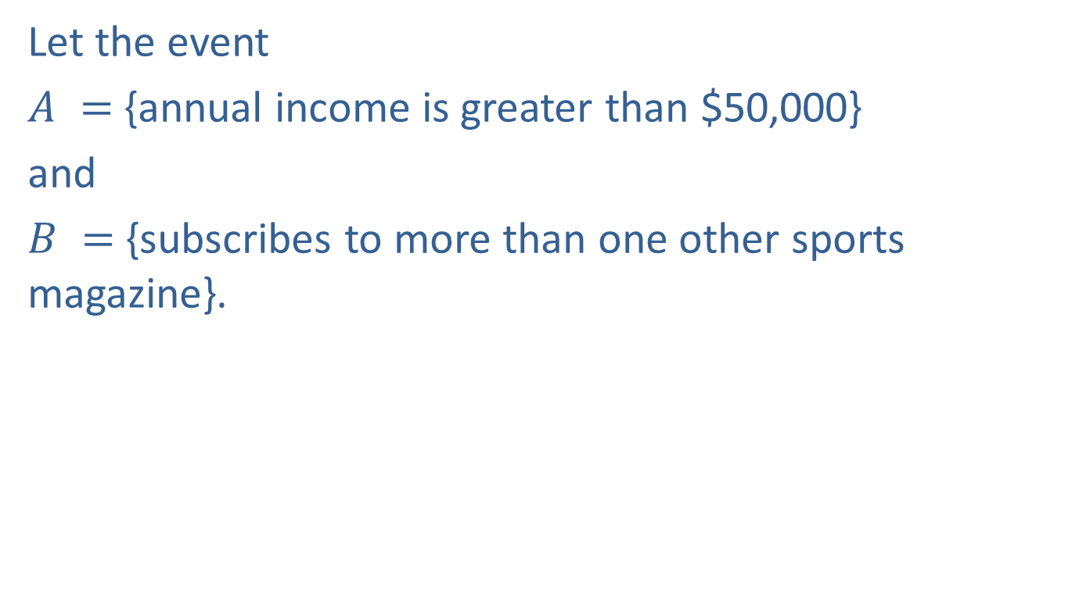
Addition Rules for Probability (cont.)
Let the event
$A =$ {annual income is greater than $50,000}
and
$B =$ {subscribes to more than one other sports magazine}.

Slide 11
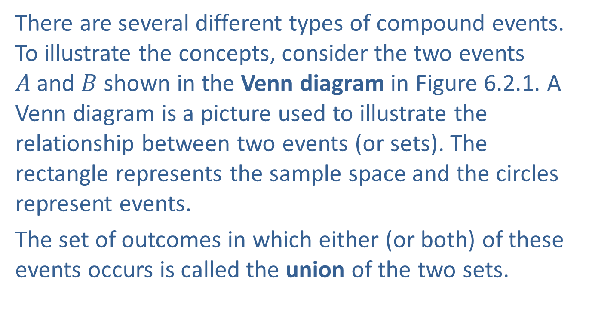
Addition Rules for Probability (cont.)
There are several different types of compound events. To illustrate the concepts, consider the two events $A$and $B$ shown in the Venn diagram in Figure 6.2.1. A Venn diagram is a picture used to illustrate the relationship between two events (or sets). The rectangle represents the sample space and the circles represent events.
The set of outcomes in which either (or both) of these events occurs is called the union of the two sets.

Slide 12
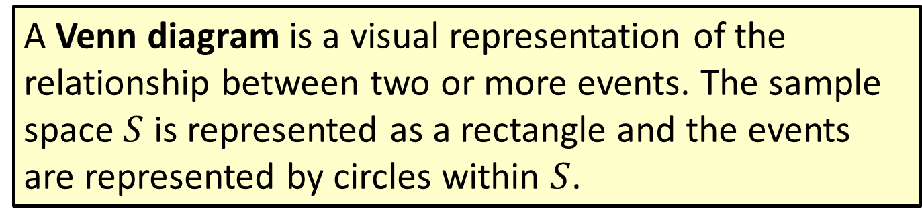
Definition: Venn Diagram
A Venn diagram is a visual representation of the relationship between two or more events. The sample space $S$ is represented as a rectangle and the events are represented by circles within $S$.

Slide 13
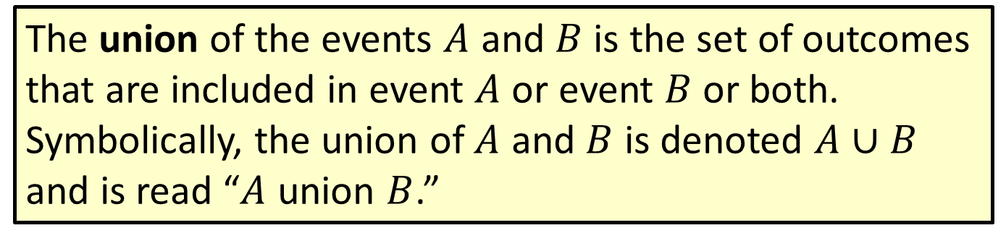
Definition: Union
The union of the events $A$ and $B$ is the set of outcomes that are included in event $A$ or event $B$ or both. Symbolically, the union of $A$ and $B$ is denoted $A$ ∪ $B$ and is read “$A$ union $B$.”

Slide 14
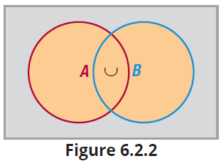

Addition Rules for Probability (cont.)
Notice in Figure 6.2.2 that the union includes all outcomes in either $A$ or $B$.

Slide 15
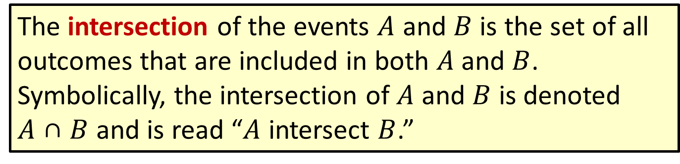
Definition: Intersection
The intersection of the events $A$ and $B$ is the set of all outcomes that are included in both $A$and $B$. Symbolically, the intersection of $A$ and $B$ is denoted
$A$ ∩ $B$ and is read “$A$ intersect $B$.”

Slide 16
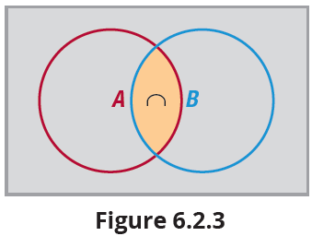

Addition Rules for Probability (cont.)
Suppose the marketing director was interested in persons who possessed an annual income greater than $50,000 and subscribed to more than one other sports magazine. That set would be called the intersection of $A$ and $B$.

Slide 17

Addition Rules for Probability (cont.)
Notice in Figure 6.2.3 that the intersection includes only those outcomes in both $A$ and $B$.
Two other useful concepts are the notions of complement of an event and events which are mutually exclusive.

Slide 18
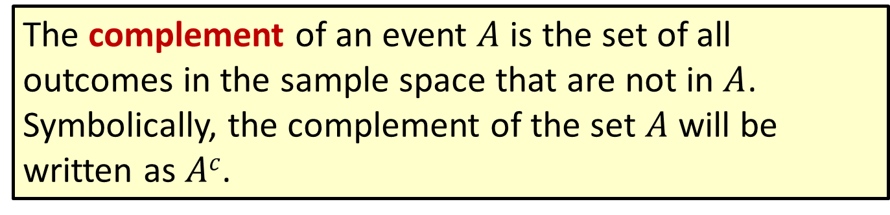
Definition: Complement
The complement of an event $A$ is the set of all outcomes in the sample space that are not in $A$. Symbolically, the complement of the set $A$ will be written as $Ac$.

Slide 19
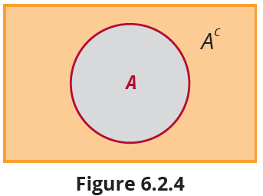

Addition Rules for Probability (cont.)
Notice in Figure 6.2.4 that the complement of event $A$ includes all outcomes which are not in $A$. For the event $A$ = {annual income is greater than $50,000}, the complement of $A$ would be

Slide 20
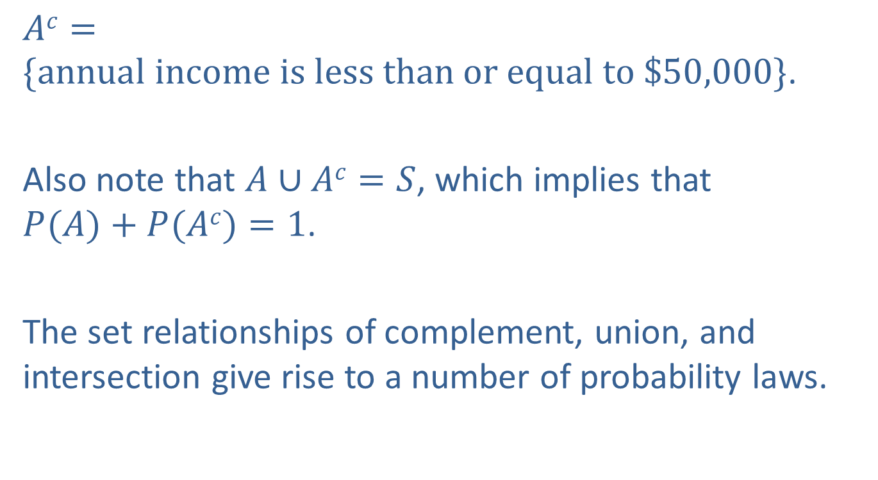
Addition Rules for Probability (cont.)
$Ac=\{annual income is less than or equal to \$50,000\}$.
Also note that $A∪Ac=S$, which implies that $P(A)+P(Ac)=1$.
The set relationships of complement, union, and intersection give rise to a number of probability laws.

Slide 21
Definition: Probability Law 5: Complement of an Event
The probability of $Ac$ is given by $P(Ac)=1−P(A).$

Slide 22
Addition Rules for Probability (cont.)
Sometimes it is much easier to compute the probability of the complement of an event, than the actual event.

Slide 23
Example 6.2.1: Finding the Probability of the Complement
Andrew Jackson was the seventh President of the United States and was involved in many duels—some have estimated as many as 100. Assume that Jackson did have 100 duels and each duel was a duel to the death in which each participant was equally likely to survive or not survive; in other words, the probability of surviving the duel is 0.5 and the probability of not surviving is 0.5.

Slide 24
Example 6.2.1: Finding the Probability of the Complement (cont.)
What is the probability that Jackson would not survive 100 duels?
Suppose Jackson was a quick and excellent marksman and the probability that he survives a duel is 0.95. What is the probability that Jackson would not survive as a result of 100 duels?
Do you believe that Andrew Jackson had 100 duels to the death?

Slide 25
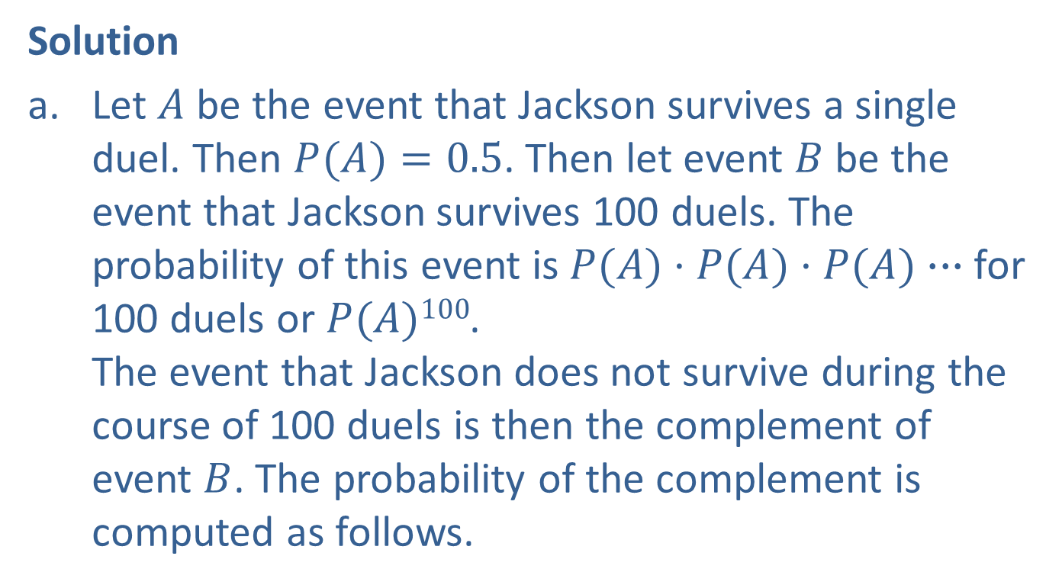
Example 6.2.1: Finding the Probability of the Complement (cont.)
Solution
Let $A$ be the event that Jackson survives a single duel. Then $P(A)=0.5$. Then let event $B$ be the event that Jackson survives 100 duels. The probability of this event is $P(A)·P(A)·P(A)∙∙∙$for 100 duels or $P(A)100$. The event that Jackson does not survive during the course of 100 duels is then the complement of event $B$. The probability of the complement is computed as follows.

Slide 26
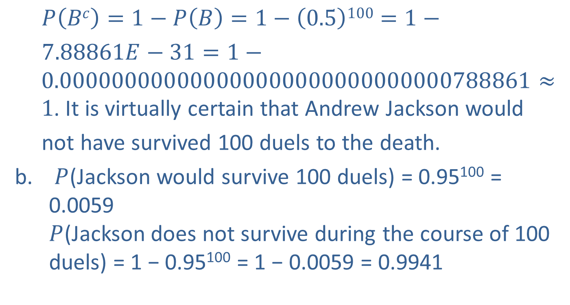
Example 6.2.1: Finding the Probability of the Complement (cont.)
$P\left(Bc\right)=1−P\left(B\right)=1−\left(0.5\right)100=1−$
$7.88861E−31=1− 0.000000000000000000000000000000788861≈ 1$. It is virtually certain that Andrew Jackson would
not have survived 100 duels to the death.
$P$(Jackson would survive 100 duels) = 0.95¹⁰⁰ = 0.0059 $P$(Jackson does not survive during the course of 100 duels) = 1 − 0.95¹⁰⁰ = 1 − 0.0059 = 0.9941

Slide 27
Example 6.2.1: Finding the Probability of the Complement (cont.)
If Andrew Jackson survived 100 duels, he literally was one of the luckiest men in America. This is an example of how probability plays a role in statistical inference. The fact that Jackson died of congestive heart failure at the age of 78 suggests that it is very unlikely he had 100 duels to the death.

Slide 28
Example 6.2.2: Finding a Probability Using the Complement
Consider an experiment to see how many tosses of a coin will be required to obtain the first head. The first head could be observed on the first toss or second toss, but there is no upper limit on the number of tosses that could be required. Therefore, the sample space for this experiment is the set of positive integers {1, 2, 3, ... }. Not only is the sample space infinitely large, but there is another problem: the outcomes are not equally likely. This is a potentially ugly environment in which to compute a probability.

Slide 29
Example 6.2.2: Finding a Probability Using the Complement (cont.)
But let’s make matters slightly worse. Suppose we want to know the probability that it will require at least two tosses (i.e., two or more tosses) to get the first head. This means that we must compute the probability of 2 tosses before the first head appears, the probability of 3 tosses to get the first head, and so on up to infinity and add them up in some way. The problem is rather insidious if approached directly.

Slide 30
Example 6.2.2: Finding a Probability Using the Complement (cont.)
Solution
The problem becomes rather trivial by determining the complement of the event and computing its probability. The complement of obtaining the first head in two or more tosses is getting a head on the first toss. The probability of getting a head on the first toss is 0.5, assuming the coin is fair. Therefore, we have the following.

Slide 31
Addition Rules for Probability (cont.)
As shown in the previous example, when you see the key words at least in a probability problem, you will often want to consider the complement to find the appropriate probability.
Another topic that is often discussed when talking about probability, and which involves the complement of an event, is odds, as in the odds of that horse winning the race are 3 to 1. You often hear this terminology at casinos and racetracks instead of statements about the probability of an event occurring. There are two types of odds often considered in gambling situations.

Slide 32
Definition: Odds
The odds in favor of an event A occurring is given by
The odds against an event A occurring is given by

Slide 33
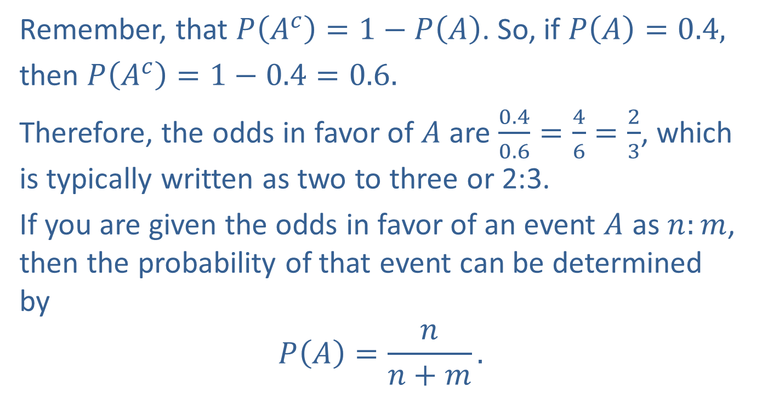
Addition Rules for Probability (cont.)
Remember, that $P\left(A^{c}\right)=1−P\left(A\right)$. So, if $P\left(A\right)=0.4,$
then $P\left(A^{c}\right)=1−0.4=0.6.$
Therefore, the odds in favor of $A$ are $\frac{0.4}{0.6}=\frac{4}{6}=\frac{2}{3}$, which is typically written as two to three or 2:3.
If you are given the odds in favor of an event $A$ as $n:m$, then the probability of that event can be determined by
$$P\left(A\right)=\frac{n}{n+m}.$$

Slide 34
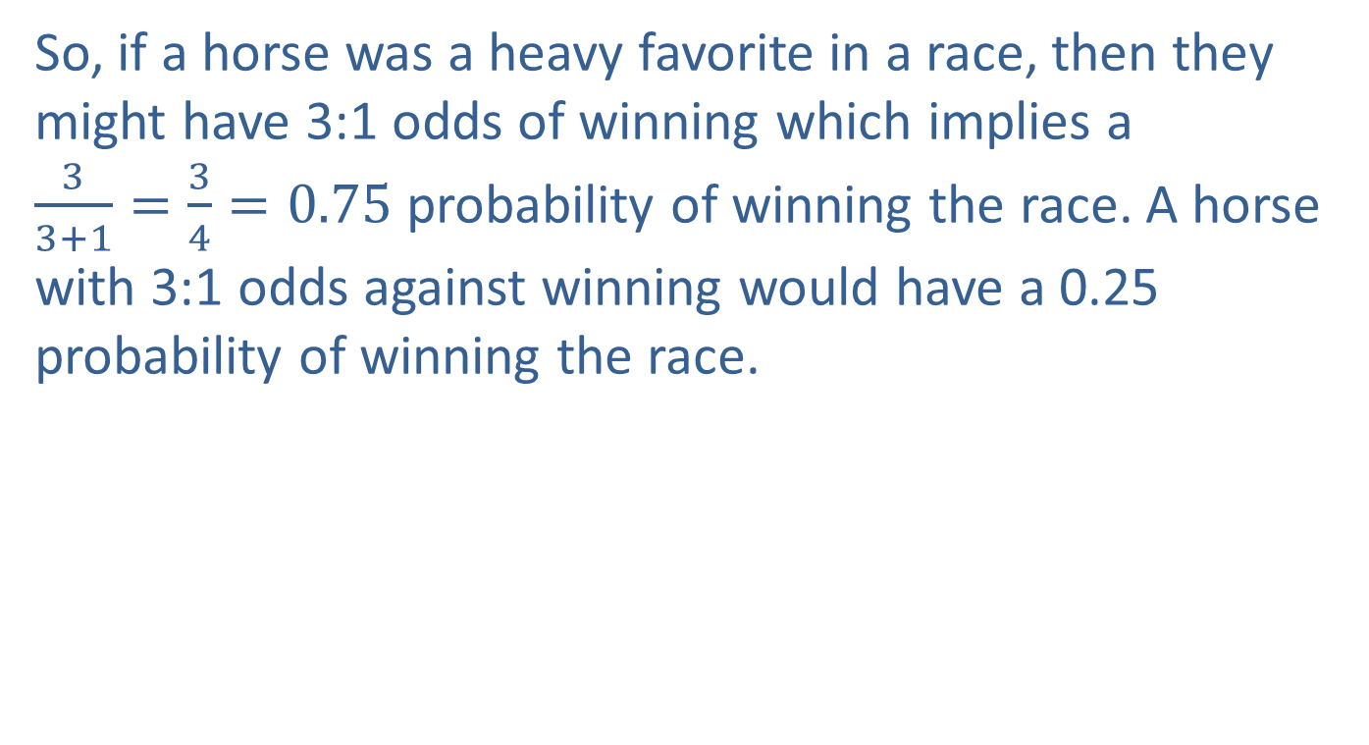
Addition Rules for Probability (cont.)
So, if a horse was a heavy favorite in a race, then they might have 3:1 odds of winning which implies a $\frac{3}{3+1}=\frac{3}{4}=0.75$ probability of winning the race. A horse with 3:1 odds against winning would have a 0.25 probability of winning the race.

Slide 35
Example 6.2.3: Determining Probabilities and Odds in Roulette
In the game of American roulette, the roulette wheel contains the numbers 1 through 36, alternating between red and black. There are two green spaces numbered 0 and 00.
Determine the probability of the roulette ball landing on a red pocket.
Determine the probability of the roulette ball not landing on a red pocket.
Determine the odds in favor of the roulette ball landing on red.

Slide 36
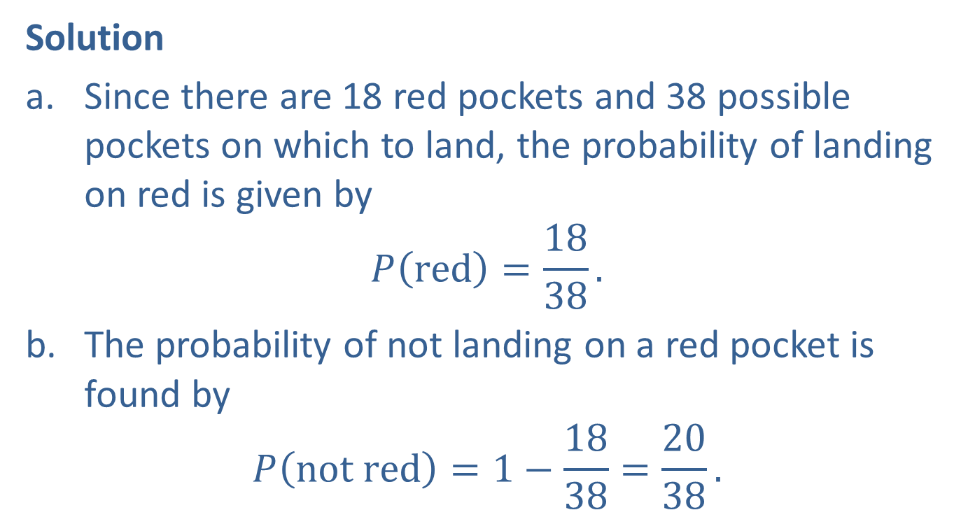
Example 6.2.3: Determining Probabilities and Odds in Roulette (cont.)
Solution
Since there are 18 red pockets and 38 possible pockets on which to land, the probability of landing on red is given by
$$P\left(red\right)=\frac{18}{38}.$$
The probability of not landing on a red pocket is found by
$$P\left(not red\right)=1−\frac{18}{38}=\frac{20}{38}.$$

Slide 37
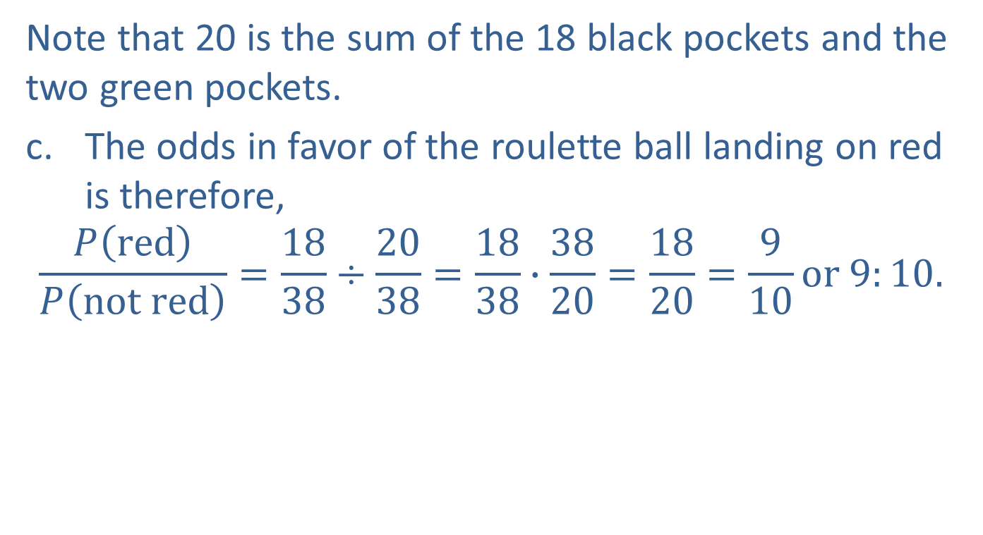
Example 6.2.3: Determining Probabilities and Odds in Roulette (cont.)
Note that 20 is the sum of the 18 black pockets and the two green pockets.
The odds in favor of the roulette ball landing on red is therefore,
$$\frac{P\left(red\right)}{P\left(not red\right)}=\frac{18}{38}÷\frac{20}{38}=\frac{18}{38}∙\frac{38}{20}=\frac{18}{20}=\frac{9}{10}or 9:10.$$

Slide 38
Addition Rules for Probability (cont.)
Another idea that is helpful in determining probabilities is the notion of mutual exclusivity.

Slide 39
Definition: Mutually Exclusive
Two events are mutually exclusive if they have no outcomes in common.

Slide 40
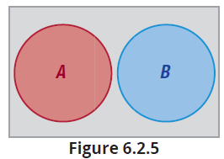
Addition Rules for Probability (cont.)
Mutual exclusivity is also called disjointedness. Figure 6.2.5 represents two disjoint events.

Slide 41
Definition: Probability Law 6: Union of Mutually Exclusive Events
If the events A and B are mutually exclusive, then

Slide 42
Definition: Probability Law 7: Intersection of Mutually Exclusive Events
If the events A and B are mutually exclusive, then

Slide 43
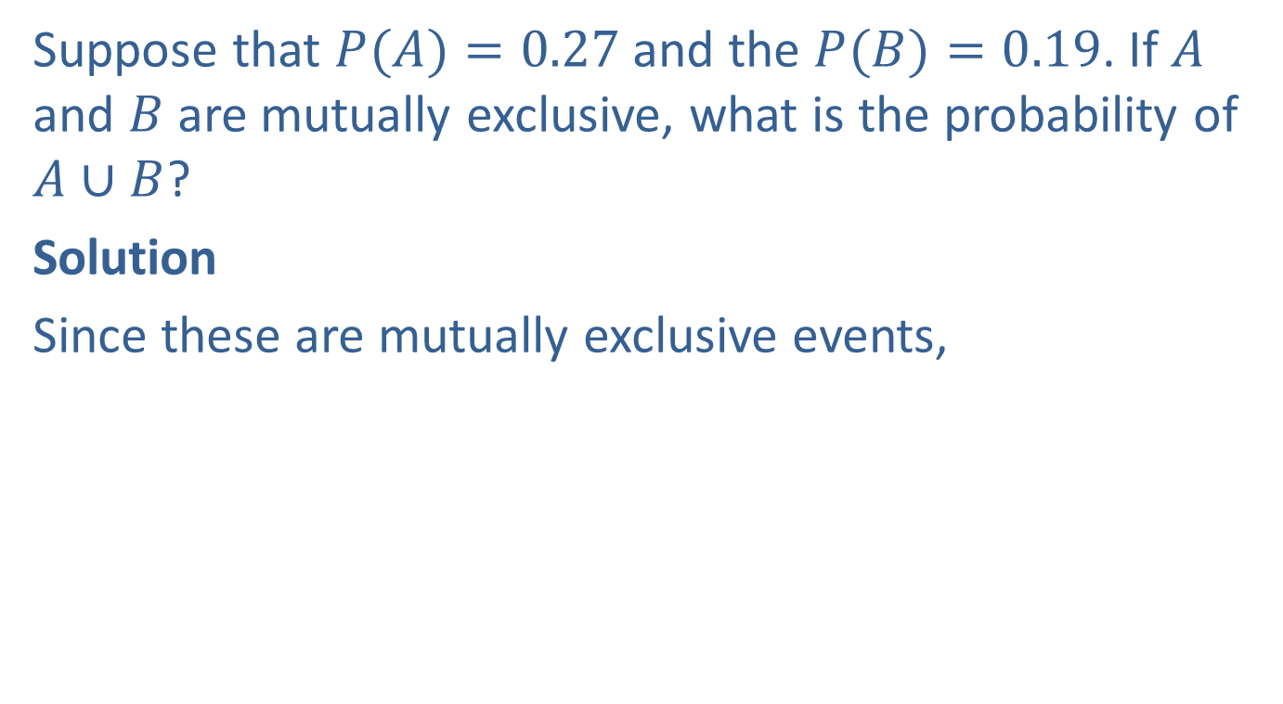
Example 6.2.4: Calculating the Probability of the Union of Mutually Exclusive Events
Suppose that $P(A)=0.27$and the $P(B)=0.19$. If $A$ and $B$ are mutually exclusive, what is the probability of $A$ ∪ $B$?
Solution
Since these are mutually exclusive events,

Slide 44
Addition Rules for Probability (cont.)
There is a more generalized rule that eliminates the assumption of exclusivity between the events.

Slide 45
Definition: Probability Law 8: The General Addition Rule
For any two events A and B,

Slide 46
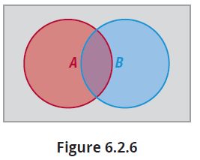
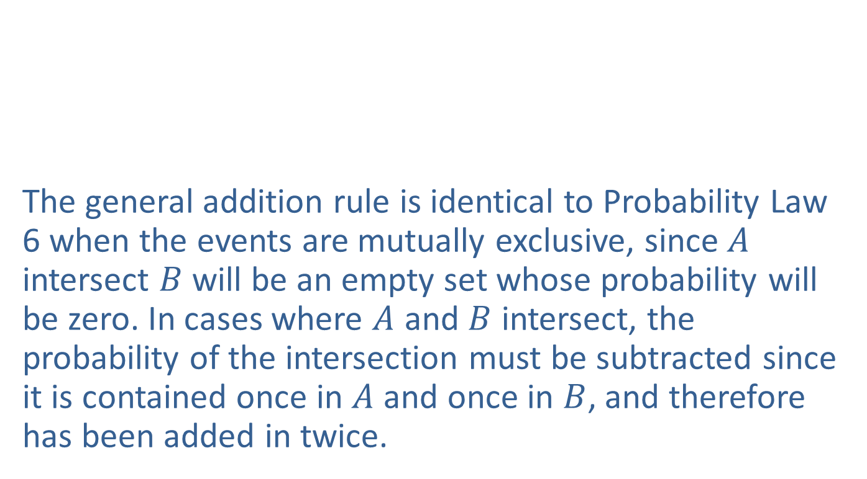
Addition Rules for Probability (cont.)
The general addition rule is identical to Probability Law 6 when the events are mutually exclusive, since $A$ intersect $B$ will be an empty set whose probability will be zero. In cases where $A$ and $B$ intersect, the probability of the intersection must be subtracted since it is contained once in $A$ and once in $B$, and therefore has been added in twice.

Slide 47
Example 6.2.4: Calculating the Probability of the Union of Two Events
Suppose that the marketing manager mentioned earlier believed that the probability that someone earns more than $50,000 is 0.2 and the probability that someone will subscribe to more than one sports magazine is 0.3. If the probability of finding someone in both categories is 0.08, what is the probability of finding someone who is earning over $50,000 or subscribes to more than one sports magazine?

Slide 48
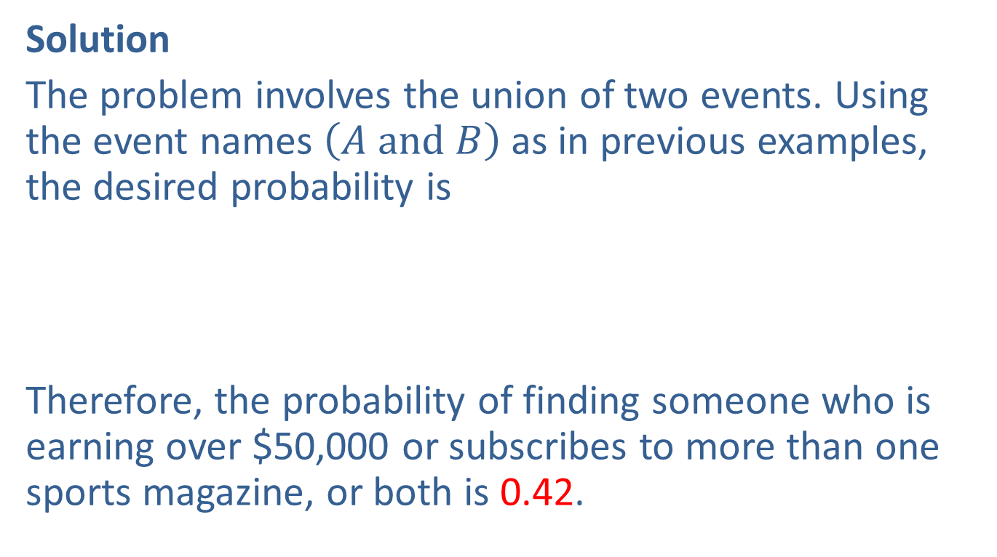
Example 6.2.4: Calculating the Probability of the Union of Two Events (cont.)
Solution
The problem involves the union of two events. Using the event names $\left(A and B\right)$ as in previous examples, the desired probability is
Therefore, the probability of finding someone who is earning over $50,000 or subscribes to more than one sports magazine, or both is 0.42.

