Slide 1
Section 6.1
Introduction to Probability

Slide 2
Introduction to Probability
Games of chance, such as tossing a coin, provide a way to demonstrate some of the fundamental laws (rules) of probability. In the language of probability, the playing of the game is called an experiment.

Slide 3
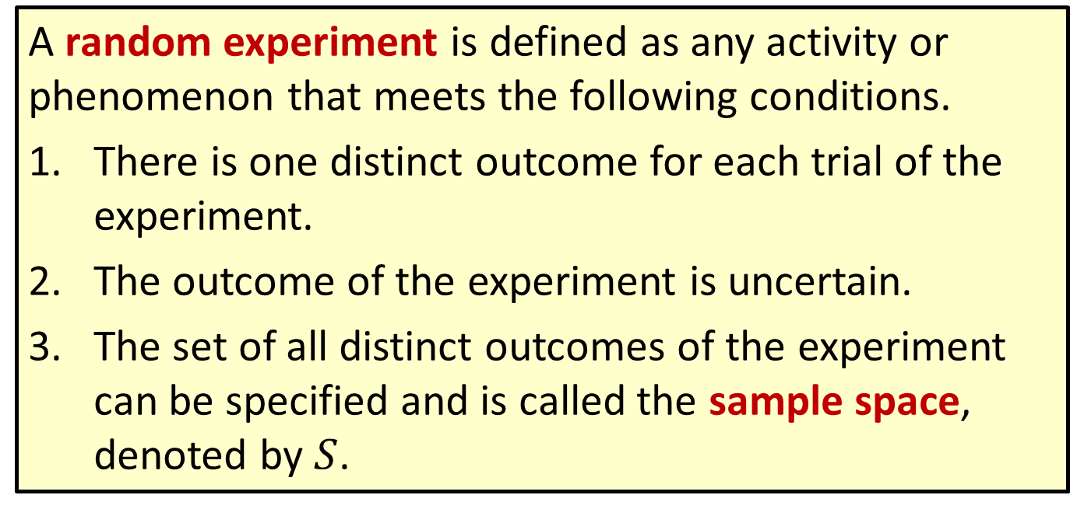
Definition: Random Experiment
A random experiment is defined as any activity or phenomenon that meets the following conditions.
There is one distinct outcome for each trial of the experiment.
The outcome of the experiment is uncertain.
The set of all distinct outcomes of the experiment can be specified and is called the sample space, denoted by $S$.

Slide 4
Definition: Outcome
An outcome is any member of the sample space.

Slide 5
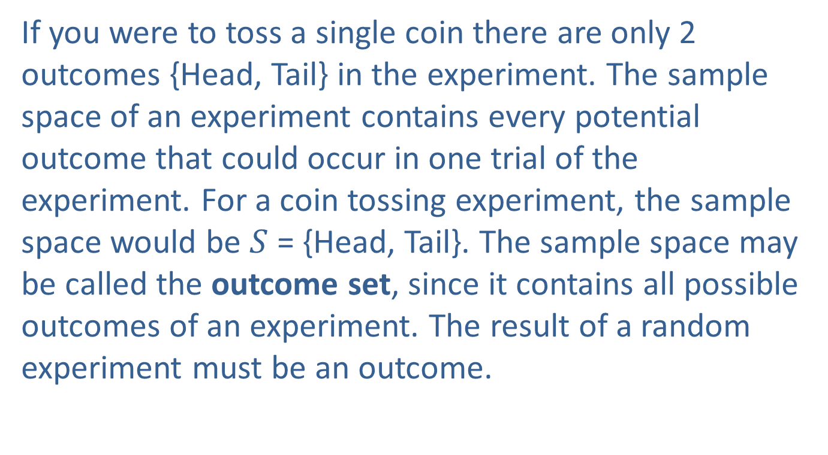
Introduction to Probability (cont.)
If you were to toss a single coin there are only 2 outcomes {Head, Tail} in the experiment. The sample space of an experiment contains every potential outcome that could occur in one trial of the experiment. For a coin tossing experiment, the sample space would be $S$ = {Head, Tail}. The sample space may be called the outcome set, since it contains all possible outcomes of an experiment. The result of a random experiment must be an outcome.

Slide 6
Definition: Event
An event is a set of outcomes.

Slide 7
Introduction to Probability (cont.)
Examples of random experiments, events, and outcomes will be used throughout the chapter to illustrate the laws of probability.
Experiment 1: Toss a coin and observe the outcome. Have we met the three conditions of a random experiment?
There will only be one outcome for each trial of the experiment since it is not possible to observe both a head and a tail on the same toss.

Slide 8
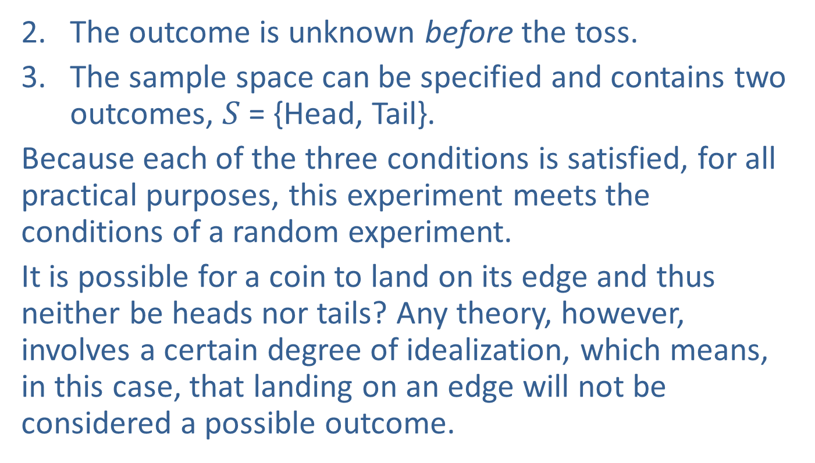
Introduction to Probability (cont.)
The outcome is unknown before the toss.
The sample space can be specified and contains two outcomes, $S$ = {Head, Tail}.
Because each of the three conditions is satisfied, for all practical purposes, this experiment meets the conditions of a random experiment.
It is possible for a coin to land on its edge and thus neither be heads nor tails? Any theory, however, involves a certain degree of idealization, which means, in this case, that landing on an edge will not be considered a possible outcome.

Slide 9
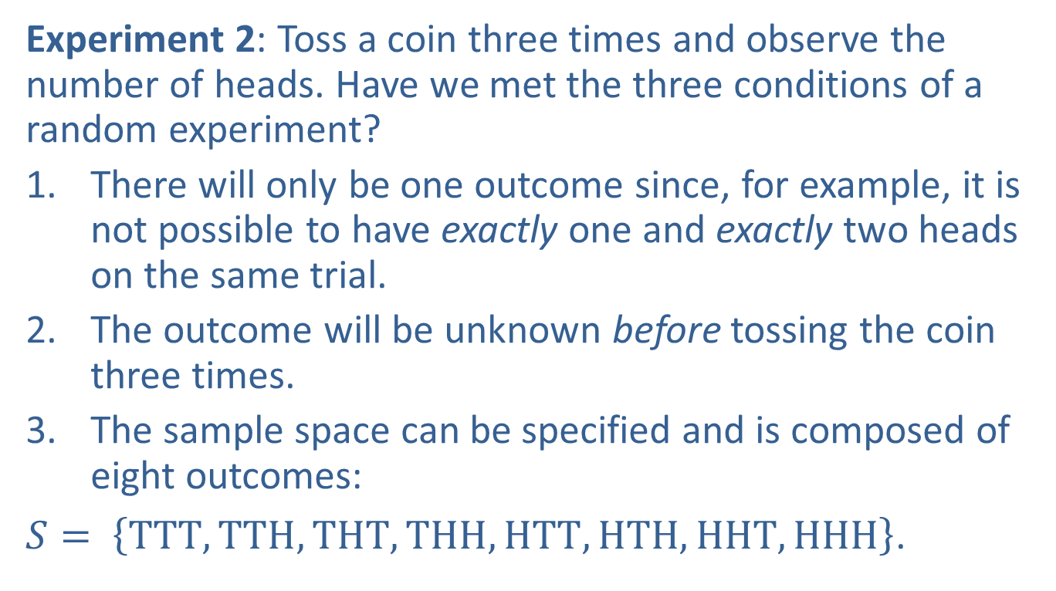
Introduction to Probability (cont.)
Experiment 2: Toss a coin three times and observe the number of heads. Have we met the three conditions of a random experiment?
There will only be one outcome since, for example, it is not possible to have exactly one and exactly two heads on the same trial.
The outcome will be unknown before tossing the coin three times.
The sample space can be specified and is composed of eight outcomes:
$S= \left\{TTT, TTH, THT, THH, HTT, HTH, HHT, HHH\right\}$.

Slide 10
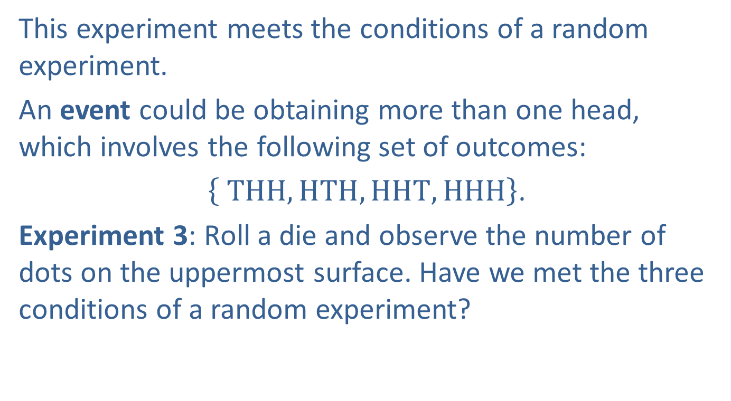
Introduction to Probability (cont.)
This experiment meets the conditions of a random experiment.
An event could be obtaining more than one head, which involves the following set of outcomes:
$\left\{ THH, HTH, HHT, HHH\right\}$.
Experiment 3: Roll a die and observe the number of dots on the uppermost surface. Have we met the three conditions of a random experiment?

Slide 11
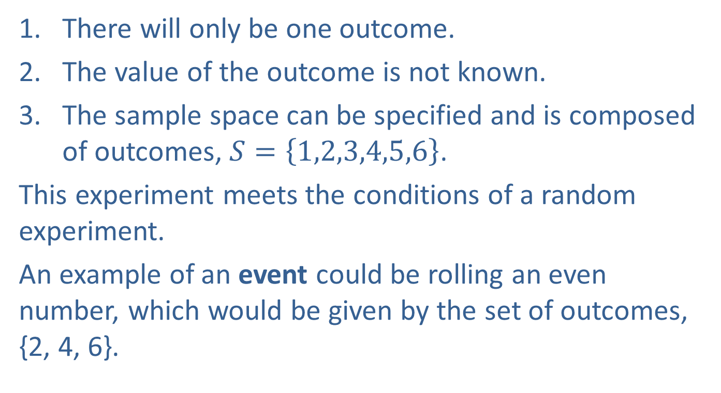
Introduction to Probability (cont.)
There will only be one outcome.
The value of the outcome is not known.
The sample space can be specified and is composed of outcomes, $S=\left\{1,2,3,4,5,6\right\}$.
This experiment meets the conditions of a random experiment.
An example of an event could be rolling an even number, which would be given by the set of outcomes, {2, 4, 6}.

Slide 12
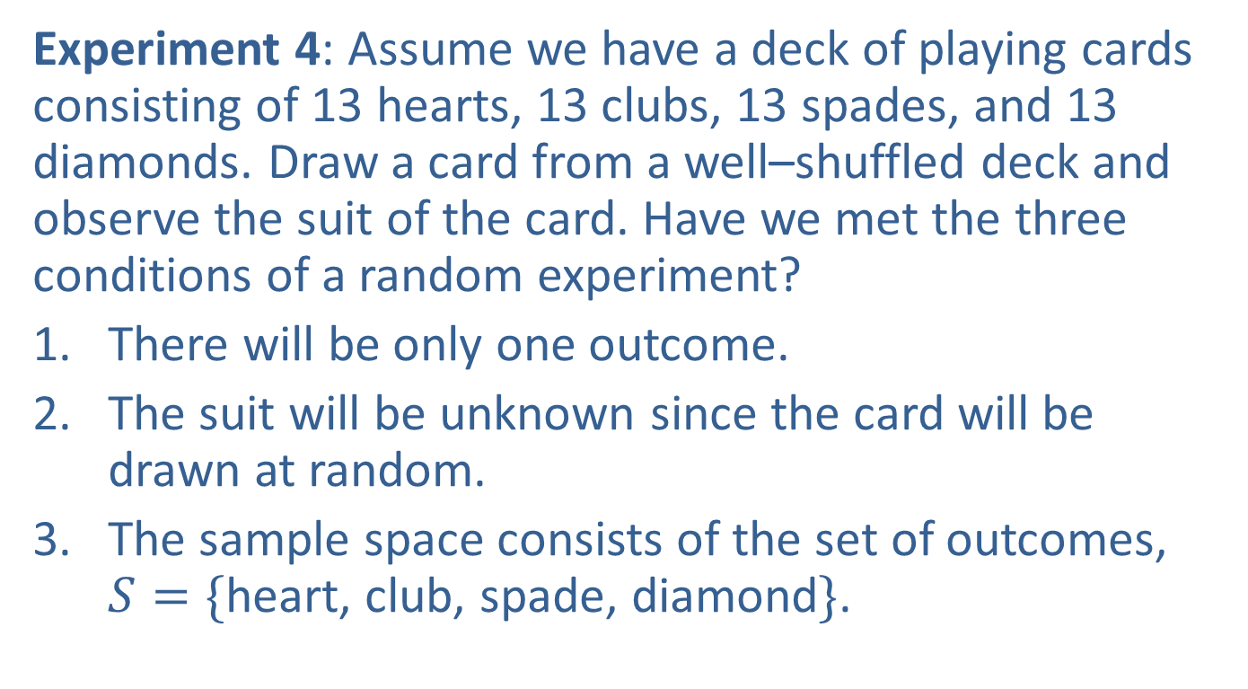
Introduction to Probability (cont.)
Experiment 4: Assume we have a deck of playing cards consisting of 13 hearts, 13 clubs, 13 spades, and 13 diamonds. Draw a card from a well–shuffled deck and observe the suit of the card. Have we met the three conditions of a random experiment?
There will be only one outcome.
The suit will be unknown since the card will be drawn at random.
The sample space consists of the set of outcomes, $S=\{$heart, club, spade, diamond$\}$.

Slide 13
Introduction to Probability (cont.)
This experiment meets the conditions of a random experiment.
If the random experiment involves drawing a card and observing a spade or a club, then the event would be given by the set of outcomes, {spade, club}.
Experiment 5: Inspect a transistor to determine if it meets quality control standards. Have we met the three conditions of a random experiment?

Slide 14
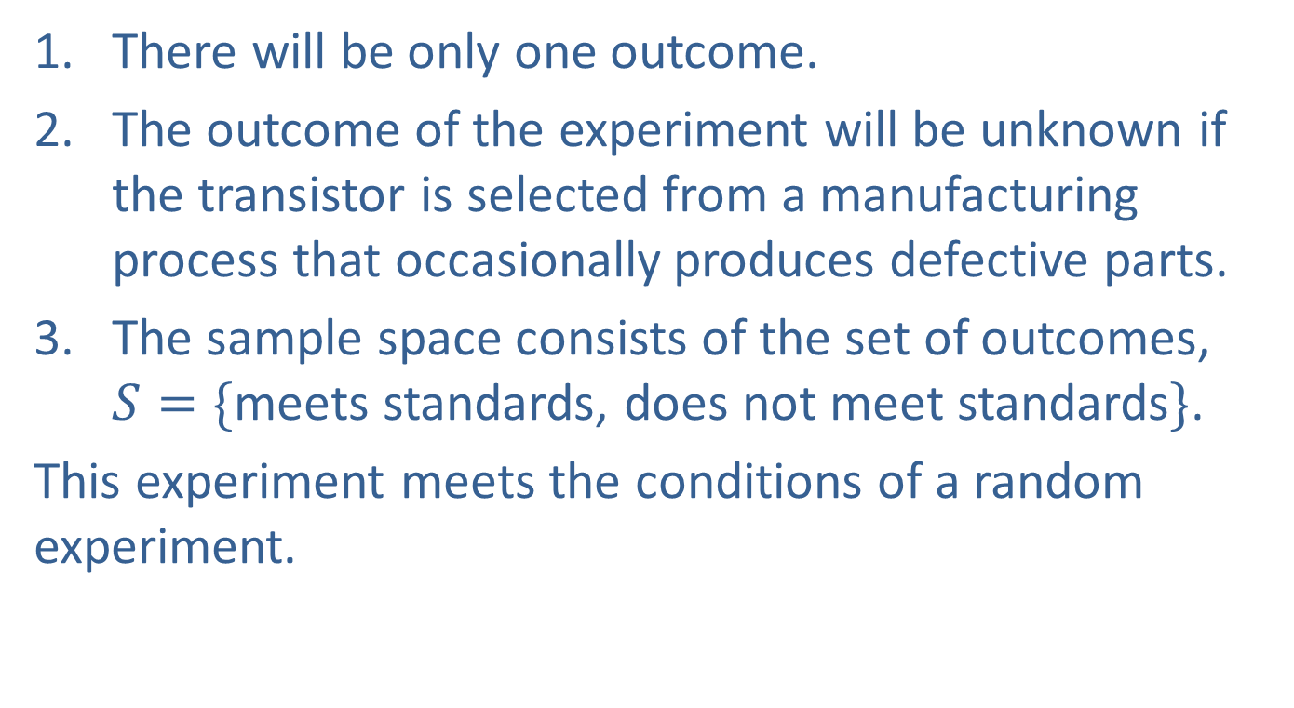
Introduction to Probability (cont.)
There will be only one outcome.
The outcome of the experiment will be unknown if the transistor is selected from a manufacturing process that occasionally produces defective parts.
The sample space consists of the set of outcomes, $S=\{$meets standards, does not meet standards$\}$.
This experiment meets the conditions of a random experiment.

Slide 15
What Is Probability?
There are several competing ideas which seek to define the interpretation of probability, similar to the competing ideas which define the notion of central tendency (mean, median, mode, trimmed mean). In fact, there is a substantial conflict of ideas between the notions of statistical regularity and degree of belief. No simple answer exists for the question, what is probability? Probability remains an abstract concept for which there is no true meaning.

Slide 16
What Is Probability? (cont.)
Fortunately, the theory of probability does not require the interpretation of probabilities, just as in geometry, the interpretation of points, lines, and planes are irrelevant.
We will first discuss the two types of objective probabilities, the relative frequency approach and the classical approach. Afterwards, we will talk about the subjective approach to probability.

Slide 17
Relative Frequency Approach
Someone who wanted to determine the probability of getting a head on the toss of a coin could toss a coin a large number of times and observe the number of times that a head appeared. The probability could be computed as the number of times a head was observed divided by the number of times the coin was flipped. This is the relative frequency interpretation of probability.

Slide 18
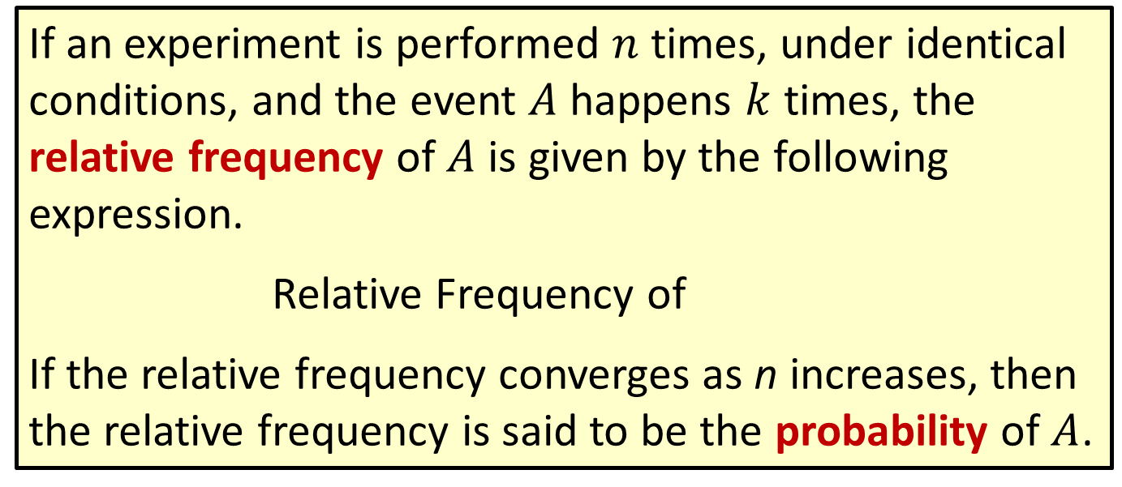
Definition: Relative Frequency Definition of Probability
If an experiment is performed $n$ times, under identical conditions, and the event $A$ happens $k$ times, the relative frequency of $A$ is given by the following expression.
Relative Frequency of
If the relative frequency converges as n increases, then the relative frequency is said to be the probability of $A$.

Slide 19
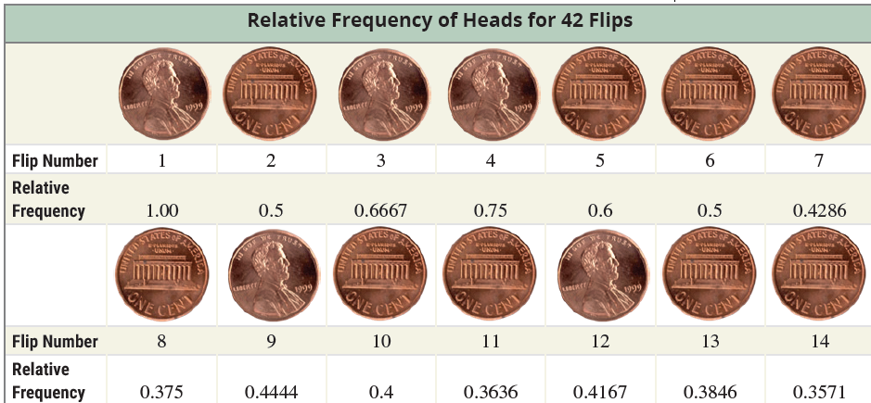
Relative Frequency Approach (cont.)
Let’s flip a coin 42 times and observe the relative frequency of a head during those tosses.

Slide 20
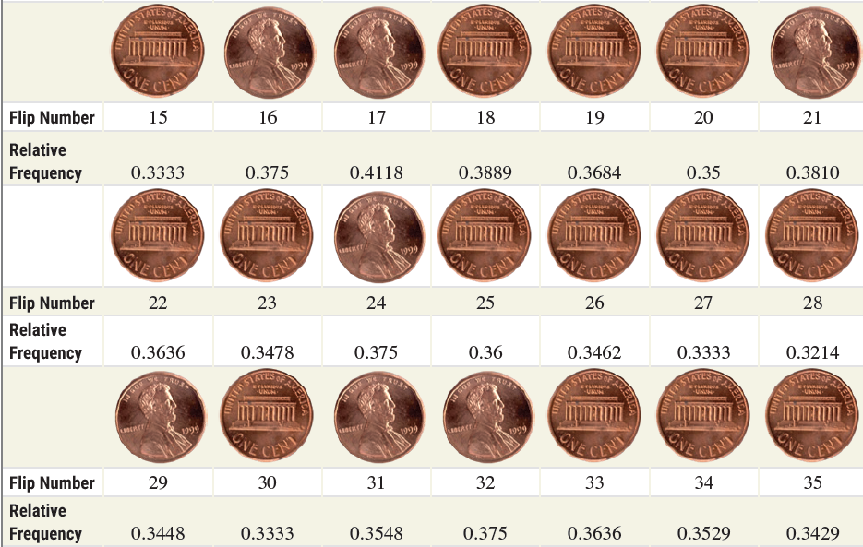
Relative Frequency Approach (cont.)

Slide 21
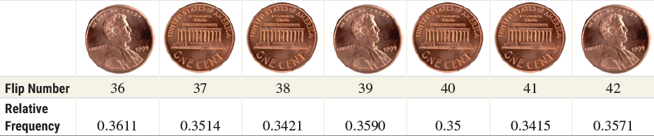
Relative Frequency Approach (cont.)
In Figure 6.1.1, you can see that the proportion of heads is very unstable during the first 15 flips. The proportion of heads begins to stabilize at around flip 20, although there is still some fluctuation in its value. Looking at the first 42 flips makes you wonder whether this is a “fair” coin, since heads is occurring only 0.3571(100)=35.71% of the time.

Slide 22
Relative Frequency Approach (cont.)
In Figure 6.1.2, which starts at about 200 flips, the proportion of heads becomes very stable. By flip number 296, there are 141 heads and 155 tails which equate to approximately a 0.4764 probability (or relative frequency) of heads. Although this is slightly less than the expected 0.5 for a “fair” coin, such a proportion is reasonable considering the randomness of the coin toss.

Slide 23
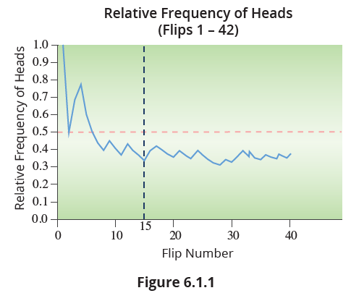
Relative Frequency Approach (cont.)

Slide 24
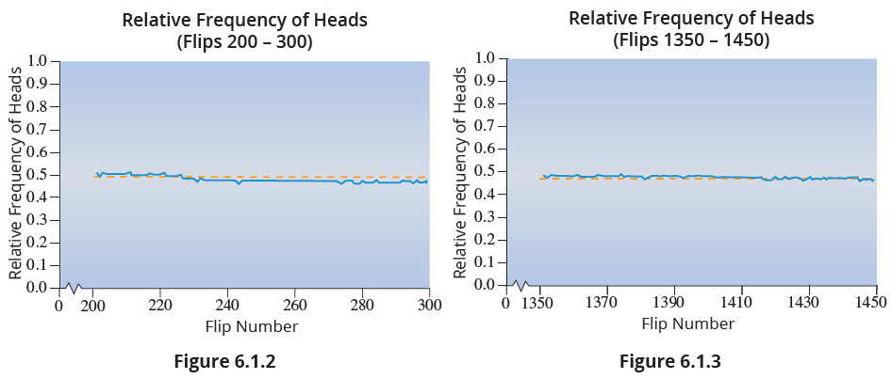
Relative Frequency Approach (cont.)

Slide 25
Relative Frequency Approach (cont.)
As can be seen in Figure 6.1.2 and Figure 6.1.3, the proportion of heads converges on some point which is close to 0.5. Figure 6.1.3 starts at about 1350 flips. As you can see, the proportion of heads remains very stable. At flip number 1450, there are 718 heads and 732 tails which equate to approximately a 0.4952 probability (or relative frequency) of heads.

Slide 26
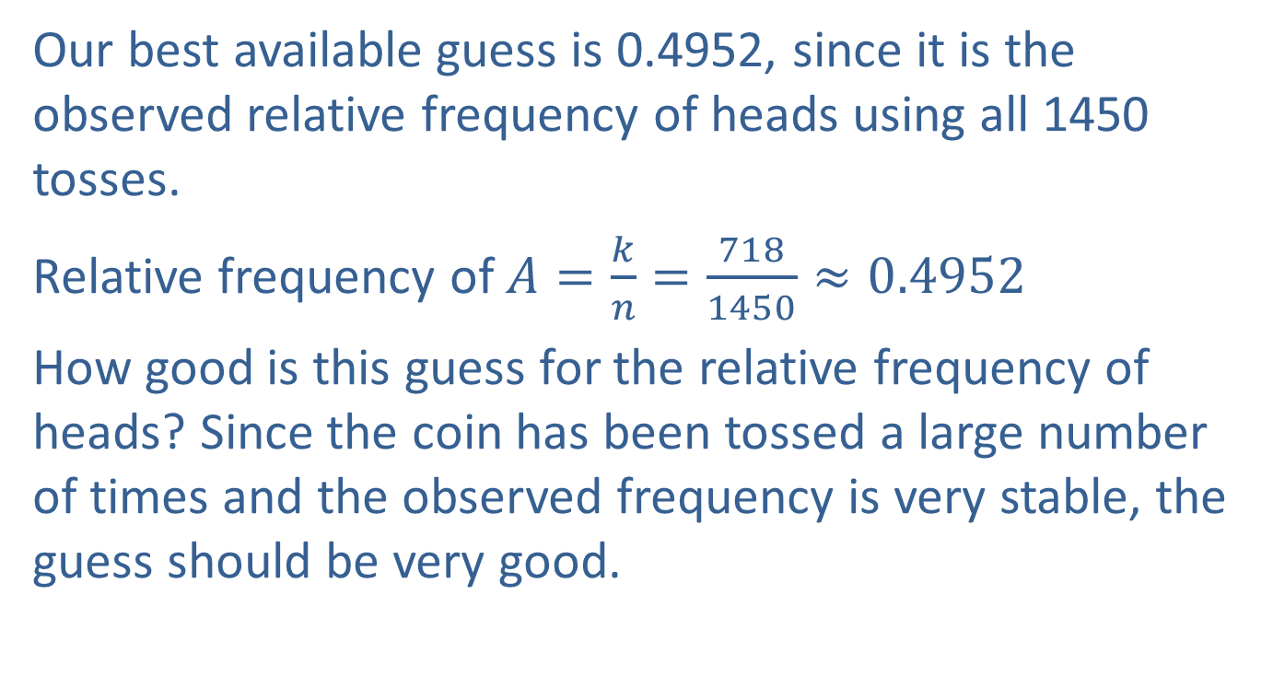
What is the Relative Frequency of a Head on Our Coin?
Our best available guess is 0.4952, since it is the observed relative frequency of heads using all 1450 tosses.
Relative frequency of $A=\frac{k}{n}=\frac{718}{1450}≈0.4952$
How good is this guess for the relative frequency of heads? Since the coin has been tossed a large number of times and the observed frequency is very stable, the guess should be very good.

Slide 27
Will the Observed Relative Frequency Ever Reach 0.5?
No mathematical or physical law requires the observed relative frequency to ever reach some predetermined level. But if the probability of observing a head was really 0.5, the observed relative frequency should closely approach this value after a large number of flips.

Slide 28
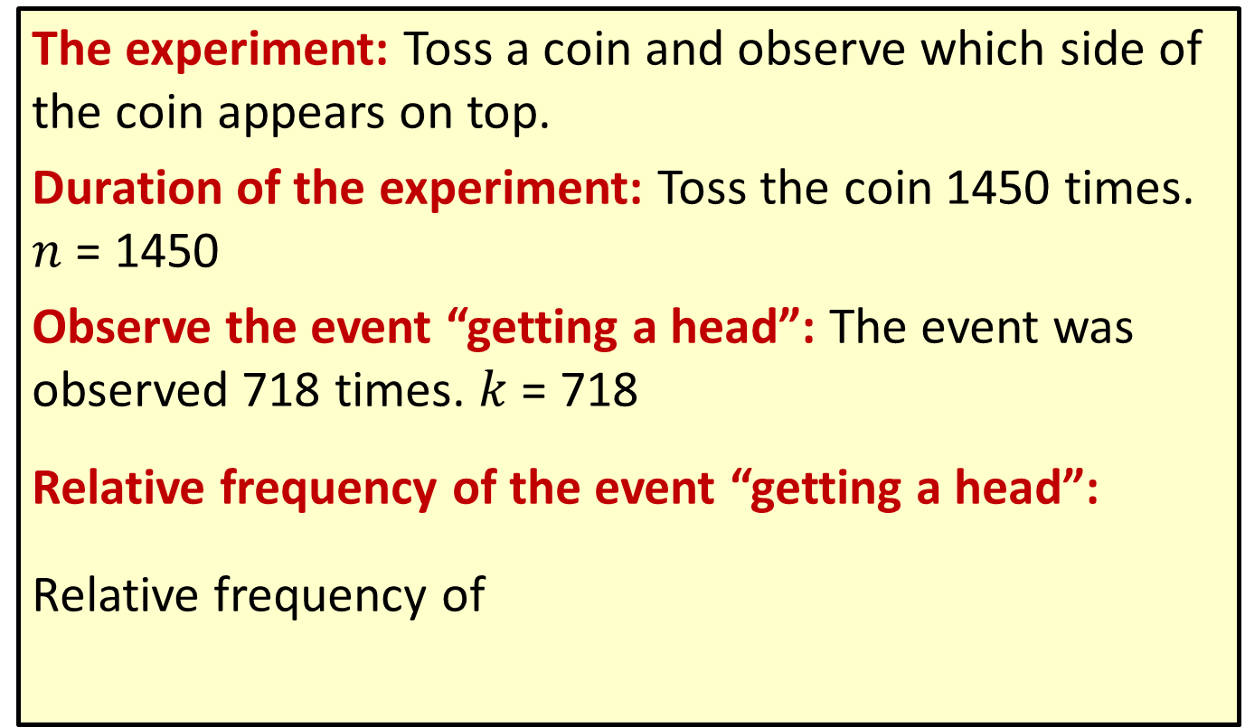
Summary
The experiment: Toss a coin and observe which side of the coin appears on top.
Duration of the experiment: Toss the coin 1450 times. $n$ = 1450
Observe the event “getting a head”: The event was observed 718 times. $k$ = 718
Relative frequency of the event “getting a head”:
Relative frequency of

Slide 29
Will the Observed Relative Frequency Ever Reach 0.5? (cont.)
The relative frequency of a head seems to converge to the expected relative frequency of 0.5. This kind of convergence is sometimes called statistical regularity. Although the outcomes of the experiment may vary, in the long run the relative frequency of an outcome tends to some value, its probability. In probability theory this property is often stated as the law of large numbers.

Slide 30
Definition: Law of Large Numbers
As the number of repetitions of an experiment increases, the relative frequency of an event tends to approach the actual probability.

Slide 31
Definition: Statistical Regularity
The belief that random events will exhibit regularity (i.e., when repeated enough times, the relative frequency of the outcomes of the experiment will approximate the true probability of the outcomes) is referred to as statistical regularity.

Slide 32
Problems with the Relative Frequency Approach
The problem with the relative frequency approach to defining probability is that probability only exists for events that can be repeated under the same conditions. Coin, dice, and card experiments can easily be repeated. However, because of the strict requirements of identical and repeatable experiments, many events in which it would be desirable to have relative frequency probabilities do not satisfy the requirement of identical repetition.

Slide 33
Problems with the Relative Frequency Approach (cont.)
Whether the next satellite launch will be successful, or whether you will make an A in your statistics course are examples of experiments that are not repeatable under the exact same conditions. Thus, they are not appropriate for the application of the relative frequency idea. This perspective greatly limits the application of the relative frequency interpretation of probability. Despite its limitations, the relative frequency approach is a widely held interpretation of probability.

Slide 34
Classical Approach
The second objective approach commonly used in probability is the classical approach. Classical probability can be measured as a simple proportion: the number of outcomes that compose the event divided by the number of outcomes in the sample space, when it can be assumed that all of the outcomes are equally likely.

Slide 35
Caution
When using the classical approach, always ensure that each outcome in the sample space is equally likely to occur.

Slide 36
Definition: Classical Probability
Using the classical approach to probability, the probability of an event A, denoted P(A), is given by

Slide 37
Example 6.1.1: Determining Classical Probability in a
Coin Experiment
In Experiment 2, a coin was tossed three times and the number of heads was observed. The sample space consists of 8 outcomes {HHH, HHT, HTH, HTT, THH, THT, TTH, TTT}. Let A be the event of getting at least one head. What is P(A)?
Solution
Since the event A consists of 7 outcomes, {HHH, HHT, HTH, HTT, THH, THT, TTH}, and there are 8 equally likely outcomes in the sample space,

Slide 38
Classical Approach (cont.)
In the previous example it was very easy to list the sample space of the experiment using a pattern to organize the outcomes. For experiments in which the sample space is large, it may be more difficult to ensure that no outcomes are omitted in the list. When an experiment, like the one above, is done in stages (each coin toss could be considered a stage), a tree diagram can be used to organize the outcomes in a systematic manner.

Slide 39
Classical Approach (cont.)
The tree begins with the possible outcomes for the first stage and then branches extend from each of these outcomes for the possible outcomes in the second stage, and so on for each stage of the experiment. The sample space is found by following each branch of the tree to identify all the possible outcomes of the experiment.

Slide 40
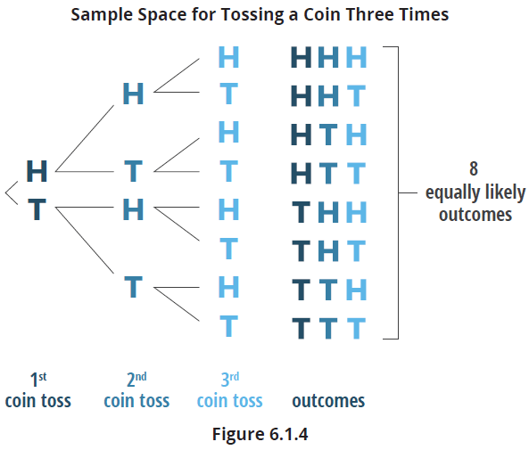
Classical Approach (cont.)
For Experiment 2, the tree diagram of the experiment and the subsequent sample space is illustrated by the following figure.

Slide 41
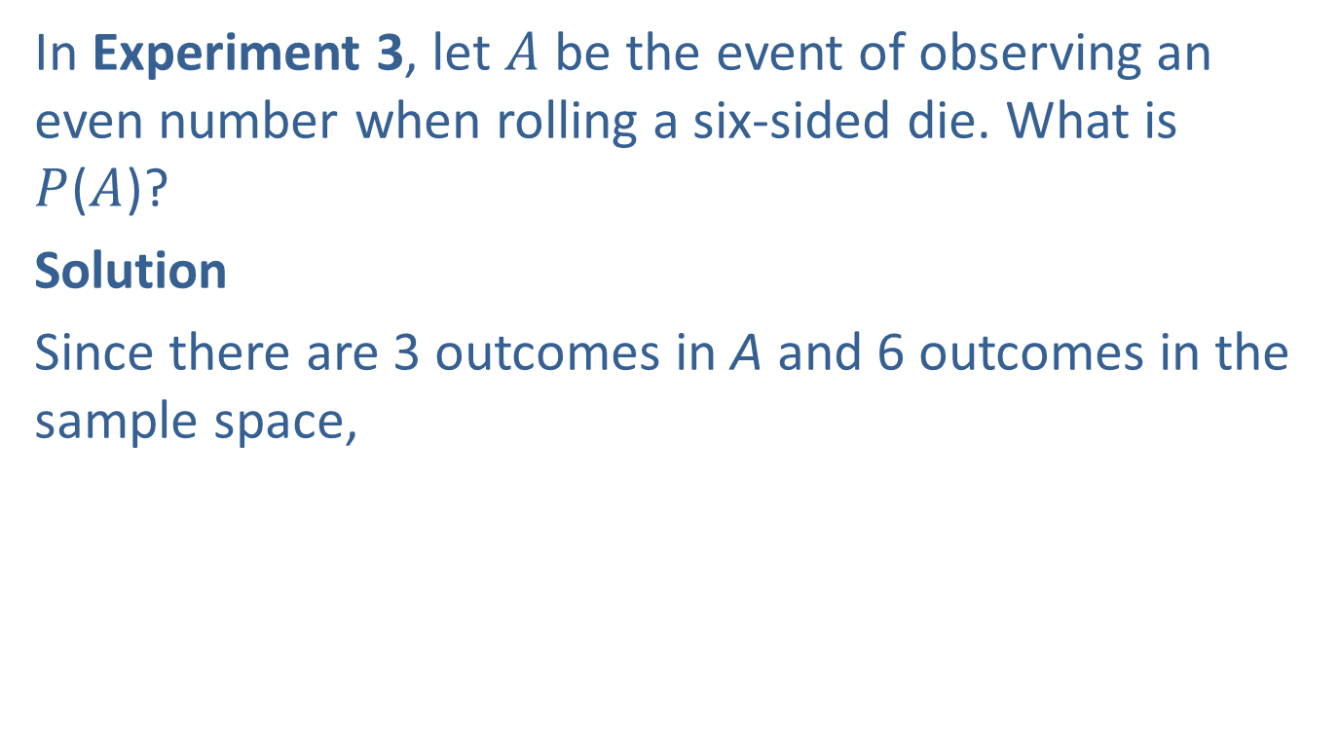
Example 6.1.2: Determining Classical Probability in a Die Roll Experiment
In Experiment 3, let $A$ be the event of observing an even number when rolling a six-sided die. What is $P$($A$)?
Solution
Since there are 3 outcomes in A and 6 outcomes in the sample space,

Slide 42
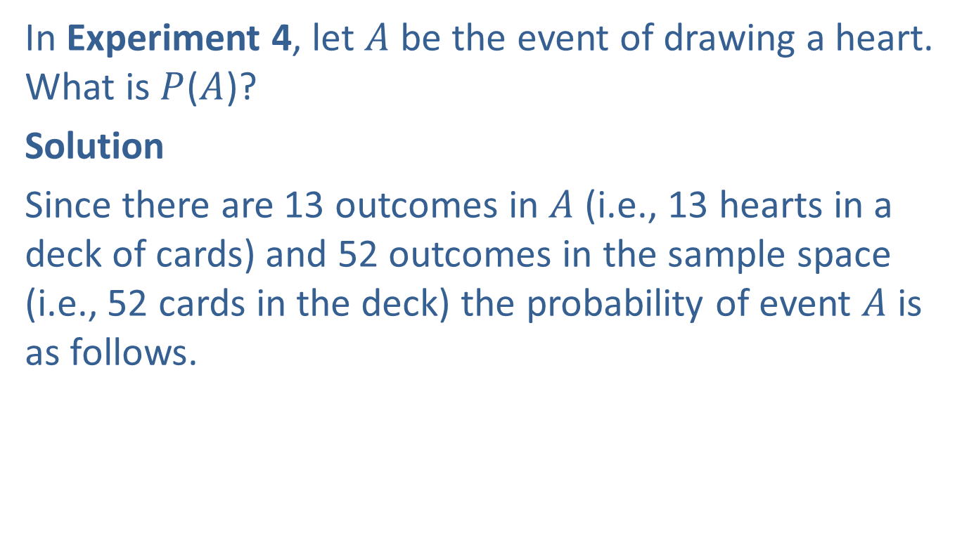
Example 6.1.3: Determining Classical Probability in a Die Roll Experiment
In Experiment 4, let $A$ be the event of drawing a heart. What is $P$($A$)?
Solution
Since there are 13 outcomes in $A$ (i.e., 13 hearts in a deck of cards) and 52 outcomes in the sample space (i.e., 52 cards in the deck) the probability of event $A$ is as follows.

Slide 43
Classical Approach (cont.)
If the sample space is composed of equally likely outcomes, then once the set of outcomes is determined, computing a probability is simply a matter of counting the members in each set and dividing by the total number of outcomes.
It is very important to remember that the classical approach rests on the assumption of equally likely outcomes. If the assumption is not reasonable, some other method of determining the probability must be used.

Slide 44
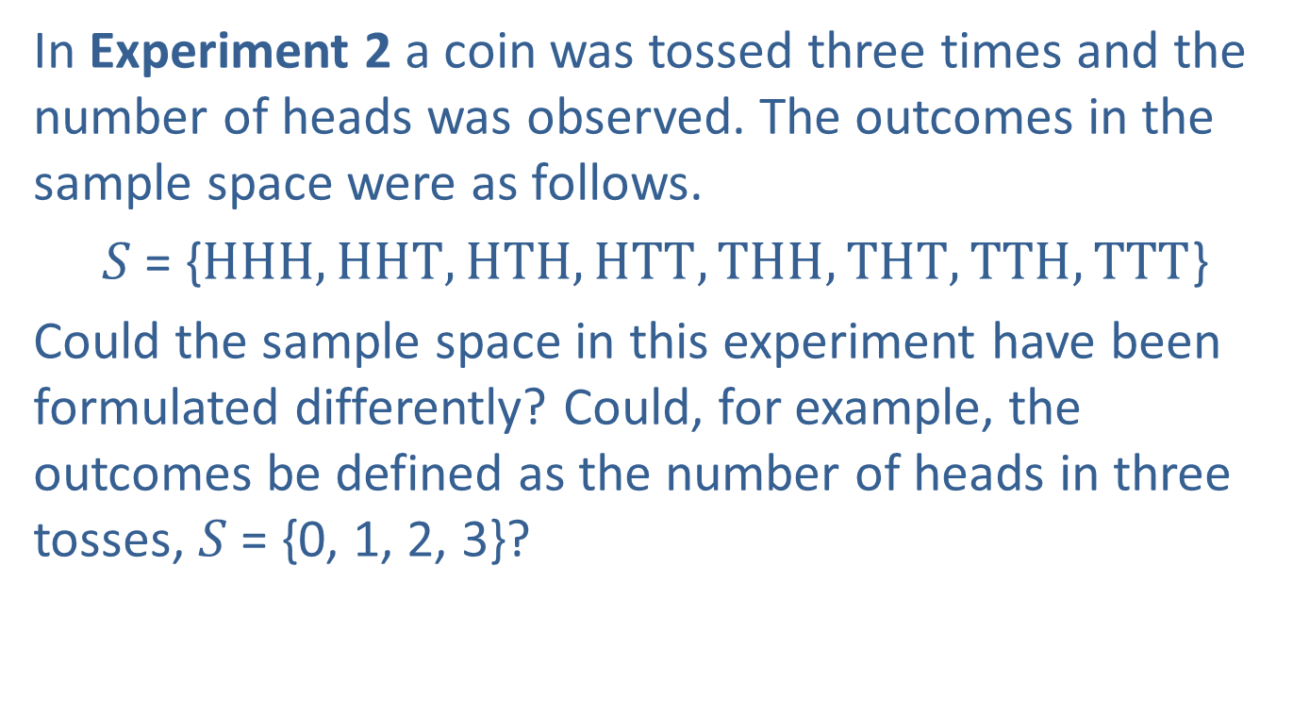
Example 6.1.4: Formulating the Sample Space
In Experiment 2 a coin was tossed three times and the number of heads was observed. The outcomes in the sample space were as follows.
$S$ = {$HHH, HHT, HTH, HTT, THH, THT, TTH, TTT$}
Could the sample space in this experiment have been formulated differently? Could, for example, the outcomes be defined as the number of heads in three tosses, $S$ = {0, 1, 2, 3}?

Slide 45

Example 6.1.4: Formulating the Sample Space (cont.)
Solution
Using the classical definition of probability requires that the outcomes be equally likely. Since the sample space $S$ = {0, 1, 2, 3} does not contain equally likely events, the classical definition of probability is not applicable.

Slide 46
Subjective Approach
The subjective viewpoint regards the probability of an event as a measure of the degree of belief that the event has occurred or will occur. Someone’s degree of belief in some event will depend on their life experiences. Different life experiences produce different degrees of belief. Hence, the subjective approach must allow for differences in the degree of belief among reasonable people examining the same evidence. One of the significant advantages of this view is the ability to discuss the probability of events that cannot be repeated.

Slide 47
Subjective Approach (cont.)
Thus, a subjectivist would be willing to assign the probability of “you” making an A in your statistics course. Someone who adopts the subjective view could use the frequency interpretation to influence the determination of a subjective probability. For example, suppose that a coin had been tossed 20,000 times and had come up heads 63% of the time. It would certainly be reasonable for a subjectivist to use this information in the formulation of a statement of probability about the outcome of the next toss.

Slide 48
Subjective Approach (cont.)
If you have ever been to a physician with a serious illness, you have placed an enormous amount of trust in a doctor’s subjective probability. Medical personnel regularly use subjective probability in the diagnostic process. Given the symptoms a patient presents and the collected diagnostic data, the physician considers a list of possible disorders that could be causing these symptoms and are consistent with the test results. This list of illnesses and their associated subjective probabilities represent a subjective probability distribution.

Slide 49
Subjective Approach (cont.)
As the clinician orders additional tests, they narrow down the list of potential illnesses. When the doctor has identified what they believe to be the most likely cause of the illness with a sufficiently high subjective probability, they issue a diagnosis and begin treatment. Different doctors may not arrive at the same diagnosis or may defer making a diagnosis because the subjective probability is not high enough.

Slide 50
Criticism of the Subjective Approach
If science is defined as finding out what is probably true, there should be a probability criterion on which all reasonable persons could agree. But when the probability is subjective how can it be used as a universally accepted criterion? Two reasonable persons might examine the same data and reach different conclusions about their degree of belief about some proposition. Without repeatability, as with a relative frequency approach, or a well-defined sample space, used in the classical approach, the conclusions are open to debate and a high level of uncertainty.

Slide 51
Probability, Statistics, and Business
Most of the time, when working with samples, statisticians try to deduce from the samples the population parameters (means, proportions, variances, etc.) of certain variables. This process of making judgments about population parameters is called statistical inference.

Slide 52
Definition: Statistical Inference
Statistical inference involves the use of sample data to form generalizations or inferences about a population. Using sample data to estimate the values of population parameters is one form of statistical inference.

