Slide 1
Section 5.5
Scatterplots for More Than Two Variables

Slide 2
Scatterplots for More Than Two Variables
As displayed in Minard’s graph of Napoleon’s march in Chapter 3, it is often desirable to show more than two variables within the same graphic to determine if a relationship exists. However, a certain degree of creativity is required in order to figure out how to depict the desired variables within the spatial or dimensional limits. As each variable is added to the graph, a new method of reference must be associated with it. Scatterplots can be employed to portray relationships between more than two variables.

Slide 3
Scatterplots for More Than Two Variables (cont.)
Suppose we are interested in creating a graph that compares countries based on air pollution and rooms per person. Using data from the Organisation for Economic Cooperation and Development (OECD) Better Life Index for 2022, we created the graph in Figure 5.5.1.

Slide 4
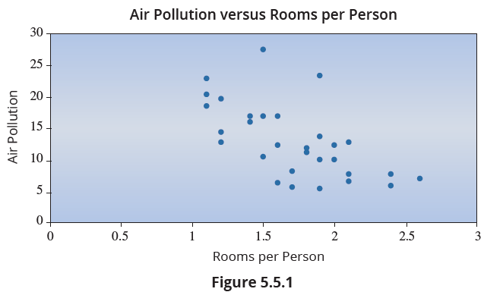
Scatterplots for More Than Two Variables (cont.)

Slide 5
Scatterplots for More Than Two Variables (cont.)
Rooms per person (RPP) is the number of rooms divided by the number of people living in the dwelling. The data is an average for a particular country.
Air pollution (AP) is measured in micrograms per cubic meter.
RPP is a measure of housing density. Lower values tend to indicate higher population densities. As Figure 5.5.1 suggests, there is a negative relationship between AP and RPP.

Slide 6
Scatterplots for More Than Two Variables (cont.)
Housing density, as measured by the ratio of rooms to people, seems to have a negative association with air pollution, with lower density housing (more rooms per person) areas typically exhibiting lower levels of pollution. This is not unexpected since human activities are one of the primary causes of air pollution. Greater densities of humans (smaller RPP) generally imply more air pollution.
Suppose we wanted to add a third variable, Personal Income, to our graph. How could we do it?

Slide 7
Scatterplots for More Than Two Variables (cont.)
One possibility is to use color. Since we have already used both of our axes for other variables, we need to find an alternative way to visually display the differences in personal income. There are multiple different ways to accomplish this; however, two of the most common methods include resizing each point on the graph based on the variable value, or assigning the values of the variable to a color scale and then coloring each point on the graph accordingly. In this case, we will use color to portray the differences in personal income between countries.

Slide 8
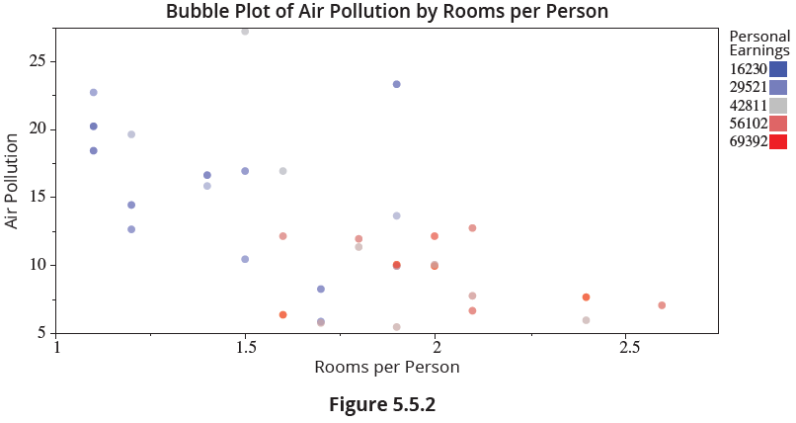
Scatterplots for More Than Two Variables (cont.)
After including our third variable as a color scale, the following plot is generated.

Slide 9
Note
The legend for personal earnings is incremental starting with the minimum of the data set and ending with the maximum; it assumes equal quartiles over the data range.

Slide 10
Scatterplots for More Than Two Variables (cont.)
Now, Figure 5.5.2 allows us to look at the data in three dimensions and gain a better understanding of how these variables relate to one another. It appears that the wealthier countries also have less pollution and larger dwellings.
Perhaps we want to add in another variable that measures the perception of health in a given country. The OECD data provides a health score for each country based on the proportion of residents that reported they were in good health or better on a questionnaire.

Slide 11
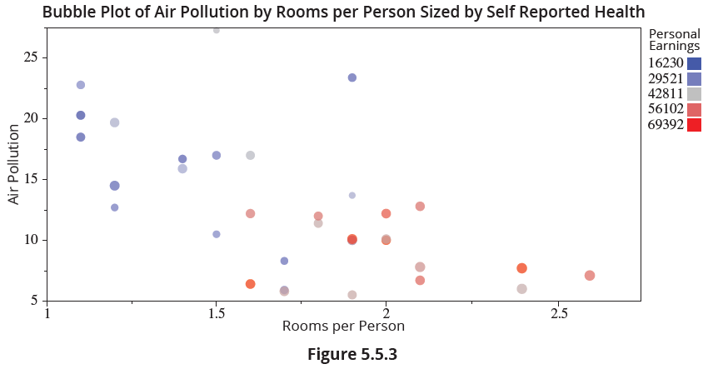
Scatterplots for More Than Two Variables (cont.)
We will relate the country health proportions with the size of each bubble, and generate the following graph.

Slide 12
Scatterplots for More Than Two Variables (cont.)
In Figure 5.5.3, we are looking at data in four dimensions. It seems that, in general, the wealthier, less dense, less polluted countries also have a higher proportion of residents who believe they are in good health.
As we just demonstrated, it is possible to cram large amounts of data into two-dimensional graphs, and such graphs can be wonderful tools that can be used for exploratory analysis in a variety of different areas. However, there are limitations to what can be visualized in a single graph.

Slide 13
Scatterplots for More Than Two Variables (cont.)
With each additional variable, more methods of measurement and presentation are needed. Furthermore, if we were analyzing a data set with thousands of observations, or rows, instead of just the 40 included in the OECD data, measurement methods like varying the size of points begin to lose their visual effectiveness. When dealing with multivariate or multidimensional data, it is sometimes a better option to create several graphs with each one containing only a couple of variables.

Slide 14
Scatterplots for More Than Two Variables (cont.)
A superb example of using multivariate graphs for exploratory analysis can be demonstrated using the Trendalyzer tool found on Gapminder.org. Gapminder is a nonprofit organization founded by Hans Rosling and supported by a coalition of economists, statisticians, and analysts, that promotes global development and education through the use of statistics. The Trendalyzer tool allows users to animate data over time and compare countries based on data provided by the World Bank, the UN, the World Health Organization, and many other sources.

Slide 15
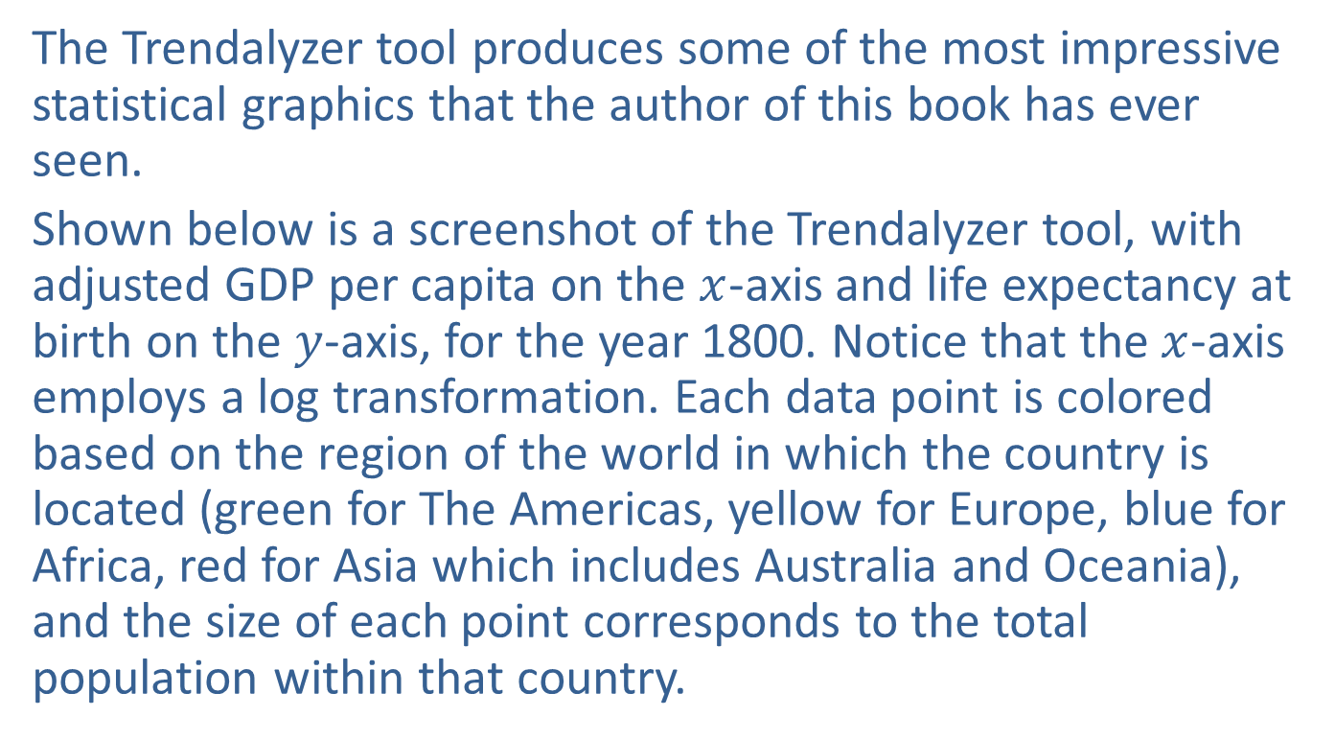
Scatterplots for More Than Two Variables (cont.)
The Trendalyzer tool produces some of the most impressive statistical graphics that the author of this book has ever seen.
Shown below is a screenshot of the Trendalyzer tool, with adjusted GDP per capita on the $x$-axis and life expectancy at birth on the $y$-axis, for the year 1800. Notice that the $x$-axis employs a log transformation. Each data point is colored based on the region of the world in which the country is located (green for The Americas, yellow for Europe, blue for Africa, red for Asia which includes Australia and Oceania), and the size of each point corresponds to the total population within that country.

Slide 16
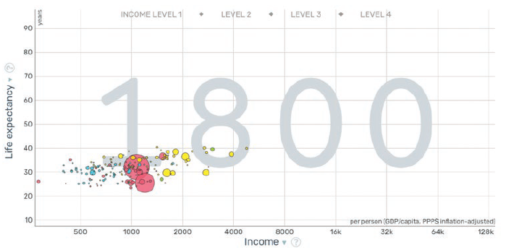
Scatterplots for More Than Two Variables (cont.)

Slide 17
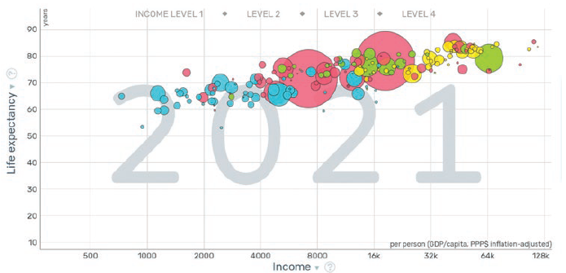
Scatterplots for More Than Two Variables (cont.)
Now, here is a screenshot of the same graph, but for the year 2021.

Slide 18
Scatterplots for More Than Two Variables (cont.)
As you can see, a lot changed between 1800 and 2021. If you would like to see the animation from 1800 to 2021, go to the Gapminder website and experiment with the Trendalyzer tool yourself. Pay attention to countries that seem to stray from the central grouping, or from where they are expected to be, and note the year that this anomaly takes place. Once you have this information, do some research using your preferred search engine or ChatGPT and try to come up with an explanation for the anomaly.

Slide 19
Scatterplots for More Than Two Variables (cont.)
You will be amazed at the amount of history that can be portrayed through the use of a seemingly simple scatterplot.

