Slide 1
Section 5.4
Fitting a Linear Time Trend

Slide 2
Fitting a Linear Time Trend
In Chapter 4, we discussed the notion that the mean is not a reasonable descriptor for nonstationary time series data. Recall that nonstationary time series do not meander around some central value. Instead, the data tends to get larger or smaller over time. How can you describe time series data that possesses a trend?

Slide 3
Fitting a Linear Time Trend (cont.)
For some time series, a linear time trend is a useful model. A linear time trend is nothing but a line that is used to model the changes in some phenomenon measured over time. In a linear time trend model, the independent variable is always a time index. The following example will illustrate the estimation of a linear time trend model.

Slide 4
Example 5.4.1: Fitting a Linear Time Trend to BMI Data
The following data is taken from the results of the 2013–2014 National Health and Nutrition Examination Survey (NHANES) of US adults age 20 and over who are above their recommended weight based on body mass index, or BMI. Body mass index, expressed as weight in kilograms divided by height in meters squared (kg/m²), is commonly used to classify people as overweight (BMI 25.0–29.9), obese (BMI greater than or equal to 30.0), and extremely obese (BMI greater than or equal to 40.0).

Slide 5
Example 5.4.1: Fitting a Linear Time Trend to BMI Data (cont.)
Based on BMI, the percent of overweight Americans from 2002 to 2018 is shown in the following table.
Percent of Overweight or Obese American Adults
Year | 2002 | 2004 | 2006 | 2008 | 2010 | 2012 | 2014 | 2018 | 2018
% Overweight or Obese | 65.1 | 66.0 | 66.7 | 67.5 | 68.5 | 68.7 | 69.5 | 70.9 | 72.5

Slide 6
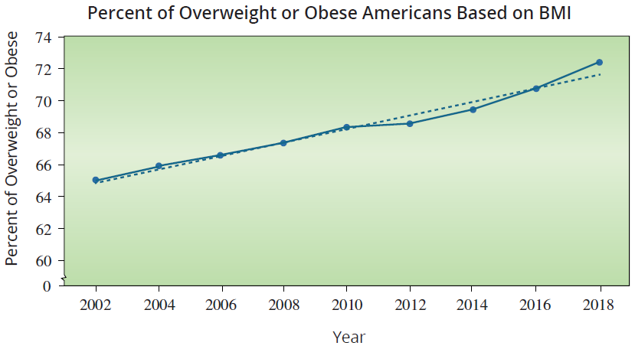
Example 5.4.1: Fitting a Linear Time Trend to BMI Data (cont.)

Slide 7
Example 5.4.1: Fitting a Linear Time Trend to BMI Data (cont.)
A graph of the data reveals an upward trend in the percent of overweight Americans. The data appears to be a nonstationary time series with an upward trend. To describe the data we will model the trend by fitting a line through the data with the notion of capturing how fast (on average) the series is changing over time. Estimating the slope of the line will provide the average rate of change per year in the percent of overweight Americans. The line is fitted using least squares estimates in exactly the same way as the other regression models we studied.

Slide 8
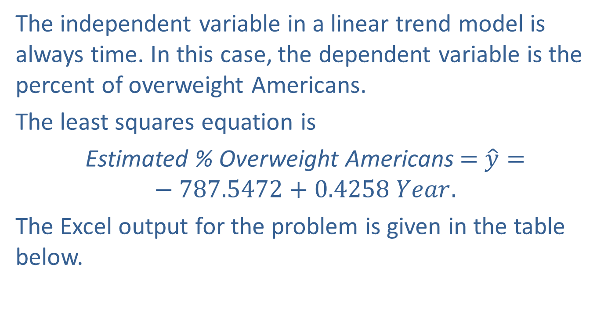
Example 5.4.1: Fitting a Linear Time Trend to BMI Data (cont.)
The independent variable in a linear trend model is always time. In this case, the dependent variable is the percent of overweight Americans.
The least squares equation is
Estimated % Overweight Americans $=$ $\hat{y}=−787.5472+0.4258 Year.$
The Excel output for the problem is given in the table below.

Slide 9
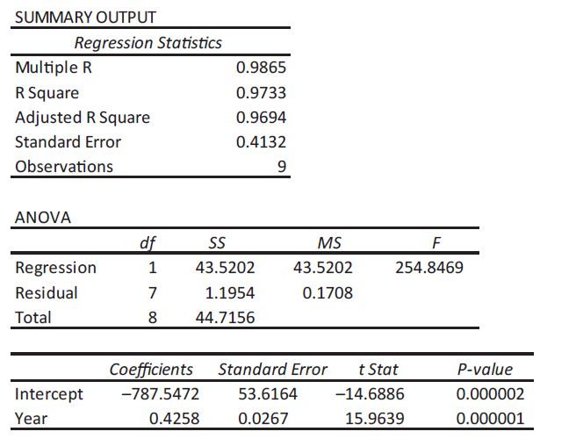
Example 5.4.1: Fitting a Linear Time Trend to BMI Data (cont.)

Slide 10
Note
For time series data, the accuracy of the forecast is vulnerable to significant error as you get further from the last time epoch of the data.

Slide 11
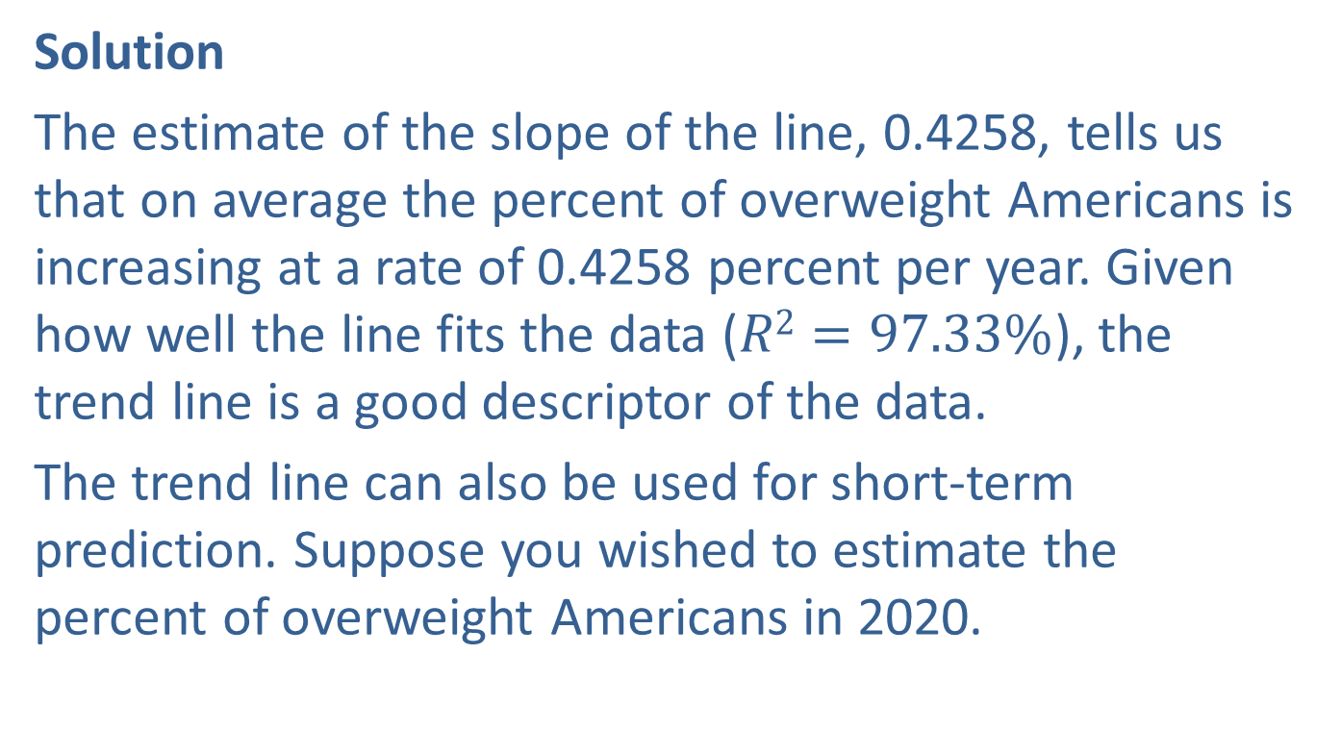
Example 5.4.1: Fitting a Linear Time Trend to BMI Data (cont.)
Solution
The estimate of the slope of the line, 0.4258, tells us that on average the percent of overweight Americans is increasing at a rate of 0.4258 percent per year. Given how well the line fits the data ($R2=97.33\%$), the trend line is a good descriptor of the data.
The trend line can also be used for short-term prediction. Suppose you wished to estimate the percent of overweight Americans in 2020.

Slide 12

Example 5.4.1: Fitting a Linear Time Trend to BMI Data (cont.)
If the data is not available, the trend model can be utilized by substituting the year, 2020, into the least squares equation.
$$−787.5472+0.4258\left(2020\right)=72.57\%$$

Slide 13
Example 5.4.2: Fitting a Linear Time Trend to Unemployment Rates
A common economic indicator is the unemployment rate. Lower rates mean more people are working which is usually a sign of a strong economy. The SC and NC Unemployment data set contains unemployment rates for North Carolina and South Carolina.

Slide 14
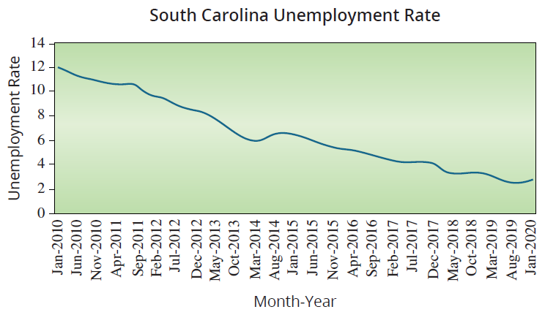
Example 5.4.2: Fitting a Linear Time Trend to Unemployment Rates (cont.)

Slide 15
Example 5.4.2: Fitting a Linear Time Trend to Unemployment Rates (cont.)
If we look at the data for South Carolina from January 2010 through January 2020, we can see a clear downward trend of the unemployment rate over time, with some minor ups and downs which are normal due to economic cycles. Using January 2010 as Month 1 and January 2020 as Month 121, we will model the trend by fitting a linear regression model to the data in order to predict the unemployment rate using time (Month) as our only independent variable.

Slide 16
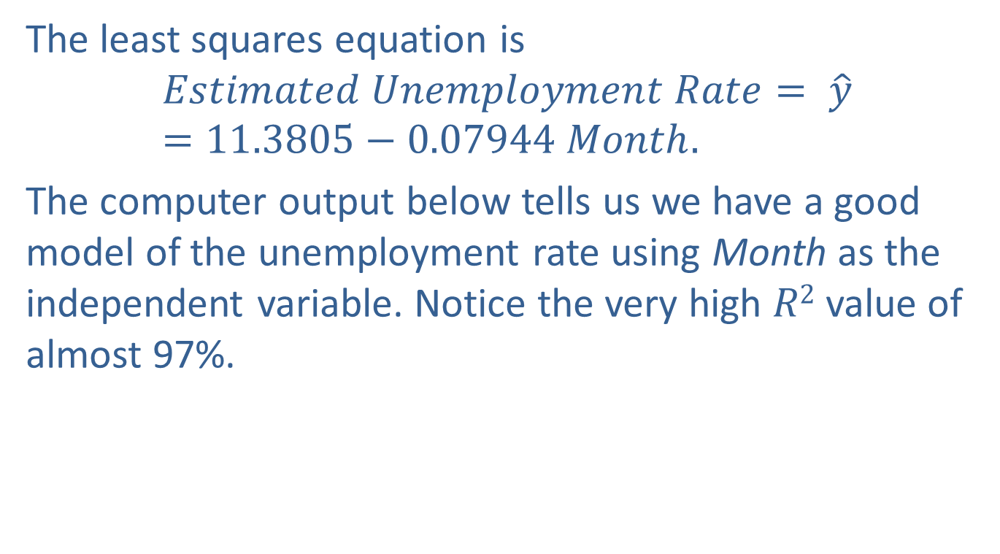
Example 5.4.2: Fitting a Linear Time Trend to Unemployment Rates (cont.)
The least squares equation is
$$Estimated Unemployment Rate= \hat{y}=11.3805−0.07944 Month.$$
The computer output below tells us we have a good model of the unemployment rate using Month as the independent variable. Notice the very high $R2$ value of almost 97%.

Slide 17
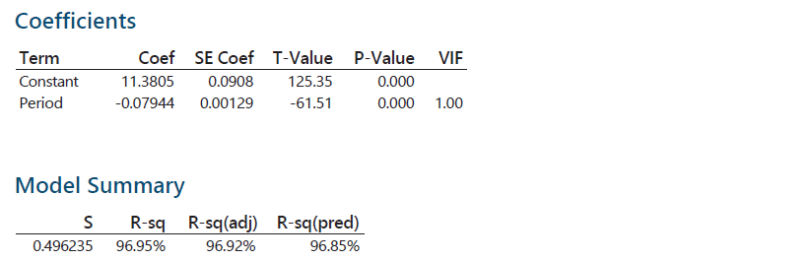
Example 5.4.2: Fitting a Linear Time Trend to Unemployment Rates (cont.)
Use the model to predict the unemployment rate in South Carolina for April 2020.

Slide 18
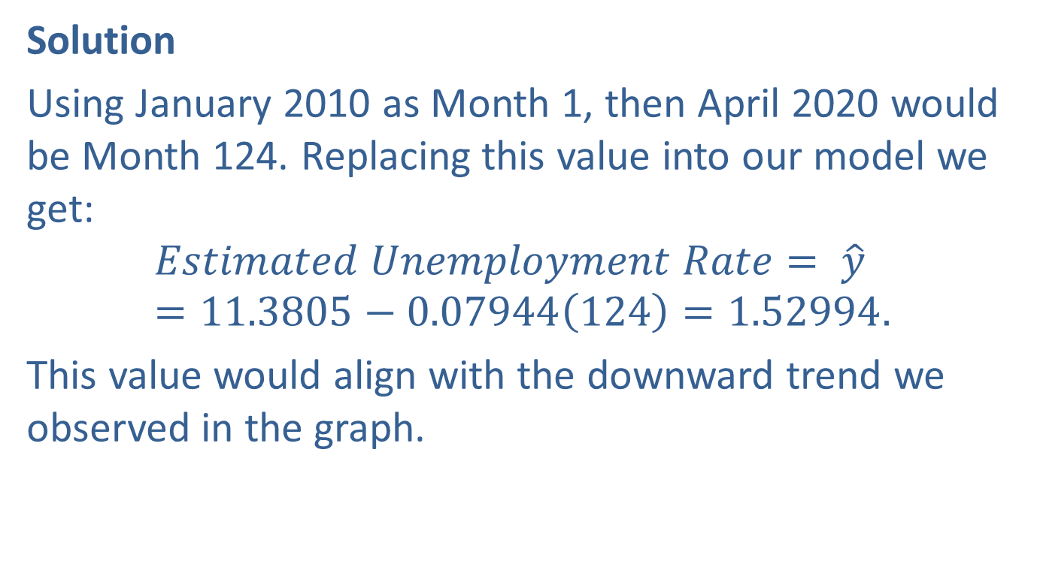
Example 5.4.2: Fitting a Linear Time Trend to Unemployment Rates (cont.)
Solution
Using January 2010 as Month 1, then April 2020 would be Month 124. Replacing this value into our model we get:
$$Estimated Unemployment Rate= \hat{y}=11.3805−0.07944\left(124\right)=1.52994.$$
This value would align with the downward trend we observed in the graph.

Slide 19
Example 5.4.2: Fitting a Linear Time Trend to Unemployment Rates (cont.)
If we also consider our model is explaining almost 97% of the variability in the unemployment rate, then we would be very confident that the unemployment rate in South Carolina in April 2020 will be close to 1.53%. However, if we look at the actual value for April 2020, we find that the unemployment rate was actually 11.7%. That is a large error. What happened?

Slide 20
Example 5.4.2: Fitting a Linear Time Trend to Unemployment Rates (cont.)
As you may know, in the beginning of 2020 we had an unprecedented global pandemic, which forced a lot of companies to lay off many of their employees, resulting in skyrocketing unemployment rates. No model could have predicted this.

