Slide 1
Section 5.3
Evaluating the Fit of a Linear Model

Slide 2
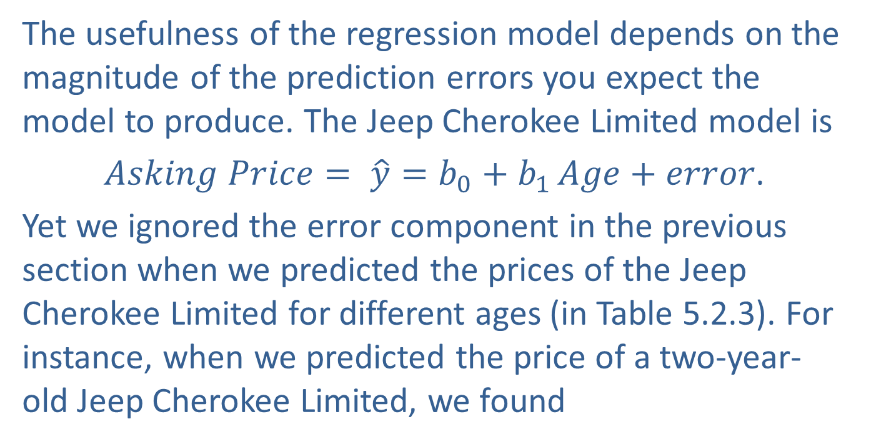
The Importance of Errors
The usefulness of the regression model depends on the magnitude of the prediction errors you expect the model to produce. The Jeep Cherokee Limited model is
$Asking Price= \hat{y}=b_{0}+b_{1 }Age+error$.
Yet we ignored the error component in the previous section when we predicted the prices of the Jeep Cherokee Limited for different ages (in Table 5.2.3). For instance, when we predicted the price of a two-year-old Jeep Cherokee Limited, we found

Slide 3
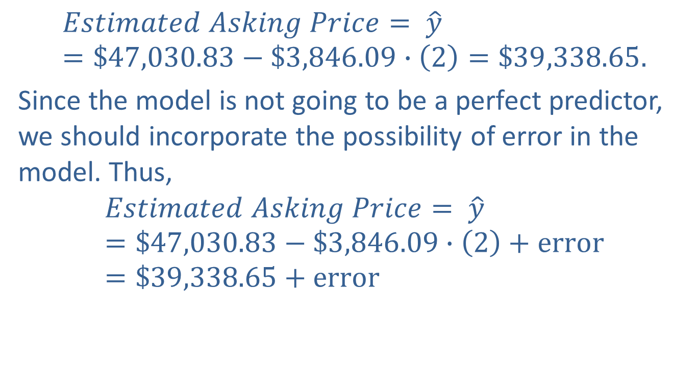
The Importance of Errors (cont.)
$$Estimated Asking Price= \hat{y}=\$47,030.83−\$3,846.09∙\left(2\right)=\$39,338.65.$$
Since the model is not going to be a perfect predictor, we should incorporate the possibility of error in the model. Thus,
$$Estimated Asking Price= \hat{y}=\$47,030.83−\$3,846.09∙\left(2\right)+error=\$39,338.65+error$$

Slide 4
The Importance of Errors (cont.)
would have been a more precise statement. It is important to assess the magnitude of the error when the model is used for predictive purposes. If the errors are too large, then it will not be advantageous to use the model for prediction.
Why Do We Assess the Magnitude of the Errors?
You may have wondered why we have been trying to predict observations that we already know. For example, an observation in the Jeep Cherokee Limited data was Age equal to 3 and Asking Price equal to $35,955.

Slide 5
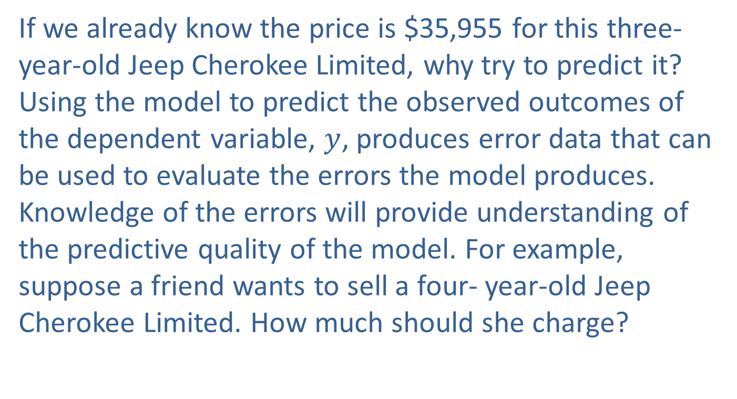
The Importance of Errors (cont.)
If we already know the price is $35,955 for this three-year-old Jeep Cherokee Limited, why try to predict it? Using the model to predict the observed outcomes of the dependent variable, $y$, produces error data that can be used to evaluate the errors the model produces. Knowledge of the errors will provide understanding of the predictive quality of the model. For example, suppose a friend wants to sell a four- year-old Jeep Cherokee Limited. How much should she charge?

Slide 6
The Importance of Errors (cont.)
How Do You Summarize the Errors a Model Produces?
For the Jeep Cherokee Limited model, the mean error is zero. This is true for all least squares models and hence the mean error won’t provide any useful information. What about the average variation in the error terms? Large variation in the errors would indicate that a model’s prediction is not very reliable. On the other hand, small variation in the errors would indicate that the model is capable of producing more trustworthy predictions.

Slide 7
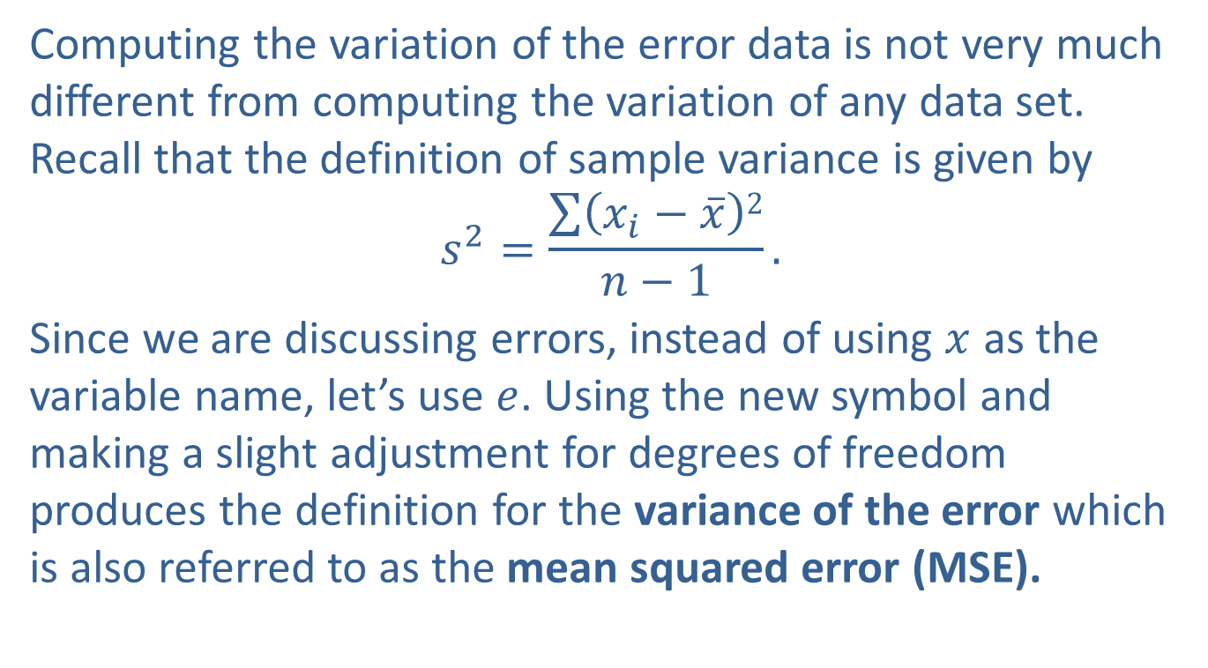
The Importance of Errors (cont.)
Computing the variation of the error data is not very much different from computing the variation of any data set. Recall that the definition of sample variance is given by
$$s^{2}=\frac{\sum{\left(x_{i}−\overline{x}\right)2}}{n−1}.$$
Since we are discussing errors, instead of using $x$ as the variable name, let’s use $e$. Using the new symbol and making a slight adjustment for degrees of freedom produces the definition for the variance of the error which is also referred to as the mean squared error (MSE).

Slide 8
Formula: Variance of the Error
The variance of the error is given by

Slide 9
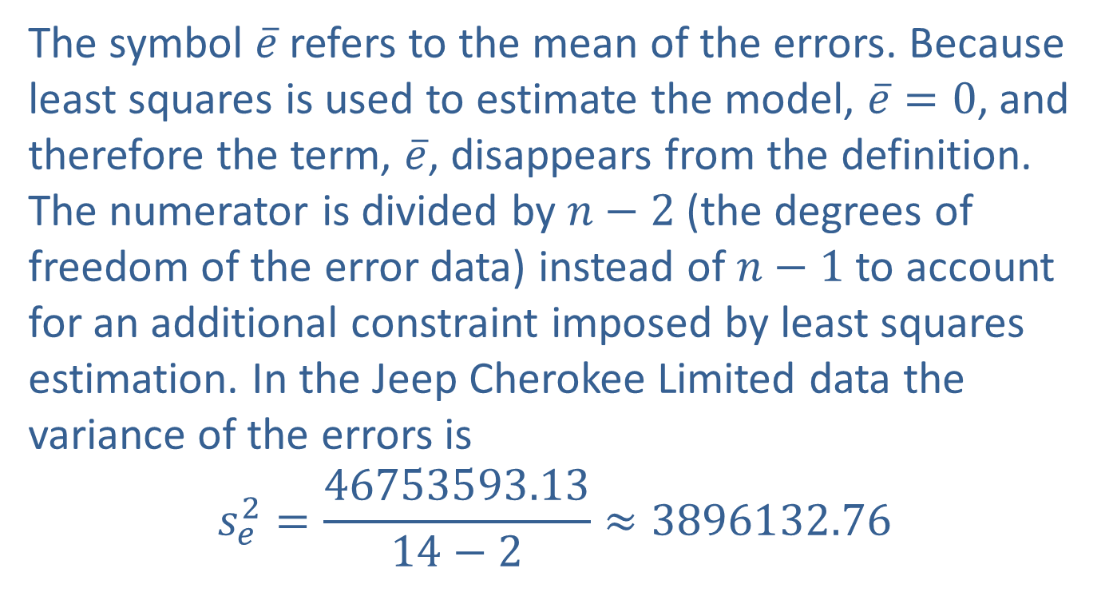
The Importance of Errors (cont.)
The symbol $\overline{e}$ refers to the mean of the errors. Because least squares is used to estimate the model, $\overline{e}=0$, and therefore the term, $\overline{e}$, disappears from the definition. The numerator is divided by $n−2$ (the degrees of freedom of the error data) instead of $n−1$ to account for an additional constraint imposed by least squares estimation. In the Jeep Cherokee Limited data the variance of the errors is
$$s_{e}^{2}=\frac{46753593.13}{14−2}≈3896132.76$$

Slide 10

The Importance of Errors (cont.)
and the standard error (standard deviation of the error terms) is given by
$$s_{e}=\sqrt{3896132.76}≈1973.86.$$

Slide 11
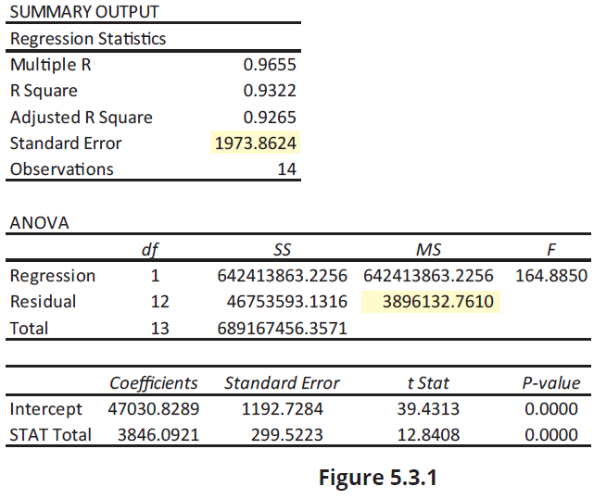
The Importance of Errors (cont.)

Slide 12
The Importance of Errors (cont.)
Figure 5.3.1 shows the summary output from Microsoft Excel for the regression analysis of the Jeep Cherokee Limited data. Notice that the mean square error is given in the column labeled ‘MS’ and the row labeled ‘Residual’. The standard error of the model is given in the ‘SUMMARY OUTPUT Regression Statistics’ table and is labeled ‘Standard Error’.
Should you be satisfied with a model whose standard error is $1,973.8624? It would certainly be more desirable if the model’s standard deviation of error was only $100.

Slide 13
The Importance of Errors (cont.)
If you know a great deal about the used car market (you have an intuitive model), then perhaps the current model would not be of value. However, if you are uninformed, the current model provides a basic understanding of the relationship between age and asking price. What constitutes small and large variation of the errors is dependent on the nature of the problem.

Slide 14
The Importance of Errors (cont.)
Using a model to predict the diameter of a valve to be used in a heart-lung machine is certainly going to produce a different idea of small than estimating the price of a car. It would be ideal to develop a measure that would summarize the degree of fit on some standardized scale.

Slide 15
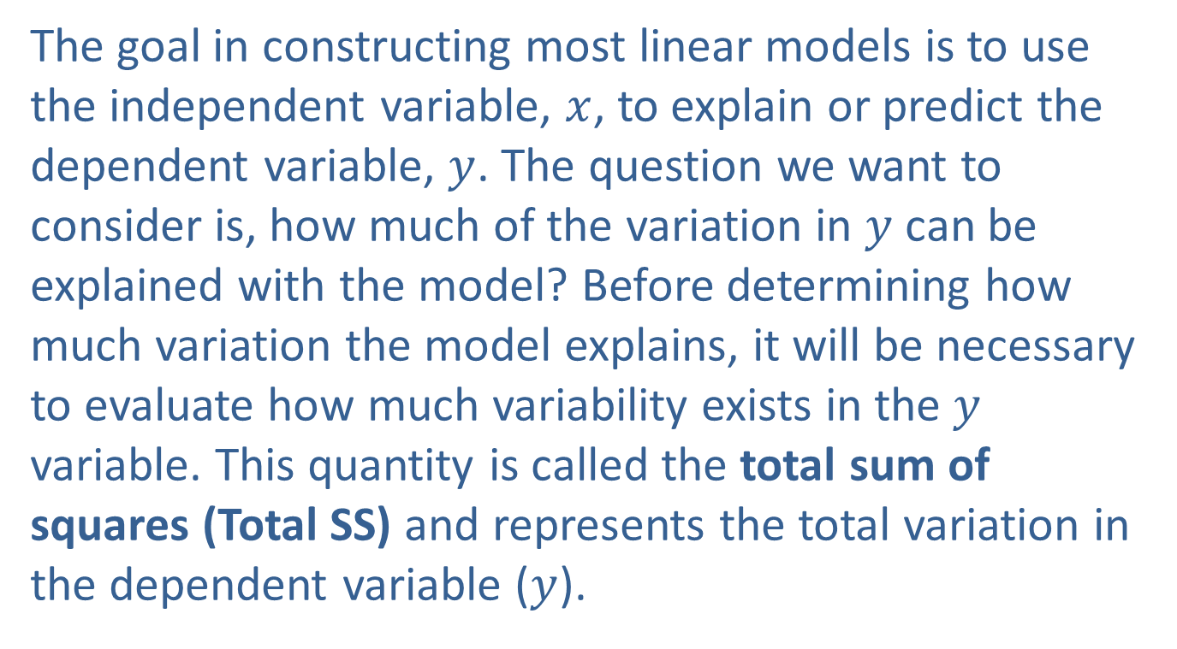
The Coefficient of Determination
The goal in constructing most linear models is to use the independent variable, $x$, to explain or predict the dependent variable, $y$. The question we want to consider is, how much of the variation in $y$ can be explained with the model? Before determining how much variation the model explains, it will be necessary to evaluate how much variability exists in the $y$ variable. This quantity is called the total sum of squares (Total SS) and represents the total variation in the dependent variable ($y$).

Slide 16
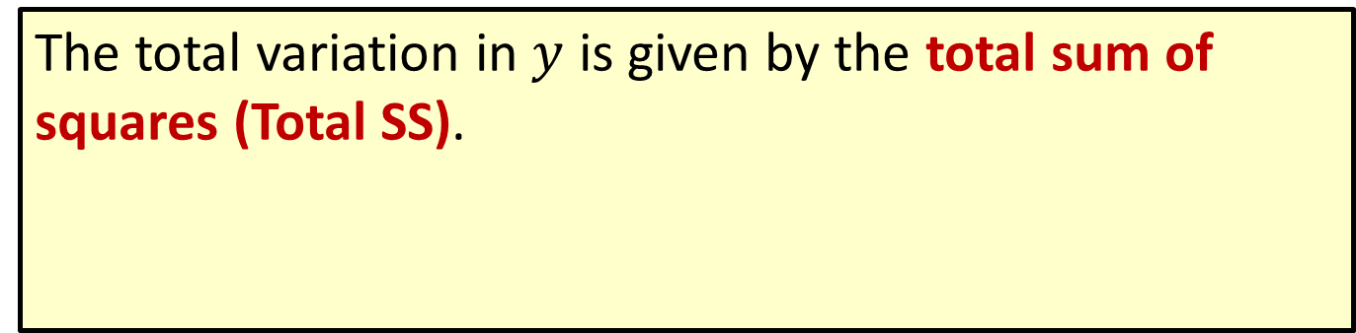
Formula: Total Sum of Squares (Total SS)
The total variation in $y$ is given by the total sum of squares (Total SS).

Slide 17
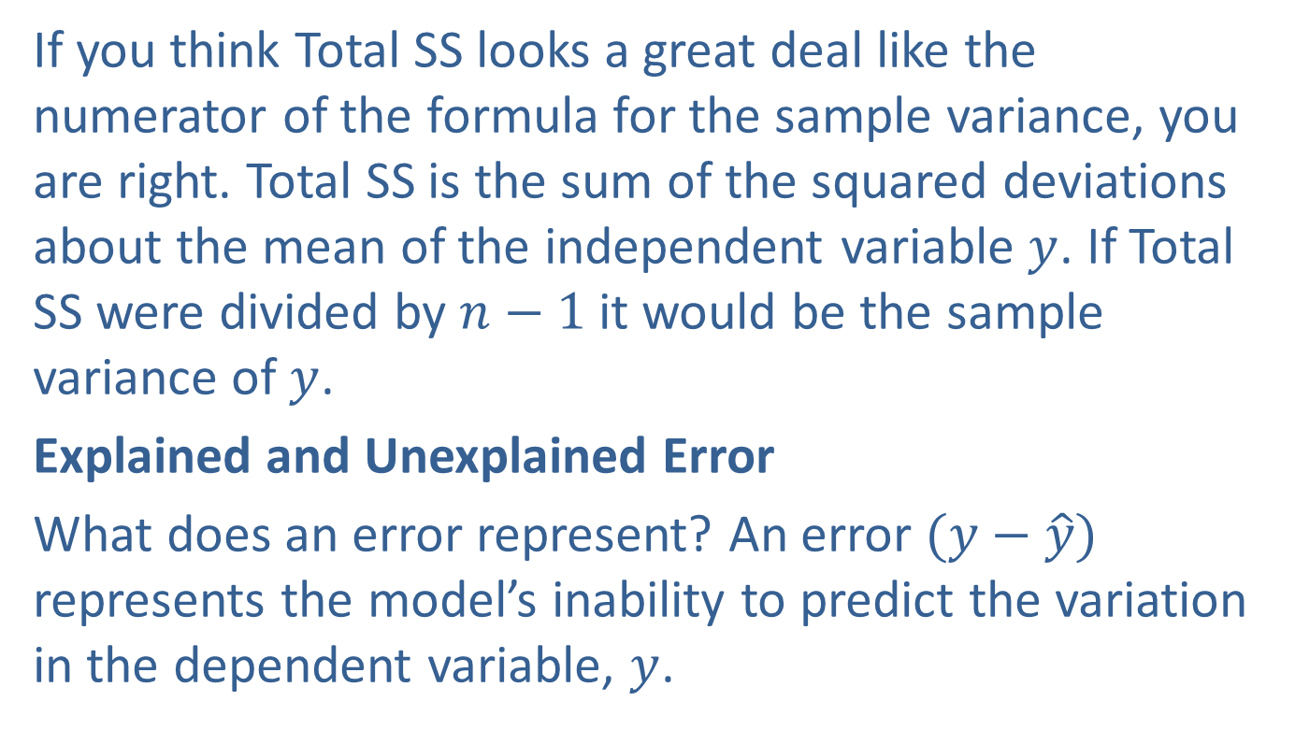
The Coefficient of Determination (cont.)
If you think Total SS looks a great deal like the numerator of the formula for the sample variance, you are right. Total SS is the sum of the squared deviations about the mean of the independent variable $y$. If Total SS were divided by $n−1$ it would be the sample variance of $y$.
Explained and Unexplained Error
What does an error represent? An error $(y−\hat{y})$ represents the model’s inability to predict the variation in the dependent variable, $y$.

Slide 18
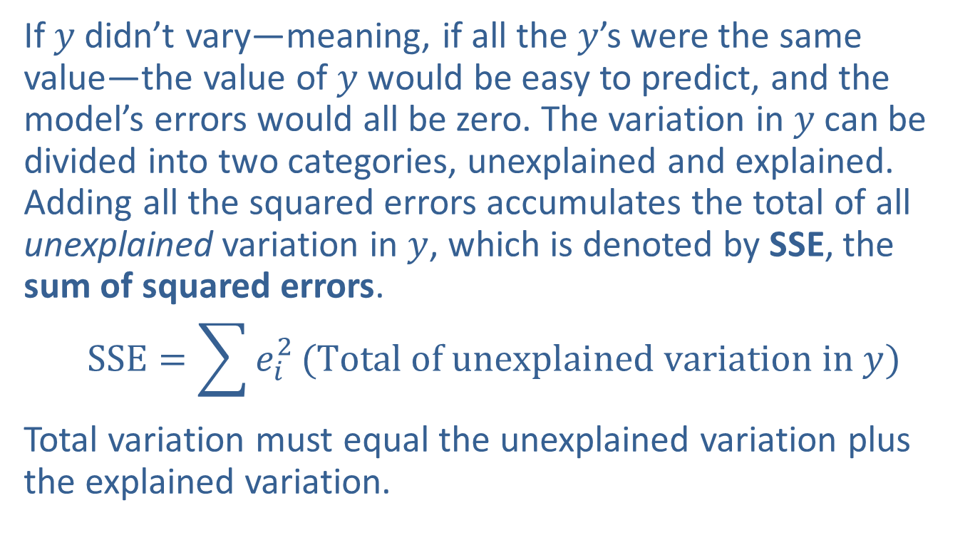
The Coefficient of Determination (cont.)
If $y$ didn’t vary—meaning, if all the $y$’s were the same value—the value of $y$ would be easy to predict, and the model’s errors would all be zero. The variation in $y$ can be divided into two categories, unexplained and explained. Adding all the squared errors accumulates the total of all unexplained variation in $y$, which is denoted by SSE, the sum of squared errors.
$$SSE=\sum{e_{i}^{2}}(Total of unexplained variation in y)$$
Total variation must equal the unexplained variation plus the explained variation.

Slide 19
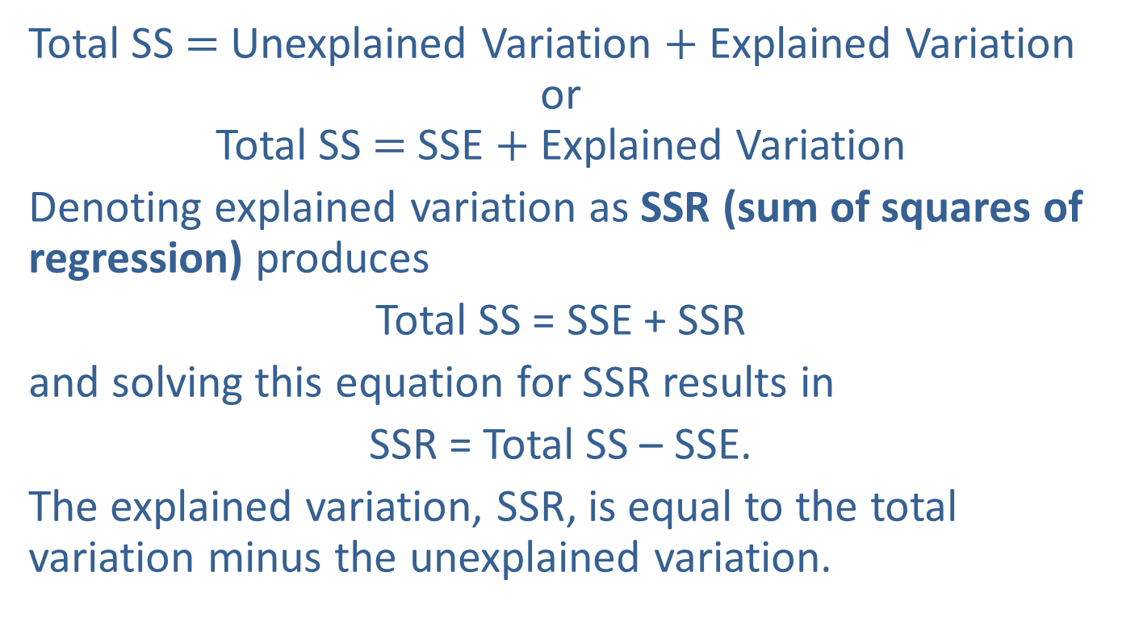
The Coefficient of Determination (cont.)
Total SS $=$ Unexplained Variation $+$ Explained Variation
or
Total SS $=$ SSE $+$ Explained Variation
Denoting explained variation as SSR (sum of squares of regression) produces
Total SS = SSE + SSR
and solving this equation for SSR results in
SSR = Total SS – SSE.
The explained variation, SSR, is equal to the total variation minus the unexplained variation.

Slide 20
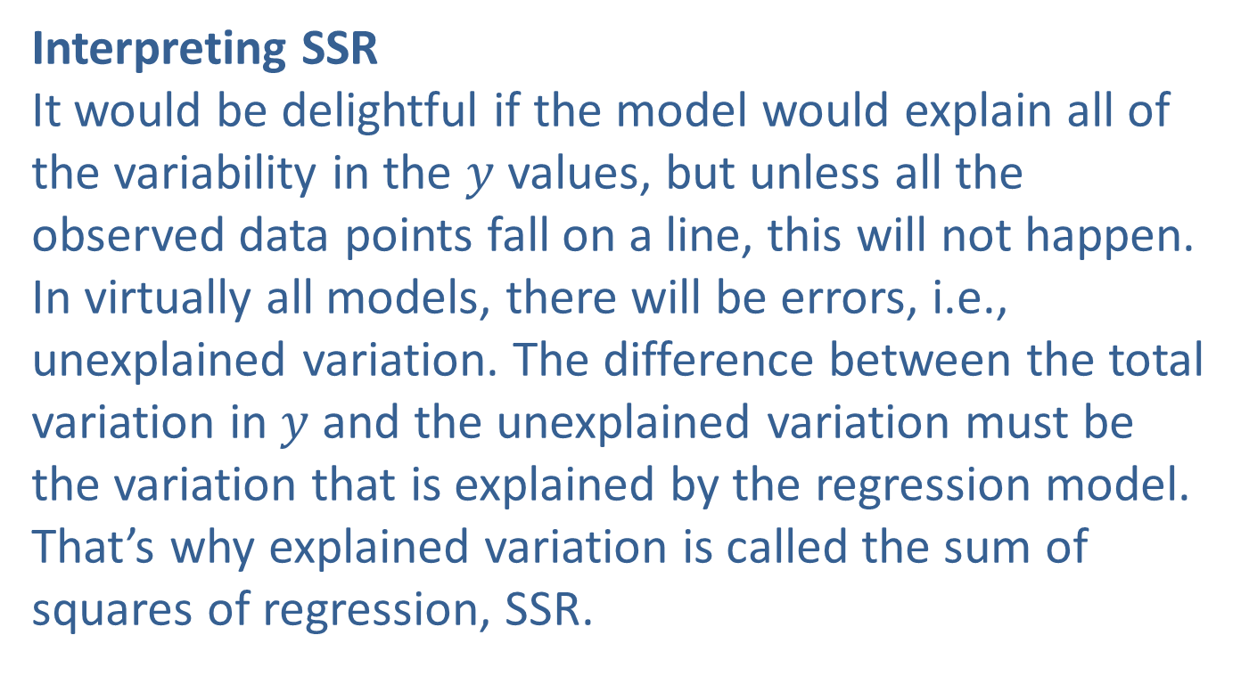
The Coefficient of Determination (cont.)
Interpreting SSR
It would be delightful if the model would explain all of the variability in the $y$ values, but unless all the observed data points fall on a line, this will not happen. In virtually all models, there will be errors, i.e., unexplained variation. The difference between the total variation in $y$ and the unexplained variation must be the variation that is explained by the regression model. That’s why explained variation is called the sum of squares of regression, SSR.

Slide 21
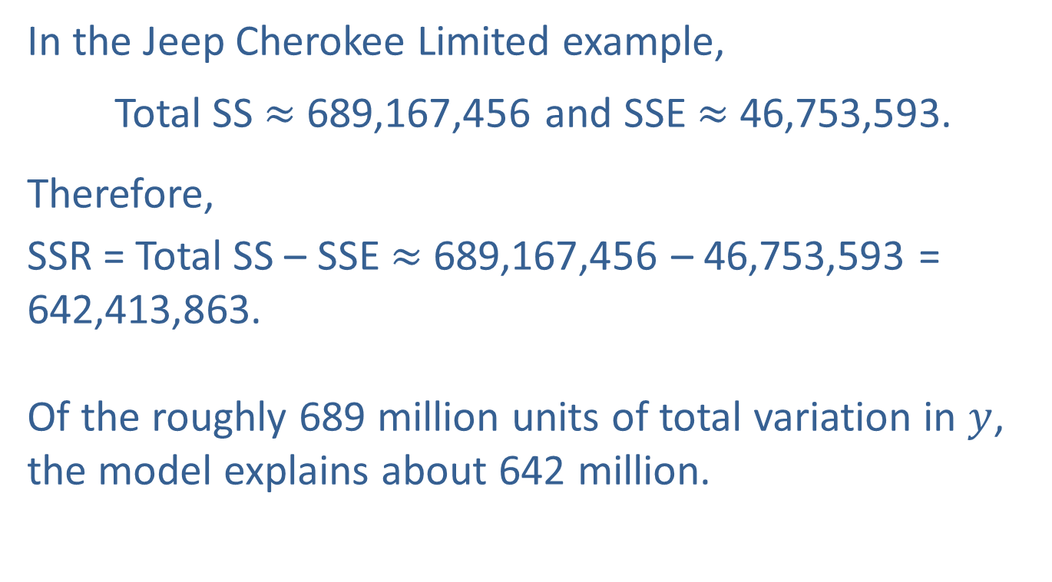
The Coefficient of Determination (cont.)
In the Jeep Cherokee Limited example,
Total SS $≈$ 689,167,456 and SSE $≈$ 46,753,593.
Therefore,
SSR = Total SS – SSE $≈$ 689,167,456 – 46,753,593 = 642,413,863.
Of the roughly 689 million units of total variation in $y$, the model explains about 642 million.

Slide 22
Definition: Coefficient of Determination
The proportion of variation explained by the model is called the coefficient of determination and is denoted as R² .
The coefficient of determination is a value between 0 and 1, inclusive. That is, 0 ≤ R² ≤ 1.

Slide 23
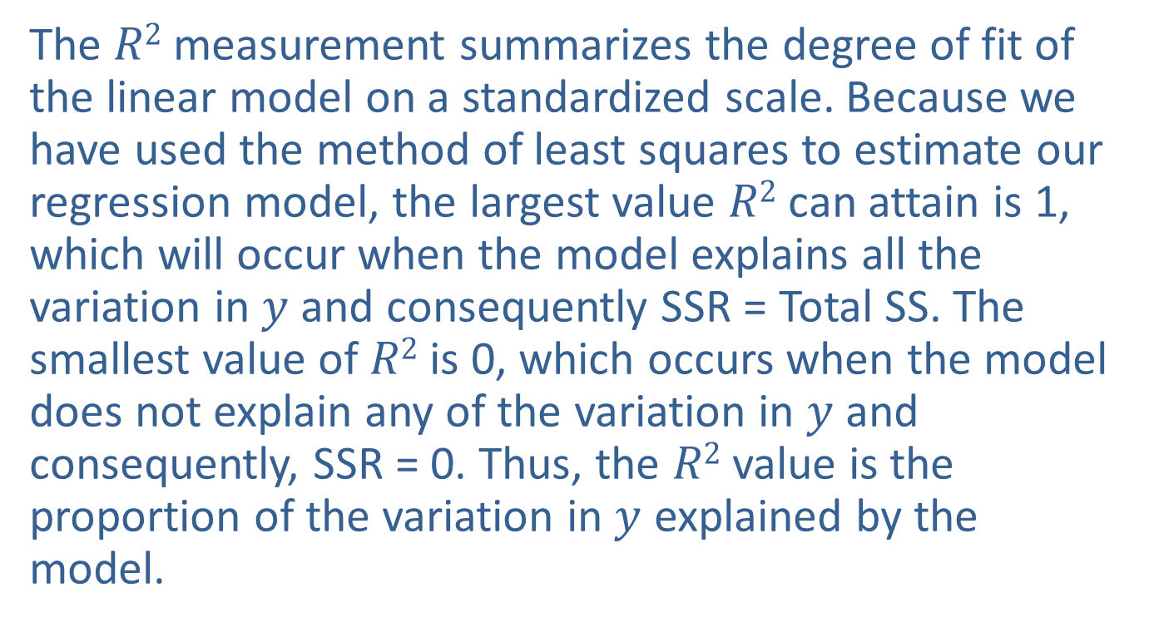
The Coefficient of Determination (cont.)
The $R2$measurement summarizes the degree of fit of the linear model on a standardized scale. Because we have used the method of least squares to estimate our regression model, the largest value $R2$ can attain is 1, which will occur when the model explains all the variation in $y$ and consequently SSR = Total SS. The smallest value of $R2$ is 0, which occurs when the model does not explain any of the variation in $y$ and consequently, SSR = 0. Thus, the $R2$ value is the proportion of the variation in $y$ explained by the model.

Slide 24
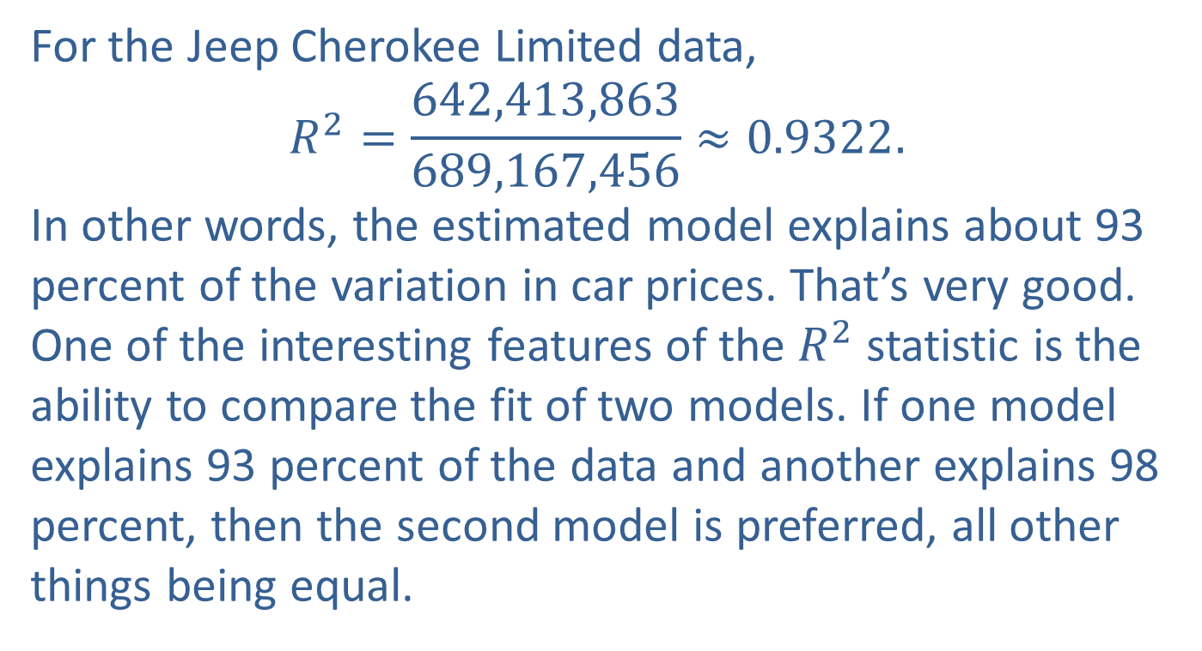
The Coefficient of Determination (cont.)
For the Jeep Cherokee Limited data,
$$R^{2}=\frac{642,413,863}{689,167,456}≈0.9322.$$
In other words, the estimated model explains about 93 percent of the variation in car prices. That’s very good. One of the interesting features of the $R^{2}$ statistic is the ability to compare the fit of two models. If one model explains 93 percent of the data and another explains 98 percent, then the second model is preferred, all other things being equal.

Slide 25
Example 5.3.1: Using a Least Squares Model to Predict GPA
The SAT has been used for years as a predictor of academic success. If SAT scores are predictors of academic success, they should be positively related to the grade point average upon graduation. Thirty graduates of a state college were sampled and their grade point averages (GPA) upon graduation and SAT scores reported upon admission are recorded as paired data values in the following table.

Slide 26
Example 5.3.1: Using a Least Squares Model to Predict GPA (cont.)
Table 5.3.2 – SAT Scores and Graduating GPA
Student | SAT Verbal | SAT Math | SAT Total | College GPA | Predicted GPA | Error | Error Squared
1 | 680 | 554 | 1234 | 3.42 | 2.8647 | 0.5553 | 0.30835809
2 | 486 | 562 | 1048 | 2.37 | 2.4741 | −0.1041 | 0.01083681
3 | 500 | 564 | 1064 | 2.52 | 2.5077 | 0.0123 | 0.00015129
4 | 501 | 564 | 1065 | 2.25 | 2.5098 | −0.2598 | 0.06749604
5 | 503 | 583 | 1086 | 2.90 | 2.5539 | 0.3461 | 0.11978521
6 | 503 | 571 | 1074 | 3.17 | 2.5287 | 0.6413 | 0.41126569
7 | 603 | 667 | 1270 | 2.76 | 2.9403 | −0.1803 | 0.03250809
8 | 507 | 552 | 1059 | 2.21 | 2.4972 | −0.2872 | 0.08248384
9 | 607 | 554 | 1161 | 2.27 | 2.7114 | −0.4414 | 0.19483396
10 | 509 | 654 | 1163 | 3.20 | 2.7156 | 0.4844 | 0.23464336
11 | 510 | 583 | 1093 | 2.83 | 2.5686 | 0.2614 | 0.06832996

Slide 27
Example 5.3.1: Using a Least Squares Model to Predict GPA (cont.)
Table 5.3.2 – SAT Scores and Graduating GPA (cont.)
Student | SAT Verbal | SAT Math | SAT Total | College GPA | Predicted GPA | Error | Error Squared
12 | 612 | 558 | 1170 | 2.91 | 2.7303 | 0.1797 | 0.03229209
13 | 517 | 568 | 1085 | 2.74 | 2.5518 | 0.1882 | 0.03541924
14 | 519 | 668 | 1187 | 3.21 | 2.7660 | 0.4440 | 0.19713600
15 | 528 | 607 | 1135 | 2.40 | 2.6568 | −0.2568 | 0.06594624
16 | 528 | 516 | 1044 | 3.41 | 2.4657 | 0.9443 | 0.89170249
17 | 536 | 559 | 1095 | 2.24 | 2.5728 | −0.3328 | 0.11075584
18 | 668 | 648 | 1316 | 3.47 | 3.0369 | 0.4331 | 0.18757561
19 | 648 | 580 | 1228 | 2.70 | 2.8521 | −0.1521 | 0.02313441
20 | 538 | 554 | 1092 | 2.80 | 2.5665 | 0.2335 | 0.05452225
21 | 638 | 624 | 1262 | 3.08 | 2.9235 | 0.1565 | 0.02449225
22 | 541 | 568 | 1109 | 2.08 | 2.6022 | -0.5222 | 0.27269284

Slide 28
Example 5.3.1: Using a Least Squares Model to Predict GPA (cont.)
Table 5.3.2 – SAT Scores and Graduating GPA (cont.)
Student | SAT Verbal | SAT Math | SAT Total | College GPA | Predicted GPA | Error | Error Squared
23 | 642 | 660 | 1302 | 3.39 | 3.0075 | 0.3825 | 0.14630625
24 | 542 | 554 | 1096 | 2.34 | 2.5749 | −0.2349 | 0.05517801
25 | 593 | 664 | 1257 | 2.35 | 2.9130 | −0.5630 | 0.31696900
26 | 643 | 571 | 1214 | 2.40 | 2.8227 | −0.4227 | 0.17867529
27 | 548 | 573 | 1121 | 3.20 | 2.6274 | 0.5726 | 0.32787076
28 | 548 | 574 | 1122 | 2.59 | 2.6295 | −0.0395 | 0.00156025
29 | 549 | 557 | 1106 | 2.37 | 2.5959 | −0.2259 | 0.05103081
30 | 549 | 564 | 1113 | 2.34 | 2.6106 | −0.2706 | 0.07322436

Slide 29
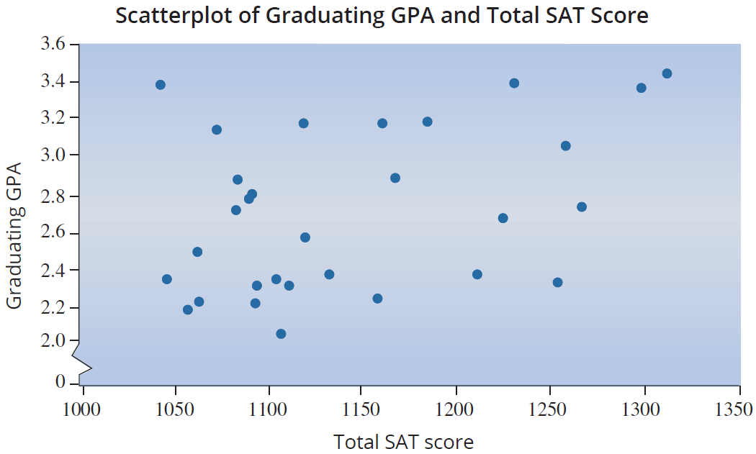
Example 5.3.1: Using a Least Squares Model to Predict GPA (cont.)

Slide 30
Example 5.3.1: Using a Least Squares Model to Predict GPA (cont.)
The scatterplot of the data suggests that as SAT scores increase the GPA tends to increase, although there is a substantial amount of variability in the relationship. The upward sloping pattern of the data suggests a linear model could be constructed. However, a great deal of variation in the model’s errors should be expected. What percent of the variation in final grade point average can be explained by the model relating total SAT score to graduating GPA?

Slide 31

Example 5.3.1: Using a Least Squares Model to Predict GPA (cont.)
Solution
Using the least squares method, the estimated model is given by
$$Estimated Graduating GPA = \hat{y}=0.2733 + 0.0021 Total SAT Score.$$

Slide 32
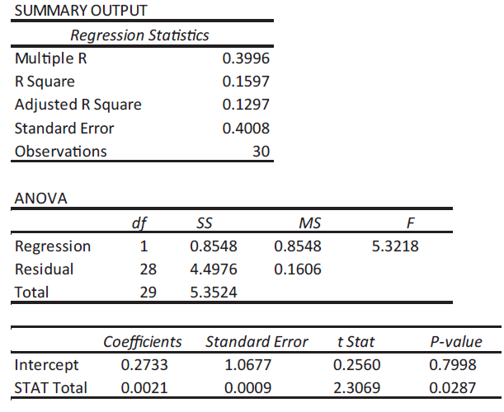
Example 5.3.1: Using a Least Squares Model to Predict GPA (cont.)

Slide 33
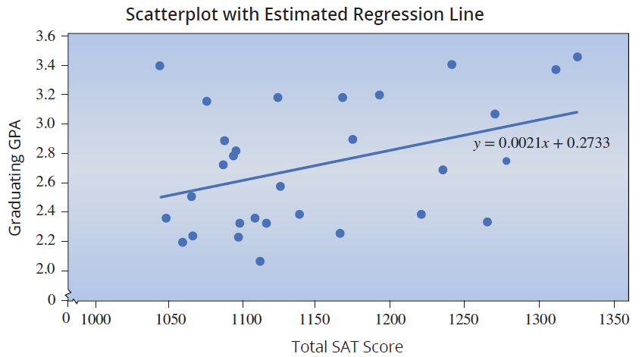
Example 5.3.1: Using a Least Squares Model to Predict GPA (cont.)

Slide 34
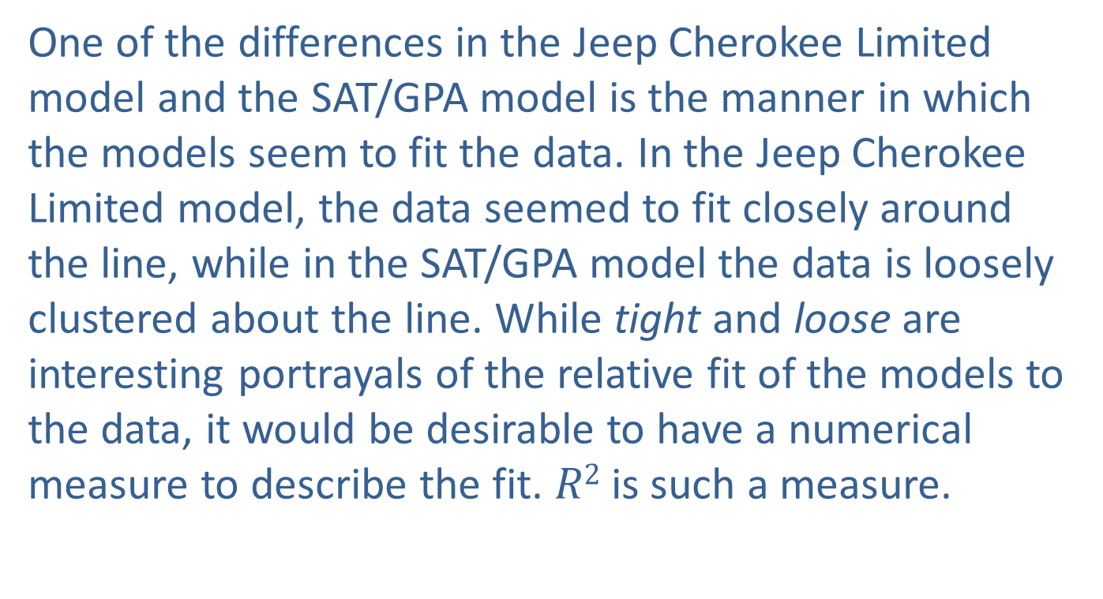
Example 5.3.1: Using a Least Squares Model to Predict GPA (cont.)
One of the differences in the Jeep Cherokee Limited model and the SAT/GPA model is the manner in which the models seem to fit the data. In the Jeep Cherokee Limited model, the data seemed to fit closely around the line, while in the SAT/GPA model the data is loosely clustered about the line. While tight and loose are interesting portrayals of the relative fit of the models to the data, it would be desirable to have a numerical measure to describe the fit. $R2$ is such a measure.

Slide 35
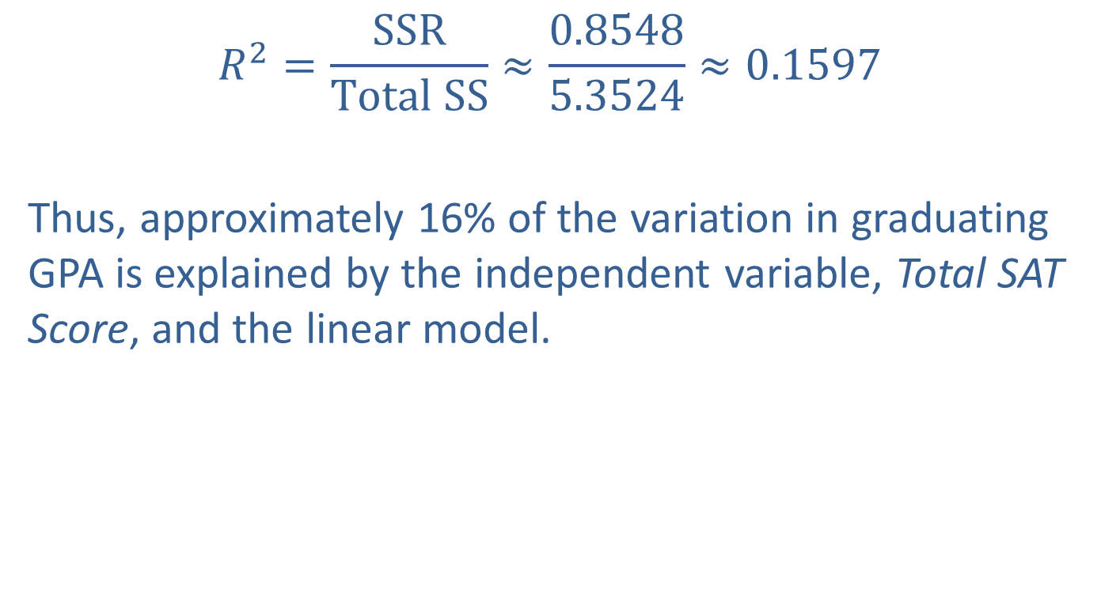
Example 5.3.1: Using a Least Squares Model to Predict GPA (cont.)
$$R^{2}=\frac{SSR}{Total SS}≈\frac{0.8548}{5.3524}≈0.1597$$
Thus, approximately 16% of the variation in graduating GPA is explained by the independent variable, Total SAT Score, and the linear model.

Slide 36
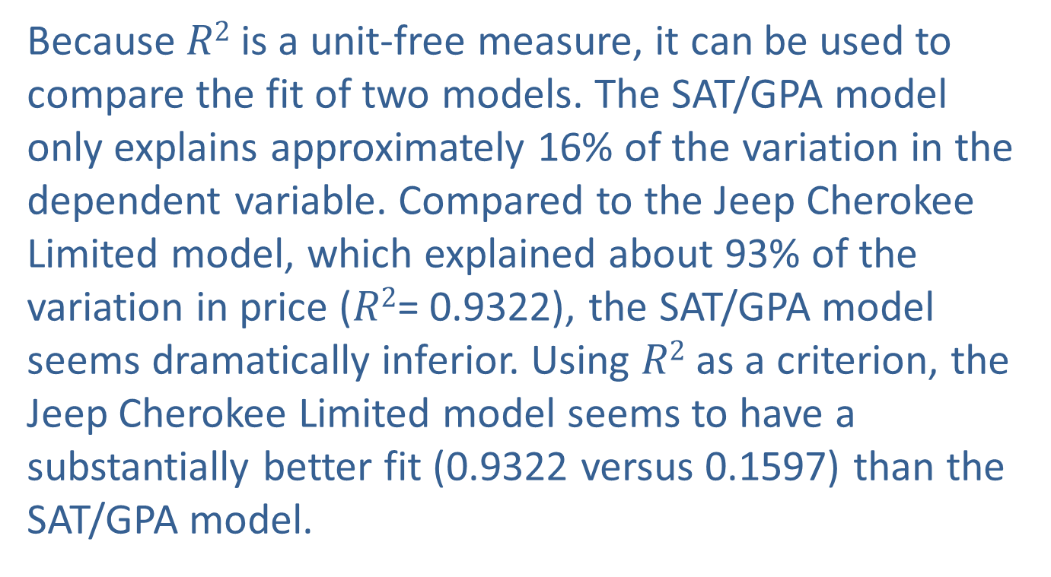
The Coefficient of Determination (cont.)
Because $R2$ is a unit-free measure, it can be used to compare the fit of two models. The SAT/GPA model only explains approximately 16% of the variation in the dependent variable. Compared to the Jeep Cherokee Limited model, which explained about 93% of the variation in price ($R2$= 0.9322), the SAT/GPA model seems dramatically inferior. Using $R2$ as a criterion, the Jeep Cherokee Limited model seems to have a substantially better fit (0.9322 versus 0.1597) than the SAT/GPA model.

Slide 37
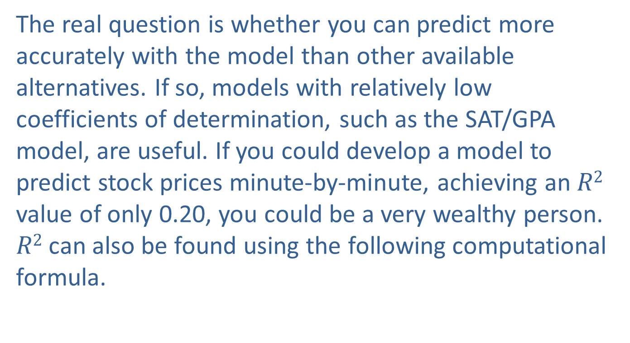
The Coefficient of Determination (cont.)
The real question is whether you can predict more accurately with the model than other available alternatives. If so, models with relatively low coefficients of determination, such as the SAT/GPA model, are useful. If you could develop a model to predict stock prices minute-by-minute, achieving an $R2$ value of only 0.20, you could be a very wealthy person.
$R2$ can also be found using the following computational formula.

Slide 38
Formula: Coefficient of Determination
The coefficient of determination, R², can be calculated using the equation:

Slide 39
The Coefficient of Determination (cont.)
Normally you will not have to use this formula since calculators and computer software can calculate the coefficient of determination. Recall the computational formula for the correlation coefficient that measures the degree of linear relationship between two variables.

Slide 40
The Coefficient of Determination (cont.)
As we discovered in performing a regression analysis of the Jeep Cherokee Limited data, the coefficient of determination is the square of the correlation coefficient. The correlation coefficient can be found by either using the formula given previously or by taking the square root of the coefficient of determination, and adding the sign corresponding to the slope coefficient. Remember that the correlation coefficient takes on values between −1 and 1, where negative values indicate a downward sloping relationship and positive values indicate an upward sloping relationship.

Slide 41
The Coefficient of Determination (cont.)
The coefficient of determination takes on values between 0 and 1 where values close to 0 indicate a weak linear relationship and values close to 1 indicate a strong linear relationship.

