Slide 1
Section 5.2
Fitting a Linear Model

Slide 2
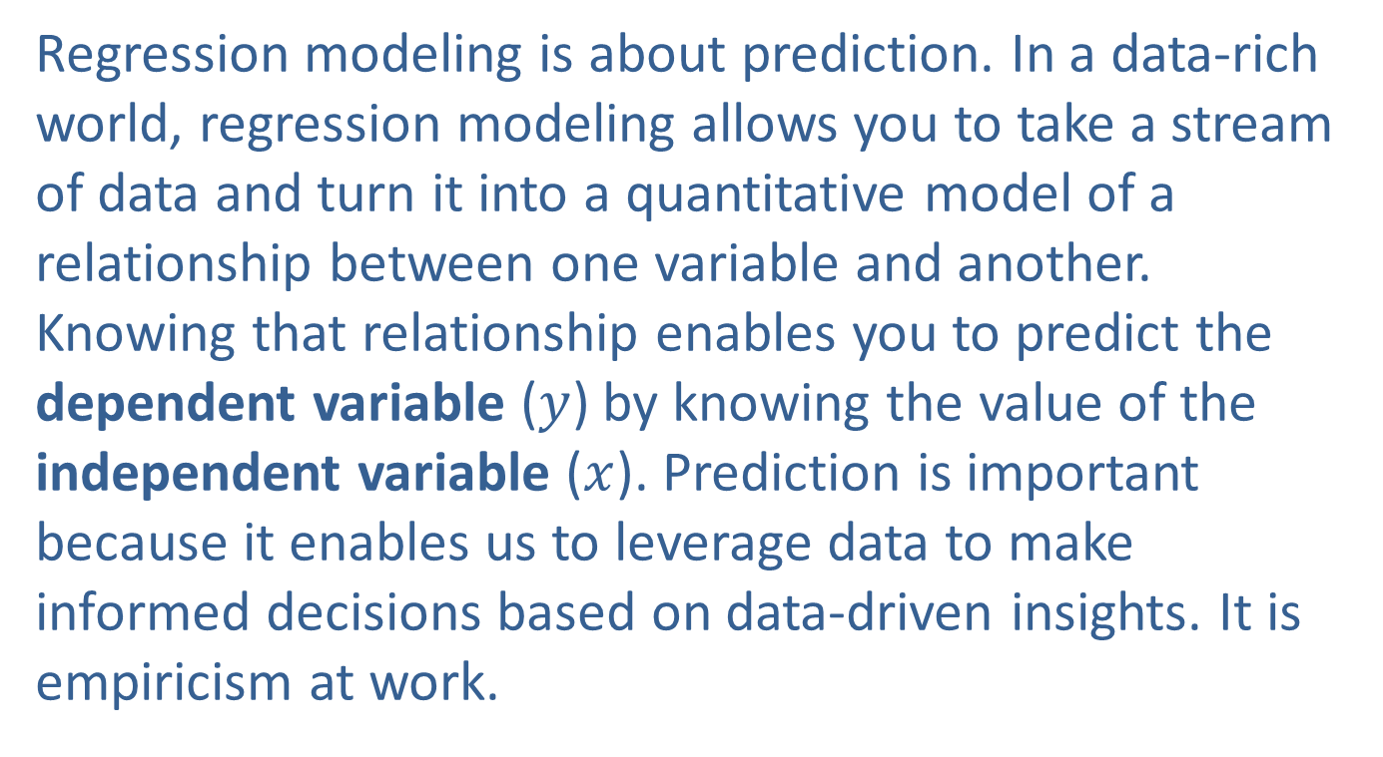
Building a Model
Regression modeling is about prediction. In a data-rich world, regression modeling allows you to take a stream of data and turn it into a quantitative model of a relationship between one variable and another. Knowing that relationship enables you to predict the dependent variable ($y$) by knowing the value of the independent variable ($x$). Prediction is important because it enables us to leverage data to make informed decisions based on data-driven insights. It is empiricism at work.

Slide 3
Building a Model (cont.)
Regression model building is a powerful predictive statistical technique! Recognizing the power of regression-based model building is crucial for anyone seeking to harness the full potential of data-driven methods.
Developing a model to fit real-world measurements is not trivial. As we saw in the section on correlation, Nature doesn’t cooperate by requiring all relationships to be straight lines. Seldom, in fact, do plotted pairs of measurements fall on a perfectly straight line.

Slide 4
Building a Model (cont.)
If a linear relationship exists, the variables will have some general tendency to move together (as one variable increases so does the other), or in opposite directions (as one variable increases the other decreases), and regression modeling attempts to model that tendency.
This chapter introduces the simplest form of regression modeling that analyzes the relationship between two variables.

Slide 5
Building a Model (cont.)
Chapter 14 discusses the development of more complex models that can incorporate additional independent variables, account for more intricate relationships, and provide a more comprehensive understanding of the data.
In the following sections we will look at ways of measuring the degree of a linear relationship between two variables, as well as estimating the parameters (slope and intercept) of a line for a specific set of data.

Slide 6
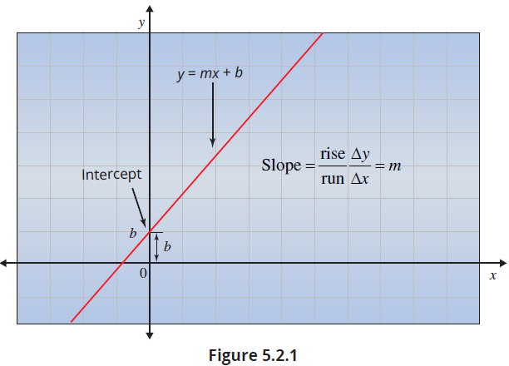

Linear Equations
Some basic concepts from algebra appear in a linear regression model. Recall the slope-intercept equation of a line: $y=mx+b$. Figure 5.2.1 displays these parts of the line.

Slide 7
Definition: Linear Relationship
A linear relationship is graphically described as a line. Mathematically, a line is a set of points that satisfy the functional relationship
y = mx + b
where m is the slope of the line and b is the point where the function crosses the y-axis, which is called the y-intercept.

Slide 8
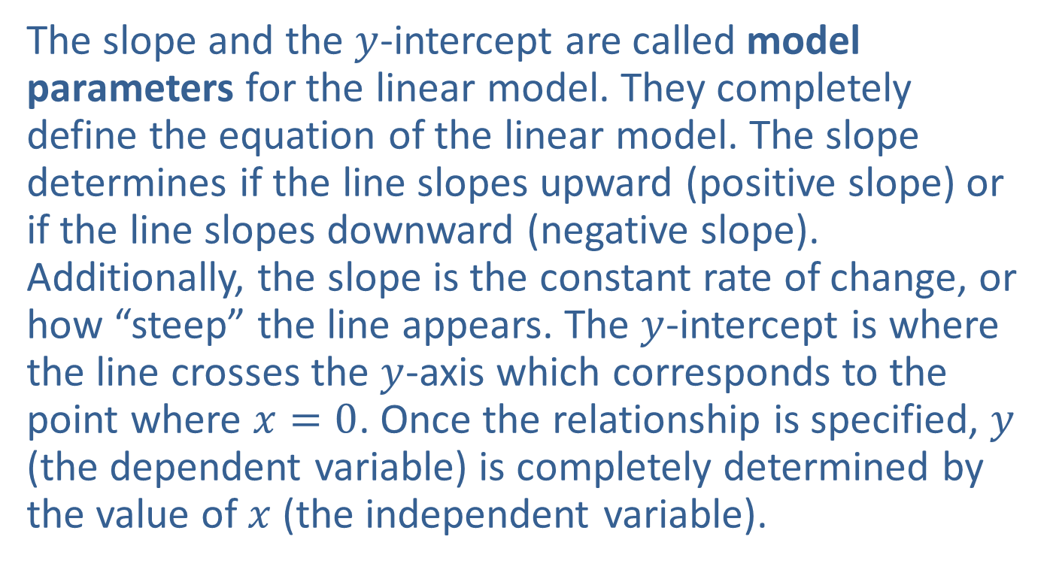
Linear Equations (cont.)
The slope and the $y$-intercept are called model parameters for the linear model. They completely define the equation of the linear model. The slope determines if the line slopes upward (positive slope) or if the line slopes downward (negative slope). Additionally, the slope is the constant rate of change, or how “steep” the line appears. The $y$-intercept is where the line crosses the $y$-axis which corresponds to the point where $x=0$. Once the relationship is specified, $y$ (the dependent variable) is completely determined by the value of $x$ (the independent variable).

Slide 9
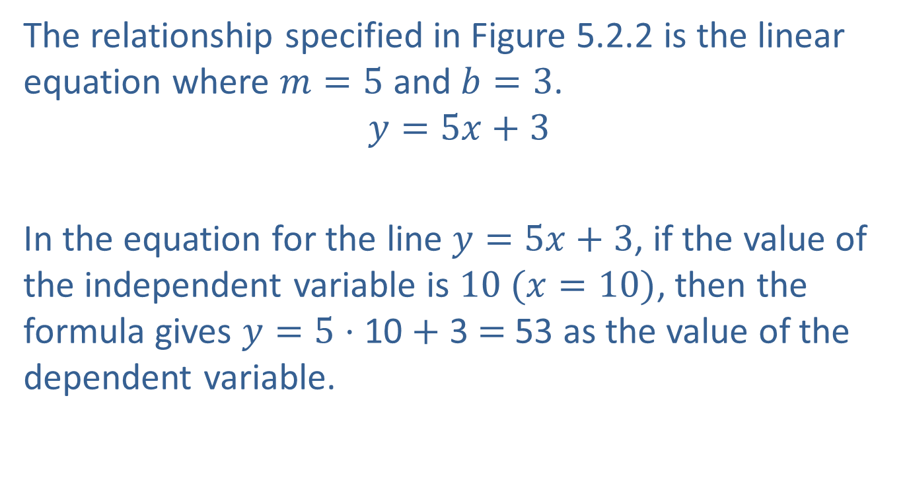
Linear Equations (cont.)
The relationship specified in Figure 5.2.2 is the linear equation where $m=5$ and $b=3$.
$$y=5x+3$$
In the equation for the line $y=5x+3$, if the value of the independent variable is $10 (x=10)$, then the formula gives $y=5$ ⋅ 10 $+$ 3 $=$ 53 as the value of the dependent variable.
Slope
Intercept

Slide 10
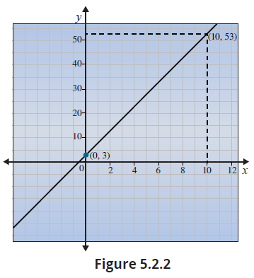
Linear Equations (cont.)

Slide 11
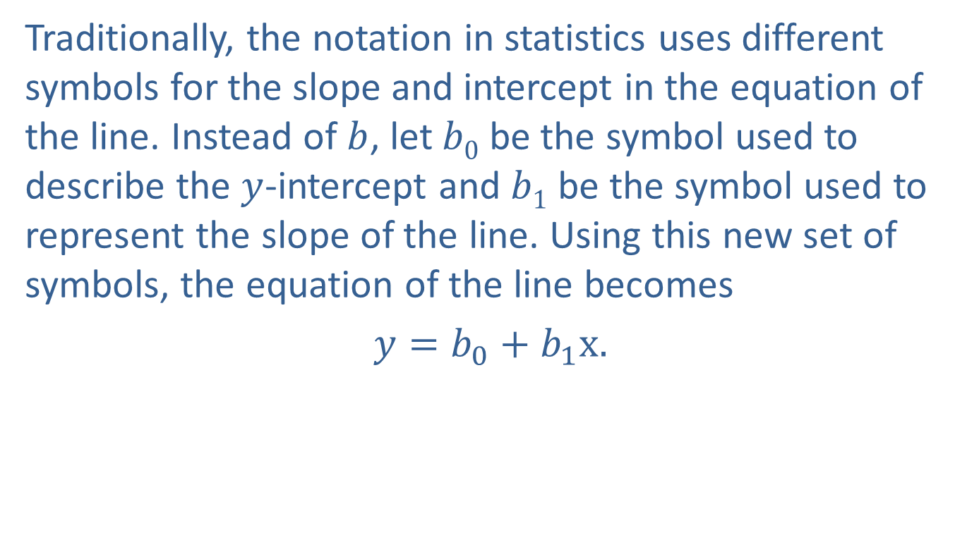
Defining a Linear Relationship in Statistics
Traditionally, the notation in statistics uses different symbols for the slope and intercept in the equation of the line. Instead of $b$, let $b0$ be the symbol used to describe the $y$-intercept and $b1$ be the symbol used to represent the slope of the line. Using this new set of symbols, the equation of the line becomes
$y=b_{0}+$ $b_{1}x.$
Intercept
Coefficient
Slope Coefficient

Slide 12
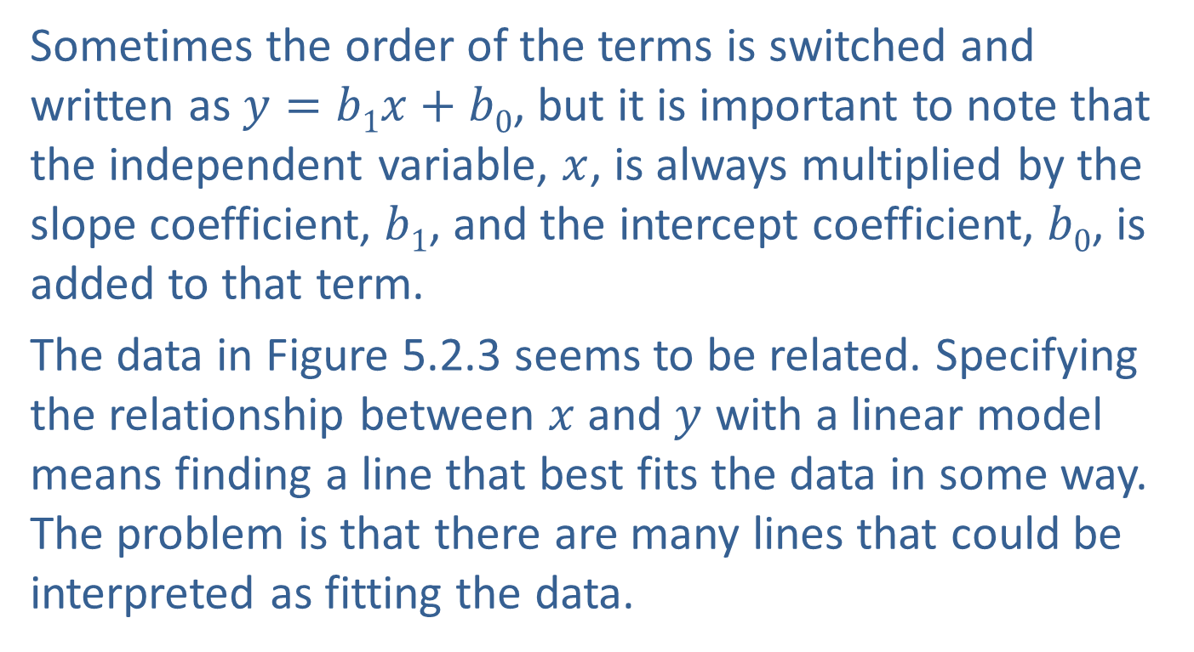
Defining a Linear Relationship in Statistics (cont.)
Sometimes the order of the terms is switched and written as $y=b1x+b0$, but it is important to note that the independent variable, $x$, is always multiplied by the slope coefficient, $b1$, and the intercept coefficient, $b0$, is added to that term.
The data in Figure 5.2.3 seems to be related. Specifying the relationship between $x$ and $y$ with a linear model means finding a line that best fits the data in some way. The problem is that there are many lines that could be interpreted as fitting the data.

Slide 13
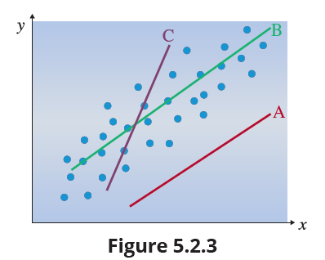
Defining a Linear Relationship in Statistics (cont.)

Slide 14
Defining a Linear Relationship in Statistics (cont.)
Which one of the lines in Figure 5.2.3 do you think best fits the data? Clearly, Line A doesn’t do a very good job. While the slope of Line A seems to parallel that of the data, the points don’t cluster around the line at all. Lines B and C are very different lines, and they both seem to go through the data in some sense. Line C is “near” the data points but the slope is just too steep. Line B seems to fit the data much better than Line C, but is it the “best” line? To find the best line, we must come up with a method of summarizing how close each line is to the data.

Slide 15
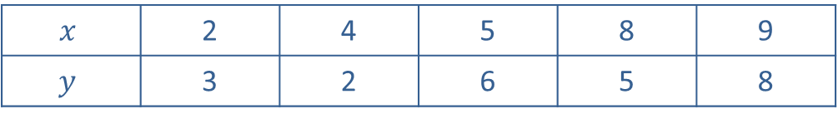
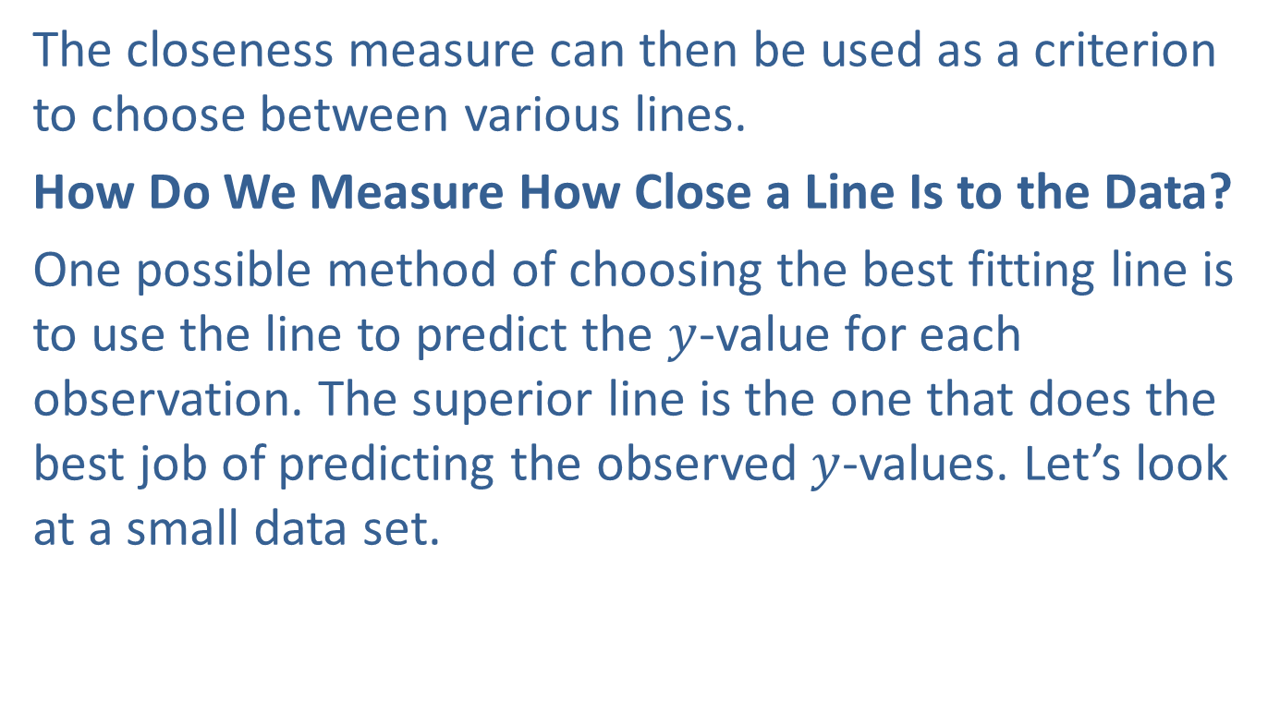
Defining a Linear Relationship in Statistics (cont.)
The closeness measure can then be used as a criterion to choose between various lines.
How Do We Measure How Close a Line Is to the Data?
One possible method of choosing the best fitting line is to use the line to predict the $y$-value for each observation. The superior line is the one that does the best job of predicting the observed $y$-values. Let’s look at a small data set.
$$x$$ | 2 | 4 | 5 | 8 | 9
$$y$$ | 3 | 2 | 6 | 5 | 8

Slide 16
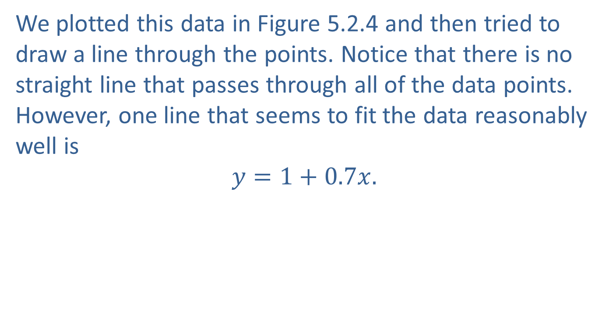
Defining a Linear Relationship in Statistics (cont.)
We plotted this data in Figure 5.2.4 and then tried to draw a line through the points. Notice that there is no straight line that passes through all of the data points. However, one line that seems to fit the data reasonably well is
$$y=1+0.7x.$$

Slide 17
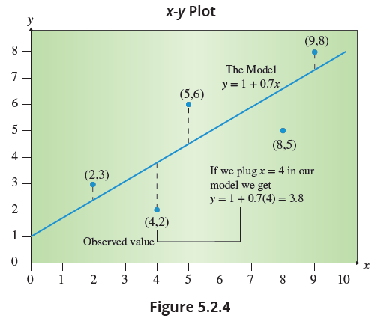
Defining a Linear Relationship in Statistics (cont.)

Slide 18
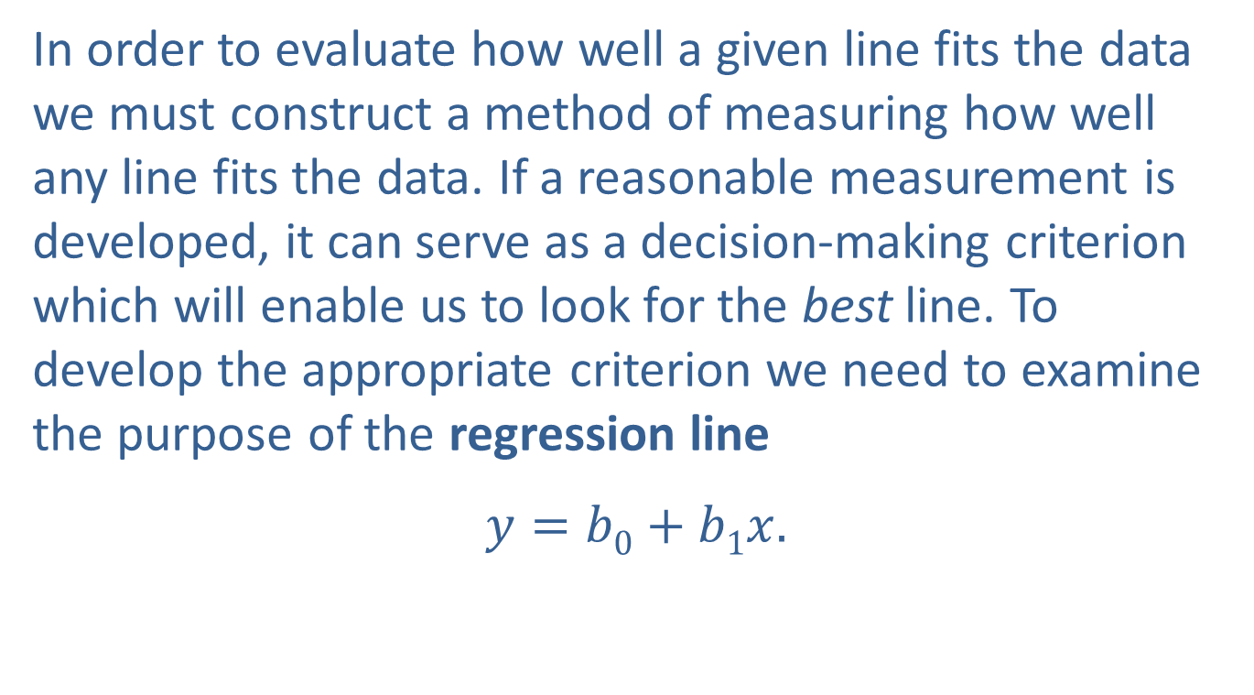
Defining a Linear Relationship in Statistics (cont.)
In order to evaluate how well a given line fits the data we must construct a method of measuring how well any line fits the data. If a reasonable measurement is developed, it can serve as a decision-making criterion which will enable us to look for the best line. To develop the appropriate criterion we need to examine the purpose of the regression line
$$y=b0+b1x.$$

Slide 19
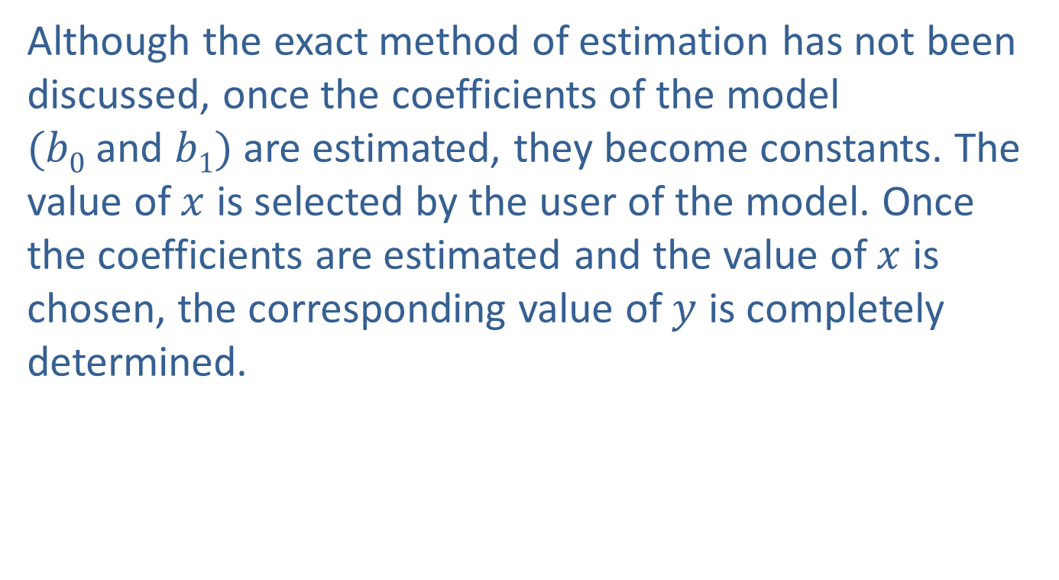
Defining a Linear Relationship in Statistics (cont.)
Although the exact method of estimation has not been discussed, once the coefficients of the model $(b0$ and $b1)$ are estimated, they become constants. The value of $x$ is selected by the user of the model. Once the coefficients are estimated and the value of $x$ is chosen, the corresponding value of $y$ is completely determined.

Slide 20
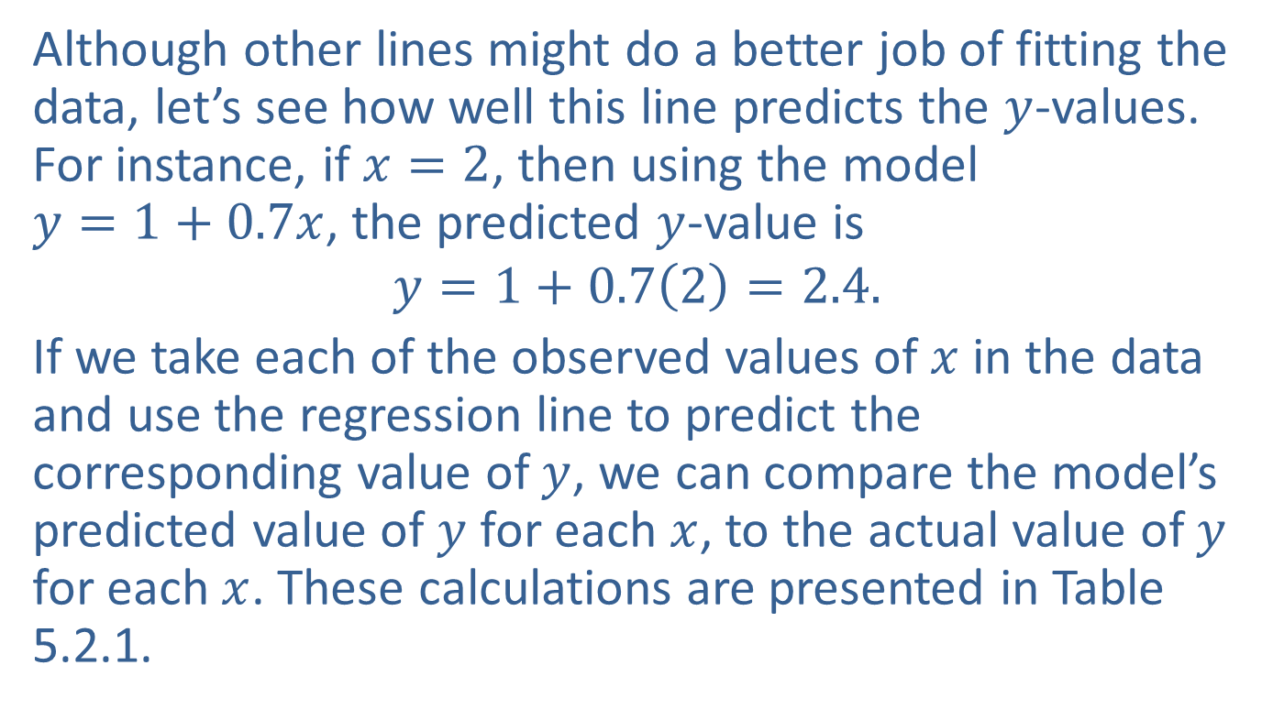
Defining a Linear Relationship in Statistics (cont.)
Although other lines might do a better job of fitting the data, let’s see how well this line predicts the $y$-values. For instance, if $x=2$, then using the model $y=1+0.7x$, the predicted $y$-value is
$$y=1+0.7\left(2\right)=2.4.$$
If we take each of the observed values of $x$ in the data and use the regression line to predict the corresponding value of $y$, we can compare the model’s predicted value of $y$ for each $x$, to the actual value of $y$ for each $x$. These calculations are presented in Table 5.2.1.

Slide 21
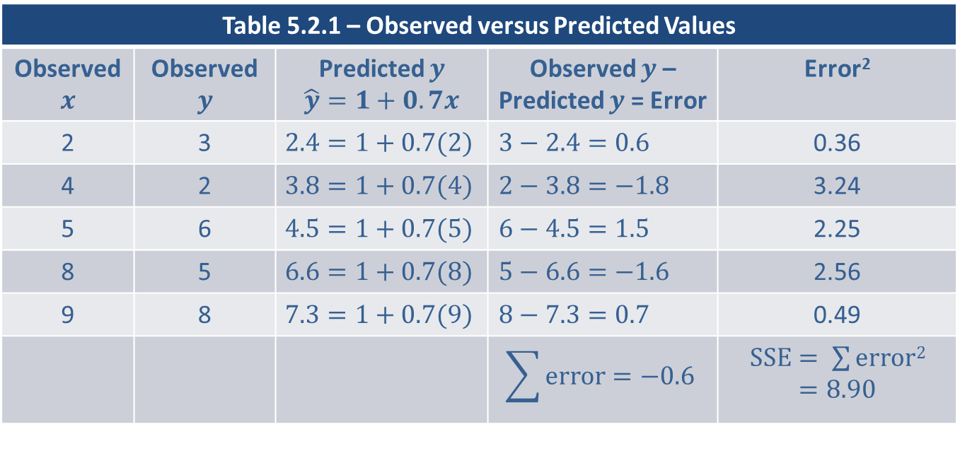
Defining a Linear Relationship in Statistics (cont.)
Table 5.2.1 – Observed versus Predicted Values
Observed $$x$$ | Observed $$y$$ | Predicted $y$ $$\hat{y}=1+0.7x$$ | Observed $y$ – Predicted $y$ = Error | Error²
2 | 3 | $$2.4=1+0.7(2)$$ | $$3−2.4=0.6$$ | 0.36
4 | 2 | $$3.8=1+0.7(4)$$ | $$2−3.8=−1.8$$ | 3.24
5 | 6 | $$4.5=1+0.7(5)$$ | $$6−4.5=1.5$$ | 2.25
8 | 5 | $$6.6=1+0.7(8)$$ | $$5−6.6=−1.6$$ | 2.56
9 | 8 | $$7.3=1+0.7(9)$$ | $$8−7.3=0.7$$ | 0.49
 |  |  | $$\sum{error=−0.6}$$ | $SSE= \sum{error2}$ $=8.90$

Slide 22
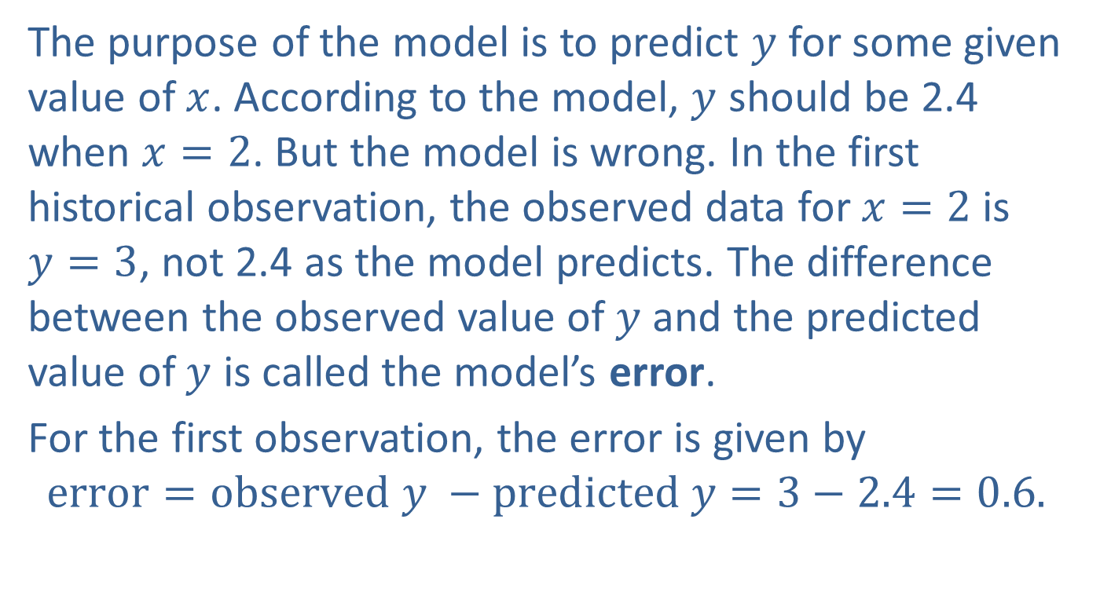
Defining a Linear Relationship in Statistics (cont.)
The purpose of the model is to predict $y$ for some given value of $x$. According to the model, $y$ should be 2.4 when $x=2$. But the model is wrong. In the first historical observation, the observed data for $x=2$is $y=3$, not 2.4 as the model predicts. The difference between the observed value of $y$ and the predicted value of $y$ is called the model’s error.
For the first observation, the error is given by
$$error=observed y −predicted y=3−2.4=0.6.$$

Slide 23
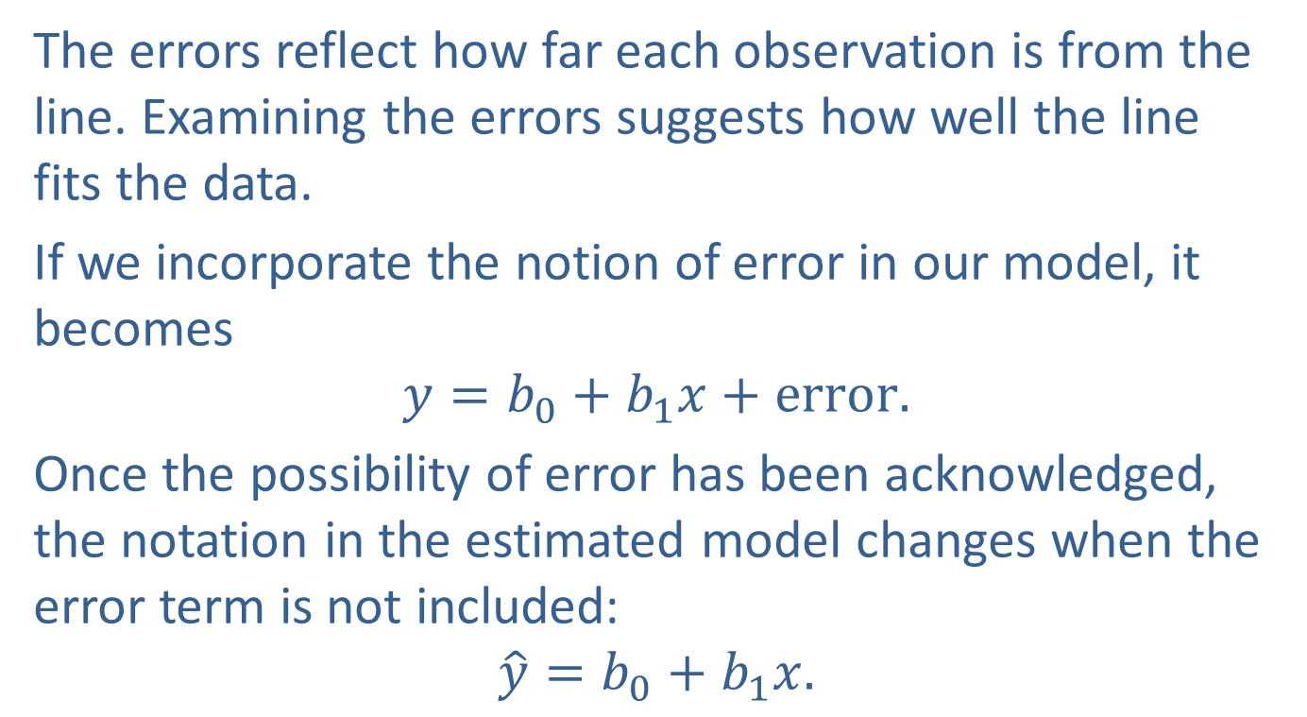
Defining a Linear Relationship in Statistics (cont.)
The errors reflect how far each observation is from the line. Examining the errors suggests how well the line fits the data.
If we incorporate the notion of error in our model, it becomes
$$y=b_{0}+b_{1}x+error.$$
Once the possibility of error has been acknowledged, the notation in the estimated model changes when the error term is not included:
$$\hat{y}=b_{0}+b_{1}x.$$

Slide 24
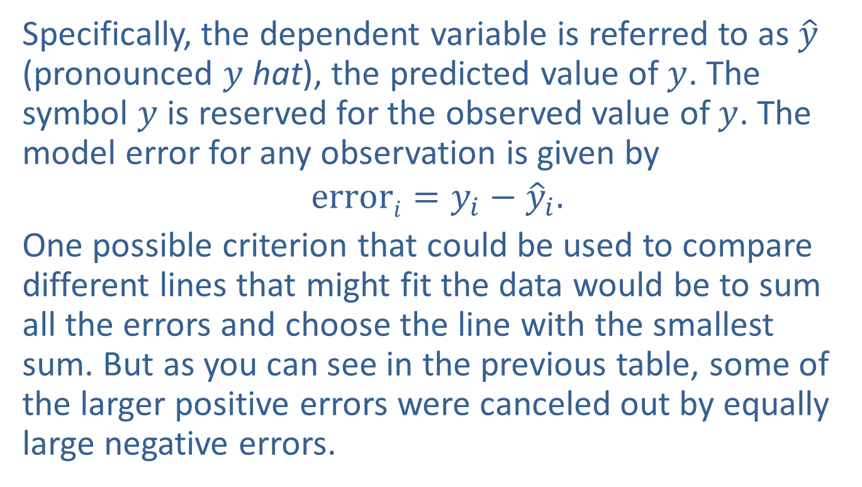
Defining a Linear Relationship in Statistics (cont.)
Specifically, the dependent variable is referred to as $\hat{y}$ (pronounced $y$ hat), the predicted value of $y$. The symbol $y$ is reserved for the observed value of $y$. The model error for any observation is given by
$$errori=y_{i}−{\hat{y}}_{i}.$$
One possible criterion that could be used to compare different lines that might fit the data would be to sum all the errors and choose the line with the smallest sum. But as you can see in the previous table, some of the larger positive errors were canceled out by equally large negative errors.

Slide 25
Defining a Linear Relationship in Statistics (cont.)
Therefore, it is possible to develop a line that has a small sum of errors, but the errors themselves are quite large. Thus, the sum of the errors is not the criterion we have been looking for, but it is close. However, by squaring the error terms and then adding the squared errors, there are no negative errors to cancel out the positive ones.
Let’s examine the measurement of the sum of squared errors (SSE).

Slide 26
Formula: Sum of Squared Errors (SSE)
The sum of squared errors (SSE) is given by

Slide 27
Defining a Linear Relationship in Statistics (cont.)
SSE can be used as a criterion for selecting the best fitting line through a set of points. If SSE is zero, then the model fits the data exactly and the observed data must lie in a straight line. If Line A’s SSE is larger than Line B’s, then Line B fits the data better than Line A. For the model we have been studying, the value of SSE is 8.90. Without studying other possible lines, there is no way to judge whether this is a large or small value for SSE.

Slide 28
Defining a Linear Relationship in Statistics (cont.)
However, if there were a method that would find the best line (the line with the least sum of squared errors), then our problem would be solved. This best line would be called the least squares line since it would have the smallest SSE.

Slide 29
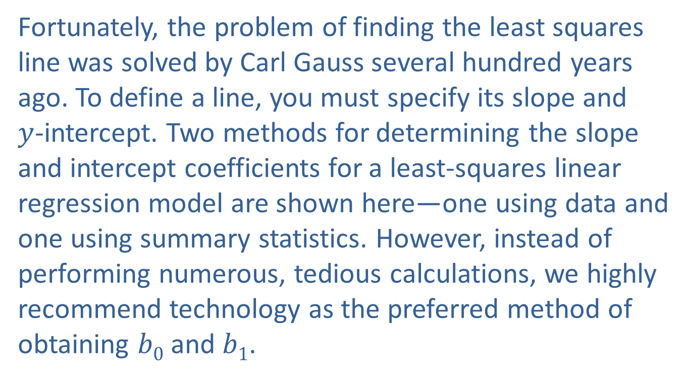
Finding the Least Squares Line
Fortunately, the problem of finding the least squares line was solved by Carl Gauss several hundred years ago. To define a line, you must specify its slope and $y$-intercept. Two methods for determining the slope and intercept coefficients for a least-squares linear regression model are shown here—one using data and one using summary statistics. However, instead of performing numerous, tedious calculations, we highly recommend technology as the preferred method of obtaining $b0$ and $b1$.

Slide 30
Formula: Slope and y-Intercept of the Least Squares Line Using Data

Slide 31
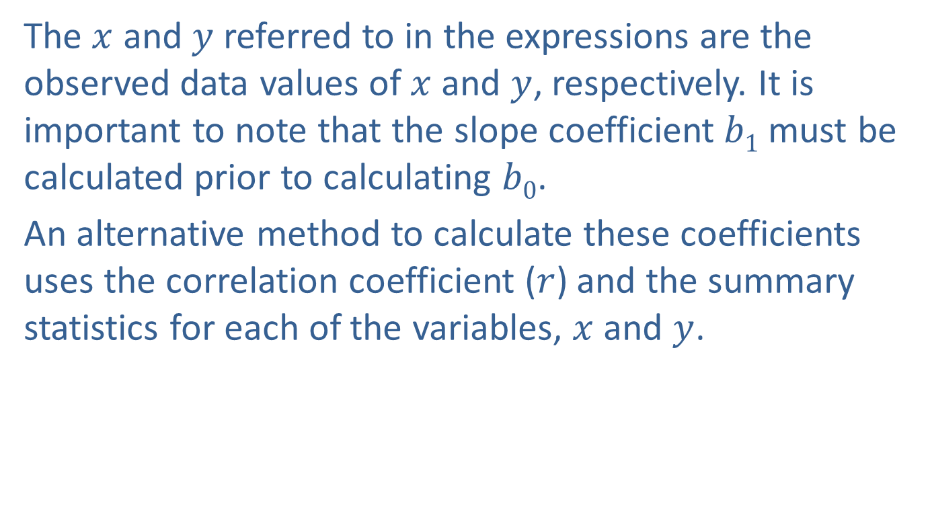
Finding the Least Squares Line (cont.)
The $x$ and $y$ referred to in the expressions are the observed data values of $x$ and $y$, respectively. It is important to note that the slope coefficient $b1$ must be calculated prior to calculating $b0$.
An alternative method to calculate these coefficients uses the correlation coefficient ($r$) and the summary statistics for each of the variables, $x$ and $y$.

Slide 32

Finding the Least Squares Line (cont.)
At times, the means ($\overline{x}$ and $\overline{y}$) and standard deviations ($sx$ and $sy$) for the independent and dependent variables may be already calculated and can be used in the following formulas to determine the coefficients of the least squares regression model.

Slide 33
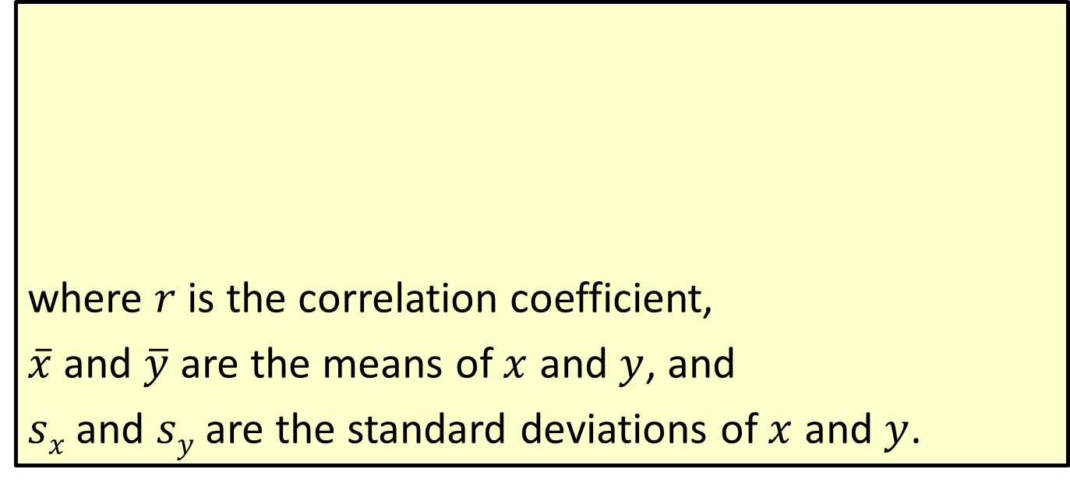
Formula: Slope and y-Intercept of the Least Squares Line Using Summary Statistics
where $r$ is the correlation coefficient,
$\overline{x}$ and $\overline{y}$ are the means of $x$ and $y$, and
$sx$ and $sy$ are the standard deviations of $x$ and $y$.

Slide 34
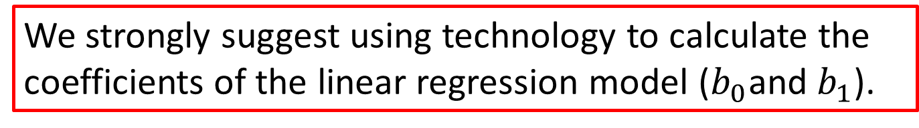
Note
We strongly suggest using technology to calculate the coefficients of the linear regression model ($b_{0}$and $b_{1}$).

Slide 35
Example 5.2.1: Determining the Least Squares Line for Temperature and Number of Cricket Chirps
The relationship between the air temperature and the number of chirps produced by crickets can be modeled using a linear regression model. The table contains the summary statistics from a sample of 22 observations taken throughout various times of the day during the month of June. A scatterplot of the data is also shown.

Slide 36
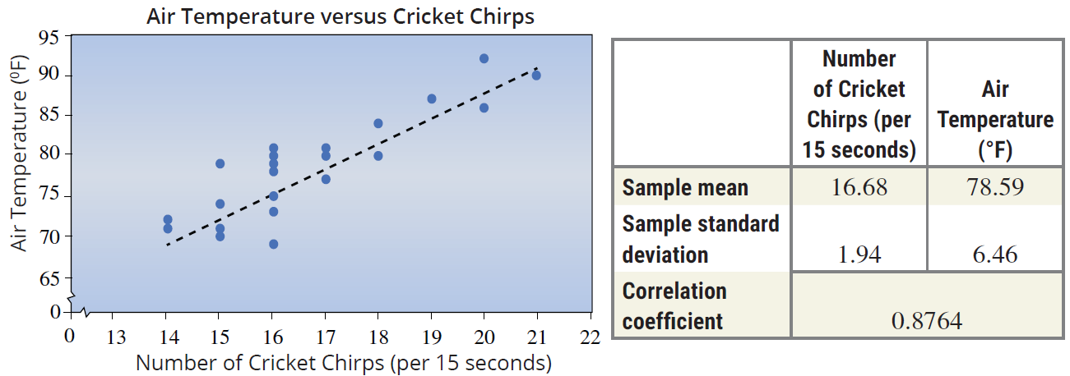
Example 5.2.1: Determining the Least Squares Line for Temperature and Number of Cricket Chirps (cont.)

Slide 37
Example 5.2.1: Determining the Least Squares Line for Temperature and Number of Cricket Chirps (cont.)
Use the summary statistics to determine the least squares regression equation which predicts air temperature from the number of cricket chirps in 15 seconds.
Verify your results using technology with the data found on the companion website.
Use the equation to predict the air temperature if an observer counted 20 cricket chirps in a fifteen second interval.
What are possible confounding variables for this model?

Slide 38
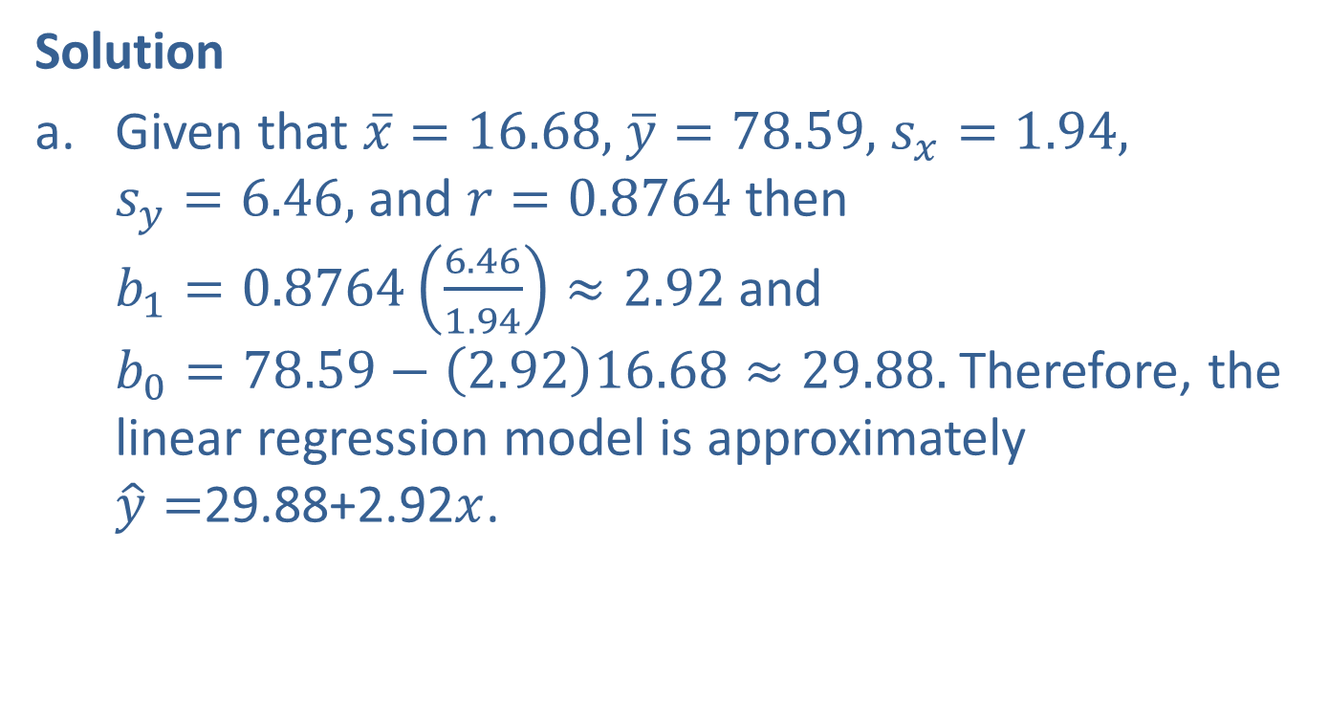
Example 5.2.1: Determining the Least Squares Line for Temperature and Number of Cricket Chirps (cont.)
Solution
Given that $\overline{x}=16.68,$ $\overline{y}=78.59,$ $s_{x}=1.94,$ $s_{y}=6.46,$ and $r=0.8764$ then $b_{1}=0.8764\left(\frac{6.46}{1.94}\right)≈2.92$ and $b_{0}=78.59−\left(2.92\right)16.68≈29.88.$ Therefore, the linear regression model is approximately $\hat{y}=$29.88+2.92$x$.

Slide 39
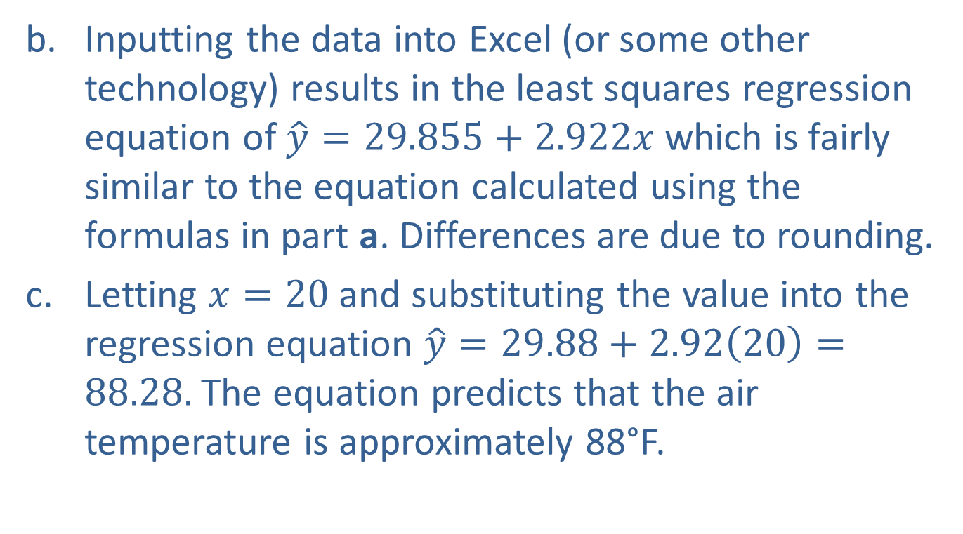
Example 5.2.1: Determining the Least Squares Line for Temperature and Number of Cricket Chirps (cont.)
Inputting the data into Excel (or some other technology) results in the least squares regression equation of $\hat{y}=29.855+2.922x$ which is fairly similar to the equation calculated using the formulas in part a. Differences are due to rounding.
Letting $x=20$and substituting the value into the regression equation $\hat{y}=29.88+2.92\left(20\right)=88.28.$ The equation predicts that the air temperature is approximately 88°F.

Slide 40
Example 5.2.1: Determining the Least Squares Line for Temperature and Number of Cricket Chirps (cont.)
Some possible confounding factors could include the species of cricket, humidity, or other weather conditions.
You may never have to use these formulas, since many calculators and computer programs compute the coefficients of the least squares line and can superimpose the graph of the least squares line onto the data shown in the scatterplot.

Slide 41
Estimating a Linear Relationship
Anyone who has ever purchased a car knows that a relationship exists between the price of a car and its age. In Table 5.2.2, data on age and asking price of a Jeep Cherokee Limited SUV has been gathered from fourteen classified car ads in a local newspaper.

Slide 42
Estimating a Linear Relationship (cont.)
Table 5.2.2 – Price of a Jeep Cherokee Limited SUV
Age (Years) | Asking Price | Age (Years) | Asking Price
1 | $44,998 | 4 | $28,997
1 | $42,768 | 4 | $29,850
2 | $38,731 | 5 | $24,750
2 | $40,999 | 5 | $27,799
2 | $37,619 | 6 | $23,899
3 | $37,573 | 6 | $27,500
3 | $35,955 | 6 | $24,689

Slide 43
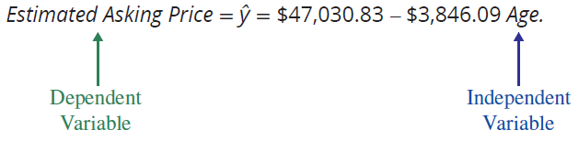
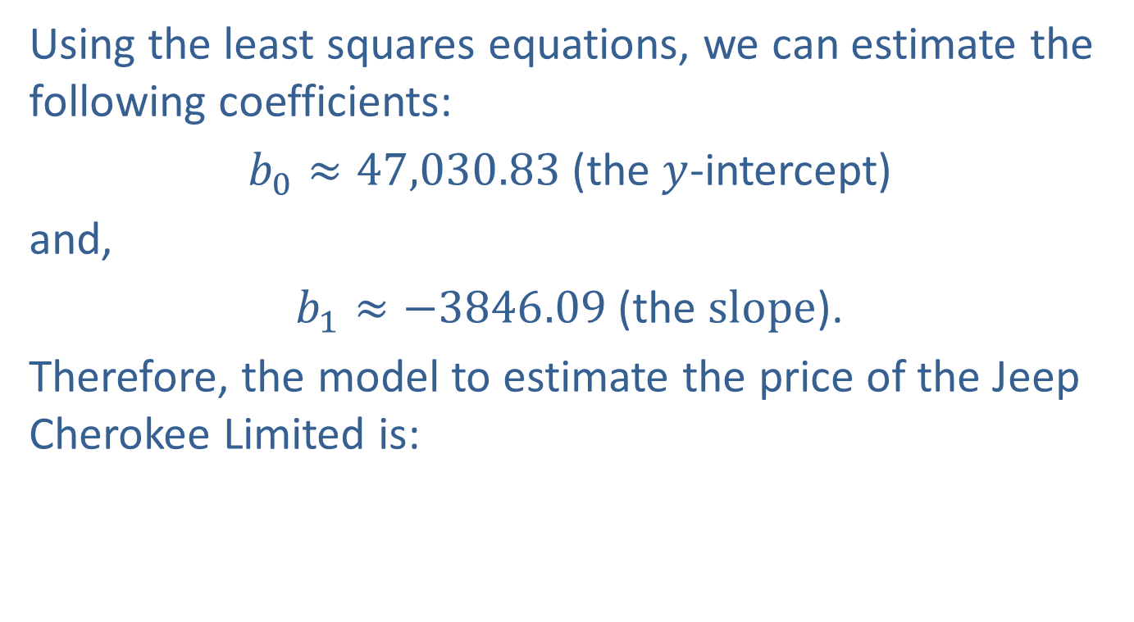
Estimating a Linear Relationship (cont.)
Using the least squares equations, we can estimate the following coefficients:
$b_{0}≈47,030.83$ (the $y$-intercept)
and,
$b_{1}≈−3846.09$ (the $slope$).
Therefore, the model to estimate the price of the Jeep Cherokee Limited is:

Slide 44
Note
The slope coefficient will ALWAYS have a meaningful interpretation within the context of the data as a rate of change.

Slide 45
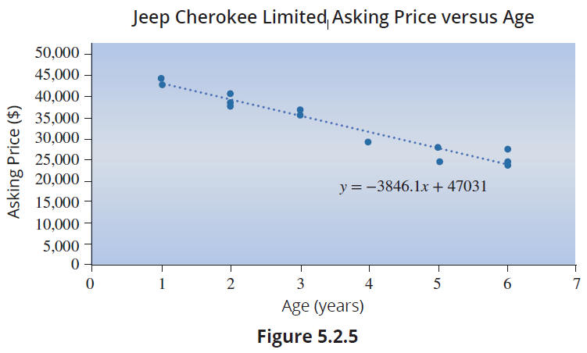
Estimating a Linear Relationship (cont.)
Figure 5.2.5 shows a graph of this model using the estimated coefficients.

Slide 46
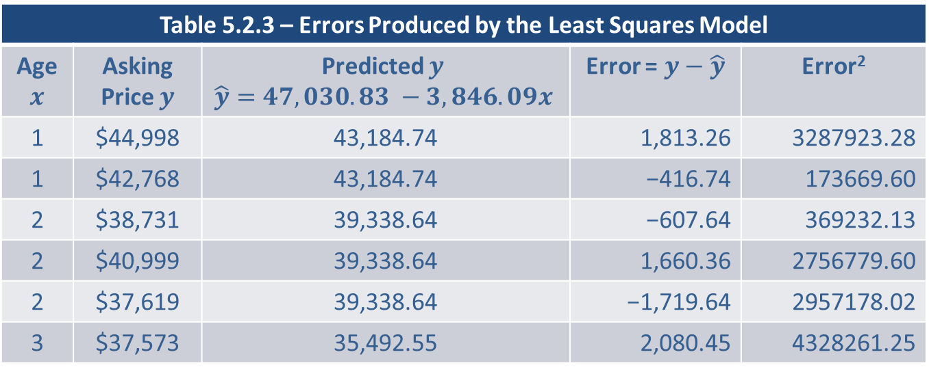
Estimating a Linear Relationship (cont.)
This model has a smaller SSE for this data than any other line. In Table 5.2.3 we examine the errors produced by the least squares model. Note that the sum of the errors equals zero.
Table 5.2.3 – Errors Produced by the Least Squares Model
Age $x$ | Asking Price $y$ | Predicted $y$ $$\hat{y}=47,030.83 −3,846.09x$$ | Error = $y−\hat{y}$ | Error²
1 | $44,998 | 43,184.74 | 1,813.26 | 3287923.28
1 | $42,768 | 43,184.74 | −416.74 | 173669.60
2 | $38,731 | 39,338.64 | −607.64 | 369232.13
2 | $40,999 | 39,338.64 | 1,660.36 | 2756779.60
2 | $37,619 | 39,338.64 | −1,719.64 | 2957178.02
3 | $37,573 | 35,492.55 | 2,080.45 | 4328261.25

Slide 47
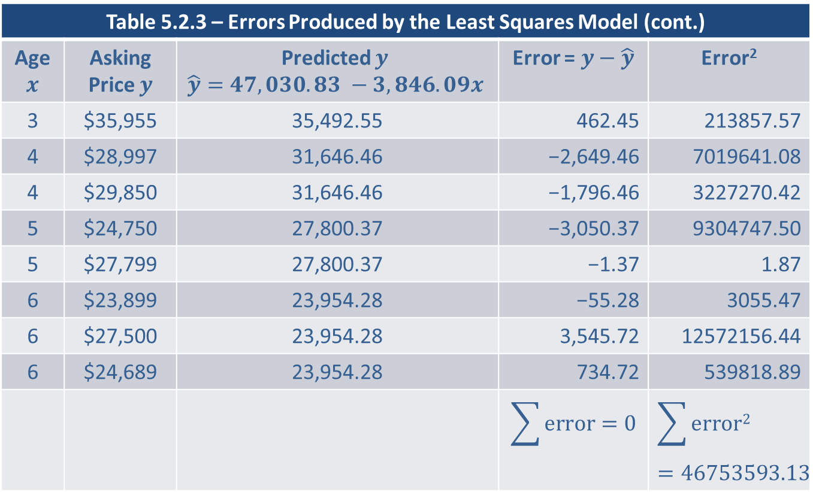
Estimating a Linear Relationship (cont.)
Table 5.2.3 – Errors Produced by the Least Squares Model (cont.)
Age $x$ | Asking Price $y$ | Predicted $y$ $$\hat{y}=47,030.83 −3,846.09x$$ | Error = $y−\hat{y}$ | Error²
3 | $35,955 | 35,492.55 | 462.45 | 213857.57
4 | $28,997 | 31,646.46 | −2,649.46 | 7019641.08
4 | $29,850 | 31,646.46 | −1,796.46 | 3227270.42
5 | $24,750 | 27,800.37 | −3,050.37 | 9304747.50
5 | $27,799 | 27,800.37 | −1.37 | 1.87
6 | $23,899 | 23,954.28 | −55.28 | 3055.47
6 | $27,500 | 23,954.28 | 3,545.72 | 12572156.44
6 | $24,689 | 23,954.28 | 734.72 | 539818.89
 |  |  | $$\sum{error}=0$$ | $$\sum{error2}=46753593.13$$

Slide 48
Estimating a Linear Relationship (cont.)
As you can see, in the building of a linear model, there is potential for a great deal of calculation. It is really important to learn to use some type of statistical analysis package or spreadsheet to compute the least squares coefficients as well as related statistics and diagnostic measures. These packages will compute a wealth of other summary and diagnostic measures concerning the estimated model.

Slide 49
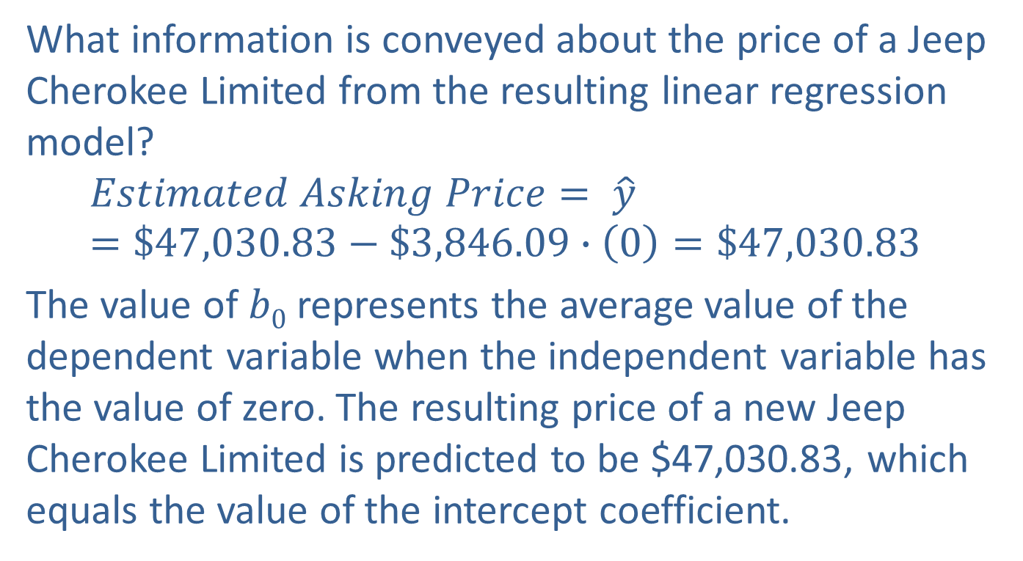
Interpreting the Regression Equation
What information is conveyed about the price of a Jeep Cherokee Limited from the resulting linear regression model?
$$Estimated Asking Price= \hat{y}=\$47,030.83−\$3,846.09∙\left(0\right)=\$47,030.83$$
The value of $b0$ represents the average value of the dependent variable when the independent variable has the value of zero. The resulting price of a new Jeep Cherokee Limited is predicted to be $47,030.83, which equals the value of the intercept coefficient.

Slide 50
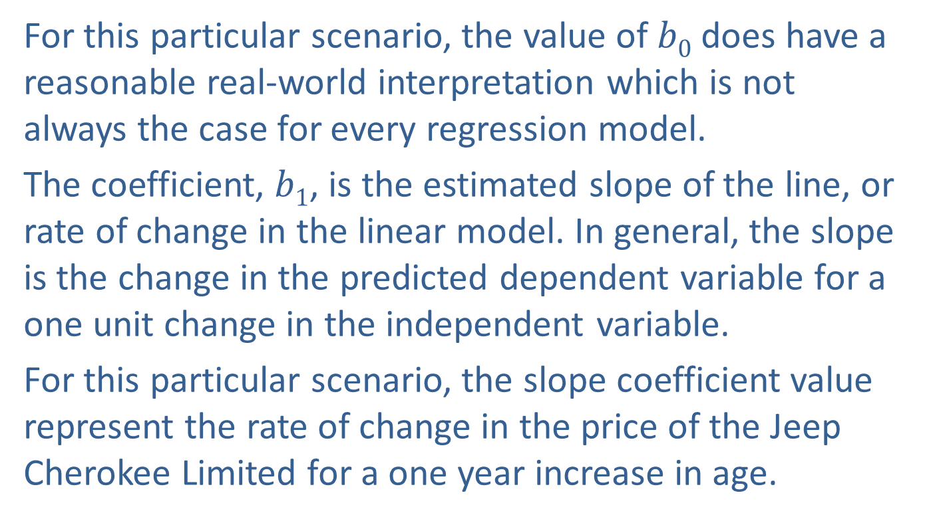
Interpreting the Regression Equation (cont.)
For this particular scenario, the value of $b0$ does have a reasonable real-world interpretation which is not always the case for every regression model.
The coefficient, $b1$, is the estimated slope of the line, or rate of change in the linear model. In general, the slope is the change in the predicted dependent variable for a one unit change in the independent variable.
For this particular scenario, the slope coefficient value represent the rate of change in the price of the Jeep Cherokee Limited for a one year increase in age.

Slide 51
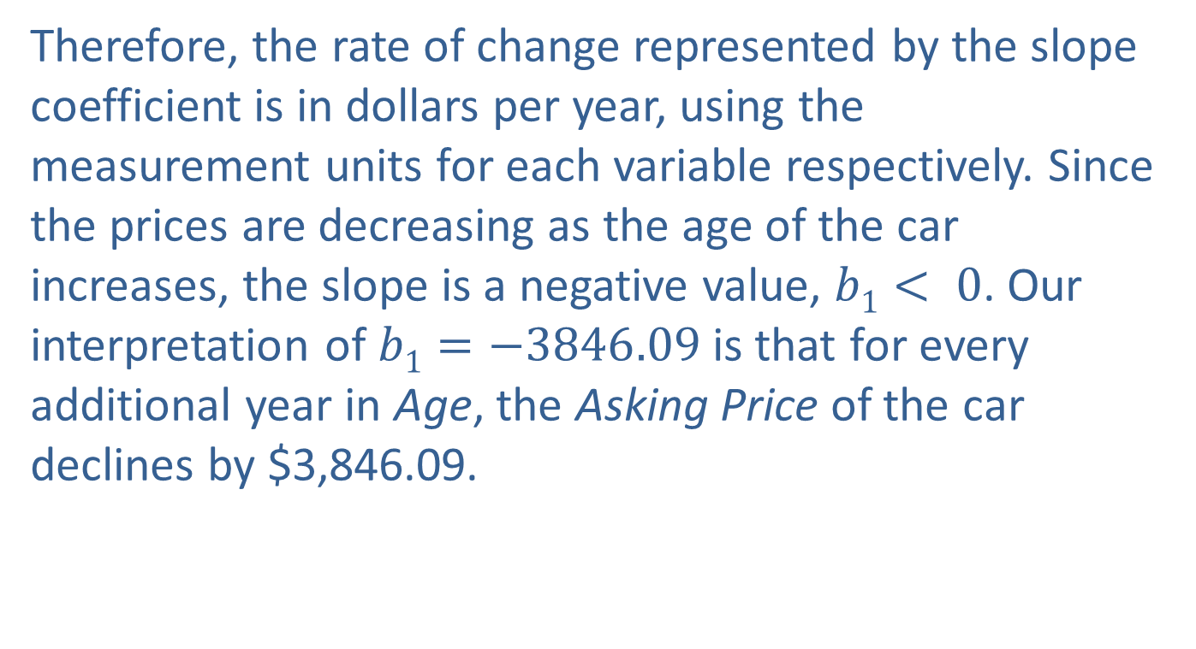
Interpreting the Regression Equation (cont.)
Therefore, the rate of change represented by the slope coefficient is in dollars per year, using the measurement units for each variable respectively. Since the prices are decreasing as the age of the car increases, the slope is a negative value, $b1< 0$. Our interpretation of $b1=−3846.09$is that for every additional year in Age, the Asking Price of the car declines by $3,846.09.

Slide 52
Interpretation of b₀ and b₁
The intercept coefficient, b₀, is the average value of the dependent variable, y, when the independent variable, x, is equal to zero.
The slope coefficient, b₁, is the average change in the dependent variable, y, for a one unit change in the independent variable, x.

