Slide 1
Section 5.1
Scatterplots and Correlation

Slide 2
Scatterplots and Correlation
In earlier chapters, all of the statistical summary measurements, like the mean, variance, and proportions, were concerned with describing univariate data (measurements of one variable). In this section we will begin to examine the interplay between two variables.

Slide 3
Bivariate Data
To understand the relationship between two variables, data on both variables needs to be collected. This type of data is called bivariate data.

Slide 4
Definition: Bivariate Data
Bivariate data is data in which two variables are recorded or measured on an entity.

Slide 5
Bivariate Data (cont.)
In Table 5.1.1 we present a subset of data from 2020 on birth rates, female literacy, child mortality, GDP per capita, crime index, and population density in 119 countries. In this table we have six numeric variables and one nominal variable (country name).

Slide 6
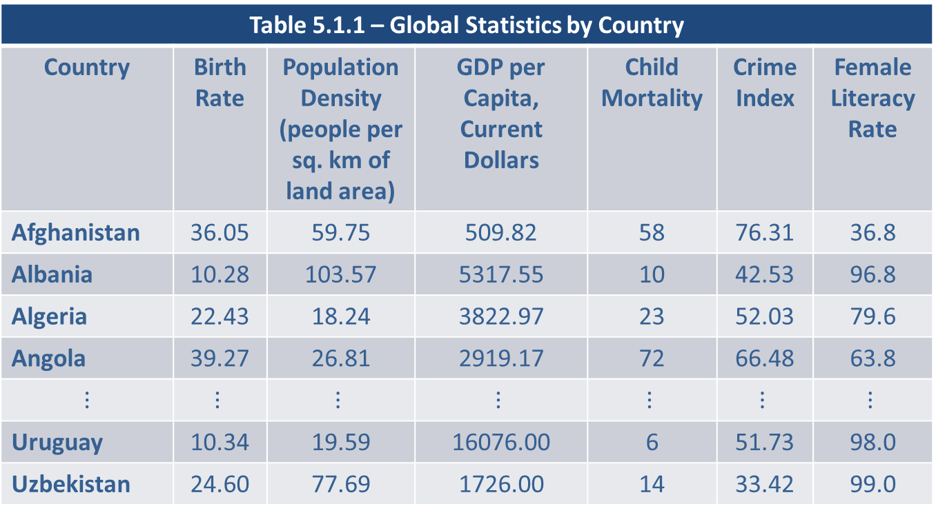
Bivariate Data (cont.)
Table 5.1.1 – Global Statistics by Country
Country | Birth Rate | Population Density (people per sq. km of land area) | GDP per Capita, Current Dollars | Child Mortality | Crime Index | Female Literacy Rate
Afghanistan | 36.05 | 59.75 | 509.82 | 58 | 76.31 | 36.8
Albania | 10.28 | 103.57 | 5317.55 | 10 | 42.53 | 96.8
Algeria | 22.43 | 18.24 | 3822.97 | 23 | 52.03 | 79.6
Angola | 39.27 | 26.81 | 2919.17 | 72 | 66.48 | 63.8
$$⋮$$ | $$⋮$$ | $$⋮$$ | $$⋮$$ | $$⋮$$ | $$⋮$$ | $$⋮$$
Uruguay | 10.34 | 19.59 | 16076.00 | 6 | 51.73 | 98.0
Uzbekistan | 24.60 | 77.69 | 1726.00 | 14 | 33.42 | 99.0

Slide 7
Bivariate Data (cont.)
Table 5.1.1 – Global Statistics by Country (cont.)
Country | Birth Rate | Population Density (people per sq. km of land area) | GDP per Capita, Current Dollars | Child Mortality | Crime Index | Female Literacy Rate
Vietnam | 15.40 | 308.36 | 2779.00 | 21 | 46.19 | 93.0
Zambia | 34.95 | 25.46 | 1281.00 | 61 | 43.62 | 63.0
Zimbabwe | 31.01 | 40.51 | 1111.00 | 54 | 59.30 | 87.0

Slide 8
Bivariate Data (cont.)
Birth Rate: The number of live births per 1,000 individuals in a population during a given time period, typically expressed as an annual rate.
Population Density: Typically measured by dividing the total population of an area by the land area (in square kilometers) of that country. This yields the number of individuals per square kilometer.
GDP per Capita: Measure of a country’s economic output that accounts for its population. It is calculated by dividing the country’s gross domestic product (GDP) by its total population.

Slide 9
Bivariate Data (cont.)
Higher values for GDP per capita generally correspond to greater access to goods and services, better healthcare, and higher levels of education.
Child Mortality: Measure of the number of deaths of children under the age of five per 1,000 live births in a given population during a specific time period, usually a year.
Crime Index: Crime rate per 1,000 population for all crimes in a country.

Slide 10
Bivariate Data (cont.)
Female Literacy Rate: The percentage of females in a population who are able to read and write.
When data on several variables is recorded about an entity, it is called a case or an observation. In Table 5.1.1, each country (entity) has six variables recorded and there are 119 cases. Looking across row 1 of the table, we see the following.
Afghanistan | 36.05 | 59.75 | 509.82 | 58 | 76.31 | 36.8

Slide 11
Bivariate Data (cont.)
We could have used any country as an example of a case.
Let’s explore the relationships between some of the variables in this data set. For example, how does female literacy, child mortality, and GDP per capita relate to level of birth rates in a country? Before we begin looking at the relationships, let’s ask ourselves some questions about the data.

Slide 12
Bivariate Data (cont.)
What is the Level of Measurement (Nominal, Ordinal, Interval, or Ratio)?
The level of measurement of the data will determine how the relationship between two variables is analyzed. If the data is nominal or ordinal, the two methods discussed in this chapter (correlation and regression) will not be applicable. We will discuss how to handle qualitative bivariate data in Chapter 17.

Slide 13
Bivariate Data (cont.)
How Is Data to Be Collected—Through Observation or Through a Controlled Experiment?
The process of collecting data is crucially linked to its usefulness in subsequent analysis. Birth rate data, for instance, is observational and may be susceptible to the influence of confounding variables, which can produce unintended effects on measurements. We will explore the concept of confounding in greater detail later in this chapter.

Slide 14
Bivariate Data (cont.)
Nonetheless, the use of planned data collection experiments (which is not possible in this example) can increase the possibility of establishing causal relationships between variables.

Slide 15
Looking for Patterns in the Data
Detecting a relationship between two variables often begins with a graph. In the case of bivariate data, a scatterplot (or scatter diagram) is the traditional exploratory graphical method used to display the relationship between two variables.

Slide 16
Definition: Scatterplot
A scatterplot is a graph used to display the relationship between two quantitative variables measured on the same entity. Data pairs (x, y) representing the two variables are plotted as a single point on a graph with x (the explanatory variable) along the horizontal axis and y (the response variable) along the vertical axis.

Slide 17
Looking for Patterns in the Data (cont.)
When examining a scatterplot, we are trying to draw conclusions concerning the overall pattern of the plotted data points. Does the data roughly follow a linear pattern? If so, is the pattern upward sloping or downward sloping? Are the data values tightly clustered in the pattern or widely dispersed? Are there significant deviations from the pattern?

Slide 18
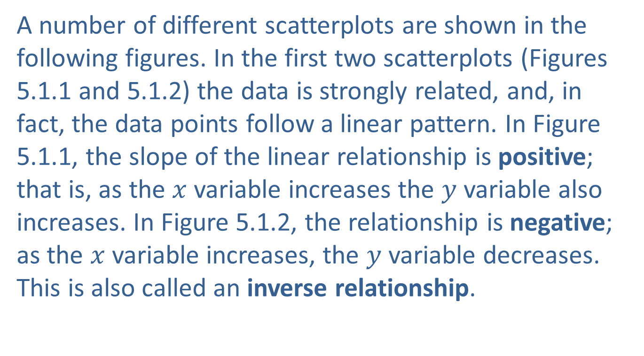
Looking for Patterns in the Data (cont.)
A number of different scatterplots are shown in the following figures. In the first two scatterplots (Figures 5.1.1 and 5.1.2) the data is strongly related, and, in fact, the data points follow a linear pattern. In Figure 5.1.1, the slope of the linear relationship is positive; that is, as the $x$ variable increases the $y$ variable also increases. In Figure 5.1.2, the relationship is negative; as the $x$variable increases, the $y$ variable decreases. This is also called an inverse relationship.

Slide 19
Definition: Inverse Relationships
When there is an inverse relationship between two variables, as one variable increases, the other variable decreases and vice versa.

Slide 20
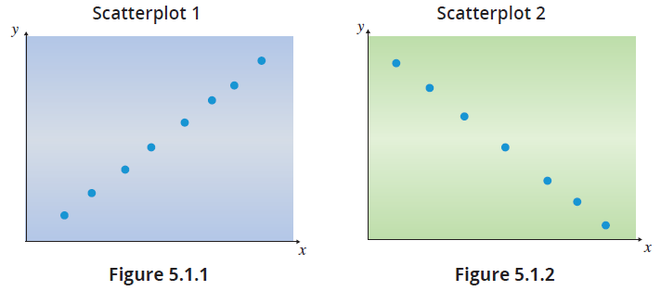

Looking for Patterns in the Data (cont.)
Figures 5.1.3 and 5.1.4 show less obvious relationships between the two variables. Figure 5.1.3 reveals a very imprecise relationship between $x$ and $y$, although as $x$ increases, $y$ tends to increase.

Slide 21
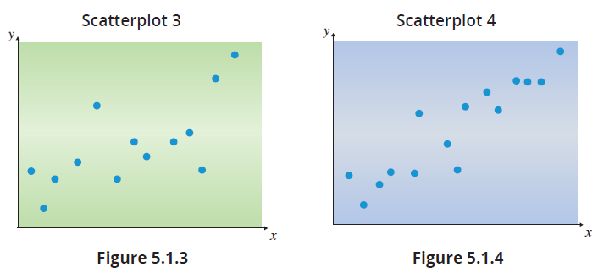

Looking for Patterns in the Data (cont.)
The relationship between $x$ and $y$ is much more apparent in Figure 5.1.4 than in Figure 5.1.3.

Slide 22
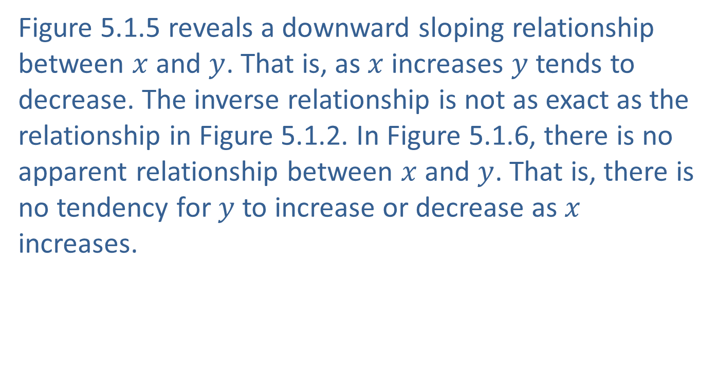
Looking for Patterns in the Data (cont.)
Figure 5.1.5 reveals a downward sloping relationship between $x$ and $y$. That is, as $x$ increases $y$ tends to decrease. The inverse relationship is not as exact as the relationship in Figure 5.1.2. In Figure 5.1.6, there is no apparent relationship between $x$ and $y$. That is, there is no tendency for $y$ to increase or decrease as $x$ increases.

Slide 23
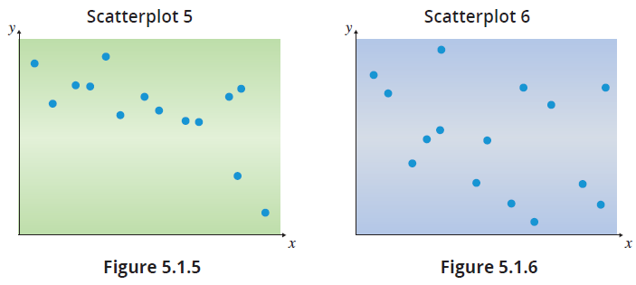
Looking for Patterns in the Data (cont.)

Slide 24
Looking for Patterns in the Data (cont.)
Let’s explore the data in Table 5.1.1 with scatterplots. In all these scatterplots there are data points that will pique your interest. For example, what are the two countries in the top left that have low female literacy and high birth rates? If you saw the graph and experienced that curiosity, the statistical tool (in this case the scatterplot) is doing its job of not only displaying relationships but encouraging curiosity and exploration.

Slide 25
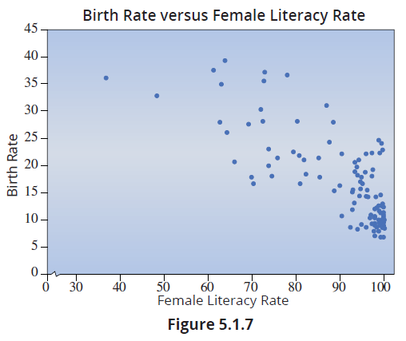
Looking for Patterns in the Data (cont.)
Examining Figure 5.1.7 reveals a somewhat downward sloping relationship. That is, as female literacy rates increase, birth rates tend to decline.

Slide 26
Looking for Patterns in the Data (cont.)
While the inverse relationship between birth rate and female literacy rate is fairly strong, it is far from exact. Most nations with high female literacy have relatively lower birth rates. The birth rate versus female literacy relationship is an example of a negative relationship because as one variable increases the other tends to decrease. The relationship between child mortality and birth rate is different, as shown in Figure 5.1.8. As child mortality increases the birth rate tends to increase—a positive relationship.

Slide 27
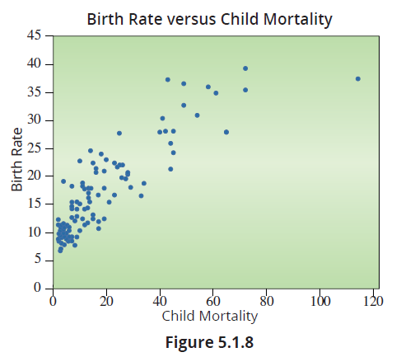
Looking for Patterns in the Data (cont.)

Slide 28
Looking for Patterns in the Data (cont.)
All the variables presented in Table 5.1.1 are potential variables in this observational data that could affect birth rates. However, cultural or religious factors may override the influence of any of these variables on fertility decisions.
The development of mathematical or statistical relationships between variables is a creative process in which a basic knowledge of mathematical functions is useful.

Slide 29
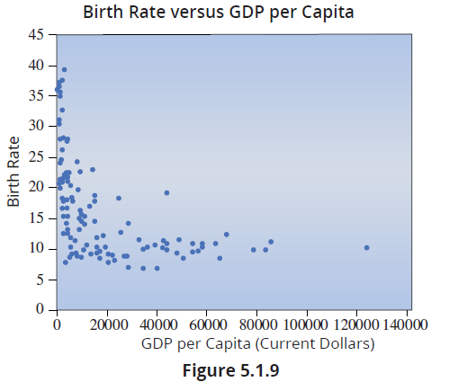
Looking for Patterns in the Data (cont.)

Slide 30
Looking for Patterns in the Data (cont.)
Although there appears to be a relationship in Figure 5.1.9, it does not appear to be linear. The relationship in the scatterplot suggests a curved function; perhaps a quadratic relationship may fit the data. We will discuss developing this type of model in a later chapter.
Birth Rate and Population Density
The population density measures the amount of people per square kilometer of land area. In countries with higher population density, we would expect to find higher birth rates.

Slide 31
Looking for Patterns in the Data (cont.)
This could be due to factors such as increased opportunities for social interaction and access to resources in densely populated areas, as well as cultural and societal norms. These factors could contribute to higher fertility rates in such areas. However, Figure 5.1.10 suggests that no significant relationship between birth rates and population density exists. That is, birth rates are unaffected by the amount of people per square kilometer.

Slide 32
Looking for Patterns in the Data (cont.)
Interestingly, Singapore is a huge outlier with a population density of almost 8000 people per square kilometer and has a birth rate below 10. The other four countries with a population density of over 1000 all have a relatively low birth rate.

Slide 33
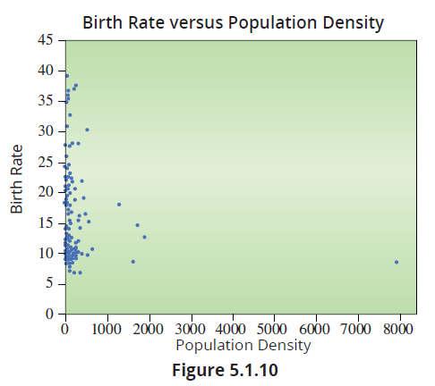
Looking for Patterns in the Data (cont.)

Slide 34
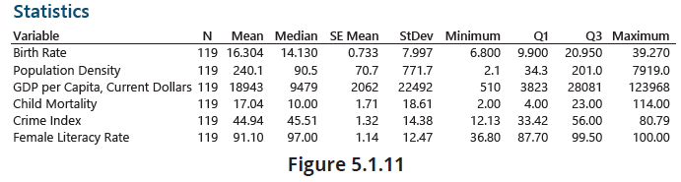
Looking for Patterns in the Data (cont.)
Figure 5.1.11 provides a table of summary measures using Minitab for the variables discussed. Similar output from Excel is shown in Figure 5.1.12.

Slide 35
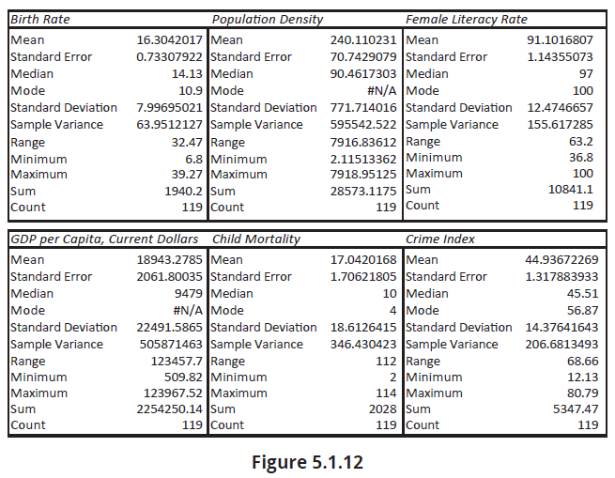
Looking for Patterns in the Data (cont.)

Slide 36
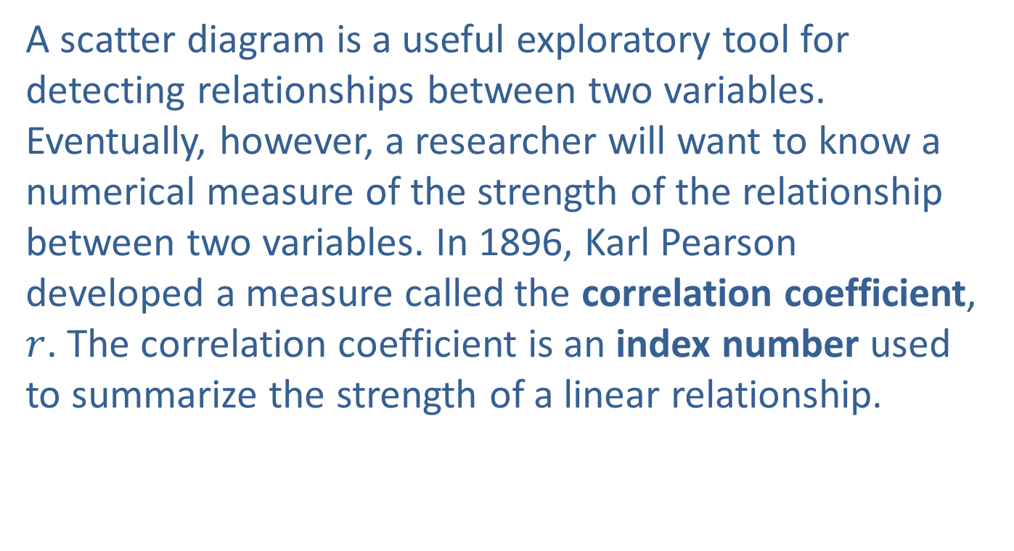
Measuring the Degree of Linear Relationship
A scatter diagram is a useful exploratory tool for detecting relationships between two variables. Eventually, however, a researcher will want to know a numerical measure of the strength of the relationship between two variables. In 1896, Karl Pearson developed a measure called the correlation coefficient, $r$. The correlation coefficient is an index number used to summarize the strength of a linear relationship.

Slide 37
Note
An index number is a value that reflects a measurement or quantity as compared to a base or standard value. The best known index number occurs in economics: the Consumer Price Index (CPI).

Slide 38
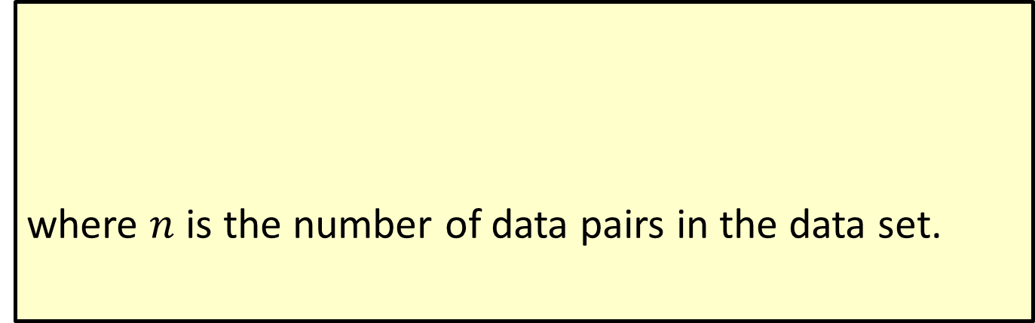
Formula: Correlation Coefficient
where $n$ is the number of data pairs in the data set.

Slide 39
Note
The application of statistics is about thinking with statistical measures, not calculating them. We strongly recommend always using technology if it is available.

Slide 40
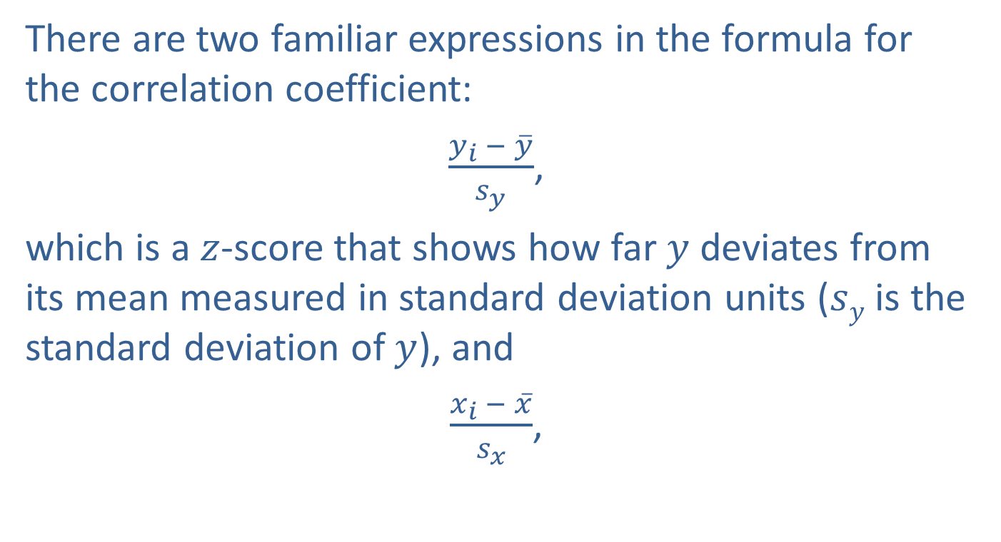
Measuring the Degree of Linear Relationship (cont.)
There are two familiar expressions in the formula for the correlation coefficient:
$\frac{y_{i} − \overline{y}}{s_{y}}$,
which is a $z$-score that shows how far $y$ deviates from its mean measured in standard deviation units ($sy$ is the standard deviation of $y$), and
$\frac{x_{i} − \overline{x}}{s_{x}}$,

Slide 41
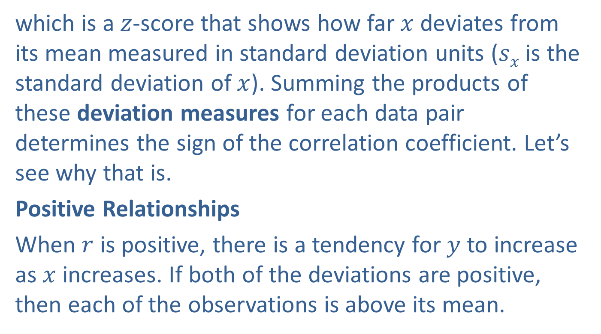
Measuring the Degree of Linear Relationship (cont.)
which is a $z$-score that shows how far $x$ deviates from its mean measured in standard deviation units ($sx$ is the standard deviation of $x$). Summing the products of these deviation measures for each data pair determines the sign of the correlation coefficient. Let’s see why that is.
Positive Relationships
When $r$ is positive, there is a tendency for $y$ to increase as $x$ increases. If both of the deviations are positive, then each of the observations is above its mean.

Slide 42
Measuring the Degree of Linear Relationship (cont.)
If both are negative, then each is below its mean. In a positive linear relationship, when one of the variables is above its mean, the other variable tends to be above its mean. Similarly, if one variable is below its mean, the other tends to be below its mean. Such is the case in Figure 5.1.13.

Slide 43
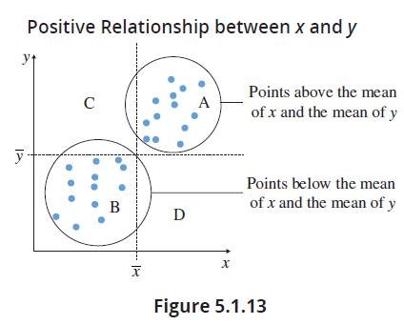
Measuring the Degree of Linear Relationship (cont.)

Slide 44
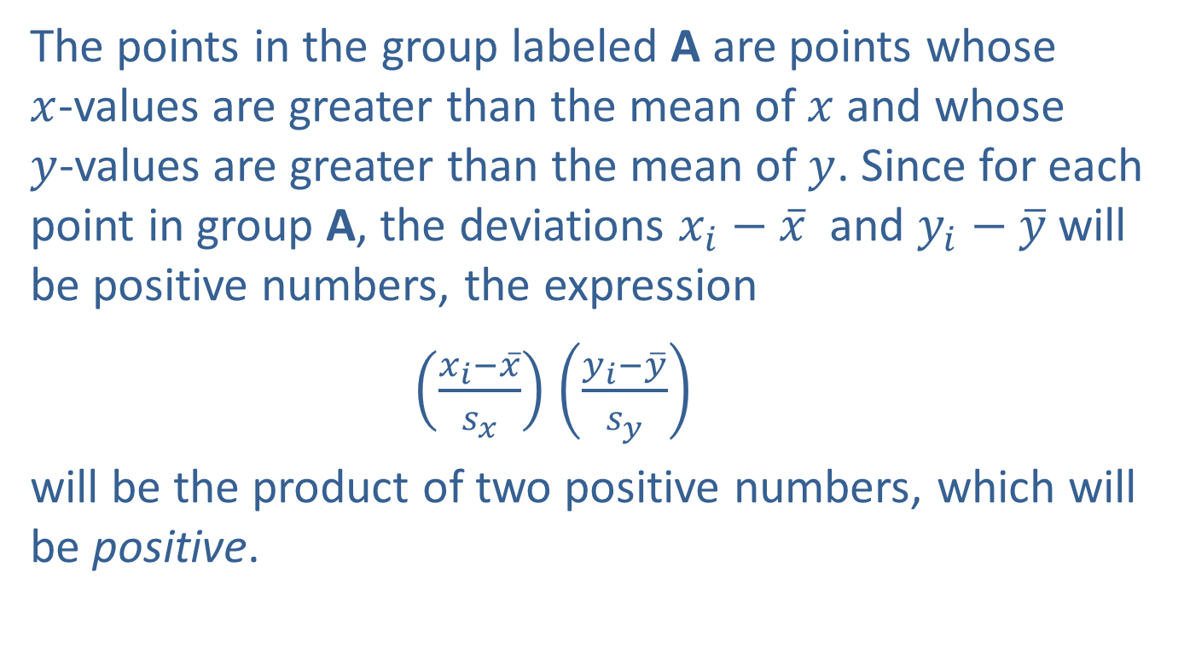
Measuring the Degree of Linear Relationship (cont.)
The points in the group labeled A are points whose $x$-values are greater than the mean of $x$and whose $y$-values are greater than the mean of $y$. Since for each point in group A, the deviations $x_{i}−\overline{x}$ and $y_{i}−\overline{y}$ will be positive numbers, the expression
$\left(\frac{x_{i}−\overline{x}}{s_{x}}\right)$ $\left(\frac{y_{i}−\overline{y}}{s_{y}}\right)$
will be the product of two positive numbers, which will be positive.

Slide 45
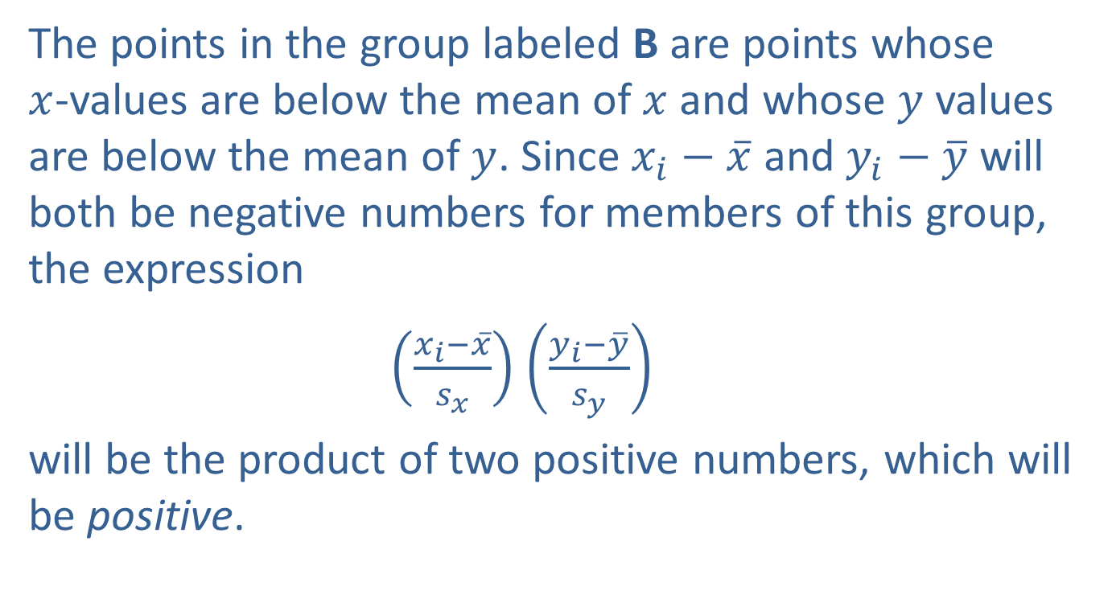
Measuring the Degree of Linear Relationship (cont.)
The points in the group labeled B are points whose $x$-values are below the mean of $x$ and whose $y$ values are below the mean of $y$. Since $x_{i}−\overline{x}$ and $y_{i}−\overline{y}$ will both be negative numbers for members of this group, the expression
$\left(\frac{x_{i}−\overline{x}}{s_{x}}\right)$ $\left(\frac{y_{i}−\overline{y}}{s_{y}}\right)$
will be the product of two positive numbers, which will be positive.

Slide 46

Measuring the Degree of Linear Relationship (cont.)
Since all the points fall into either group A or B, all the products in the summation are positive. Thus, the correlation measure $(r)$ will have a positive value for an upward sloping (positive) relationship. Now, let’s look at a downward sloping relationship.

Slide 47
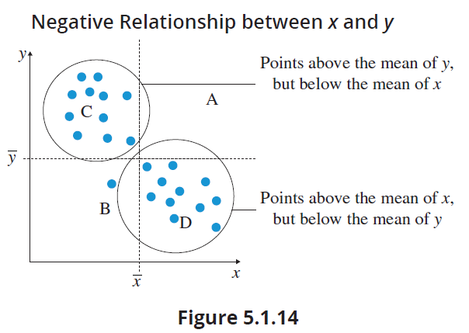
Measuring the Degree of Linear Relationship (cont.)
Negative Relationships

Slide 48
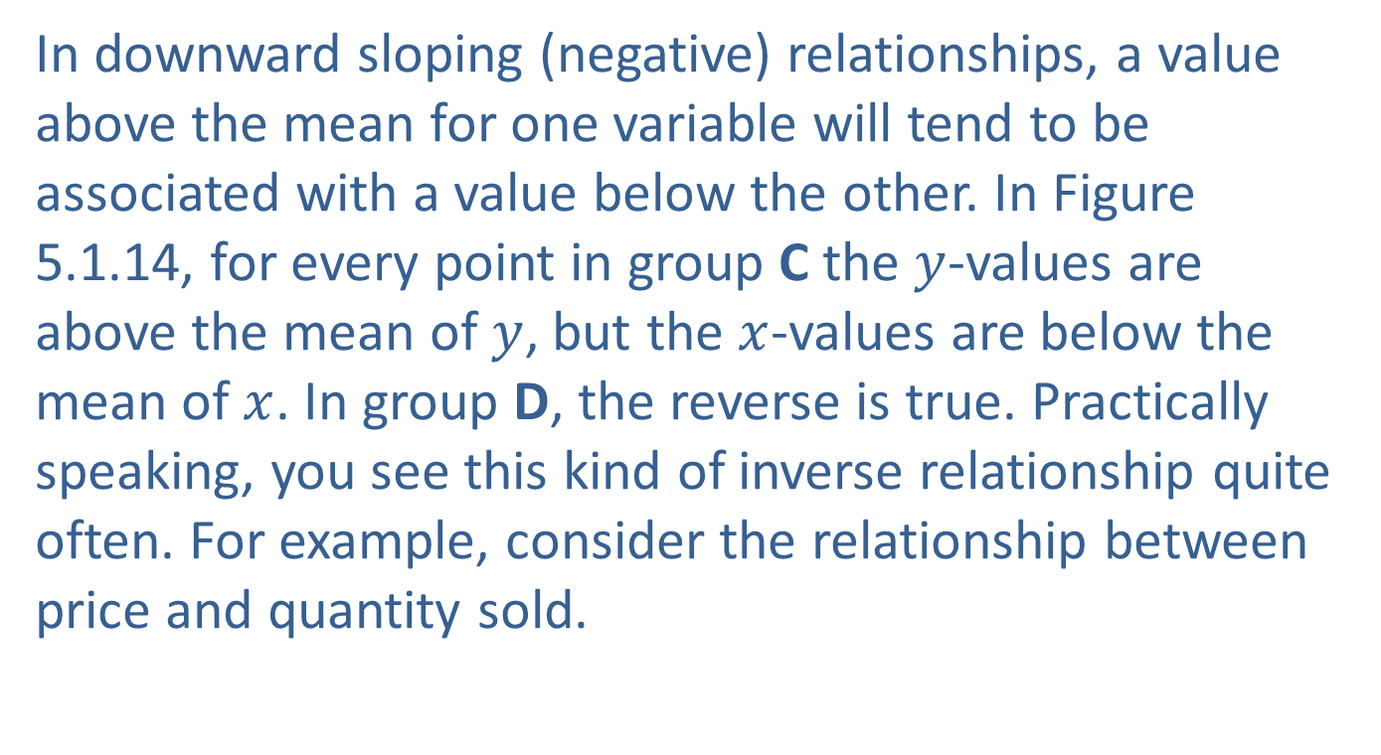
Measuring the Degree of Linear Relationship (cont.)
In downward sloping (negative) relationships, a value above the mean for one variable will tend to be associated with a value below the other. In Figure 5.1.14, for every point in group C the $y$-values are above the mean of $y$, but the $x$-values are below the mean of $x$. In group D, the reverse is true. Practically speaking, you see this kind of inverse relationship quite often. For example, consider the relationship between price and quantity sold.

Slide 49
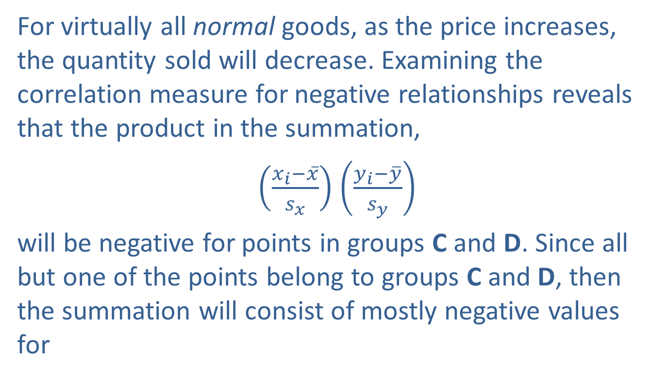
Measuring the Degree of Linear Relationship (cont.)
For virtually all normal goods, as the price increases, the quantity sold will decrease. Examining the correlation measure for negative relationships reveals that the product in the summation,
$\left(\frac{x_{i}−\overline{x}}{s_{x}}\right)$ $\left(\frac{y_{i}−\overline{y}}{s_{y}}\right)$
will be negative for points in groups C and D. Since all but one of the points belong to groups C and D, then the summation will consist of mostly negative values for

Slide 50

Measuring the Degree of Linear Relationship (cont.)
$\left(\frac{x_{i}−\overline{x}}{s_{x}}\right)$ $\left(\frac{y_{i}−\overline{y}}{s_{y}}\right)$;
therefore, the value of the correlation coefficient will be negative.

Slide 51
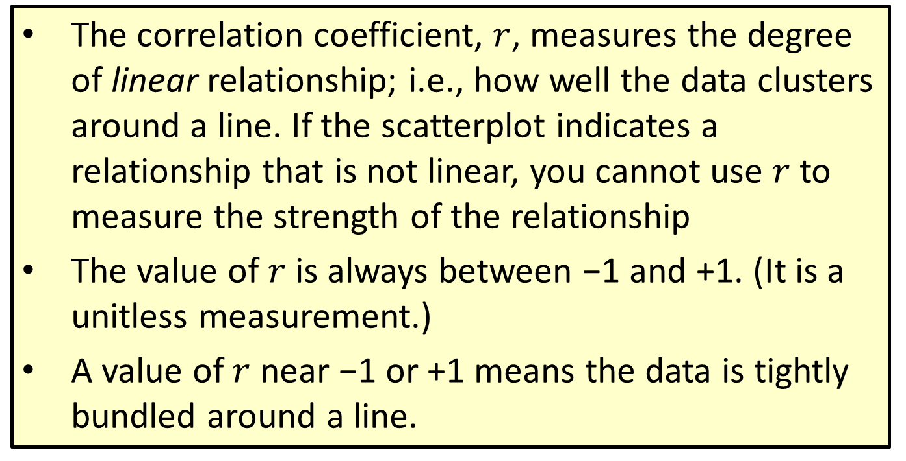
Properties: Properties of the Correlation Coefficient
The correlation coefficient, $r$, measures the degree of linear relationship; i.e., how well the data clusters around a line. If the scatterplot indicates a relationship that is not linear, you cannot use $r$ to measure the strength of the relationship
The value of $r$ is always between −1 and +1. (It is a unitless measurement.)
A value of $r$ near −1 or +1 means the data is tightly bundled around a line.

Slide 52
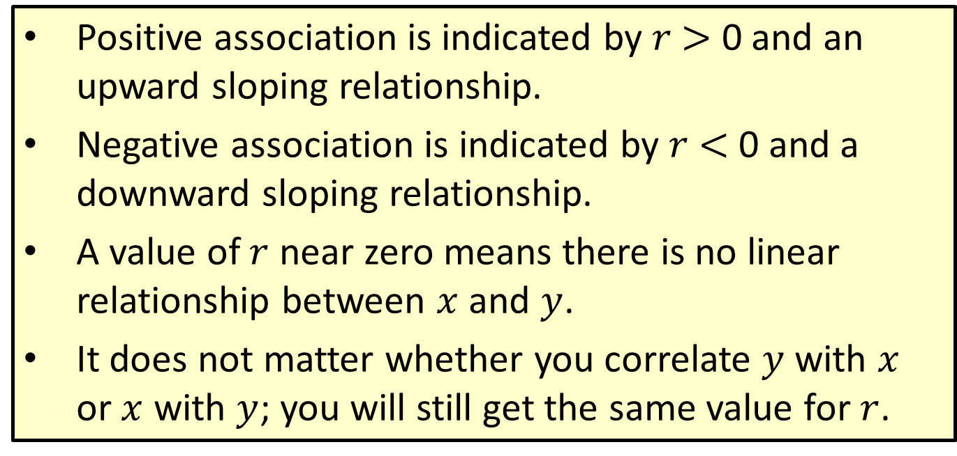
Properties: Properties of the Correlation Coefficient (cont.)
Positive association is indicated by $r$ $>$ 0 and an upward sloping relationship.
Negative association is indicated by $r$ $<$ 0 and a downward sloping relationship.
A value of $r$ near zero means there is no linear relationship between $x$ and $y$.
It does not matter whether you correlate $y$ with $x$ or $x$ with $y$; you will still get the same value for $r$.

Slide 53
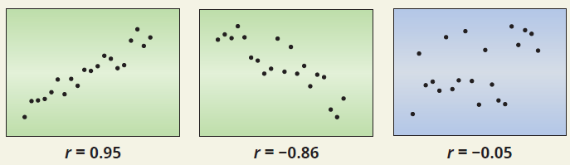
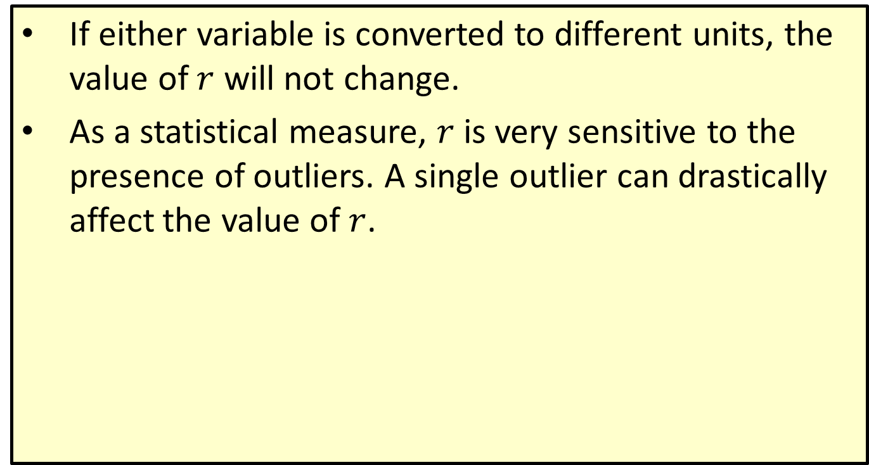
Properties: Properties of the Correlation Coefficient (cont.)
If either variable is converted to different units, the value of $r$ will not change.
As a statistical measure, $r$ is very sensitive to the presence of outliers. A single outlier can drastically affect the value of $r$.

Slide 54
Avoiding Some Correlation Pitfalls
A high correlation does not imply causation. Suppose that a high correlation has been observed between the weekly sales of ice cream and the number of snake bites each week. It seems unlikely that ice cream sales would cause snakes to bite people or that more snake bites would cause higher ice cream sales. Yet when the data is analyzed, you may find an unexpectedly high correlation. If the two variables aren’t actually related, what could explain such an observed relationship?

Slide 55
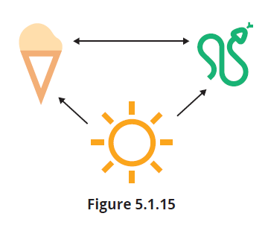
Avoiding Some Correlation Pitfalls (cont.)
Suppose both variables are related to a third variable. In this case the high temperatures in the summer cause increases in both ice cream sales and reptile activity.

Slide 56
Avoiding Some Correlation Pitfalls (cont.)
The high summer temperatures would be confounding the relationship between ice cream sales and snake bites. This kind of confounding is caused by a phenomenon called common response.

Slide 57
Definition: Common Response
In statistics, common response refers to the phenomenon where changes in both the explanatory and the response variables result from a change in a third variable.

Slide 58
Avoiding Some Correlation Pitfalls (cont.)
Sometimes this confounding effect is referred to as a lurking variable. Observational studies are particularly vulnerable to confounding variables. A good design of experiment can minimize the effect of confounding. Some statisticians differentiate between a confounding variable and a lurking variable by whether the researcher is aware of the confounding variable. Lurking variables are confounding variables the researcher is not aware of.

Slide 59
Avoiding Some Correlation Pitfalls (cont.)
Correlating summary measures, such as means, can also contribute to an inflated correlation measure. Ignoring the variation of the individual values can magnify the correlation measure, leading to a distorted view of the underlying relationship.
Suppose there is good reason to believe that a relationship exists between two variables, but when a correlation is performed the value of the correlation is near zero, indicating no association. Does the lack of correlation between the two variables prove no relationship exists?

Slide 60
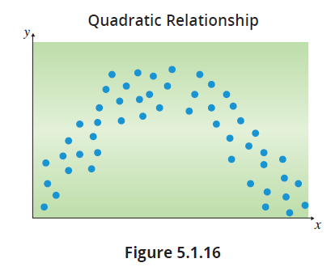
Avoiding Some Correlation Pitfalls (cont.)
There are several reasons why two related variables might not have a high correlation.

Slide 61
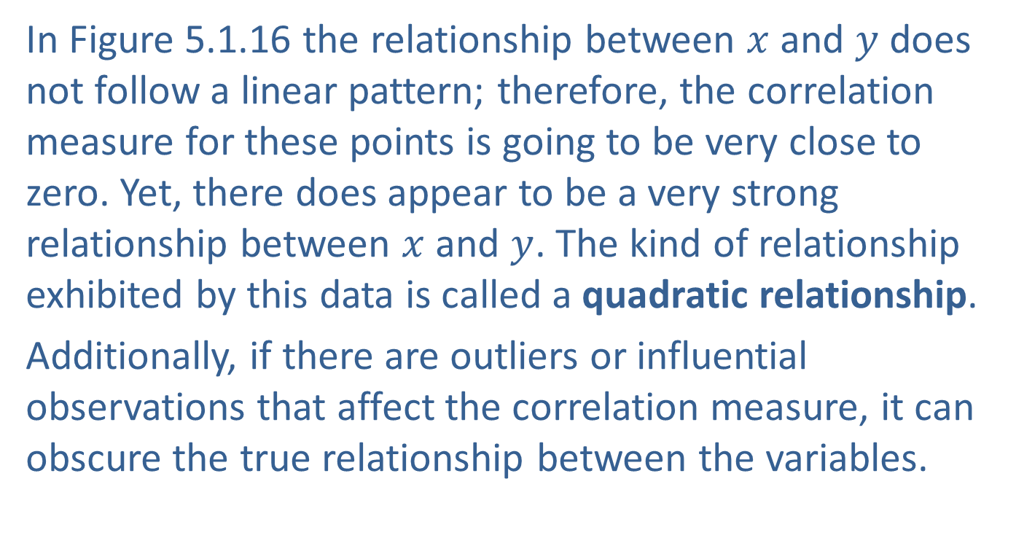
Avoiding Some Correlation Pitfalls (cont.)
In Figure 5.1.16 the relationship between $x$ and $y$ does not follow a linear pattern; therefore, the correlation measure for these points is going to be very close to zero. Yet, there does appear to be a very strong relationship between $x$ and $y$. The kind of relationship exhibited by this data is called a quadratic relationship.
Additionally, if there are outliers or influential observations that affect the correlation measure, it can obscure the true relationship between the variables.

Slide 62
Definition: Quadratic Relationship
A quadratic relationship is a mathematical relationship between two variables that follows the form of a quadratic equation (degree = 2). A scatterplot of the data will look like a parabola.

Slide 63
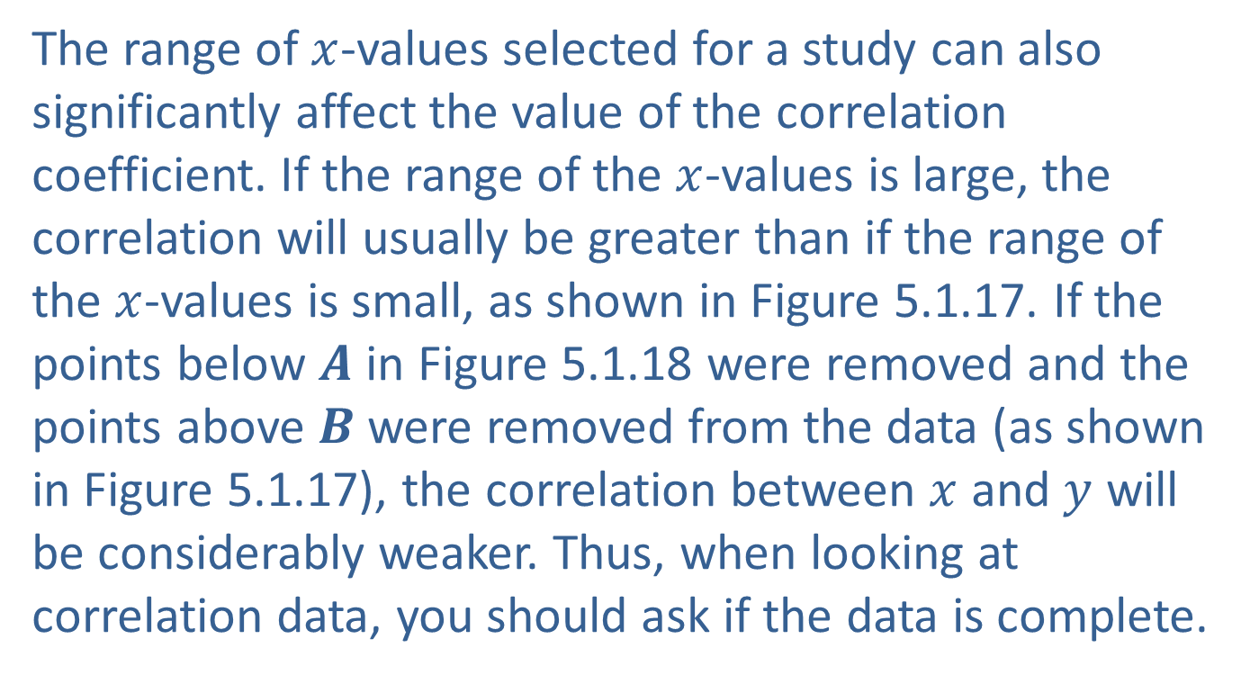
Avoiding Some Correlation Pitfalls (cont.)
The range of $x$-values selected for a study can also significantly affect the value of the correlation coefficient. If the range of the $x$-values is large, the correlation will usually be greater than if the range of the $x$-values is small, as shown in Figure 5.1.17. If the points below $A$ in Figure 5.1.18 were removed and the points above $B$ were removed from the data (as shown in Figure 5.1.17), the correlation between $x$ and $y$ will be considerably weaker. Thus, when looking at correlation data, you should ask if the data is complete.

Slide 64
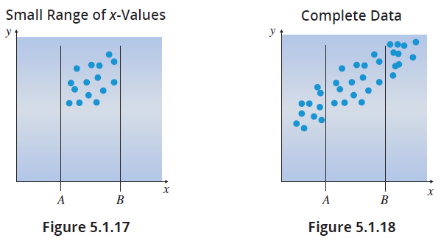
Avoiding Some Correlation Pitfalls (cont.)

Slide 65
Avoiding Some Correlation Pitfalls (cont.)
Sometimes unrelated variables are highly correlated. When this occurs the variables are said to have a spurious correlation. For example, the line graphs in Figure 5.1.19a show that both the per capita consumption of cheese in the US and the total revenue generated by US golf courses were both increasing at roughly the same rate. The following graphs display some interesting spurious correlations that have been discovered.

Slide 66
Note
Figures 5.1.19a and 5.1.19b display the same data, one in time series form (Figure 5.1.19a) and then as a scatterplot (Figure 5.1.19b). Figures 5.1.20a and 5.1.20b are similarly related.

Slide 67
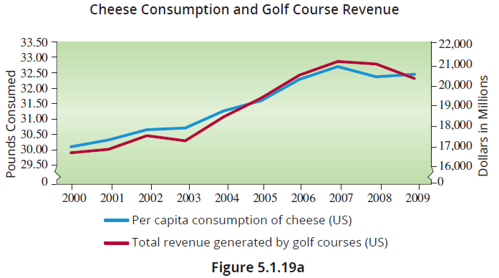

Avoiding Some Correlation Pitfalls (cont.)
If you plot this data using a scatterplot, there appears to be a very strong linear relationship with a correlation of $r=0.9897$.

Slide 68
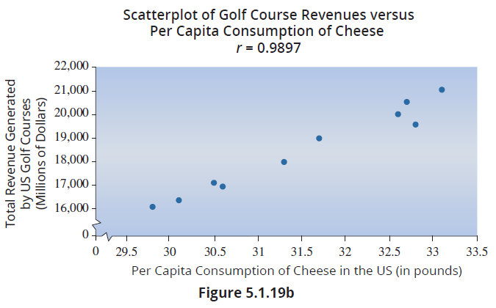
Avoiding Some Correlation Pitfalls (cont.)

Slide 69
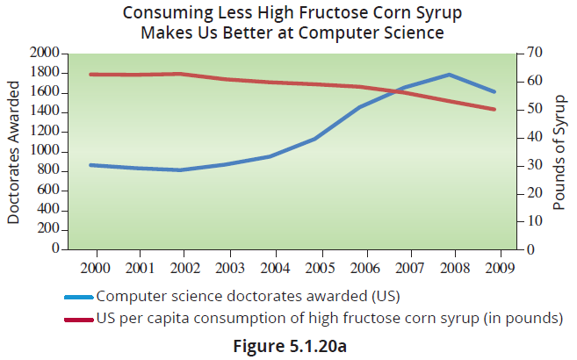
Avoiding Some Correlation Pitfalls (cont.)
Similarly, there is a very strong relationship between high fructose syrup consumption and Computer Science doctorates awarded.

Slide 70
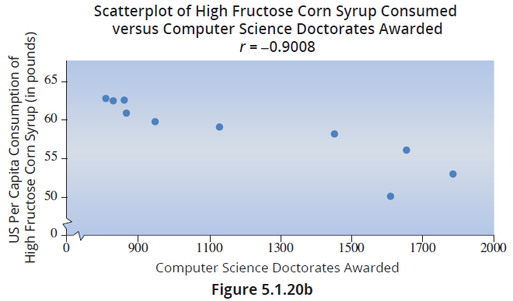
Avoiding Some Correlation Pitfalls (cont.)

Slide 71
Avoiding Some Correlation Pitfalls (cont.)
There are several websites devoted entirely to spurious correlations. You may enjoy entering the term “spurious correlations” into a search engine and perusing the results.
This next example points out the importance of plotting the variables suspected of having a relationship, and to not rely on numerical measures alone.

Slide 72
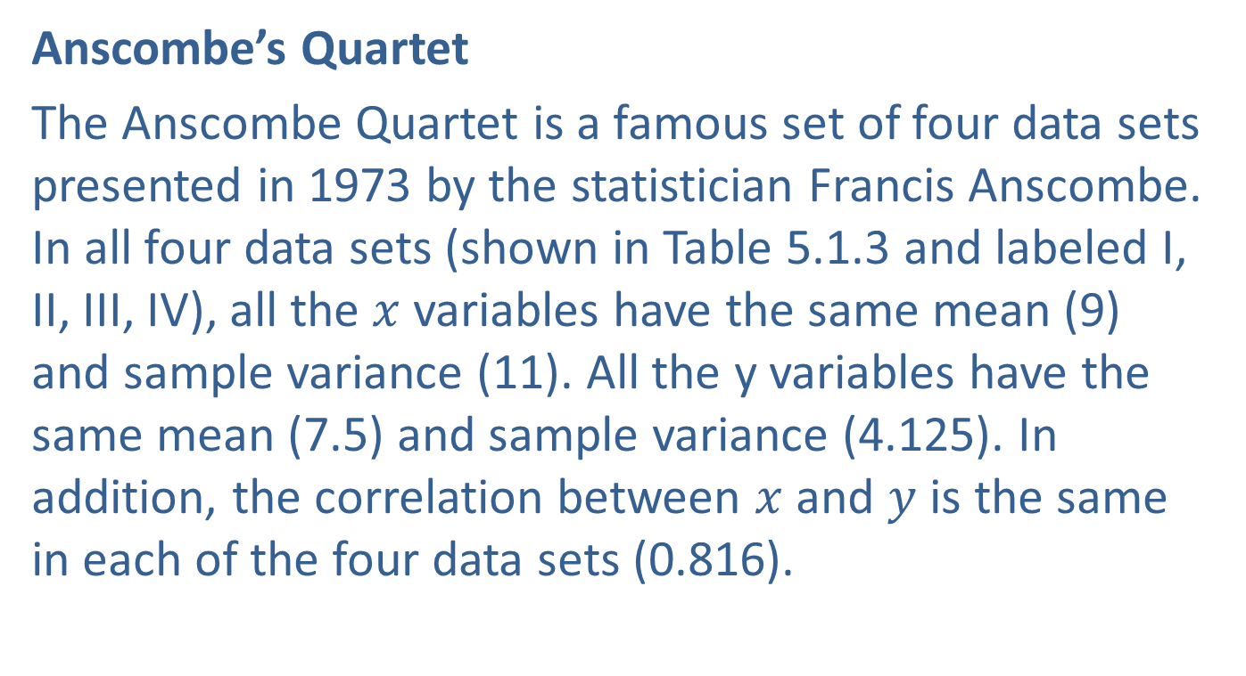
Avoiding Some Correlation Pitfalls (cont.)
Anscombe’s Quartet
The Anscombe Quartet is a famous set of four data sets presented in 1973 by the statistician Francis Anscombe. In all four data sets (shown in Table 5.1.3 and labeled I, II, III, IV), all the $x$ variables have the same mean (9) and sample variance (11). All the y variables have the same mean (7.5) and sample variance (4.125). In addition, the correlation between $x$ and $y$ is the same in each of the four data sets (0.816).

Slide 73
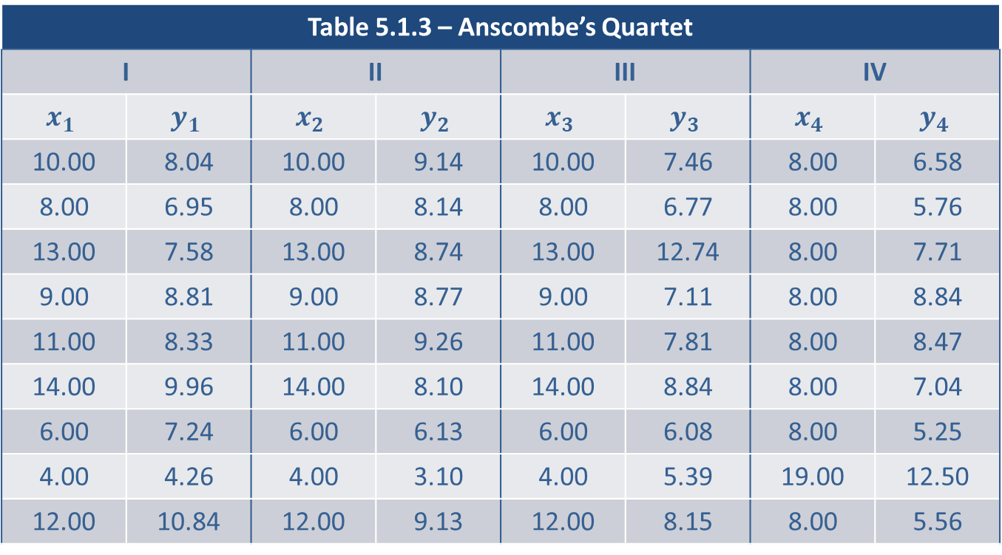
Avoiding Some Correlation Pitfalls (cont.)
Table 5.1.3 – Anscombe’s Quartet
I |  | II |  | III |  | IV
$$x_{1}$$ | $$y_{1}$$ | $$x_{2}$$ | $$y_{2}$$ | $$x_{3}$$ | $$y_{3}$$ | $$x_{4}$$ | $$y_{4}$$
10.00 | 8.04 | 10.00 | 9.14 | 10.00 | 7.46 | 8.00 | 6.58
8.00 | 6.95 | 8.00 | 8.14 | 8.00 | 6.77 | 8.00 | 5.76
13.00 | 7.58 | 13.00 | 8.74 | 13.00 | 12.74 | 8.00 | 7.71
9.00 | 8.81 | 9.00 | 8.77 | 9.00 | 7.11 | 8.00 | 8.84
11.00 | 8.33 | 11.00 | 9.26 | 11.00 | 7.81 | 8.00 | 8.47
14.00 | 9.96 | 14.00 | 8.10 | 14.00 | 8.84 | 8.00 | 7.04
6.00 | 7.24 | 6.00 | 6.13 | 6.00 | 6.08 | 8.00 | 5.25
4.00 | 4.26 | 4.00 | 3.10 | 4.00 | 5.39 | 19.00 | 12.50
12.00 | 10.84 | 12.00 | 9.13 | 12.00 | 8.15 | 8.00 | 5.56

Slide 74
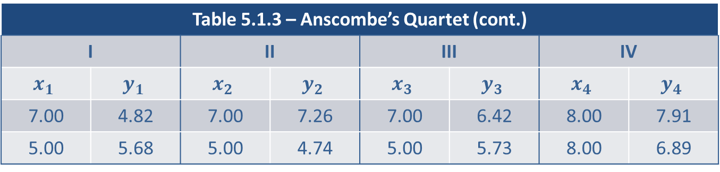
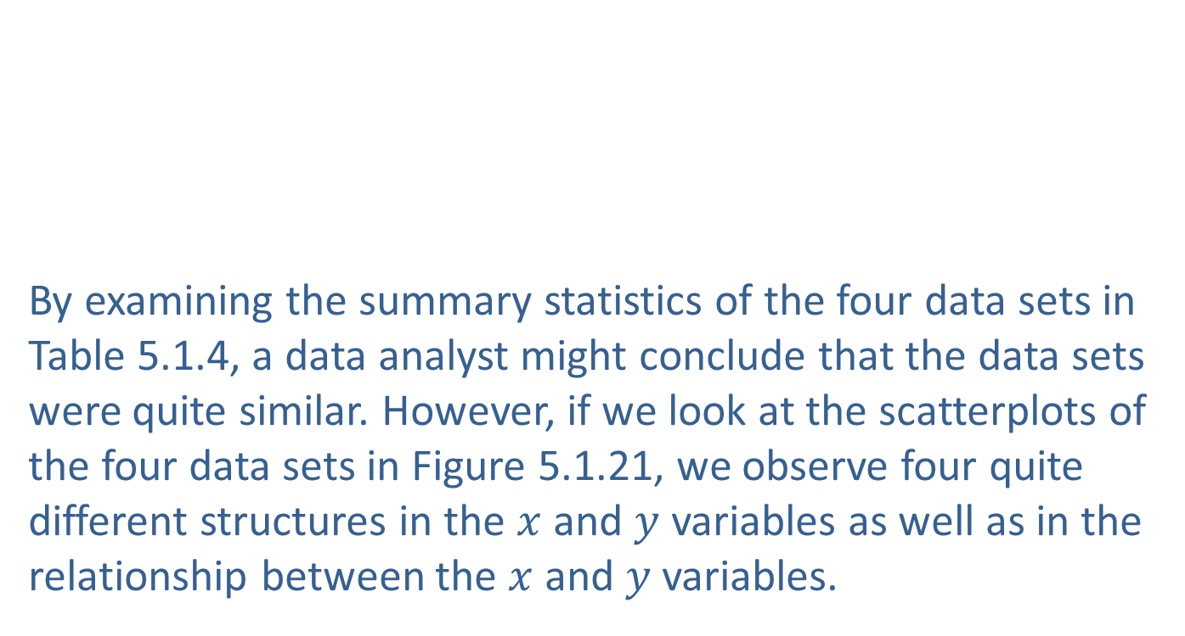
Avoiding Some Correlation Pitfalls (cont.)
By examining the summary statistics of the four data sets in Table 5.1.4, a data analyst might conclude that the data sets were quite similar. However, if we look at the scatterplots of the four data sets in Figure 5.1.21, we observe four quite different structures in the $x$ and $y$ variables as well as in the relationship between the $x$ and $y$ variables.
Table 5.1.3 – Anscombe’s Quartet (cont.)
I |  | II |  | III |  | IV
$$x_{1}$$ | $$y_{1}$$ | $$x_{2}$$ | $$y_{2}$$ | $$x_{3}$$ | $$y_{3}$$ | $$x_{4}$$ | $$y_{4}$$
7.00 | 4.82 | 7.00 | 7.26 | 7.00 | 6.42 | 8.00 | 7.91
5.00 | 5.68 | 5.00 | 4.74 | 5.00 | 5.73 | 8.00 | 6.89

Slide 75
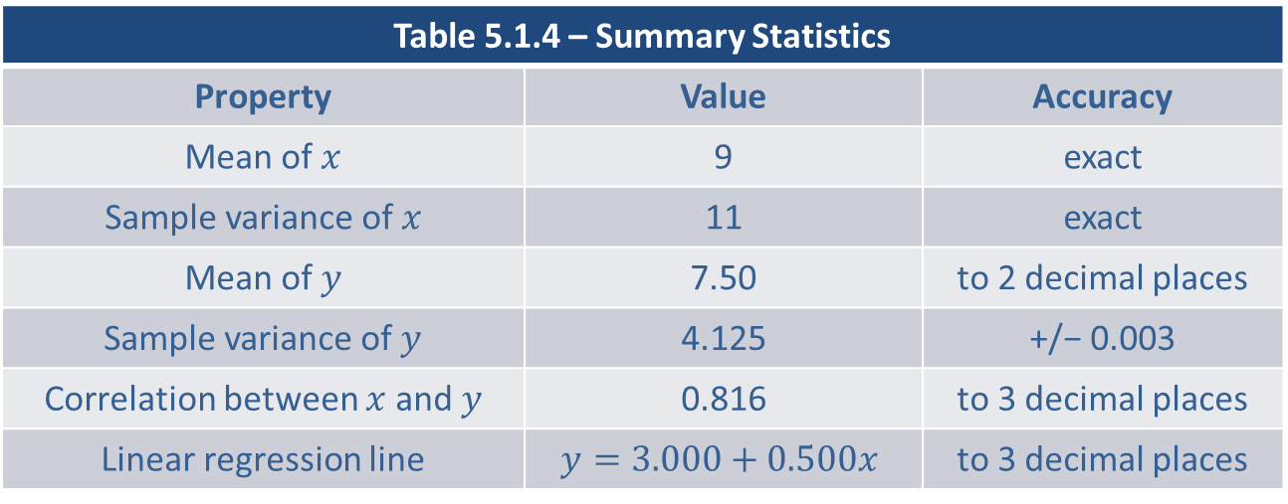
Avoiding Some Correlation Pitfalls (cont.)
Table 5.1.4 – Summary Statistics
Property | Value | Accuracy
Mean of $x$ | 9 | exact
Sample variance of $x$ | 11 | exact
Mean of $y$ | 7.50 | to 2 decimal places
Sample variance of $y$ | 4.125 | +/− 0.003
Correlation between $x$ and $y$ | 0.816 | to 3 decimal places
Linear regression line | $$y=3.000+0.500x$$ | to 3 decimal places

Slide 76
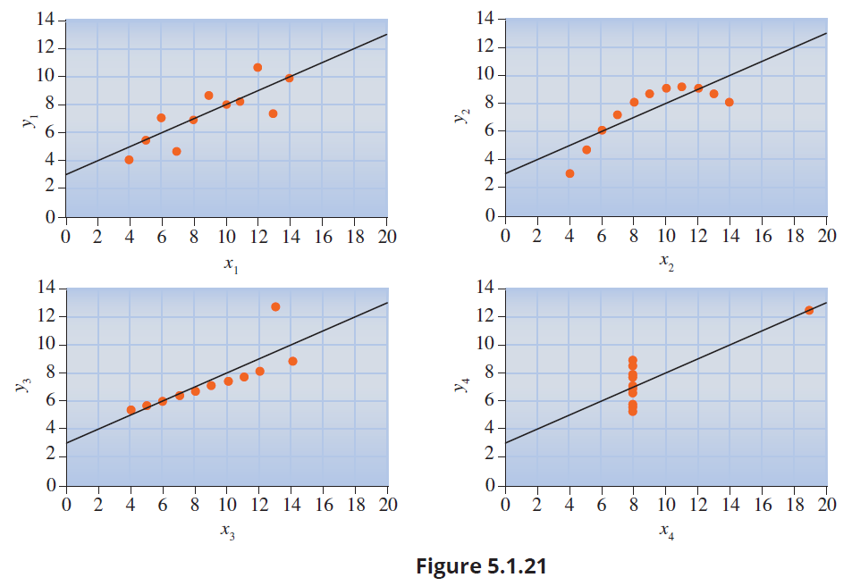
Avoiding Some Correlation Pitfalls (cont.)

Slide 77
Avoiding Some Correlation Pitfalls (cont.)
The Anscombe Quartet brings out an important data analytic principle. No matter what kind of numeric data is being analyzed, it is critically important to plot it before making any conclusions. For single variables, an analyst should at least be looking at histograms and box plots. When we begin to look for relationships in bivariate or multivariate data, creating scatterplots to display the relationship between the variables is more important than calculating summary measures of linear relationship, i.e., the correlation coefficient.

