Slide 1
Section 4.6
Proportions and Percentages

Slide 2
Proportions
A proportion is one of the more common summary measures especially for qualitative data. A proportion can be expressed as a fraction or a percentage.

Slide 3
Definition: Proportion
A proportion measures the fraction of a group that possesses some characteristic.

Slide 4
Proportions (cont.)
To calculate a proportion, simply count the number in the group that possess the characteristic of interest and divide the count by the number in the group. Let

Slide 5

Proportions (cont.)
The symbol $\hat{p}$ is pronounced “$p$-hat”.

Slide 6
Example 4.6.1: Determining the Proportion of Left-Handed Students
Suppose your statistics class is composed of 48 students of which 4 are left-handed. What proportion of the class is left-handed?
There are 48 pieces of data in the class. Think of the data as composed of 0s and 1s. Any left-handed person will be a 1, and any right-handed person will be a 0. In our data set, there are four 1s and forty-four 0s.

Slide 7
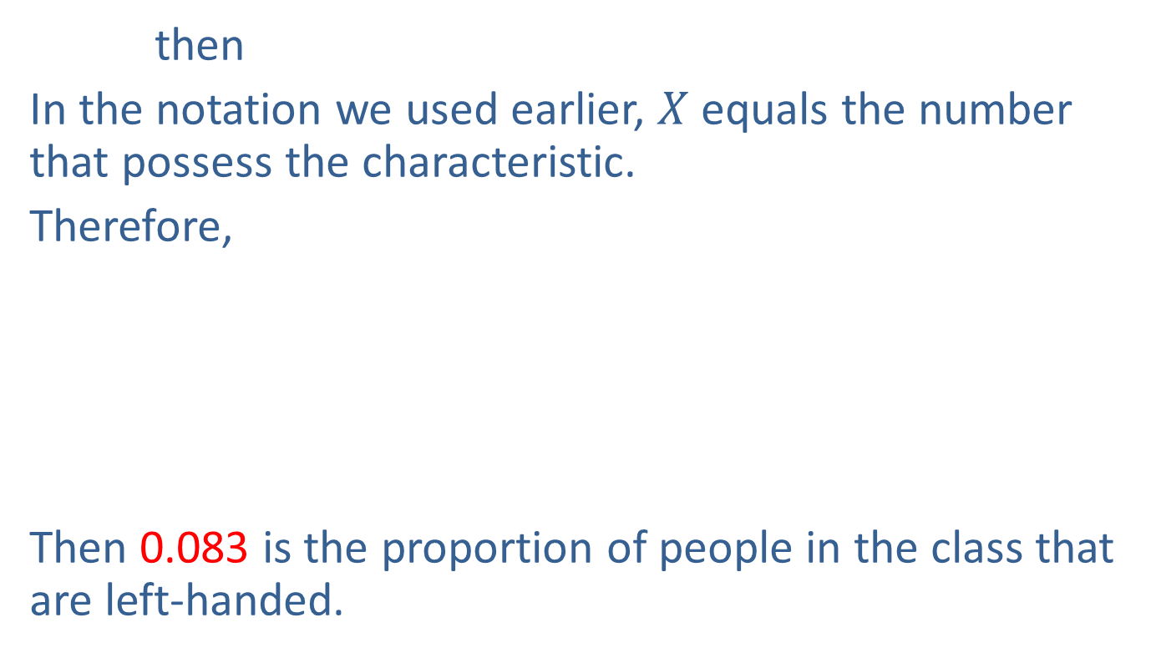
Example 4.6.1: Determining the Proportion of Left-Handed Students (cont.)
then
In the notation we used earlier, $X$ equals the number that possess the characteristic.
Therefore,
Then 0.083 is the proportion of people in the class that are left-handed.

Slide 8
Proportions (cont.)
In the previous example, the proportion of people in the class who are left-handed could have been reported as a percentage. Instead of saying that 0.083 is the proportion of people in the class that are left-handed, it could be stated that 8.3% of people in the class are left-handed.

Slide 9
Example 4.6.2: Determining a Batting Average
Suppose you have been playing softball and have kept records on each plate appearance. According to your records you have batted 216 times. Of those 216 plate appearances, you have walked 24 times, gotten out on a sacrifice hit 7 times, and reached base on a hit 64 times. Let’s compute your batting average, which is a proportion. The batting average is the proportion of times you reached base on a hit, excluding walks and sacrifice hits. In this case the number in the group of at bats we will consider is

Slide 10
Example 4.6.2: Determining a Batting Average (cont.)
N = Plate appearances − Walks − Sacrifice Hits
= 216 − 24 −7 = 185 at bats.
The proportion of times you got a hit (excluding walks and sacrifice hits) is
Hence your batting average is 0.346.

Slide 11
Example 4.6.2: Determining a Batting Average (cont.)
For the softball example, you would not convert 0.346 to a percentage because batting averages are always reported as a proportion. In Major League Baseball (MLB) statistics, the zero in front of the decimal point is usually omitted in batting averages. So, if you were in MLB your batting average would be reported as .346.
This chapter has been devoted to summarizing data. Yet with the exception of the mode, none of the summary methods discussed should be applied to nominal data.

Slide 12
Example 4.6.2: Determining a Batting Average (cont.)
Using proportions is one of the few summary methods available for analyzing qualitative data.

