Slide 1
Section 4.5
Analyzing Grouped Data

Slide 2
Analyzing Grouped Data
All of the statistical measurements we have discussed so far presume that individual data measurements are readily available. However, there may be instances in which only a frequency distribution of the data is available. When data is presented in that form, it is called grouped data. It is important to be able to compute measures such as the mean and standard deviation for this type of data. Note that because the raw data observations are not available, the measures will be approximate.

Slide 3
Analyzing Grouped Data (cont.)
The strategy for finding the mean of grouped data involves finding the midpoint of each of the classes in the frequency distribution and then weighting each of these midpoints by the number of observations in the class.

Slide 4
Formula: Mean of Grouped Data
The population mean of grouped data is given by
where
f_{i} = the number of observations in the i^{th} class,
N = the total number of observations in all classes,
and

Slide 5
Formula: Mean of Grouped Data (cont.)
M_{i} = the midpoint of the i^{th} class,
The sample mean of grouped data is given by
where n is the number of observations in the sample.

Slide 6
Analyzing Grouped Data (cont.)
We can also estimate the variance and standard deviation of grouped data using the following formulas.

Slide 7
Formula: Variance of Grouped Data
The population variance of grouped data is given by the following expression.
The corresponding formula for the sample variance is as follows.
where n equals the total number of observations in the sample.

Slide 8
Analyzing Grouped Data (cont.)
There are also computational formulas that can be used to calculate the variance of grouped data. These formulas may make it easier to calculate the variance by hand. These formulas will be used in the example that follows. We do highly recommend the use of technology instead of manual calculations when possible.

Slide 9
Formula: Computational Formulas for the Variance
The computational formulas for the population and sample variances of grouped data are as follows.

Slide 10
Example 4.5.1: Calculating the Mean and Variance of Grouped Data for Blood Pressure
The table presents the systolic blood pressure reading of 85 patients, in grouped form. Compute the mean and standard deviation for this data.
Grouped Blood Pressure Data
Systolic Blood Pressure | Frequency f_{i}
106-115 | 2
116-125 | 5
126-135 | 13
136-145 | 12
146-155 | 19
156-165 | 9
166-175 | 8
176-185 | 8
186-195 | 7
196-205 | 2

Slide 11
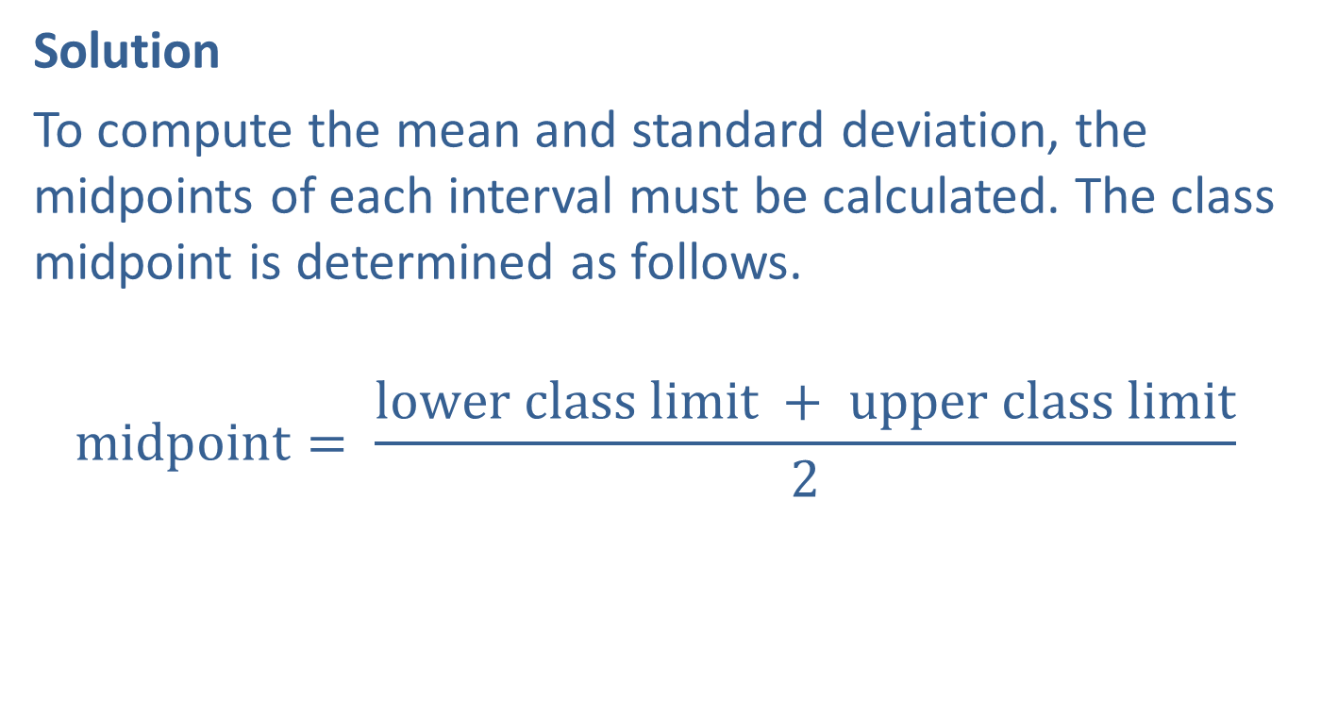
Example 4.5.1: Calculating the Mean and Variance of Grouped Data for Blood Pressure (cont.)
Solution
To compute the mean and standard deviation, the midpoints of each interval must be calculated. The class midpoint is determined as follows.
$$\text{midpoint}= \frac{\text{lower} \text{class} \text{limit} + \text{upper} \text{class} \text{limit}}{2}$$

Slide 12
Example 4.5.1: Calculating the Mean and Variance of Grouped Data for Blood Pressure (cont.)
The midpoints as well as the other required calculations are presented below.
Determining the Mean and Variance of Grouped Data
Systolic Blood Pressure | Midpoint M_{i} | Frequency f_{i}
105.5 − 115.5 | 110.5 | 2 | 221.0 | 12210.25 | 24420.50
115.5 − 125.5 | 120.5 | 5 | 602.5 | 14520.25 | 72601.25
125.5 − 135.5 | 130.5 | 13 | 1696.5 | 17030.25 | 221393.25
135.5 − 145.5 | 140.5 | 12 | 1686.0 | 19740.25 | 236883.00
145.5 − 155.5 | 150.5 | 19 | 2859.5 | 22650.25 | 430354.75
155.5 − 165.5 | 160.5 | 9 | 1444.5 | 25760.25 | 231842.25
165.5 − 175.5 | 170.5 | 8 | 1364.0 | 29070.25 | 232562.00
175.5 − 185.5 | 180.5 | 8 | 1444.0 | 32580.25 | 260642.00
185.5 − 195.5 | 190.5 | 7 | 1333.5 | 36290.25 | 254031.75
195.5 − 205.5 | 200.5 | 2 | 401.0 | 40200.25 | 80400.50
TOTAL |  | 85 | 13052.5 | 250052.5 | 2045131.25

Slide 13
Example 4.5.1: Calculating the Mean and Variance of Grouped Data for Blood Pressure (cont.)
Assuming the data are population data, the mean systolic blood pressure for the 85 patients is calculated as follows.
The variance of the grouped data is calculated using the computational formula.

Slide 14
Example 4.5.1: Calculating the Mean and Variance of Grouped Data for Blood Pressure (cont.)
To find the population standard deviation we would then take the square root of the variance, 480.06, to obtain 21.91.

Slide 15
Example 4.5.1: Calculating the Mean and Variance of Grouped Data for Blood Pressure (cont.)
If the data were sample data, then the sample variance would be calculated.
The sample standard deviation would then be the square root of 485.77 or 22.04.

Slide 16
Analyzing Grouped Data (cont.)
It is important to remember that the calculation of the mean and standard deviation are approximate. That is, if the individual data is available, the actual mean and standard deviation would likely differ from the measures calculated using the grouped data.

