Slide 1
Section 4.4
Data Subsetting

Slide 2
Data Subsetting
Looking at the 2021–2022 tuition data presented in Figure 4.4.1 provides some idea about the location and dispersion of the data, but nothing specific. Histograms are outstanding at defining the shape of a set of data.

Slide 3
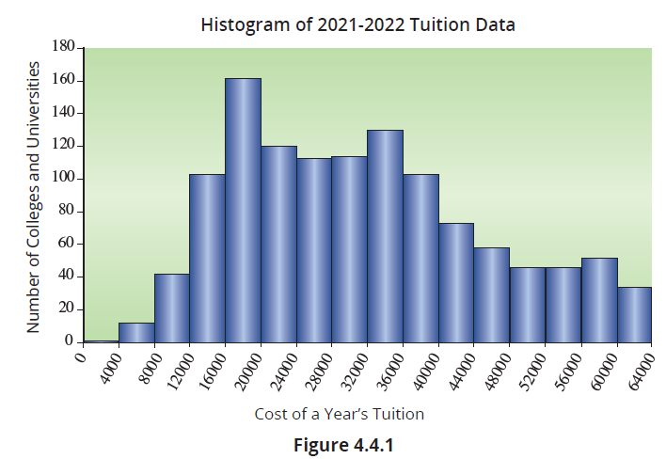
Data Subsetting (cont.)

Slide 4
Data Subsetting (cont.)
There are several measurements that can be used to describe the location or central value of the tuition data (see Table 4.4.1). The mode is not considered because the data is quantitative and there are a large number of observations. Moreover, the mode is not a very informative measure of central tendency. Since the mean of the data is somewhat larger than both the median and the 10% trimmed mean, the choice of central value in this case will make a difference.

Slide 5
Data Subsetting (cont.)
The histogram suggests that the difference is due to the skewness of the data to the right caused by schools with tuition costs greater than $40,000. As mentioned previously, the mean is more sensitive to the presence of outliers than either the median or the trimmed mean. So, which one of the three candidate measurements should be considered as the central value of the data?
There is no overwhelming reason to select the mean, trimmed mean, or median. You are justified in selecting any of the three statistical measures.

Slide 6
Data Subsetting (cont.)
Reporting all three would confirm the data has a well-defined central value around $30,000. If only one measure is reported, identify the measure as the mean or the median, or trimmed mean rather than the average. The term average is a bit too ambiguous in current usage.
Table 4.4.1 – Tuition Data
Location Measurement | Value
Mean | $31,321.98
Median | $29,923.00
10% Trimmed Mean | $30,435.47

Slide 7
Describing Dispersion of the Tuition Data
Several measurements which assess variation have been discussed, including variance, standard deviation, mean absolute deviation, and percentiles. Since the variance and standard deviation are different forms of the same measurement, usually only the standard deviation is reported. For the tuition data, a reasonable description of dispersion for the 1208 values would be given by the following statistics.

Slide 8
Describing Dispersion of the Tuition Data (cont.)
Table 4.4.2 – Tuition Data
Standard Deviation | $13,914.55
Minimum | $4,416.00
First Quartile | $19,508.00
Median | $29,923.00
Third Quartile | $40,380.00
Maximum | $63,530.00
Table 4.4.3 – Percentiles for the Tuition Data
Percentile | Value
100th (maximum) | $63,530.00
95th | $58,389.60
90th | $52,788.40
75th | $40,380.00
50th | $29,923.00
25th | $19,508.00
10th | $15,259.60
5th | $12,440.30
0th (minimum) | $4,416.00

Slide 9
Describing Dispersion of the Tuition Data (cont.)
The histogram of the tuition data in Figure 4.4.1, reveals a heavy concentration of tuition costs from $12,000 to $40,000, with the distribution being skewed to the right. If you have ever researched colleges, perhaps to determine which ones to apply to, then you already know that tuition costs vary widely from one institution to another. What might be the reason(s) for the heavy concentration in tuition costs in the lower two-thirds of the data range? Looking at the shape of this histogram, it appears that there may be multiple underlying distributions.

Slide 10
Describing Dispersion of the Tuition Data (cont.)
If we could separate these distributions, we might be able to get a clearer picture of the tuition data. One potential characteristic that may explain some of the variability in tuition costs is that some schools are state-supported and others are privately funded. This notion concerning the variability in tuition costs could be checked rather easily if the data is divided or subsetted into private and state-supported schools.

Slide 11
Data Subsetting
The original data contained the annual tuition cost of private and state-funded institutions. Out-of-state tuition was used for the state-supported schools.

Slide 12
Definition: Subsetting
The structure of a set of data is often exposed by using another variable to break the data into smaller groups. This is called subsetting.

Slide 13
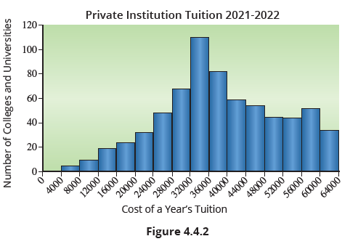
Data Subsetting (cont.)
A natural structuring of the tuition data can be obtained by subsetting the data into private and state-supported institutions.

Slide 14
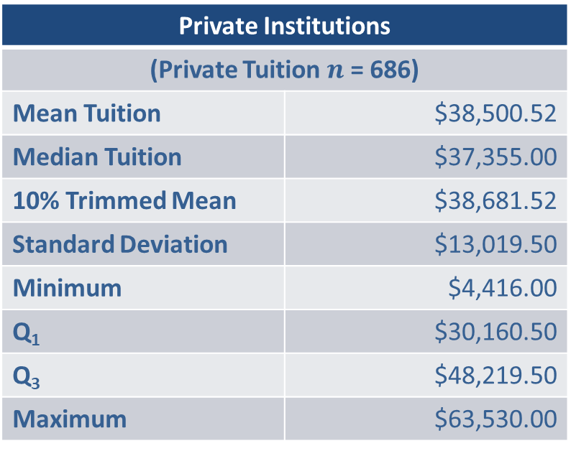
Data Subsetting (cont.)
Private Institutions
(Private Tuition $n$ = 686)
Mean Tuition | $38,500.52
Median Tuition | $37,355.00
10% Trimmed Mean | $38,681.52
Standard Deviation | $13,019.50
Minimum | $4,416.00
Q₁ | $30,160.50
Q₃ | $48,219.50
Maximum | $63,530.00

Slide 15
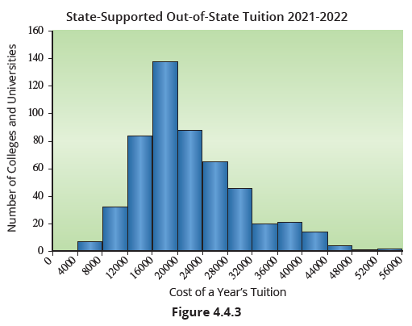
Data Subsetting (cont.)

Slide 16
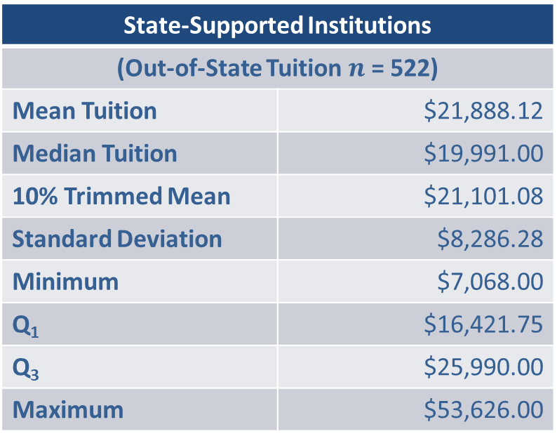
Data Subsetting (cont.)
State-Supported Institutions
(Out-of-State Tuition $n$ = 522)
Mean Tuition | $21,888.12
Median Tuition | $19,991.00
10% Trimmed Mean | $21,101.08
Standard Deviation | $8,286.28
Minimum | $7,068.00
Q₁ | $16,421.75
Q₃ | $25,990.00
Maximum | $53,626.00

Slide 17
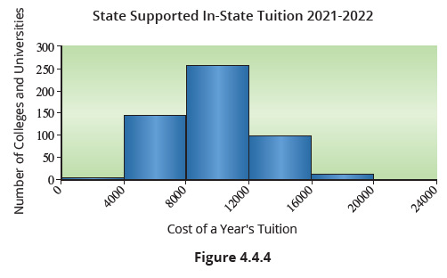
Data Subsetting (cont.)

Slide 18
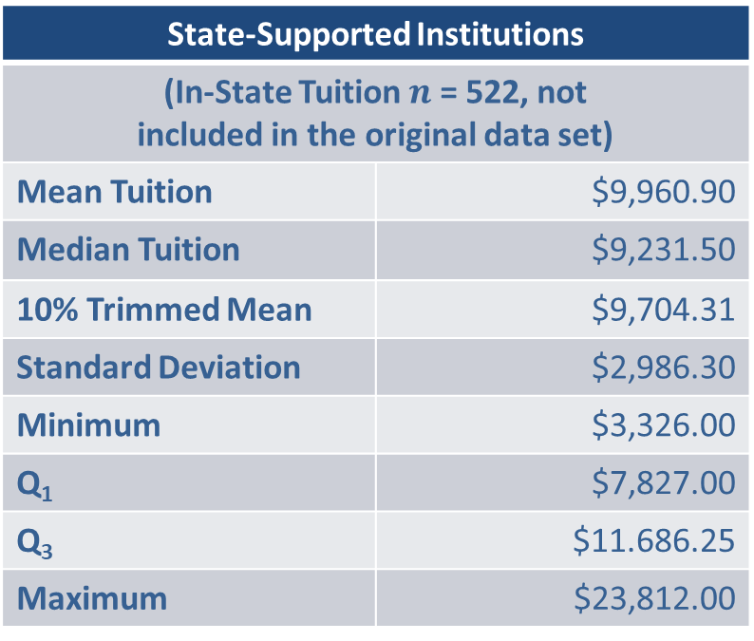
Data Subsetting (cont.)
State-Supported Institutions
(In-State Tuition $n$ = 522, not included in the original data set)
Mean Tuition | $9,960.90
Median Tuition | $9,231.50
10% Trimmed Mean | $9,704.31
Standard Deviation | $2,986.30
Minimum | $3,326.00
Q₁ | $7,827.00
Q₃ | $11.686.25
Maximum | $23,812.00

Slide 19
Data Subsetting (cont.)
The data subsetting suggests that the heavy concentration of tuition costs in the lower two-thirds of the data range that was evident in the histogram in Figure 4.4.1, is the result of merging data from different kinds of educational institutions. Once the data is subsetted, we can see different pictures of tuition costs. Looking at the mean costs for each group, from a tuition point of view, state-supported schools are substantially less expensive than private schools. There is a mean difference of over $16,000 in annual tuition fees between private schools and the out-of-state tuition charged by state-supported colleges.

Slide 20
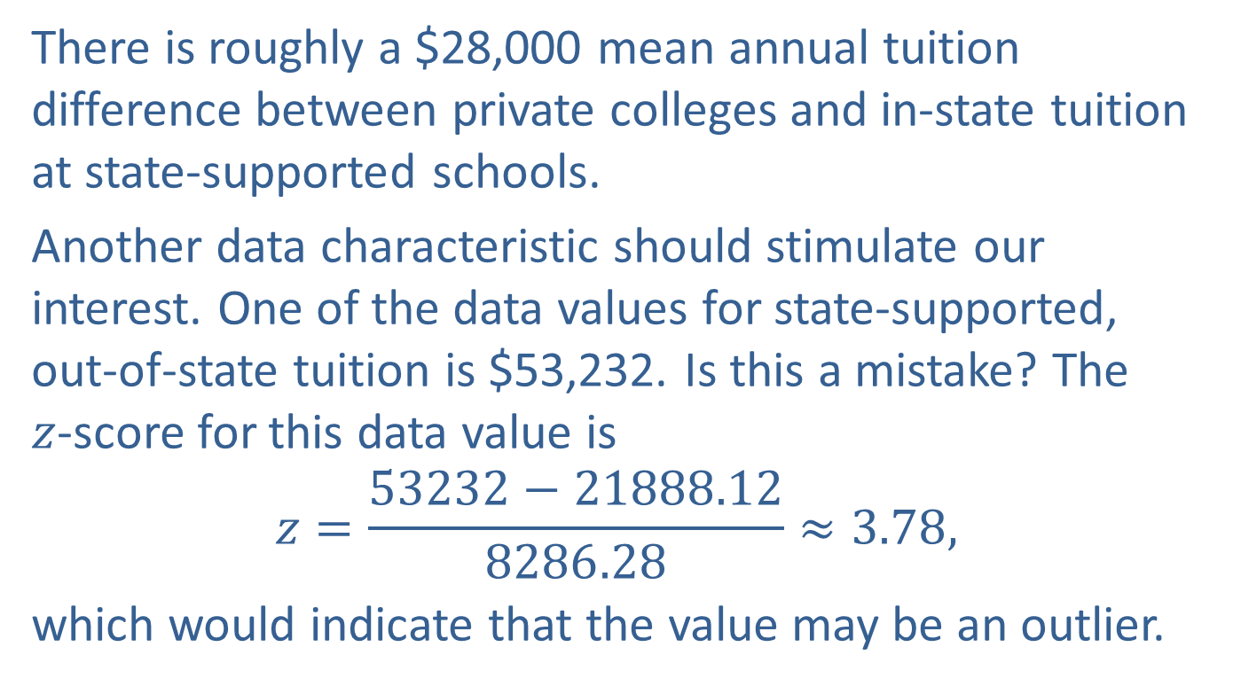
Data Subsetting (cont.)
There is roughly a $28,000 mean annual tuition difference between private colleges and in-state tuition at state-supported schools.
Another data characteristic should stimulate our interest. One of the data values for state-supported, out-of-state tuition is $53,232. Is this a mistake? The $z$-score for this data value is
$$z=\frac{53232−21888.12}{8286.28}≈3.78,$$
which would indicate that the value may be an outlier.

Slide 21
Data Subsetting (cont.)
Any value that is 3.78 standard deviation units from the mean is worth investigating. In this case the value is correct. The tuition cost corresponds to the University of Michigan in Ann Arbor.

Slide 22
Example 4.4.1: An Example of Simpson’s Paradox
A discrimination lawsuit was filed against the California Department of Developmental Services (DDS). The California DDS provides funding for developmentally-disabled individuals within the state. The lawsuit claimed that White Non-Hispanics were receiving more funding than Hispanics. If this was true, the DDS would face some serious legal and financial ramifications, so they hired several statisticians to analyze the data behind the issue. Were these claims of discrimination by a state department actually true?

Slide 23
Example 4.4.1: An Example of Simpson’s Paradox (cont.)
Solution
First, we will create box plots to visualize how the lawsuit arose. We will look at the relationship between ethnicity and expenditure per person by plotting the expenditures grouped by the different ethnicities.

Slide 24
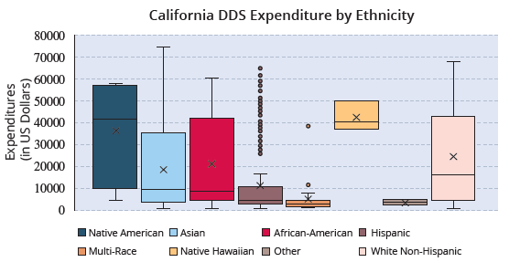
Example 4.4.1: An Example of Simpson’s Paradox (cont.)

Slide 25
Example 4.4.1: An Example of Simpson’s Paradox (cont.)
If the data is examined on a purely ethnic basis, then the figure above suggests that there is discrimination towards multiple different ethnic groups. But, now we need to think about any variables that could be confounding this picture.
The statisticians discovered that age played a massive role in the expenditure per person, because more costs are associated with caring for older developmentally-disabled individuals.

Slide 26
Example 4.4.1: An Example of Simpson’s Paradox (cont.)
To account for the variation in expenditure between different ages, the statisticians decided to subset the whole data set into six different age groups, and then examine the expenditure by ethnicity within each age group to see if the discrimination claim still held true. The box plots in the following figure illustrate their findings.

Slide 27
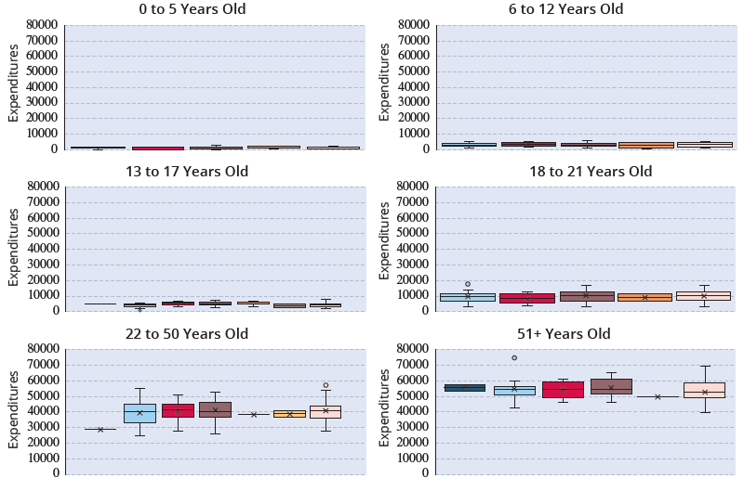
Example 4.4.1: An Example of Simpson’s Paradox (cont.)

Slide 28
Example 4.4.1: An Example of Simpson’s Paradox (cont.)
To the surprise of many involved, the box plots were roughly the same for each ethnic group once age was considered. There was no evidence of discrimination once the confounding variable “age” was accounted for.
This is a classic example of Simpson’s paradox, which states that the perceived association between two variables (ethnicity and expenditures per person in this case) can be drastically affected (confounded) by a third variable.

Slide 29
Example 4.4.1: An Example of Simpson’s Paradox (cont.)
When the data is partitioned by the third variable (age in our case) the “alleged” relationship may not exist or be just the opposite. We encountered this in Chapter 2 when we discussed the gender discrimination lawsuit regarding admissions at the University of California, Berkeley. When analyzing data, it is good to keep in mind Oscar Wilde’s cautionary quote, “the truth is rarely pure, and never simple”. We must always be very cautious when attributing causation.

