Slide 1
Section 4.3
Measures of Relative Position, Box Plots, and Outliers

Slide 2
Measures of Relative Position, Box Plots, and Outliers
Suppose you want to know where an observation stands in relation to other values in a data set. For example, on many standardized tests such as the SAT, GMAT, and ACT, the test scores themselves are rather meaningless unless they are associated with some measure that tells you how well you did relative to others taking the same test. There are two principal methods of communicating relative position: percentiles and z-scores. Both of these methods are data transformations which change the scale of the data in some way.

Slide 3
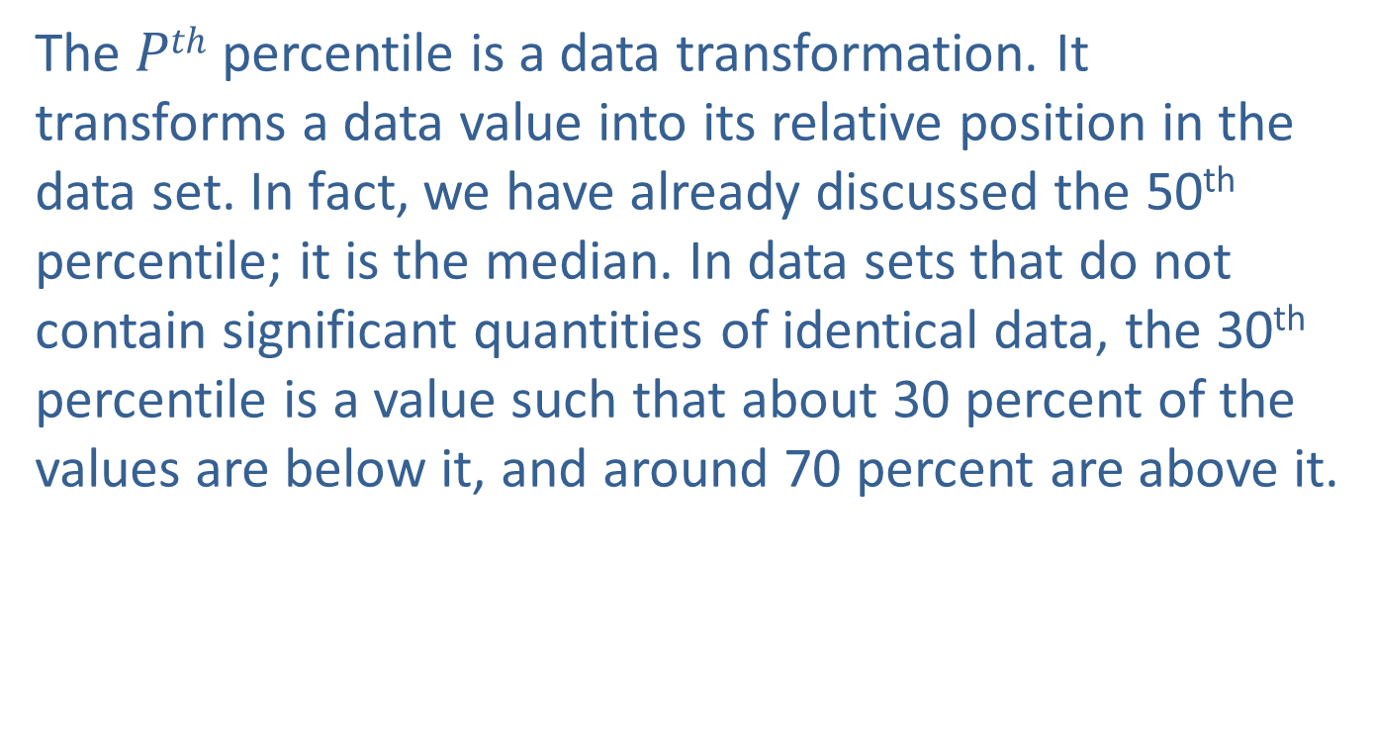
Percentiles
The $Pth$ percentile is a data transformation. It transforms a data value into its relative position in the data set. In fact, we have already discussed the 50th percentile; it is the median. In data sets that do not contain significant quantities of identical data, the 30th percentile is a value such that about 30 percent of the values are below it, and around 70 percent are above it.

Slide 4
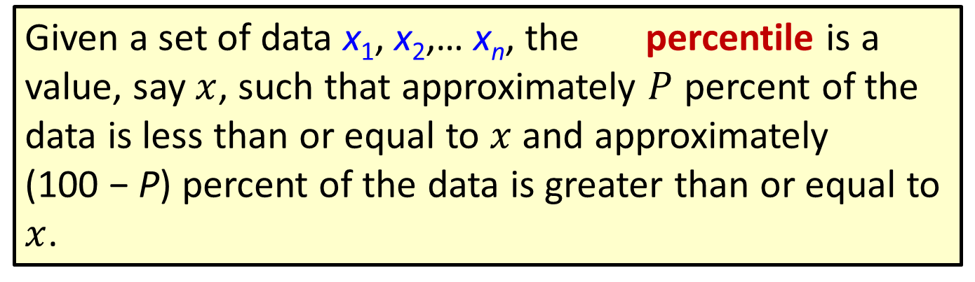

Definition: $Pth$Percentile
Given a set of data x₁, x₂,… x_{n}, the percentile is a value, say $x$, such that approximately $P$ percent of the data is less than or equal to $x$ and approximately (100 − P) percent of the data is greater than or equal to $x$.

Slide 5
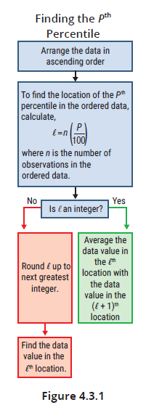
Measures of Relative Position, Box Plots, and Outliers (cont.)

Slide 6

Percentiles (cont.)
To determine the $Pth$ percentile, perform the following steps.

Slide 7
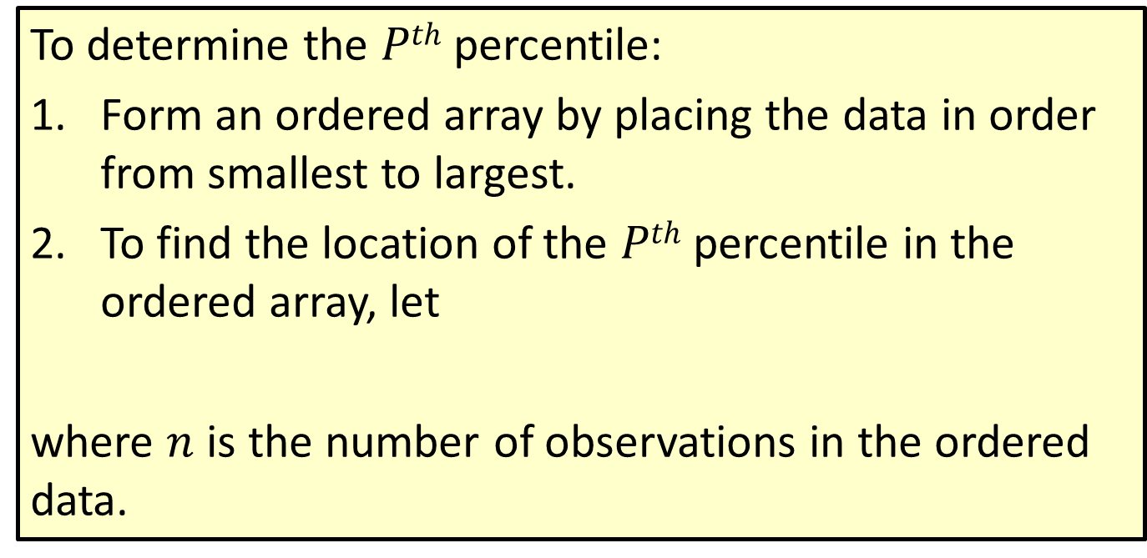

Procedure: Finding the $Pth$ Percentile
To determine the $Pth$ percentile:
Form an ordered array by placing the data in order from smallest to largest.
To find the location of the $Pth$ percentile in the ordered array, let
where $n$ is the number of observations in the ordered data.

Slide 8
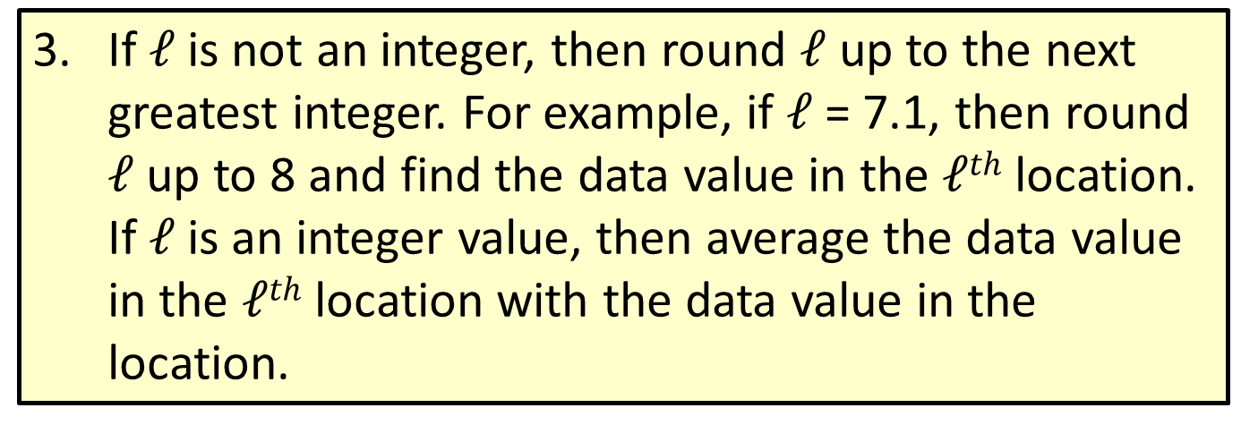

Procedure: Finding the $Pth$ Percentile (cont.)
If $𝓁$ is not an integer, then round $𝓁$ up to the next greatest integer. For example, if $𝓁$ = 7.1, then round $𝓁$ up to 8 and find the data value in the $𝓁th$ location. If $𝓁$ is an integer value, then average the data value in the $𝓁th$ location with the data value in the location.

Slide 9
Percentiles (cont.)
For example, if the result of calculating (and rounding up) 𝓁 is 15, then the desired percentile would be the fifteenth value in the ordered list.

Slide 10
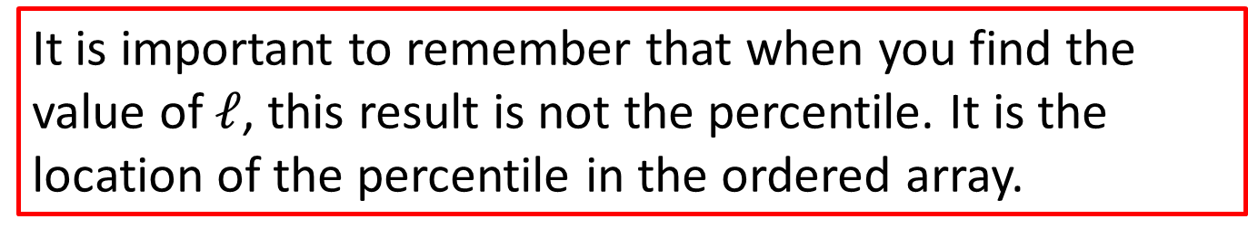
Caution
It is important to remember that when you find the value of $𝓁$, this result is not the percentile. It is the location of the percentile in the ordered array.

Slide 11
Note
Percentile questions are based on the methodology presented in this text. Excel percentile functions will not always provide correct answers because they use algorithms that do not align with our methodology.

Slide 12

Example 4.3.1: Determining the Percentile of Spelling Errors
Find the 50th percentile for the following data on the number of spelling errors found on 7 pages of a web site.
Solution
Number of observations, n = 7.
The percentile, P = 50.
The location of the percentile,

Slide 13
Example 4.3.1: Determining the Percentile of Spelling Errors (cont.)
Since the location of the percentile is not an integer, the value is rounded up to 4.
Thus, the fourth observation in the ordered array is the 50th percentile.
0, 1, 2, 3, 5, 7, 9
Therefore, the median value (which is the 50th percentile) is 3.
fourth observation

Slide 14
Example 4.3.2: Determining Percentiles of Screening Test Scores
Suppose that 40 members of your company are given a screening test for a new position. These scores are reported in the table on the left below. To inform potential employees of their screening test performance you may wish to report various percentiles for the test scores. Find the 10th and 88th percentiles for the test.

Slide 15
Example 4.3.2: Determining Percentiles of Screening Test Scores (cont.)
Test Scores
67 | 45 | 18 | 82
45 | 54 | 61 | 55
63 | 47 | 21 | 31
58 | 46 | 43 | 49
34 | 71 | 69 | 56
54 | 80 | 73 | 77
27 | 70 | 41 | 29
66 | 32 | 44 | 33
21 | 64 | 52 | 81
48 | 55 | 57 | 62
Ordered Test Scores
18 | 43 | 54 | 66
21 | 44 | 55 | 67
21 | 45 | 55 | 69
27 | 45 | 56 | 70
29 | 46 | 57 | 71
31 | 47 | 58 | 73
32 | 48 | 61 | 77
33 | 49 | 62 | 80
34 | 52 | 63 | 81
41 | 54 | 64 | 82

Slide 16
Example 4.3.2: Determining Percentiles of Screening Test Scores (cont.)
Solution
In order to calculate the percentiles, the data must be placed in an ordered array (Ordered Test Scores). To compute the 10th percentile, its position in the ordered array must be determined. The number of observations is n = 40. The percentile is P = 10. The location of the percentile is found by

Slide 17
Example 4.3.2: Determining Percentiles of Screening Test Scores (cont.)
Since is an integer, the 4th and 5th observations in the array must be averaged. Since the fourth data value is 27 and the fifth data value is 29, then the 10th percentile is determined as follows.
To determine the 88th percentile, first determine its location in the ordered array.

Slide 18
Example 4.3.2: Determining Percentiles of Screening Test Scores (cont.)
Since the location is not an integer, its value is rounded up to 36. The 36th observation in the ordered array will correspond to the 88th percentile. The 36th value in the table of ordered scores is 73, so 73 is the 88th percentile.

Slide 19
Percentiles (cont.)
A slightly different problem connected with percentiles involves taking a raw score and determining its corresponding percentile. Raw scores are usually not very meaningful. If someone scores a 50 on the screening test in the previous example, is that substantially less or about the same as someone who scored a 67 on the same test? To compare these two scores find the percentile of each.

Slide 20
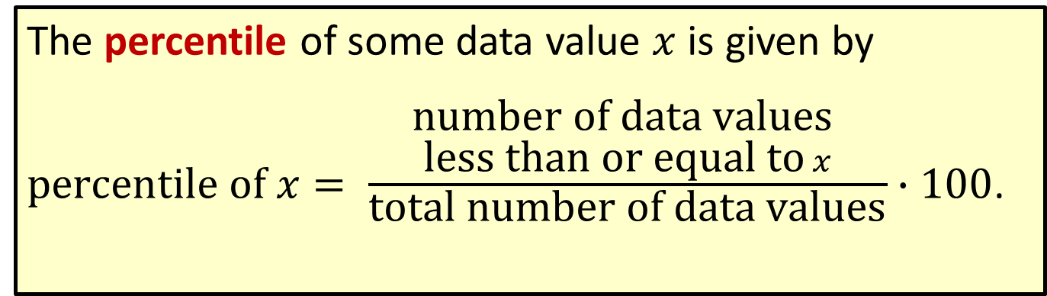
Formula: Percentile
The percentile of some data value $x$ is given by
$\text{percentile} \text{of} x= \frac{\begin{aligned}\text{number} \text{of} \text{data} \text{values} \\ \text{less} \text{than} \text{or} \text{equal} \text{to} x\end{aligned}}{\text{total} \text{number} \text{of} \text{data} \text{values}}∙100$.

Slide 21
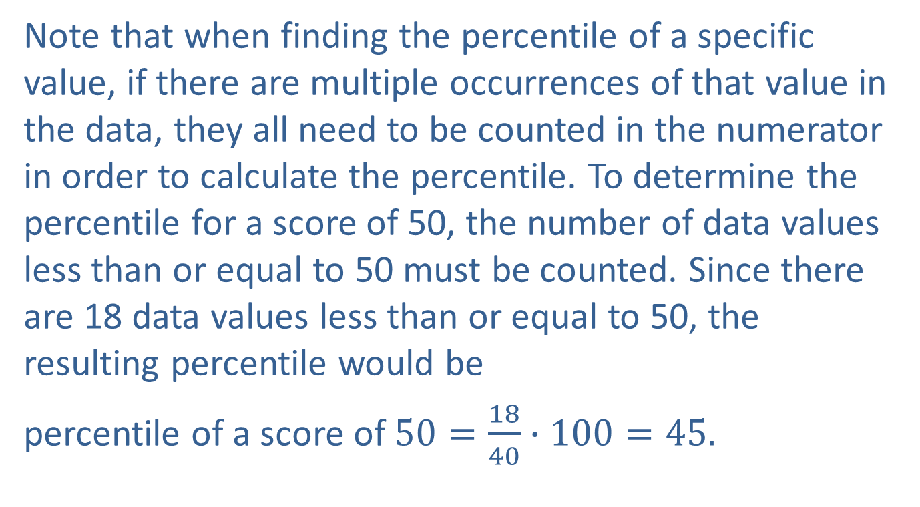
Percentiles (cont.)
Note that when finding the percentile of a specific value, if there are multiple occurrences of that value in the data, they all need to be counted in the numerator in order to calculate the percentile. To determine the percentile for a score of 50, the number of data values less than or equal to 50 must be counted. Since there are 18 data values less than or equal to 50, the resulting percentile would be
percentile of a score of $50=\frac{18}{40}∙100=45.$

Slide 22
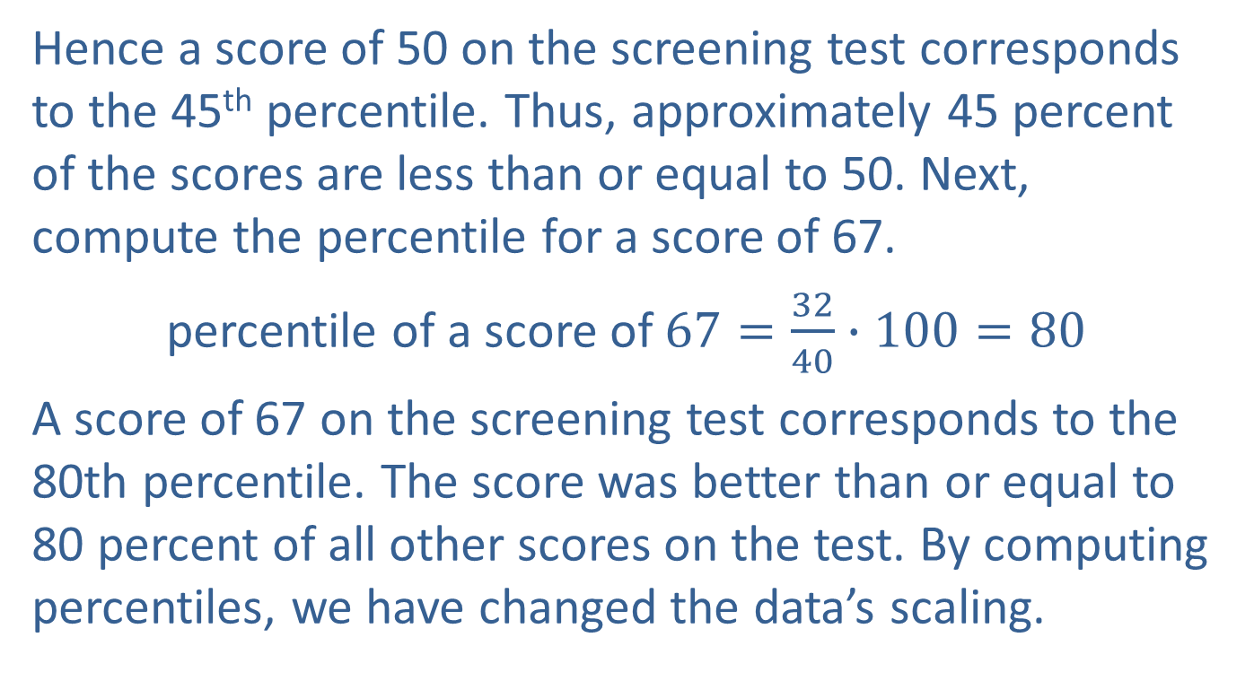
Percentiles (cont.)
Hence a score of 50 on the screening test corresponds to the 45th percentile. Thus, approximately 45 percent of the scores are less than or equal to 50. Next, compute the percentile for a score of 67.
percentile of a score of $67=\frac{32}{40}∙100=80$
A score of 67 on the screening test corresponds to the 80th percentile. The score was better than or equal to 80 percent of all other scores on the test. By computing percentiles, we have changed the data’s scaling.

Slide 23
Percentiles (cont.)
We see the data from a new perspective. Using percentiles, it is clear that a score of 67 is significantly better than a score of 50. The 17 point difference in raw score is translated into a 35 percent differential on the percentile scale.

Slide 24
Definition: Quartiles
The 25th, 50th, and 75th percentiles are known as quartiles and are denoted as Q₁, Q₂ , and Q₃ respectively.

Slide 25
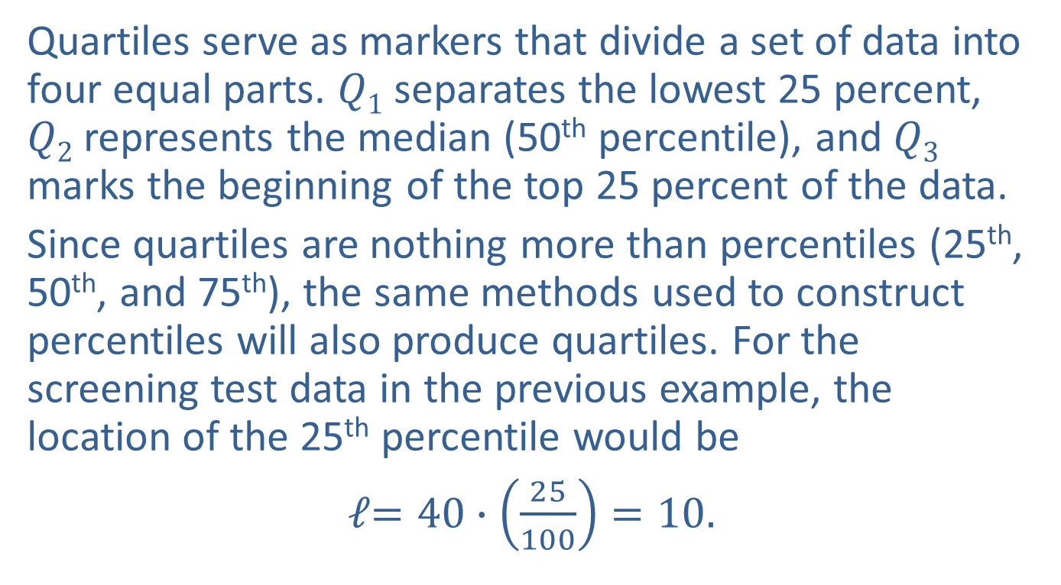
Percentiles (cont.)
Quartiles serve as markers that divide a set of data into four equal parts. $Q1$ separates the lowest 25 percent, $Q2$ represents the median (50th percentile), and $Q3$ marks the beginning of the top 25 percent of the data.
Since quartiles are nothing more than percentiles (25th, 50th, and 75th), the same methods used to construct percentiles will also produce quartiles. For the screening test data in the previous example, the location of the 25th percentile would be
𝓁$=40∙\left(\frac{25}{100}\right)=10.$

Slide 26
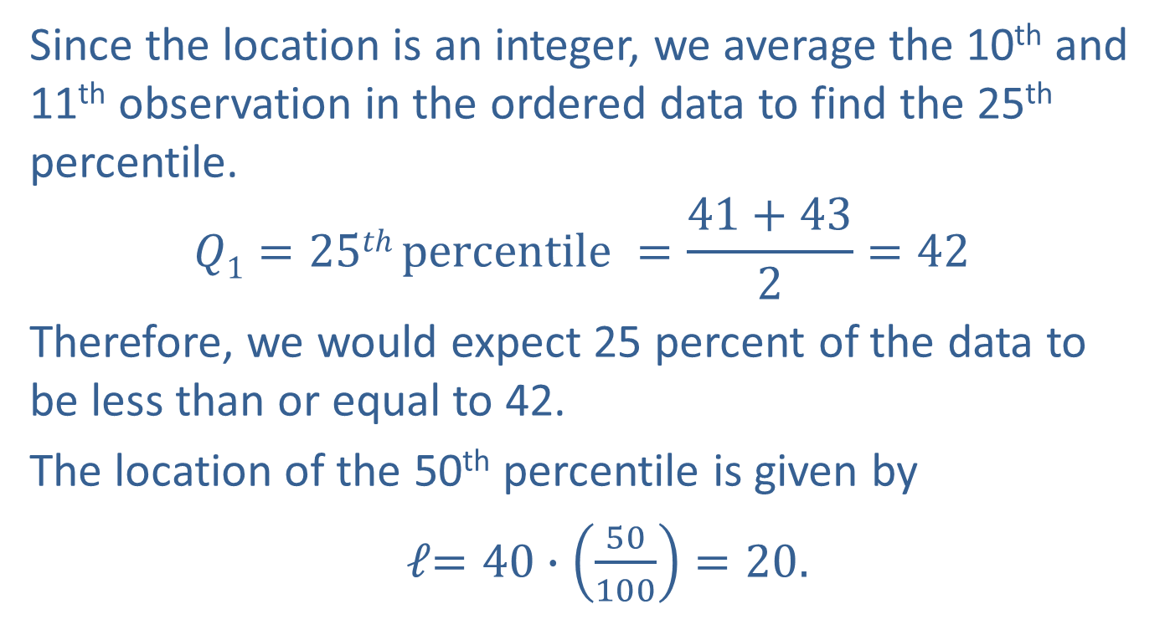
Percentiles (cont.)
Since the location is an integer, we average the 10th and 11th observation in the ordered data to find the 25th percentile.
$$Q1=25th percentile =\frac{41+43}{2}=42$$
Therefore, we would expect 25 percent of the data to be less than or equal to 42.
The location of the 50th percentile is given by
𝓁$=40∙\left(\frac{50}{100}\right)=20.$

Slide 27
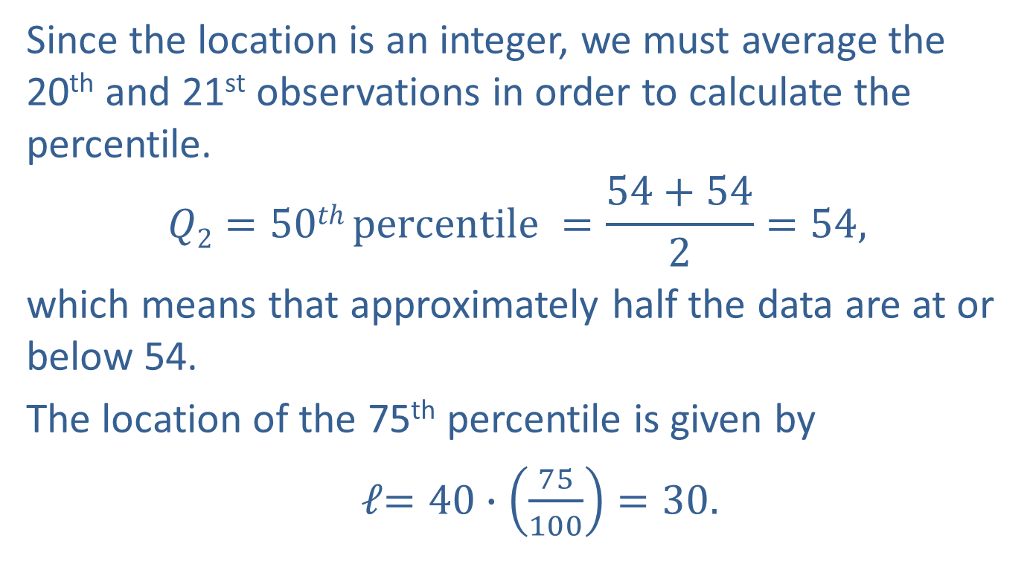
Percentiles (cont.)
Since the location is an integer, we must average the 20th and 21st observations in order to calculate the percentile.
$$Q2=50th percentile =\frac{54+54}{2}=54,$$
which means that approximately half the data are at or below 54.
The location of the 75th percentile is given by
𝓁$=40∙\left(\frac{75}{100}\right)=30.$

Slide 28
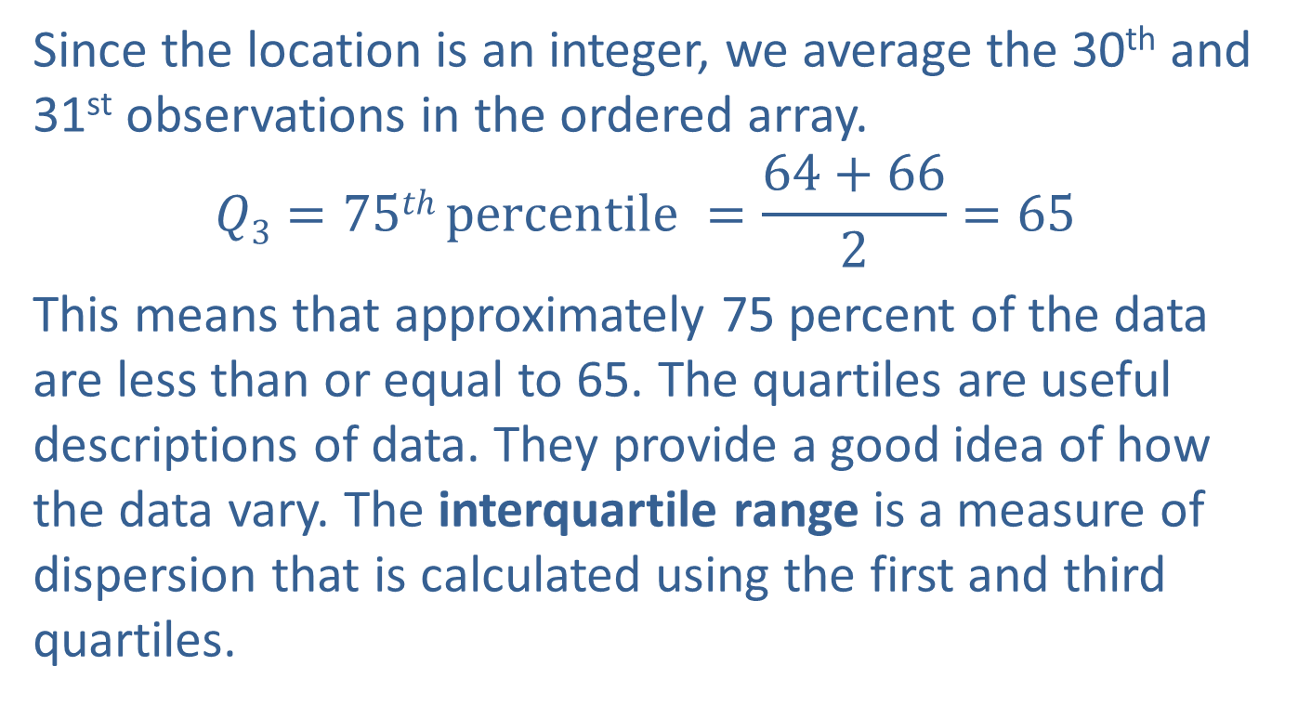
Percentiles (cont.)
Since the location is an integer, we average the 30th and 31st observations in the ordered array.
$$Q3=75th percentile =\frac{64+66}{2}=65$$
This means that approximately 75 percent of the data are less than or equal to 65. The quartiles are useful descriptions of data. They provide a good idea of how the data vary. The interquartile range is a measure of dispersion that is calculated using the first and third quartiles.

Slide 29
Formula: Interquartile Range
The interquartile range is a measure of dispersion which describes the range of the middle fifty percent of the data. It is calculated as follows.
IQR = Q₃− Q₁

Slide 30
Percentiles (cont.)
For the screening test data, the interquartile range is 65 − 42 = 23, indicating that the middle 50 percent of the data spans a 23-unit range.

Slide 31
Box Plots − Graphing with Quartiles
A very important use of quartiles is in the construction of box plots. As the name implies, box plots are graphical summaries of the data which, when constructed, have a box-like shape. They provide an alternative method to the histogram for displaying data. Box plots are a graphical summary of the central tendency, the spread, the skewness, and the potential existence of outliers in the data. Figure 4.3.2 displays a box plot of the screening test data from Example 4.3.2.

Slide 32
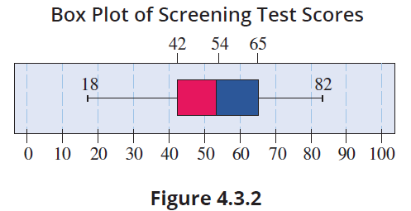
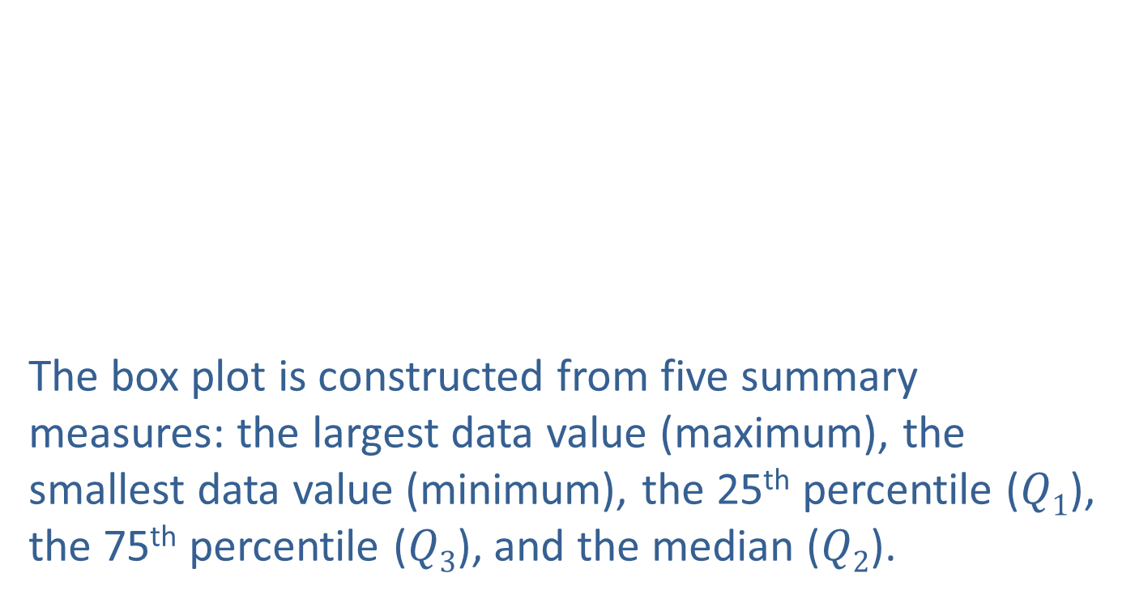
Box Plots − Graphing with Quartiles (cont.)
The box plot is constructed from five summary measures: the largest data value (maximum), the smallest data value (minimum), the 25th percentile ($Q1$), the 75th percentile ($Q3$), and the median ($Q2$).

Slide 33
Definition: 5-Number Summary
For a set of data, the 5-number summary consists of the following five values:
Minimum
First quartile, Q₁
Second quartile, Q₂, or the median
Third quartile, Q₃
Maximum

Slide 34
Caution
Different technologies may yield different box plots due to differences in the procedures used for determining quartiles.

Slide 35
Box Plots − Graphing with Quartiles (cont.)
The lower boundary of the box is the 25th percentile, which is 42 for the screening test data. The upper boundary of the box is the 75th percentile, which is 65 for the screening test data. The median is marked with a line through the box. The median of the test scores data is 54. Notice that the box itself represents the middle 50% of the data, and the length of the box is the interquartile range.

Slide 36
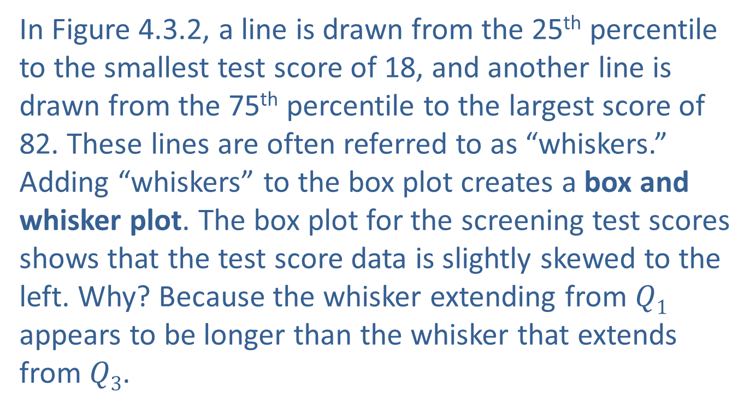
Box Plots − Graphing with Quartiles (cont.)
In Figure 4.3.2, a line is drawn from the 25th percentile to the smallest test score of 18, and another line is drawn from the 75th percentile to the largest score of 82. These lines are often referred to as “whiskers.” Adding “whiskers” to the box plot creates a box and whisker plot. The box plot for the screening test scores shows that the test score data is slightly skewed to the left. Why? Because the whisker extending from $Q1$ appears to be longer than the whisker that extends from $Q3$.

Slide 37
Procedure: Procedure for Constructing a Box Plot
Determine the 5-number summary for the data set.
Draw a scale that includes the minimum and maximum data values.
Construct a box extending from Q₁ to Q₃.
Draw a line through the box at the value of the median.
Draw lines extending from Q₁ to the minimum and from Q₃ to the maximum.

Slide 38
Detecting Outliers
The concept of an outlier is an arbitrary concept. What you consider an outlier and what someone else considers an outlier may not be the same thing. However, one definition of an outlier which has gained some acceptance is developed in the context of a box plot.

Slide 39
Definition: Outlier
A data point is considered an outlier if it is 1.5 times the interquartile range above the 75th percentile or 1.5 times the interquartile range below the 25th percentile.

Slide 40
Detecting Outliers (cont.)
If there is an outlier in the data set, the whiskers are drawn to the largest or smallest data point which is within 1.5 times the interquartile range from the box, and the outliers are marked with a point. For example, suppose test scores of 110 and 2 were added to the screening test data in Example 4.3.2. For the screening test data, a point is considered an outlier if it is
larger than the 75th percentile + 1.5 times the interquartile range = 66 + 1.5(25) = 103.5 or

Slide 41
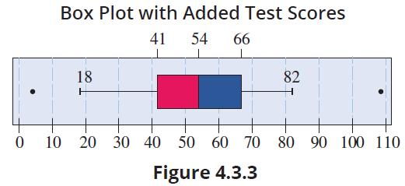
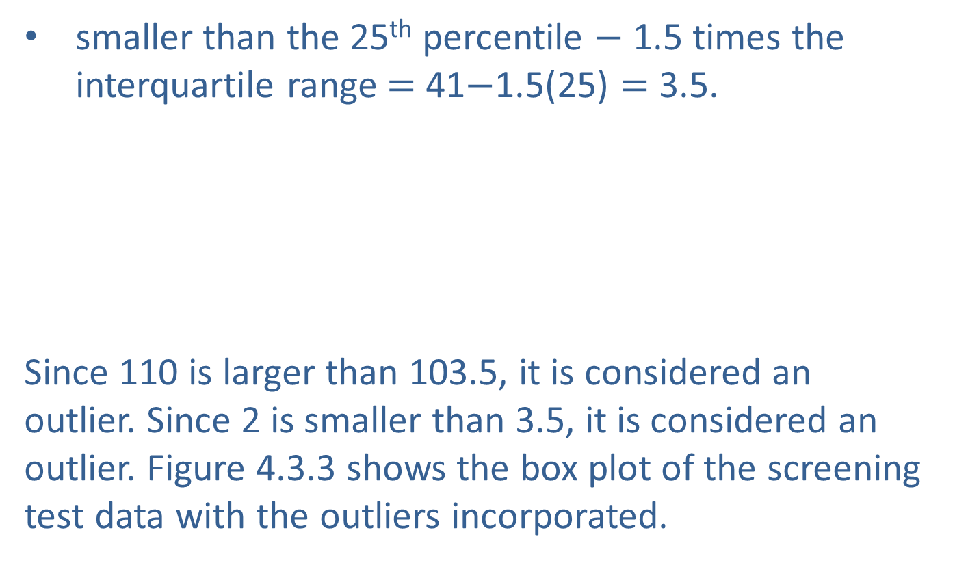
Detecting Outliers (cont.)
smaller than the 25th percentile $−$ 1.5 times the interquartile range $=$ 41$−$1.5(25) $=$ 3.5.
Since 110 is larger than 103.5, it is considered an outlier. Since 2 is smaller than 3.5, it is considered an outlier. Figure 4.3.3 shows the box plot of the screening test data with the outliers incorporated.

Slide 42
Detecting Outliers (cont.)
Notice that the whiskers did not change because 82 and 18 are still the largest and smallest observations within 1.5 times the interquartile range from the box. This type of box plot is often referred to in statistical software packages as a modified box plot.

Slide 43
Detecting Outliers (cont.)
Although the box plot can be used to display data for a single variable, the histogram is probably more useful for this purpose. The real power of the box plot is the ease with which it allows the comparison of several variables. In fact, it is almost impossible to open the journal Science without seeing box plots scattered throughout the pages.
Consider the data from the number of wins per baseball team given in Chapter 3. The four variables are displayed by the box plots in Figure 4.3.4.

Slide 44
Detecting Outliers (cont.)
It is easy to see from the box plots that the median of the Yankees’ number of wins is higher than that for the Dodgers, which is also greater than the median of both the Braves and the Cubs. This indicates that the Yankees have typically won more total games in a season than the other franchises. Note the existence of outliers to the left for both the Cubs and the Dodgers; these would indicate unusually poor seasons for those teams.

Slide 45
Detecting Outliers (cont.)
Also, it appears that the spread of the data, or the variation within the observed values, is not the same for all four variables. The Cubs have the largest range and the Braves have the largest IQR. The Yankees and Dodgers are more similar in their variability as their range and IQR are nearly equal. This type of comparison will be used in later chapters to help confirm assumptions which must be made about the data in order to perform statistical inference.

Slide 46
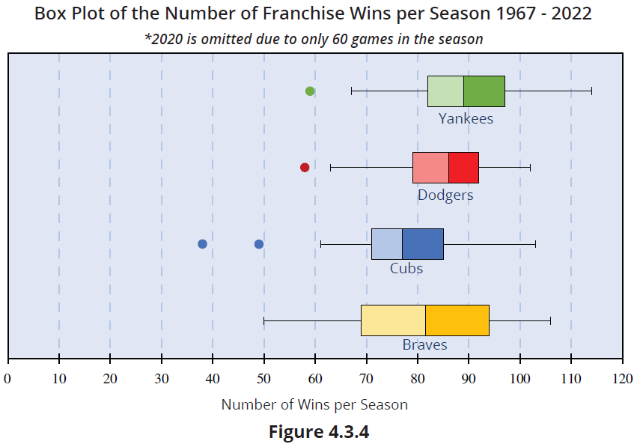
Detecting Outliers (cont.)

Slide 47
Example 4.3.3: Drawing Conclusions from Side by Side Box Plots of Education and Earnings
Education attainment seems to have a positive association with a person’s income. The amount of education a person has can be divided into five categories.
Less than a high school diploma
High school graduate, no college
Some college or associate degree
Bachelor’s degree only
Advanced degree

Slide 48
Example 4.3.3: Drawing Conclusions from Side by Side Box Plots of Education and Earnings (cont.)
The categories are ordered according to educational attainment. The vertical box plots in the figure below show the distributions of personal income per week for each level of education, for individuals age 25 and older. Rather than extending the whiskers to the smallest and largest income values in each category, the whisker endpoints represent the 10th and 90th percentiles. What conclusions can be drawn from this figure?

Slide 49
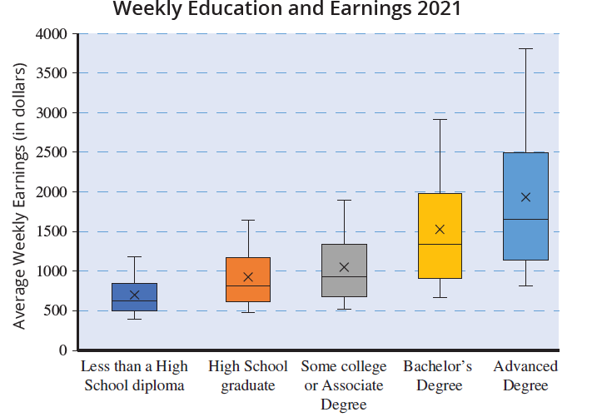
Example 4.3.3: Drawing Conclusions from Side by Side Box Plots of Education and Earnings (cont.)

Slide 50
Example 4.3.3: Drawing Conclusions from Side by Side Box Plots of Education and Earnings (cont.)
Solution
It is rather obvious from this figure that more education tends to produce higher earning opportunities. Also, there is a lot of spread in the last two box plots as shown by the longer lengths of the boxes. This is probably due in part to the market demands for degrees in scientific disciplines, especially computer science.

Slide 51
Detecting Outliers (cont.)
An interesting set of data is that of the violent crime rate in the United States. The FBI has a Uniform Crime Reporting (UCR) program which defines what constitutes a violent crime and standardizes reporting from 18,000 enforcement agencies. The crime rate is normalized and defined as the number of reported violent crimes per 100,000 residents. The data from 2010 to 2020 is shown in Figure 4.3.5. Washington, D.C. is the outermost outlier in each year, followed by Alaska.

Slide 52
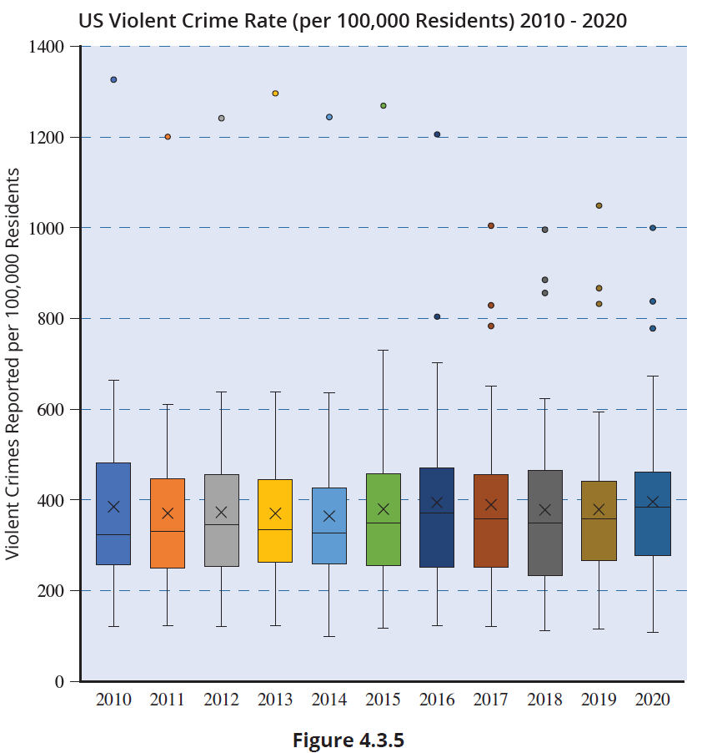
Detecting Outliers (cont.)

Slide 53

z -Scores
The $z$-score is a data transformation. It transforms a data value into a standardized measure of relative position with respect to the mean and variability (as measured by the standard deviation) of a data set.

Slide 54
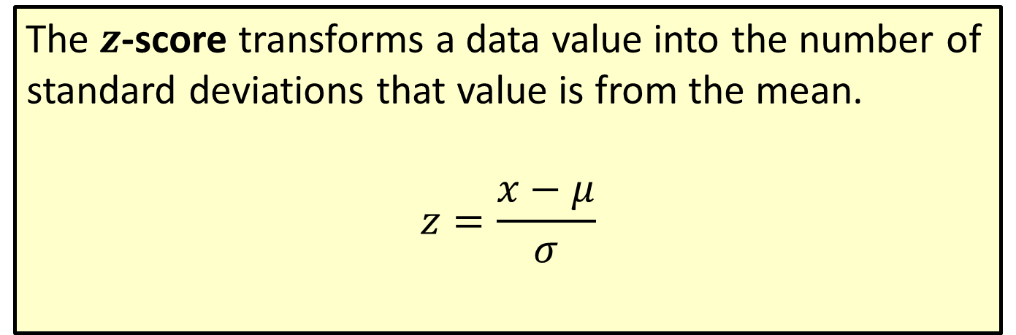
Formula: z-Score
The $z$-score transforms a data value into the number of standard deviations that value is from the mean.
$$z=\frac{x−μ}{σ}$$

Slide 55
z –Scores (cont.)
Describing a data value by its number of standard deviations from the mean is a fundamental concept in statistics that is found throughout this book. It is used as a standardization technique, a yardstick, to describe properties of data sets and to compare the relative values of data from different data sets.

Slide 56
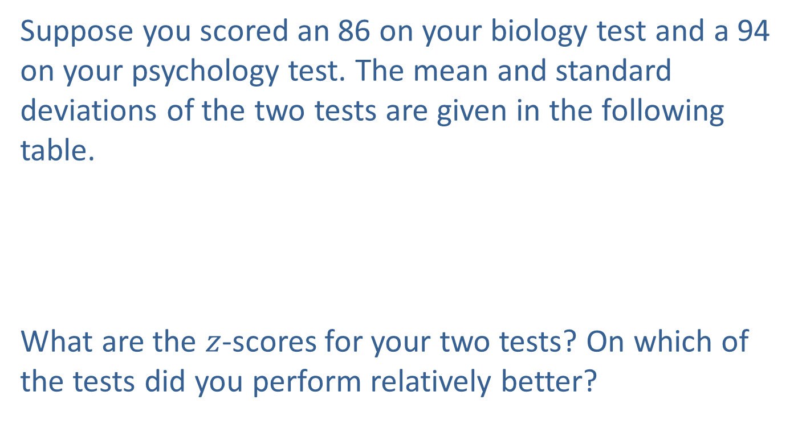
Example 4.3.4: Determining z-Scores for Biology and Psychology Test Scores
Suppose you scored an 86 on your biology test and a 94 on your psychology test. The mean and standard deviations of the two tests are given in the following table.
What are the $z$-scores for your two tests? On which of the tests did you perform relatively better?
Test Scores
Course | Mean | Standard Deviation
Biology | 74 | 10
Psychology | 82 | 11

Slide 57
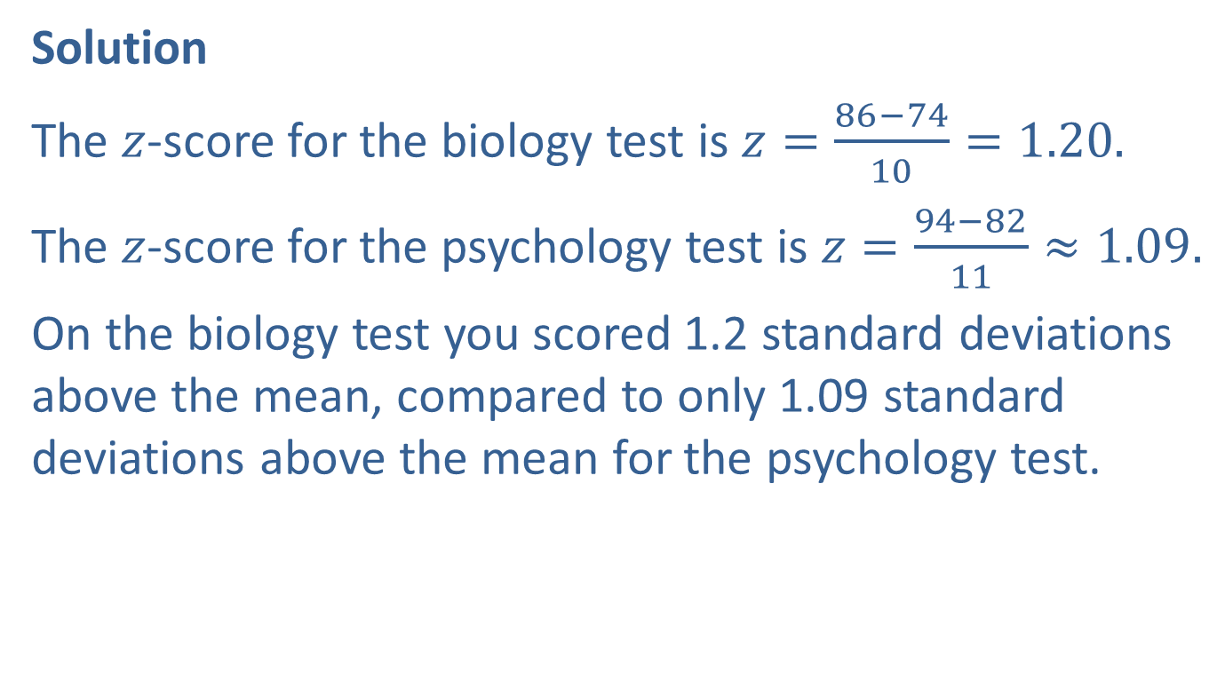
Example 4.3.4: Determining z-Scores for Biology and Psychology Test Scores (cont.)
Solution
The $z$-score for the biology test is $z=\frac{86−74}{10}=1.20.$
The $z$-score for the psychology test is $z=\frac{94−82}{11}≈1.09.$
On the biology test you scored 1.2 standard deviations above the mean, compared to only 1.09 standard deviations above the mean for the psychology test.

Slide 58
Example 4.3.4: Determining z-Scores for Biology and Psychology Test Scores (cont.)
Even though the raw score on the psychology test is larger than the raw score on the biology test, relative to the means and variability in the data sets, the performance on the biology test was slightly better. Once again, changing the scale of the data (to standard deviation units) has beneficial effects. It enables the comparison of two measurements that are drawn from different populations.

Slide 59
Properties: Properties of a z-Score
If a z-score is negative, the corresponding data value is less than the mean.
Conversely, if a z-score is positive, the corresponding data value is greater than the mean.
The z-score is a unit-free measure. That is, regardless of the original units of measurement (centimeters, meters, or kilometers), an observation’s z-score will be the same.

