Slide 1
Section 4.2
Measures of Dispersion

Slide 2
Measures of Dispersion
Suppose all people looked alike, all cars looked alike, everyone wore the same kind of clothes, and there was only one kind of hamburger (plain). Without diversity it would be a boring world and a world in which statistics would be of little value. Since much of statistics is devoted to describing, analyzing, and explaining variability, understanding how variability is measured is essential to understanding statistics.
The concept of variability (also referred to as dispersion or spread) is as vague as the concept of central tendency.

Slide 3
Measures of Dispersion (cont.)
And vague concepts lead to different measurement ideas. The same issues that are important in evaluating location measures are meaningful in evaluating measures of dispersion.
Many of the good measures of dispersion use the concept of deviation from the mean. If the mean is a focal point or base, use it as a common basis from which to measure variation. The distance that a point is from its mean is called a deviation from the mean. A data set and its deviations from the mean are calculated in Table 4.2.1.

Slide 4
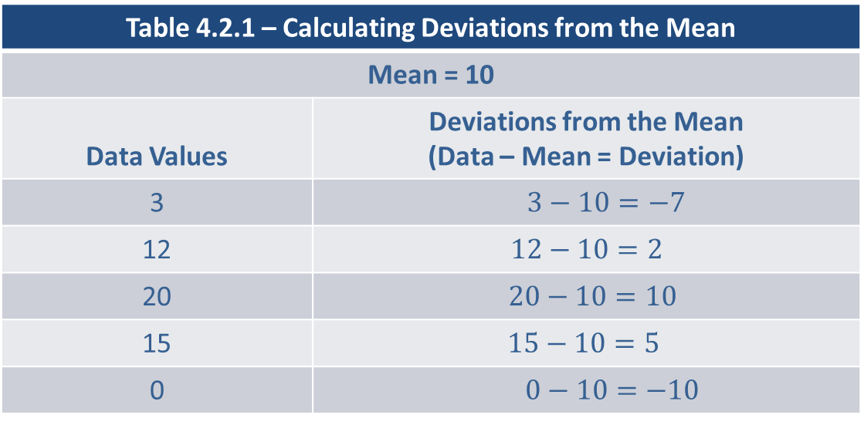
Measures of Dispersion (cont.)
Table 4.2.1 – Calculating Deviations from the Mean
Mean = 10
Data Values | Deviations from the Mean (Data – Mean = Deviation)
3 | $3−10=−7$
12 | $$12−10=2$$
20 | $20−10=10$
15 | $$15−10=5$$
0 | $$0−10=−10$$

Slide 5
Measures of Dispersion (cont.)
Because the mean is the point at which the sum of the positive deviations equals the sum of the absolute values of the negative deviations, the deviations will always sum to zero. Many of the variability measures we will discuss average these deviations in some form.

Slide 6
The Range
The range is a primitive measure of spread that does not use the deviation concept. It is highly sensitive to outliers and consequently, not a resistant measure.

Slide 7
Definition: Range
The range is the difference between the largest and smallest data values.

Slide 8
Example 4.2.1: Determining the Range of Sodium Content of Breakfast Cereals
Determine the range of the data on the sodium content of ten popular breakfast cereals from Example 4.1.6.
Sodium Content of Breakfast Cereals
Cereal Brand | Sodium (mg)
Apple Jacks | 125
Captain Crunch | 220
Corn Flakes | 290
Golden Grahams | 280
Crispix | 220
Froot Loops | 125
Frosted Flakes | 200

Slide 9
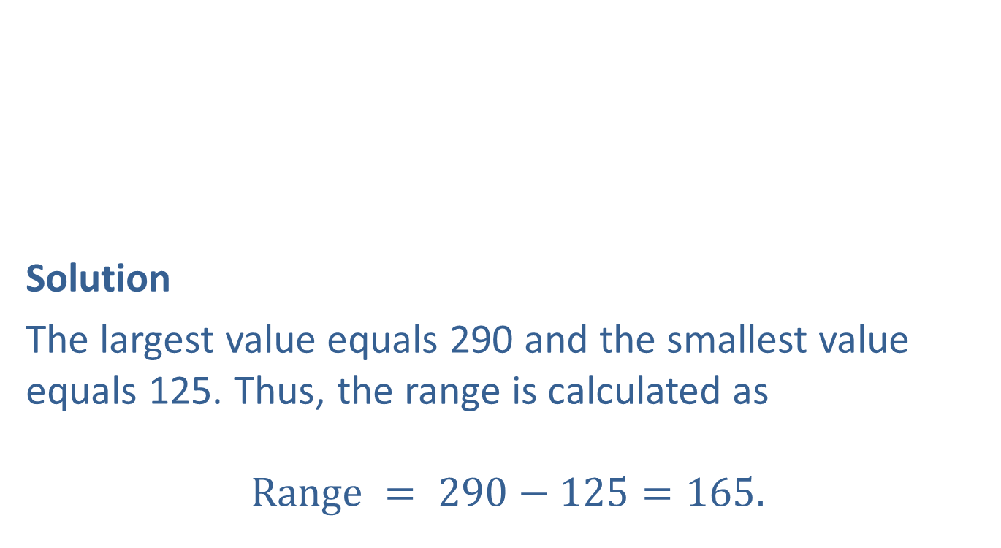
Example 4.2.1: Determining the Range of Sodium Content of Breakfast Cereals (cont.)
Solution
The largest value equals 290 and the smallest value equals 125. Thus, the range is calculated as
$$Range = 290−125=165.$$
Sodium Content of Breakfast Cereals (cont.)
Cereal Brand | Sodium (mg)
Fruity Pebbles | 135
Honey Nut Cheerios | 250
Life | 150

Slide 10
The Range (cont.)
One problem with the range is that it is affected by outliers. Another is that it ignores all the information in the data about variation except for two data points. For example, you could have a data set with four hundred values of 0, and one value of 600 which would have a range of 600. Another data set might have one value of 0, 200 values in the four hundreds, 200 values in the five hundreds, and exactly 100 values of six hundred, and the range would also be 600. While both data sets have the same range, the data sets are distinctively different.

Slide 11
The Range (cont.)
One is clustered around 0 and the other is clustered around 500. Focusing only on the largest and smallest data values produces a very misleading idea about the variation of the data. That is why measures of variation that use all the data are much more desirable methods of reflecting the concept of data variation.

Slide 12
Mean Absolute Deviation (MAD)
One of the ways of obtaining information about the spread of a set of data is to analyze the deviations from the mean. If instead of adding the raw deviations, suppose the absolute values of the deviations (which can be interpreted as distance from the mean) are summed and divided by the number of deviations. This new measure computes the average distance from the mean for the data set. This measure is called the mean absolute deviation. If data set A has a larger average deviation than B, then it is reasonable to believe that data set A has more variability than data set B.

Slide 13
Formula: Mean Absolute Deviation
The sample mean absolute deviation (MAD) is given by

Slide 14
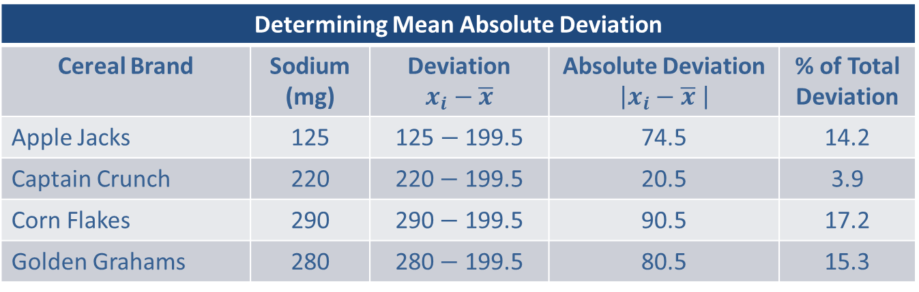
Example 4.2.2: Determining the Mean Absolute Deviation of Sodium Content of Breakfast Cereals
Using the cereal data from the previous example, determine the mean absolute deviation of sodium content.
Solution
Determining Mean Absolute Deviation
Cereal Brand | Sodium (mg) | Deviation $$x_{i}−\overline{x}$$ | Absolute Deviation $$\left|x_{i}−\overline{x} \right|$$ | % of Total Deviation
Apple Jacks | 125 | 125 $−$ 199.5 | 74.5 | 14.2
Captain Crunch | 220 | 220$−$ 199.5 | 20.5 | 3.9
Corn Flakes | 290 | 290$−$ 199.5 | 90.5 | 17.2
Golden Grahams | 280 | 280$−$ 199.5 | 80.5 | 15.3

Slide 15
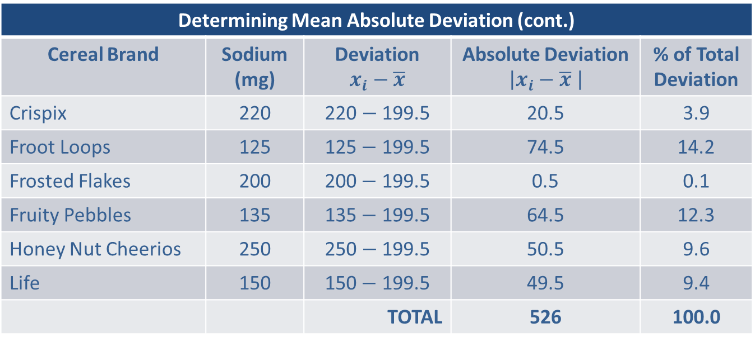

Example 4.2.2: Determining the Mean Absolute Deviation of Sodium Content of Breakfast Cereals (cont.)
Determining Mean Absolute Deviation (cont.)
Cereal Brand | Sodium (mg) | Deviation $$x_{i}−\overline{x}$$ | Absolute Deviation $$\left|x_{i}−\overline{x} \right|$$ | % of Total Deviation
Crispix | 220 | 220 $−$ 199.5 | 20.5 | 3.9
Froot Loops | 125 | 125$−$ 199.5 | 74.5 | 14.2
Frosted Flakes | 200 | 200$−$ 199.5 | 0.5 | 0.1
Fruity Pebbles | 135 | 135$−$ 199.5 | 64.5 | 12.3
Honey Nut Cheerios | 250 | 250 $−$ 199.5 | 50.5 | 9.6
Life | 150 | 150$−$ 199.5 | 49.5 | 9.4
 |  | TOTAL | 526 | 100.0
Mean Absolute Deviation $=\frac{526}{10}=52.6$

Slide 16
Example 4.2.2: Determining the Mean Absolute Deviation of Sodium Content of Breakfast Cereals (cont.)
Thus, on average, the points are 52.6 units from the mean. Note that the contribution to the sum of the deviations is proportional to the size of the deviation. That is, if one absolute deviation is twice as large as another, it contributes twice as much to the value of the statistic. For example, compare the data point 125, which is 74.5 units from the mean (199.5), to the data point 220, which is 20.5 units from the mean. The percentage contribution to the total deviation is 14.2% for 125 and 3.9% for 220, which is in proportion to their respective distances from the mean.

Slide 17
Example 4.2.2: Determining the Mean Absolute Deviation of Sodium Content of Breakfast Cereals (cont.)
A variability measure in which each data value contributes proportionally to its distance from the mean seems a reasonable measure of variation.
The mean absolute deviation is sensitive to outliers and is not a resistant measure, as demonstrated in the following example.

Slide 18
Example 4.2.3: Determining the Mean Absolute Deviation of Sodium Content with an Outlier
Suppose the value 500 is added to the data set given in Example 4.2.2.
The mean is drastically affected, increasing from 199.5 to 226.8. In the table below we redo the basic calculations for the mean absolute deviation. What effect, if any, does the value of 500 have on the MAD?

Slide 19
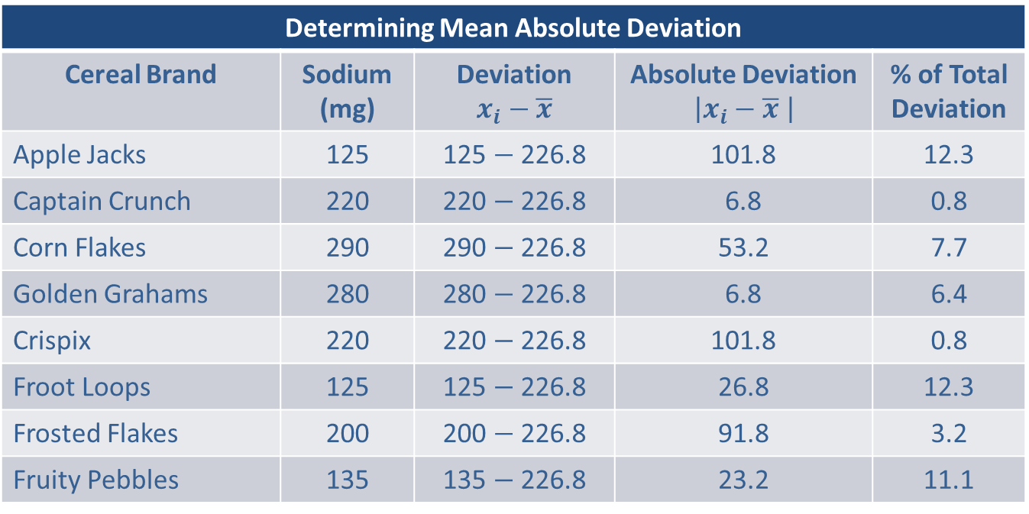
Example 4.2.3: Determining the Mean Absolute Deviation of Sodium Content with an Outlier (cont.)
Solution
Determining Mean Absolute Deviation
Cereal Brand | Sodium (mg) | Deviation $$x_{i}−\overline{x}$$ | Absolute Deviation $$\left|x_{i}−\overline{x} \right|$$ | % of Total Deviation
Apple Jacks | 125 | 125 $−$ 226.8 | 101.8 | 12.3
Captain Crunch | 220 | 220 $−$ 226.8 | 6.8 | 0.8
Corn Flakes | 290 | 290 $−$ 226.8 | 53.2 | 7.7
Golden Grahams | 280 | 280 $−$ 226.8 | 6.8 | 6.4
Crispix | 220 | 220 $−$ 226.8 | 101.8 | 0.8
Froot Loops | 125 | 125 $−$ 226.8 | 26.8 | 12.3
Frosted Flakes | 200 | 200 $−$ 226.8 | 91.8 | 3.2
Fruity Pebbles | 135 | 135 $−$ 226.8 | 23.2 | 11.1

Slide 20
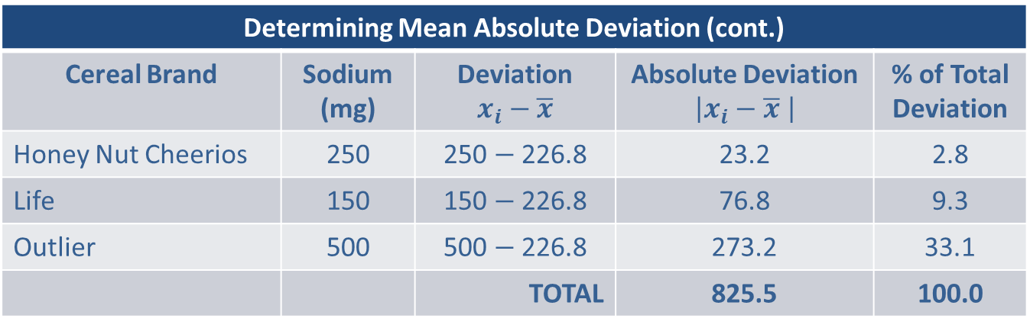

Example 4.2.3: Determining the Mean Absolute Deviation of Sodium Content with an Outlier (cont.)
Mean Absolute Deviation $=\frac{825.5}{11}≈75.0$
Determining Mean Absolute Deviation (cont.)
Cereal Brand | Sodium (mg) | Deviation $$x_{i}−\overline{x}$$ | Absolute Deviation $$\left|x_{i}−\overline{x} \right|$$ | % of Total Deviation
Honey Nut Cheerios | 250 | 250 $−$ 226.8 | 23.2 | 2.8
Life | 150 | 150 $−$ 226.8 | 76.8 | 9.3
Outlier | 500 | 500 $−$ 226.8 | 273.2 | 33.1
 |  | TOTAL | 825.5 | 100.0

Slide 21
Example 4.2.3: Determining the Mean Absolute Deviation of Sodium Content with an Outlier (cont.)
The mean absolute deviation changes considerably, increasing to 75.0. Therefore, the mean absolute deviation is sensitive to outliers and is not a resistant measure. The mean absolute deviation is a very intuitive measure of variation but is not used very often.

Slide 22
Variance and Standard Deviation
The variance and standard deviation are the most common measures of variability. Since the standard deviation is computed directly from the variance, our discussion will center on the variance. Like the MAD, the variance and standard deviation provide numerical measures of how the data varies around the mean. If the data is tightly packed around the mean, the variance and standard deviation will be relatively small. On the other hand, if the data is widely dispersed about the mean, the variance and standard deviation will be relatively large.

Slide 23
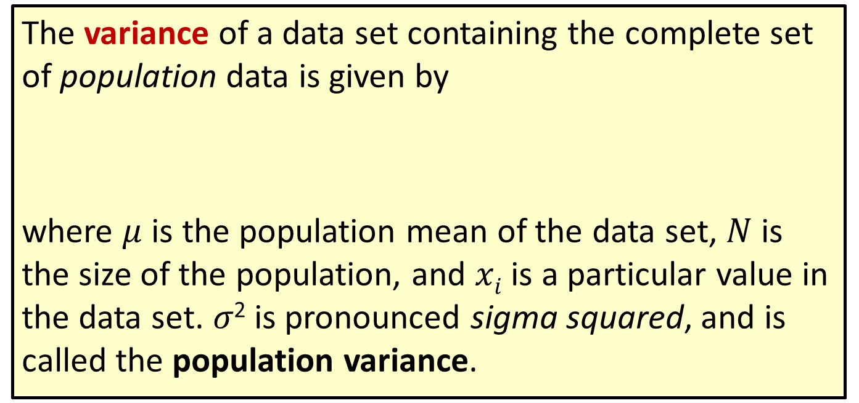
Formula: Variance
The variance of a data set containing the complete set of population data is given by
where $μ$ is the population mean of the data set, $N$ is the size of the population, and $xi$ is a particular value in the data set. 𝜎² is pronounced sigma squared, and is called the population variance.

Slide 24
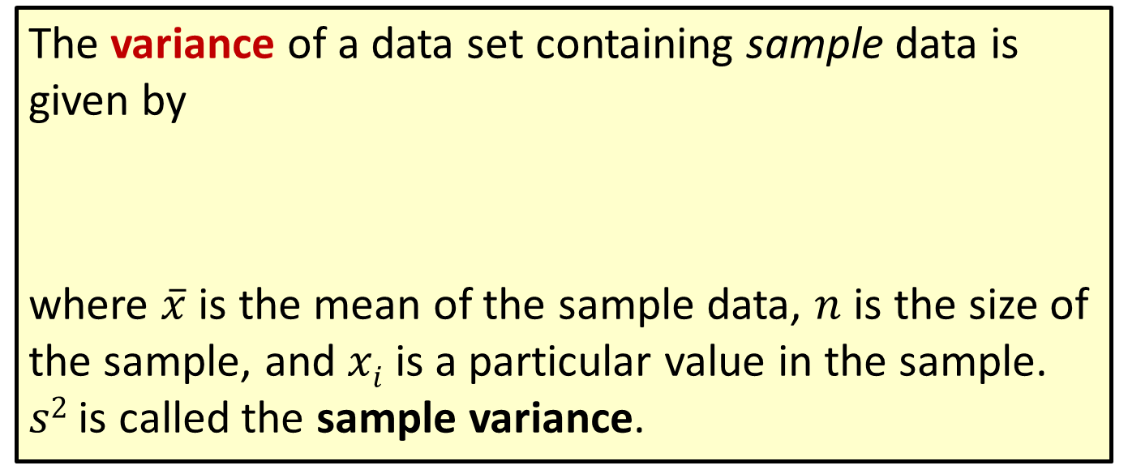
Formula: Variance (cont.)
The variance of a data set containing sample data is given by
where $\overline{x}$ is the mean of the sample data, $n$ is the size of the sample, and $xi$ is a particular value in the sample. $s2$ is called the sample variance.

Slide 25
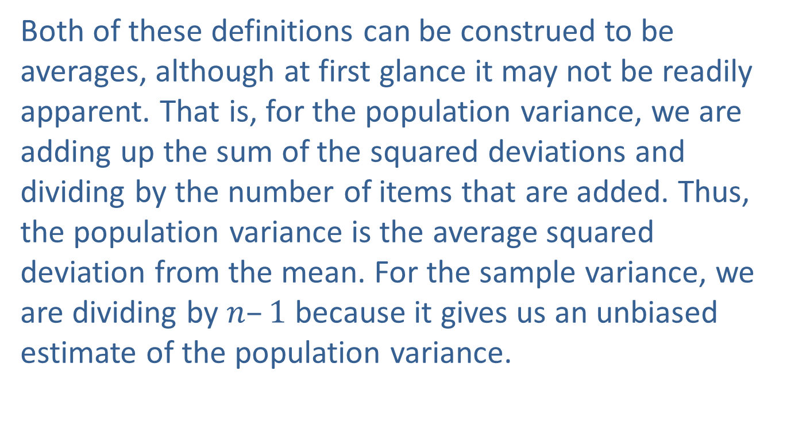
Variance and Standard Deviation (cont.)
Both of these definitions can be construed to be averages, although at first glance it may not be readily apparent. That is, for the population variance, we are adding up the sum of the squared deviations and dividing by the number of items that are added. Thus, the population variance is the average squared deviation from the mean. For the sample variance, we are dividing by $n–1$ because it gives us an unbiased estimate of the population variance.

Slide 26
Variance and Standard Deviation (cont.)
It is usually not necessary to compute a variance using manual methods, except to become familiar with the definition.

Slide 27
Example 4.2.4: Determining the Sample Variance of Sodium Content
Using the cereal data in Example 4.1.6, determine the sample variance of sodium content.
Solution
We previously computed the mean of this sample as 199.5. In the table below we do the basic calculations needed to compute the sample variance. Note the only difference from the table for calculating mean absolute deviation (Example 4.2.2) is that we are squaring the deviations instead of taking the absolute value.

Slide 28
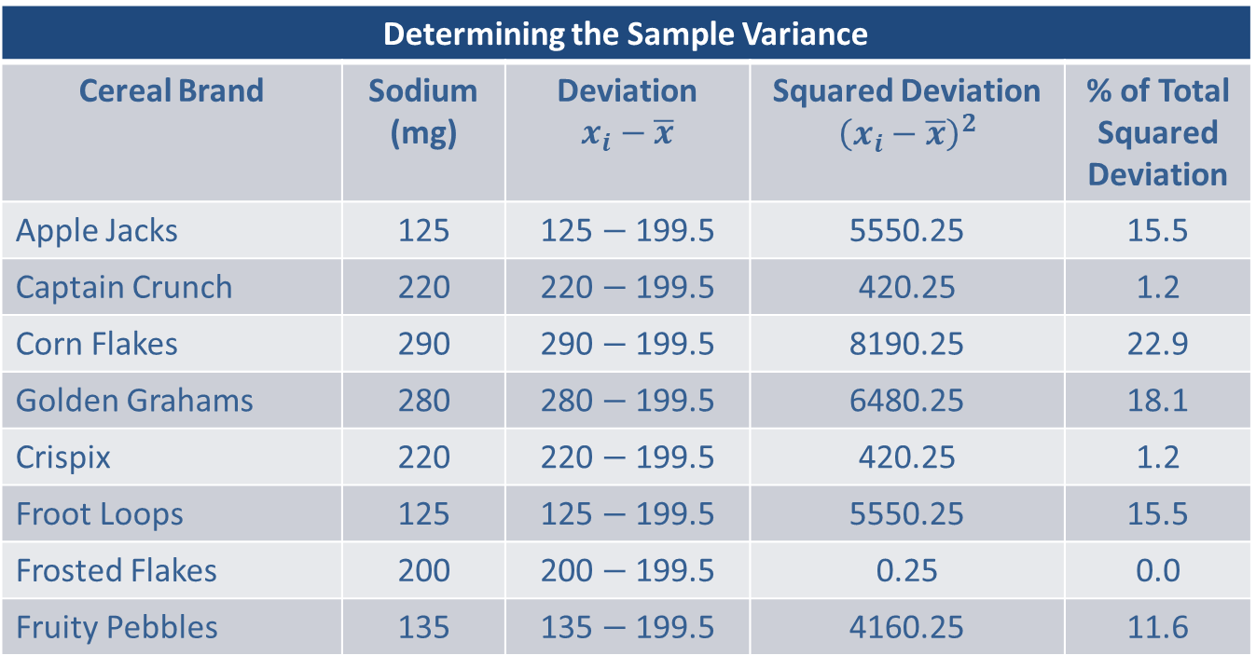
Example 4.2.4: Determining the Sample Variance of Sodium Content (cont.)
Determining the Sample Variance
Cereal Brand | Sodium (mg) | Deviation $$x_{i}−\overline{x}$$ | Squared Deviation $${\left(x_{i}−\overline{x}\right)}^{2}$$ | % of Total Squared Deviation
Apple Jacks | 125 | 125 $−$ 199.5 | 5550.25 | 15.5
Captain Crunch | 220 | 220 $−$ 199.5 | 420.25 | 1.2
Corn Flakes | 290 | 290 $−$ 199.5 | 8190.25 | 22.9
Golden Grahams | 280 | 280 $−$ 199.5 | 6480.25 | 18.1
Crispix | 220 | 220 $−$ 199.5 | 420.25 | 1.2
Froot Loops | 125 | 125 $−$ 199.5 | 5550.25 | 15.5
Frosted Flakes | 200 | 200 $−$ 199.5 | 0.25 | 0.0
Fruity Pebbles | 135 | 135 $−$ 199.5 | 4160.25 | 11.6

Slide 29
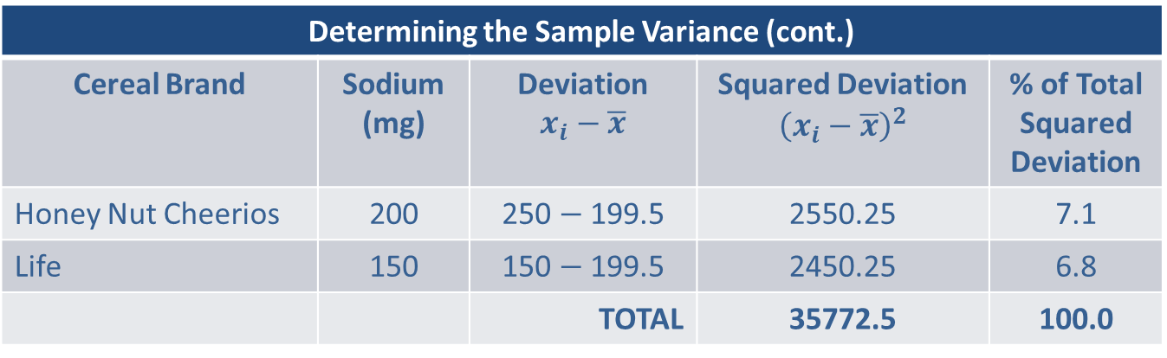

Example 4.2.4: Determining the Sample Variance of Sodium Content (cont.)
$$s^{2}=\frac{\sum{\left(x_{i}−\overline{x}\right)2}}{n−1}=\frac{35772.5}{9}≈3974.7 squared mg$$
Determining the Sample Variance (cont.)
Cereal Brand | Sodium (mg) | Deviation $$x_{i}−\overline{x}$$ | Squared Deviation $${\left(x_{i}−\overline{x}\right)}^{2}$$ | % of Total Squared Deviation
Honey Nut Cheerios | 200 | 250 $−$ 199.5 | 2550.25 | 7.1
Life | 150 | 150 $−$ 199.5 | 2450.25 | 6.8
 |  | TOTAL | 35772.5 | 100.0

Slide 30
Example 4.2.4: Determining the Sample Variance of Sodium Content (cont.)
Thus, the average squared deviation of the data is 3974.7 squared milligrams. The phrase “squared milligrams” in the last sentence may seem a bit odd. No one carries out transactions in square milligrams, or square dollars, or square tons, so it is difficult to interpret the significance of the measurement in this form. That is why the standard deviation exists. It converts the measure into the original units by taking the square root of the variance.

Slide 31
Definition: Standard Deviation
The standard deviation is also a measure of how much the data varies around the mean. It is found by taking the square root of the variance.

Slide 32
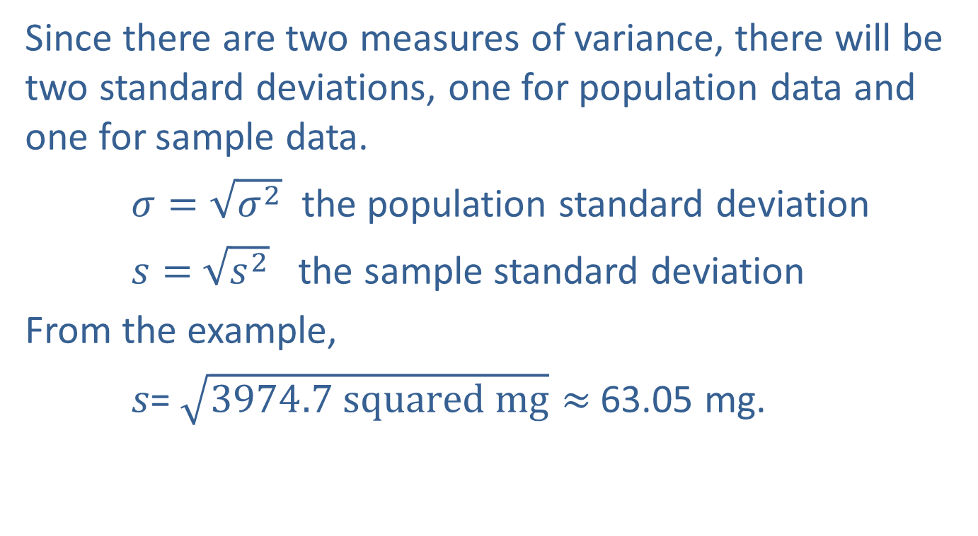
Example 4.2.4: Determining the Sample Variance of Sodium Content (cont.)
Since there are two measures of variance, there will be two standard deviations, one for population data and one for sample data.
$σ=\sqrt{σ^{2}}$ the population standard deviation
$s=$ $\sqrt{s^{2}}$ the sample standard deviation
From the example,
𝑠= $\sqrt{3974.7 squared mg}≈$63.05 mg.

Slide 33
Example 4.2.4: Determining the Sample Variance of Sodium Content (cont.)
It is important to remember these symbols (𝜎 and s) since the standard deviation is a fundamental statistical concept.
Describing the standard deviation in an intuitive way is not easy. It is not the average deviation from the mean (which always equals 0), although in most cases it will be reasonably close to the mean absolute deviation. The fact is that the standard deviation is the square root of the average squared deviation. It is not an intuitive concept!

Slide 34
Example 4.2.4: Determining the Sample Variance of Sodium Content (cont.)
Certainly, a reasonable question at this juncture is, if the standard deviation is not very intuitive, why use it to measure variation? Part of the answer lies in the fact that it takes the measure of variation (the variance) and expresses it in the same units as the data. The variance is an important theoretical measure of variability because it has “nice” mathematical properties (in contrast to the more intuitive MAD).
The standard deviation can be used to measure how far data values are from their mean.

Slide 35
Example 4.2.4: Determining the Sample Variance of Sodium Content (cont.)
You will often see that the majority of data values lie within one standard deviation of the mean. Furthermore, relatively few data values will be more than two standard deviations from the mean.
The variance and standard deviation both suffer from the same problem as the mean; they are very sensitive to outliers. Suppose the value 500 was added to the data in Example 4.2.4, in a similar fashion as in Example 4.2.3.

Slide 36
Example 4.2.4: Determining the Sample Variance of Sodium Content (cont.)
The sample variance would increase from 3974.7 to 11786.4; the new sample variance (which includes the outlier 500) then is almost 3 times as large as the original variance. The standard deviation increases from 63.05 to 108.57. The presence of the outlier tarnishes the interpretation of the standard deviation as a measure of variability.
Another interesting property of the variance is that values farther from the mean contribute a disproportionate amount to the value of the statistic.

Slide 37
Example 4.2.4: Determining the Sample Variance of Sodium Content (cont.)
In Example 4.2.4, one data point, 290, which is 90.5 units from the mean, contributes over 22.9% of the total variation in the data (see the column labeled % of Total Squared Deviation in Table 4.2.4). Compare this to the data point 220, which is 20.5 units from the mean yet only contributes 1.2% to the total variation. The reason that 290 contributes so heavily to the total variation is because the deviations are squared. By squaring the deviations, values further from the mean have a disproportionate effect on the sum of the squared deviations.

Slide 38
Properties: Properties of the Standard Deviation
The standard deviation is always nonnegative. It is zero only if all the data values are exactly the same.
The standard deviation can increase dramatically if there are one or more outliers in the data.
The standard deviation is expressed in the same units as the original data values.

Slide 39
Example 4.2.4: Determining the Sample Variance of Sodium Content (cont.)
While there are a number of descriptive tools available for summarizing variability, the variance and standard deviation are the most frequently used statistics.

Slide 40
Dispersion and Time Series Data
If a time series is stationary, then the methods discussed in this section can be used to measure dispersion. However, if the series is nonstationary, the dispersion measures we have discussed are not applicable. Measuring variation in a nonstationary time series is beyond the scope of this text.

Slide 41
Using the Standard Deviation
Although standard deviation is not an especially intuitive concept, knowing the mean and standard deviation of a data set provides a great deal of information about the data. If the histogram of the measurements is bell-shaped, the empirical rule describes the variability of a set of measurements. Chebyshev’s Theorem is a more general rule describing the variability of any set of data regardless of the shape of its distribution.

Slide 42
Using the Standard Deviation (cont.)
Empirical Rule
Recall from the discussion in Chapter 1 that empiricism is the belief that knowledge comes from experience and data. From an experiential perspective the histogram of large data sets from many natural phenomena as well as psychological, sociological, and business data frequently appear to have bell-shaped histograms.

Slide 43
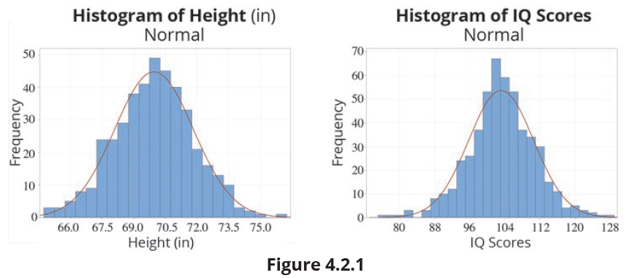
Using the Standard Deviation (cont.)

Slide 44
Using the Standard Deviation (cont.)
The histogram peaks at the median and decreases symmetrically on both sides in the shape of a bell. This bell-shaped histogram phenomenon is observed so frequently that it is called the empirical rule. If the mean and variance are known, the empirical rule allows a data analyst the ability to create accurate probability statements about the concentration of measurements around the mean. This rule doesn’t apply to all distributions, only those that are bell-shaped.

Slide 45
Properties: Empirical Rule
If the distribution of the data is bell-shaped, then
About 68% of the data should lie within 1 standard deviation of the mean.
About 95% of the data should lie within 2 standard deviations of the mean.
About 99.7% of the data should lie within 3 standard deviations of the mean.

Slide 46
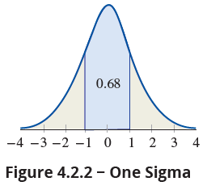
Using the Standard Deviation (cont.)
One sigma rule: If the distribution of the data is bell-shaped, about 68% of the data should lie within one standard deviation of the mean.
A deviation of more than one sigma from the mean is to be expected about once in every three observations.

Slide 47
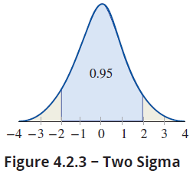
Using the Standard Deviation (cont.)
Two sigma rule: If the distribution of the data is bell-shaped, about 95% of the data should lie within two standard deviations of the mean.
A deviation of more than two sigma from the mean is to be expected about once in every twenty observations.

Slide 48
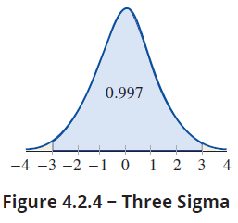
Using the Standard Deviation (cont.)
Three sigma rule: If the distribution of the data is bell-shaped, about 99.7% of the observations should lie within three standard deviations of the mean.
A deviation of more than three sigma from the mean is to be expected about once in every 370 observations, slightly less than 0.3% of the time.

Slide 49
Example 4.2.5: Applying the Empirical Rule to Stock Earnings
Suppose a group of high technology stocks has an average earnings per share during the fourth quarter of $6.26, with a standard deviation of $1.37 at the close of trading on December 31st. If the data possesses a bell-shaped distribution, which interval is known to contains 68% of the earnings? Which interval contains 95% of the earnings?
Solution
Using the one sigma rule, we will capture 68% of the observations.

Slide 50
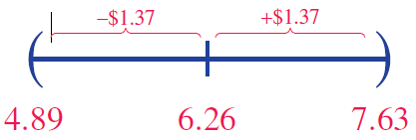
Example 4.2.5: Applying the Empirical Rule to Stock Earnings (cont.)
$6.26 ± $1.37
Using the one sigma rule results in an interval from $6.26 − $1.37 to $6.26 + $1.37. Doing the arithmetic produces an interval from $4.89 to $7.63.

Slide 51
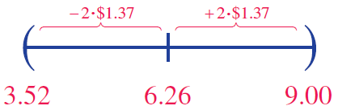
Example 4.2.5: Applying the Empirical Rule to Stock Earnings (cont.)
To capture 95% of the earnings, use the two sigma rule, $6.26 ± 2 ⋅ $1.37. Doing the arithmetic results in an interval from $3.52 to $9.00.
Note that to increase the percentage of data captured from 68% to 95% requires an interval that is twice as large.

Slide 52
Chebyshev’s Theorem
It is important to remember that the empirical rule applies only to bell-shaped distributions. For any distribution, regardless of shape, Chebyshev’s Theorem may be used, although its results are much more approximate.

Slide 53
Definition: Chebyshev’s Theorem
The proportion of any data set lying within k standard deviations of the mean is at least
If k = 2 at least (or 75 %) of the data values lie
within 2 standard deviations of the mean, for any data
set.

Slide 54
Definition: Chebyshev’s Theorem (cont.)
If k = 3 at least (or 88.9 %) of the data values lie within 3 standard deviations of the mean, for any data set.

Slide 55

Chebyshev’s Theorem (cont.)
Note that $k$ does not have to be an integer value. If $k=1.5,$ at least $1−\frac{1}{1.52}=\frac{5}{9}$ (or approximately 55.6%) of the data values will lie within 1.5 standard deviations of the mean for any data set.

Slide 56
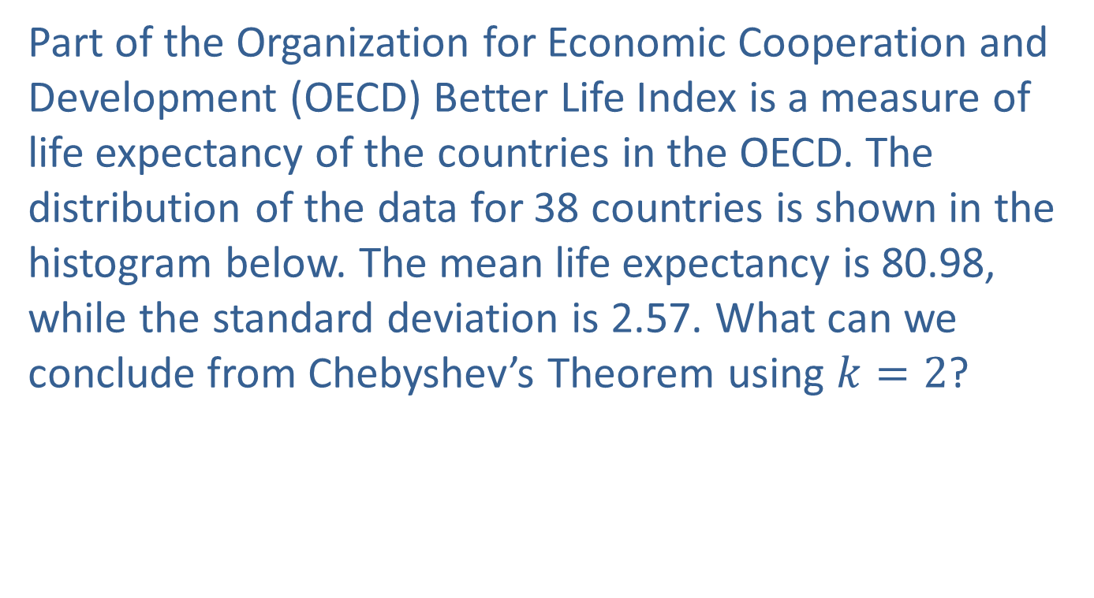
Example 4.2.6: Applying Chebyshev’s Theorem to Life
Expectancy of OECD Countries
Part of the Organization for Economic Cooperation and Development (OECD) Better Life Index is a measure of life expectancy of the countries in the OECD. The distribution of the data for 38 countries is shown in the histogram below. The mean life expectancy is 80.98, while the standard deviation is 2.57. What can we conclude from Chebyshev’s Theorem using $k=2$?

Slide 57
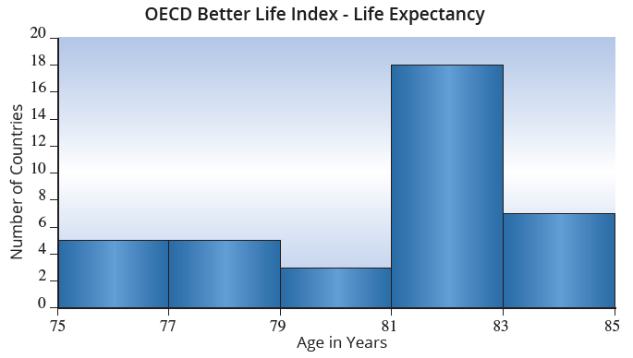
Example 4.2.6: Applying Chebyshev’s Theorem to Life
Expectancy of OECD Countries (cont.)

Slide 58
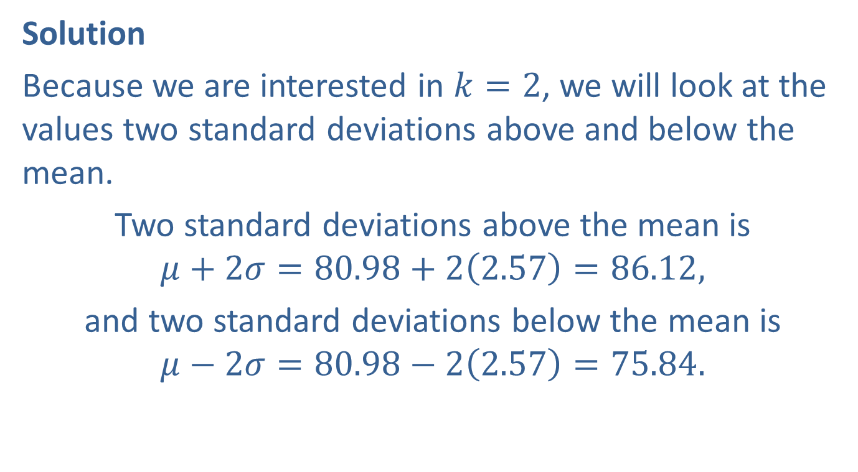
Example 4.2.6: Applying Chebyshev’s Theorem to Life
Expectancy of OECD Countries (cont.)
Solution
Because we are interested in $k=2$, we will look at the values two standard deviations above and below the mean.
Two standard deviations above the mean is
$$μ+2σ=80.98+2\left(2.57\right)=86.12,$$
and two standard deviations below the mean is
$$μ−2σ=80.98−2\left(2.57\right)=75.84.$$

Slide 59
Example 4.2.6: Applying Chebyshev’s Theorem to Life
Expectancy of OECD Countries (cont.)
Therefore, by Chebyshev’s Theorem, we can say that at least 75% of OECD countries have a life expectancy that is between 75.84 and 86.12 years old.

Slide 60
The Coefficient of Variation
Sometimes a data analyst wants to compare the variation of two or more data sets. The coefficient of variation is a unit-free statistical measure that enables the comparison of the variation in two or more data sets.

Slide 61
Formula: Coefficient of Variation
For population data, the measure is defined as
and for sample data,

Slide 62
The Coefficient of Variation
When comparing the variation of data sets, many times the units of measure will be different. The coefficient of variation standardizes the variation measure by dividing it by the mean. The division has one interesting side effect: the unit of measure is removed from the statistic.
One of the primary focuses of quality control in manufacturing is the reduction in variation of the output of the production process. A bolt manufacturer wants to compare the variability of two bolt manufacturing processes.

Slide 63
The Coefficient of Variation (cont.)
One process creates bolts with a mean length of 2.5 cm and a standard deviation of 0.2 cm. Is this process more variable than one that produces a bolt that has a mean length of 1 inch and a standard deviation of 0.052 inches?
Using the coefficient of variation as our measure of variability allows us to compare the two processes although the measurements are in different units.

Slide 64
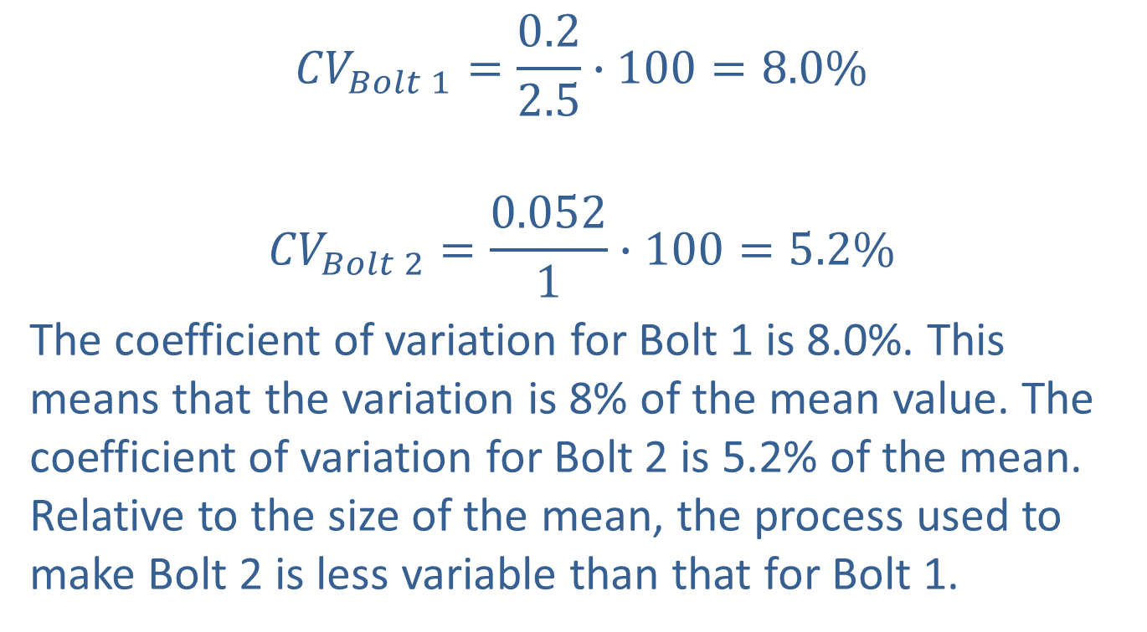
The Coefficient of Variation (cont.)
$${CV}_{Bolt 1}=\frac{0.2}{2.5}∙100=8.0\%$$
$${CV}_{Bolt 2}=\frac{0.052}{1}∙100=5.2\%$$
The coefficient of variation for Bolt 1 is 8.0%. This means that the variation is 8% of the mean value. The coefficient of variation for Bolt 2 is 5.2% of the mean. Relative to the size of the mean, the process used to make Bolt 2 is less variable than that for Bolt 1.

