Slide 1
Section 4.1
Measures of Location

Slide 2
Attributes for Summarizing Data
To adequately summarize a set of data, a data analyst might ask the following questions.
Location: Where is the center of the data?
Dispersion: Is the data widely scattered or tightly grouped around the central point?
Shape: Is the data spread symmetrically about the central value? Is the data unbalanced (e.g., are the values much larger than the mean, but not much smaller?)
Does the data tend to cluster in several groups?

Slide 3
Describing and Summarizing Data from One Variable
Different types of measurements will be developed for each of the attributes listed above. For example, the mean (average) and the median measure the location or central tendency of a data set. Both statistical measures are trying to tell us something about the location of the middle of the data, but they use different ideas for defining that notion of middle.

Slide 4
Describing and Summarizing Data from One Variable
From the morning paper to the evening news, general concepts are translated into specific statistical measures. Some examples are listed here.
Poverty rates in 2021 ranged from a low of 7.2% in New Hampshire to a high of 19.6% in Louisiana.
In 2021, Maryland ($90,203) and Washington, D.C. ($90,088) had median household incomes that were among the highest; Mississippi had the lowest ($48,716).

Slide 5
Describing and Summarizing Data from One Variable
In 2021, 33.1% of 18 to 34-year-olds living in households lived in their parents’ home. (Compare this to 14.7% in 1975.)
The median sales price of an existing home in the U.S. as of August 2023 was $407,100.4
The average hourly manufacturing earnings in the U.S. in August 2023 was $32.61. (Compare this to the average of $14.84 in 2002 which is $25.38 as of September 2023, adjusted for inflation.)

Slide 6
Describing and Summarizing Data from One Variable
These examples of numerical descriptive statistics go beyond mere summaries of data; they become elements of storytelling, painting a factual and relatable picture of the socioeconomic landscape, housing markets, and labor trends.

Slide 7
Definition: Numerical Descriptive Statistics
Numerical descriptive statistics are numerical summaries of quantitative data.

Slide 8
Describing and Summarizing Data from One Variable
There is a distinction between measures that are applied to populations and measures that are applied to samples.

Slide 9
Definition: Parameter vs. Statistic
A parameter is a numerical measure that describes a characteristic of a population.
A statistic is a numerical measure that describes a characteristic of a sample.

Slide 10
Describing and Summarizing Data from One Variable
In most instances a data analyst will not know what the population parameters are, since the cost and/or feasibility of obtaining all the population data is usually prohibitive. Inferential statistics involves making conclusions regarding a population using data from a sample.

Slide 11
Definition: Inferential Statistics
Inferential statistics is concerned with making conclusions or inferences about population parameters using sample statistics.

Slide 12
Describing and Summarizing Data from One Variable
There are many formulas in this chapter that you will have to spend some time examining to appreciate. In most cases, the concepts which motivate these formulas are simple. Yet if these concepts are either ignored or forgotten, statistics becomes a meaningless assortment of symbols, instead of a useful problem-solving and decision-making tool.

Slide 13
Describing and Summarizing Data from One Variable
The data in Table 4.1 displays the first six rows of the annual tuition costs of 1208 colleges for the academic year (AY) 2021-2022. Looking at 1208 pieces of data without using a graphical representation would be confusing. (It seems 1208 measurements would contain a great deal of information, yet the sheer volume of the data obscures comprehension.) It’s the old problem of not being able to see the forest for the trees.

Slide 14
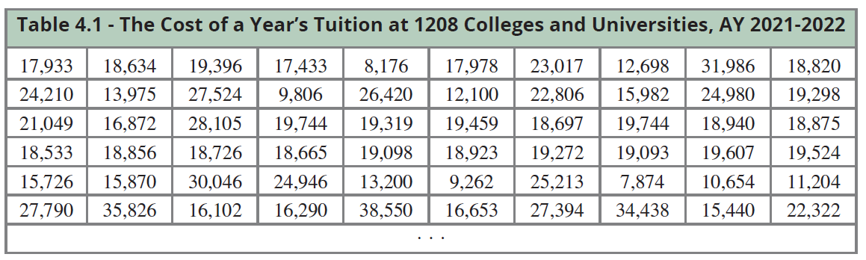
Describing and Summarizing Data from One Variable

Slide 15
Describing and Summarizing Data from One Variable
Looking at a histogram of the data (see Figure 4.3) is always a good first step. But, we need to learn more. To do this, we use statistical tools designed to reveal the data’s fundamental characteristics. These statistical tools answer important questions such as, Where is the center of the data? and How dispersed is the data?

Slide 16
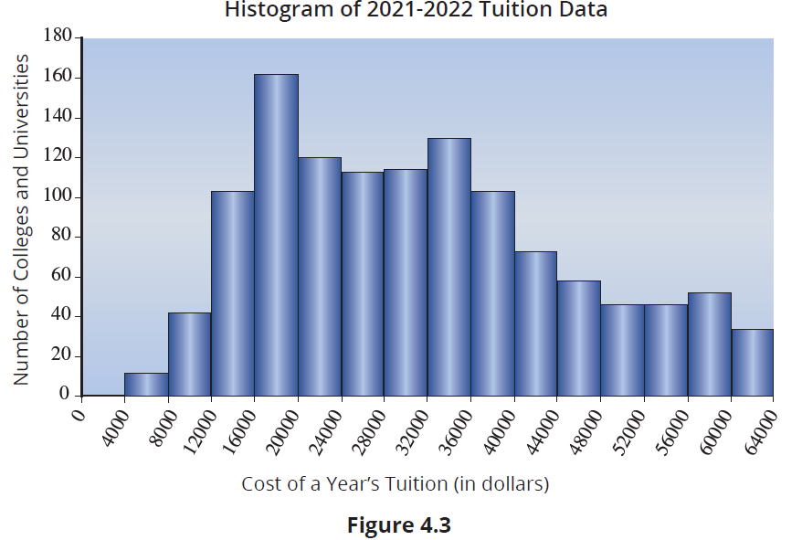
Describing and Summarizing Data from One Variable

Slide 17
Measures of Location
To your question concerning the whereabouts of Tom Stevens, a mutual friend responds, “In the library.” The answer is informative in that it provides general information about Tom’s whereabouts. Even though you don’t know what part of the library he is in, the information does provide a focal point—an approximate idea of his location. The information may also permit some inferences regarding what Tom is doing.

Slide 18
Measures of Location (cont.)
Statistically speaking, the idea of location is similar to knowing that Tom is in the library. If we think of a data set as a group of data values that cluster around some central value, then this central value provides a focal point for the data set—a location of sorts. Unfortunately, the notion of central value is a vague concept, which is as much defined by the way it is measured as by the notion itself. There are several statistical measures that can be used to define the notion of center: the arithmetic mean, weighted mean, trimmed mean, median, and mode.

Slide 19
The Arithmetic Mean
The arithmetic mean is one of the more commonly used statistical measures. It appears every day in newspapers, business publications, and frequently in conversation. For example, after receiving a grade on a test, you might be curious about how the rest of the class performed. You might ask the instructor, What was the average on the test? The term average is often associated with the arithmetic mean, which is more commonly referred to as just the mean.

Slide 20
Definition: Arithmetic Mean
Suppose there are n observations in a data set, consisting of the observations x₁, x₂,..., x_{n}; then the arithmetic mean is defined to be

Slide 21
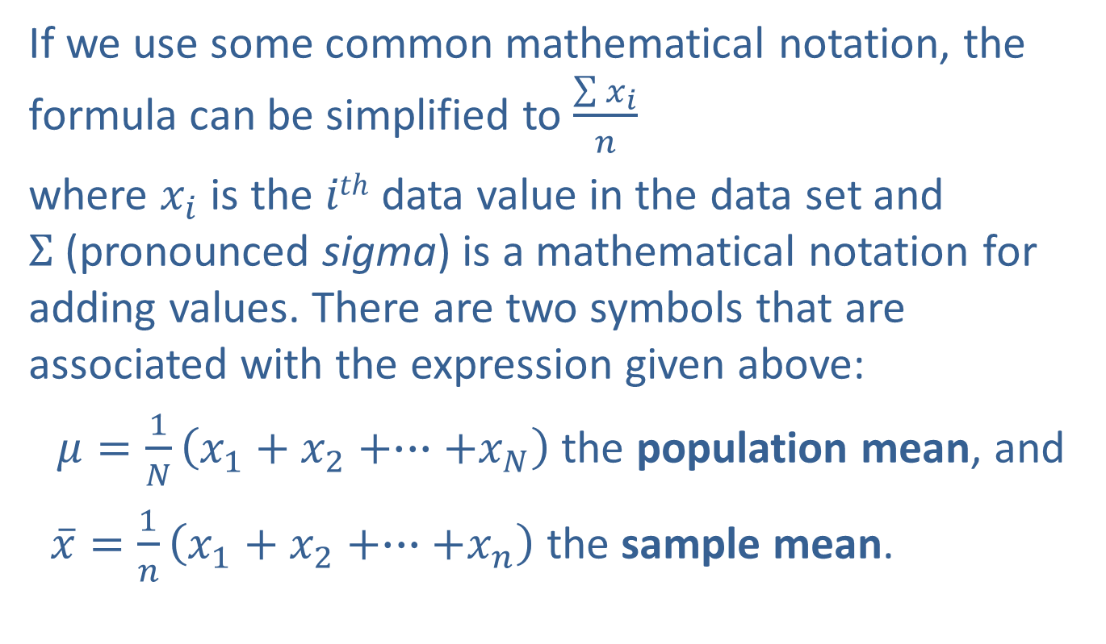
The Arithmetic Mean (cont.)
If we use some common mathematical notation, the formula can be simplified to $\frac{\sum{x_{i}}}{n}$
where $x_{i}$ is the $ith$ data value in the data set and $Σ$ (pronounced sigma) is a mathematical notation for adding values. There are two symbols that are associated with the expression given above:
$μ=\frac{1}{N}\left(x_{1}+x_{2}+∙∙∙+x_{N}\right)$ the population mean, and
$\overline{x}=\frac{1}{n}\left(x_{1}+x_{2}+∙∙∙+x_{n}\right)$ the sample mean.

Slide 22
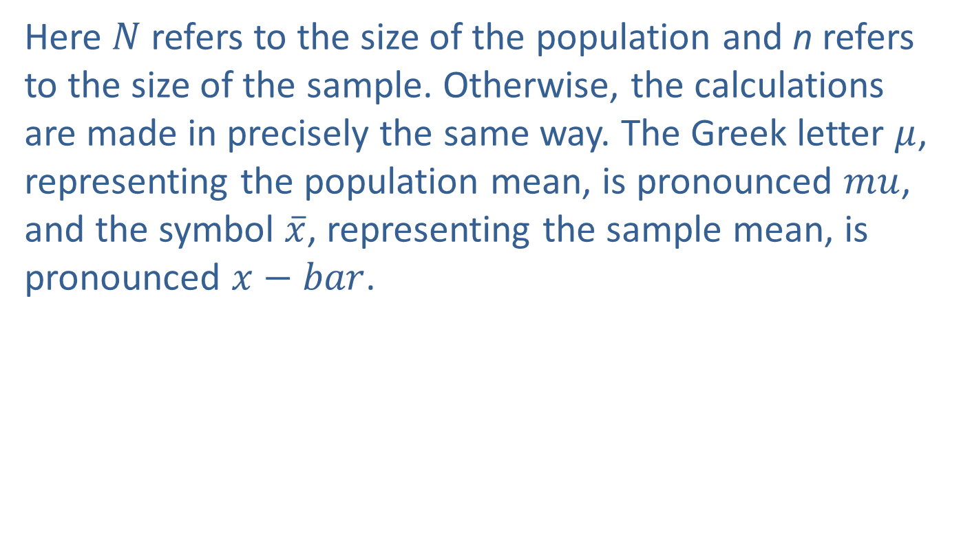
The Arithmetic Mean (cont.)
Here $N$ refers to the size of the population and n refers to the size of the sample. Otherwise, the calculations are made in precisely the same way. The Greek letter $μ$, representing the population mean, is pronounced $mu$, and the symbol $\overline{x}$, representing the sample mean, is pronounced $x−bar$.

Slide 23
Example 4.1.1: Determining the Sample Mean
Determine the sample mean of the following sample data values: 4, 10, 7, 15.
Solution
Note that

Slide 24
The Arithmetic Mean (cont.)
The sample mean is 9. But why does adding up a group of numbers and dividing by the number of numbers measure central tendency? As unlikely as it sounds, the answer is related to balancing a scale.

Slide 25
Definition: Deviation
Given some point A and a data point x, then x − A represents how far x deviates from A. This difference is also called a deviation.

Slide 26
The Arithmetic Mean (cont.)
Let’s compute the deviations from the mean (9) for the data in Example 4.1.1. Examining the deviations from the mean in Table 4.1.1, we can see the deviations on the left side (−5 and −2) and right side (1 and 6) are in balance. In fact, the mean is considered a point of centrality because the deviations from the mean on the positive side and the negative side are equal (see Figure 4.1.1). The sample mean can be interpreted as a center of gravity.

Slide 27
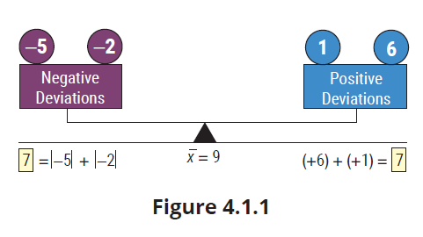
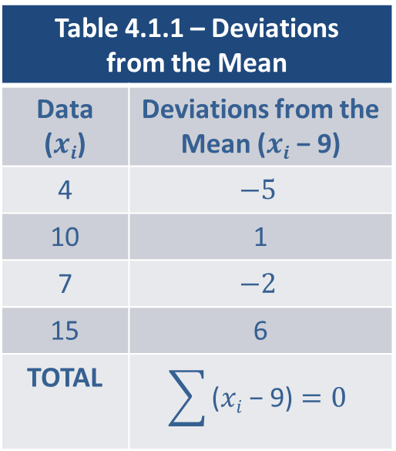
The Arithmetic Mean (cont.)
Table 4.1.1 – Deviations from the Mean
Data ($xi$) | Deviations from the Mean ($xi$ − 9)
4 | $$−5$$
10 | 1
7 | $$−2$$
15 | 6
TOTAL | $$\sum{\text{(}xi\text{ − 9)}=0}$$

Slide 28
The Arithmetic Mean (cont.)
On the other hand, if we compute the deviations about any other value the deviations do not balance. For example, assume the central value is 8. The deviation from the alleged central value, 8, for each data value is computed in Table 4.1.2 and shown in Figure 4.1.2.
The positive deviations (+2 and +7) are not counterbalanced by the negative deviations (−4 and −1). A desirable characteristic of a central value would be to have the positive and negative deviations equal to each other in absolute value.

Slide 29
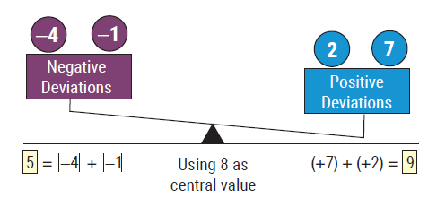

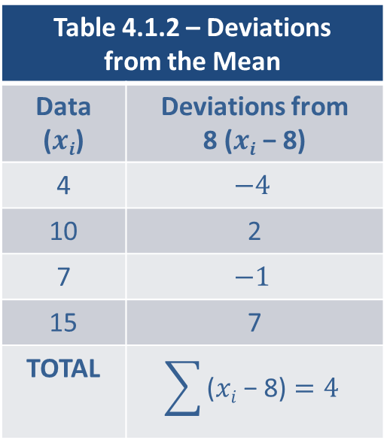
The Arithmetic Mean (cont.)
Table 4.1.2 – Deviations from the Mean
Data ($xi$) | Deviations from 8 ($xi$ − 8)
4 | $$−4$$
10 | 2
7 | $$−1$$
15 | 7
TOTAL | $$\sum{\text{(}xi\text{ − }\text{8}\text{)}=4}$$

Slide 30
The Arithmetic Mean (cont.)
Although the arithmetic mean is frequently used, there are times when it should not be employed. Since the mean requires that the data values be added, it should only be used for quantitative data. Furthermore, if one of the data values is extremely large or small relative to the others, this data value could be considered an outlier. An outlier can have a dramatic impact on the value of the mean and dramatically affect its value as a measure of central tendency. (See Section 4.3 for further discussion of outliers.)

Slide 31
Definition: Outliers and Resistant Measures
An outlier is a data value that is extremely different from other measurements in the data set. Statistical measures which are not affected by outliers are said to be resistant.

Slide 32
The Arithmetic Mean (cont.)
The mean is not a resistant measure.

Slide 33
Weighted Mean
The weighted mean is similar to the arithmetic mean except it allows you to give different weights (or importance) to each data value. The weighted mean gives you the flexibility to assign weights when you find it inappropriate to treat each observation the same. The weights are usually positive numbers that sum to one, with the largest weight being applied to the observation with the greatest importance. The weights can be determined in a variety of ways, such as the number of employees, the market value of a company, or some other objective or subjective method.

Slide 34
Weighted Mean (cont.)
There are occasions in which it is easier to assign the weights without worrying that they will sum to one. If you are concerned about your weights summing to one, you can make your weights sum to one by dividing each weight by the sum of all the weights.

Slide 35
Formula: Weighted Mean
The weighted mean of a data set with values x₁, x₂, x₃ ,..., x_{n} is given by
where w_{i} is the weight of observation x_{i} .

Slide 36
Example 4.1.2: Determining a Weighted Mean for Final Grade Average
Meghan’s grade in her Statistics class is based on three tests, each worth 20%, and a final exam, worth 40%. Determine her final grade if she scored a 79, 85, and an 80 on her three tests and a 91 on her final exam.
Solution
Meghan’s final grade in the course would be 85.2.

Slide 37
The Trimmed Mean
Since outliers can have an enormous effect on the value of the mean, the mean’s usefulness as a typical measure of a set of data is diminished if the data contains outliers.

Slide 38
Definition: Trimmed Mean
The trimmed mean is a modification of the arithmetic mean which ignores an equal percentage of the highest and lowest data values in calculating the mean.

Slide 39
Note
If you are using the Excel TRIMMEAN function, you need to double the percentage you intend to remove in order to remain aligned with the method in the book.

Slide 40
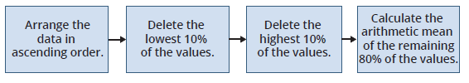
The Trimmed Mean (cont.)
Finding the 10% Trimmed Mean

Slide 41
The Trimmed Mean (cont.)
Before calculating the trimmed mean, the data is arranged in ascending order of magnitude. A 10% trimmed mean uses the middle 80% of the data values. It is calculated by removing the top 10% and the bottom 10% of the data values, then finding the arithmetic average of the remaining values. If the data set does not contain any outliers, the mean and the trimmed mean will be similar. Unlike the arithmetic mean, the trimmed mean is less affected by outliers compared to other measures of central tendency, and is considered a resistant measure.

Slide 42

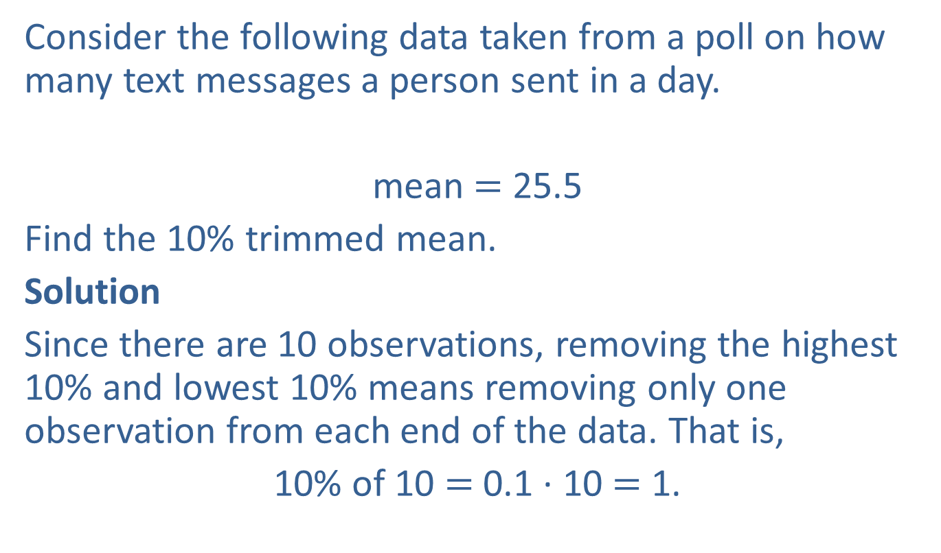
Example 4.1.3: Determining a Trimmed Mean for Text Messages
Consider the following data taken from a poll on how many text messages a person sent in a day.
mean $=$ 25.5
Find the 10% trimmed mean.
Solution
Since there are 10 observations, removing the highest 10% and lowest 10% means removing only one observation from each end of the data. That is,
10% of 10 $=$ 0.1 ∙ 10 $=$ 1.

Slide 43
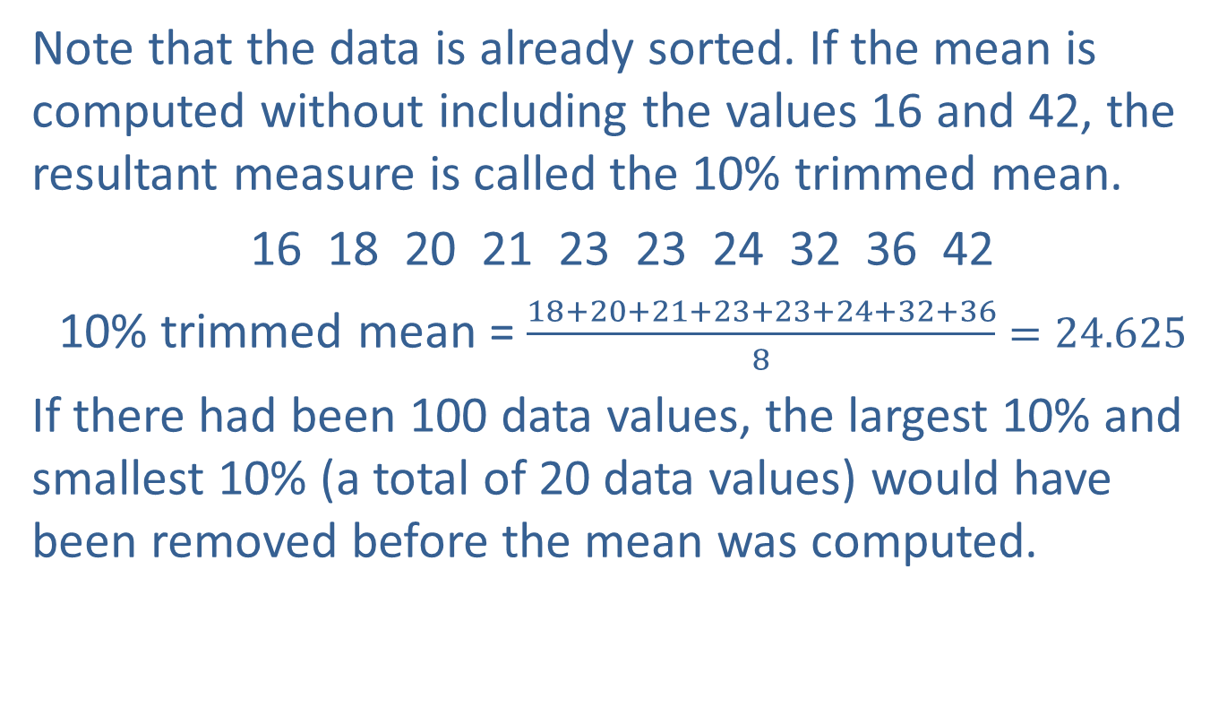
Example 4.1.3: Determining a Trimmed Mean for Text Messages (cont.)
Note that the data is already sorted. If the mean is computed without including the values 16 and 42, the resultant measure is called the 10% trimmed mean.
16 18 20 21 23 23 24 32 36 42
10% trimmed mean = $\frac{18+20+21+23+23+24+32+36}{8}=24.625$
If there had been 100 data values, the largest 10% and smallest 10% (a total of 20 data values) would have been removed before the mean was computed.

Slide 44

Example 4.1.4: Determining a Trimmed Mean for Text Messages with an Outlier
Consider the same data set, except the last data value is replaced with an outlier.
mean = 70.3
Find the 10% trimmed mean.
Solution
Since there are 10 observations, removing the highest 10% and lowest 10% means removing only one observation from each end of the data.
16 18 20 21 23 23 24 32 36 490

Slide 45
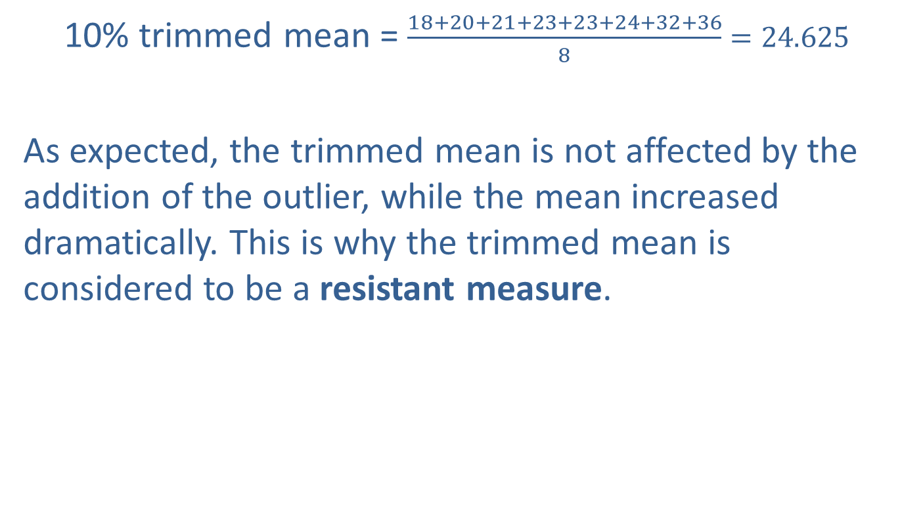
Example 4.1.4: Determining a Trimmed Mean for Text Messages with an Outlier (cont.)
10% trimmed mean = $\frac{18+20+21+23+23+24+32+36}{8}=24.625$
As expected, the trimmed mean is not affected by the addition of the outlier, while the mean increased dramatically. This is why the trimmed mean is considered to be a resistant measure.

Slide 46
The Median
The median of a set of data provides another measure of center that is different from a “mean”. It is a simple idea. To find the median, place the data in ascending order and then find the observation that has an equal number of data values on either side. That is, half of the observations are less than the median and half of the observations are greater than the median. The median is the middle value.

Slide 47
Definition: Median
The median of a set of observations is the measure of center that is the middle value of the data when it is arranged in ascending order. The same number of data values lie on either side of the median.

Slide 48
The Median (cont.)
To determine the median of a set of data, we use the following steps.

Slide 49
Procedure: Finding the Median of a Data Set
Arrange the data in ascending order.
Determine the number of values in the data.
Find the data value in the middle of the data set.
If the number of data values is odd, then the median is the data value that is exactly in the middle of the data set.
If the number of data values is even, then the median is the mean of the two middle observations in the data set.

Slide 50

Example 4.1.5: Determining the Median Hematocrit Level
A patient’s hematocrit level has been fluctuating in and out of the normal range (35.5% to 44.9%). The physician suspects that the patient has anemia and has the patient undergo a hematocrit test weekly to check the proportion of red blood cells in the blood. The following percentages were collected for the last 9 weeks. What is the median hematocrit level for the 9-week period?

Slide 51
Example 4.1.5: Determining the Median Hematocrit Level (cont.)
Find the median.
Solution
First, the data set must be ordered,
27, 28, 29, 29, 30, 31, 32, 36, 36
Since the data set contains an odd number of values, 9, the middle observation in the ordered array must be the fifth observation. Since the median is the fifth observation, the median value is 30%.

Slide 52
Example 4.1.6: Determining the Median Sodium Level
Approximately 30% of Americans have high blood pressure. Consuming excess sodium, which is especially prevalent in processed foods, is a contributing factor to an increase in blood pressure. The following data represent the sodium content per serving (in milligrams) of ten popular breakfast cereals.

Slide 53
Example 4.1.6: Determining the Median Sodium Level (cont.)
Sodium Content of Breakfast Cereals
Cereal Brand | Sodium (mg)
Apple Jacks | 125
Captain Crunch | 220
Corn Flakes | 290
Golden Grahams | 280
Crispix | 220
Froot Loops | 125
Frosted Flakes | 200
Fruity Pebbles | 135
Honey Nut Cheerios | 250
Life | 150

Slide 54
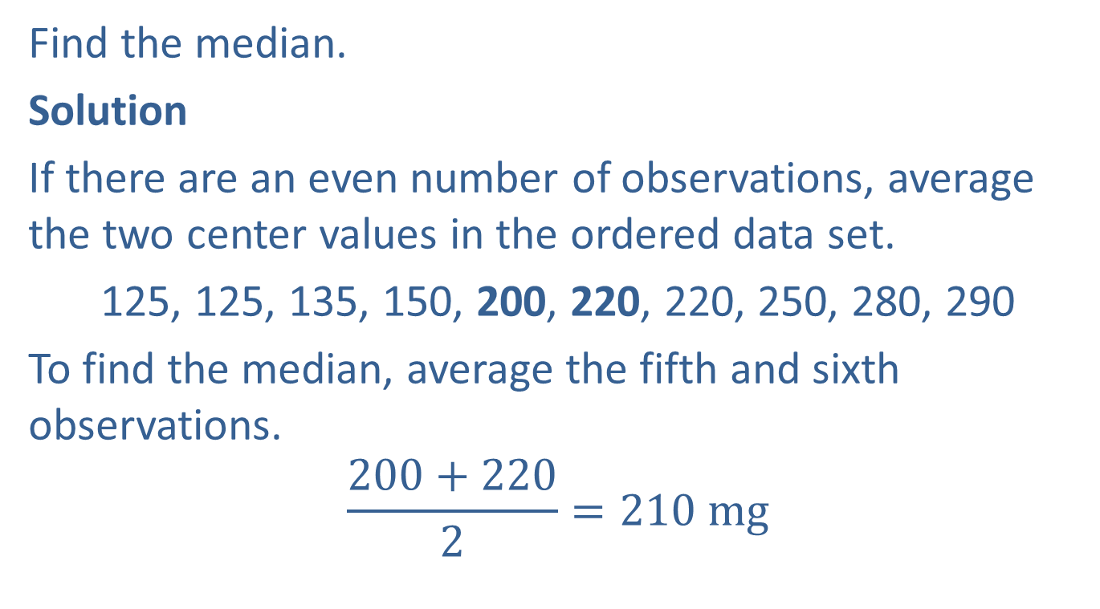
Example 4.1.6: Determining the Median Sodium Level (cont.)
Find the median.
Solution
If there are an even number of observations, average the two center values in the ordered data set.
125, 125, 135, 150, 200, 220, 220, 250, 280, 290
To find the median, average the fifth and sixth observations.
$$\frac{200+220}{2}=210 mg$$

Slide 55
The Median (cont.)
The median possesses a rather obvious notion of centrality since it is defined as the central value in an ordered list. It is not affected by outliers and is therefore a resistant measure. For example, if we replaced 290 with 200,000,000 in the data set from the previous example, the median would not change at all. The median does possess one limitation: it cannot be applied to nominal data. In order to calculate the median, the data must be placed in order.

Slide 56
The Median (cont.)
To accomplish this task meaningfully, the level of measurement must be at least ordinal. Unless the data set is skewed or contains outliers, the median and the mean usually have similar values.

Slide 57
The Mode
The mode is another measure of location. It is not used as frequently as the mean or the median, and its relation to the “central tendency” concept and the values of the mean and median are not predictable. The mode is the only measure of location that can be used for nominal data. Of the three measures of location, the mode is used the least due to the limited information it provides. Sometimes sorting the data (in ascending or descending order) makes it easier to find the mode.

Slide 58
Definition: Mode
The mode of a data set is the most frequently occurring value.

Slide 59
The Mode (cont.)
When reporting the mode for numerical data, do not round. The value of the mode should be the same as the original data value.

Slide 60

Example 4.1.7: Determining the Mode of Apgar Scores
An Apgar score is a quick way for doctors to evaluate the health of a newborn a few minutes after birth. Scores range from 0 to 10 with a score of 10 being the best possible outcome. Find the mode of the following data representing the Apgar scores of eleven newborns born at a local hospital.

Slide 61
Example 4.1.7: Determining the Mode of Apgar Scores (cont.)
Solution
Since the value of 9 occurs more than any other value, it is the mode. In this instance, as a measure of location, the modal value is not a particularly appealing choice. However, as noted previously, the mode does possess one very favorable property—it is the only measure of location that can be applied to nominal data. Therefore, for nominal measurements like color preferences, it would be perfectly reasonable to discuss the modal color.

Slide 62
The Mode (cont.)
Suppose we added one more value to the data set in Example 4.1.7. If this value were a 7, then both 9 and 7 would be repeated three times and there would be two modes. When this occurs, the data is said to be bimodal. Any time a data set has more than two modes, it is said to be multimodal. If all observations in a data set occur with the same frequency, the data set has no mode.

Slide 63
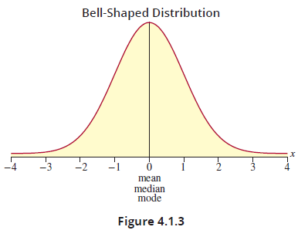
The Relationship between the Mean, Median, and Mode
Often times, the shape of the data determines how the mean, median, and mode are related. For a bell-shaped distribution, the mean, median, and mode are identical.

Slide 64
The Relationship between the Mean, Median, and Mode (cont.)
Certainly, not all data produces distributions that follow a bell-shaped curve. If the distribution of the data has a long tail on the right, it is said to be skewed to the right, or positively skewed. Conversely, if the distribution has a long tail on the left, it is said to be skewed to the left, or negatively skewed. If the data is positively skewed, the median will be smaller than the mean. If the data is negatively skewed, the mean will be smaller than the median.

Slide 65
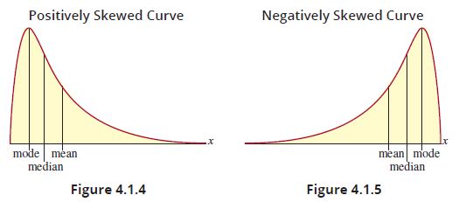
The Relationship between the Mean, Median, and Mode (cont.)

Slide 66
The Relationship between the Mean, Median, and Mode (cont.)
Where does the mode fall on these graphs? The area containing the greatest number of observations contains the mode. That area is represented by the large peak in the curve. In Figure 4.1.4 and Figure 4.1.5 the obvious peaks in the curves are the portions of the distributions that will contain the mode. The highest point on the curve will be the mode of the distribution. Notice that in a bell-shaped distribution (Figure 4.1.3), the mode is equal to the mean and median.

Slide 67
The Relationship between the Mean, Median, and Mode (cont.)
If the distribution is positively skewed (Figure 4.1.4), the mode is less than the mean and median. If the distribution is negatively skewed (Figure 4.1.5), the mode is greater than the mean and median.

Slide 68
Selecting a Measure of Location
The objective of using descriptive statistics is to provide measures that convey useful summary information about the data. When selecting a statistic to represent the central value of a data set, the first thing to consider is the type of data being analyzed.
The arithmetic mean is used so frequently that its computation is almost a knee-jerk reaction to analyzing data. Unfortunately, it is not always a reasonable measure of centrality or location. Table 4.1.3 defines the applicable levels of measurement for each measure of location.

Slide 69
Selecting a Measure of Location (cont.)
Table 4.1.4 defines the sensitivity to outliers for each measure of location. When the data is qualitative (nominal or ordinal), the mean should not be computed and, if the data is quantitative and contains outliers, the mean does not convey the notion of typical value as well as some other measures. The only time in which the mean should be used without any explanation is when the distribution of the data is symmetrical or nearly so. In that event, the mean and median should be approximately the same value.

Slide 70
Selecting a Measure of Location (cont.)
Table 4.1.3 – Applicable Level of Measurement
 | Qualitative |  | Quantitative
 | Nominal | Ordinal | Interval | Ratio
Mean |  |  | ✓ | ✓
Median |  | ✓ | ✓ | ✓
Mode | ✓ | ✓ | ✓ | ✓
Trimmed Mean |  |  | ✓ | ✓
Table 4.1.4 – Sensitivity to Outliers
 | Not Sensitive | Very Sensitive
Mean |  | ✓
Median | ✓
Mode | ✓
Trimmed Mean | ✓

Slide 71
Selecting a Measure of Location (cont.)
The median is also a good measure of central tendency. It is not sensitive to outliers and can be applied to data gathered from all levels of measurements except nominal.
If the level of measurement of the data is interval or ratio and there are no outliers, the mean is a reasonable choice. If the data set appears to have any unusual values, then the trimmed mean or the median would be more appropriate.

Slide 72
Selecting a Measure of Location (cont.)
If the level of measurement is nominal or ordinal (the data are qualitative), appropriate measures of center are limited. If the data is ordinal, then the median is the best choice. If the data is nominal, there is only one choice, the mode. The mode is applicable to all data types, although it is not very useful for quantitative data.

Slide 73
Time Series Data and Measures of Centrality
We discussed two types of time series data in Chapter 2, stationary and nonstationary. Stationary time series wobbled around some central value, so calculating a central value is perfectly reasonable, and the methods we previously discussed are applicable. A nonstationary time series is another story. Nonstationary time series possess trend. That means there is no central value for the time series. Instead, the series trends in one direction or another. Computing a central value using the methods discussed earlier would be inappropriate for such data.

Slide 74
Time Series Data and Measures of Centrality (cont.)
Table 4.1.5 shows the first six rows of the data on average US gas price from 1991 to 2023. In this nonstationary time series, the central value of the process is trending upward as shown in Figure 4.1.6. One way to capture this movement is with a moving average.

Slide 75
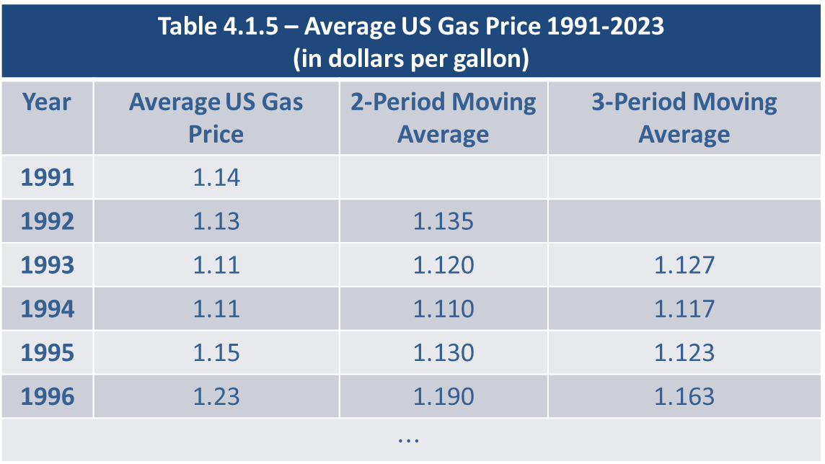
Time Series Data and Measures of Centrality (cont.)
Table 4.1.5 – Average US Gas Price 1991-2023 (in dollars per gallon)
Year | Average US Gas Price | 2-Period Moving Average | 3-Period Moving Average
1991 | 1.14
1992 | 1.13 | 1.135
1993 | 1.11 | 1.120 | 1.127
1994 | 1.11 | 1.110 | 1.117
1995 | 1.15 | 1.130 | 1.123
1996 | 1.23 | 1.190 | 1.163
$$⋯$$

Slide 76
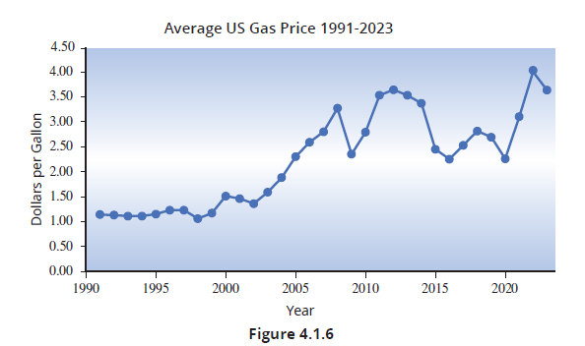
Time Series Data and Measures of Centrality (cont.)

Slide 77
Definition: Moving Average
A moving average is obtained by adding consecutive observations for a number of periods and dividing the result by the number of periods included in the average.

Slide 78
Time Series Data and Measures of Centrality (cont.)
A moving average can be used to forecast the new level of a series over time or as a descriptive method. By averaging just two or three periods at a time we can still see long-term trends, but at the same time smooth out some of the short-term variability in the time series. How the average is associated with a specific period is dependent on its purpose. We will assume the moving average is to be used as a method of forecasting the next level of the time series.

Slide 79
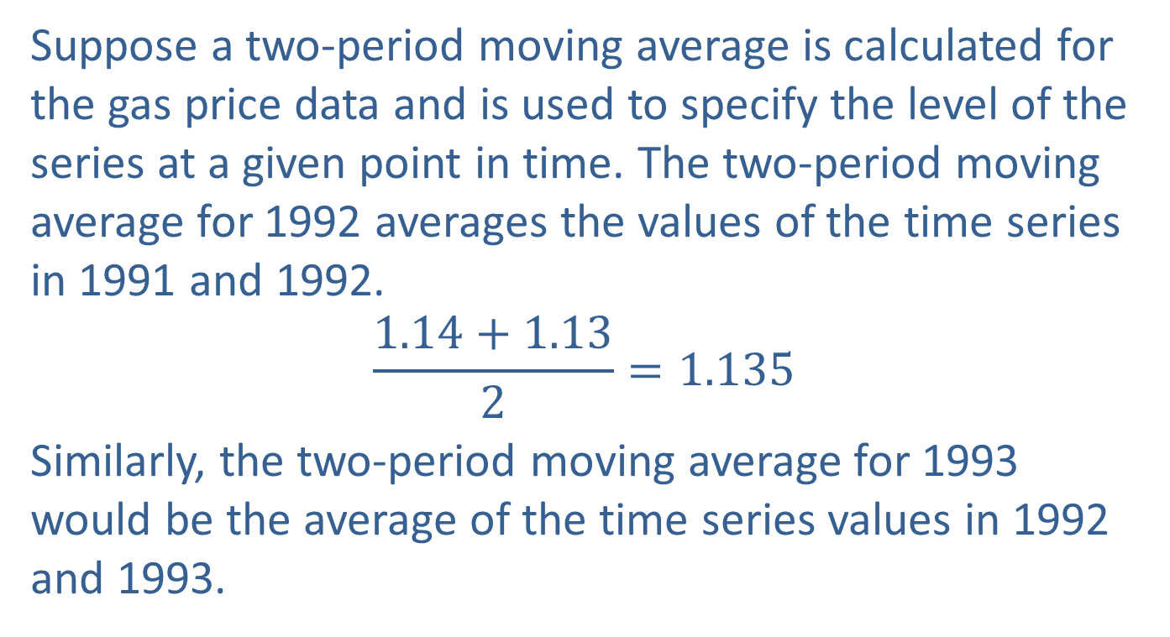
Time Series Data and Measures of Centrality (cont.)
Suppose a two-period moving average is calculated for the gas price data and is used to specify the level of the series at a given point in time. The two-period moving average for 1992 averages the values of the time series in 1991 and 1992.
$$\frac{1.14+1.13}{2}=1.135$$
Similarly, the two-period moving average for 1993 would be the average of the time series values in 1992 and 1993.

Slide 80
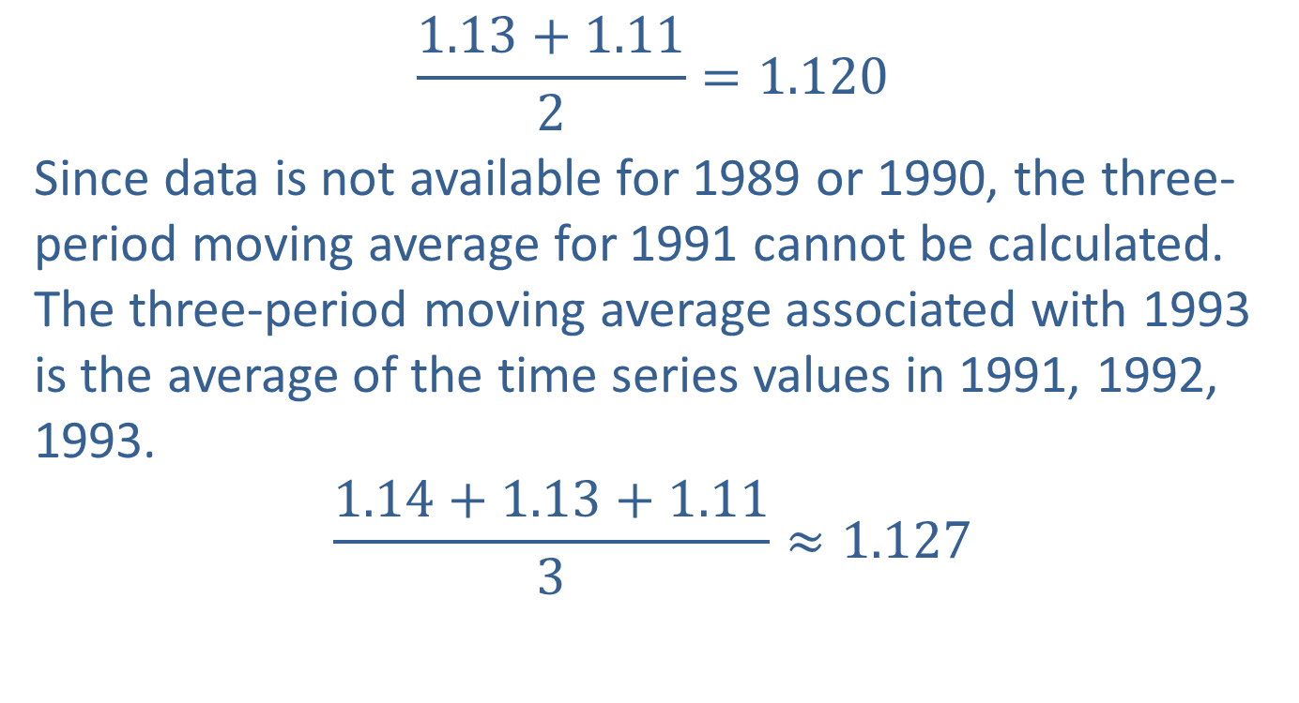
Time Series Data and Measures of Centrality (cont.)
$$\frac{1.13+1.11}{2}=1.120$$
Since data is not available for 1989 or 1990, the three-period moving average for 1991 cannot be calculated. The three-period moving average associated with 1993 is the average of the time series values in 1991, 1992, 1993.
$$\frac{1.14+1.13+1.11}{3}≈1.127$$

Slide 81
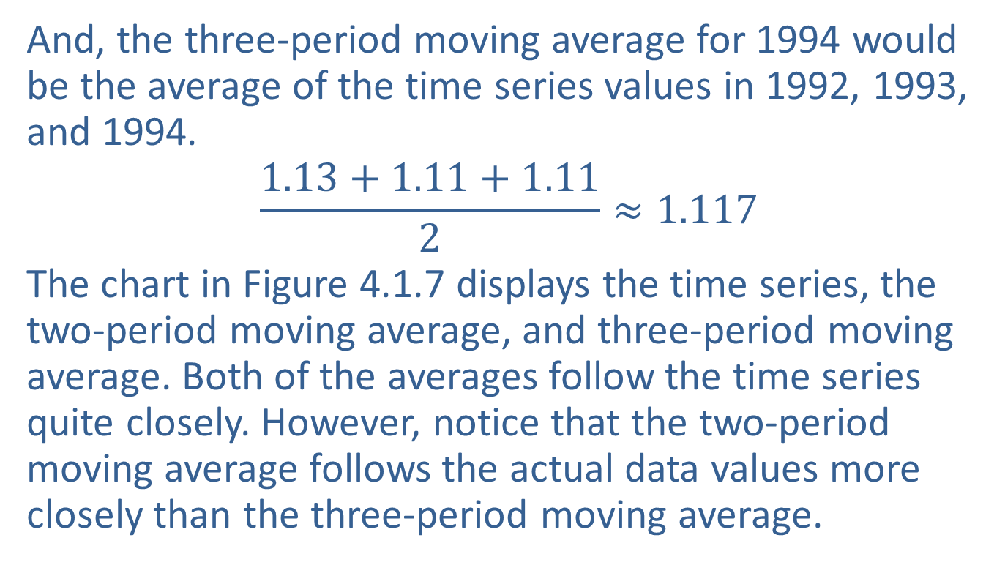
Time Series Data and Measures of Centrality (cont.)
And, the three-period moving average for 1994 would be the average of the time series values in 1992, 1993, and 1994.
$$\frac{1.13+1.11+1.11}{2}≈1.117$$
The chart in Figure 4.1.7 displays the time series, the two-period moving average, and three-period moving average. Both of the averages follow the time series quite closely. However, notice that the two-period moving average follows the actual data values more closely than the three-period moving average.

Slide 82
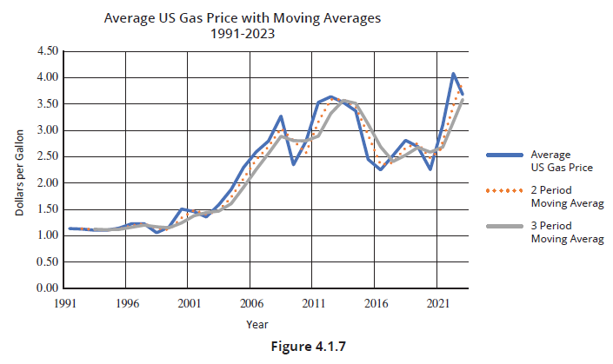
Time Series Data and Measures of Centrality (cont.)

