Slide 1
Section 3.4
Analyzing Graphs

Slide 2
Analyzing Graphs
Graphs that help us visualize data can either be enlightening, in the sense that they give us insight and understanding of a set of data, or misleading, either intentionally or unintentionally. When you see graphs in the media, you need to be cautious to ensure the data has been accurately represented by the graph. This section will help you analyze graphs for accuracy and appropriate presentation of the given information. Here are a few key ideas to consider when interpreting information displayed in graphical form.

Slide 3
Graph Labeling
Every graph should be properly labeled with an appropriate title that tells you what type of information is being displayed. Also, if the graph has a horizontal and vertical axis, these should be labeled and should include the unit of measurement when necessary for the understanding of the data. For example, in Figure 3.4.1, the title does not provide enough information about the data. Why were those countries chosen? Do they have relatively high or low prison populations compared to the rest of the world?

Slide 4
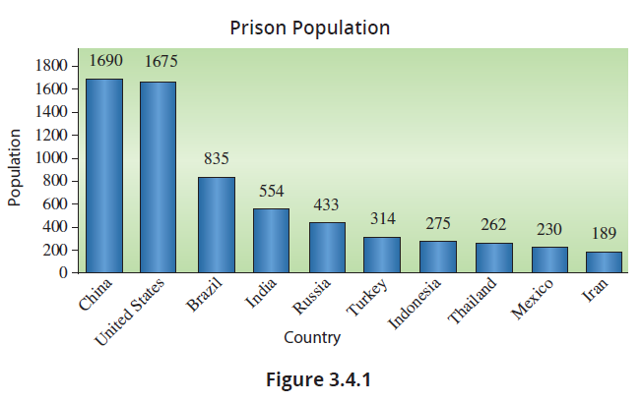
Graph Labeling (cont.)

Slide 5
Graph Labeling (cont.)
Furthermore, we do not know whether this information is relevant to modern times. Is this data for a specific year? The countries are labeled along the horizontal axis but note that the vertical axis is just labeled Population. We have no idea what the values along the vertical axis represent. Is the prisoner population in units of thousands, millions, or billions? In fact, this chart shows the countries with the top ten highest prisoner populations for the year 2021.

Slide 6
Graph Labeling (cont.)
The unit for the vertical axis should be thousands, which means that the United States had a prison population of approximately 1690 thousand, or 1.690 million, in the year 2021. Without these seemingly small pieces of information, the graph is not very informative. It is also good practice to use the largest possible unit for the scale of an axis, which in this case is correctly chosen to be thousands.

Slide 7
Sources
When examining graphs in the media it is very important to consider the source of the information, i.e., who is telling the story. What good is a graph if the underlying data is not credible? The data on the US population from 1790 to 2010 from the previous section came from census data collected by the U.S. Census Bureau, which is a highly reputable source of information. Typically, government entities and scientific journals are considered relatively trustworthy sources.

Slide 8
Sources (cont.)
When looking at the credibility of your data, keep in mind the old quote, “Large skepticism leads to large understanding. Small skepticism leads to small understanding. No skepticism leads to no understanding.”

Slide 9
Appropriateness of a Graph
Throughout this chapter we have looked at a wide variety of graphs. What we want to consider now is the appropriateness of a graph. In other words, we want to be able to determine whether the type of graph being used is best suited for the data being displayed. For example, let’s contrast the different uses of line graphs and bar graphs. In the previous section, we looked at the US population since 1790 and chose to display that data using a line graph. We could have just as easily used the bar graph shown in Figure 3.4.2.

Slide 10
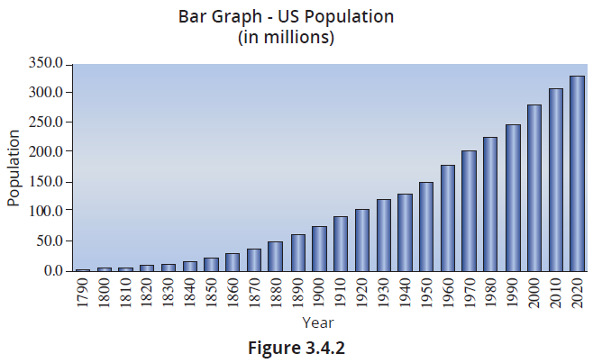
Appropriateness of a Graph (cont.)

Slide 11
Note
Our companion website, stat.hawkeslearning.com, has a link to a video called “The Art of Data Visualization” that was produced by PBS. While no particular data sets are featured in the video, it displays interesting data driven art and information. The video is only about seven minutes long and is worth taking a quick look.

Slide 12
Appropriateness of a Graph (cont.)
The bar graph also shows the increasing trend of the US population over time, but the trend is better seen using a line graph. The lengths and widths of the bars in the bar graph are somewhat distracting and obscure the change in population from one time period to the next.
Bar graphs and pie charts are often interchangeable when displaying qualitative data, but if you want to accurately display the categories as parts of a whole, the pie chart will give the best representation, as it allows you to visually compare the slices of the “pie” very quickly.

Slide 13
Appropriateness of a Graph (cont.)
However, the pie chart becomes less effective as the number of categories increases as was depicted in Section 3.2.

Slide 14
Scaling of Graphs
Another important feature to keep in mind when analyzing graphs is whether a graph is scaled appropriately. If you stretch or shrink the scale on either axis, the shape of the graph can change dramatically, and thus affect the interpretation of the graph. For example, suppose that we change the scale for Figure 3.2.10 on federal government spending to range from 0% to 80% instead of 0% to 25%.

Slide 15
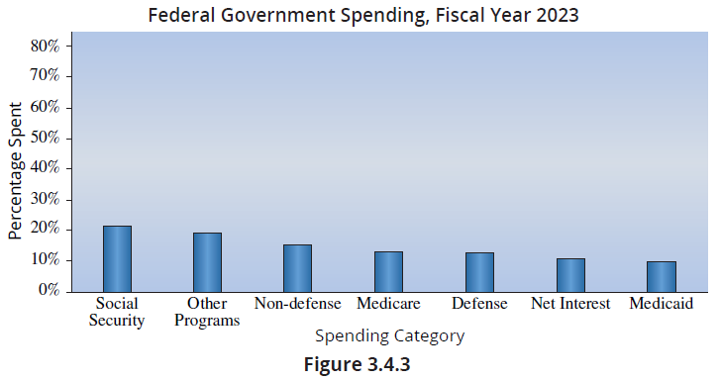
Scaling of Graphs (cont.)

Slide 16
Note
There is a very good TED Talk video on YouTube entitled “The Beauty of Data Visualization” by David McCandless. In the video, McCandless presents interesting data and a number of “normalization” techniques that are creative.

Slide 17
Scaling of Graphs (cont.)
Note that Figure 3.4.3 now minimizes the differences among the seven spending categories compared to the original graph. The large amount of “white space” in the graph is a good indicator that the scale may not be appropriate for the data. Therefore, when analyzing a graph, make sure that the scale represents the data well.

Slide 18
Data Transformations
It is often useful to transform data by replacing a variable in the data set with a function of that variable so that the distribution is easier to work with, interpret, or meet a “parametric” assumption of a statistical inference model you intend to use.
We have already applied a transformation to a variable in the geospatial graphs in Section 3.3. Recall that, due to the significant variation in US county populations, we could not accurately compare the obesity prevalence between counties when we plotted (colored) the number of obese people in each county.

Slide 19
Data Transformations (cont.)
To account for the difference in county populations, we applied a function to our data that transformed the variable of interest, the number of obese people in a county, into the percentage of obese people in a county. The function divided the number of obese people in a county by the total county population, multiplied the quotient by 100, and resulted in the percentage of the county population that was obese. This alternate perspective of the data then allowed us to easily compare counties since the variable of interest was normalized by total county population.

Slide 20
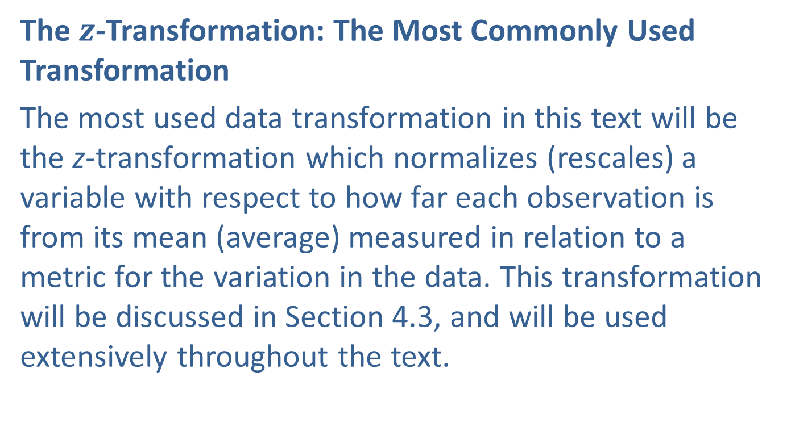
Data Transformations (cont.)
The $z$-Transformation: The Most Commonly Used Transformation
The most used data transformation in this text will be the z-transformation which normalizes (rescales) a variable with respect to how far each observation is from its mean (average) measured in relation to a metric for the variation in the data. This transformation will be discussed in Section 4.3, and will be used extensively throughout the text.

Slide 21
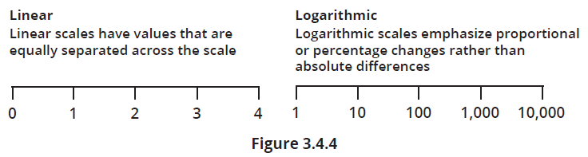
Data Transformations (cont.)
Log Transforms
In statistics, one frequently used technique is the transformation of data from a linear scale to a logarithmic scale.

Slide 22
Data Transformations (cont.)
In a linear scale, every unit increment signifies a constant and identical change in the quantity being measured, due to the interval property. For instance, in measuring distance, the gap from 1 to 2 is the same distance as that from 7 to 8.
The common logarithm serves to identify the exponent required to elevate 10 to obtain the given number. In logarithmic scales, the interval property that characterizes linear scales does not apply. In a base-10 logarithmic scale, the focus is not on equal differences, but on equal ratios.

Slide 23
Data Transformations (cont.)
For example, on a base-10 logarithmic scale, the distance from 1 to 10 is the same as the distance from 10 to 100 or from 100 to 1000. Each interval represents a tenfold increase, which is a proportional increase—not a constant increase. As a consequence, in a base-10 logarithmic scale, moving from 1 to 2 is analogous to shifting from 10 to 20 in terms of scale change. In each case, the values increase tenfold rather than by a constant amount.
log(1)=0 log(10)=1 log(100)=2 log(1000)=3
log(10)=1 log(100)=2 log(1000)=3 log(10000)=4

Slide 24
Data Transformations (cont.)
In each case the difference between the two values is 1.
In this example, each pair of numbers (1, 2), (10, 20), and (100, 200) features a second number in the pair that is twice as large as the first number. But when we take the log of the pairs, the differences between the paired numbers is constant (.301) rather than a doubling.
log(1) = 0 log(10) = 1 log(100) = 2
log(2) ≈ 0.301 log(20) ≈ 1.301 log(200) ≈ 2.301

Slide 25
Data Transformations (cont.)
While it’s accurate to say that the data is merely “rescaled” when transformed to a logarithmic scale, this rescaling can significantly alter the characteristics of the data. This includes the impact and prominence of unusually large or small observations (outliers) in the data set, as well as the relationship between the data values.

Slide 26
Data Transformations (cont.)
The Effects of a Log Transformation on Data
Compression of Scale: One of the characteristics of logarithmic scales is they compress large values and make small changes at the lower end of the scale more visible—making this scale useful for visualizing data that span several orders of magnitude.
Emphasize relative change: Logarithmic scales emphasize the relative—rather than absolute—changes in data. A change from 1 to 2 is as significant on the log scale as a change from 10 to 20 or 100 to 200.

Slide 27
Data Transformations (cont.)
Relative Spacing: Doing a log transformation changes the relative spacing between points. See Figure 3.4.5. If you compare the histograms in Figures 3.4.6 and 3.4.7, the outliers in the log transformed data have “disappeared” due to the transformation of scales and relative spacing of the data.

Slide 28
Data Transformations (cont.)
The potential benefits of a log transformation are the following.
Meets distributional assumptions: It is sometimes the case that the log scale changes the shape of the data’s distribution to a useful form. Many statistical models require the usage of data that has a certain distributional type. Taking the log transformation of the data can sometimes meet those assumptions. In fact, you can see that the distribution of the data has become more “bell-shaped” in Figure 3.4.7.

Slide 29
Data Transformations (cont.)
Transforms exponential growth to linear growth: Logarithmic transformation can linearize exponential growth patterns, which can facilitate the use of linear regression techniques for prediction and analysis.
Reduces skewness: Logarithmic transformation can make the data more symmetric, reduce the impact of outliers, and make the data more “normal” in statistical terms. This could potentially “pull in” outliers.

Slide 30
Data Transformations (cont.)
If your data contains 0 or any negative values, you cannot use the log transformation since the log function is not defined for 0 or negative numbers.
Let’s examine the population of the 50 states. There are numerous states with small populations and a few with very large populations.

Slide 31
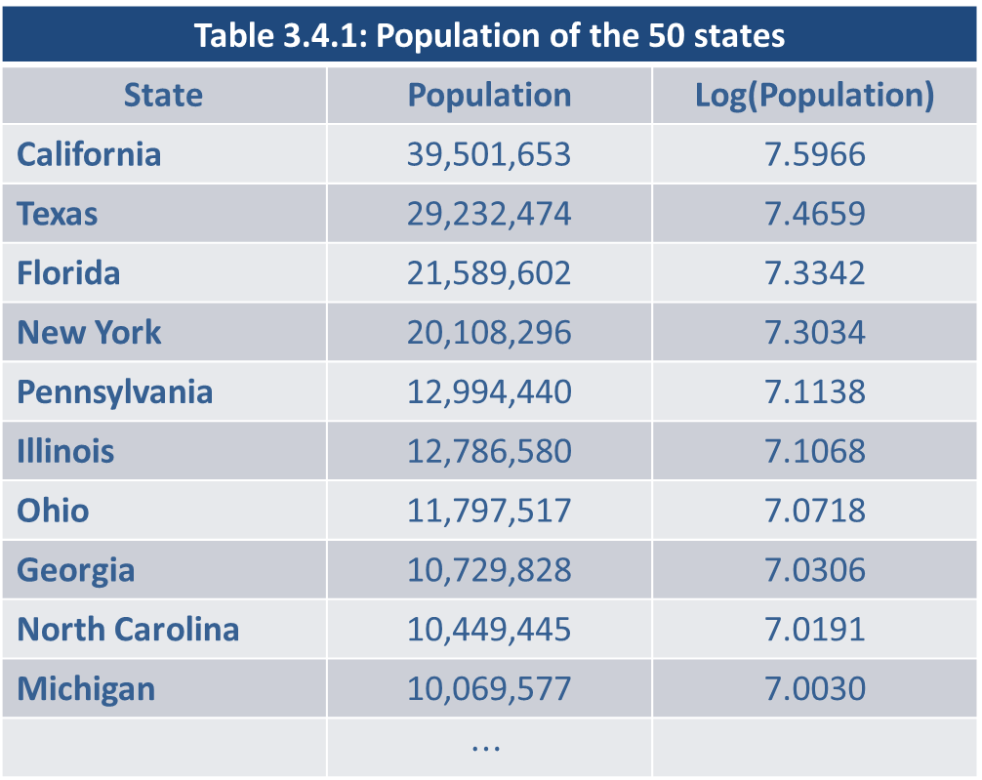
Data Transformations (cont.)
Table 3.4.1: Population of the 50 states
State | Population | Log(Population)
California | 39,501,653 | 7.5966
Texas | 29,232,474 | 7.4659
Florida | 21,589,602 | 7.3342
New York | 20,108,296 | 7.3034
Pennsylvania | 12,994,440 | 7.1138
Illinois | 12,786,580 | 7.1068
Ohio | 11,797,517 | 7.0718
Georgia | 10,729,828 | 7.0306
North Carolina | 10,449,445 | 7.0191
Michigan | 10,069,577 | 7.0030
 | $$⋯$$

Slide 32
Data Transformations (cont.)
Table 3.4.1: Population of the 50 states (cont.)
State | Population | Log(Population)
New Hampshire | 1,378,587 | 6.1394
Maine | 1,363,557 | 6.1347
Rhode Island | 1,096,345 | 6.0399
Montana | 1,087,075 | 6.0363
Delaware | 992,114 | 5.9966
South Dakota | 887,799 | 5.9483
North Dakota | 779,518 | 5.8918
Alaska | 732,923 | 5.8651
Vermont | 642,893 | 5.8081
Wyoming | 577,605 | 5.7616

Slide 33
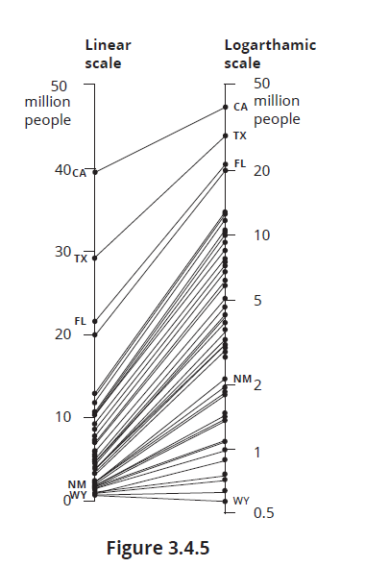
Data Transformations (cont.)

Slide 34
Data Transformations (cont.)
The state population data shown in Figure 3.4.5 on the linear scale is tightly clustered together at the bottom of the scale with a few larger states at the top. Once the data is transformed to a logarithmic scale, the data is more separated and easier to distinguish. For the state population data, the log transformation can be used to help “unclutter” data points for visualization purposes. As you can see in Figure 3.4.5, log transformations numerically “stretch” the portion of the axis closest to zero, and “compress” the portion of the axis farthest from zero.

Slide 35
Data Transformations (cont.)
This allows us to better visualize each individual point while also maintaining the underlying relationship between the variables being graphed.
Changing the Shape of the Data to a More Desirable Form
In a data set comprising population figures for 50 states, 46 of these data points conform to a general range, while four significantly diverge from this norm. Among these four, California and Texas stand out markedly. These atypical data points are commonly termed outliers.

Slide 36
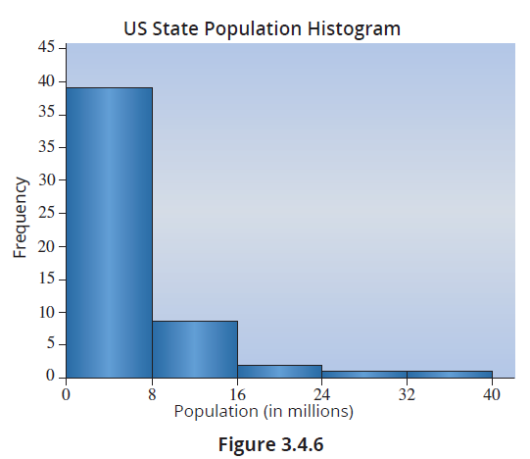
Data Transformations (cont.)
A histogram revealing the distribution of the data is shown below in Figure 3.4.6.

Slide 37
Data Transformations (cont.)
Another reason for performing log transformations is that the transformation can make the data more bell-shaped (normally distributed) which is an underlying assumption in many statistical models. In the state population data, the log transformation took data that was skewed right and converted it into a more bell-shaped distribution as shown in Figure 3.4.7.

Slide 38
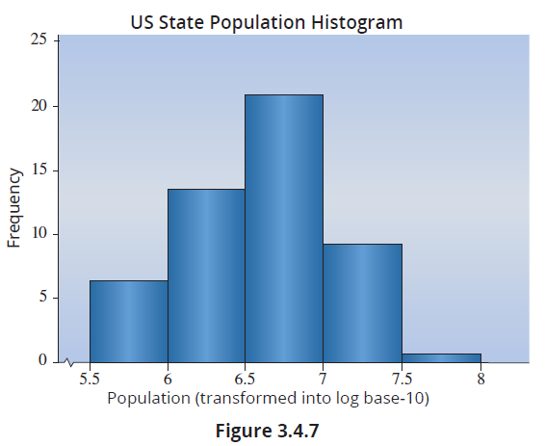
Data Transformations (cont.)

Slide 39
Data Transformations (cont.)
Note, if you calculate a simple average for state populations, the average state population of the 50 US states is 6,616,813. However, after taking the log of the data values and averaging the log values you obtain 6.609. If you convert the average of the logs back to the original population scale, this number is 4,064,433—incidentally, this is also called the geometric mean. So, the log transformation reduces the effects of the outlier values (like California and Texas).

Slide 40
Transforming Exponential Growth
Let’s take a look at the growth of the price of Amazon stock since its initial public offering in 1997.
Figure 3.4.8 depicts Amazon’s stock prices in their raw form since its initial public offering (IPO) in May 1997, showcasing an exponential growth rate over this period.

Slide 41
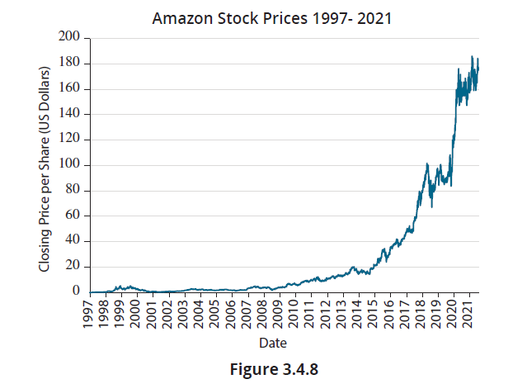
Transforming Exponential Growth (cont.)

Slide 42
Transforming Exponential Growth (cont.)
In Figure 3.4.9, a log transformation has been applied to the Amazon stock price data. Note that in the early days the price was less than 1 and the log of values between 0 and 1 are negative. Even with the surge in Amazon stock price due to the Covid-19 pandemic, the transformed stock prices possess a strong linear trend starting in 2006 and perhaps as early as 2001. A linear trend for log transformed data indicates the stock price has been growing at a relatively constant percentage rate over time.

Slide 43
Transforming Exponential Growth (cont.)
Log transformations can offer numerous advantages when it comes to making your data more model-friendly, both for predictive modeling and for statistical inference.

Slide 44
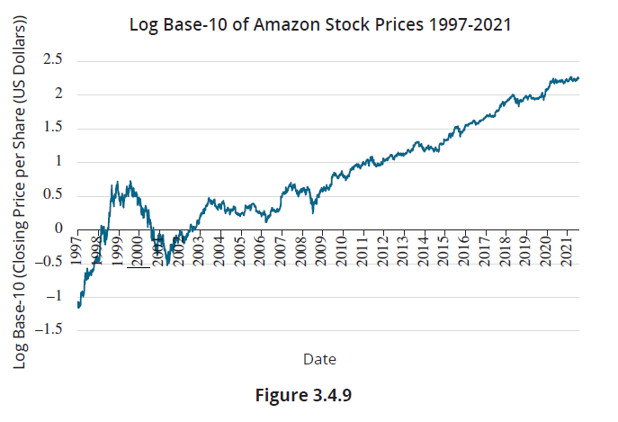
Transforming Exponential Growth (cont.)

Slide 45
Transforming Exponential Growth (cont.)
There are many other useful data transformations, particularly in predictive modeling, which we will begin to discuss in Chapter 5. Should you wish to delve deeper into predictive modeling subjects like machine learning, you’ll discover that transforming data is often the starting point for building predictive models. The topic of data transformation is both intriguing and practical, and you can easily acquire a wealth of accessible information on the subject through ChatGPT or other advanced language models.

Slide 46
Transforming Exponential Growth (cont.)
Log scales are used in various scientific, engineering, and everyday contexts. Here are some common log scales:
Richter Scale: Used to measure the magnitude of earthquakes. Each whole number increase on the Richter scale represents a tenfold increase in amplitude of the seismic waves and roughly 31.6 times more energy release.

Slide 47
Transforming Exponential Growth (cont.)
pH Scale: Used in chemistry to measure the acidity or alkalinity of a solution. A pH less than 7 is acidic, 7 is neutral, and above 7 is alkaline. Each unit change in pH represents a tenfold change in acidity or alkalinity. For instance, a solution with a pH of 4 is ten times more acidic than one with a pH of 5.
Decibel (dB) Scale: Used in acoustics to measure sound intensity. The decibel scale is a logarithmic scale where each increase of 10 dB represents a tenfold increase in intensity. It’s also used in electronics and signals to measure power and voltage ratios.

Slide 48
Transforming Exponential Growth (cont.)
Biological and Geometric Scales: In biology, especially in microbiology, the growth of bacterial colonies can be exponential. When assessing the number of bacteria over time, especially in a culture that grows rapidly, a log-transform can linearize exponential growth patterns.
Demography and Finance: In various fields, growth (like population growth or compound interest in finance) or decay (like radioactive decay) can often be described using logarithmic or exponential models.

Slide 49
Misleading Graphs
An issue related to scaling that is often used to mislead readers is to start the vertical scale at some value other than zero. We saw this earlier with the sales performance data in Section 3.2. By starting the scale on the vertical axis at $180,000 and using increments of $5,000, the sales performance differences were exaggerated (see Figures 3.2.2 and 3.2.3).
One type of graph commonly used in the media is a pictograph, because it is visually appealing and simple to understand. A pictograph is basically a bar graph that uses pictures of objects in place of the bars.

Slide 50
Misleading Graphs (cont.)
For example, the graph on the left in Figure 3.4.10 shows a potentially misleading pictograph of the top five countries ranked in order by the amount of forested area they contain. The bars in this bar chart are represented by trees. Note how as the amount of forest area increases, the trees expand with regard to width and height, thus giving the illusion that the amount of increase is much larger than it is in reality. This is a common problem with pictographs found in the media.

Slide 51
Misleading Graphs (cont.)
Often when the size of the object is increased or decreased, the change is not simply one‑dimensional. So be very cautious when looking at data displayed with a pictograph to make sure the graph isn’t misleading by representing increases or decreases along one dimension (height of the bar) using an object that is changing in area or volume. The graph on the right represents the correct way to scale a pictograph by only changing the heights of the trees.

Slide 52
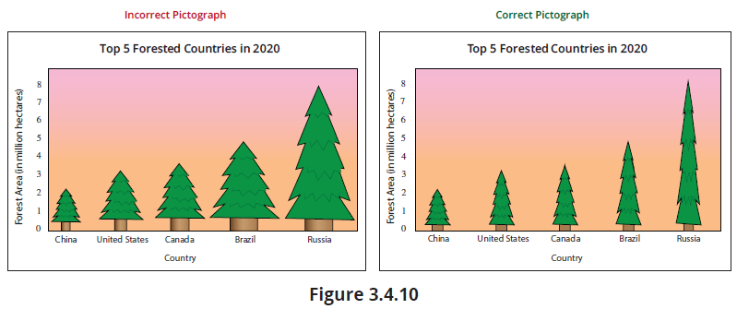
Misleading Graphs (cont.)

