Slide 1
Section 3.3
Displaying Quantitative Data Graphically

Slide 2
Displaying Quantitative Data Graphically
Quantitative graphs are powerful tools used in data visualization to represent and analyze numerical data. They come in various forms, including bar graphs, line graphs, histograms, scatter plots, dot plots, pie charts, and choropleth maps, each with its unique utility. These graphs help to summarize large data sets, display patterns, trends, and correlations, and make complex information more comprehensible.

Slide 3
Displaying Quantitative Data Graphically (cont.)
Examining raw data as compared to viewing a well-designed graph of that data is akin to hearing a symphony described in words versus actually listening to the music; the latter offers an immediate, rich understanding that simple description can never capture.

Slide 4
Histograms
A histogram is a common graphical method that reveals the distribution of a set of data. Histograms are often constructed based on frequency distributions of quantitative data. They look similar to bar graphs but are used to analyze quantitative data rather than qualitative data.
Histograms literally show the shape of the data by graphically displaying a frequency distribution.

Slide 5
Definition: Histogram
A histogram is a graphical representation of a frequency or relative frequency distribution. The horizontal scale corresponds to classes of quantitative data values and the vertical scale corresponds to the frequency or relative frequency of each class.

Slide 6
Histograms (cont.)
Each of the classes in the frequency distribution is represented by a vertical bar whose height is proportional to the frequency of the class interval. The horizontal boundaries of each vertical bar correspond to the class boundaries. Once the frequency distribution has been calculated, all the information necessary for plotting a histogram is available.
In Figure 3.3.1, the histogram is created from the frequency distribution of the heart rate data in Table 3.1.3.

Slide 7
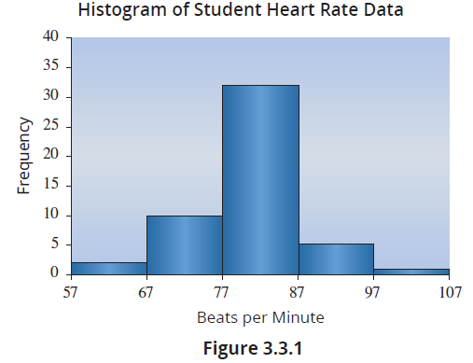
Histograms (cont.)

Slide 8
Histograms (cont.)
You can quickly see that most of the heart rates are in the third class interval from 77 to 86. The center of the data appears to be near 80 and the data appears to have a mound shape with most of the data in the middle.
Histograms are one of the more frequently used statistical tools. A histogram is not only easy to interpret, it also reveals a great deal about the structure of the data. You can quickly see that most of the heart rates are in the second and third classes (67 to 87). By examining the histogram, one can determine the shape of the distribution of the data, and whether the data is symmetric or skewed.

Slide 9
Definition: Symmetric vs. Skewed
If you split the histogram of a distribution down the center, and the left and right sides of the histogram are approximately mirror images of one another, the distribution is said to be symmetric.
A skewed distribution is a nonsymmetric (or asymmetric) distribution that extends more to one side than the other. The distribution is said to be skewed to the right (or positively skewed) if the tail to the right of the peak of the distribution is longer than the tail to the left of the peak.

Slide 10
Definition: Symmetric vs. Skewed (cont.)
The distribution is said to be skewed to the left (or negatively skewed) if the tail to the left of the peak of the distribution is longer than the tail to the right of the peak.

Slide 11
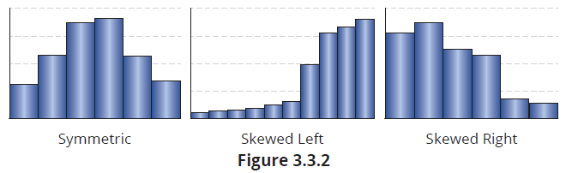
Histograms (cont.)
When we look at a histogram, what features are important?
Is the distribution of the data as described by these frequency distributions symmetric or skewed?
Does the distribution have several peaks or modes (unimodal, bimodal, multimodal)?

Slide 12
Histograms (cont.)
Where is the center of the distribution?
Are there outliers, data values that are very different from the others?
The histogram of the census data given in section 3.1 shows the distribution of ages in the US population in 2020. The shape of the histogram (whether it is symmetric, skewed, bimodal, etc.) can offer valuable clues about the underlying nature of the population.

Slide 13
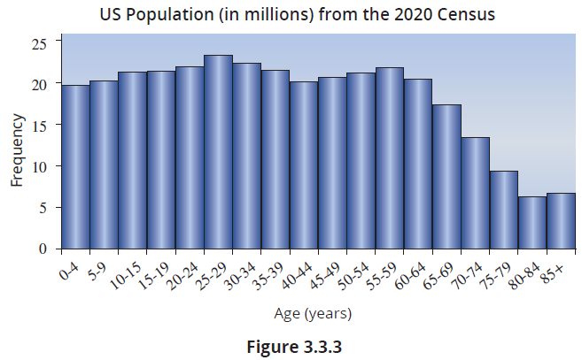
Histograms (cont.)

Slide 14
Histograms (cont.)
Table 3.3.1 - US Population in 2020
Age Group | Population (in millions)
0-4 | 19.650
5-9 | 19.979
10-14 | 21.108
15-19 | 21.175
20-24 | 21.820
25-29 | 23.262
30-34 | 22.223
35-39 | 21.346
40-44 | 20.001
45-49 | 20.570
Table 3.3.1 - US Population in 2020
Age Group | Population (in millions)
50-54 | 20.971
55-59 | 21.786
60-64 | 20.316
65-69 | 17.302
70-74 | 13.246
75-79 | 9.114
80-84 | 6.079
85+ | 6.622

Slide 15
Histograms (cont.)
If you wanted to swiftly grasp the age distribution of the U.S., which representation would you prefer, the histogram or the data in Table 3.3.1? The histogram provides a comprehensive snapshot, enabling you to perceive the relationships between age groups and promptly comprehend the shape, central tendency, and spread of the age distribution. In addition, visualizing the histogram allows for easy identification of patterns like peaks, gaps, or asymmetry.

Slide 16
Histograms (cont.)
In contrast, thoroughly examining the data items in the frequency distribution to discover these characteristics would be a tedious process.
When dealing with sizable data sets, creating histograms to visualize the data distribution is typically one of the initial statistical techniques employed. For example, suppose you were analyzing how different authors use the alphabet in their writing works. In Figure 3.3.4, the histograms for the relative frequency of each letter in ten different titles is shown.

Slide 17
Histograms (cont.)
These histograms compress the information contained in ten novels (roughly ten million characters in this case) to these ten histograms. So, about 100,000,000 data points are mapped into these ten data visualizations, and we can “see” the character frequency in these works is very similar. That is simply amazing! The simple act of creating and graphing a relative frequency distribution of the alphabetic characters in each work revealed something unexpected.

Slide 18
Histograms (cont.)
Despite the writing style and stories embedded in these works being substantially different, the usage of alphabetic characters in the language remains remarkably consistent and stable.

Slide 19
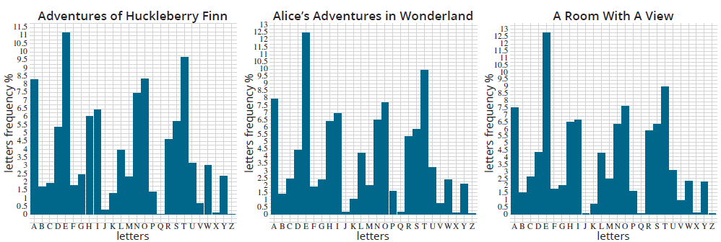
Histograms (cont.)

Slide 20
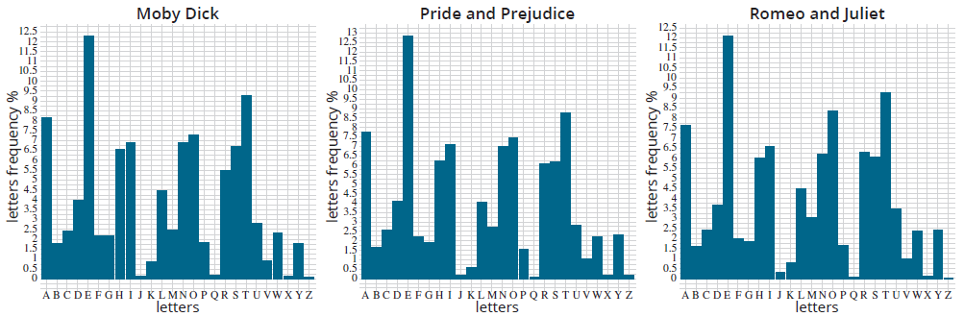
Histograms (cont.)

Slide 21
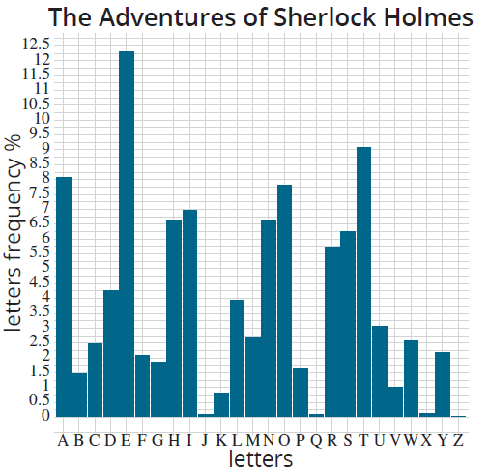
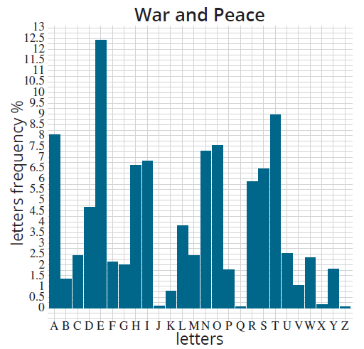
Histograms (cont.)

Slide 22
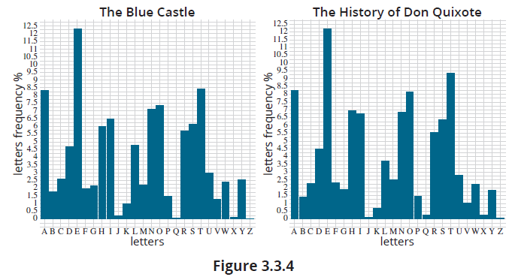
Histograms (cont.)

Slide 23
Histograms (cont.)
You might think that knowing the frequency of alphabetic letters used in the English language is of little utility. Cryptographers often leverage the frequencies of characters, such as alphabetic characters, in a given language to decode messages encrypted using classical ciphers. By analyzing the relative occurrence of letters or symbols in the encoded text, cryptanalysts can deduce patterns and make educated guesses about the substitution or transposition techniques employed in the encryption.

Slide 24
Histograms (cont.)
For example, if certain characters appear more frequently than others, they might represent common letters like ‘e’ or ‘t’ in plain text. Armed with statistical insights gained from frequency analysis, cryptographers can develop strategies to crack simple ciphers and reveal the original message.

Slide 25
Back-to-Back Histograms
Suppose you want to compare the distributions of two related data sets to explore similarities and disparities. In the graphs below, we can observe four distinct age distributions. These graphs represent the age distribution for a population of approximately 179 million men and women in the year 1960, as well as the projected age distribution for an estimated population of 404 million men and women in the year 2060.

Slide 26
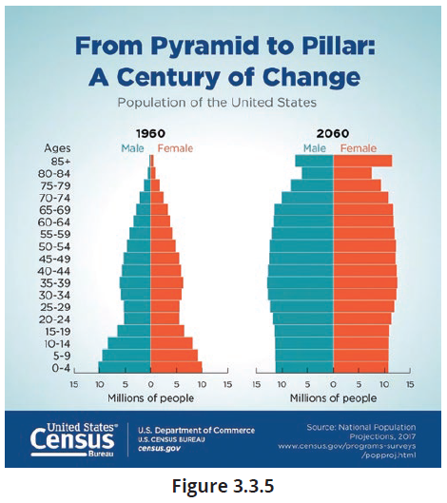
Back-to-Back Histograms (cont.)

Slide 27
Back-to-Back Histograms (cont.)
If the objective is to compare the age distributions between men and women, a back-to-back histogram would be an excellent visual tool for presenting the data effectively. There are YouTube videos on how to create Back-to-Back histograms in Excel and R. Also, you can obtain instructions for Back-to-Back histograms using Minitab from ChatGPT.

Slide 28
Stem-and-Leaf Plot
The stem-and-leaf plot (or stemplot) is a hybrid graphical method for relatively small data sets containing a discrete variable. The plot is similar to a histogram, but the data remains visible to the user. Like all graphical displays, the stem-and-leaf plot is useful for both ordering and detecting patterns in the data. It is one of the few graphical methods in which the individual data is not lost in the construction of the graph. As the name implies, there is a “stem” to which “leaves” will be attached in some pattern.

Slide 29
Stem-and-Leaf Plot (cont.)
The stem-and-leaf plot is a useful graphical method for small and moderate-sized data sets containing up to a few hundred data points.

Slide 30
Definition: Stem-and-Leaf Plot
The stem-and-leaf plot is a graph representing quantitative data that separates each data value into two parts: the stem and the leaf.

Slide 31
Stem-and-Leaf Plot (cont.)
Consider the following data: 97, 99, 108, 110, and 111. If we are interested in the variation of the last digit, the stem and leaves are as shown in Table 3.3.2 and displayed in Figure 3.3.6. The leaves in this case are the ones digit and the stems are the tens and hundreds digits. All of the data values that have common stems are grouped together, and their leaves branch out from the common stem.

Slide 32
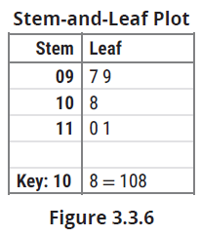
Stem-and-Leaf Plot (cont.)
Table 3.3.2 - Data, Stems, and Leaves
Data | Stem | Leaf
97 | 09 | 7
99 | 09 | 9
108 | 10 | 8
110 | 11 | 0
111 | 11 | 1

Slide 33
Stem-and-Leaf Plot (cont.)
Notice the key at the bottom of the stem-and-leaf plot to show how the data is to be read from the plot. It is also important to keep the spacing between the leaves consistent.
If we are interested in the variation of the last two digits, the stem and leaves are shown in Table 3.3.3 and displayed in Figure 3.3.7. The leaves in this case are the tens and ones digits and the stems are the hundreds digits. Again, all of the data values that have common stems are grouped together, and their leaves branch out from the common stem.

Slide 34
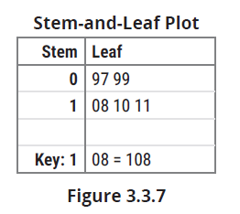
Stem-and-Leaf Plot (cont.)
Table 3.3.3 - Data, Stems, and Leaves
Data | Stem | Leaf
97 | 0 | 97
99 | 0 | 99
108 | 1 | 08
110 | 1 | 10
111 | 1 | 11

Slide 35
Stem-and-Leaf Plot (cont.)
Deciding which part to make the stem and which part to make the leaf depends on the focus or purpose of the analysis. Sometimes the choice of stem and leaf is easy. With the heart rate data, using the tens digit as the stem will break the data into four classes. Figure 3.3.8 shows a stem-and-leaf plot of the heart rate data using the tens digit as the stem.

Slide 36
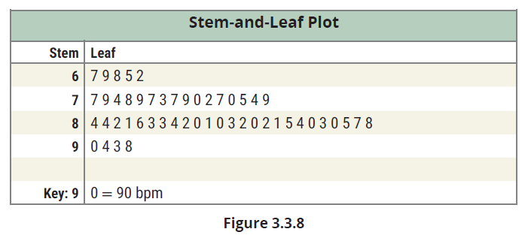
Stem-and-Leaf Plot (cont.)
It is often advantageous to place the leaves of a stem-and-leaf plot in numerical order. Ordering the leaves in the heart rate data pictured above gives us Figure 3.3.9.

Slide 37
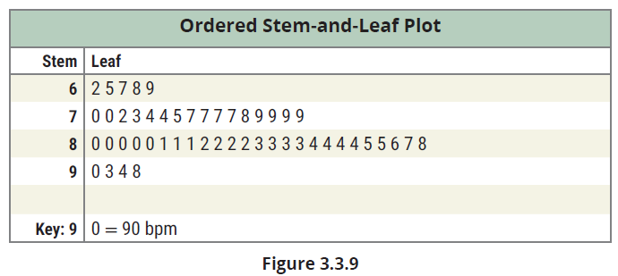
Stem-and-Leaf Plot (cont.)

Slide 38
Example 3.3.1: Constructing a Stem and Leaf Plot of Home Runs
Construct a stem and leaf plot that compares the annual home run production Babe Ruth and Barry Bonds hit per season.
Barry Bonds
Year | 1986 | 1987 | 1988 | 1989 | 1990 | 1991
HR | 16 | 25 | 24 | 19 | 33 | 25
Year | 1992 | 1993 | 1994 | 1995 | 1996 | 1997
HR | 34 | 46 | 37 | 33 | 42 | 40
Year | 1998 | 1999 | 2000 | 2001 | 2002 | 2003
HR | 37 | 34 | 49 | 73 | 46 | 39
Year | 2004 | 2005 | 2006 | 2007
HR | 45 | 5 | 26 | 28

Slide 39
Example 3.3.1: Constructing a Stem and Leaf Plot of Home Runs (cont.)
Babe Ruth
Year | 1914 | 1915 | 1916 | 1917 | 1918 | 1919
HR | 0 | 4 | 3 | 2 | 11 | 29
Year | 1920 | 1921 | 1922 | 1923 | 1924 | 1925
HR | 54 | 59 | 35 | 41 | 46 | 25
Year | 1926 | 1927 | 1928 | 1929 | 1930 | 1931
HR | 47 | 60 | 54 | 46 | 49 | 46
Year | 1932 | 1933 | 1934 | 1935
HR | 41 | 34 | 22 | 6

Slide 40
Example 3.3.1: Constructing a Stem and Leaf Plot of Home Runs (cont.)
Solution
Home runs Hit per Season: Babe Ruth vs Barry Bonds
Ruth |  | Bonds
0 4 3 2 6 | 0 | 5
1 | 1 | 6 9
9 5 2 | 2 | 5 4 5 6 8
5 4 | 3 | 3 4 7 3 7 4 9
1 6 7 6 9 6 1 | 4 | 6 2 0 9 6 5

Slide 41
Example 3.3.1: Constructing a Stem and Leaf Plot of Home Runs (cont.)
Home runs Hit per Season: Babe Ruth vs Barry Bonds
Ruth |  | Bonds
4 9 4 | 5
0 | 6
 | 7 | 3
Key: 0 | 6 | 1 = 60 HR for Ruth, 61 HR for Bonds

Slide 42
Example 3.3.1: Constructing a Stem and Leaf Plot of Home Runs (cont.)
Note that in order to compare the two sets of data more readily, we needed to use the same stems for each. This was accomplished in this example by sharing the common stems and creating one plot instead of two separate ones. This is commonly referred to as a side-by-side (or back-to-back) stem-and-leaf plot.

Slide 43
The Ordered Array
An ordered array is a listing of all the data in either increasing or decreasing magnitude. Data listed in increasing order are said to be listed in rank order. If listed in decreasing order, they are listed in reverse rank order. Listing the data in an ordered way can be very helpful. It allows you to scan the data quickly for the largest and smallest values, for large gaps in the data, and for concentrations or clusters of values.

Slide 44
Example 3.3.2: Listing a Data Set in Rank Order
The personnel records for a clothing department store located in the local mall are examined, and the current ages for all employees are noted. There are 25 employees, and their ages are listed in the following table. It is desired that their ages be placed in rank order.
Ages of Employees
32 | 21 | 24 | 19 | 61 | 18 | 18 | 16 | 16 | 35 | 39 | 17 | 22
21 | 60 | 18 | 53 | 18 | 57 | 63 | 28 | 20 | 29 | 35 | 45

Slide 45
Example 3.3.2: Listing a Data Set in Rank Order (cont.)
Solution
For relatively small data sets, it is always a good idea to get a look at the ordered array of the data early in your analysis. Examining the ranked data produces a good intuitive sense for the data. Looking at the ordered array, it is evident that over half of the employees are younger than 25 and only three employees are 60 or older. We can also easily see that the youngest employee is 16 years old and the oldest employee is 63 years old.
Ages of Employees
16 | 16 | 17 | 18 | 18 | 18 | 18 | 19 | 20 | 21 | 21 | 22 | 24
28 | 29 | 32 | 35 | 35 | 39 | 45 | 53 | 57 | 60 | 61 | 63

Slide 46
The Ordered Array (cont.)
Ordered arrays are easy to create. Virtually all statistics, spreadsheet, and database programs enable the user to quickly sort the data in ascending or descending order. If a spreadsheet or database program is not available, a stem-and-leaf plot can be helpful in sorting the data.

Slide 47
Dot Plots
A dot plot is a graph where each data value is plotted as a point (or a dot) above a horizontal axis. They are particularly useful for visualizing distributions of discrete data. If there are multiple entries of the same data value, they are plotted one above the other. Dot plots are useful when you are interested in where the data is clustered and which values occur most often.

Slide 48
Example 3.3.3: Constructing a Dot Plot of Number of Wins
The following table contains the number of wins by baseball’s Chicago Cubs for a recent 60-year period. Use this data to construct a dot plot.
Wins by the Chicago Cubs (1963–2022)
61 | 85 | 67 | 68 | 78 | 76 | 73 | 81 | 85 | 87 | 71 | 74
66 | 97 | 88 | 90 | 84 | 77 | 71 | 79 | 77 | 84 | 34 | 59
73 | 83 | 89 | 67 | 49 | 93 | 96 | 80 | 66 | 92 | 84 | 72
97 | 75 | 79 | 65 | 73 | 77 | 77 | 64 | 75 | 84 | 95 | 76
103 | 71 | 66 | 88 | 76 | 77 | 70 | 38 | 75 | 83 | 92 | 82

Slide 49
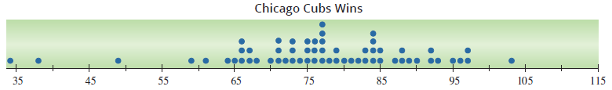
Example 3.3.3: Constructing a Dot Plot of Number of Wins (cont.)
Solution
We plot each data value on the axis. For values where there are multiple entries, such as for 77, we stack the points on top of one another.
From the dot plot we see that most values occur between 64 and 97, and the value that occurs most frequently is 77.

Slide 50
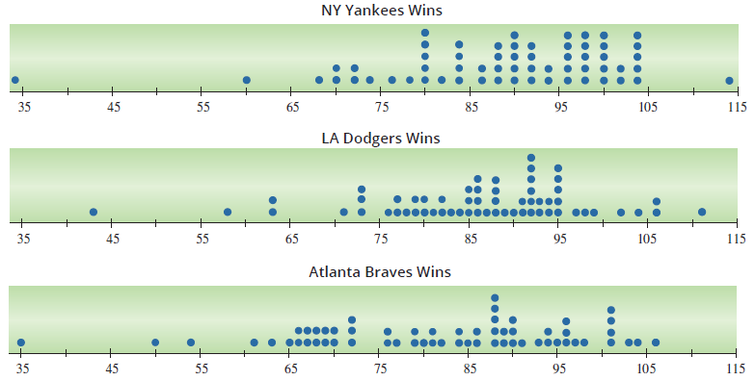
Example 3.3.3: Constructing a Dot Plot of Number of Wins (cont.)
By way of comparison, the dot plots for a few other teams are given below.

Slide 51
Time Series Plots
A good example of time series data is the census measurements taken every decade since 1790. The population of the United States has been growing steadily since the first census as shown in Table 3.3.4. Interestingly, the change in population between 2010 and 2020 was 17.9 million, which is greater than the entire population of the United States in 1840.
Table 3.3.4 - US Census Data
Year | Population | Population (in millions)
1790 | 3,929,214 | 3.9
1800 | 5,308,483 | 5.3
1810 | 7,239,881 | 7.2

Slide 52
Time Series Plots (cont.)
Table 3.3.4 - US Census Data (cont.)
Year | Population | Population (in millions)
1820 | 9,638,453 | 9.6
1830 | 12,860,702 | 12.9
1840 | 17,063,353 | 17.1
1850 | 23,191,876 | 23.2
1860 | 31,443,321 | 31.4
1870 | 38,558,371 | 38.6
1880 | 50,155,783 | 50.2
1890 | 62,979,766 | 63.0
1900 | 76,212,168 | 76.2
1910 | 92,228,496 | 92.2
1920 | 106,021,537 | 106.0

Slide 53
Time Series Plots (cont.)
1990Table 3.3.4 - US Census Data (cont.)
Year | Population | Population (in millions)
1930 | 123,202,624 | 123.2
1940 | 132,164,569 | 132.2
1950 | 151,325,798 | 151.3
1960 | 179,323,175 | 179.3
1970 | 203,302,031 | 203.3
1980 | 226,542,199 | 226.5
1990 | 248,709,873 | 248.7
2000 | 281,421,906 | 281.4
2010 | 308,745,538 | 308.7
2020 | 326,569,308 | 326.6

Slide 54
Time Series Plots (cont.)
In a line graph, time is always labeled on the horizontal axis, with the variable being measured labeled on the vertical axis. Points are then plotted for each time period, and a line is drawn that connects each consecutive point. In Figure 3.3.10, each of the points is plotted with the year on the horizontal axis and the corresponding population (in millions) on the vertical axis.

Slide 55
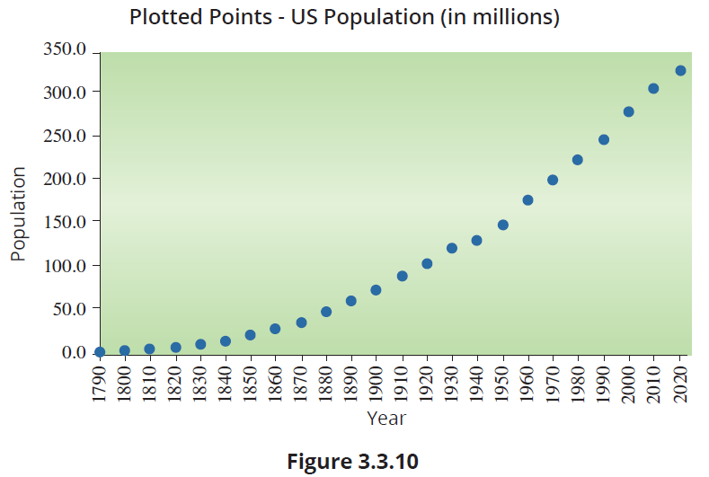
Time Series Plots (cont.)

Slide 56
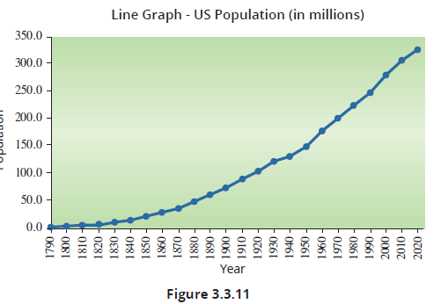
Time Series Plots (cont.)
In Figure 3.3.11, a line segment connects consecutive points in the time series to produce a line graph. From the line graph we can easily see that the series is nonstationary, and that there is an upward trend in the data.

Slide 57
Time Series Plots (cont.)
Does it make sense to draw a histogram for a nonstationary time series? We could create a histogram of the population data we have been examining, but it would not reveal anything very interesting. For a nonstationary time series (a time series with a trend), a histogram is usually not warranted.
It is not uncommon to see time series graphs with multiple sets of data plotted. It is also not uncommon to see two vertical axes used if the data sets have different scales.

Slide 58
Time Series Plots (cont.)
In Figure 3.3.12, both the sea level change and the global temperature change since 1901 are shown on the same graph. The vertical scale on the left refers to the change in sea level. The vertical scale on the right refers to the change in global temperature. By plotting both sets of data on the same graph, we can see the trend that the two sets of data share.

Slide 59
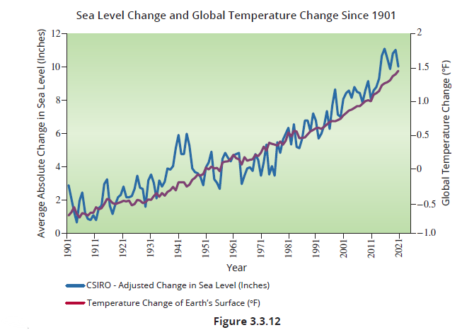
Time Series Plots (cont.)

Slide 60
Geospatial Graphs—Cognitive Art
For centuries, humans have used maps to portray information about specific places or regions. Today, it is very common to see data that is associated with some type of geographic location such as zip codes, county codes, states, countries, or even specific longitudes and latitudes. This association allows us to layer the data values on top of a map of a certain area, or satellite image, ultimately providing us with a greater understanding of how different regions compare to one another based on a variety of different variables.

Slide 61
Geospatial Graphs—Cognitive Art (cont.)
Choropleth maps are one type of geospatial graph that has become very popular, although their use dates back to the early 19th century. Choropleth maps utilize shades of color to measure a variable across several pre-defined areas. Choropleth maps are similar to heat maps; however, heat maps use the given data to define regions whereas choropleth maps come with predefined regions with which data is already associated.

Slide 62
Note
You frequently hear data visualization specialists refer to encoding data into a graphic. For example, in a histogram the data is encoded into different categories. If you are creating a choropleth map, the data is encoded spatially by placing the data in a region (usually county, state, or country). The magnitude of the data is usually represented by a color shade. So, the data is encoded in two dimensions.

Slide 63
Geospatial Graphs—Cognitive Art (cont.)
An example of a heat map would be weather radar, where the shaded region is dynamically defined by the amount and type of precipitation in an area rather than by state or county lines.
Suppose we are interested in visualizing obesity in different regions of the United States. The Centers for Disease Control and Prevention (CDC) provides a county level data set containing the number of people in each county who are above the obesity threshold.

Slide 64
Geospatial Graphs—Cognitive Art (cont.)
For our inquiry, we are only interested in two columns of the full data set: the county code, or FIPS Code, and the number of people in a county who are obese in the year 2016. A preview of the data we will use is in Table 3.3.5.

Slide 65
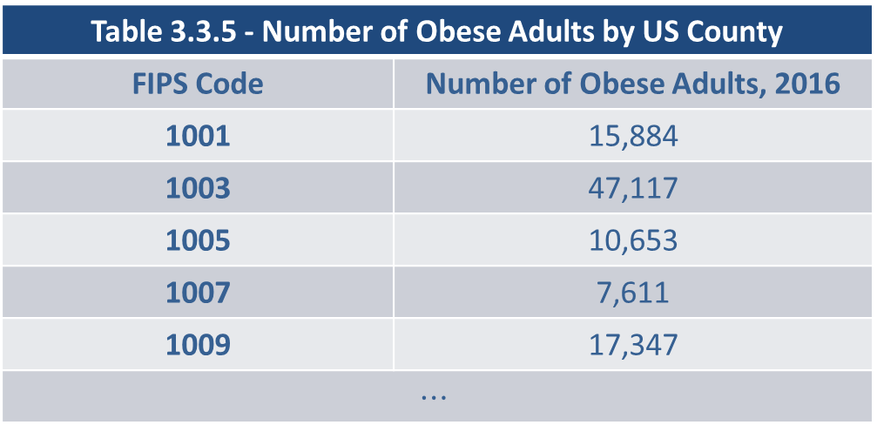
Geospatial Graphs—Cognitive Art (cont.)
Table 3.3.5 - Number of Obese Adults by US County
FIPS Code | Number of Obese Adults, 2016
1001 | 15,884
1003 | 47,117
1005 | 10,653
1007 | 7,611
1009 | 17,347
$$⋯$$
We want to plot this data onto a map of the United States. Each FIPS Code can be used to determine the geographic boundaries of each county, and then we will shade each county region on a map of the U.S. based on the number of adults who are obese in that area.

Slide 66
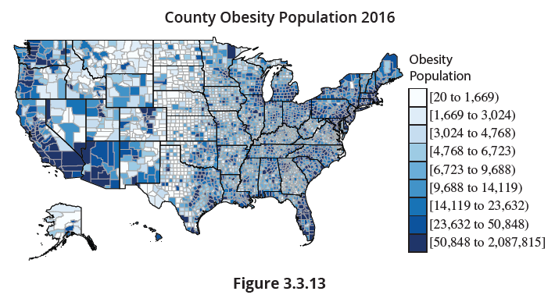
Geospatial Graphs—Cognitive Art (cont.)
A lighter shade will indicate that the number of obese adults is smaller, and a darker shade will indicate that the number is higher.

Slide 67
Geospatial Graphs—Cognitive Art (cont.)
Figure 3.3.13 suggests that the majority of obese adults in the United States reside in the Southwest and Northeast, and that the Midwest and Central Plains areas don’t have very many obese adults at all. By looking at the legend to the right, you can see that there is an extremely wide range from the lowest class to the highest. This is because some counties contain millions of residents, while others contain as few as a couple hundred.

Slide 68
Geospatial Graphs—Cognitive Art (cont.)
So, for many of the rural counties in the center of the country, even if every single person in the county was obese, they still would not compare with, say, Los Angeles County which has a total population of nearly 10 million.
It is inaccurate to rank the counties simply by the total number of obese adults, and doing so will lead to faulty or incomplete conclusions. In order to get a better understanding of how the counties truly compare to one another, we need to normalize the values being graphed.

Slide 69
Geospatial Graphs—Cognitive Art (cont.)
Since our variable of interest in Figure 3.3.14, number of obese adults, is a subset of the total population in each county, we can use the total population in each county to find the percentage in each county that is obese. This can be done by dividing the number of people in a county who are obese by the total county population; however, the US County data set provides the percentages for us. A preview of the updated data set, with the new variable of interest, is shown in Table 3.3.6.

Slide 70
Note
On our companion website, stat.hawkeslearning.com, there is a link to a number of beautiful map visualizations offering several perspectives on the locations of every McDonald’s restaurant in the United States.

Slide 71
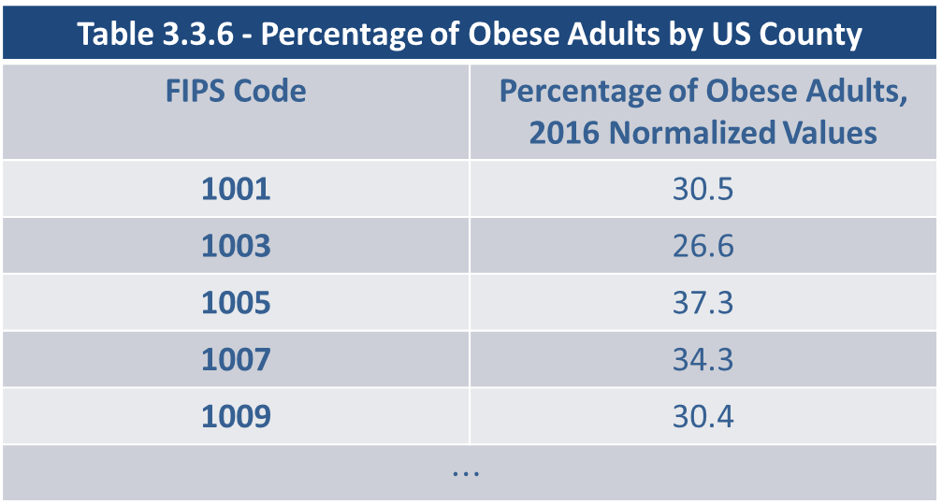
Geospatial Graphs—Cognitive Art (cont.)
Table 3.3.6 - Percentage of Obese Adults by US County
FIPS Code | Percentage of Obese Adults, 2016 Normalized Values
1001 | 30.5
1003 | 26.6
1005 | 37.3
1007 | 34.3
1009 | 30.4
$$⋯$$

Slide 72
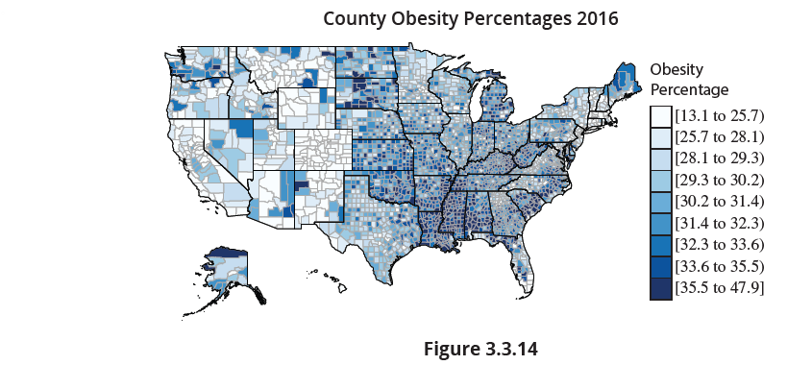
Geospatial Graphs—Cognitive Art (cont.)
Using our new data, we generate the following map.

Slide 73
Geospatial Graphs—Cognitive Art (cont.)
There are over 3000 counties in the U.S. The incredible aspect of these graphs is you can literally see the 3000+ data points and their geographic distribution. If we use Figure 3.3.13 to come to a conclusion about the geographic distribution of obesity in the U.S., we would have assumed that the Southwest and Northeast regions are the areas in the country that struggle with obesity. Comparing Figure 3.3.14 to Figure 3.3.13 produces an entirely new set of conclusions.

Slide 74
Geospatial Graphs—Cognitive Art (cont.)
Once we normalize the obesity variable by making it a ratio of the total county population, Figure 3.3.14 suggests that it is actually the Southeast and the Midwest that have the greatest struggle with obesity. In many instances, the data you start with will need to undergo some form of transformation to make it valuable for your intended purposes or goals.

