Slide 1
Section 3.2
Displaying Qualitative Data Graphically

Slide 2
Displaying Qualitative Data Graphically
Graphical analysis presents a trade-off: although we lose sight of the individual observations (the raw data), it allows us to create a representation of the data distribution that “speaks to the eyes.” The trade is almost always beneficial since a well-designed graph gives our visual processing system the kind of image it processes best, a picture.
Because a set of data can be graphically represented in many different ways, selecting and creating graphical displays requires a certain amount of artistic judgment.

Slide 3
Displaying Qualitative Data Graphically
Several types of graphs and tabular displays will be discussed in this chapter. Bar charts, stacked bar charts, and pie charts are effective, visually appealing methods of graphically displaying qualitative data. A quick look at publications such as Time, USA Today, The Wall Street Journal, Scientific American, and Forbes provides convincing evidence of the frequent and beneficial usage of these data visualization techniques.

Slide 4
Bar Charts
Bar charts are often used to illustrate a frequency distribution for qualitative data.

Slide 5
Definition: Bar Chart
The bar chart is a simple graphical display in which the length of each bar corresponds to the number of observations in a category.

Slide 6
Bar Charts (cont.)
Louis Harris and Associates Inc. conducted a poll of 1250 adults to determine How Americans Grade the School System. There were 24 questions in the original survey, producing a total of 30,000 pieces of data (24 questions for each of 1250 adults). Without some way of summarizing, this data would not produce usable information.
The first question in the survey was: In general, how would you rate the quality of American public schools? The frequency of each response category is shown in Table 3.2.1.

Slide 7
Bar Charts (cont.)
The frequency distribution for the second question involving a lack of parental involvement with a child’s education is given in Table 3.2.2. The summary tables are much more informative than looking at 1250 observations for each question.

Slide 8
Bar Charts (cont.)
Table 3.2.1: Question 1
In general, how would you rate the quality of American public schools?
Responses | Frequency | Relative Frequency
Excellent | 462 | 37%
Pretty good | 288 | 23%
Only fair | 225 | 18%
Poor | 225 | 18%
Not sure | 50 | 4%
Table 3.2.2: Question 2
How serious is a lack of parental involvement with a child’s education?
Responses | Frequency | Relative Frequency
Very serious | 700 | 56%
Somewhat serious | 325 | 26%
Not very serious | 112 | 9%
Not a problem | 75 | 6%
Not sure | 38 | 3%

Slide 9
Bar Charts (cont.)
As one can see in the tables above, the majority of adults who participated in the poll rate the quality of American public schools as ‘Pretty good’ or ‘Excellent’. The poll also reveals that the lack of parental involvement with a child’s education is considered ‘Very serious’ or ‘Somewhat serious’ by 82% of the adults who took the poll. Summarizing qualitative data using a frequency distribution table or a relative frequency distribution table allows the researcher to make conclusions about the data without having to view each observation.

Slide 10
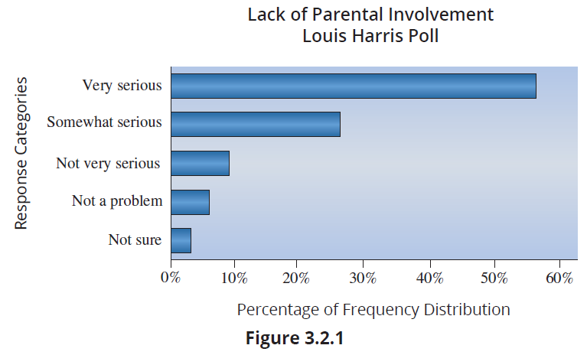
Bar Charts (cont.)
Figure 3.2.1 is a bar chart constructed from the responses to Question 2, shown in Table 3.2.2.

Slide 11
Bar Charts (cont.)
In addition to displaying the distribution of the data, bar charts are valuable as presentation tools and are especially effective at reinforcing differences in magnitudes since they permit the visual comparison of data by displaying the magnitude of each category by a vertical or horizontal bar.

Slide 12
The Aesthetics of Bar Chart Construction
Bar chart construction requires numerous layout decisions such as size, use of color, and label locations. These decisions are frequently made on a trial-and-error basis. However, certain conventions have been developed that improve the quality and effectiveness of the charts. They are presented below as suggestions, not rules. Actually, several of the points are general in nature and would serve as useful guidelines in the construction of any graph.

Slide 13
The Aesthetics of Bar Chart Construction (cont.)
Bar charts can be constructed horizontally or vertically. Customarily, horizontal orientation is used for categories that are descriptively labeled, and vertical (or columnar) orientation is used for categories that are numerical. It is important to remember that this idea is only a suggestion. If you believe that a vertical bar chart is more appealing, use it.

Slide 14
The Aesthetics of Bar Chart Construction (cont.)
If the categories have some associated order, they maintain that order in the bar chart. Otherwise, the categories may be listed alphabetically, in either ascending or descending order, or in some other pattern related to the nature of the data.
Miscellaneous or “other” categories should be listed at the bottom of the chart (if oriented horizontally) or at the far right (if oriented vertically).

Slide 15
The Aesthetics of Bar Chart Construction (cont.)
The difference in bar length is the principal visual feature in comparing category amounts. Consequently, scales for the axes should be chosen that will most effectively allow for the desired comparisons. Unless there is a good reason, the axis used to measure the bars should start at zero. Otherwise, the axis can be stretched to exaggerate differences in the bar lengths. For example, suppose the data in the following table were plotted.

Slide 16
The Aesthetics of Bar Chart Construction (cont.)
Table 3.2.3 - Sales Performance
Salesperson | Total Sales (in thousands of dollars)
Susan | 187
William | 201
Beth | 207
Rob | 193

Slide 17
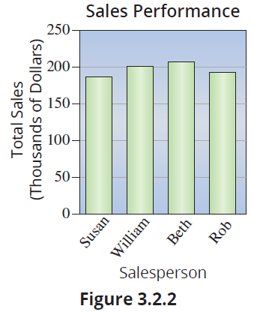
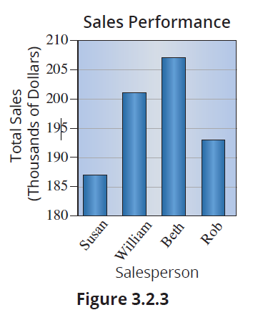
The Aesthetics of Bar Chart Construction (cont.)

Slide 18
The Aesthetics of Bar Chart Construction (cont.)
Figures 3.2.2 and 3.2.3 are plots of the same data (Table 3.2.3). What a difference axis scaling can make on perception! Figure 3.2.3 starts the y-axis at 180 instead of zero. If you want to emphasize similarity, use Figure 3.2.2 to do the job. If you want to emphasize differences, use Figure 3.2.3. However, it is difficult to imagine any legitimate reason for using Figure 3.2.3 to represent the data. Axis stretching is often employed to mislead. When you see an axis that does not start at zero, you should be a bit skeptical as to the conclusions the author intends for you to make.

Slide 19
The Aesthetics of Bar Chart Construction (cont.)
Bar widths should be chosen that are pleasing visually and should not be allowed to vary within a particular chart.
Appropriate shading, crosshatching, and coloring of the bars can help in presenting the data. Many spreadsheet programs incorporate sophisticated graphing programs which make changes in shading, color, and crosshatching patterns extremely easy.

Slide 20
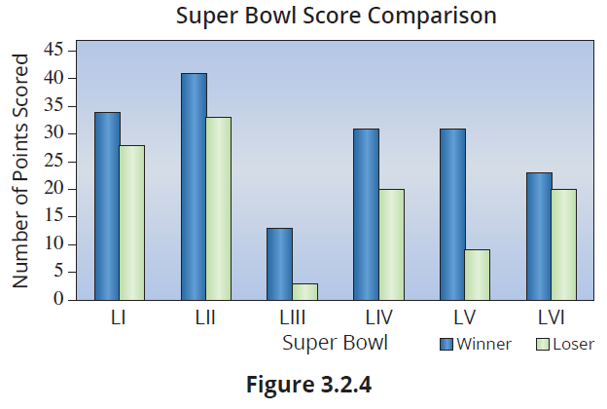
The Aesthetics of Bar Chart Construction (cont.)

Slide 21
The Aesthetics of Bar Chart Construction (cont.)
The spacing between bars can dramatically affect the perception of the graph. Spacing should be set at approximately one‑half the width of a bar. This, however, is not a rigid rule. Artistic judgment is needed.
Gridlines extended into the body of the chart are often useful and may be included if deemed helpful. Study Figure 3.2.5 and Figure 3.2.6. Both bar charts illustrate the same data. Notice that the readability of the graph in Figure 3.2.6 is improved by adding vertical gridlines.

Slide 22
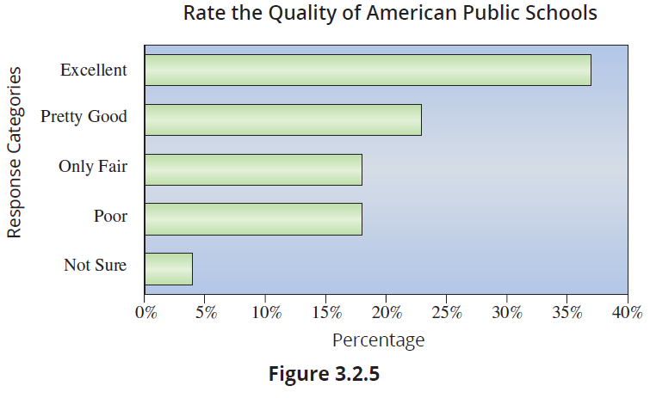
The Aesthetics of Bar Chart Construction (cont.)

Slide 23
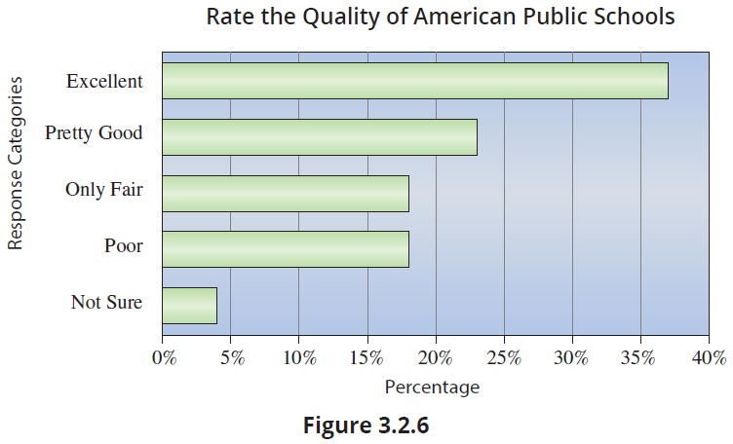
The Aesthetics of Bar Chart Construction (cont.)

Slide 24
The Aesthetics of Bar Chart Construction (cont.)
If there is sufficient room on the graphs, labels should be provided for each bar (category) and for each axis.
Notes on sources of data or other footnotes should be given below the chart.
One of the themes of this chapter is that a graph can be an analytical device and a presentation tool. Simple graphics are fine for certain analytical purposes, but if you are trying to make a point, then a higher standard is required to create visual impact.

Slide 25
The Aesthetics of Bar Chart Construction (cont.)
Designing effective graphics is not just about making things look better; graphics can help the reader comprehend information. Using graphics well can emphasize meaning and organize content.

Slide 26
Pareto Charts
The order in which the categories of a bar chart are displayed does not matter unless you want to create a Pareto chart. Figure 3.2.7 is an example of a Pareto chart for the countries with the highest cinema attendance in 2021.

Slide 27
Definition: Pareto Chart
The Pareto chart is a bar graph whose bars are
arranged in decreasing order of frequency.

Slide 28
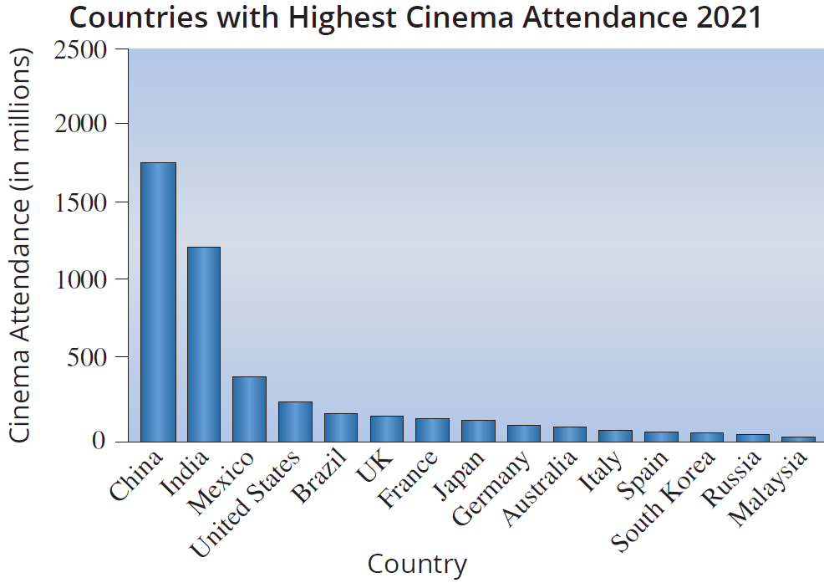

Pareto Chart (cont.)

Slide 29
Pareto Charts (cont.)
Pareto charts play an important role in helping identify and rank potential problem areas or significant sources of variation in a process. Their purpose in Statistical Process Control is to focus problem-solving efforts on the vital few instead of the trivial many.

Slide 30
Stacked Bar Charts
Stacked bar charts are an interesting variation on the standard bar chart. The number of medals (gold, silver, and bronze) won during the 2022 Winter Olympics for selected countries is given in Figure 3.2.8.

Slide 31
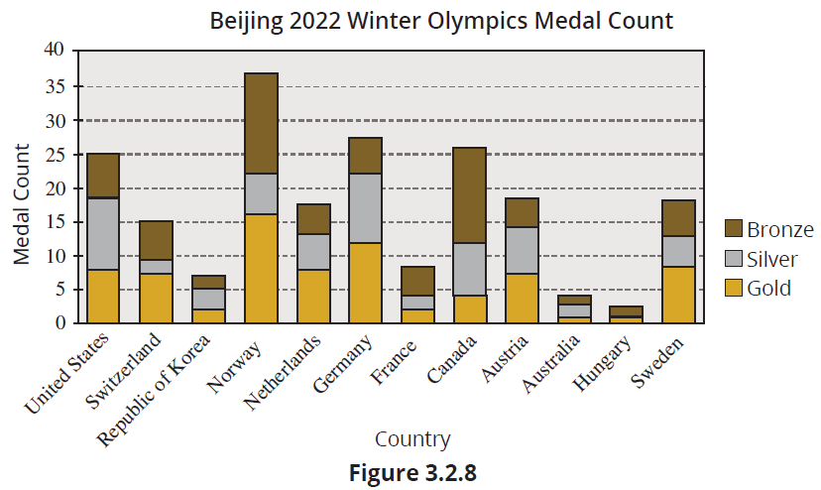
Stacked Bar Charts (cont.)

Slide 32
Note
The data presented in this chart pertaining to the 2022 Olympics is subject to the influence of the COVID-19 pandemic.

Slide 33
Stacked Bar Charts (cont.)
Without the stacked bar chart, the reader would have to view either three different charts tallying medal counts for the 2022 Winter Olympics or a much “busier” chart plotting each medal on the horizontal axis above each country like in Figure 3.2.9.

Slide 34
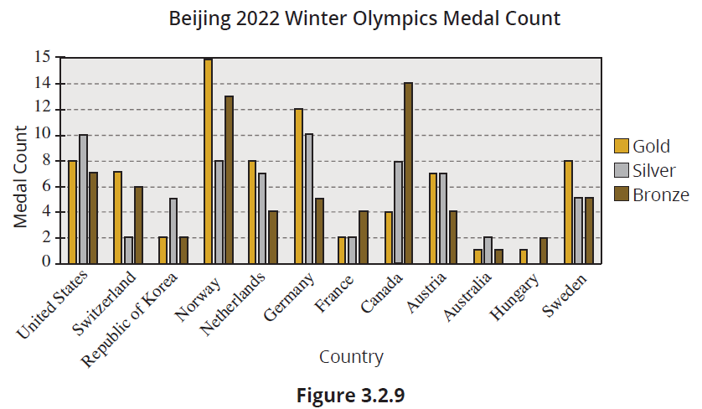
Stacked Bar Charts (cont.)

Slide 35
Pie Charts
We have just explored how bar charts serve as a tool for representing frequency distributions. Similarly, pie charts can also fulfill this purpose, providing an alternative method for visualizing the distribution of data.

Slide 36
Definition: Pie Chart
A pie chart (or circle graph) is a graph used to display categorical data as slices of a circle. The size of each slice is proportional to the amount or frequency in each category. The proportion of the total that each slice represents is often displayed as a percentage on the chart. These percentages should total 100%.

Slide 37
Pie Charts (cont.)
The circle represents the total “pie” available, and the slices are proportional to the amount in each category. One of the advantages of the pie chart is the ability to easily compare the total in each of the classifications to the total number of observations.
One common use of pie charts is to display how some set of assets is spent. One of the biggest asset pies in the world is the budget of the United States government. In 2023, government outlays were in the neighborhood of 6.4 trillion dollars.

Slide 38
Pie Charts (cont.)
If the budget is split into seven categories, the percentages spent in 2023 in each category are provided in Table 3.2.4. While the table provides the information, it is not visually interesting. A pie chart will enable you to improve the presentation of the information in the following table (Table 3.2.4).

Slide 39
Pie Charts (cont.)
Table 3.2.4 - Percentage Spent by the Federal Government in 2023
Category | Percentage Spent
Defense | 12.6%
Non-defense | 14.7%
Social Security | 21.1%
Medicare | 12.9%
Medicaid | 9.5%
Other Programs | 18.8%
Net Interest | 10.4%

Slide 40
Pie Charts (cont.)
The graphical displays in Figure 3.2.10 tell an interesting story about how our tax dollars are spent. The Pareto chart orders the spending categories from greatest to least. In a glance at the pie chart, your eyes are drawn to two of the biggest slices, a 21.1% slice going to Social Security and a 18.8% slice going to Other Programs. If you would like to look at current information on how government monies are spent, go explore the Office of Management and Budget on the White House website.

Slide 41
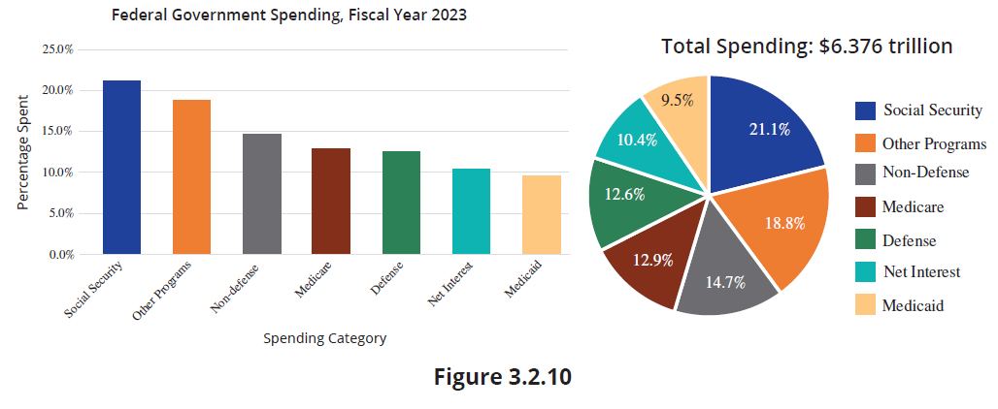
Pie Charts (cont.)

Slide 42
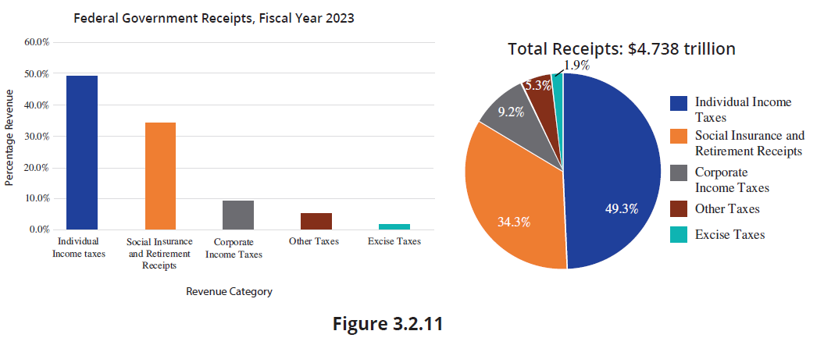
Pie Charts (cont.)

Slide 43
Pie Chart (cont.)
A pie chart showing where government revenues originate is given in Figure 3.2.11. In order to determine from the pie chart how much was received in a particular category, multiply the total amount by the percentage given for that category in the pie chart. For example, to find the amount of government receipts contributed by individual income taxes, multiply the total amount of government receipts ($4.738 trillion) by the percentage contributed by individual income taxes (49.3%).

Slide 44
Pie Chart (cont.)
This means that 4.738∙0.493 = $2.3358 trillion of all government receipts come from individual income taxes.
Although pie charts are useful displays of categorical data, they have their limitations. Once the number of categories rises above ten, the information conveyed by a pie chart is less meaningful. As Figure 3.2.12 and Figure 3.2.13 demonstrate, when the number of employees increases from 5 to 40, using a pie chart to show the percentage of sales for each employee is not as informative.

Slide 45
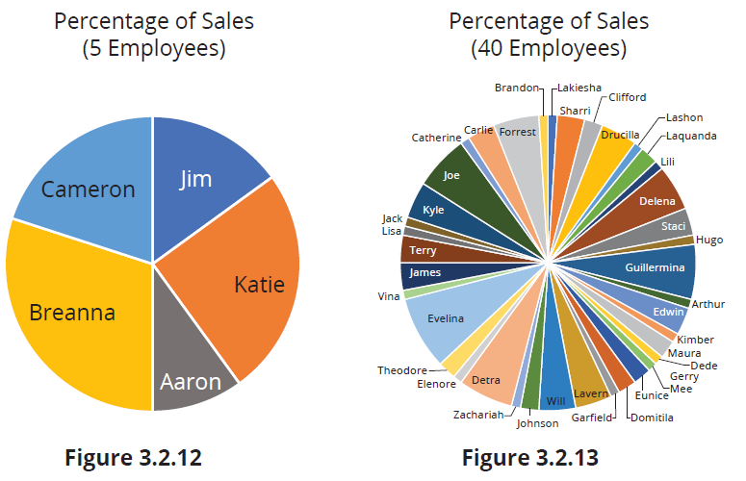
Pie Chart (cont.)

