Slide 1
Section 3.1
Frequency Distributions

Slide 2
Frequency Distributions
Variation lies at the core of statistical analysis. Over the last few hundred years, statisticians have created a set of methods to explore, characterize, and comprehend the nature of variation. Chapters 3 and 4 focus on the development of graphical and numerical methods to investigate, describe, and quantify variation. Building upon this, chapters 6, 7, 8, and 9 delve deeper into modeling variation using probability distributions, enabling a more precise description of the variability present within a variable.

Slide 3
Frequency Distributions (cont.)
Chapters 5, 13, 14, 15, and 16 are dedicated to the development of statistical models that are designed to explain and interpret the observed variations.
This chapter is about organizing and describing variation with tables and data visualization methods. A primary responsibility of a data analyst is to comprehend the underlying patterns, regularities, and structure that may exist within the data set. To examine structural characteristics, ask questions such as,
Where are most of the observations located?

Slide 4
Frequency Distributions (cont.)
Does the data cluster around one central point or are there several points that data seems to cluster around?
Does the data seem to be uniformly spread out over some interval or bunched in some range?
These questions all relate to the concept of “distribution.” A distribution is a representation of the way data is spread out or dispersed. It shows the frequency or likelihood of various values occurring in a data set.

Slide 5
Frequency Distributions (cont.)
By observing the distribution of a data set, data analysts can uncover the data’s structure, make comparisons, and draw conclusions about variation. The word distribution will be used often in this textbook and by your instructor. It is really important that you intuitively understand this idea.

Slide 6
Definition: Distribution
A distribution shows the frequency or likelihood of various values occurring in a data set.

Slide 7
Frequency Distributions (cont.)
One way of thinking about distribution is to consider the ‘shape’ or ‘structure’ of the data. How can data have shape? Data must be refined before we can observe its shape. The first step in the refinement process is often creating a frequency distribution. The purpose of a frequency distribution is to compress a set of data into a meaningful summary form. This summary form is one expression of the data.

Slide 8
Frequency Distributions (cont.)
When the data is organized into groups (sometimes called ‘bins’ or ‘classes’) and the frequency of each group is counted and presented in a table, it is called a frequency distribution. We can view the frequency of observations within each class to better understand the distribution (structure) of the data.

Slide 9
Definition: Frequency Distribution
A frequency distribution is a summary technique that organizes data into classes and provides in tabular form a list of the classes along with the number of observations in each class.

Slide 10
Frequency Distributions (cont.)
Let’s begin by organizing nearly 330 million data points into a frequency distribution. At the start of each decade, the United States government invests considerable resources into obtaining a count of every person living in the country. Additional demographic information such as marital status, household composition, race/ethnicity, income, and education is also obtained through this effort. As you could imagine, this activity results in an enormous amount of data.

Slide 11
Frequency Distributions (cont.)
Determining the age distribution of the US population has been a key aspect of the census since its inception in 1790. This distribution provides valuable information about the different age groups of US residents, presenting a clear and structured picture of the data. It would be impossible to gather these insights by looking at individual data points.
To develop the distribution of ages of the members of the US population in 2020, the census bureau created age classes [0-4, 5-9, 10-14, 15-19, … 80-84, 85+].

Slide 12
Frequency Distributions (cont.)
Once the classes were created, the census bureau computers counted how many persons in the census fell into each class.
Table 3.1.1 - Frequency Distribution of US Population Ages from the 2020 Census
Age Group | Population
0-4 | 19,650,192
5-9 | 19,979,039
10-14 | 21,107,910
15-19 | 21,174,955
20-24 | 21,820,378
25-29 | 23,262,155
30-34 | 22,223,010
35-39 | 21,346,055

Slide 13
Frequency Distributions (cont.)
Table 3.1.1 - Frequency Distribution of US Population Ages from the 2020 Census (cont.)
Age Group | Population
40-44 | 20,000,622
45-49 | 20,569,969
50-54 | 20,970,767
55-59 | 21,785,721
60-64 | 20,315,718
65-69 | 17,301,772
70-74 | 13,246,178
75-79 | 9,113,714
80-84 | 6,079,337
85+ | 6,621,816

Slide 14
Frequency Distributions (cont.)
When the data is organized into a frequency distribution, you begin to see the shape of the data. The population rises in each category up to the 25-29 age group and then begins to fall. There are about as many 0 to 4 year-olds as there are 55 to 59 year-olds. Also, the distribution illustrates one of the profound stories of the human experience: there is an impermanence to existence that should remind us to appreciate the present and the opportunities that life provides.

Slide 15
Frequency Distributions (cont.)
This distribution also reveals other stories and raises questions about population characteristics, socioeconomic factors, and the future implications of the age distribution in the U.S. For example:
How does the age distribution in 2020 compare to previous years or decades? Are there any noticeable trends, such as an aging population or a growing youth demographic?

Slide 16
Frequency Distributions (cont.)
What are the implications of the age distribution for social security, healthcare, and other public services? Will there be enough resources to support an aging population?
Frequency distributions are just one statistical method that policymakers can use to describe the shape of the distribution of ages in the U.S. We will explore other methods later in this chapter and in Chapter 4.

Slide 17
Constructing a Frequency Distribution
Frequency distributions are rather easy to create. There are three steps in the construction of a frequency distribution.

Slide 18
Procedure: Constructing a Frequency Distribution
Choose the classifications.
Count the number in each class.
Create a table putting the classifications in one column and the associated counts for that class in the other column.

Slide 19
Constructing a Frequency Distribution (cont.)
There are slight differences in creating categories for qualitative and quantitative data. For data that’s quantitative, like weights, heights, or volumes, deciding on the best way to categorize the data isn’t always clear. You’ll often divide the full range of these measurements into equal-sized categories (sometimes called bins or classes). The exceptions might be the first and last categories, which can sometimes be different. The most important decision you’ll make when organizing your data into a frequency distribution is how many categories or bins you should use.

Slide 20
Constructing a Frequency Distribution (cont.)
When dealing with qualitative data that naturally falls into distinct categories, such as book genres, pizza toppings, or occupations, choosing these categories becomes significantly simpler. It is often the case that each unique value of the qualitative variable is its own category.
Whether you’re dealing with qualitative or quantitative data, there are two key rules you should remember when setting up your categories.

Slide 21
Constructing a Frequency Distribution (cont.)
First, the categories need to be mutually exclusive, meaning they should not overlap. Second, they should be exhaustive, covering all possible data values.

Slide 22
Qualitative Frequency Distributions
To construct a qualitative frequency distribution, choose the categories to classify the data. In many instances, the problem at hand will suggest the classification scheme. If we are classifying students by class level, then we have four classes: freshmen, sophomores, juniors, and seniors. For qualitative data, it would be unusual if a reasonable set of categories is not relatively obvious.
After the categories have been chosen, count the items belonging to each class in order to construct the frequency distribution.

Slide 23
Example 3.1.1: Creating a Frequency Distribution of Survey Results
Consider an example of a frequency distribution using ordinal data from a survey which asked customers to rate their satisfaction levels with a certain product on a scale of 1 to 5, where 1 represents “Very Dissatisfied” and 5 represents “Very Satisfied.” When the survey was conducted in July, there were 20 responses:
3, 2, 3, 4, 2, 3, 5, 3, 2, 4, 4, 3, 3, 4, 2, 4, 5, 3, 4, 2
For nominal or ordinal data with only a few different values, it is common to make each unique data value its own class (category).

Slide 24
Example 3.1.1: Creating a Frequency Distribution of Survey Results (cont.)
It is difficult to gain insight from the raw data even in a small sample like this one. By examining the frequency distribution, we can quickly gain an understanding of the overall performance of the product from the users’ perspectives.
Write several sentences that summarize information about the customer satisfaction that can be observed in the frequency distribution.

Slide 25
Example 3.1.1: Creating a Frequency Distribution of Survey Results (cont.)
July Customer Satisfaction Survey
Response | Frequency
1—Very Dissatisfied | 0
2—Somewhat Dissatisfied | 5
3—Neutral | 7
4—Somewhat Satisfied | 6
5—Very Satisfied | 2
Solution
Regrettably, the most common satisfaction level is 3 with a frequency of 7 respondents.

Slide 26
Example 3.1.1: Creating a Frequency Distribution of Survey Results (cont.)
If your company is producing this product, you are not happy about the fact that 12 of the 20 persons interviewed are less than “somewhat satisfied” about the utility of your product. If the product is to have long-term success, the company needs to research the causes of dissatisfaction and improve the product. Fortunately, if we combine the categories ‘Somewhat Satisfied’ and ‘Very Satisfied’ there are 8 respondents who favorably rated their experience. So, the product may generate sufficient revenue to enable the company to do the needed research and product improvements.

Slide 27
Quantitative Frequency Distributions
The construction of a frequency distribution for quantitative data requires making decisions regarding the classification or grouping of the data. Why did the census bureau select 18 categories to display the frequency distribution? Could they have selected 16 or 20 or 25? In the case of the population age data these intervals have been used to create age distributions for quite some time and using the same intervals enable comparison from census to census.

Slide 28
Quantitative Frequency Distributions (cont.)
Generally, too few intervals in a frequency distribution can oversimplify the data, potentially obscuring important patterns or details, and too many intervals can obscure broad trends and patterns. Determining the appropriate number of classifications for a frequency distribution is subjective and involves a certain level of judgment. Researchers may choose different classifications schemes based on their individual preferences and considerations.
A data set containing the heart rates of 50 students is given below.

Slide 29
Quantitative Frequency Distributions (cont.)
However, looking at the individual data is not very revealing. Even with only 50 observations, there are just too many data values to comprehend the overall characteristics of the measurements.
Let’s examine the process of creating a quantitative frequency distribution manually.
Table 3.1.2 - Heart Rates (beats per minute)
77 | 84 | 79 | 90 | 67 | 84 | 82 | 74 | 88 | 75
69 | 81 | 94 | 68 | 65 | 86 | 78 | 79 | 79 | 70
83 | 83 | 84 | 82 | 93 | 80 | 81 | 80 | 87 | 80
62 | 98 | 77 | 83 | 82 | 80 | 82 | 73 | 85 | 77
77 | 79 | 81 | 70 | 72 | 85 | 84 | 80 | 74 | 83

Slide 30
Procedure: Constructing a Frequency Distribution
Determine how many classes should be in the distribution. Choosing the number of classes is arbitrary and should depend on the amount of data available. The more data available, the more classes that can be used. Generally, fewer than four classes would be too much compression of the data, and greater than 20 classes provides too little summary information.

Slide 31
Procedure: Constructing a Frequency Distribution (cont.)
Determine the class width. In some cases, the data set easily lends itself to natural divisions, such as decades or years. At other times, we must choose divisions for ourselves. You will want to choose a class width so that the classes formed present a clear representation of the data and include all values in the data set. The width of each class should be the same whenever possible; exceptions may occur for the beginning and ending intervals.

Slide 32
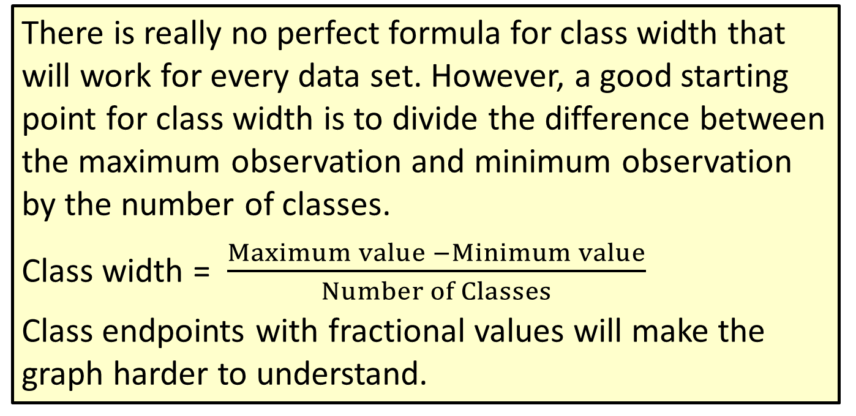
Procedure: Constructing a Frequency Distribution (cont.)
There is really no perfect formula for class width that will work for every data set. However, a good starting point for class width is to divide the difference between the maximum observation and minimum observation by the number of classes.
Class width = $\frac{Maximum value −Minimum value}{Number of Classes}$
Class endpoints with fractional values will make the graph harder to understand.

Slide 33
Procedure: Constructing a Frequency Distribution (cont.)
If possible, try to keep the width to an integer value by rounding the class width up to the next largest integer or choosing an integer value close to the calculated class width that makes sense.
Find the class limits. The lower class limit is the smallest number that can belong to a particular class, and the upper class limit is the largest number that can belong to a class. Using the minimum data value, or a smaller number, as the lower limit of the first class is a good place to start.

Slide 34
Procedure: Constructing a Frequency Distribution (cont.)
However, judgment is required. You should choose the first lower limit so that reasonable classes will be produced. After choosing the lower limit of the first class, add the class width to it to find the lower limit of the second class. Continue until you have the desired number of lower class limits. The upper limit of each class is determined such that the classes do not overlap. Once you create your classes, if there are any data values that fall outside the class limits, you must adjust either the class width or your choice for the first lower class limit.

Slide 35
Procedure: Constructing a Frequency Distribution (cont.)
To find a class midpoint, add the lower and upper limits of the class and divide by 2.
Determine the frequency of each class. If you are creating the frequency distribution manually, make a tally mark for each data value in the appropriate class. Count the marks to find the total frequency for each class. Summing the frequencies in each class together should equal the total number of observations in the data.

Slide 36
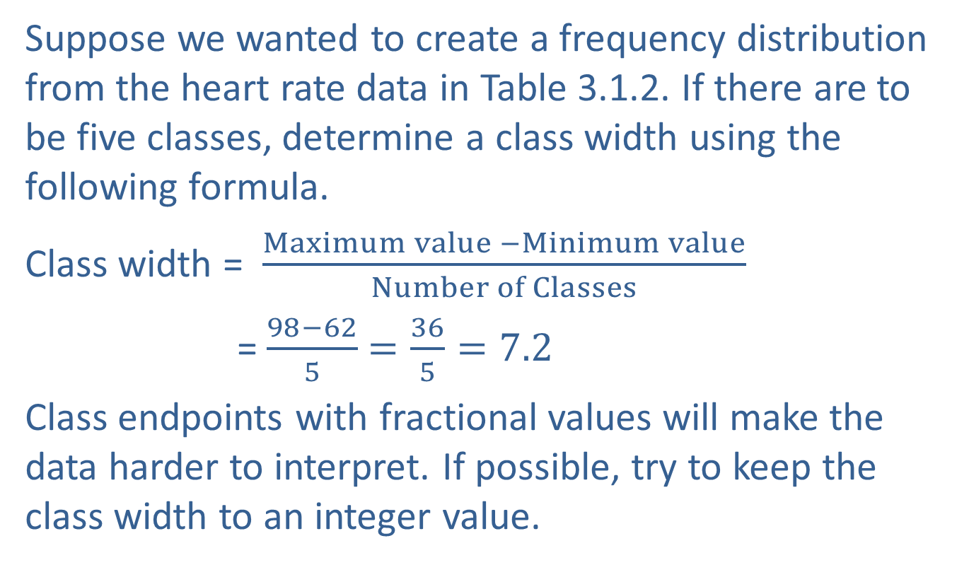
Quantitative Frequency Distributions (cont.)
Suppose we wanted to create a frequency distribution from the heart rate data in Table 3.1.2. If there are to be five classes, determine a class width using the following formula.
Class width = $\frac{Maximum value −Minimum value}{Number of Classes}$
= $\frac{98−62}{5}$ $=\frac{36}{5}=7.2$
Class endpoints with fractional values will make the data harder to interpret. If possible, try to keep the class width to an integer value.

Slide 37
Quantitative Frequency Distributions (cont.)
If the calculated class width is 7.2, you might try a class width in the range of 8 to 10. An interval width of 10 is used throughout the heart rate example, but 10 is an arbitrary choice. Once the frequency distribution is created and if you feel that 10 was not the right choice for the interval width, try another width.
Generally, class widths should be equal. To form the first interval, take the smallest value in the data and use that value or round it down to an appropriate value. The exact value selected is arbitrary.

Slide 38
Quantitative Frequency Distributions (cont.)
In the example, we have selected the starting point of the first class as 57. However, 55, 58, or 60 could just as easily have been used, since the smallest data value is 62. If 57 is selected as the beginning point for the first interval, then the first class will span the interval 57 to 66. Adding the class width to the lower class limit creates the next interval. So, our classes are 57–66, 67–76, 77–86, 87–96, and 97–106. Now tally the data in each interval and you have the frequency distribution in Table 3.1.3.

Slide 39
Quantitative Frequency Distributions (cont.)
With the frequency distribution, we are able to see the broader structure of the data. It is now easy to see that the overwhelming majority of heart rates are between 77 and 86 beats per minute.
Table 3.1.3 - Frequency Distribution of Heart Rates
Heart Rate | Number of Students
57–66 | 2
67–76 | 10
77–86 | 32
87–96 | 5
97–106 | 1

Slide 40
Quantitative Frequency Distributions (cont.)
Further, heart rates above 96 and below 67 are uncommon. These conclusions would be considerably more difficult to establish without the organization that the frequency distribution provides.
The frequency distribution given in Table 3.1.3 is just one way of organizing the data. There are three other distributions that can be calculated from the frequency distribution: relative frequency, cumulative frequency, and cumulative relative frequency. Each gives a slightly different perspective on the data.

Slide 41
Relative Frequency Distribution
A relative frequency distribution is a table that shows the proportion of the total observations in each category or class. It is calculated by dividing the frequency of each category or class by the total number of observations. Relative frequency is a normalizing technique. Consequently, relative frequency distributions are useful for comparing data sets with different numbers of observations.

Slide 42
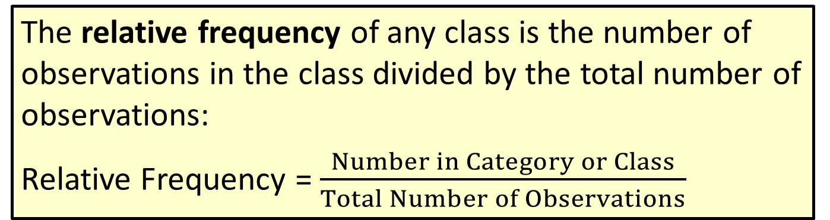
Definition: Relative Frequency
The relative frequency of any class is the number of observations in the class divided by the total number of observations:
Relative Frequency = $\frac{Number in Category or Class}{Total Number of Observations}$

Slide 43
Relative Frequency Distribution (cont.)
What percentage of students have a heart rate between 77 and 86 beats per minute? To answer this question, we can determine the relative frequency for that particular class. Table 3.1.4 shows the relative frequencies for every class of the heart rate data.

Slide 44
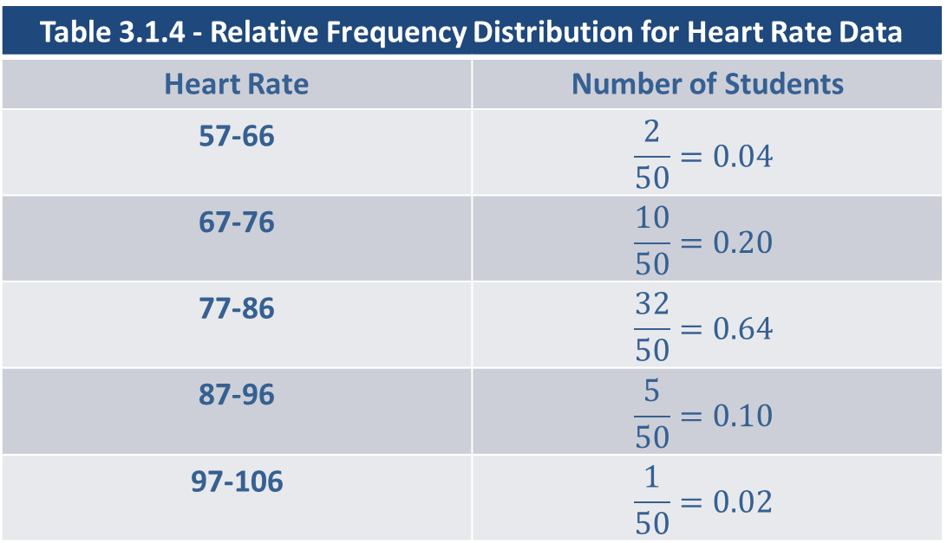
Relative Frequency Distribution (cont.)
Table 3.1.4 - Relative Frequency Distribution for Heart Rate Data
Heart Rate | Number of Students
57-66 | $$\frac{2}{50}=0.04$$
67-76 | $$\frac{10}{50}=0.20$$
77-86 | $$\frac{32}{50}=0.64$$
87-96 | $$\frac{5}{50}=0.10$$
97-106 | $$\frac{1}{50}=0.02$$
Using Table 3.1.4 it is easy to see that 64% of the observed heart rates are between 77 and 86 beats per minute.

Slide 45
Example 3.1.2: Creating a Relative Frequency Distribution of Survey Results
Returning to the data from the customer satisfaction survey from Example 3.1.1, determine the relative frequency for each response.
Solution
Noting that there were 20 responses in July, we can add a column to the table from Example 3.1.1 for the relative frequency as follows.

Slide 46
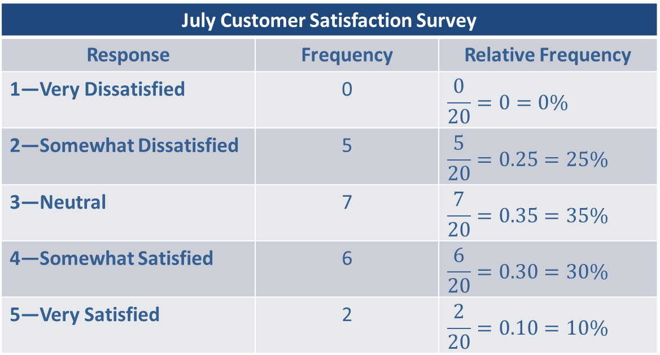
Example 3.1.2: Creating a Relative Frequency Distribution of Survey Results (cont.)
July Customer Satisfaction Survey
Response | Frequency | Relative Frequency
1—Very Dissatisfied | 0 | $$\frac{0}{20}=0=0\%$$
2—Somewhat Dissatisfied | 5 | $$\frac{5}{20}=0.25=25\%$$
3—Neutral | 7 | $$\frac{7}{20}=0.35=35\%$$
4—Somewhat Satisfied | 6 | $$\frac{6}{20}=0.30=30\%$$
5—Very Satisfied | 2 | $$\frac{2}{20}=0.10=10\%$$

Slide 47
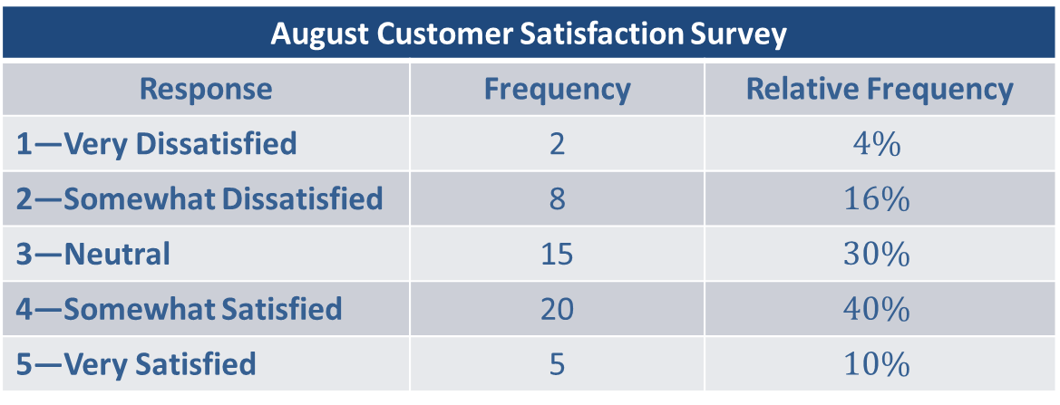
Example 3.1.2: Creating a Relative Frequency Distribution of Survey Results (cont.)
Suppose the satisfaction survey is repeated for the customers in the next month. The product manufacturer has made some small improvements and wants to measure the impact. The August survey had 50 responses which are summarized in the table below.
August Customer Satisfaction Survey
Response | Frequency | Relative Frequency
1—Very Dissatisfied | 2 | $$4\%$$
2—Somewhat Dissatisfied | 8 | $$16\%$$
3—Neutral | 15 | $$30\%$$
4—Somewhat Satisfied | 20 | $$40\%$$
5—Very Satisfied | 5 | $$10\%$$

Slide 48
Example 3.1.2: Creating a Relative Frequency Distribution of Survey Results (cont.)
Despite the different sample sizes between the two surveys, the relative frequencies normalize the frequencies which enables comparison of the two distributions. For example, the number of customers who were Somewhat Dissatisfied in August was greater than those in that category in July. However, due to the differing number of responses, the percentage of customers who were Somewhat Dissatisfied in August was less than in July.

Slide 49
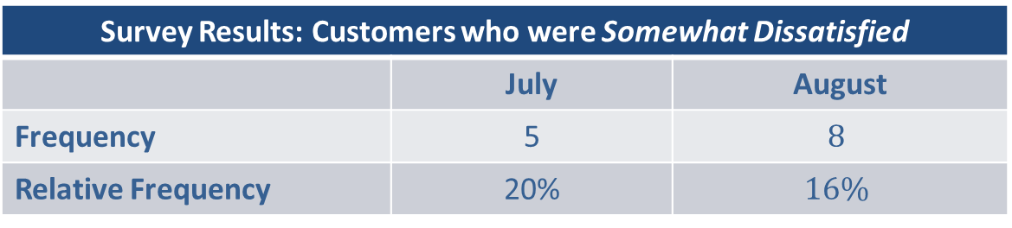
Example 3.1.2: Creating a Relative Frequency Distribution of Survey Results (cont.)
Survey Results: Customers who were Somewhat Dissatisfied
 | July | August
Frequency | 5 | $$8$$
Relative Frequency | 20% | $$16\%$$

Slide 50
Cumulative Frequency Distribution
The cumulative frequency distribution gives the reader an opportunity to look at any category or class and determine immediately the number of observations that belong to a particular category and all categories below it.

Slide 51
Definition: Cumulative Frequency
The cumulative frequency is the sum of the frequency of a particular class and all preceding classes.

Slide 52
Cumulative Frequency Distribution (cont.)
In order to calculate the cumulative frequency distribution, the variable must possess a natural ordering which is the case for ratio, interval, and ordinal levels of measurements (See Section 2.2). Consequently, a nominal variable cannot be described using a cumulative frequency distribution.

Slide 53
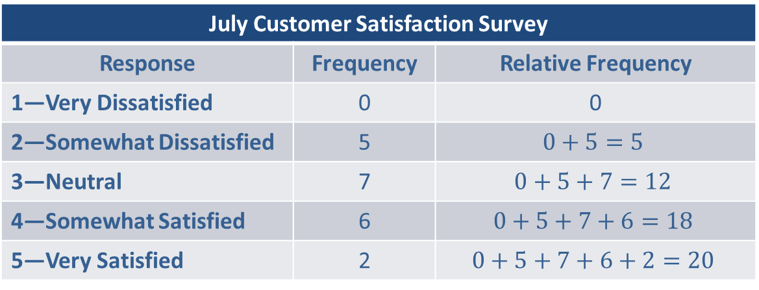
Example 3.1.3: Creating a Cumulative Frequency Distribution of Survey Results
Determine the cumulative frequency distribution for the July customer satisfaction survey data shown in Example 3.1.1.
Solution
July Customer Satisfaction Survey
Response | Frequency | Relative Frequency
1—Very Dissatisfied | 0 | 0
2—Somewhat Dissatisfied | 5 | $$0+5=5$$
3—Neutral | 7 | $$0+5+7=12$$
4—Somewhat Satisfied | 6 | $$0+5+7+6=18$$
5—Very Satisfied | 2 | $$0+5+7+6+2=20$$

Slide 54
Example 3.1.4: Creating a Cumulative Frequency Distribution for the Heart Rate Data
Determine the cumulative frequency distribution for the heart rate data discussed earlier in this section.
Solution
Heart Rate Cumulative Frequency Distribution
Heart Rate | Frequency | Cumulative Frequency
57-66 | 2 | 2
67-76 | 10 | 12
77-86 | 32 | 44
87-96 | 5 | 49
97-106 | 1 | 50

Slide 55
Example 3.1.4: Creating a Cumulative Frequency Distribution for the Heart Rate Data (cont.)
In this example, the reader can easily see that 49 out of 50 heart rates are less than or equal to 96 beats per minute.

Slide 56
Cumulative Relative Frequency
To obtain the cumulative relative frequency for data arranged in ascending order, add the relative frequencies of all preceding classes to the relative frequency of the current class. It is also possible to determine the cumulative relative frequencies by dividing each of the cumulative frequencies by the total number of observations.

Slide 57
Definition: Cumulative Relative Frequency
The cumulative relative frequency is the sum of the frequency of a particular class and all preceding classes.

Slide 58
Cumulative Relative Frequency (cont.)
The cumulative relative frequency values range from 0 to 1 (0% to 100%) with the value for the highest category or class of a frequency distribution equaling 100%.

Slide 59
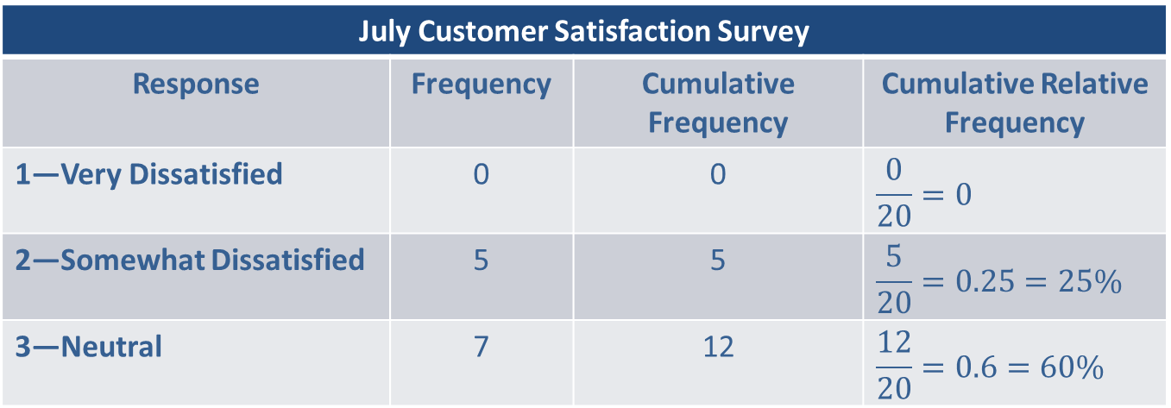
Example 3.1.5: Creating a Cumulative Relative Frequency Distribution of Survey Results
Determine the cumulative relative frequency for the July customer satisfaction survey data from Example 3.1.1.
July Customer Satisfaction Survey
Response | Frequency | Cumulative Frequency | Cumulative Relative Frequency
1—Very Dissatisfied | 0 | 0 | $$\frac{0}{20}=0$$
2—Somewhat Dissatisfied | 5 | 5 | $$\frac{5}{20}=0.25=25\%$$
3—Neutral | 7 | 12 | $$\frac{12}{20}=0.6=60\%$$

Slide 60
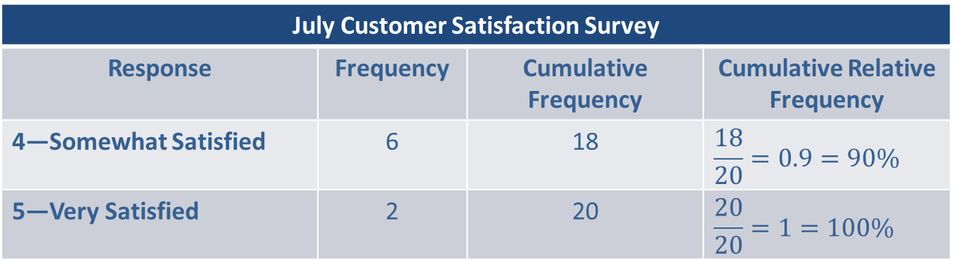
Example 3.1.5: Creating a Cumulative Relative Frequency Distribution of Survey Results
From the cumulative relative frequency distribution it is apparent that 60% of customers from the July survey do not have a favorable opinion of the product.
July Customer Satisfaction Survey
Response | Frequency | Cumulative Frequency | Cumulative Relative Frequency
4—Somewhat Satisfied | 6 | 18 | $$\frac{18}{20}=0.9=90\%$$
5—Very Satisfied | 2 | 20 | $$\frac{20}{20}=1=100\%$$

Slide 61
Example 3.1.6: Creating a Cumulative Relative Frequency Distribution for the Heart Rate Data
Determine the cumulative relative frequency distribution for the heart rate data.
Solution
Heart Rate Cumulative Relative Frequency
Heart Rate | Relative Frequency | Cumulative Relative Frequency
57-66 | 0.04 | 0.04
67-76 | 0.20 | 0.24
77-86 | 0.64 | 0.88
87-96 | 0.10 | 0.98
97-106 | 0.02 | 1.00

Slide 62
Example 3.1.6: Creating a Cumulative Relative Frequency Distribution for the Heart Rate Data (cont.)
From the cumulative relative frequency distribution it is easy to see that 88% of the students had heart rates less than or equal to 86 beats per minute.

