Slide 1
Section 2.5
Time Series Data versus
Cross-Sectional Data

Slide 2
Time Series Data
Time series data refers to a specific type of data that is collected and recorded over a sequence of regularly spaced time intervals (hourly, weekly, monthly, yearly, etc.) in chronological order. In a time series data set, each observation is associated with a timestamp, representing when the data point was collected. Time series data allows us to study how variables change over time and uncover underlying patterns and trends. By analyzing time series data, we can gain insights about historical behavior and make predictions about the future.

Slide 3
Definition: Time Series
Time series data originates as measurements usually taken from some process over equally spaced intervals of time.

Slide 4
Time Series Data (cont.)
Recall from Chapter 1 that the science of statistics is divided into two categories: descriptive statistics and inferential statistics. Fundamental to the concept of statistical inference is the notion of population—the total collection of measurements. Because time series measurements are taken over time, the concept of a population gets a little blurry. Suppose we want to examine the divorce rate in the United States since 1895. What is the population we are studying?

Slide 5
Time Series Data (cont.)
Presumably the members of the population under study would be the residents of the United States. But in 1895 there were only about 65 million people in this country. Now there are over 332 million. In order to compare the years, we need to normalize the data. In this case, the data is normalized by providing the number of divorces per 1000 population. Defining a population for a time series is challenging unless we agree to define the time series data itself as the population.

Slide 6
Time Series Data (cont.)
As we proceed in our study of statistical methods for time series data, we’ll be focusing on techniques for visualizing data and making predictions.
Table 2.5.1 - Divorce Rate in the U.S. 1900–2021 (per 1000 Total Population)
Year | Divorce Rate | Year | Divorce Rate | Year | Divorce Rate
1900 | 0.7 | 1980 | 5.2 | 2008 | 3.5
1905 | 0.8 | 1985 | 5.0 | 2009 | 3.5
1910 | 0.9 | 1990 | 4.7 | 2010 | 3.6
1915 | 1.0 | 1995 | 4.4 | 2011 | 3.6
1920 | 1.6 | 1996 | 4.3 | 2012 | 3.4
1925 | 1.5 | 1997 | 4.3 | 2013 | 3.3

Slide 7
Time Series Data (cont.)
Table 2.5.1 - Divorce Rate in the U.S. 1900–2021 (per 1000 Total Population) (cont.)
Year | Divorce Rate | Year | Divorce Rate | Year | Divorce Rate
1930 | 1.6 | 1998 | 4.2 | 2014 | 3.2
1935 | 1.7 | 1999 | 4.1 | 2015 | 3.1
1940 | 2.0 | 2000 | 4.0 | 2016 | 3.0
1945 | 3.5 | 2001 | 4.0 | 2017 | 2.9
1950 | 2.6 | 2002 | 3.9 | 2018 | 2.9
1955 | 2.3 | 2003 | 3.8 | 2019 | 2.7
1960 | 2.2 | 2004 | 3.7 | 2020 | 2.3
1965 | 2.5 | 2005 | 3.6 | 2021 | 2.5
1970 | 3.5 | 2006 | 3.7
1975 | 4.8 | 2007 | 3.6

Slide 8
Stationary and Nonstationary Processes
Time series data originates from processes. Processes can be divided into two categories: stationary and nonstationary. All time series that are interesting vary, and the nature of the variability determines how the process is characterized. In a stationary process, the time series varies around some central value and has approximately the same variation over the series. In a nonstationary process, the time series possesses a trend—the tendency for the series to either increase or decrease over time.

Slide 9
Definition: Stationary process
A stationary process refers to time series data whose central value and variation patterns remain constant over the series.

Slide 10
Definition: Nonstationary process
A nonstationary process refers to time series data that possesses time-varying behavior.

Slide 11
Example 2.5.1: Identifying Batting Average as Stationary or Nonstationary
A batting average represents the percentage of the time a player gets on base as a result of a hit. In major league baseball the better players have batting averages between .300 and .400, which means they get on base as a result of a hit between 30% and 40% of the time. The following table is a list of the batting average champions of the American League since 1970. Plot the time series and determine if the series is stationary or nonstationary.

Slide 12
Example 2.5.1: Identifying Batting Average as Stationary or Nonstationary (cont.)
Solution
Glancing at a plot of the data suggests the conditions for stationary seem to be met. The time series seems to be wobbling around a central value and the dispersion around the central value is reasonably constant throughout the series. Thus, the series appears to be stationary.

Slide 13
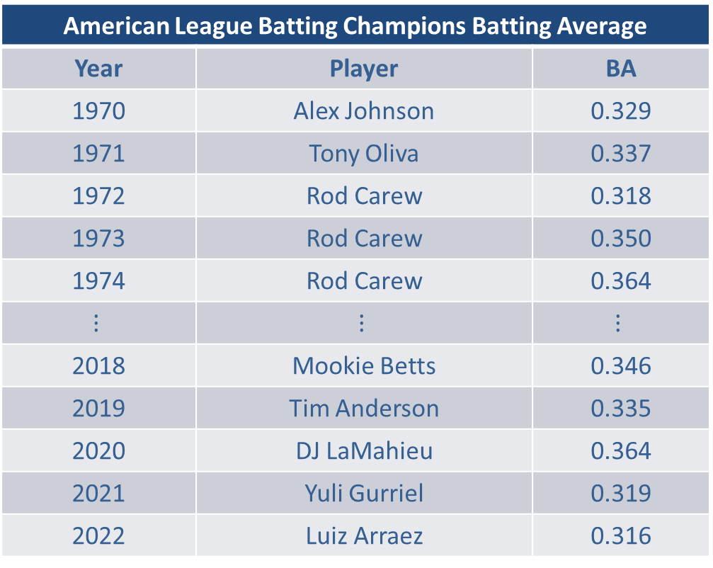
Example 2.5.1: Identifying Batting Average as Stationary or Nonstationary (cont.)
American League Batting Champions Batting Average
Year | Player | BA
1970 | Alex Johnson | 0.329
1971 | Tony Oliva | 0.337
1972 | Rod Carew | 0.318
1973 | Rod Carew | 0.350
1974 | Rod Carew | 0.364
$$⋮$$ | $$⋮$$ | $$⋮$$
2018 | Mookie Betts | 0.346
2019 | Tim Anderson | 0.335
2020 | DJ LaMahieu | 0.364
2021 | Yuli Gurriel | 0.319
2022 | Luiz Arraez | 0.316

Slide 14
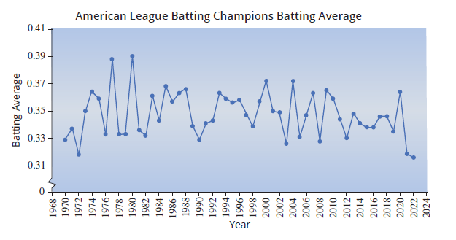
Example 2.5.1: Identifying Batting Average as Stationary or Nonstationary (cont.)

Slide 15
Example 2.5.2: Identifying Wildfire Acres Burned as
Stationary or Nonstationary
Look at the wildfire data in the following table. Plot the time series and determine if the series is stationary or nonstationary.
Solution
The variation in the data, graphed below, seems to be increasing over time, and the central value around which those variations occur is also increasing. Thus the series seems to meet the conditions of a nonstationary series.

Slide 16
Example 2.5.2: Identifying Wildfire Acres Burned as
Stationary or Nonstationary (cont.)
Acres Burned by Wildfires
Year | Acres | Year | Acres | Year | Acres
1983 | 1,323,666 | 1997 | 2,856,959 | 2011 | 8,711,367
1984 | 1,148,409 | 1998 | 1,329,704 | 2012 | 9,326,238
1985 | 2,896,147 | 1999 | 5,626,093 | 2013 | 4,319,546
1986 | 2,719,162 | 2000 | 7,393,493 | 2014 | 3,595,613
1987 | 2,447,296 | 2001 | 3,570,911 | 2015 | 10,125,149
1988 | 5,009,290 | 2002 | 7,184,712 | 2016 | 5,509,995
1989 | 1,827,310 | 2003 | 3,960,842 | 2017 | 10,026,086
1990 | 4,621,621 | 2004 | 8,097,880 | 2018 | 8,767,492
1991 | 2,953,578 | 2005 | 8,689,389 | 2019 | 4,664,364
1992 | 2,069,929 | 2006 | 9,873,745 | 2020 | 10,122,336

Slide 17
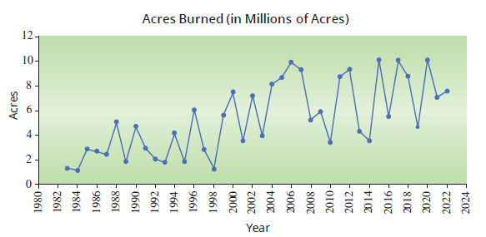
Example 2.5.2: Identifying Wildfire Acres Burned as
Stationary or Nonstationary (cont.)
Acres Burned by Wildfires (cont.)
Year | Acres | Year | Acres | Year | Acres
1993 | 1,797,574 | 2007 | 9,328,045 | 2021 | 7,125,643
1994 | 4,073,579 | 2008 | 5,292,468 | 2022 | 7,577,183
1995 | 1,840,546 | 2009 | 5,921,786
1996 | 6,065,998 | 2010 | 3,422,724

Slide 18
Example 2.5.3: Identifying Divorce Rate as Stationary or Nonstationary
Look at the divorce rate data in Table 2.5.1 at the beginning of the section. Is the time series stationary or nonstationary?
Solution
The graphed data in the figure below suggests that there is strong evidence of an upward trend until about 1980, and then the data begins to trend downward. However, the data never seems to gravitate towards a central value; thus, the time series is nonstationary.

Slide 19
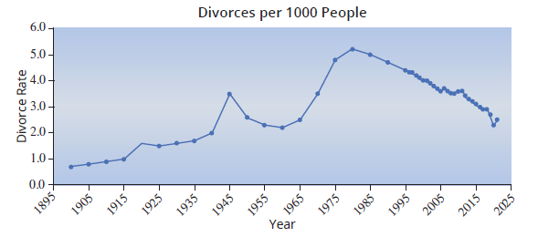
Example 2.5.3: Identifying Divorce Rate as Stationary or Nonstationary (cont.)
(Note: this data is not affected by population increases over the years since it is given in divorces per 1000 total population residing in the country.)

Slide 20
Example 2.5.4: Identifying Vehicle Registration as Stationary or Nonstationary
The U.S. is a large country that depends greatly on the use of automobiles for transportation. Let’s look at the data on automobile registration and see if there are any trends.
Vehicle Registration in the U.S. 1985–2020
Year | Number of Vehicles (in millions) | Year | Number of Vehicles (in millions) | Year | Number of Vehicles (in millions)
1985 | 171.7 | 1997 | 207.8 | 2009 | 246.3
1986 | 175.7 | 1998 | 211.6 | 2010 | 242.1
1987 | 178.9 | 1999 | 216.3 | 2011 | 253.2
1988 | 184.4 | 2000 | 221.5 | 2012 | 253.6

Slide 21
Example 2.5.4: Identifying Vehicle Registration as Stationary or Nonstationary (cont.)
Vehicle Registration in the U.S. 1985–2020 (cont.)
Year | Number of Vehicles (in millions) | Year | Number of Vehicles (in millions) | Year | Number of Vehicles (in millions)
1989 | 187.4 | 2001 | 230.4 | 2013 | 255.9
1990 | 188.8 | 2002 | 229.6 | 2014 | 260.4
1991 | 188.1 | 2003 | 231.4 | 2015 | 263.6
1992 | 190.4 | 2004 | 237.2 | 2016 | 268.8
1993 | 194.1 | 2005 | 241.2 | 2017 | 272.4
1994 | 198.0 | 2006 | 244.2 | 2018 | 273.6
1995 | 201.5 | 2007 | 247.3 | 2019 | 276.5
1996 | 206.6 | 2008 | 248.2 | 2020 | 275.9

Slide 22
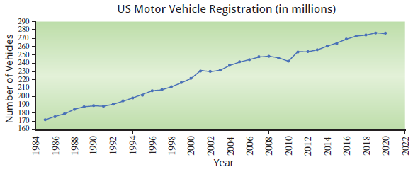
Example 2.5.4: Identifying Vehicle Registration as Stationary or Nonstationary (cont.)
Solution
The graph below reveals an obvious upward trend in vehicle registration. The trend is probably attributable to population increases during the period.

Slide 23
Cross-Sectional Data
Cross-sectional data is essentially a snapshot of a population at a specific point in time. Conventional statistical inference and descriptive methods are commonly used to analyze and draw conclusions from cross-sectional data, examine relationships between variables, and make comparisons among different groups.

Slide 24
Definition: Cross-Sectional Data
Cross-sectional data are measurements created at approximately the same period of time.

Slide 25
Cross-Sectional Data (cont.)
For example, consider the life expectancy at birth in 2020 for selected countries given in Table 2.5.2.
Table 2.5.2 - Life Expectancy at Birth 2020
Country | Life Expectancy
Afghanistan | 66
Australia | 84
Botswana | 70
Egypt | 73
Guatemala | 75
Japan | 85
Kenya | 67
Sierra Leone | 56

Slide 26
Cross-Sectional Data (cont.)
The data in table 2.5.2 represents cross-sectional measurements since the measurements were made in the same time period (2020). People in Japan are expected to live on average until age 85—about 6 years longer than the average for Americans.
Table 2.5.2 - Life Expectancy at Birth 2020 (cont.)
Spain | 84
Sri Lanka | 78
Sweden | 83
United Kingdom | 82
United States | 79

Slide 27
Cross-Sectional Data (cont.)
Developed countries such as Australia and the United States generally have higher life expectancies than developing countries such as Sierra Leone and Kenya. But according to the World Health Organization, life expectancies in developing countries are on the rise due to medical interventions based on advanced technology and drugs. In fact, developing countries are expected to experience a massive increase in their elderly populations over the next 25 years. Most of the statistical methods developed in this text are devoted to cross-sectional data.

