Slide 1
Section 2.3
Empiricism at Work: Data Collection and The Scientific Method

Slide 2
Empiricism at Work: Data Collection and The Scientific Method
“Scientific behavior, taken as a whole, is the best example we have of rationality.”
- Thomas Kuhn

Slide 3
Causality and Confounding
The notion of cause and effect is deeply embedded in our psyche. Over the long history of our species, human existence has depended on instincts about cause and effect. Ten thousand years ago, if we saw a lion on the savannah we believed from previous experiences (empiricism) becoming lunch for a lion was “cause” for a serious problem. The ability to recognize patterns helped our ancient ancestors stay alive and reproduce in a merciless world.

Slide 4
Causality and Confounding (cont.)
Through countless generations of natural selection, we have become hardwired (neuroscientists tell us in the neocortex) to see patterns and devise explanations for them. However, the pattern-recognition skills that were invaluable to our ancient ancestors are not the appropriate methods for demonstrating causality in complex problems. Establishing compelling evidence for cause and effect in a scientific field is a difficult problem.

Slide 5
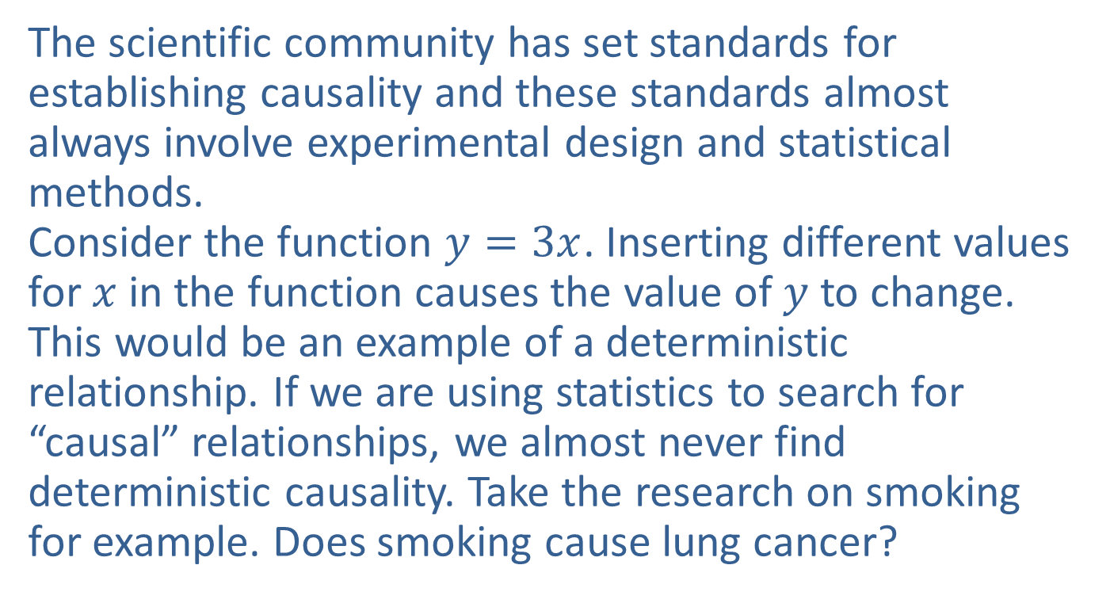
Causality and Confounding (cont.)
The scientific community has set standards for establishing causality and these standards almost always involve experimental design and statistical methods.
Consider the function $y=3x$. Inserting different values for $x$ in the function causes the value of $y$ to change. This would be an example of a deterministic relationship. If we are using statistics to search for “causal” relationships, we almost never find deterministic causality. Take the research on smoking for example. Does smoking cause lung cancer?

Slide 6
Causality and Confounding (cont.)
Clearly, not everyone who smokes gets lung cancer. People who don’t smoke also get lung cancer. The creation of cancer in the lungs comes about from a complex set of potential factors including smoking. However, it took decades of research to demonstrate this link between smoking and cancer. In an environment in which there are many potential causes for an outcome, establishing a potential causal relationship can be extremely difficult. These “other causes” are said to confound the relationship between smoking and lung cancer.

Slide 7
Definition: Confounding Variables
Confounding variables are “extra” variables that are not accounted for during experimentation and can cause results to become skewed.

Slide 8
The Evolution of the Scientific Method
The development of the scientific method emerged as a response to the limitations of informal empirical approaches, which are vulnerable to the effects of confounding variables. As a researcher in the 1600s, the conclusions of your research were not only vulnerable to the effects of confounding variables, but engaging in scientific pursuits at all could be a dangerous undertaking. Reaching conclusions that contradicted established beliefs might result in severe punishment, such as hanging or even worse.

Slide 9
The Evolution of the Scientific Method (cont.)
Galileo’s confirmation of Copernicus’s earlier findings that the Earth orbits the Sun, rather than the other way around, led to his conviction for heresy in 1633 and a life sentence of house arrest. But in 1620 the pursuit of knowledge in England began a revolutionary change. Sir Francis Bacon proposed an inductive and empirical approach to acquiring knowledge. Advocating for observation and experimentation as the means to gaining knowledge, Bacon is credited with developing the foundation of the scientific method.

Slide 10
The Evolution of the Scientific Method (cont.)
Thanks to Bacon’s ideas, scientists today have confidence in the scientific method and the way data is analyzed. When scientists come up with new ideas or theories, other scientists will carefully review the evidence to make sure that it’s accurate and reliable. This is called peer review, and it’s a really important part of the scientific process because it helps to make sure that the things we learn from science are trustworthy. It is this empirical faith (trustworthiness) that Bacon intended to create, and it remains a cornerstone of science today.

Slide 11
The Evolution of the Scientific Method (cont.)
Although statistics was not very developed in 1620, it has become a part of the ‘trustworthiness’ of the scientific method.
Since Bacon’s initial proposition for scientific inquiry, approaches and techniques for investigating research questions have developed in various fields of study. These methods, collectively referred to as the scientific method, represent an empirical means of acquiring knowledge. While the specific methods may differ slightly among disciplines, they all adhere to the fundamental principles outlined below.

Slide 12
Procedure: The Scientific Method
Observation: Scientists make observations about a phenomenon or problem, gathering data and information to identify patterns or trends.
Question: Based on observations, scientists formulate a question or set of questions that need to be addressed.
Hypothesis: A testable and falsifiable statement (or set of statements) is proposed to explain the observed phenomenon. A good hypothesis should make clear predictions that can be tested through experimentation.

Slide 13
Procedure: The Scientific Method (cont.)
Experimentation: Scientists design and carry out controlled experiments to test the hypothesis. These experiments involve manipulating variables and collecting data to determine if the hypothesis is supported or refuted.
Analysis: Researchers analyze the data from the experiments, often using statistical methods, to determine the significance of the results and the relationship between variables.

Slide 14
Procedure: The Scientific Method (cont.)
Conclusion: Based on the analysis, scientists draw conclusions about whether the hypothesis is supported or not. If the hypothesis is not supported, it may be revised or discarded, and new hypotheses may be formulated.
Communication: Findings are shared with the scientific community through publications, presentations, or other means, allowing for peer review and further discussion.

Slide 15
Procedure: The Scientific Method (cont.)
Replication and verification: Other researchers may attempt to replicate the experiments or conduct their own studies to verify or build upon the original findings.

Slide 16
The Evolution of the Scientific Method (cont.)
The scientific method repeatedly cycles through its steps, and researchers often refine and modify their hypotheses, experiments, and conclusions as new evidence emerges. The goal of the scientific method is to create a body of knowledge that is reliable, accurate, and constantly evolving based on new insights and discoveries.
The data collection process in stages one and four of the scientific method can be quite different. The first step of the scientific method is exploratory, finding out the “reality” about the subject under consideration.

Slide 17
The Evolution of the Scientific Method (cont.)
Since the data in this phase need not produce convincing evidence, whatever data is available is used to generate ideas. However, the fourth step begins the validation of a hypothesis. Scientists are trained to be critical thinkers. If a new idea is to be accepted by the scientific community, convincing evidence must be developed at the fourth stage. The manner in which the data is collected is an important part of that evidence.

Slide 18
The Evolution of the Scientific Method (cont.)
If the evidence is to be persuasive, a data gathering strategy (an experimental design) that will produce data without the unwelcome influences of confounding variables is required.
Experimental design, a branch of statistics, focuses on designing experiments that yield data with maximum information. Other branches of statistics focus on exploratory methods for examining data that assist in developing the hypotheses mentioned in step one of the scientific method. Still other branches develop theories to test the hypotheses using data collected from an experiment. Causation is difficult to prove!

Slide 19
Creating Higher Quality Data: Data by Design
Instead of unraveling the effects of confounding variables in the analysis phase of a study, it is much better to address potential confounding in the data creation phase. This is the point of experimental design. Controlled experiments were developed to counter the effects of confounding variables. Experimental design is a crucial area of study in statistics, which comprises various types of controlled experiments.

Slide 20
Creating Higher Quality Data: Data by Design (cont.)
Through such experiments, researchers exercise a greater degree of control over confounding variables, eliminating the need for “untangling” the various confounding effects and thereby creating a stronger foundation for establishing cause-and-effect relationships.
Sir Ronald Fisher is often credited with pioneering the design of experiments. In the early 20th century, Fisher developed statistical methods for designing experiments, analyzing data, and drawing conclusions based on the results.

Slide 21
Creating Higher Quality Data: Data by Design (cont.)
His work laid the foundation for modern experimental design and has been widely influential in fields such as agriculture, medicine, and psychology.
In its simplest form this kind of experimentation involves manipulating a variable while holding other variables constant to see what happens. Suppose you wanted to know whether an agricultural crop would have higher yields if 500 pounds of additional fertilizer per acre was used. This kind of question would be ideal for a controlled experiment.

Slide 22
Creating Higher Quality Data: Data by Design (cont.)
The purpose of controlled experiments is to reveal the response of one variable (crop yield, the response variable) to changes in another variable (level of fertilization, the explanatory variable). In a controlled experiment the researcher attempts to control the environment of the experiment so that the effect of one variable on another can be isolated (not confounded) and measured.
In these studies there is a control group and an experimental group. Ideally, there is no initial difference between the two groups.

Slide 23
Creating Higher Quality Data: Data by Design (cont.)
In the crop yield experiment, the control and experimental groups would be planted on equivalent plots of land with identical soil type, rainfall, sunlight and seeds — all potentially confounding variables. The only difference would be that a treatment (500 pounds of additional fertilizer per acre) is applied to the experimental group plots. When the crops are harvested, the yield per acre for the control group will be compared to the yield per acre of the treatment (experimental) group in a statistical procedure and a conclusion will be reached.

Slide 24
Creating Higher Quality Data: Data by Design (cont.)
Assuming the experiment is of sufficient size and the confounding variables are controlled in the experiment, a cause and effect relationship between the explanatory variable and the response variable may be inferred using a statistical method to compare the response variable in the control and experimental groups. There are many different kinds of controlled experiments.

Slide 25
Definition: Response Variable
A response variable measures the outcome of interest in an experiment or study.

Slide 26
Definition: Explanatory Variable
An explanatory variable causes or explains changes in a response variable.

Slide 27
Comparative Experiments
A comparative experiment involves comparing two or more treatments or conditions to determine which one is more effective in producing a desired outcome. To ensure that the results are accurate and meaningful, it is important to control for any potentially confounding variables that could influence the outcome. This requires designing a controlled experiment in which the effects of one variable on another can be isolated and measured.

Slide 28
Comparative Experiments (cont.)
By regulating the values of confounding variables, the researcher can produce data that accurately reflects the impact of the variables of interest, allowing for more accurate comparisons and conclusions.
Experimental design involves the use of various techniques to control for confounding variables and increase the internal validity of the experiment. One such technique is physical control, which involves controlling the physical environment, instruments, and procedures used in the experiment.

Slide 29
Comparative Experiments (cont.)
Physical control techniques can include using
standardized equipment, carefully monitoring and regulating environmental conditions, and following strict procedures for handling and processing the data.

Slide 30
Example 2.3.1: Analyzing an Experiment on Tomato Plant Yield
Suppose a new species of tomato has been genetically engineered to increase yields. The question: Does the new species produce higher yields? How do we set up an experimental design to accurately answer this question?
Solution
In this experimental design, the plots of tomatoes will be divided into two groups, one that contains the new species and another that contains the unaltered variety.

Slide 31
Example 2.3.1: Analyzing an Experiment on Tomato Plant Yield (cont.)
The plots containing the genetically engineered variety will be the treatment group, and the plots containing the standard variety will be the control group. If the experiment is properly performed, any change in the response variable (yield) can be attributed to the explanatory variable (genetic engineering) and not to other variables that are controlled. The untangling of variables at the data-gathering stage makes the analysis of the data much easier. There is no better way to establish a causal relationship.

Slide 32
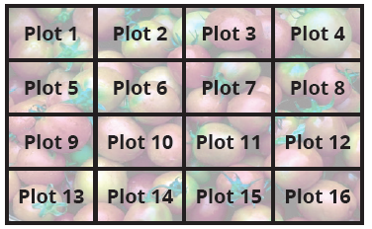
Example 2.3.1: Analyzing an Experiment on Tomato Plant Yield (cont.)
Environmental variables like rainfall, amount of sunshine, or type of soil can have a significant impact on the yield of tomatoes. To ensure the validity of the experiment, it is important to consider physical control methods for controlling these confounding variables before considering statistical controls.

Slide 33
Example 2.3.1: Analyzing an Experiment on Tomato Plant Yield (cont.)
For instance, placing the plants in similar open fields that have a common soil type and receive the same amount of sunshine and water would be a basic experimental design. Researchers can confirm the uniformity of water distribution across all plots by deploying rain gauges in the fields and regulating irrigation.
Suppose you believed that two fields contained the same soil type. In one field you planted the experimental tomato variety and in an adjoining field you planted the unaltered variety.

Slide 34
Example 2.3.1: Analyzing an Experiment on Tomato Plant Yield (cont.)
Then you compared the differences between the yields. This is an experimental design but could there be hidden confounding effects? The soil pH (acidity) could be slightly different between the fields, for example. Thus, the researcher cannot be sure that a difference in yield is caused purely by the genetic alteration.
Suppose, instead, you divided both fields up into 20 plots and randomly chose whether the unaltered or altered plant would be planted there. Would this be a stronger experimental design?

Slide 35
Example 2.3.1: Analyzing an Experiment on Tomato Plant Yield (cont.)
This experiment is an example of a completely randomized design (discussed further in Chapter 15) in which experimental units (tomato plants in this case) are randomly assigned to two or more different treatments. The potential difference in pH levels should affect the groups similarly and is thus controlled in the randomized experiment.
Randomization is a key component of most experimental designs.

Slide 36
Example 2.3.1: Analyzing an Experiment on Tomato Plant Yield (cont.)
Researchers typically randomly assign participants or units to different groups, such as a treatment group and a control group. Randomization is not a substitute for other control measures in an experiment, but rather a complementary tool that can help to further improve the validity and reliability of the results by reducing the risk of bias and confounding variables.

Slide 37
The Before and After Study
The before and after study also contains a comparative experiment. There is one group of participants which initially is called the control group. The response variable is measured in the control group at the beginning of the study, and then a treatment is applied to the control group. After the treatment is applied, the control group becomes the experimental group. The response variable is again measured after the treatment has been applied. If the treatment affects the response variable then there should be a difference between the value of the response variable before and after treatment.

Slide 38
Example 2.3.2: Analyzing a Study on an SAT Preparation Course
Does an SAT preparation course improve performance on the SAT?
Solution
A group of high school students take the SAT. Then they are given an SAT preparation course. They retake the SAT. If the group’s second SAT performance improves, then it may be related to the SAT preparation course.
Treatment: SAT preparation course
Response variable: Difference in the SAT scores

Slide 39
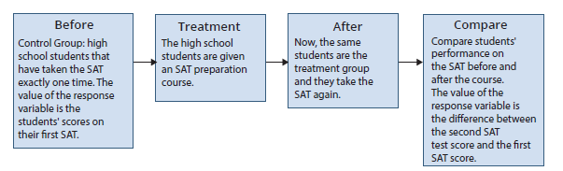
Example 2.3.2: Analyzing a Study on an SAT Preparation Course (cont.)
Suppose there were two groups of students, one that had taken the course (treatment group) and one that had not (the control group).

Slide 40
Example 2.3.2: Analyzing a Study on an SAT Preparation Course (cont.)
Could you assign any difference in results solely to the SAT preparation course? Because of potential differences in the cognitive abilities of the two groups of students, this experiment would be much more vulnerable to the justifiable criticism that the differences in student cognitive ability caused the difference in the group’s SAT performance rather than the SAT preparation course. However, by using the before and after method we have only one group of students and cognitive ability is controlled.

Slide 41
The Placebo Effect
A difficult problem arises in experiments involving people. In clinical trials of some drug or medical treatment, patients often respond favorably to any treatment, including a “dummy” or “fake” treatment. These fake treatments are called placebos.

Slide 42
Definition: Placebos
A placebo is a fake treatment that has the potential to cause a response.

Slide 43
The Placebo Effect (cont.)
In medical research, a placebo is a pill that contains no active ingredients. It has been shown in several pain studies that placebos relieve pain in 30% to 40% of patients, even though the placebo has none of the drug that is being tested. The placebo effect is not
confined to medicine. Similar effects have been noticed in psychological research in which the subjects seem to try to help the researcher prove some conclusion.

Slide 44
The Placebo Effect (cont.)
One of the more interesting experiments contaminated by this effect was the Hawthorne Study conducted at the Western Electric Company’s Hawthorne Works in Chicago between 1927 and 1932. The studies were initiated to determine the effect of lighting on worker productivity. Lighting was increased in stages, and the investigators found that each time lighting increased, worker output increased. The investigators were
suspicious that another effect might be causing worker productivity to improve.

Slide 45
The Placebo Effect (cont.)
So, workers were told lighting was to be increased when, in fact, it was decreased. Despite the decrease, worker output increased again. Clearly there was some other variable affecting worker output.
The workers wanted the study to be successful, and their desire was confounding the experiment. Instead of discovering the expected relationship between worker output and lighting, the investigators found that the social system and the employees’ roles within that system had a great deal more to do with worker productivity than lighting.

Slide 46
The Placebo Effect (cont.)
The Hawthorne Study has been credited with introducing psychology to the workplace. It also points out the hazards of measurement, even in a controlled experiment.

Slide 47
Double-Blind Studies
The placebo effect is prevalent in medical studies, and another data gathering methodology is used to counteract it.

Slide 48
Definition: Double-Blind Study
Double-blind studies are used to counteract the placebo effect. In a double-blind study, neither the subjects nor the evaluators—those measuring the response variable—are told who is in the control group and who is in the treatment group.

Slide 49
Double-Blind Studies (cont.)
In the 1960s, ulcers in the upper intestine were a rather common illness. In 1962, gastric freezing was introduced as a new treatment for these types of ulcers. This treatment required the patient to swallow a deflated balloon with tubes attached. A refrigerated solution was then pumped through the balloon for an hour. The idea behind this therapy was to cool the stomach wall and reduce the amount of acid produced. Initially, the results looked promising and the treatment was used for several years. However, none of the initial studies were double-blind.

Slide 50
Double-Blind Studies (cont.)
In the double-blind study half the patients were given the procedure and the other half were given a placebo treatment, which included swallowing the balloon, but no cooling solution was injected into the balloon. In the double-blind study, patients that had the placebo treatment actually did better than the ones that received the real treatment. Gastric freezing was eventually abandoned as a treatment for upper-intestinal ulcers.

Slide 51
Double-Blind Studies (cont.)
In a single-blind study, the participants in the study would be unaware of whether they are receiving the treatment or the placebo but those conducting the research would know this information. This arrangement can be necessary when it is not feasible or practical to conduct a double-blind study. For example, if the treatment medication has dangerous side effects then the researchers would need to monitor the participants closely for safety reasons.

Slide 52
Double-Blind Studies (cont.)
While a double-blind study would be the ideal standard, the single-blind study can still help reduce bias and improve the validity of the study.

Slide 53
Observational Studies
Observational data comes about when data is obtained (by direct measurement or a secondary source) without a data collection design—essentially, obtaining data from subjects in their natural environment without manipulating the subjects nor the environment. If you are trading stocks, the market data you receive is observational. It is simply what is happening in the marketplace at the time. Census data is observational; it is a measure of how things are in a specific geographic area at a given point in time.

Slide 54
Observational Studies (cont.)
There is no experimental design associated with the data. Virtually all of the data we routinely encounter is observational. Examples regularly appearing in the newspaper include:
stock, commodity, bond, option, and currency market data
almost all federal government data, including census, economic, and educational
virtually all local and state government data
sports data.

Slide 55
Observational Studies (cont.)
These data values are not the result of a designed experiment.
While observational data may prove beneficial in certain scenarios, it is generally considered to be less reliable than data acquired through controlled experiments because observational studies can be extremely vulnerable to confounding variables. For example, the effect of vitamin C has been the subject of controversy for some time. Numerous claims of beneficial health effects from regularly consuming vitamin C have been made.

Slide 56
Observational Studies (cont.)
However, Enstrom, Kemin, and Klein (“Vitamin C Intake and Mortality,” Epidemiology, May 1992) in an observational study with 10,000 participants noted that males in their study who supplemented their diets with 500 milligrams of vitamin C each day (on average) lived approximately six years longer than those who did not take the vitamin. Females taking this dosage of vitamin C (on average) lived approximately one year longer. Although this study was quite large, it does not prove that vitamin C causes increased longevity.

Slide 57
Observational Studies (cont.)
If the data had come from a controlled experiment, the strength of the study’s conclusion would be much more powerful. The Vitamin C study is an observational study because the subjects were not chosen randomly for the control and treatment groups. If the experiment were conducted as a controlled experiment, the control group would be given a placebo and the treatment group would be given vitamin C.

Slide 58
Untangling Variables in an Observational Study
Untangling variables is difficult. It is much better to untangle data (with respect to the effects of one variable on another) in a controlled experiment before doing the analysis. But sometimes the data has already been collected and there is no choice.
In 1973, the Graduate Division at the University of California, Berkeley, carried out an observational study on gender bias in admissions to the Graduate School. There were 8442 men and 4321 women who applied for admission.

Slide 59
Untangling Variables in an Observational Study (cont.)
Of the men that applied, 3714 were subsequently accepted, and 1512 of the women were accepted. Given that almost twice as many men applied to the graduate program, it is reasonable to expect that more men would be accepted.
To make a reasonable comparison, the first thing that is needed is to adjust for the difference in application rates between men and women. Comparing the percentage of each group that was accepted will take care of this problem.

Slide 60
Untangling Variables in an Observational Study (cont.)
Nearly 44% of the men and 35% of the women were admitted. These admission statistics suggested there was “statistical” support for the idea of discrimination against women.
The graduate school admission process at UC Berkeley was done by major. If there was a discrimination against women, those departments that were discriminating would stand out when the admissions data was examined on a departmental basis. But when the data was examined, the investigator did not find what was expected.

Slide 61
Untangling Variables in an Observational Study (cont.)
Suppose the data in Table 2.3.1 represents the six largest majors on the Berkeley campus.
Table 2.3.1 - College Acceptance Rates
 | Men |  | Women
Major | Number of Applicants | Percent Admitted | Number of Applicants | Percent Admitted
I | 825 | 62 | 108 | 82
II | 560 | 63 | 25 | 68
III | 325 | 37 | 593 | 34
IV | 417 | 33 | 375 | 35
V | 191 | 28 | 393 | 24
VI | 373 | 6 | 341 | 7

Slide 62
Untangling Variables in an Observational Study (cont.)
In all but two of the majors, women were admitted more frequently than men. Not only were women not being discriminated against, but there appears to be potential discrimination against men in Major I. How could this completely opposite conclusion be true? A close examination of the data showed that in the majors with the largest percentage admitted (the easiest to get into—Majors I and II) there were many male applicants and very few female applicants.

Slide 63
Untangling Variables in an Observational Study (cont.)
The majors that had very low acceptance rates (difficult to be admitted) had relatively very few men and many women applying. Thus, the variable major field of study was confounding the variable gender in the original analysis and biasing the original conclusion. This is one of the most well-known examples of a phenomenon called Simpson’s paradox, which states that the relationship between two variables can be heavily affected by a third variable. It also points out the fact that interesting variation in data can be lost by focusing too much attention on simplistic summary measures.

Slide 64
Definition: Bias
Bias is the tendency to overestimate or underestimate the value of a certain population parameter.

Slide 65
Untangling Variables in an Observational Study (cont.)
The original conclusion was the result of the fact that women were applying to the most difficult departments for admission, not because of gender discrimination. By separating the data by major, the analyst was able to control for the confounding variable, choice of major, and remove the bias. When it is possible to remove the effect of one variable, we are said to be controlling for that variable. The Berkeley data illustrates a subtle problem in the comparison of two or more proportions.

Slide 66
Untangling Variables in an Observational Study (cont.)
In this instance the analyst was able to untangle the two variables, but this is not always the case. Unless the data is gathered with a controlled experiment, it may not be possible to untangle the effects of the causal factors.

Slide 67
Surveys
A great deal of the statistical information presented to us is the result of surveys.
Often, we will see in the news that one of the major polling organizations, Gallup, Harris, ABC-Washington Post, and NBC-New York Times, is reporting findings on various topics, from the approval rating of the President to the popularity of a television show.
In some instances, the purpose of a survey is purely descriptive, as those described above. However, in many cases the researcher is interested in discovering a relationship.

Slide 68
Surveys (cont.)
Because virtually all surveys produce observational data, survey research belongs to the discovery steps (Steps 1 and 2) of the scientific method. Sometimes a plausible relationship is discovered, and a designed experiment is undertaken to demonstrate the relationship more convincingly.
A famous observational study, known as the Framingham Study, recorded various data on 4,500 middle-aged men. The men were followed for many years with the hope of uncovering what factors relate to the development of heart disease.

Slide 69
Surveys (cont.)
It was discovered that the development of heart disease seemed to be associated with obesity, heavy smoking, and high blood pressure. Because of the large number of participants and the researcher’s ability to control for potentially confounding variables after the data was collected, this research influenced many physicians to work with their patients to control the three causal factors found in the study.
Surveys are frequently used by businesses to collect data for informed decision making, service enhancement, and meeting customer expectations.

Slide 70
Surveys (cont.)
For instance, a streaming service provider may utilize a survey like the one shown in Figure 2.3.1. The survey questions are designed to provide feedback on the customer preferences regarding usage patterns, satisfaction with current providers, and potential consumer inclinations for the future.

Slide 71
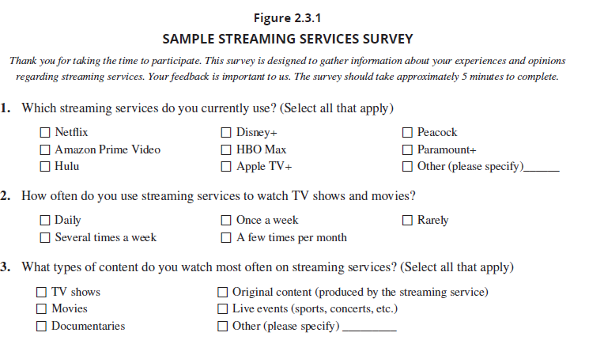
Surveys (cont.)

Slide 72
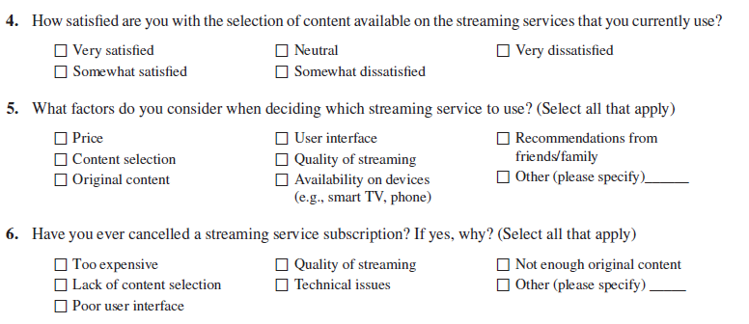
Surveys (cont.)

Slide 73
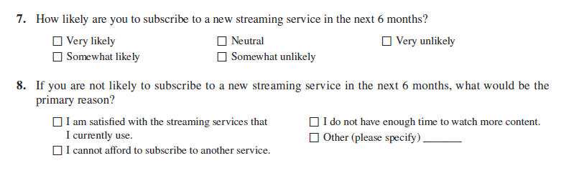
Surveys (cont.)

