Slide 1
Section 17.6
The Kruskal-Wallis Test

Slide 2
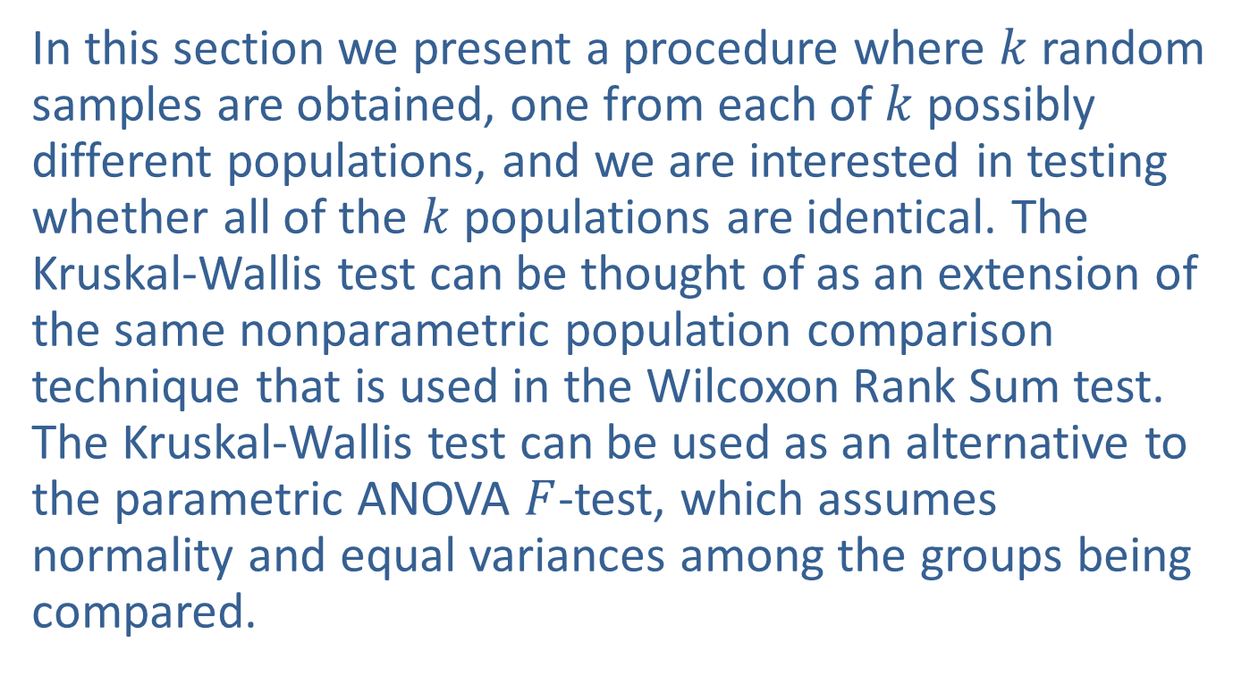
The Kruskal-Wallis Test
In this section we present a procedure where $k$ random samples are obtained, one from each of $k$possibly different populations, and we are interested in testing whether all of the $k$ populations are identical. The Kruskal-Wallis test can be thought of as an extension of the same nonparametric population comparison technique that is used in the Wilcoxon Rank Sum test. The Kruskal-Wallis test can be used as an alternative to the parametric ANOVA $F$-test, which assumes normality and equal variances among the groups being compared.

Slide 3
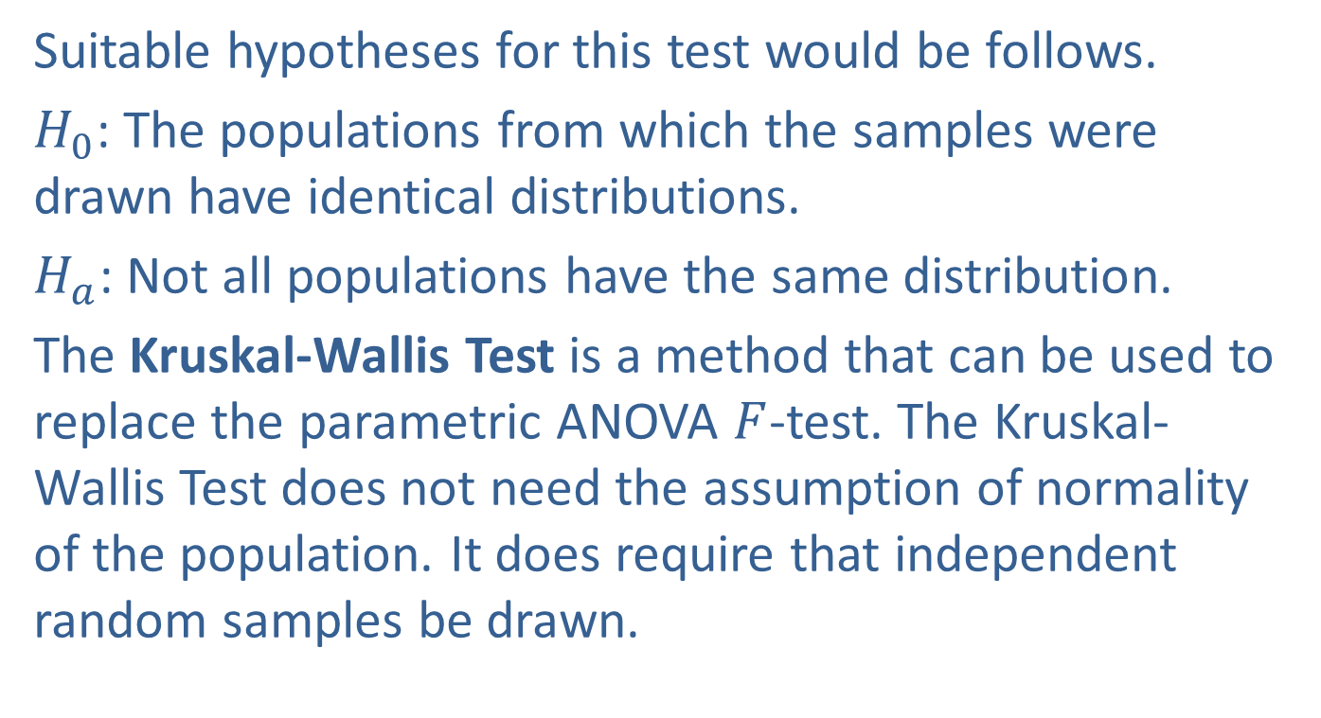
The Kruskal-Wallis Test (cont.)
Suitable hypotheses for this test would be follows.
$H_{0}$: The populations from which the samples were drawn have identical distributions.
$H_{a}$: Not all populations have the same distribution.
The Kruskal-Wallis Test is a method that can be used to replace the parametric ANOVA $F$-test. The Kruskal-Wallis Test does not need the assumption of normality of the population. It does require that independent random samples be drawn.

Slide 4
The Kruskal-Wallis Test (cont.)
The Kruskal-Wallis Test is similar to the Wilcoxon Rank-Sum Test in that the test statistic will be based on the sums of the ranks of the groups being compared. Similar to the Wilcoxon Rank-Sum Test, when all the samples in the Kruskal-Wallis Test are drawn from the same population and the null hypothesis is true, we would expect to see a mixture of small, medium, and high ranks in each sample. However, under the alternative hypothesis, one or more samples may be dominated by either high or low ranks.

Slide 5
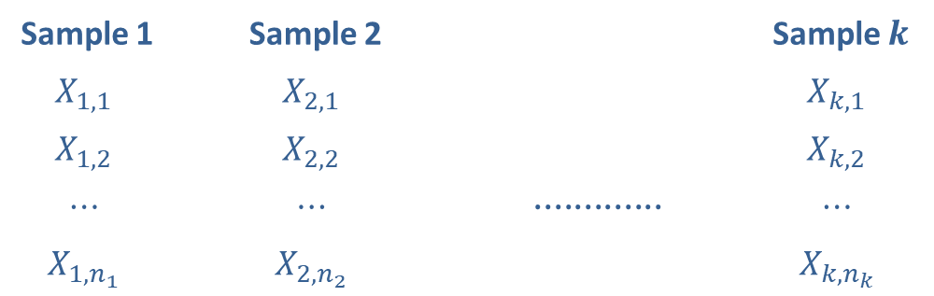
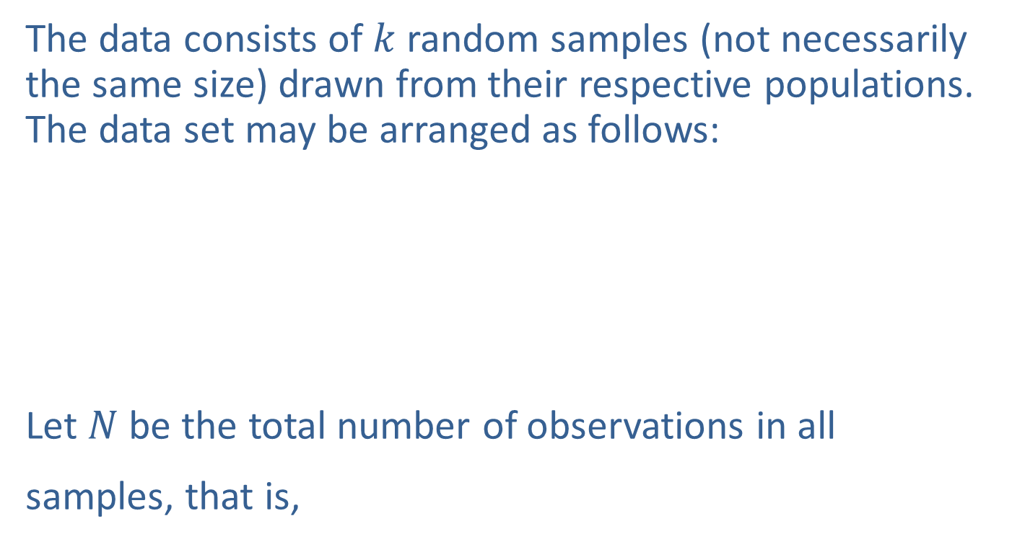
The Kruskal-Wallis Test (cont.)
The data consists of $k$ random samples (not necessarily the same size) drawn from their respective populations. The data set may be arranged as follows:
Let $N$ be the total number of observations in all samples, that is,
Sample 1 | Sample 2 |  | Sample $k$
$$X_{1,1}$$ | $$X_{2,1}$$ |  | $$X_{k,1}$$
$$X_{1,2}$$ | $$X_{2,2}$$ |  | $$X_{k,2}$$
$$⋯$$ | $$⋯$$ | $$∙∙∙∙∙∙∙∙∙∙∙∙∙$$ | $$⋯$$
$$X_{1,n_{1}}$$ | $$X_{2,n_{2}}$$ |  | $$X_{k,n_{k}}$$

Slide 6
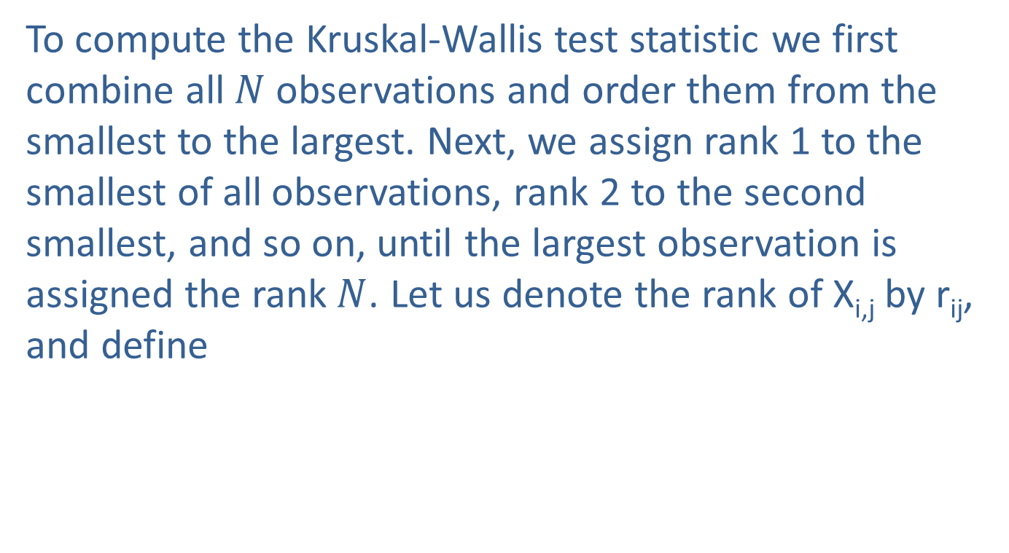
The Kruskal-Wallis Test (cont.)
To compute the Kruskal-Wallis test statistic we first combine all $N$observations and order them from the smallest to the largest. Next, we assign rank 1 to the smallest of all observations, rank 2 to the second smallest, and so on, until the largest observation is assigned the rank$N$. Let us denote the rank of X_{i,j} by r_{ij}, and define

Slide 7
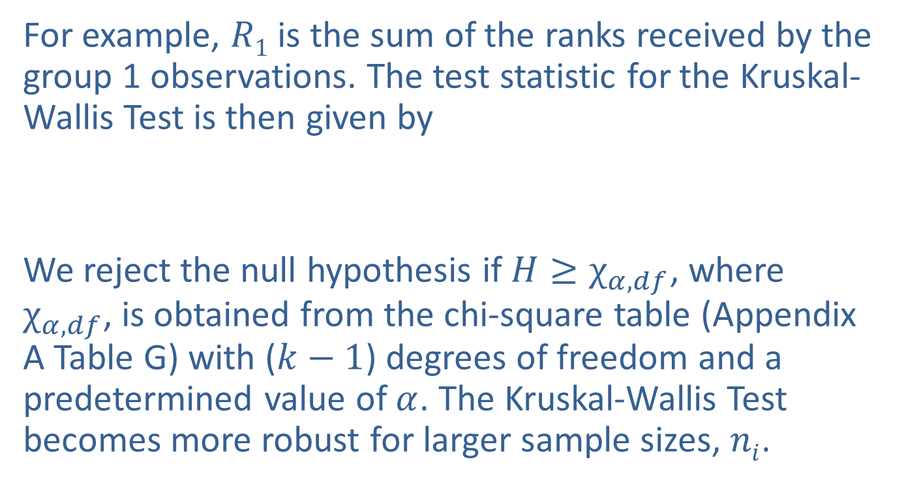
The Kruskal-Wallis Test (cont.)
For example, $R1$ is the sum of the ranks received by the group 1 observations. The test statistic for the Kruskal-Wallis Test is then given by
We reject the null hypothesis if $H≥χ_{α,df}$, where $χ_{α,df}$, is obtained from the chi-square table (Appendix A Table G) with ($k−1$) degrees of freedom and a predetermined value of $α$. The Kruskal-Wallis Test becomes more robust for larger sample sizes, $ni$.

Slide 8
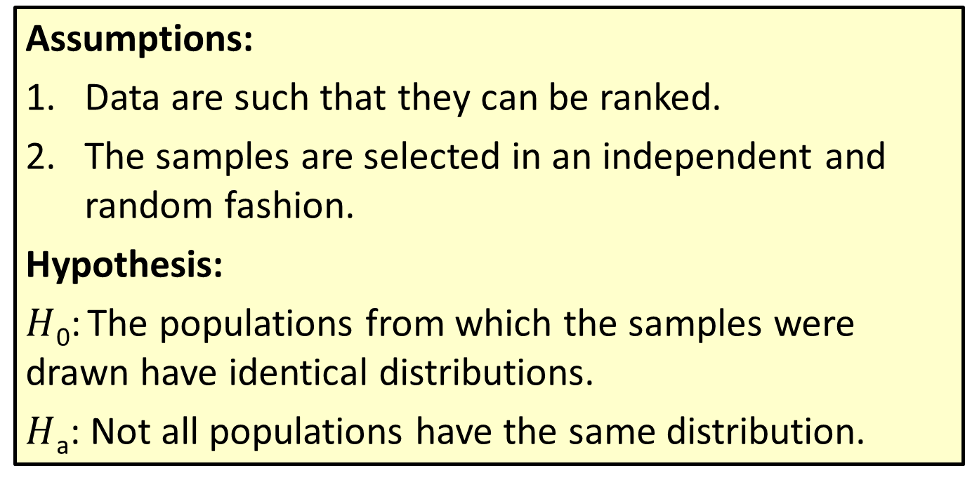
Procedure: Test Procedure for the Kruskal-Wallis Test
Assumptions:
Data are such that they can be ranked.
The samples are selected in an independent and random fashion.
Hypothesis:
$H$₀: The populations from which the samples were drawn have identical distributions.
$H$_{a}: Not all populations have the same distribution.

Slide 9
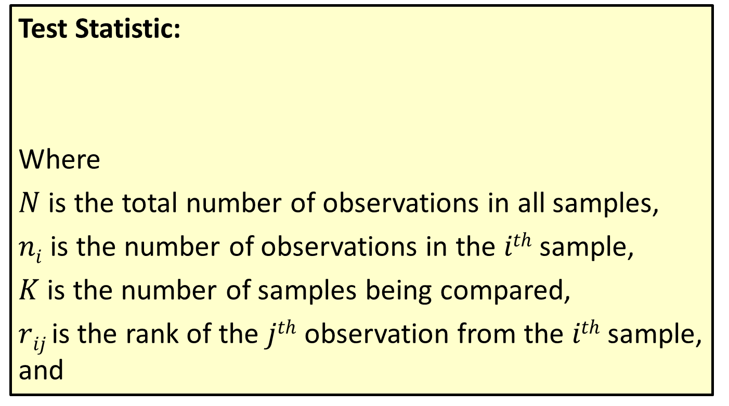
Procedure: Test Procedure for the Kruskal-Wallis Test (cont.)
Test Statistic:
Where
$N$ is the total number of observations in all samples,
$ni$ is the number of observations in the $ith$ sample,
$K$ is the number of samples being compared,
$rij$ is the rank of the $jth$ observation from the $ith$ sample, and

Slide 10
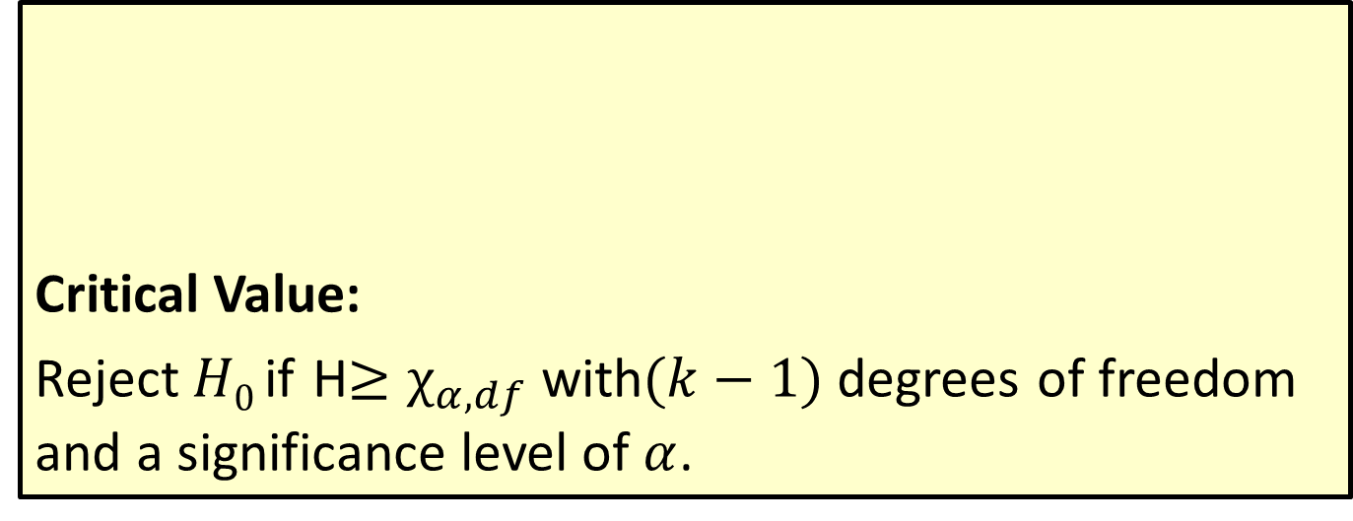
Procedure: Test Procedure for the Kruskal-Wallis Test (cont.)
Critical Value:
Reject $H0$ if H$≥χ_{α,df}$ with$(k−1)$degrees of freedom and a significance level of $α$.

Slide 11
Example 17.6.1: Performing the Kruskal-Wallis Test to Determine if Home Prices are Identical
A real estate agent sells single-family homes in the towns of Mouse Creek, Spring Valley, and Smyrna. Some homes for sale in these towns have the following prices (in thousands of dollars).
Selling Prices (in thousands of dollars)
Mouse Creek | Spring Valley | Smyrna
89 | 128 | 82
114 | 147 | 129
142 | 168 | 149
164 | 222 | 169
219 | 289 | 389
 | 489

Slide 12
Example 17.6.1: Performing the Kruskal-Wallis Test to Determine if Home Prices are Identical (cont.)
Use the Kruskal-Wallis Test to check whether the house prices in these samples come from identical populations using α = 0.05.
Solution
The N = 16 home prices are assigned overall ranks. In the following table, the ranks are shown in the column next to each observation.

Slide 13
Example 17.6.1: Performing the Kruskal-Wallis Test to Determine if Home Prices are Identical (cont.)
Selling Prices Ranked
Mouse Creek | Rank | Spring Valley | Rank | Smyrna | Rank
89 | 2 | 128 | 4 | 82 | 1
114 | 3 | 147 | 7 | 129 | 5
142 | 6 | 168 | 10 | 149 | 8
164 | 9 | 222 | 13 | 169 | 11
219 | 12 | 289 | 14 | 389 | 15
 |  | 489 | 16
The hypotheses for the test can be written as follows.
H₀: The samples come from populations with the same distribution.
H_{a}: The samples come from populations with different distributions.

Slide 14
Example 17.6.1: Performing the Kruskal-Wallis Test to Determine if Home Prices are Identical (cont.)
The sum of the ranks for each city are as follows.
Mouse Creek: 2 + 3 + 6 + 9 + 12 = 32 = R₁
Spring Valley: 4 + 7 + 10 + 13 + 14 + 16 = 64 = R₂
Smyrna: 1 + 5 + 8 + 11 + 15 = 40 = R₃
Hence using we get

Slide 15
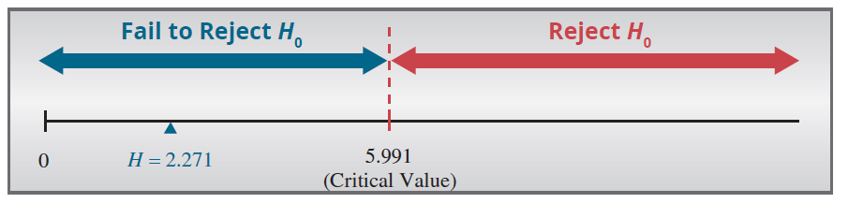
Example 17.6.1: Performing the Kruskal-Wallis Test to Determine if Home Prices are Identical (cont.)
There are k − 1 = 3 − 1 = 2 degrees of freedom. The critical value can be found in Table G of Appendix A as Since 2.271 < 5.991, we do not reject the null hypothesis and state that the house prices do not differ significantly in these three towns.

Slide 16
Example 17.6.2: Performing the Kruskal-Wallis Test to Determine if Braking Distances are Identical
A traffic safety engineer records the braking distances of a test vehicle at a fixed speed using three different brake pads. Braking distances (in feet) and their respective ranks for brake pads of types A, B and C are given in the following table. Is there sufficient evidence at the 0.05 level to conclude that the braking distances for the three pads are not all the same?

Slide 17
Example 17.6.2: Performing the Kruskal-Wallis Test to Determine if Braking Distances are Identical (cont.)
Solution
Braking Distances (in feet) with Ranks
 | Brake Pad A | Rank | Brake Pad B | Rank | Brake Pad C | Rank
 | 89 | 1 | 97 | 5 | 98 | 6
 | 99 | 7 | 139 | 15 | 116 | 11
 | 101 | 8 | 119 | 12 | 104 | 10
 | 94 | 2 | 103 | 9 | 96 | 4
 | 95 | 3 | 127 | 14 | 126 | 13
Rank Sum |  | 21 |  | 55 |  | 44
The hypotheses for this test can be written as follows.
H₀: The braking distances for the three pads are the same.
H_{a}: At least one of the braking distances is different.

Slide 18
Example 17.6.2: Performing the Kruskal-Wallis Test to Determine if Braking Distances are Identical (cont.)
The ranks of the observations are given in the table. The sum of the ranks for each type of brake pad is found in the last row of the table.
R₁ = 21 R₂ = 55 R₃ = 44
We can now calculate the test statistic,
We find that

Slide 19
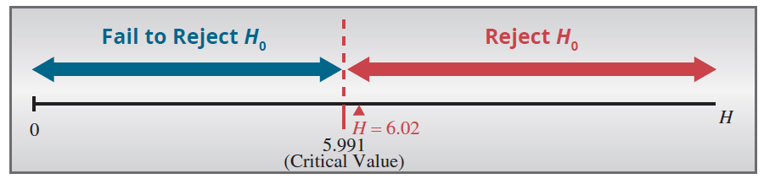
Example 17.6.2: Performing the Kruskal-Wallis Test to Determine if Braking Distances are Identical (cont.)
Referring to Appendix A, Table G, we see that
Because the test statistic exceeds the critical value (6.02 > 5.991) we reject the null hypothesis and conclude that at least one of the braking distances is sufficiently different.

