Slide 1
Section 17.5
The Runs Test for Randomness

Slide 2
The Runs Test for Randomness
Randomness is an important concept in probability and statistics. In this section, we discuss a method for determining whether a sequence of observations exhibit randomness. To illustrate this concept we will use the familiar coin tossing experiment. One characteristic of the coin-tossing experiment is that in the long run there should be approximately equal numbers of heads and tails. In an ordered sequence, however, randomness implies more than compliance with this frequency criterion.

Slide 3
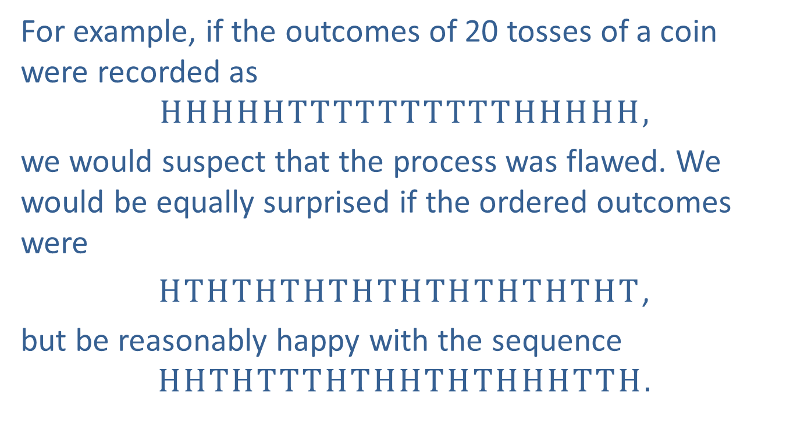
The Runs Test for Randomness (cont.)
For example, if the outcomes of 20 tosses of a coin were recorded as
$$HHHHHTTTTTTTTTTHHHHH,$$
we would suspect that the process was flawed. We would be equally surprised if the ordered outcomes were
$HTHTHTHTHTHTHTHTHTHT$,
but be reasonably happy with the sequence
$$HHTHTTTHTHHTHTHHHTTH.$$

Slide 4
The Runs Test for Randomness (cont.)
A characteristic that reflects our reservations about the first two sequences is the number of runs, where a run in this instance, is a subsequence of one or more heads (or tails). More generally, a run is a subsequence of one or more like items or symbols in a two-valued data sequence.

Slide 5
Definition: Run
A run is a subsequence of one or more like items or symbols in a two-valued data sequence.

Slide 6
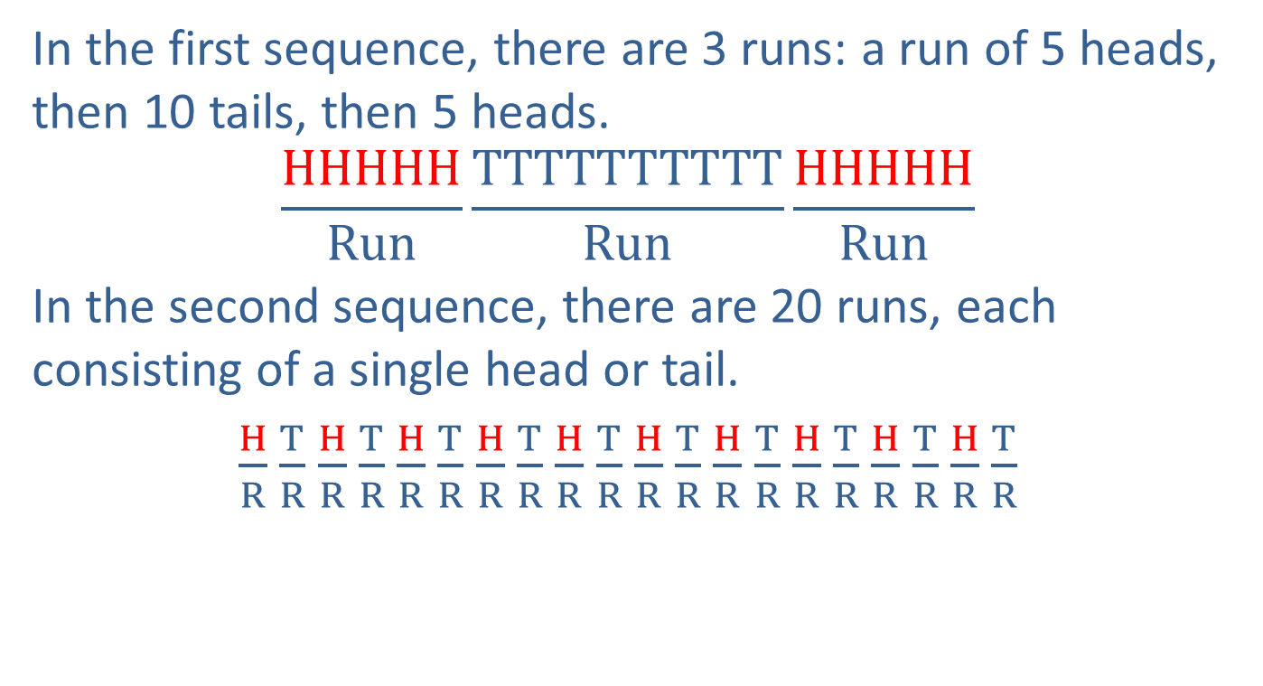
The Runs Test for Randomness (cont.)
In the first sequence, there are 3 runs: a run of 5 heads, then 10 tails, then 5 heads.
$$\frac{HHHHH}{Run}\frac{TTTTTTTTTT}{Run}\frac{HHHHH}{Run}$$
In the second sequence, there are 20 runs, each consisting of a single head or tail.
$\frac{H}{R}$ $\frac{T}{R}$ $\frac{H}{R}$ $\frac{T}{R}$ $\frac{H}{R}$ $\frac{T}{R}$ $\frac{H}{R}$ $\frac{T}{R}$ $\frac{H}{R}$ $\frac{T}{R}$ $\frac{H}{R}$ $\frac{T}{R}$ $\frac{H}{R}$ $\frac{T}{R}$ $\frac{H}{R}$ $\frac{T}{R}$ $\frac{H}{R}$ $\frac{T}{R}$ $\frac{H}{R}$ $\frac{T}{R}$

Slide 7
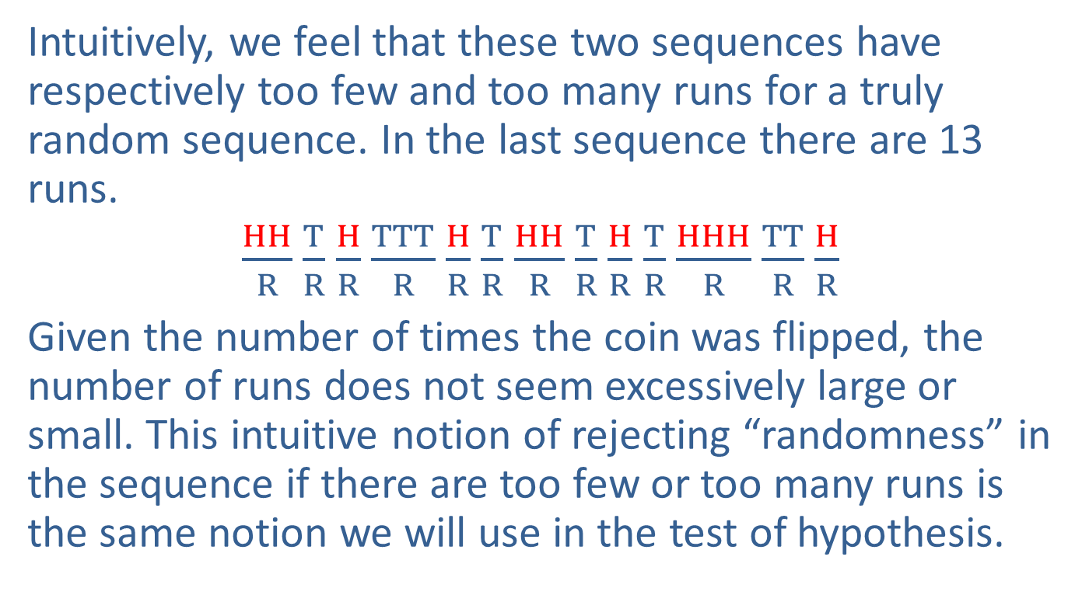
The Runs Test for Randomness (cont.)
Intuitively, we feel that these two sequences have respectively too few and too many runs for a truly random sequence. In the last sequence there are 13 runs.
$\frac{HH}{R}$ $\frac{T}{R}$ $\frac{H}{R}$ $\frac{TTT}{R}$ $\frac{H}{R}$ $\frac{T}{R}$ $\frac{HH}{R}$ $\frac{T}{R}$ $\frac{H}{R}$ $\frac{T}{R}$ $\frac{HHH}{R}$ $\frac{TT}{R}$ $\frac{H}{R}$
Given the number of times the coin was flipped, the number of runs does not seem excessively large or small. This intuitive notion of rejecting “randomness” in the sequence if there are too few or too many runs is the same notion we will use in the test of hypothesis.

Slide 8
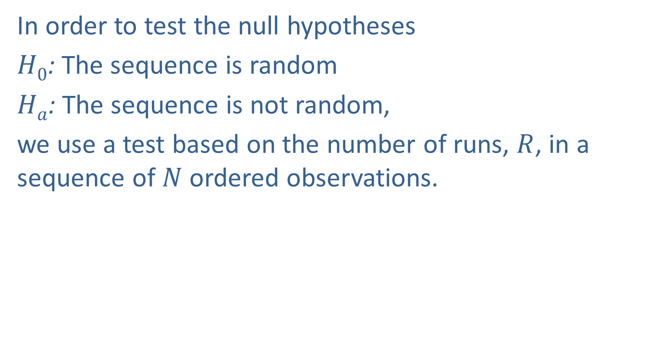
The Runs Test for Randomness (cont.)
In order to test the null hypotheses
$H0$: The sequence is random
$Ha$: The sequence is not random,
we use a test based on the number of runs, $R$, in a sequence of $N$ ordered observations.

Slide 9
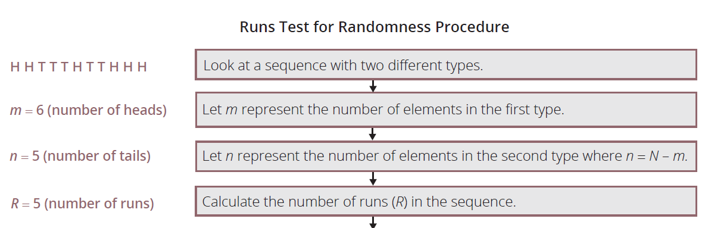
The Runs Test for Randomness (cont.)

Slide 10
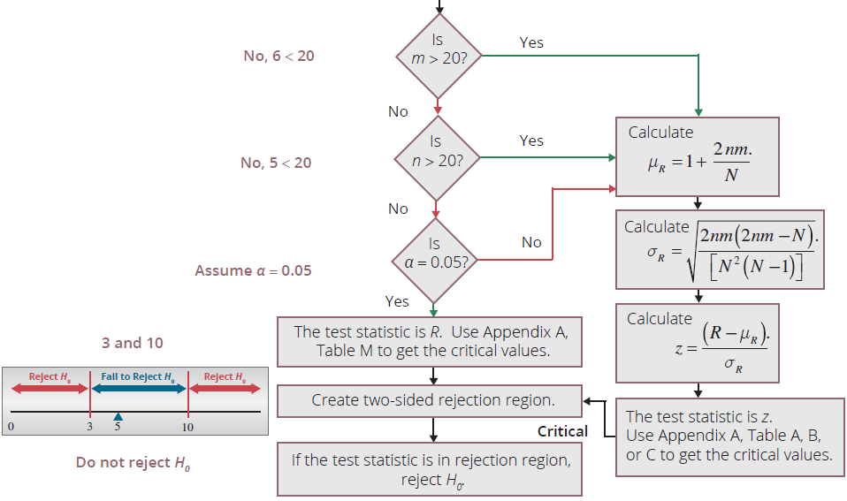
The Runs Test for Randomness (cont.)

Slide 11
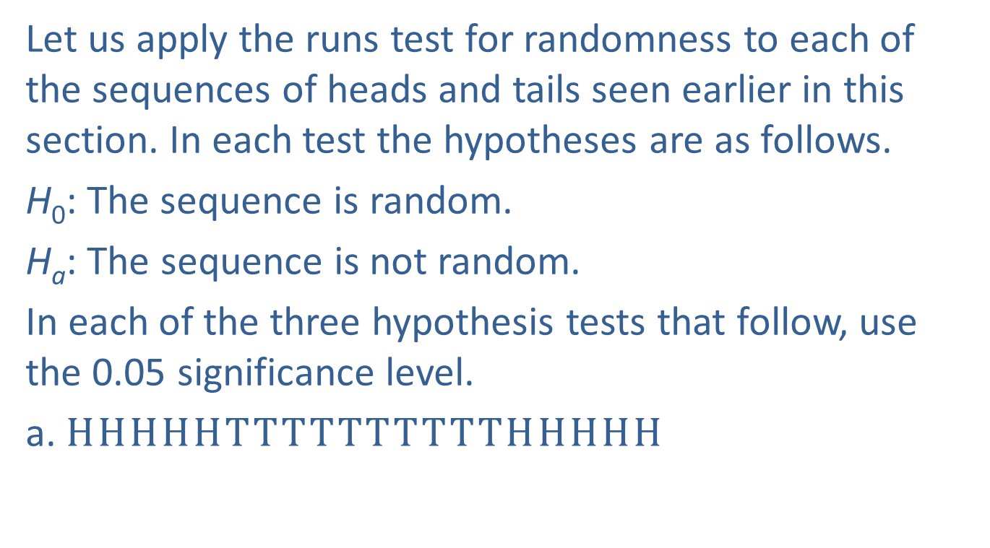
Example 17.5.1: Performing the Runs Test to Determine If a Sequence of Coin Flips is Random
Let us apply the runs test for randomness to each of the sequences of heads and tails seen earlier in this section. In each test the hypotheses are as follows.
H₀: The sequence is random.
H_{a}: The sequence is not random.
In each of the three hypothesis tests that follow, use the 0.05 significance level.
a. $HHHHHTTTTTTTTTTHHHHH$

Slide 12
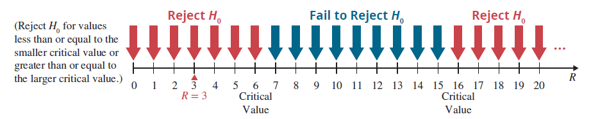
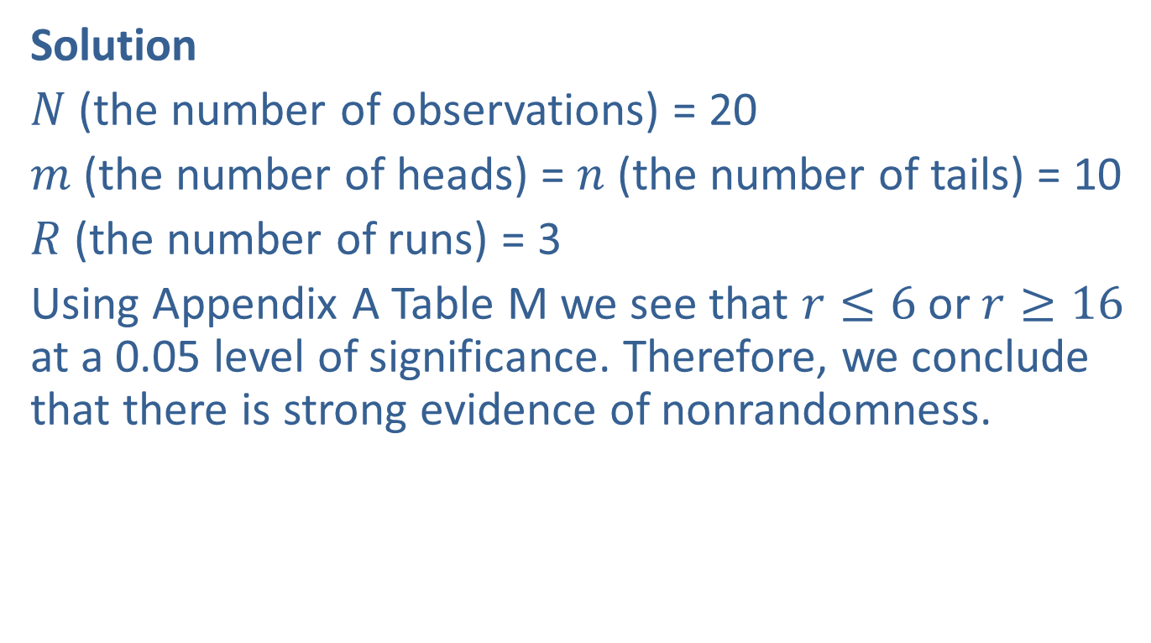
Example 17.5.1: Performing the Runs Test to Determine If a Sequence of Coin Flips is Random (cont.)
Solution
$N$ (the number of observations) = 20
$m$(the number of heads) = $n$ (the number of tails) = 10
$R$ (the number of runs) = 3
Using Appendix A Table M we see that $r≤6$or $r≥16$ at a 0.05 level of significance. Therefore, we conclude that there is strong evidence of nonrandomness.

Slide 13
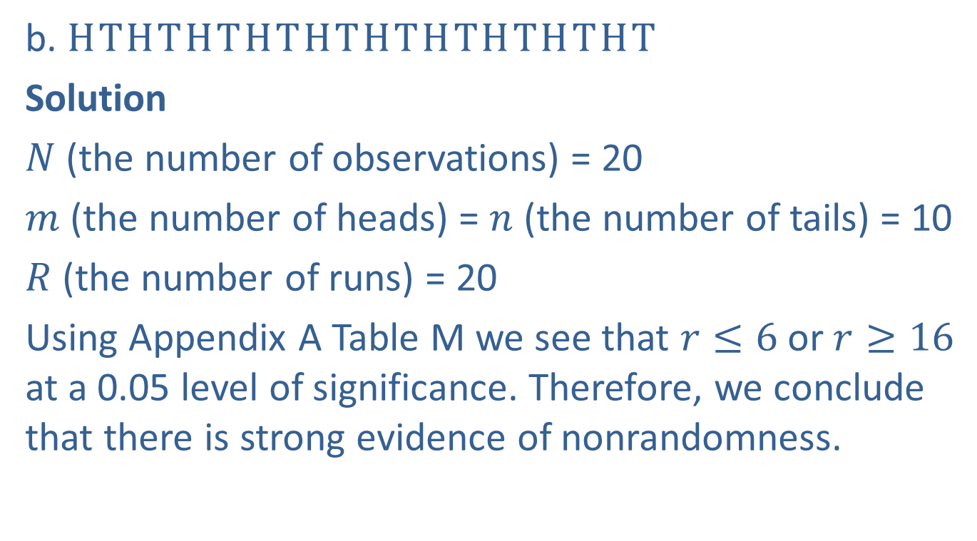
Example 17.5.1: Performing the Runs Test to Determine If a Sequence of Coin Flips is Random (cont.)
b. $HTHTHTHTHTHTHTHTHTHT$
Solution
$N$ (the number of observations) = 20
$m$(the number of heads) = $n$ (the number of tails) = 10
$R$ (the number of runs) = 20
Using Appendix A Table M we see that $r≤6$or $r≥16$ at a 0.05 level of significance. Therefore, we conclude that there is strong evidence of nonrandomness.

Slide 14
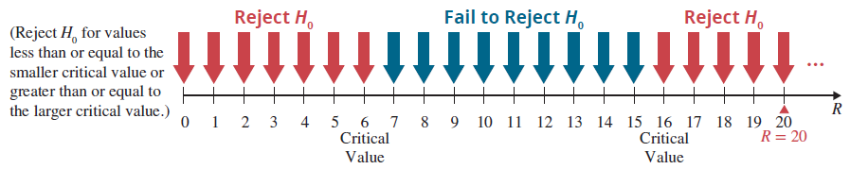
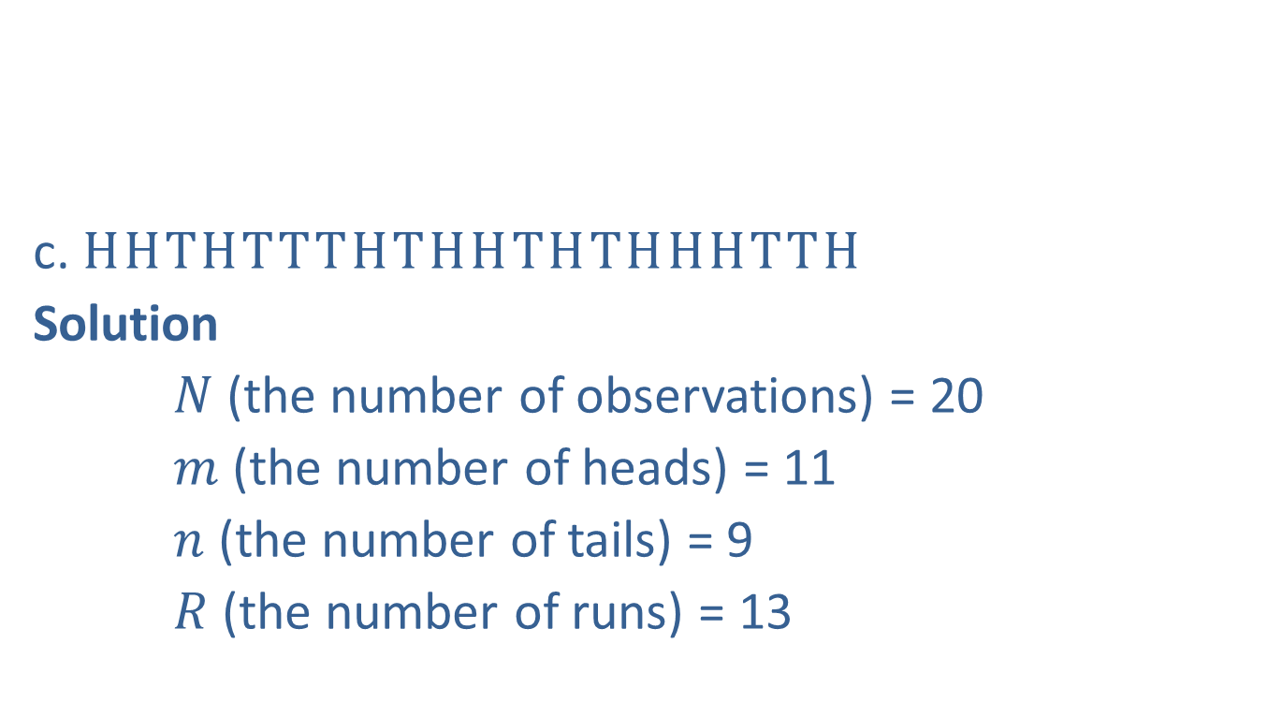
Example 17.5.1: Performing the Runs Test to Determine If a Sequence of Coin Flips is Random (cont.)
c. $HHTHTTTHTHHTHTHHHTTH$
Solution
$N$ (the number of observations) = 20
$m$ (the number of heads) = 11
$n$ (the number of tails) = 9
$R$ (the number of runs) = 13

Slide 15
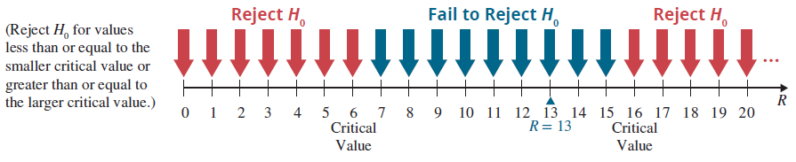

Example 17.5.1: Performing the Runs Test to Determine If a Sequence of Coin Flips is Random (cont.)
Using Appendix A Table M we see that $r≤6$or $r≥16$ at a 0.05 level of significance. Therefore, we conclude that there is no evidence of nonrandomness.

Slide 16
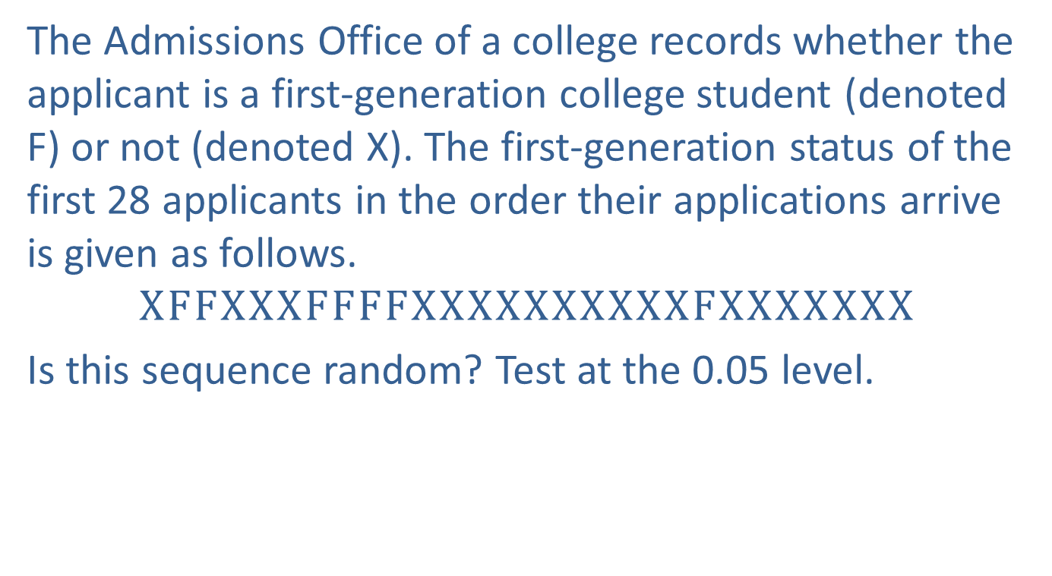
Example 17.5.2: Performing the Runs Test to Detect a Pattern in College Applications
The Admissions Office of a college records whether the applicant is a first-generation college student (denoted F) or not (denoted X). The first-generation status of the first 28 applicants in the order their applications arrive is given as follows.
$$XFFXXXFFFFXXXXXXXXXXFXXXXXXX$$
Is this sequence random? Test at the 0.05 level.

Slide 17
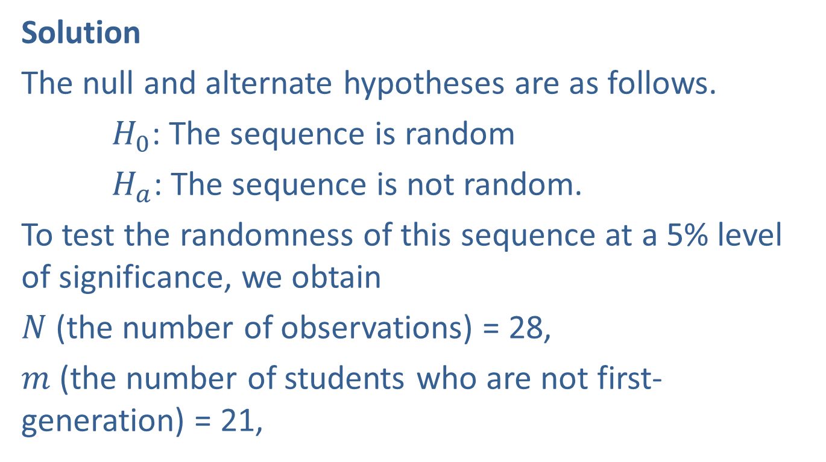
Example 17.5.2: Performing the Runs Test to Detect a Pattern in College Applications (cont.)
Solution
The null and alternate hypotheses are as follows.
$H_{0}$: The sequence is random
$H_{a}$: The sequence is not random.
To test the randomness of this sequence at a 5% level of significance, we obtain
$N$ (the number of observations) = 28,
$m$ (the number of students who are not first-generation) = 21,

Slide 18

Example 17.5.2: Performing the Runs Test to Detect a Pattern in College Applications (cont.)
$n$ (the number of first-generation students) = 7, and
$R$ (the number of runs) = 7.
Since $m>20$, we calculate

Slide 19
Example 17.5.2: Performing the Runs Test to Detect a Pattern in College Applications (cont.)

Slide 20
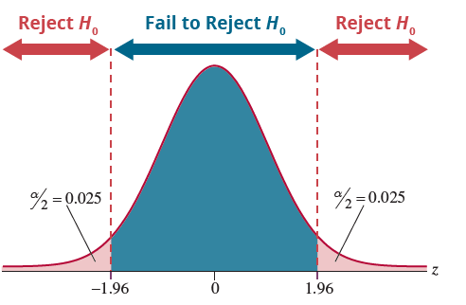
Example 17.5.2: Performing the Runs Test to Detect a Pattern in College Applications (cont.)
Thus,

Slide 21
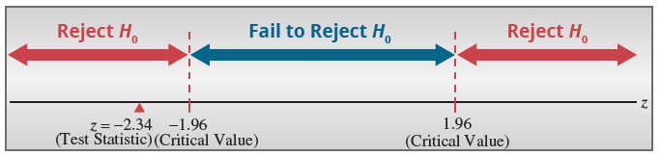
Example 17.5.2: Performing the Runs Test to Detect a Pattern in College Applications (cont.)
Since the test statistic is in the rejection region, reject the null hypothesis that the first-generation status of arriving students follow a random sequence.

Slide 22
Example 17.5.3: Detecting Randomness of a Set of Numbers
Is the following data random?
16, 25, 52, 11, 38, 47, 12, 98, 4
Solution
How do you test randomness with a numerical data set? Create a new data set comparing each value to the median value. To do this, substitute each value in the original data set with an A if it is above the median value, a B if it is below the median value, and eliminate any values that equal the median.

Slide 23
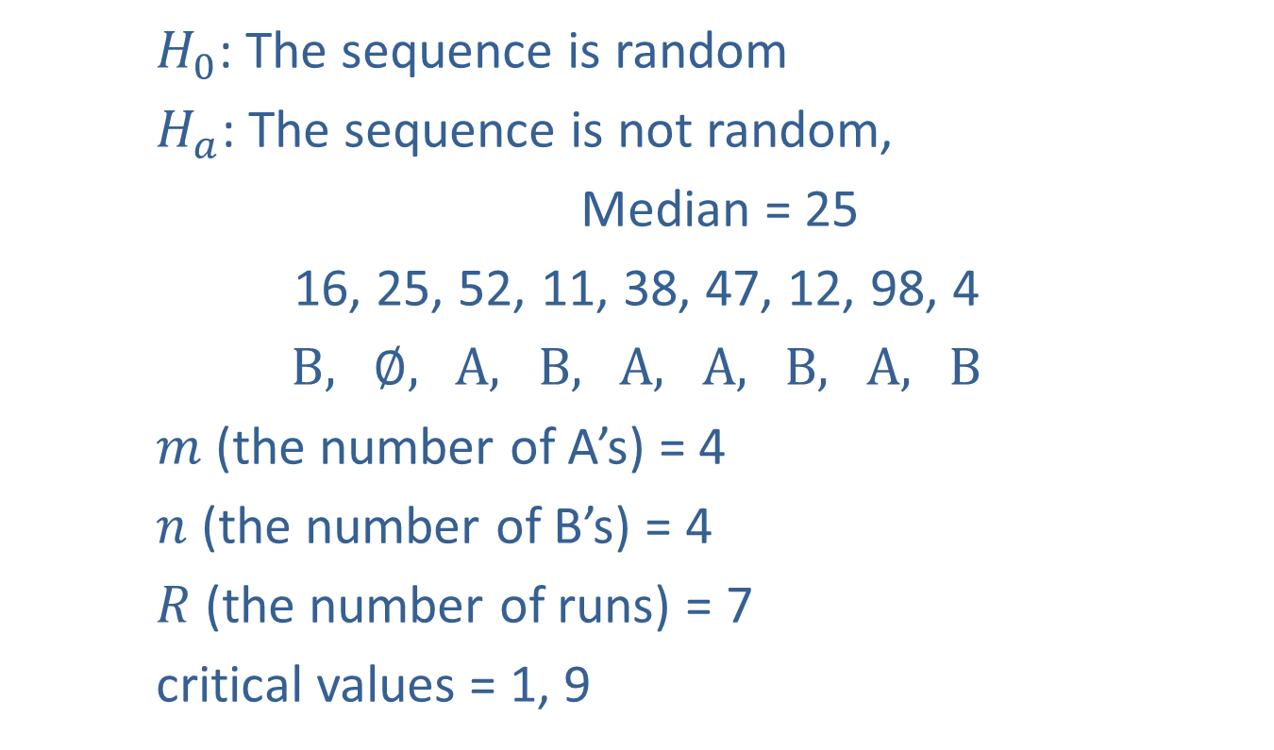
Example 17.5.3: Detecting Randomness of a Set of Numbers
$H_{0}$: The sequence is random
$H_{a}$: The sequence is not random,
Median = 25
16, 25, 52, 11, 38, 47, 12, 98, 4
$B,$ $∅,$ $A,$ $B,$ $A,$ $A,$ $B,$ $A,$ $B$
$m$ (the number of A’s) = 4
$n$ (the number of B’s) = 4
$R$ (the number of runs) = 7
critical values = 1, 9

Slide 24
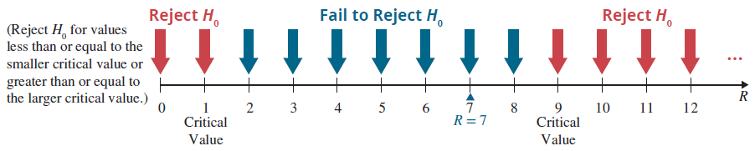

Example 17.5.3: Detecting Randomness of a Set of Numbers
Fail to reject $H_{0}$; there is no evidence of nonrandomness.

