Slide 1
Section 17.4
The Rank Correlation Test

Slide 2
The Rank Correlation Test
In Section 5.1 we studied the coefficient of correlation as a measure of association between two random variables. In this section instead of directly correlating the variables, we will transform the data into ranks and develop a method for detecting an association between the two variables. The rank correlation coefficient that bears his name was proposed by Spearman in 1904. Rank correlation coefficients were initially developed for scenarios where there is no underlying continuous measurement scale.

Slide 3
The Rank Correlation Test (cont.)
They are commonly used in situations where the ranks only represent the order of preference assigned by assessors. The rank correlation coefficient should also be used when normality of the data from which the samples are taken cannot be assumed.

Slide 4
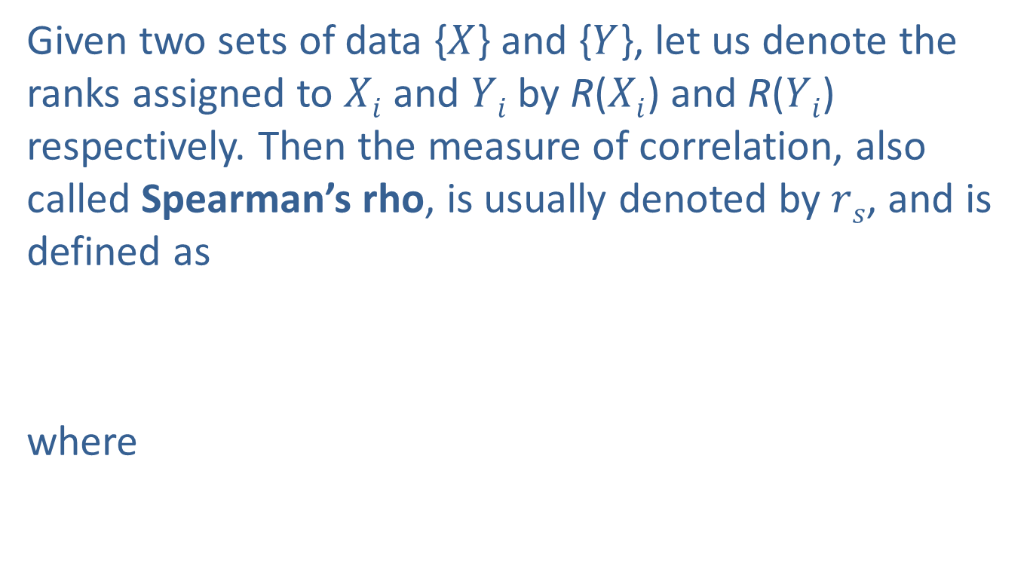
Measure of Correlation
Given two sets of data {$X$} and {$Y$}, let us denote the ranks assigned to $Xi$ and $Yi$ by R($Xi$) and R($Yi$) respectively. Then the measure of correlation, also called Spearman’s rho, is usually denoted by $rs$, and is defined as
where

Slide 5
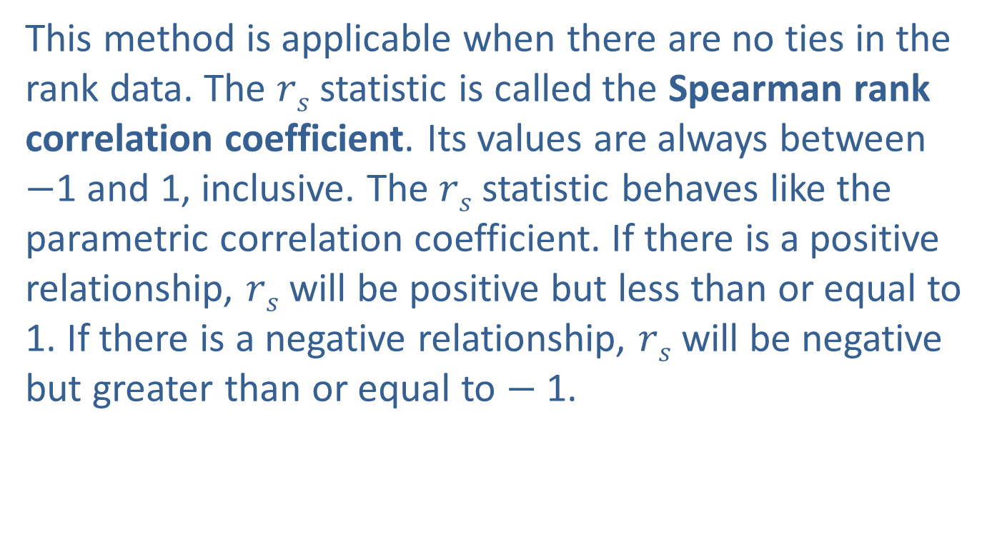
Measure of Correlation (cont.)
This method is applicable when there are no ties in the rank data. The $rs$ statistic is called the Spearman rank correlation coefficient. Its values are always between $−$1 and 1, inclusive. The $rs$ statistic behaves like the parametric correlation coefficient. If there is a positive relationship, $rs$ will be positive but less than or equal to 1. If there is a negative relationship, $rs$ will be negative but greater than or equal to $−$1.

Slide 6
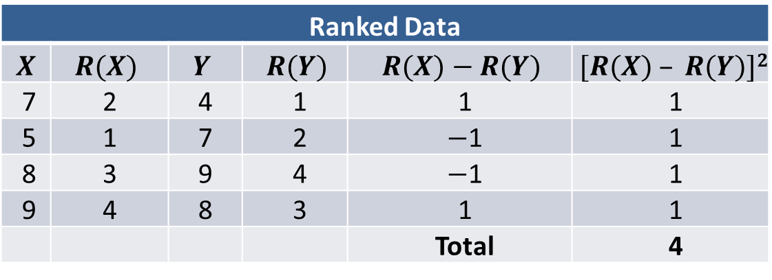
Example 17.4.1: Calculating the Spearman Rank Correlation Coefficient
Consider the given data set
Original Data
X | 7 | 5 | 8 | 9
Y | 4 | 7 | 9 | 8
Converting the data to ranks, we obtain:
Ranked Data
$$X$$ | $$R(X)$$ | $$Y$$ | $$R(Y)$$ | $$R(X)−R(Y)$$ | $$[R(X) – R(Y)]2$$
7 | 2 | 4 | 1 | 1 | 1
5 | 1 | 7 | 2 | $−$1 | 1
8 | 3 | 9 | 4 | $−$1 | 1
9 | 4 | 8 | 3 | 1 | 1
 |  |  |  | Total | 4

Slide 7

Example 17.4.1: Calculating the Spearman Rank Correlation Coefficient (cont.)
Therefore, $T=4$. In this example, $n=4$ since there are four pairs of values.
The value of $rs$ is then given by

Slide 8
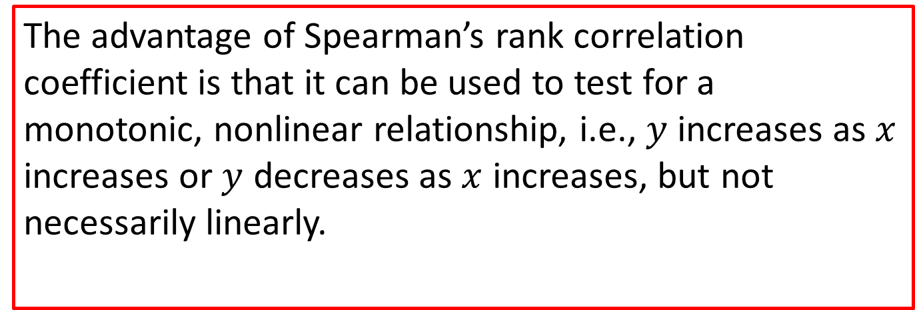
Note
The advantage of Spearman’s rank correlation coefficient is that it can be used to test for a monotonic, nonlinear relationship, i.e., $y$ increases as $x$ increases or $y$ decreases as $x$ increases, but not necessarily linearly.

Slide 9
Measure of Correlation (cont.)
We want to test the null hypothesis that there is no correlation between the two variables against the alternative hypothesis that there is a correlation. More specifically, we test
H₀: ρ = 0. There is no correlation between the two variables.
H_{a}: ρ ≠ 0. There is a correlation between the two variables.

Slide 10
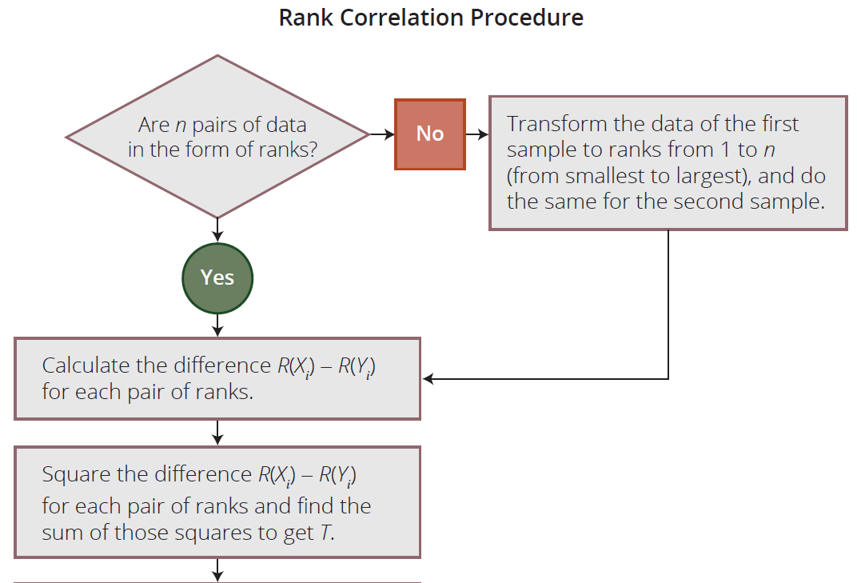
Measure of Correlation (cont.)

Slide 11
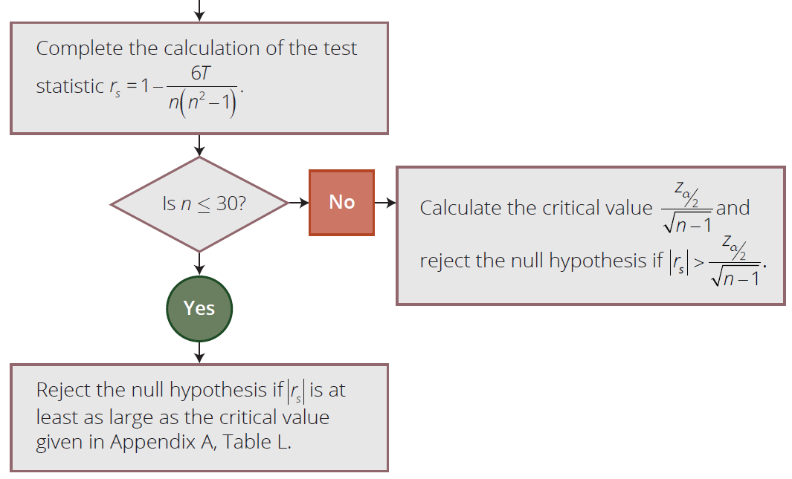
Measure of Correlation (cont.)

Slide 12
Example 17.4.2: Performing the Rank Correlation Test
The academic performances of fifteen college graduates are observed to examine the relationship between their SAT scores and their GPAs. The SAT scores and the GPAs are given in the following table.

Slide 13
Example 17.4.2: Performing the Rank Correlation Test (cont.)
Student | SAT Total | College GPA | Student | SAT Total | College GPA
1 | 1064 | 2.52 | 9 | 1122 | 2.59
2 | 1085 | 2.74 | 10 | 1163 | 3.20
3 | 1270 | 2.76 | 11 | 1187 | 3.21
4 | 1093 | 2.83 | 12 | 1302 | 3.39
5 | 1170 | 2.91 | 13 | 1044 | 3.41
6 | 1135 | 2.40 | 14 | 1234 | 3.42
7 | 1262 | 3.08 | 15 | 1316 | 3.47
8 | 1074 | 3.17
Test the hypothesis that there is no relationship between the variables at the α = 0.10 level.

Slide 14
Example 17.4.2: Performing the Rank Correlation Test (cont.)
Solution
In order to test whether an association exists between these two variables at α = 0.10, we prepare the following table.
H₀: ρ = 0
H_{a}: ρ ≠ 0

Slide 15
Example 17.4.2: Performing the Rank Correlation Test (cont.)
Student | SAT Total (X) | College GPA (Y) | R(X) | R(Y) | [R(X) − R(Y)]²
1 | 1064 | 2.52 | 2 | 2 | 0
2 | 1085 | 2.74 | 4 | 4 | 0
3 | 1270 | 2.76 | 13 | 5 | 64
4 | 1093 | 2.83 | 5 | 6 | 1
5 | 1170 | 2.91 | 9 | 7 | 4
6 | 1135 | 2.40 | 7 | 1 | 36
7 | 1262 | 3.08 | 12 | 8 | 16
8 | 1074 | 3.17 | 3 | 9 | 36
9 | 1122 | 2.59 | 6 | 3 | 9
10 | 1163 | 3.20 | 8 | 10 | 4
11 | 1187 | 3.21 | 10 | 11 | 1
12 | 1302 | 3.39 | 14 | 12 | 4
13 | 1044 | 3.41 | 1 | 13 | 144
14 | 1234 | 3.42 | 11 | 14 | 9
15 | 1316 | 3.47 | 15 | 15 | 0

Slide 16

Example 17.4.2: Performing the Rank Correlation Test (cont.)
We then calculate the test statistic
Since our sample size is
15 ($n≤30$), the value of the statistic is compared with the critical value obtained using Appendix A Table L.
n | ... | α = 0.10 | α = 0.05 | α = 0.02
11 |  | 0.523 0.497 0.475 0.457 | 0.623 | 0.736
12 |  |  | 0.591 | 0.703
13 |  |  | 0.566 | 0.673
14 |  |  | 0.545 | 0.646
15 |  | 0.441 | 0.525 | 0.623

Slide 17
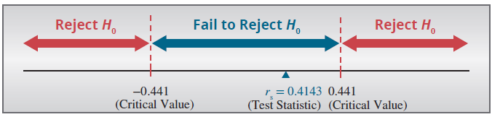

Example 17.4.2: Performing the Rank Correlation Test (cont.)
Note: Table L in Appendix A is constructed for a two-tailed test. So, we want to reject H₀ if $rs<−0.441$or
$rs>0.441$. Since $0.4143<0.441$, we fail to reject the null hypothesis at the 10% level of significance. Hence, there does not seem to be an association between SAT scores and GPAs.

