Slide 1
Section 17.3
The Wilcoxon Rank-Sum Test

Slide 2
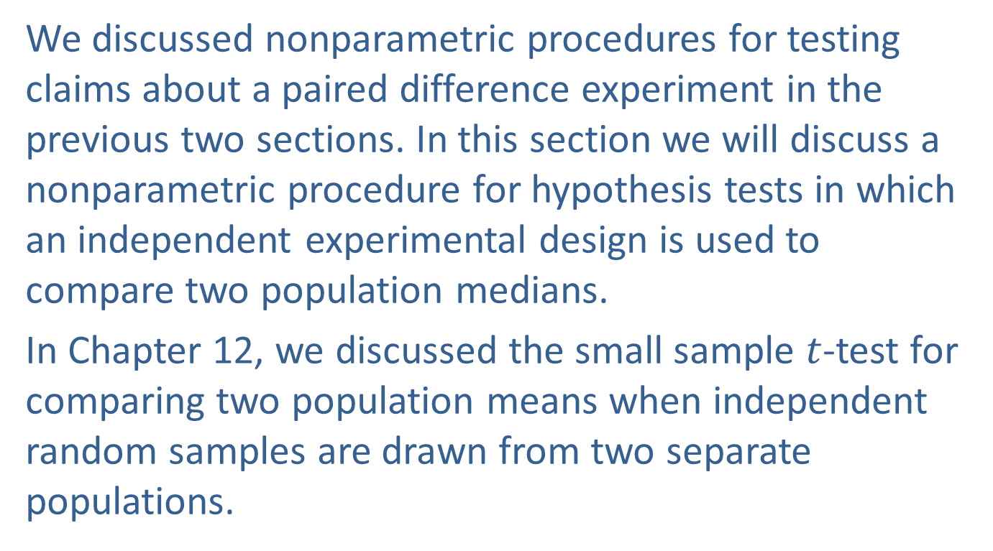
The Wilcoxon Rank-Sum Test
We discussed nonparametric procedures for testing claims about a paired difference experiment in the previous two sections. In this section we will discuss a nonparametric procedure for hypothesis tests in which an independent experimental design is used to compare two population medians.
In Chapter 12, we discussed the small sample $t$-test for comparing two population means when independent random samples are drawn from two separate populations.

Slide 3
The Wilcoxon Rank-Sum Test (cont.)
In order to perform that test we need to make two important assumptions, namely that the distributions of both populations of interest are approximately normal and that they have equal variances.
The Wilcoxon Rank-Sum Test is a nonparametric technique which can be used to compare two probability distributions when we are either unwilling or unable to make the assumption of normality. It may also be used in the situation where the level of the data is only ordinal, meaning we can only rank the data.

Slide 4
The Wilcoxon Rank-Sum Test (cont.)
Although the Wilcoxon Rank-Sum Test does not require the assumptions of normality and equal variance for validity, it does require that the two samples are drawn in a random and independent manner and that the data must be such that it can be ranked from largest to smallest.
The test procedure for the Wilcoxon Rank-Sum Test will be illustrated in the following example.

Slide 5
Example 17.3.1: Performing the Wilcoxon Rank-Sum Test
The administrator of a local hospital is attempting to control skyrocketing medical costs. A study has indicated that the longer a patient stays in the hospital the more costly it is for both the patient and the hospital. Contrary to popular belief, the hospital suffers in these situations because it is often not able to collect the entire bill for the stay. Generally the insurance company is unwilling to pay for the entire stay, or the individual is unable to pay.

Slide 6
Example 17.3.1: Performing the Wilcoxon Rank-Sum Test (cont.)
Based on the study, it appears that there are two wards with particularly lengthy hospital stays, the pediatric ward and the geriatric ward (excluding long-term care patients). It also appears that of these two areas the length of stay in the hospital is higher in the pediatric ward than in the geriatric ward. If there is overwhelming evidence that this is the case, all initial cost control efforts will be targeted specifically at the pediatric ward.

Slide 7
Example 17.3.1: Performing the Wilcoxon Rank-Sum Test (cont.)
However, it could be that this observed difference is due to ordinary sampling variation as only 10 randomly selected patient stays from each ward were observed for the study. In this case, the hospital will target its initial cost control efforts at both wards equally. Partial results of the study are presented in the table below. Does the data provide sufficient evidence for the administrator to conclude that hospital stays are longer on the pediatric ward than on the geriatric ward at
α = 0.05?

Slide 8
Example 17.3.1: Performing the Wilcoxon Rank-Sum Test (cont.)
Length of Hospital Stay in Days
Pediatric Ward | Rank | Geriatric Ward | Rank
10 | 9 | 4 | 3
2 | 1 | 13 | 10
8 | 7 | 7 | 6
17 | 12 | 18 | 13.5
60 | 20 | 32 | 17
20 | 15 | 50 | 19
30 | 16 | 18 | 13.5
35 | 18 | 15 | 11
5 | 4 | 6 | 5
9 | 8 | 3 | 2
Rank-Sum | 110 |  | 100

Slide 9
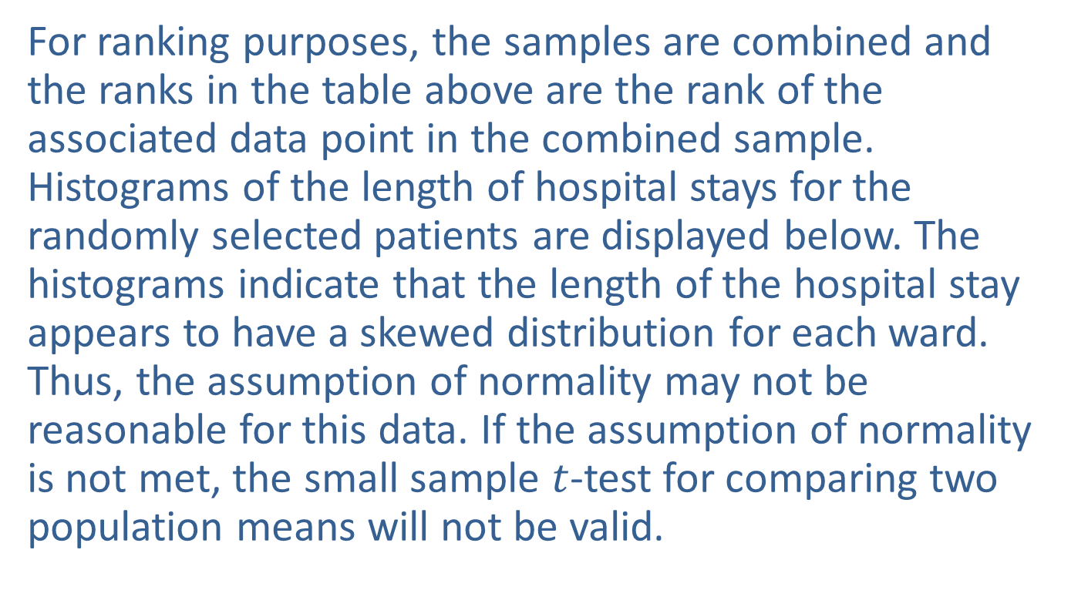
Example 17.3.1: Performing the Wilcoxon Rank-Sum Test (cont.)
For ranking purposes, the samples are combined and the ranks in the table above are the rank of the associated data point in the combined sample. Histograms of the length of hospital stays for the randomly selected patients are displayed below. The histograms indicate that the length of the hospital stay appears to have a skewed distribution for each ward. Thus, the assumption of normality may not be reasonable for this data. If the assumption of normality is not met, the small sample $t$-test for comparing two population means will not be valid.

Slide 10
Example 17.3.1: Performing the Wilcoxon Rank-Sum Test (cont.)
However, independent random samples were drawn from each ward and the data can be ranked. Thus, the assumptions of the Wilcoxon Rank-Sum Test are satisfied and we can proceed with that test procedure.

Slide 11
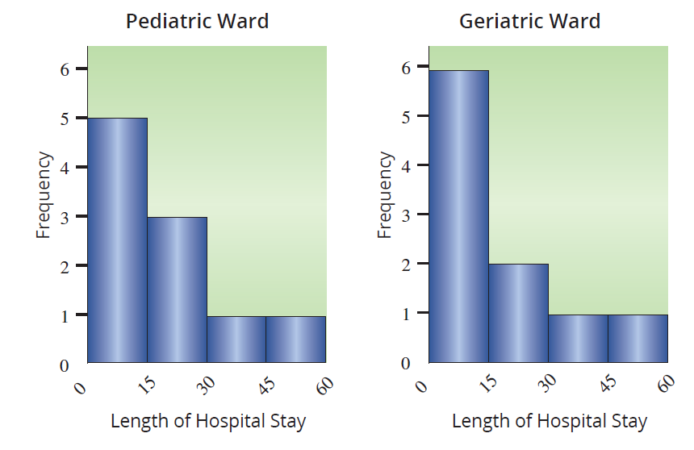
Example 17.3.1: Performing the Wilcoxon Rank-Sum Test (cont.)

Slide 12
Example 17.3.1: Performing the Wilcoxon Rank-Sum Test (cont.)
Step 1: Determine the population parameter to be used and develop the null and alternative hypotheses.
Null Hypothesis: The length of the hospital stay for the two wards is the same.
Alternative Hypothesis: The length of the hospital stay is longer for the pediatric ward than the geriatric ward.
Because we are not making a hypothesis about a specific population parameter, we will delay the discussion of the statistical measures until Step 3.

Slide 13
Example 17.3.1: Performing the Wilcoxon Rank-Sum Test (cont.)
Since the hospital administrator is interested in knowing if the length of stay in the pediatric ward is longer than in the geriatric ward, this is a one-sided test.
H₀: The probability distributions of the length of hospital stay for the pediatric ward and the geriatric ward are the same.
H_{a}: The probability distribution for length of hospital stay in the pediatric ward is shifted to the right of that of the probability distribution of length of stay in the geriatric ward.

Slide 14
Example 17.3.1: Performing the Wilcoxon Rank-Sum Test (cont.)
Step 2: Specify the significance level α.
The level of the test is specified in the problem to be
α = 0.05.
Step 3: Validate the assumptions of the hypothesis test, identify the appropriate test statistic and compute its value.
The assumptions have already been verified.
Data can be ranked (length of stay).
The two samples are selected in an independent and random fashion.

Slide 15
Example 17.3.1: Performing the Wilcoxon Rank-Sum Test (cont.)
The Wilcoxon Rank-Sum Test uses the idea that if the null hypothesis is true, both samples come from the same population and you should be able to combine them. After the samples are combined, rank the data and compute the sum of the ranks for each sample. In our example, the Wilcoxon Rank-Sum Test compares the sum of the ranks, the Rank-Sum, for the pediatric ward patients to the sum of the ranks for the geriatric ward patients.

Slide 16
Example 17.3.1: Performing the Wilcoxon Rank-Sum Test (cont.)
If the null hypothesis is true, we would expect the Rank-Sums to have approximately the same value. If the alternative hypothesis is true, we expect lower ranks to dominate in one population and higher ranks in the other. So, if the Rank-Sums are very different, it will cause us to doubt that the observations come from the same population. Thus, the Rank-Sum will be the measure which will be used for our test statistic. How large a difference in the Rank-Sums is necessary before they are considered significantly different?

Slide 17
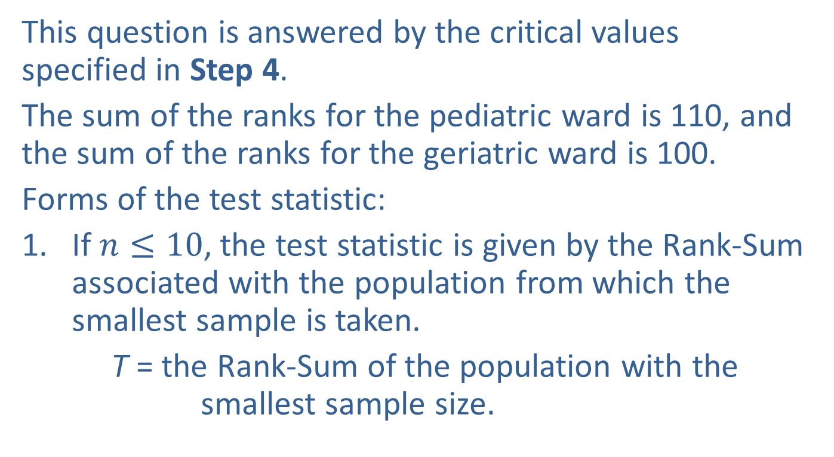
Example 17.3.1: Performing the Wilcoxon Rank-Sum Test (cont.)
This question is answered by the critical values specified in Step 4.
The sum of the ranks for the pediatric ward is 110, and the sum of the ranks for the geriatric ward is 100.
Forms of the test statistic:
If $n≤10$, the test statistic is given by the Rank-Sum associated with the population from which the smallest sample is taken.
T = the Rank-Sum of the population with the smallest sample size.

Slide 18
Example 17.3.1: Performing the Wilcoxon Rank-Sum Test (cont.)
If the sample sizes are equal, use the Rank-Sum associated with the “shifted” population in the alternative hypothesis. In our example, the alternative hypothesis states that the pediatric ward length of stay is greater than the geriatric ward length of stay, which implies the distribution of the length of stay for the pediatric patients is shifted to the right of the distribution of the geriatric patients’ length of stay.

Slide 19
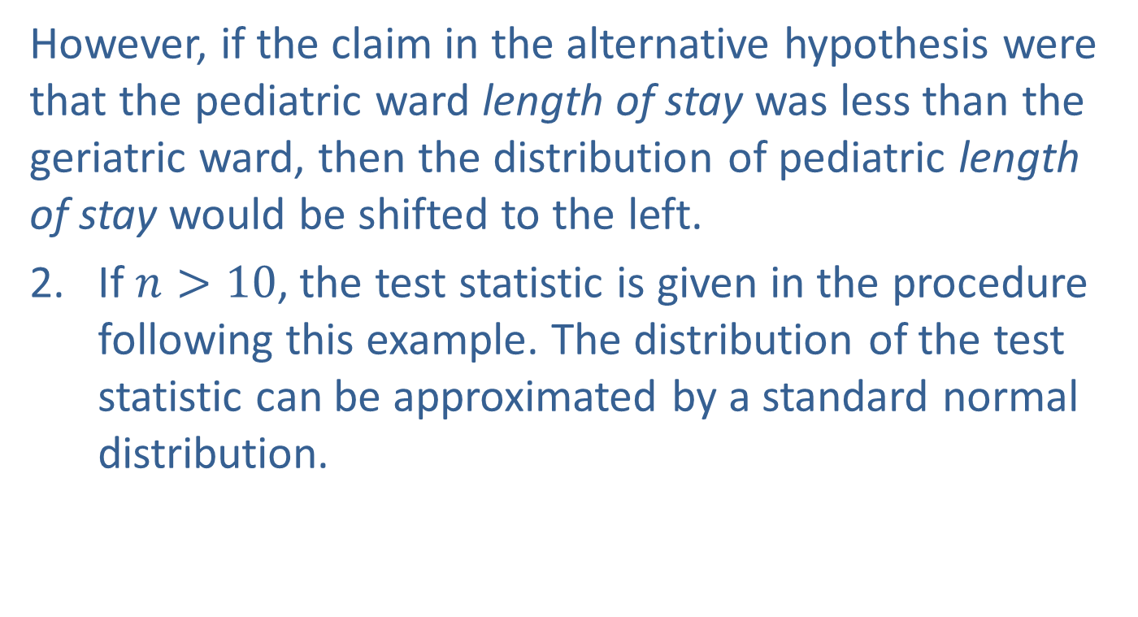
Example 17.3.1: Performing the Wilcoxon Rank-Sum Test (cont.)
However, if the claim in the alternative hypothesis were that the pediatric ward length of stay was less than the geriatric ward, then the distribution of pediatric length of stay would be shifted to the left.
If $n>10$, the test statistic is given in the procedure following this example. The distribution of the test statistic can be approximated by a standard normal distribution.

Slide 20
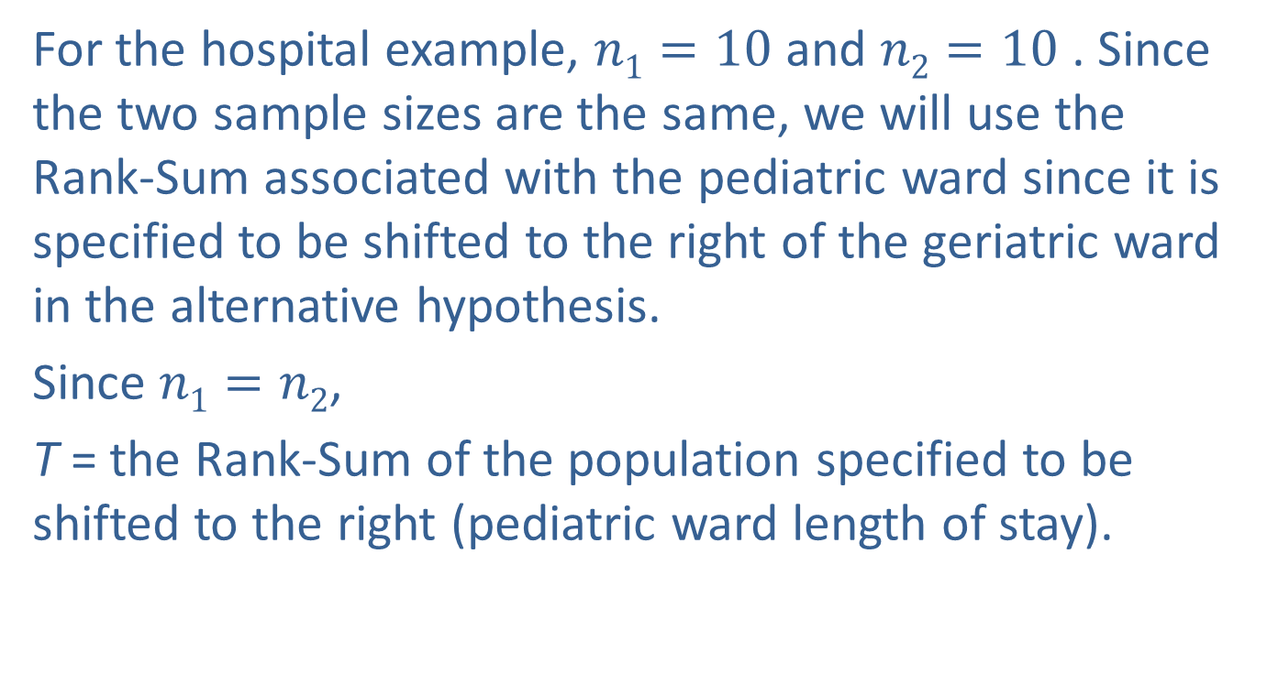
Example 17.3.1: Performing the Wilcoxon Rank-Sum Test (cont.)
For the hospital example, $n1=10$ and $n2=10$ . Since the two sample sizes are the same, we will use the Rank-Sum associated with the pediatric ward since it is specified to be shifted to the right of the geriatric ward in the alternative hypothesis.
Since $n1=n2$,
T = the Rank-Sum of the population specified to be shifted to the right (pediatric ward length of stay).

Slide 21
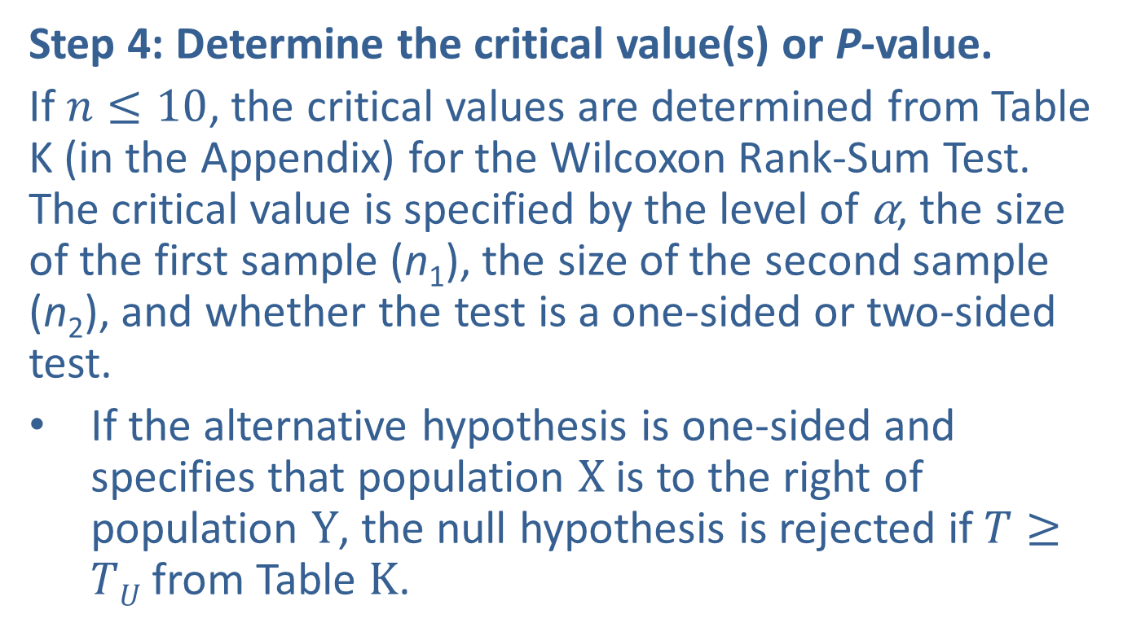
Example 17.3.1: Performing the Wilcoxon Rank-Sum Test (cont.)
Step 4: Determine the critical value(s) or P-value.
If $n≤10$, the critical values are determined from Table K (in the Appendix) for the Wilcoxon Rank-Sum Test. The critical value is specified by the level of α, the size of the first sample (n₁), the size of the second sample (n₂), and whether the test is a one-sided or two-sided test.
If the alternative hypothesis is one-sided and specifies that population $X$ is to the right of population $Y$, the null hypothesis is rejected if $T≥TU$from Table $K$.

Slide 22
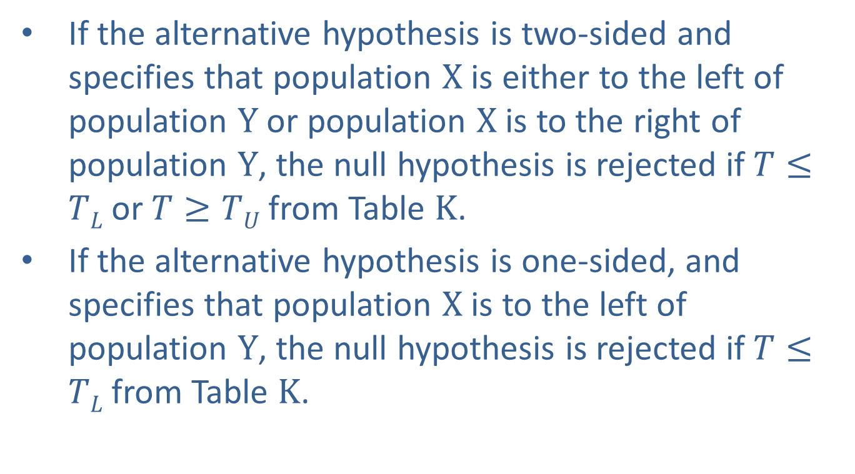
Example 17.3.1: Performing the Wilcoxon Rank-Sum Test (cont.)
If the alternative hypothesis is two-sided and specifies that population $X$ is either to the left of population $Y$ or population $X$ is to the right of population $Y$, the null hypothesis is rejected if $T≤TL$or $T≥TU$from Table $K$.
If the alternative hypothesis is one-sided, and specifies that population $X$ is to the left of population $Y$, the null hypothesis is rejected if $T≤TL$from Table $K$.

Slide 23
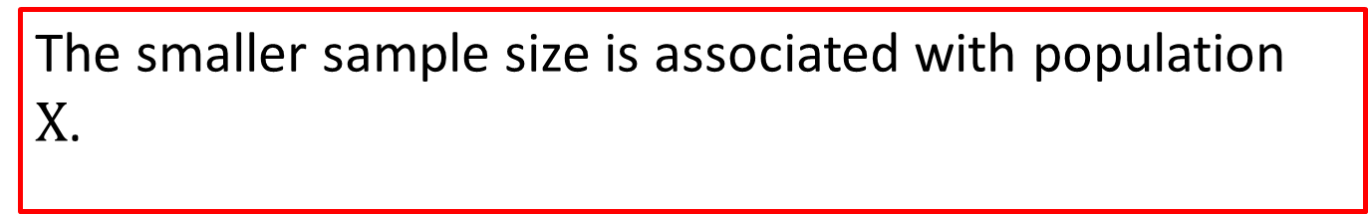
Note
The smaller sample size is associated with population $X$.

Slide 24
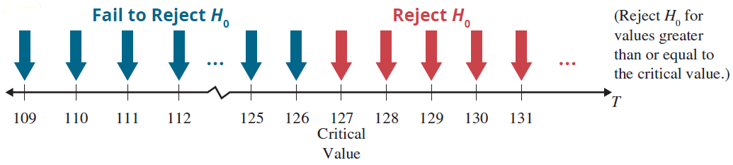
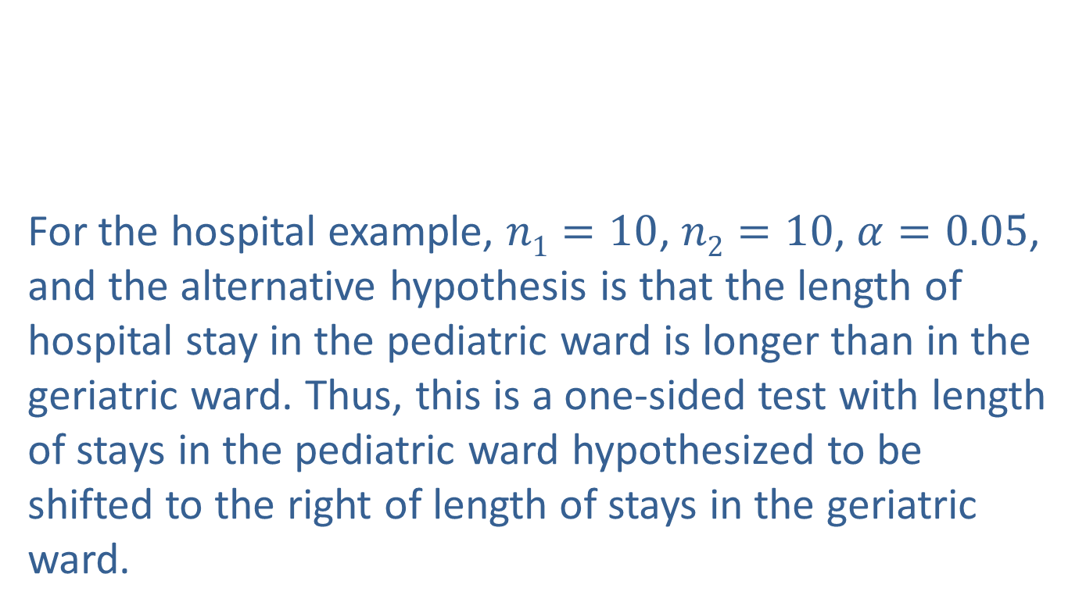
Example 17.3.1: Performing the Wilcoxon Rank-Sum Test (cont.)
For the hospital example, $n1=10$, $n2=10$, $α=0.05$, and the alternative hypothesis is that the length of hospital stay in the pediatric ward is longer than in the geriatric ward. Thus, this is a one-sided test with length of stays in the pediatric ward hypothesized to be shifted to the right of length of stays in the geriatric ward.

Slide 25
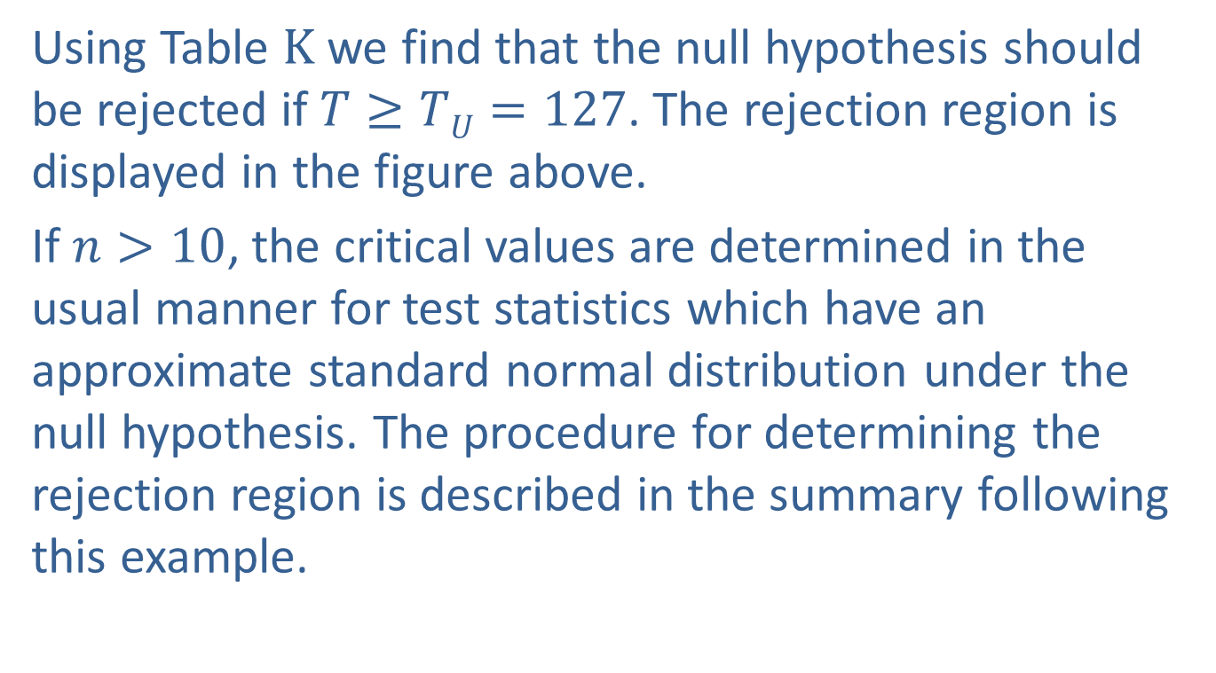
Example 17.3.1: Performing the Wilcoxon Rank-Sum Test (cont.)
Using Table $K$ we find that the null hypothesis should be rejected if $T≥TU=127$. The rejection region is displayed in the figure above.
If $n>10$, the critical values are determined in the usual manner for test statistics which have an approximate standard normal distribution under the null hypothesis. The procedure for determining the rejection region is described in the summary following this example.

Slide 26
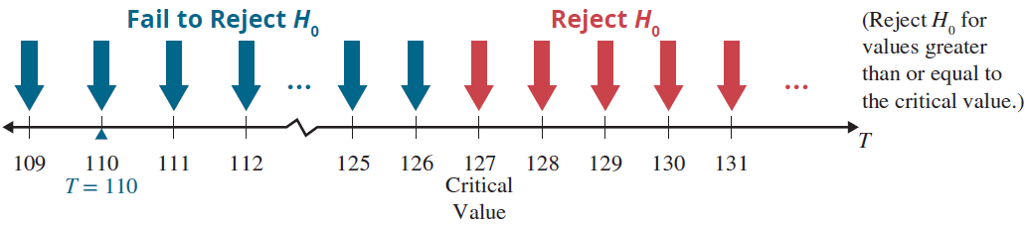

Example 17.3.1: Performing the Wilcoxon Rank-Sum Test (cont.)
Step 5: Choose between the null and alternative hypotheses.
As shown above, the value of the test statistic does not fall in the rejection region (110 is less than 127). Thus, we fail to reject the null hypothesis at $α=0.05$.

Slide 27
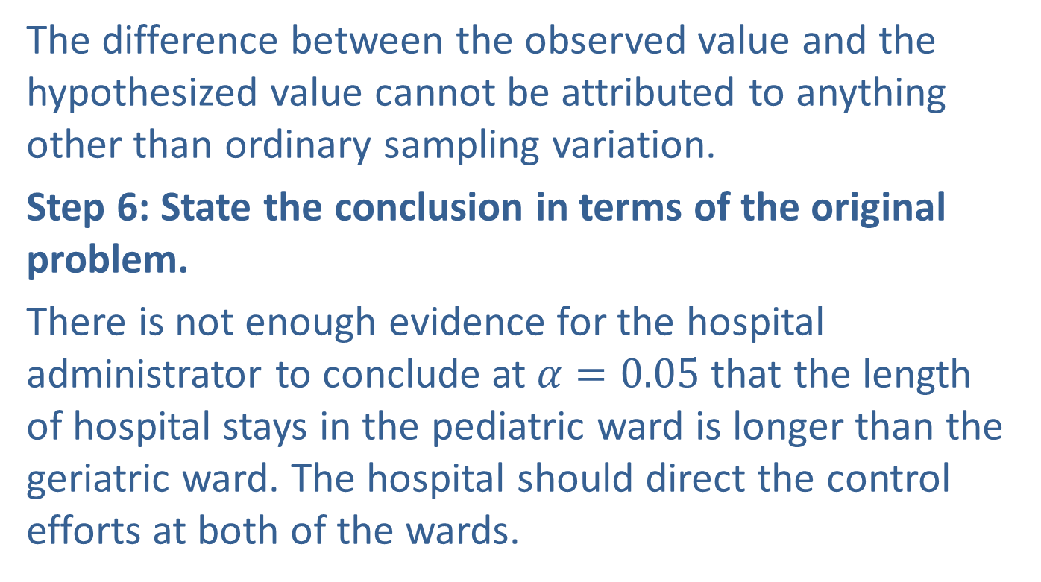
Example 17.3.1: Performing the Wilcoxon Rank-Sum Test (cont.)
The difference between the observed value and the hypothesized value cannot be attributed to anything other than ordinary sampling variation.
Step 6: State the conclusion in terms of the original problem.
There is not enough evidence for the hospital administrator to conclude at $α=0.05$that the length of hospital stays in the pediatric ward is longer than the geriatric ward. The hospital should direct the control efforts at both of the wards.

Slide 28
Procedure: Test Procedure for the Wilcoxon Rank-Sum Test
Assumptions:
Data is such that they can be ranked.
The two samples are selected in an independent and random fashion.

Slide 29
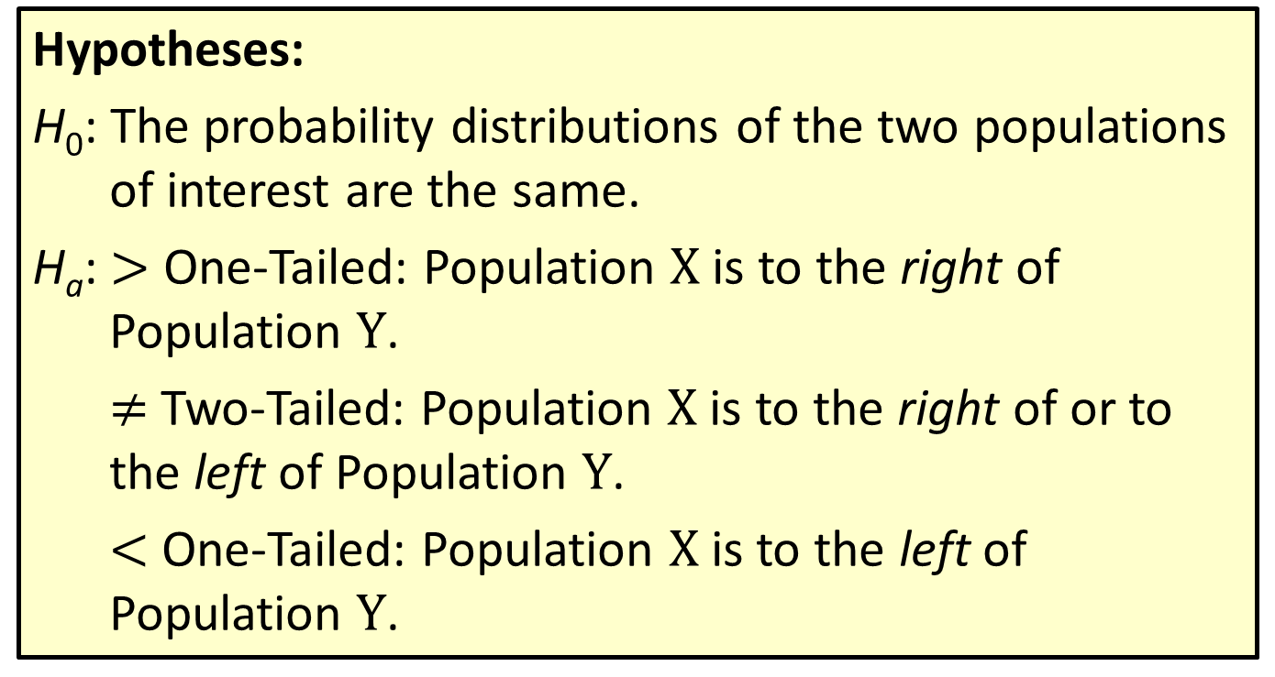
Procedure: Test Procedure for the Wilcoxon Rank-Sum Test (cont.)
Hypotheses:
H₀: The probability distributions of the two populations of interest are the same.
H_{a}: $>$ One-Tailed: Population $X$ is to the right of Population $Y$.
$≠$ Two-Tailed: Population $X$ is to the right of or to the left of Population $Y$.
$<$ One-Tailed: Population $X$ is to the left of Population $Y$.

Slide 30
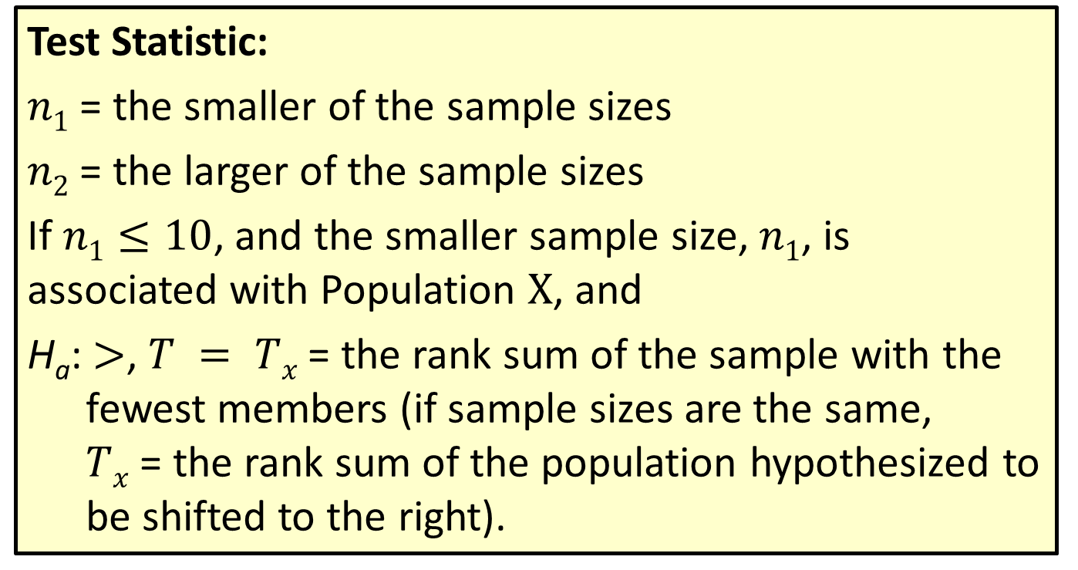
Procedure: Test Procedure for the Wilcoxon Rank-Sum Test (cont.)
Test Statistic:
$n1$ = the smaller of the sample sizes
$n2$ = the larger of the sample sizes
If $n1≤10$, and the smaller sample size, $n1$, is associated with Population $X$, and
H_{a}: $>$, $T = Tx$= the rank sum of the sample with the fewest members (if sample sizes are the same,
$Tx$ = the rank sum of the population hypothesized to be shifted to the right).

Slide 31
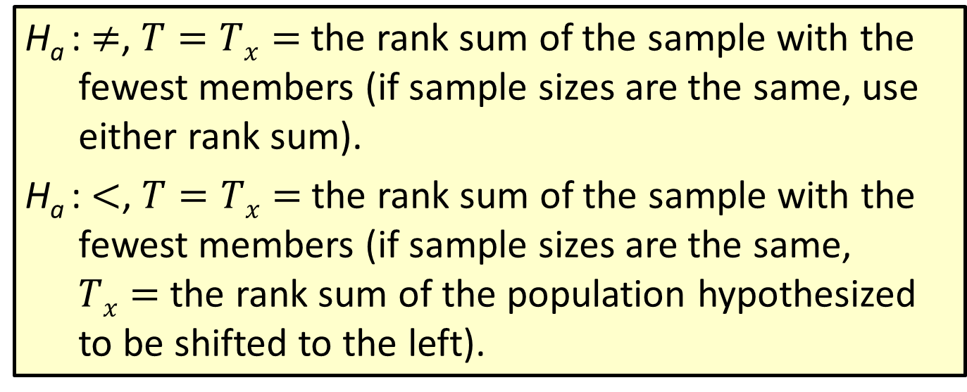
Procedure: Test Procedure for the Wilcoxon Rank-Sum Test (cont.)
H_{a} : $≠$, $T=Tx=$the rank sum of the sample with the fewest members (if sample sizes are the same, use either rank sum).
H_{a} : $<$, $T=Tx=$the rank sum of the sample with the fewest members (if sample sizes are the same,
$Tx=$ the rank sum of the population hypothesized to be shifted to the left).

Slide 32
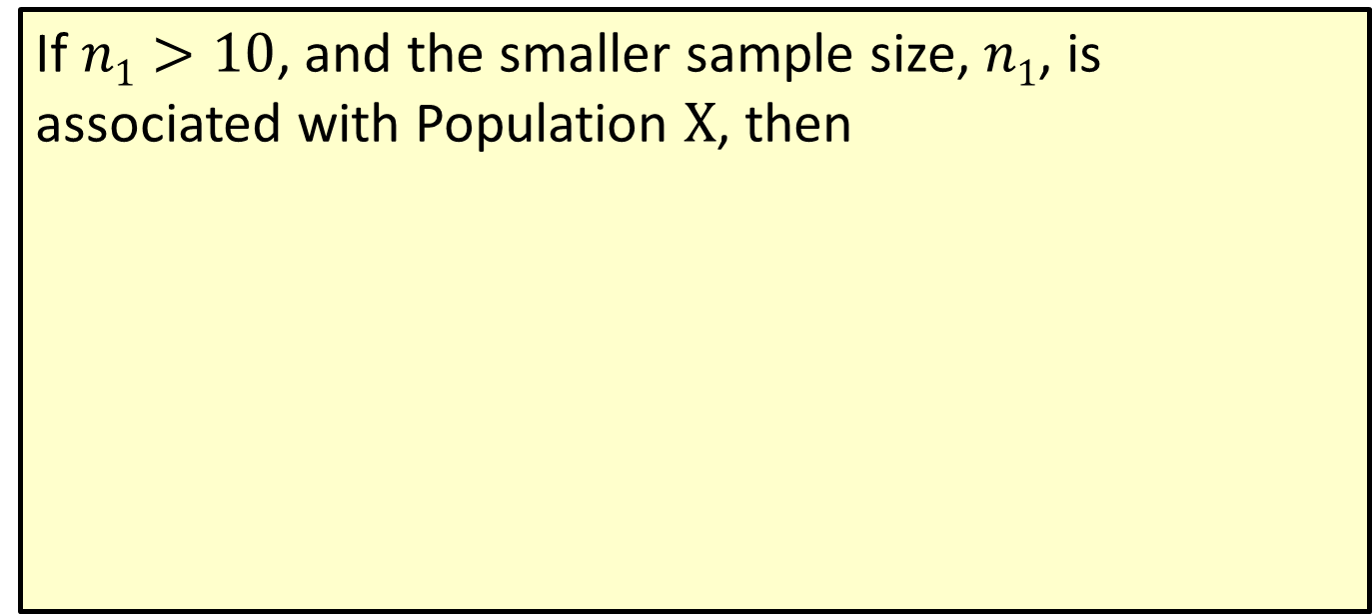
Procedure: Test Procedure for the Wilcoxon Rank-Sum Test (cont.)
If $n1>10$, and the smaller sample size, $n1$, is associated with Population $X$, then
where T_{x} is defined as above.

Slide 33
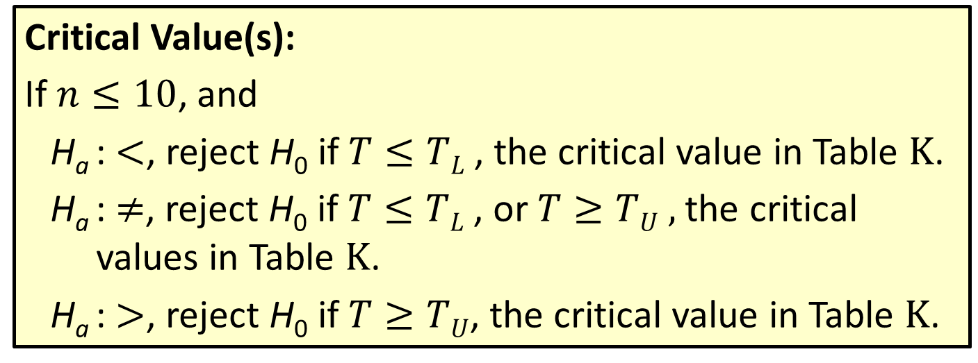
Procedure: Test Procedure for the Wilcoxon Rank-Sum Test (cont.)
Critical Value(s):
If $n≤10$, and
H_{a} : $<$, reject H₀ if $T≤TL$ , the critical value in Table $K$.
H_{a} : $≠$, reject H₀ if $T≤TL$, or $T≥TU ,$the critical values in Table $K$.
H_{a} : $>$, reject H₀ if $T≥TU$, the critical value in Table $K$.

Slide 34
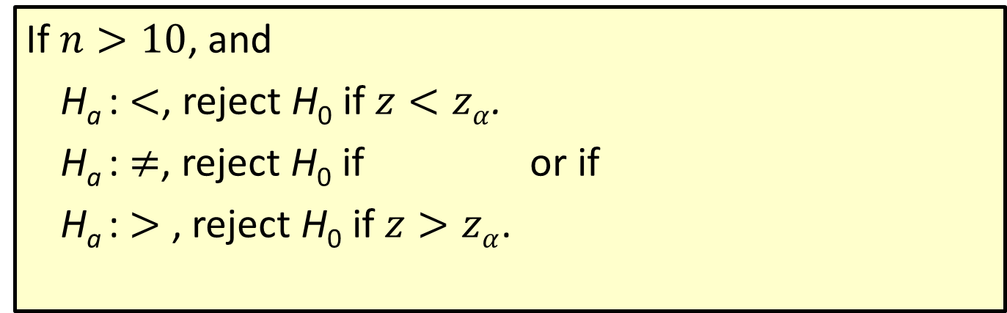
Procedure: Test Procedure for the Wilcoxon Rank-Sum Test (cont.)
If $n>10$, and
H_{a} : $<$, reject H₀ if $z<zα$.
H_{a} : $≠$, reject H₀ if or if
H_{a} : $>$ , reject H₀ if $z>zα$.

