Slide 1
Section 17.2
The Wilcoxon Signed-Rank Test

Slide 2
The Wilcoxon Signed-Rank Test
A disadvantage of the Sign Test, discussed in the previous section, is that it wastes information. The Sign Test merely counts the number of positive or negative signs in a paired difference experiment and ignores the magnitude of the differences. The Wilcoxon Signed-Rank Test is a nonparametric technique which can be used to evaluate a paired difference experiment where the magnitude of these differences is not ignored. However, the magnitude is not taken directly into account; instead, the ranks of the data are analyzed.

Slide 3
The Wilcoxon Signed-Rank Test (cont.)
This test is designed to detect populations whose centers are shifted to the right or the left of each other. As with the Sign Test, no distributional assumption is required. However, the pairs of data must have been selected in a random fashion, and it must be possible to rank the differences.

Slide 4
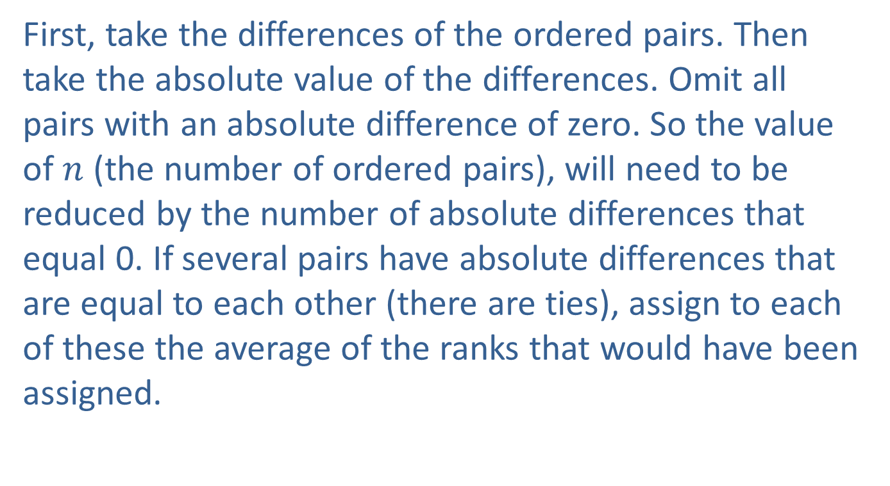
Ranking Procedure
First, take the differences of the ordered pairs. Then take the absolute value of the differences. Omit all pairs with an absolute difference of zero. So the value of $n$ (the number of ordered pairs), will need to be reduced by the number of absolute differences that equal 0. If several pairs have absolute differences that are equal to each other (there are ties), assign to each of these the average of the ranks that would have been assigned.

Slide 5
Ranking Procedure (cont.)
So, if two pairs had the same difference and they are tied for ranks 4 and 5, then we will average the ranks and give each of these pairs the average rank of 4.5 If three pairs are tied for the ranks 7, 8, and 9 then the average of those ranks is 8, so each of the three pairs will be given a rank of 8.

Slide 6
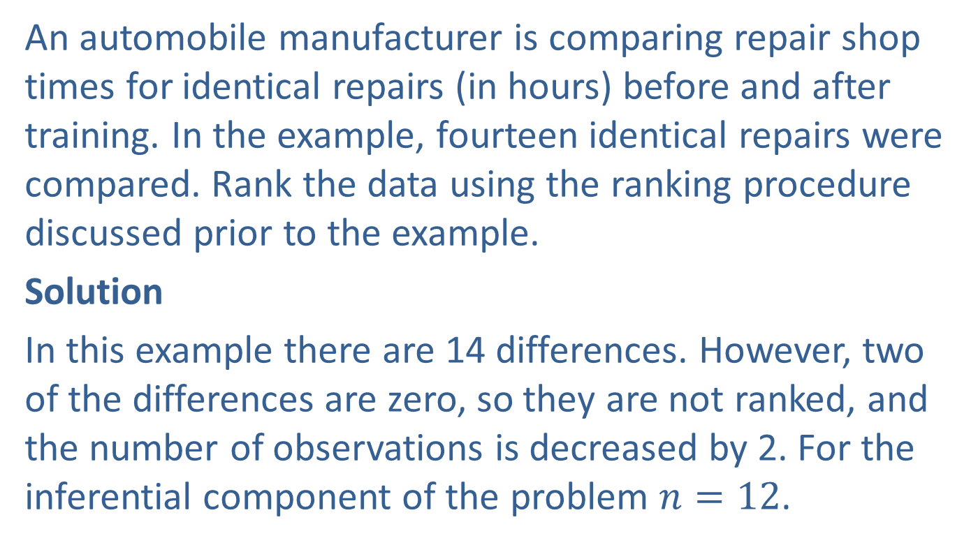
Example 17.2.1: Ranking Quantitative Data
An automobile manufacturer is comparing repair shop times for identical repairs (in hours) before and after training. In the example, fourteen identical repairs were compared. Rank the data using the ranking procedure discussed prior to the example.
Solution
In this example there are 14 differences. However, two of the differences are zero, so they are not ranked, and the number of observations is decreased by 2. For the inferential component of the problem $n=12$.

Slide 7
Example 17.2.1: Ranking Quantitative Data (cont.)
There are two sets of differences in which two of the differences are tied and their ranks are averaged. There is one set of differences in which three of the differences are tied and the ranks are averaged. After the ranking of the differences is complete, we will give the rank the sign of the original difference.

Slide 8
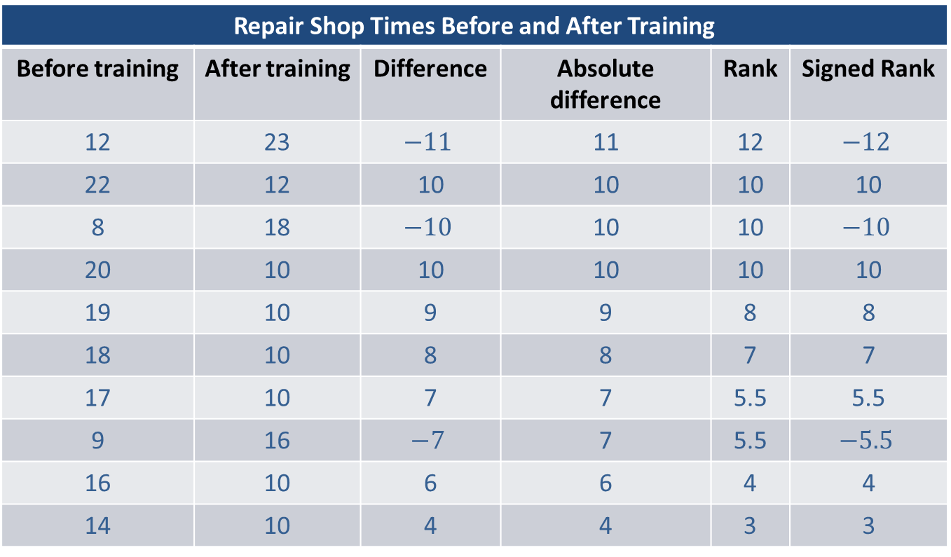
Example 17.2.1: Ranking Quantitative Data (cont.)
Repair Shop Times Before and After Training
Before training | After training | Difference | Absolute difference | Rank | Signed Rank
12 | 23 | $$−11$$ | 11 | 12 | $$−12$$
22 | 12 | 10 | 10 | 10 | 10
8 | 18 | $$−10$$ | 10 | 10 | $$−10$$
20 | 10 | 10 | 10 | 10 | 10
19 | 10 | 9 | 9 | 8 | 8
18 | 10 | 8 | 8 | 7 | 7
17 | 10 | 7 | 7 | 5.5 | 5.5
9 | 16 | $$−7$$ | 7 | 5.5 | $$−5.5$$
16 | 10 | 6 | 6 | 4 | 4
14 | 10 | 4 | 4 | 3 | 3

Slide 9
Example 17.2.1: Ranking Quantitative Data (cont.)
Repair Shop Times Before and After Training (cont.)
Before training | After training | Difference | Absolute difference | Rank | Signed Rank
13 | 10 | 3 | 3 | 2 | 2
12 | 10 | 2 | 2 | 1 | 1
10 | 10 | 0 | 0 | NR
10 | 10 | 0 | 0 | NR

Slide 10
Example 17.2.2: Performing the Wilcoxon Signed-Rank Test
A consulting firm implemented a quality program in an effort to improve the productivity level of its employees. All employees received two and one-half days of intensive training on the concepts of total quality management, with an emphasis on process mapping. In addition to the initial training, each employee participated on a team (a QET-Quality Enhancement Team or CIT-Continuous Improvement Team) which focused on either breakthrough improvements in a process-QET or the continuous improvement of a process-CIT.

Slide 11
Example 17.2.2: Performing the Wilcoxon Signed-Rank Test (cont.)
Each team was given the responsibility and the authority to implement the improvements to the process which it deemed necessary. A year after the initial training, the management of the company conducted a study to see if the productivity level of its employees had improved. The productivity level of employees is measured by realized billable hours per week. Realized billable hours are the number of hours which an employee works and bills to a client.

Slide 12
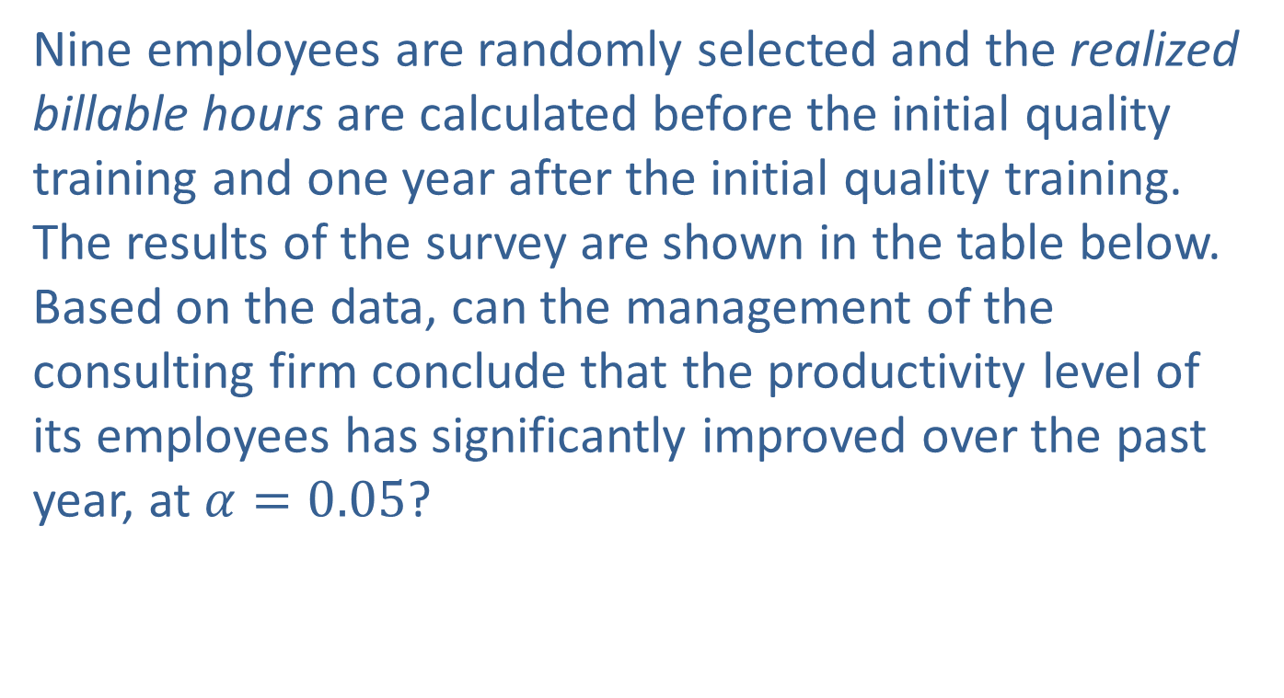
Example 17.2.2: Performing the Wilcoxon Signed-Rank Test (cont.)
Nine employees are randomly selected and the realized billable hours are calculated before the initial quality training and one year after the initial quality training. The results of the survey are shown in the table below. Based on the data, can the management of the consulting firm conclude that the productivity level of its employees has significantly improved over the past year, at $α=0.05$?

Slide 13
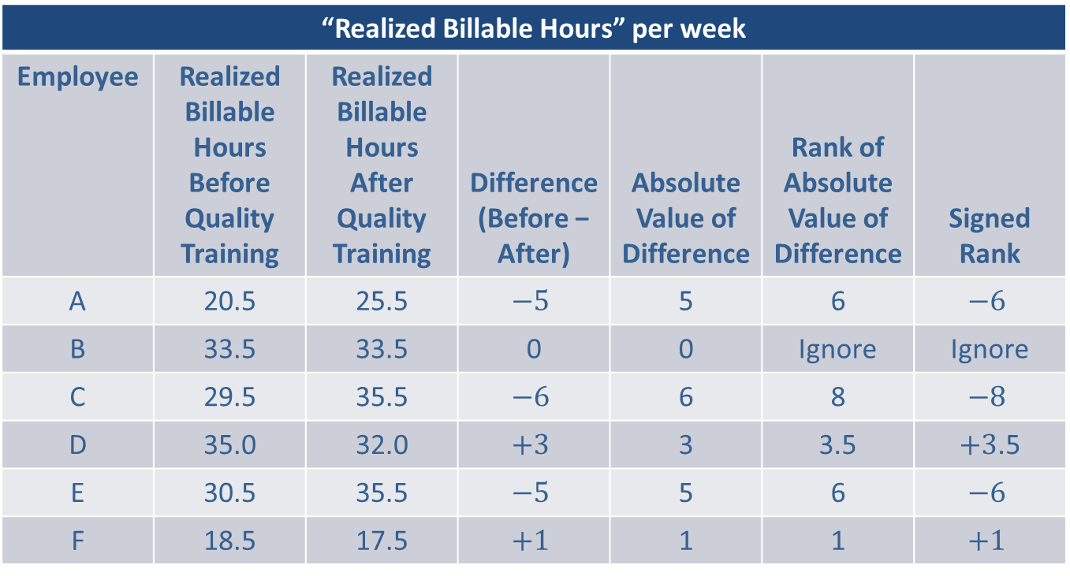
Example 17.2.2: Performing the Wilcoxon Signed-Rank Test (cont.)
“Realized Billable Hours” per week
Employee | Realized Billable Hours Before Quality Training | Realized Billable Hours After Quality Training | Difference (Before − After) | Absolute Value of Difference | Rank of Absolute Value of Difference | Signed Rank
A | 20.5 | 25.5 | $$−5$$ | 5 | 6 | $$−6$$
B | 33.5 | 33.5 | 0 | 0 | Ignore | Ignore
C | 29.5 | 35.5 | $$−6$$ | 6 | 8 | $$−8$$
D | 35.0 | 32.0 | $$+3$$ | 3 | 3.5 | $+3$.5
E | 30.5 | 35.5 | $$−5$$ | 5 | 6 | $$−6$$
F | 18.5 | 17.5 | $$+1$$ | 1 | 1 | $$+1$$

Slide 14
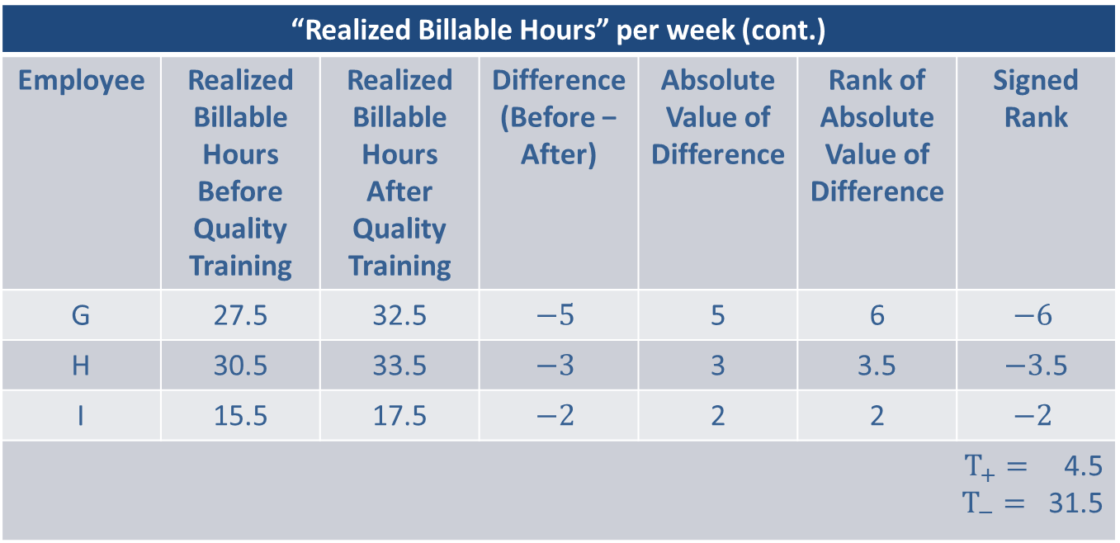
Example 17.2.2: Performing the Wilcoxon Signed-Rank Test (cont.)
“Realized Billable Hours” per week (cont.)
Employee | Realized Billable Hours Before Quality Training | Realized Billable Hours After Quality Training | Difference (Before − After) | Absolute Value of Difference | Rank of Absolute Value of Difference | Signed Rank
G | 27.5 | 32.5 | $$−5$$ | 5 | 6 | $$−6$$
H | 30.5 | 33.5 | $$−3$$ | 3 | 3.5 | $−3$.5
I | 15.5 | 17.5 | $$−2$$ | 2 | 2 | $$−2$$
$T_{+}=$ 4.5 $T_{−}=$ 31.5

Slide 15
Example 17.2.2: Performing the Wilcoxon Signed-Rank Test (cont.)
Step 1: Determine the population parameter to be used and develop the null and alternative hypotheses.
Null Hypothesis: The productivity level of employees has not improved over the past year.
Alternative Hypothesis: The productivity level of employees has improved over the past year.
Recall that in nonparametric statistics we do not make inferences about population parameters. The Wilcoxon Signed-Rank Test is no exception.

Slide 16
Example 17.2.2: Performing the Wilcoxon Signed-Rank Test (cont.)
It compares the probability distribution of the realized billable hours before the quality training to the probability distribution of realized billable hours one year after the quality training. How this is accomplished will be discussed in Step 3.
Since management is interested in knowing if productivity has improved, they are interested in knowing if realized billable hours have increased. Thus, this is a one-sided test.

Slide 17
Example 17.2.2: Performing the Wilcoxon Signed-Rank Test (cont.)
H₀: The probability distributions of realized billable hours both before and after the quality training are the same.
H_{a}: The probability distribution for realized billable hours after the training is shifted to the right of realized billable hours before the training.

Slide 18
Example 17.2.2: Performing the Wilcoxon Signed-Rank Test (cont.)
Step 2: Specify the significance level α.
The level of the test is specified in the problem to be α = 0.05.
Step 3: Validate the assumptions of the hypothesis test, identify the appropriate test statistic and compute its value.
We must verify that the pairs of data have been selected in a random fashion and are such that the absolute value of their differences can be ranked.

Slide 19
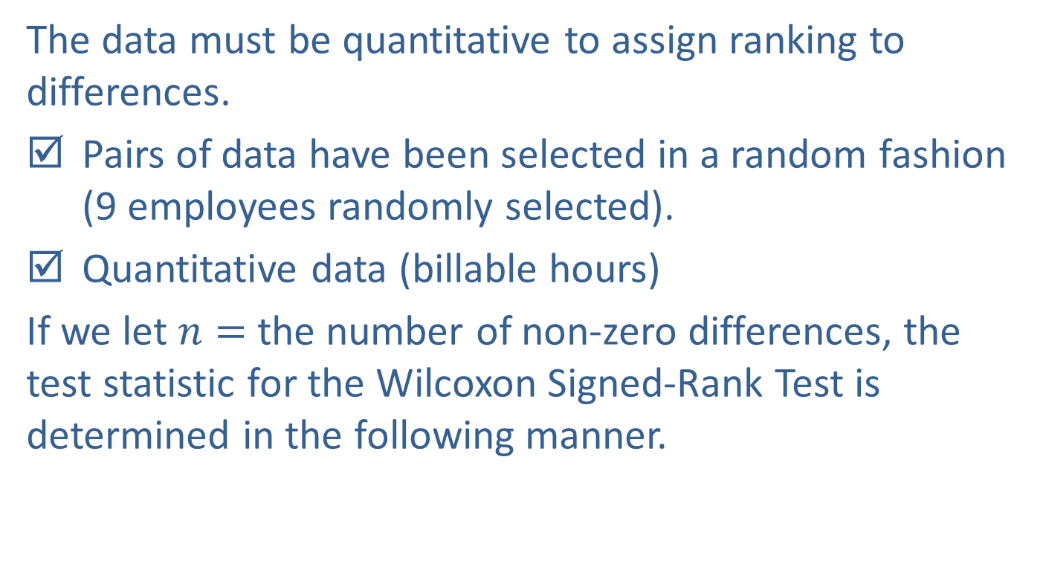
Example 17.2.2: Performing the Wilcoxon Signed-Rank Test (cont.)
The data must be quantitative to assign ranking to differences.
Pairs of data have been selected in a random fashion (9 employees randomly selected).
Quantitative data (billable hours)
If we let $n=$ the number of non-zero differences, the test statistic for the Wilcoxon Signed-Rank Test is determined in the following manner.

Slide 20

Note
In the following discussion, population $X$ will be the group after training and population $Y$ will be the group before training.

Slide 21
Example 17.2.2: Performing the Wilcoxon Signed-Rank Test (cont.)
Compute the differences for each of the pairs.
Rank the absolute value of the differences from lowest to highest (ignoring zero differences).
Calculate T₊ = the sum of the ranks associated with positive differences.
Calculate T₋ = the sum of the ranks associated with negative differences.
The test statistic will vary depending on the sample size, the number of non-zero differences, and the alternative hypothesis.

Slide 22

Example 17.2.2: Performing the Wilcoxon Signed-Rank Test (cont.)
If $n≤25$, and
The alternative hypothesis is that population $X$ is shifted to the left or to the right of population $Y$, use T = min(T₊, T₋) $=$ the sum of the ranks with the smallest value.

Slide 23
Note
This is analogous to the “not equal to” alternative hypothesis.

Slide 24
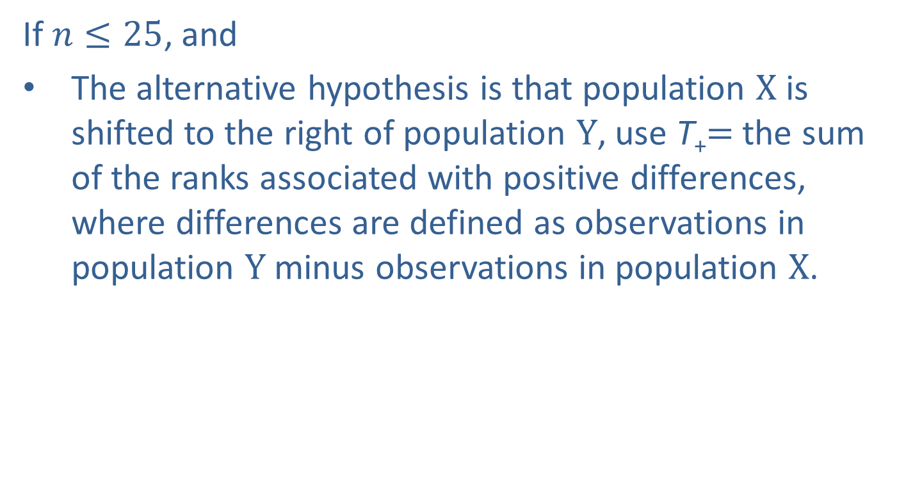
Example 17.2.2: Performing the Wilcoxon Signed-Rank Test (cont.)
If $n≤25$, and
The alternative hypothesis is that population $X$ is shifted to the right of population $Y$, use T₊$=$the sum of the ranks associated with positive differences, where differences are defined as observations in population $Y$ minus observations in population $X$.

Slide 25
Note
This is analogous to the “greater than” alternative hypothesis.

Slide 26
Example 17.2.2: Performing the Wilcoxon Signed-Rank Test (cont.)
(The test statistic is defined in this manner because we expect the number of negative differences to outnumber the number of positive differences, and thus expect T₊ to be the rank sum with the smallest value.)

Slide 27
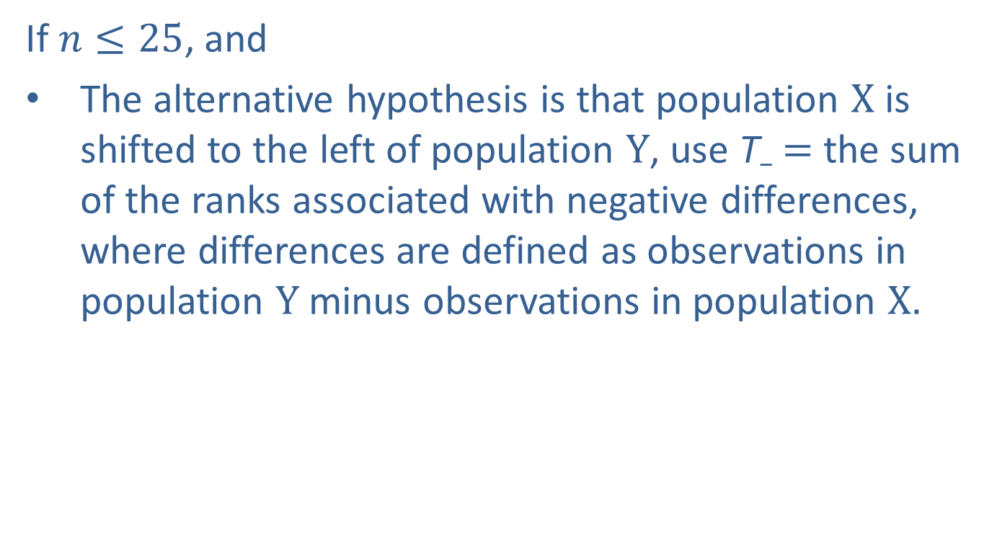
Example 17.2.2: Performing the Wilcoxon Signed-Rank Test (cont.)
If $n≤25$, and
The alternative hypothesis is that population $X$ is shifted to the left of population $Y$, use T₋ $=$ the sum of the ranks associated with negative differences, where differences are defined as observations in population $Y$ minus observations in population $X$.

Slide 28
Example 17.2.2: Performing the Wilcoxon Signed-Rank Test (cont.)
(The test statistic is defined in this manner because we expect the number of positive differences to outnumber the number of negative differences, and thus expect T₋ to be the rank sum with the smallest value.)

Slide 29
Note
This is analogous to the “less than” alternative hypothesis.

Slide 30
Example 17.2.2: Performing the Wilcoxon Signed-Rank Test (cont.)
It is important to note that if the smaller sum of the ranks is not as expected, the test should be halted and the decision should be to fail to reject the null hypothesis since there is no evidence in favor of the alternative hypothesis.

Slide 31
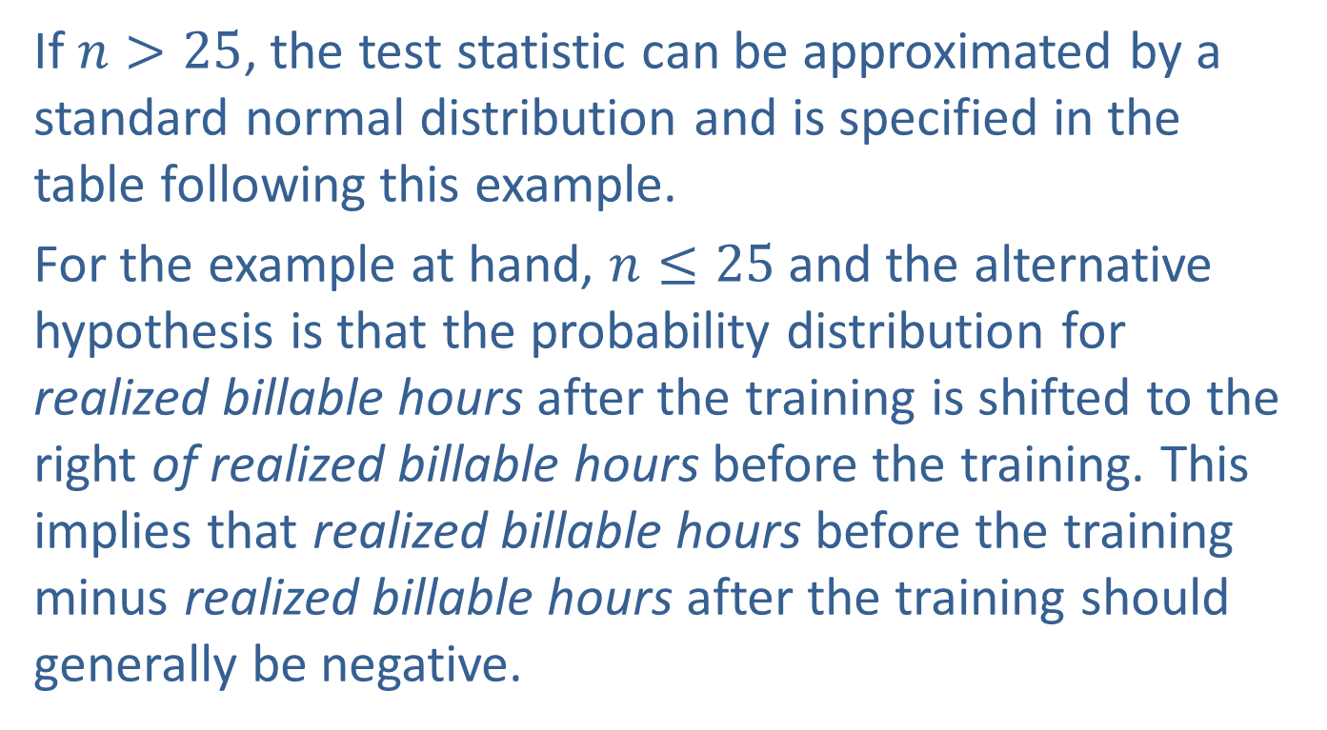
Example 17.2.2: Performing the Wilcoxon Signed-Rank Test (cont.)
If $n>25$, the test statistic can be approximated by a standard normal distribution and is specified in the table following this example.
For the example at hand, $n≤25$and the alternative hypothesis is that the probability distribution for realized billable hours after the training is shifted to the right of realized billable hours before the training. This implies that realized billable hours before the training minus realized billable hours after the training should generally be negative.

Slide 32
Example 17.2.2: Performing the Wilcoxon Signed-Rank Test (cont.)
If the rank sum with the smallest value is T₋, fail to reject the null hypothesis since there is no evidence that the alternative hypothesis is more reasonable. Otherwise, the test statistic is given by
T = T₊ = the sum of the ranks associated with positive differences.
In order to calculate the test statistic, the signed ranks must be determined. To determine the signed ranks, first compute the difference for each pair of data values. Next, find the absolute value of each difference.

Slide 33
Example 17.2.2: Performing the Wilcoxon Signed-Rank Test (cont.)
Rank the absolute value of the differences using the ranking technique illustrated in Example 17.2.1 (ignore differences of zero). Once the absolute value of the differences has been ranked, reassign the ranks the sign which each associated difference had before the absolute value was computed. Finally, add all of the ranks with positive signs to determine T₊, and add all of the ranks with negative signs to determine T₋ . This procedure is illustrated in the table at the beginning of the example.

Slide 34
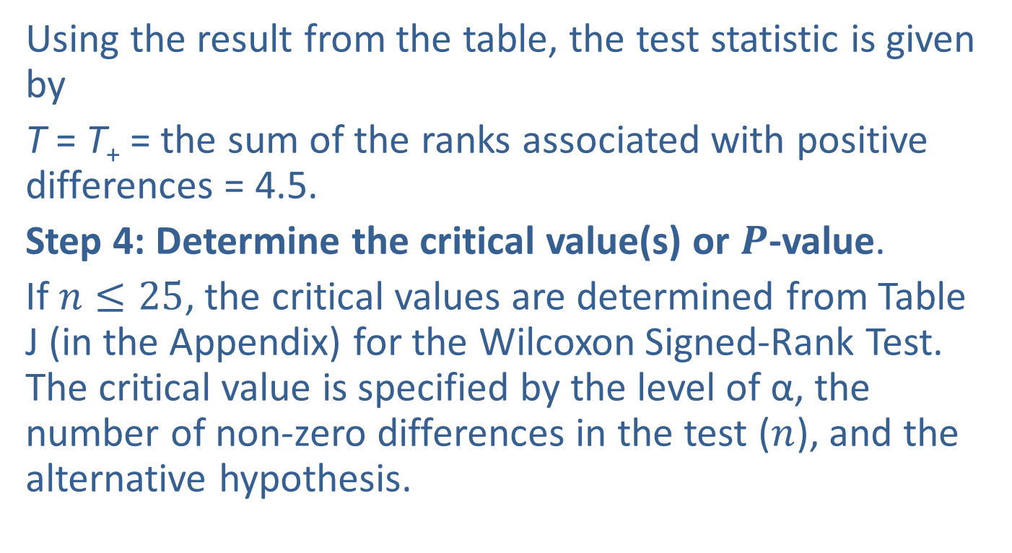
Example 17.2.2: Performing the Wilcoxon Signed-Rank Test (cont.)
Using the result from the table, the test statistic is given by
T = T₊ = the sum of the ranks associated with positive differences = 4.5.
Step 4: Determine the critical value(s) or $P$-value.
If $n≤25$, the critical values are determined from Table J (in the Appendix) for the Wilcoxon Signed-Rank Test. The critical value is specified by the level of α, the number of non-zero differences in the test ($n$), and the alternative hypothesis.

Slide 35
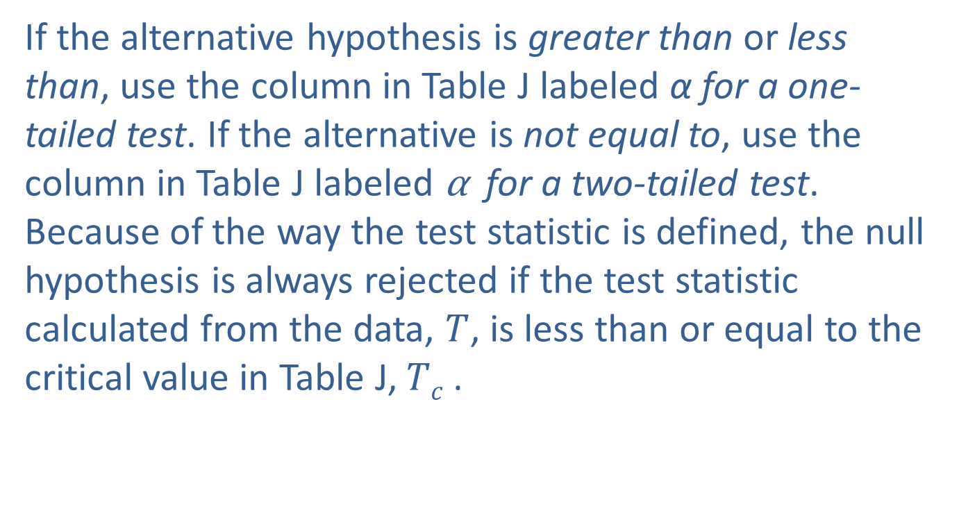
Example 17.2.2: Performing the Wilcoxon Signed-Rank Test (cont.)
If the alternative hypothesis is greater than or less than, use the column in Table J labeled α for a one-tailed test. If the alternative is not equal to, use the column in Table J labeled α for a two-tailed test. Because of the way the test statistic is defined, the null hypothesis is always rejected if the test statistic calculated from the data, $T$, is less than or equal to the critical value in Table J, $Tc$ .

Slide 36
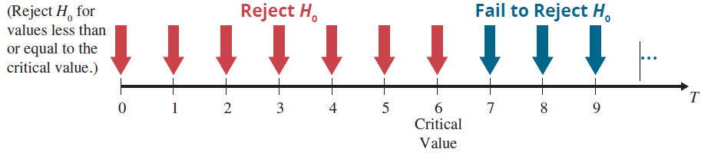

Example 17.2.2: Performing the Wilcoxon Signed-Rank Test (cont.)
For the quality example, $n=8$ (recall there was one difference which was zero), α = 0.05, and the test is a one-sided test. Based on these specifications, the critical value determined from Table J is = 6. The null hypothesis will be rejected if $T≤6$. This rejection region is displayed in the figure above.

Slide 37
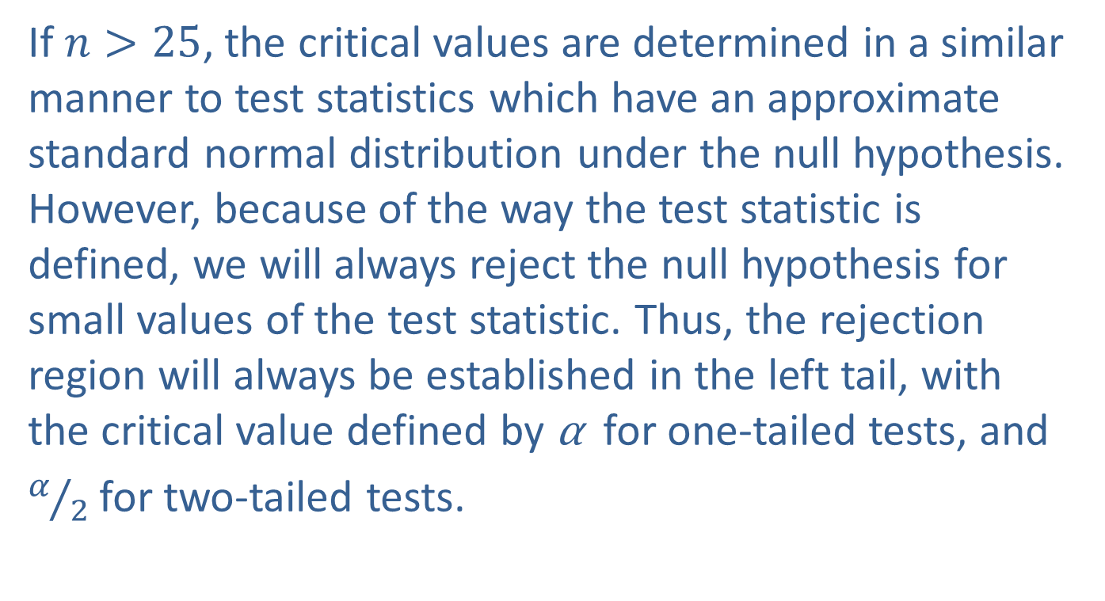
Example 17.2.2: Performing the Wilcoxon Signed-Rank Test (cont.)
If $n>25$, the critical values are determined in a similar manner to test statistics which have an approximate standard normal distribution under the null hypothesis. However, because of the way the test statistic is defined, we will always reject the null hypothesis for small values of the test statistic. Thus, the rejection region will always be established in the left tail, with the critical value defined by α for one-tailed tests, and
$α/2$ for two-tailed tests.

Slide 38
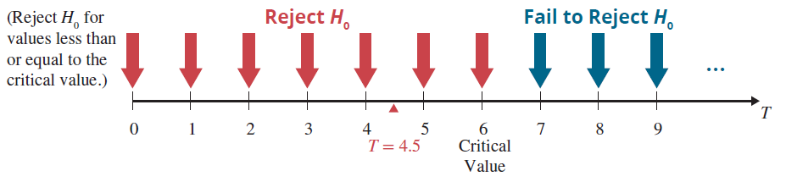
Example 17.2.2: Performing the Wilcoxon Signed-Rank Test (cont.)
Step 5: Choose between the null and alternative hypotheses.
As shown above, the value of the test statistic falls in the rejection region (4.5 is less than 6). Thus, we reject the null hypothesis at α = 0.05.

Slide 39
Example 17.2.2: Performing the Wilcoxon Signed-Rank Test (cont.)
It is unlikely that the difference between the observed value and the hypothesized value is due to ordinary sampling variation.
Step 6: State the conclusion in terms of the original problem.
There is sufficient evidence for the management of the consulting firm to conclude at α = 0.05 that realized billable hours one year after the quality training are significantly higher than the realized billable hours before the quality training.

Slide 40
Procedure: Test Procedure for the Wilcoxon Signed-Rank Test
Assumptions:
Pairs of data have been selected in a random fashion.
Data are quantitative.
Hypothesis:
H₀: The probability distributions of the two populations of interest are the same.

Slide 41
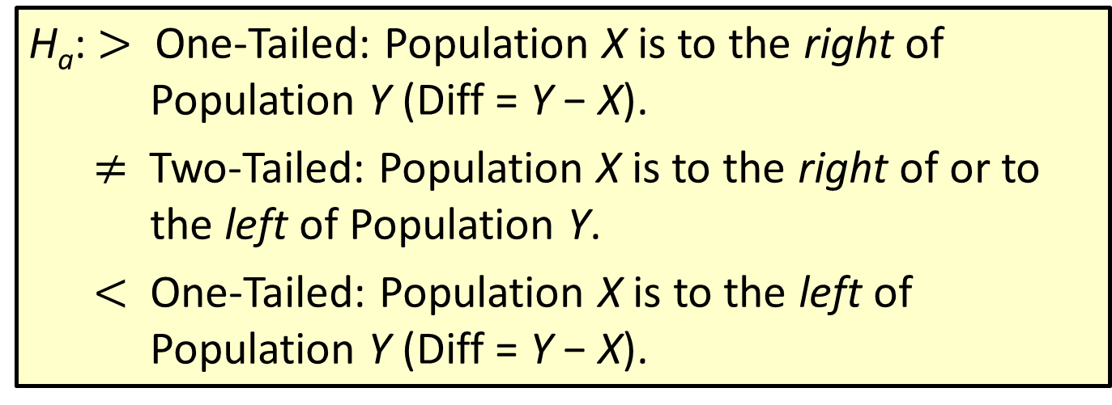
Procedure: Test Procedure for the Wilcoxon Signed-Rank Test (cont.)
H_{a}: $>$ One-Tailed: Population X is to the right of Population Y (Diff = Y − X).
$≠$ Two-Tailed: Population X is to the right of or to the left of Population Y.
$<$ One-Tailed: Population X is to the left of Population Y (Diff = Y − X).

Slide 42
Procedure: Test Procedure for the Wilcoxon Signed-Rank Test (cont.)
Test Statistic:
If n ≤ 25, and
H_{a}: >, then T = T₊ = the sum of the ranks of the positive differences.
H_{a}: ≠, then T = Min (T₊, T₋).
H_{a}: <, then T = T₋ = the sum of the ranks of the negative differences.

Slide 43
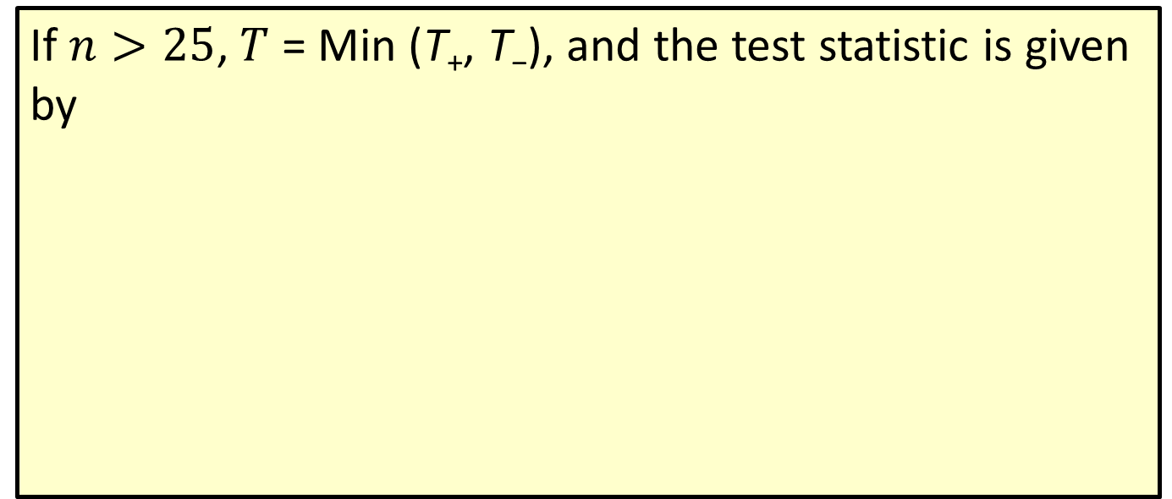
Procedure: Test Procedure for the Wilcoxon Signed-Rank Test (cont.)
If $n>25$, $T$ = Min (T₊, T₋), and the test statistic is given by

Slide 44
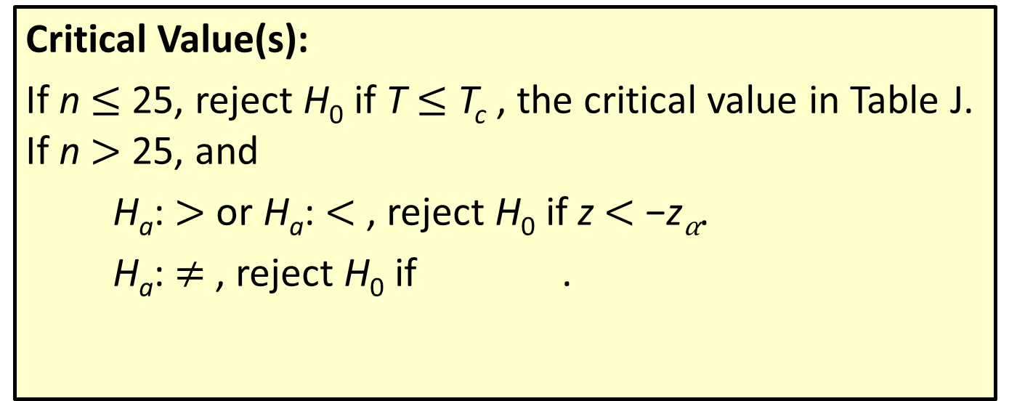
Procedure: Test Procedure for the Wilcoxon Signed-Rank Test (cont.)
Critical Value(s):
If n $≤$ 25, reject H₀ if T $≤$ T_{c} , the critical value in Table J. If n $>$ 25, and
H_{a}: $>$ or H_{a}: $<$ , reject H₀ if z $<$ −z_{α}.
H_{a}: $≠$ , reject H₀ if .

