Slide 1
Section 17.1
The Sign Test

Slide 2
Introduction
One of the characteristics of parametric statistics is that hypothesis testing procedures rely on assumptions concerning the distribution of the population from which the sample is drawn. For example, when using test statistics which rely on the t-distribution or the F-distribution, we assume that the distribution of the underlying population from which the data is drawn is approximately normal.

Slide 3
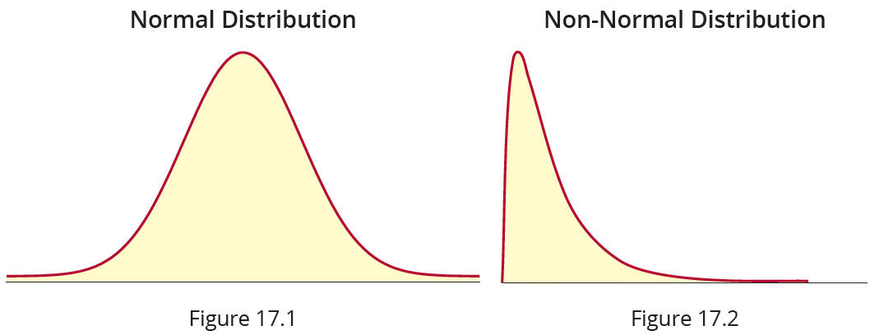
Introduction
Figures 17.1 and 17.2 show examples of a normal and a non-normal distribution, respectively. Inferences made from parametric statistics are valid only to the extent that the assumptions made about the underlying distribution of the population from which the data is sampled are correct.

Slide 4
Introduction
In this chapter the focus is on nonparametric statistical methods. There are three characteristics of nonparametric statistical methods:
They do not involve the estimation of specific population parameters.
These methods are tests of hypotheses using data measured on an ordinal scale (in most instances).
Assumptions regarding the underlying distribution of the data are not required.

Slide 5
Introduction
The fact that a distributional assumption about the data is not necessary to make valid inferences is one of the significant advantages of nonparametric techniques.
However, there are some disadvantages of nonparametric statistics. Because nonparametric tests tend to waste information, they are not as powerful as their parametric counterparts. Some nonparametric tests reduce exact ratio level measurements to ordinal level measurements.

Slide 6
Introduction
For example, taking an income measurement of $48,200 (a ratio measurement) and converting it into an ordinal variable consisting of three ordinal categories (low, medium, high) results in a significant loss of information. A nonparametric test, called the Sign Test, will require us to take ratio measurements and throw everything away except the sign (+ or −) of the measurement.

Slide 7
The Sign Test
Sign Tests are used in the comparison of paired data when it is not possible to assume that the differences have an approximately normal distribution. The methodology for the Sign Test is based on the assumption that the two populations have the same median. Suppose we were to subtract the paired sample values. If the population medians are identical, the resulting differences should be centered around zero. Further, we would expect the number of positive differences to be roughly equal to the number of negative differences.

Slide 8
The Sign Test (cont.)
If the number of positive differences significantly outnumbers the number of negative differences or vice versa, this will cause us to doubt that the two populations have the same median.

Slide 9
Using the Sign Test on Paired Data
We will present the test procedure for the Sign Test by reconsidering the paired data problem from Section 12.3. In that paired data discussion, there is an assumption that the differences of the population of paired values possess an approximately normal distribution. The Sign Test makes no such assumption.

Slide 10
Example 17.1.1: Performing the Sign Test on Paired Data
A researcher is interested in knowing the effect one ounce of 100-proof alcohol has on individuals. To study this effect the researcher randomly selects 10 subjects and records their reaction times (in seconds) both before and after drinking one ounce of 100-proof alcohol. The results of the study are displayed in the table below. In addition to the original data from Example 12.3.2, this table contains an extra column of data, the signs of the differences. These signs will be used in the nonparametric test of hypothesis.

Slide 11
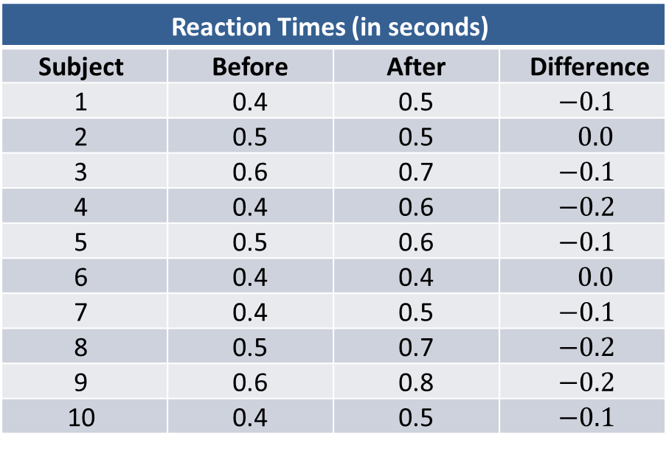
Example 17.1.1: Performing the Sign Test on Paired Data (cont.)
Reaction Times (in seconds)
Subject | Before | After | Difference
1 | 0.4 | 0.5 | $$−0.1$$
2 | 0.5 | 0.5 | $$0.0$$
3 | 0.6 | 0.7 | $$−0.1$$
4 | 0.4 | 0.6 | $$−0.2$$
5 | 0.5 | 0.6 | $$−0.1$$
6 | 0.4 | 0.4 | $$0.0$$
7 | 0.4 | 0.5 | $$−0.1$$
8 | 0.5 | 0.7 | $$−0.2$$
9 | 0.6 | 0.8 | $$−0.2$$
10 | 0.4 | 0.5 | $$−0.1$$
Can the researcher conclude at α = 0.01 that the median reaction time is longer after consuming one ounce of
100-proof alcohol?

Slide 12
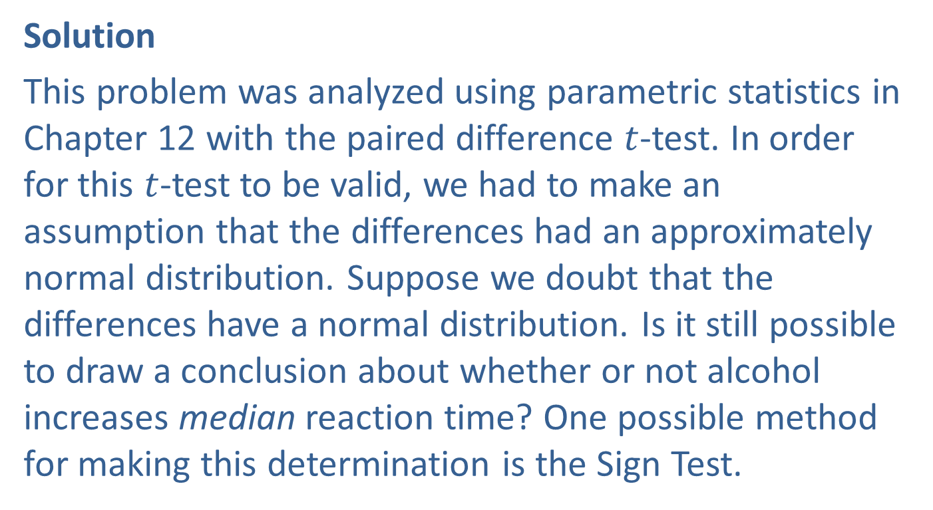
Example 17.1.1: Performing the Sign Test on Paired Data (cont.)
Solution
This problem was analyzed using parametric statistics in Chapter 12 with the paired difference $t$-test. In order for this $t$-test to be valid, we had to make an assumption that the differences had an approximately normal distribution. Suppose we doubt that the differences have a normal distribution. Is it still possible to draw a conclusion about whether or not alcohol increases median reaction time? One possible method for making this determination is the Sign Test.

Slide 13
Example 17.1.1: Performing the Sign Test on Paired Data (cont.)
The Sign Test is based on the idea that if two data sets have the same medians, the number of differences with positive signs should approximately equal the number of differences with negative signs. We will conclude that alcohol increases the median reaction time if the number of negative signs is significantly larger than the number of positive signs. How large is large? Let’s answer this question by way of example.

Slide 14
Example 17.1.1: Performing the Sign Test on Paired Data (cont.)
Step 1: Determine the population parameter to be used and develop the null and alternative hypotheses.
Null Hypothesis: There is no difference in median reaction time after drinking one ounce of 100-proof alcohol.
Alternative Hypothesis: The median reaction time is significantly longer after drinking one ounce of 100-proof alcohol.

Slide 15
Example 17.1.1: Performing the Sign Test on Paired Data (cont.)
Since the researcher is interested in whether or not the median reaction time is longer after drinking one ounce of 100-proof alcohol, this is a one-sided test.
The procedure we are using is called the Sign Test because it relies on counting the number of positive differences and the number of negative differences. Only the sign of the difference matters; the magnitude is ignored. Differences of zero are also ignored.

Slide 16
Example 17.1.1: Performing the Sign Test on Paired Data (cont.)
The statistical measures being used are counts of the number of positive signs and negative signs. If the reaction time is prolonged after the alcohol has been consumed, then the reaction time before drinking the alcohol will be less than the reaction time after drinking the alcohol. Consequently, we would expect the number of differences with negative signs to outnumber the differences with positive signs.

Slide 17
Example 17.1.1: Performing the Sign Test on Paired Data (cont.)
If the reaction times before and after drinking one ounce of 100-proof alcohol are identical, then we would expect that any difference would be due to random variation, in which case we would have about the same number of positive and negative signs.
Using these ideas, we can translate our plain English hypotheses into the following.

Slide 18
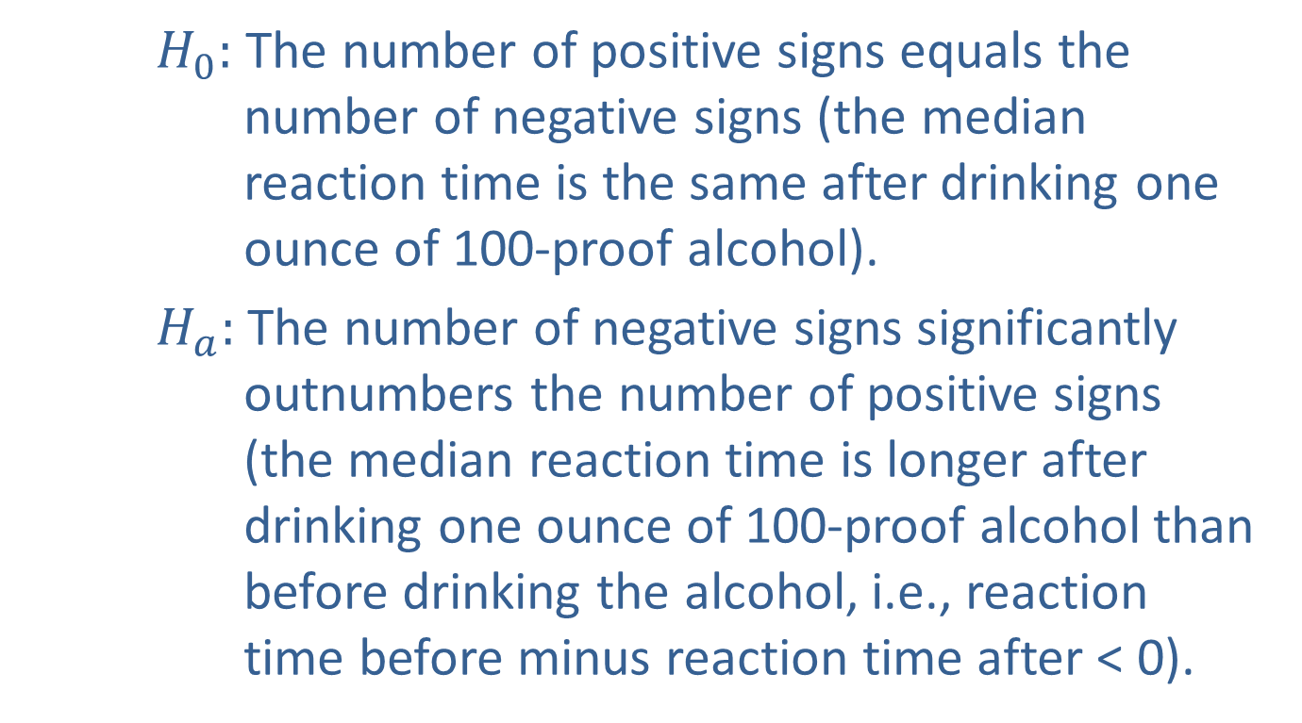
Example 17.1.1: Performing the Sign Test on Paired Data (cont.)
$H_{0}:$ The number of positive signs equals the number of negative signs (the median reaction time is the same after drinking one ounce of 100-proof alcohol).
$H_{a}:$ The number of negative signs significantly outnumbers the number of positive signs (the median reaction time is longer after drinking one ounce of 100-proof alcohol than before drinking the alcohol, i.e., reaction time before minus reaction time after < 0).

Slide 19
Example 17.1.1: Performing the Sign Test on Paired Data (cont.)
Step 2: Specify the significance level α.
The level of the test is specified in the problem to be
α = 0.01.
Step 3: Validate the assumptions of the hypothesis test, identify the appropriate test statistic and compute its value.
We do need to assume that the sample is random.
Pairs of data are selected in a random fashion.

Slide 20
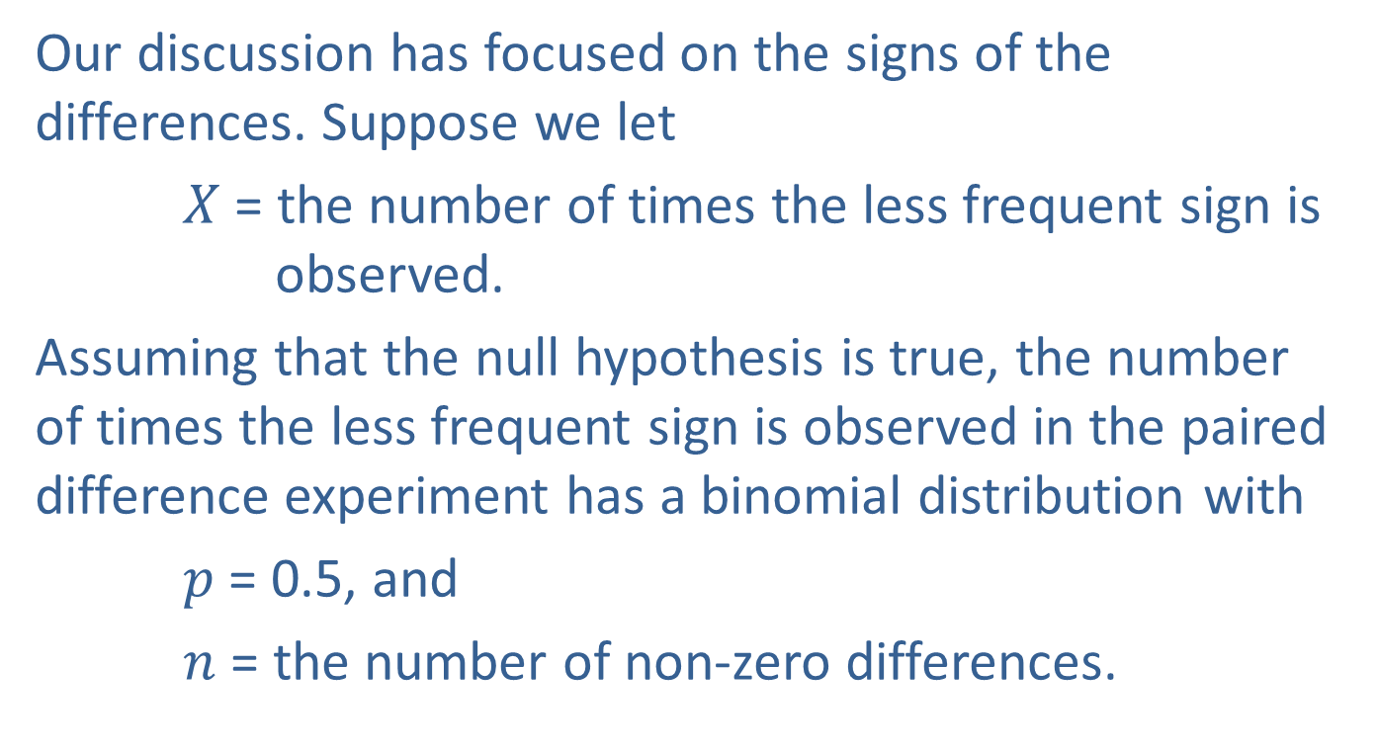
Example 17.1.1: Performing the Sign Test on Paired Data (cont.)
Our discussion has focused on the signs of the differences. Suppose we let
$X$ = the number of times the less frequent sign is observed.
Assuming that the null hypothesis is true, the number of times the less frequent sign is observed in the paired difference experiment has a binomial distribution with
$p$ = 0.5, and
$n$ = the number of non-zero differences.

Slide 21
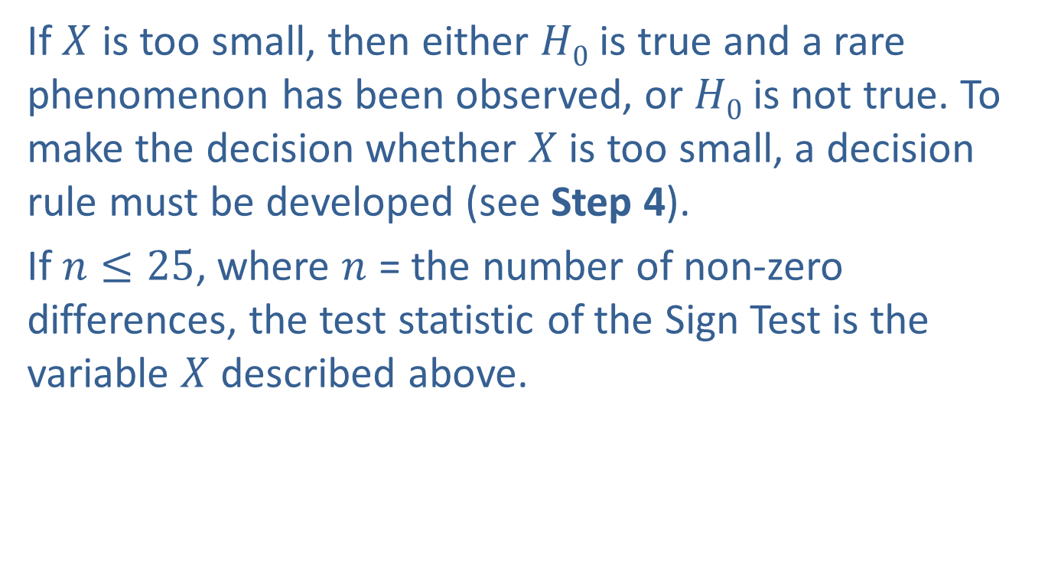
Example 17.1.1: Performing the Sign Test on Paired Data (cont.)
If $X$ is too small, then either $H0$ is true and a rare phenomenon has been observed, or $H0$ is not true. To make the decision whether $X$ is too small, a decision rule must be developed (see Step 4).
If $n≤25$, where $n$ = the number of non-zero differences, the test statistic of the Sign Test is the variable $X$ described above.

Slide 22

Example 17.1.1: Performing the Sign Test on Paired Data (cont.)
If $n>25$, $X$ can be approximated by a normal distribution and the test statistic is given by
Assuming the null hypothesis is true, z has an approximately standard normal distribution.

Slide 23
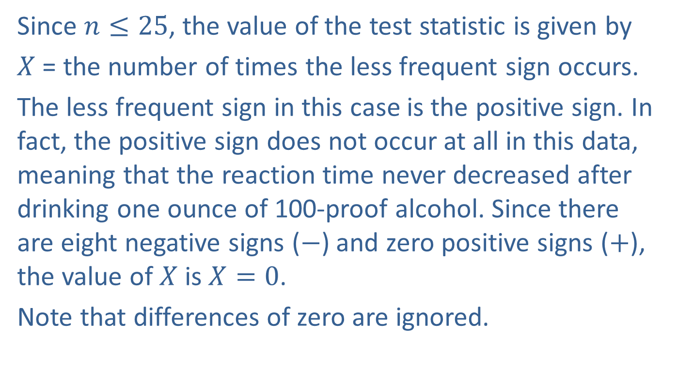
Example 17.1.1: Performing the Sign Test on Paired Data (cont.)
Since $n≤25$, the value of the test statistic is given by
$X$ = the number of times the less frequent sign occurs.
The less frequent sign in this case is the positive sign. In fact, the positive sign does not occur at all in this data, meaning that the reaction time never decreased after drinking one ounce of 100-proof alcohol. Since there are eight negative signs ($−$) and zero positive signs ($+$), the value of $X$ is $X=0$.
Note that differences of zero are ignored.

Slide 24
Example 17.1.1: Performing the Sign Test on Paired Data (cont.)
Since the number of positive signs is zero, this tends to support the alternative hypothesis that drinking one ounce of 100-proof alcohol prolongs reaction time. It is safe to proceed with the test. Suppose there were not any negative signs, meaning that all of the reaction times were quicker after drinking the alcohol. This evidence would not support the alternative hypothesis, and the test must be halted at this point with a conclusion that the null hypothesis cannot be rejected.

Slide 25
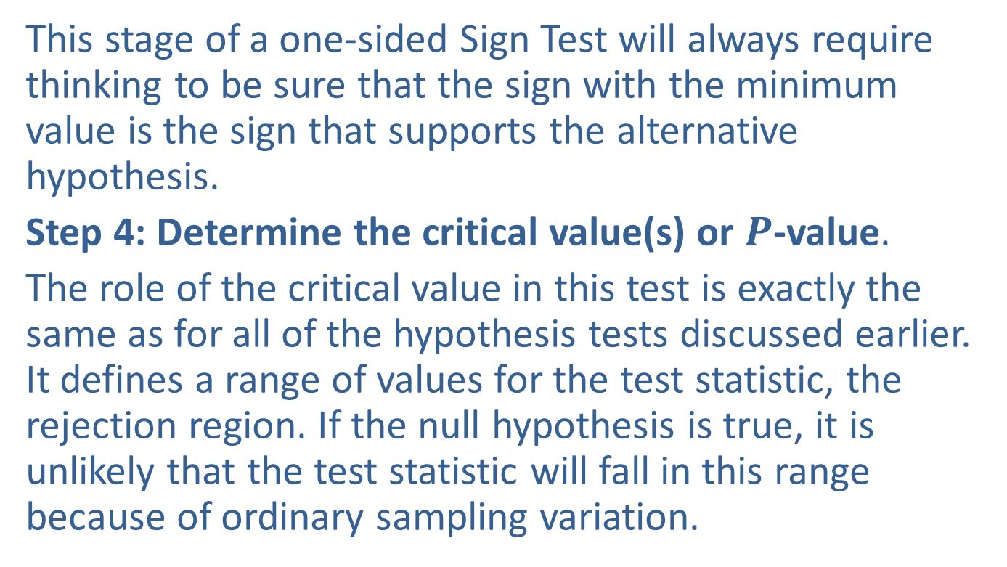
Example 17.1.1: Performing the Sign Test on Paired Data (cont.)
This stage of a one-sided Sign Test will always require thinking to be sure that the sign with the minimum value is the sign that supports the alternative hypothesis.
Step 4: Determine the critical value(s) or $P$-value.
The role of the critical value in this test is exactly the same as for all of the hypothesis tests discussed earlier. It defines a range of values for the test statistic, the rejection region. If the null hypothesis is true, it is unlikely that the test statistic will fall in this range because of ordinary sampling variation.

Slide 26
Example 17.1.1: Performing the Sign Test on Paired Data (cont.)
The level of the test defines the rareness criterion that will be used and implicitly determines the size of the rejection region. Should the computed value of the test statistic fall in the rejection region, its value will be presumed to be too rare to have occurred because of ordinary sampling variation, and the null hypothesis will be rejected.

Slide 27
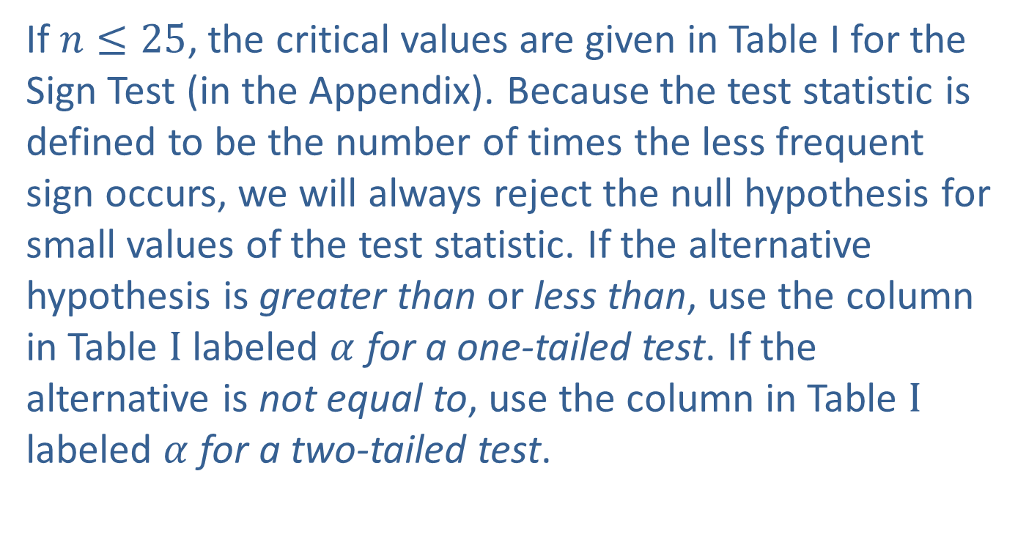
Example 17.1.1: Performing the Sign Test on Paired Data (cont.)
If $n≤25$, the critical values are given in Table I for the Sign Test (in the Appendix). Because the test statistic is defined to be the number of times the less frequent sign occurs, we will always reject the null hypothesis for small values of the test statistic. If the alternative hypothesis is greater than or less than, use the column in Table $I$ labeled $α$ for a one-tailed test. If the alternative is not equal to, use the column in Table $I$ labeled $α$ for a two-tailed test.

Slide 28
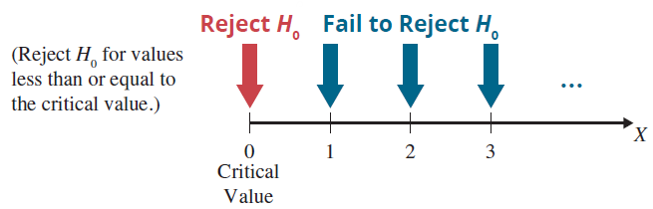
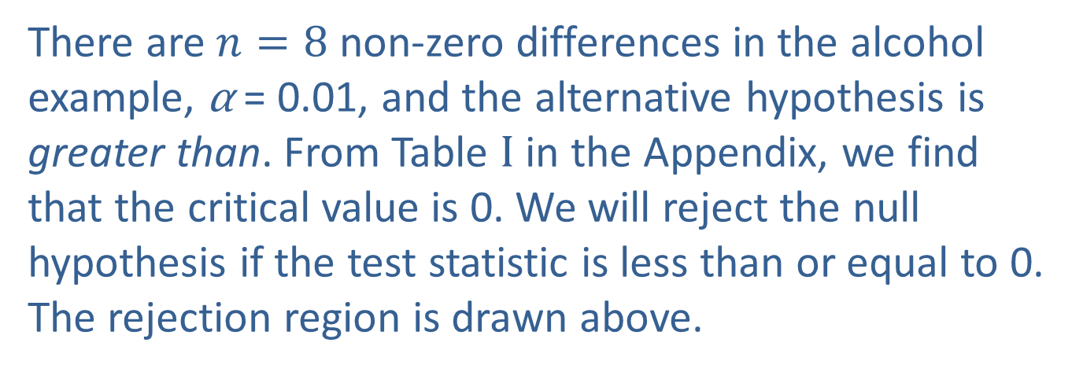
Example 17.1.1: Performing the Sign Test on Paired Data (cont.)
There are $n=8$ non-zero differences in the alcohol example, α = 0.01, and the alternative hypothesis is greater than. From Table $I$ in the Appendix, we find that the critical value is 0. We will reject the null hypothesis if the test statistic is less than or equal to 0. The rejection region is drawn above.

Slide 29
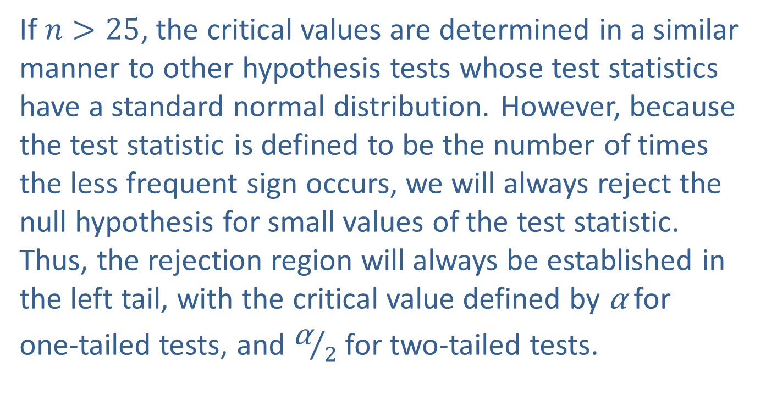
Example 17.1.1: Performing the Sign Test on Paired Data (cont.)
If $n>25$, the critical values are determined in a similar manner to other hypothesis tests whose test statistics have a standard normal distribution. However, because the test statistic is defined to be the number of times the less frequent sign occurs, we will always reject the null hypothesis for small values of the test statistic. Thus, the rejection region will always be established in the left tail, with the critical value defined by α for
one-tailed tests, and ${\text{α}}/2$ for two-tailed tests.

Slide 30
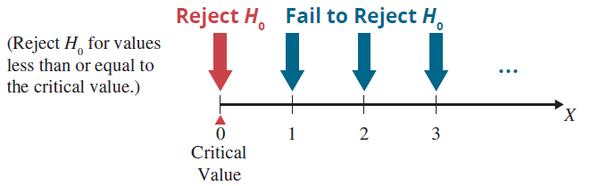
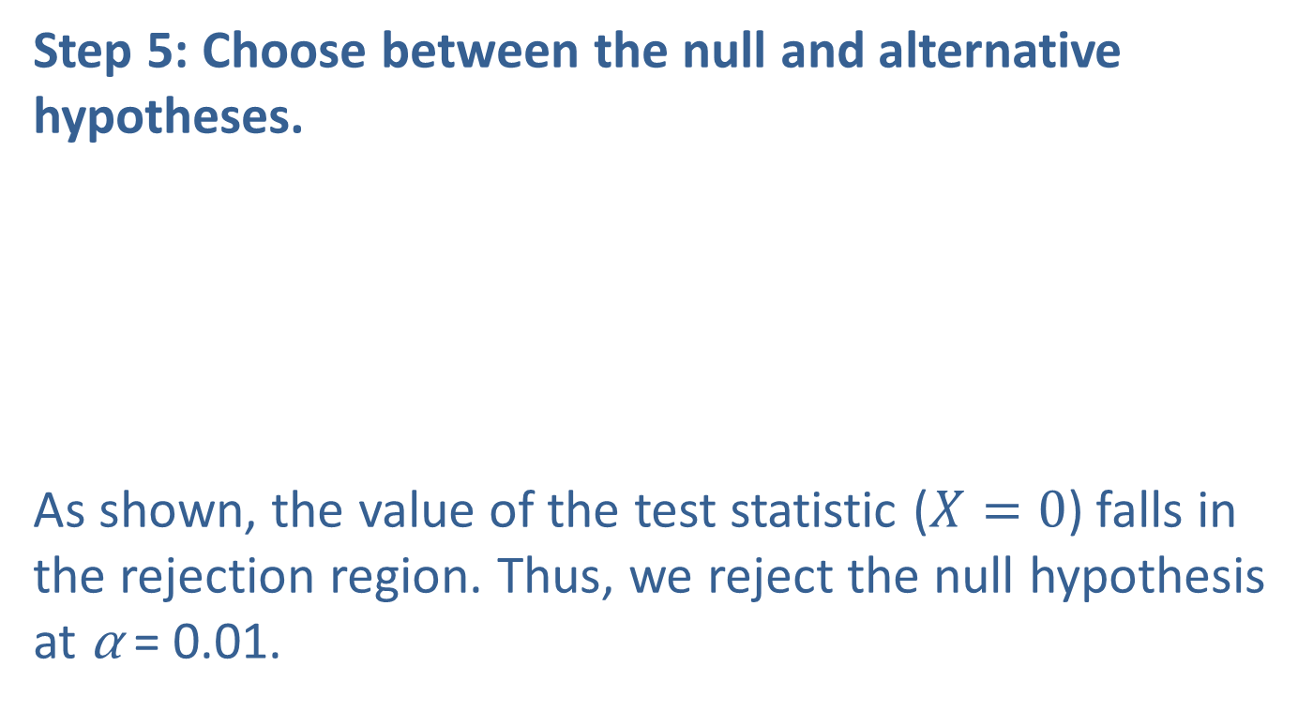
Example 17.1.1: Performing the Sign Test on Paired Data (cont.)
Step 5: Choose between the null and alternative hypotheses.
As shown, the value of the test statistic ($X=0$) falls in the rejection region. Thus, we reject the null hypothesis at α = 0.01.

Slide 31
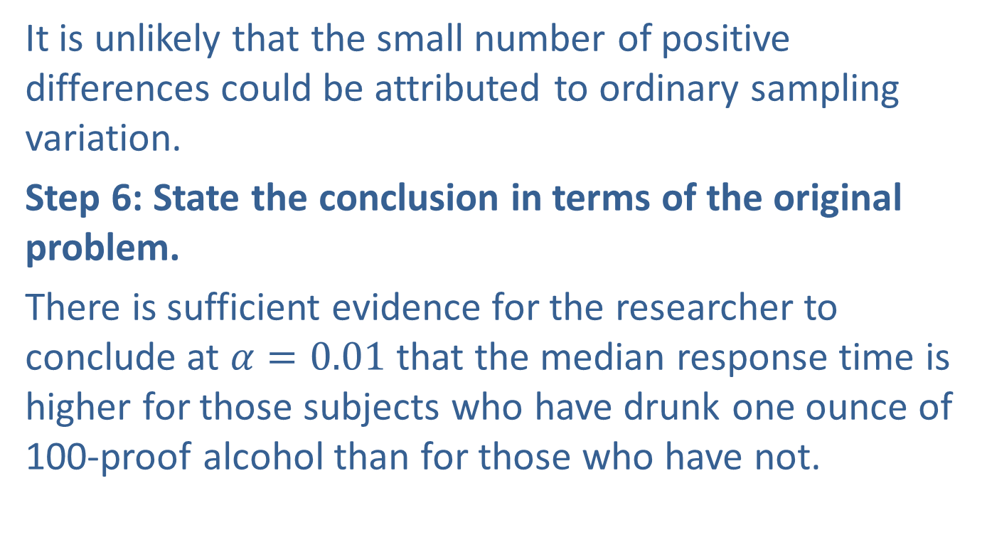
Example 17.1.1: Performing the Sign Test on Paired Data (cont.)
It is unlikely that the small number of positive differences could be attributed to ordinary sampling variation.
Step 6: State the conclusion in terms of the original problem.
There is sufficient evidence for the researcher to conclude at $α=0.01$that the median response time is higher for those subjects who have drunk one ounce of 100-proof alcohol than for those who have not.

Slide 32
Note
No sign is given if the difference is zero and the difference is ignored.

Slide 33
Procedure: Test Procedure for the Sign Test
Assumptions:
Pairs of data are selected in a random fashion. Hypotheses:
H₀: The number of positive (negative) signs equals the number of negative (positive) signs.
H_{a}: The number of negative (positive) signs is significantly greater than, less than, or not equal to the number of positive (negative) signs (depending on the claim which is being tested.)

Slide 34
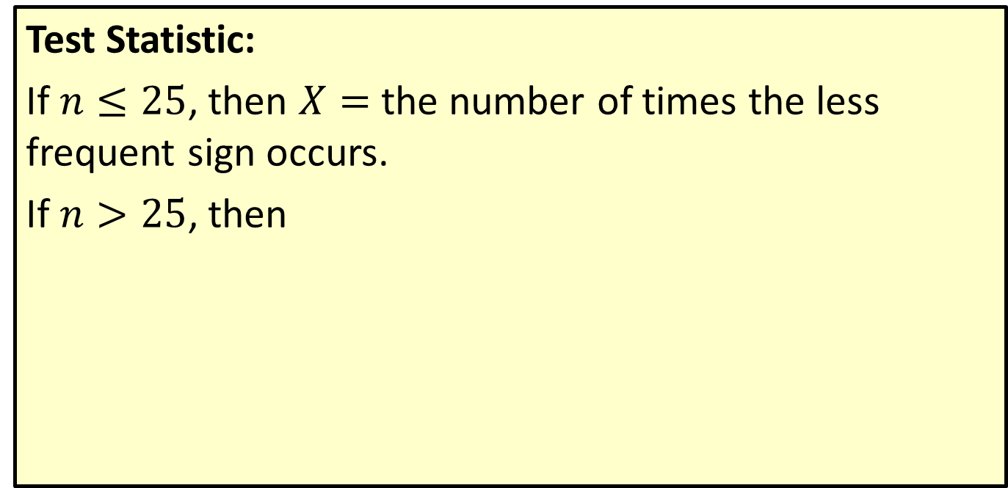
Procedure: Test Procedure for the Sign Test (cont.)
Test Statistic:
If $n≤25$, then $X=$ the number of times the less frequent sign occurs.
If $n>25$, then

Slide 35
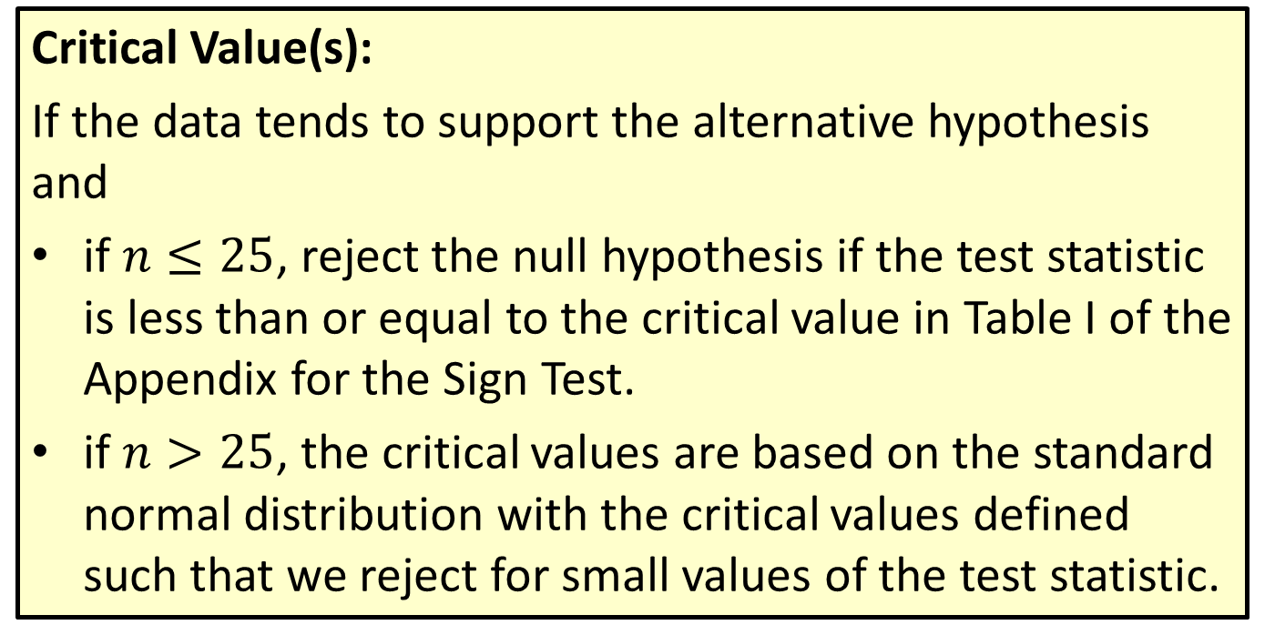
Procedure: Test Procedure for the Sign Test (cont.)
Critical Value(s):
If the data tends to support the alternative hypothesis and
if $n≤25$, reject the null hypothesis if the test statistic is less than or equal to the critical value in Table I of the Appendix for the Sign Test.
if $n>25$, the critical values are based on the standard normal distribution with the critical values defined such that we reject for small values of the test statistic.

Slide 36
Testing a Population Median with the Sign Test
The median is a more useful measure of the center of the population than is the mean in certain situations such as:
When there are extreme data values (outliers) which significantly skew the distribution of the data.
When the mean cannot be used as a measure of the center of the data, as with ordinal level data.
The Sign Test can be used to test claims about the median of the population. The procedure for using the Sign Test to evaluate claims about a single population median is presented in the following example.

Slide 37
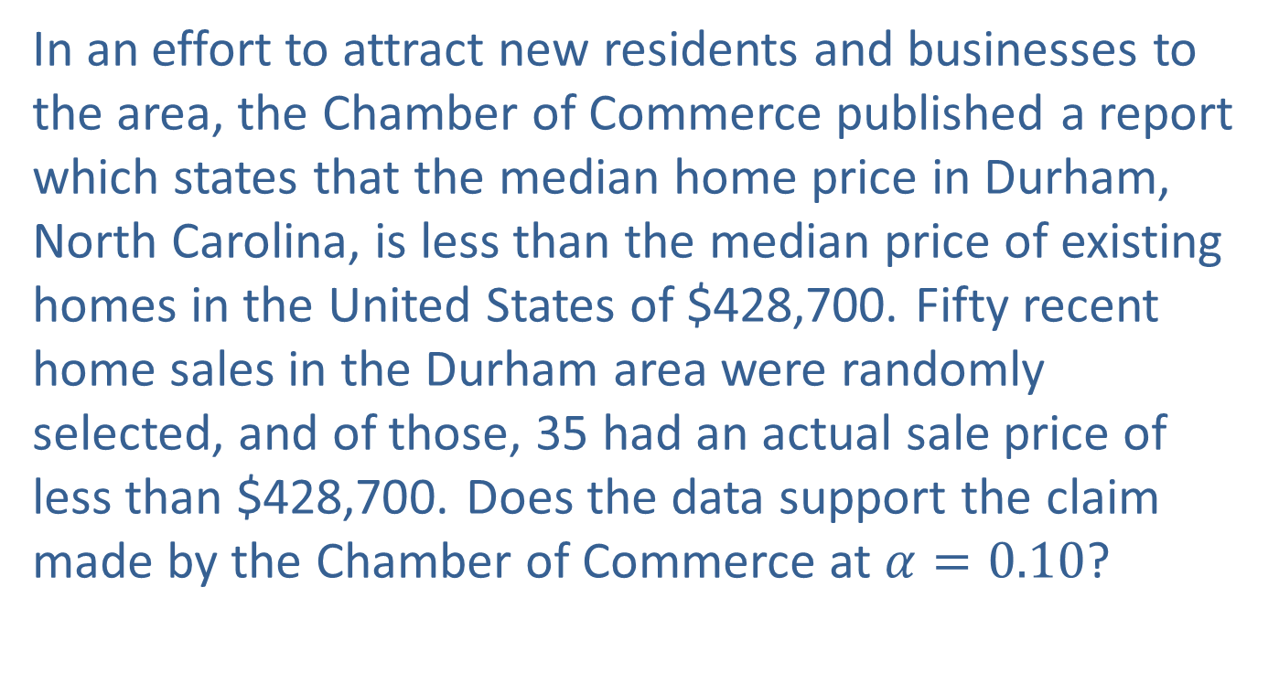
Example 17.1.2: Testing a Population Median with the Sign Test
In an effort to attract new residents and businesses to the area, the Chamber of Commerce published a report which states that the median home price in Durham, North Carolina, is less than the median price of existing homes in the United States of $428,700. Fifty recent home sales in the Durham area were randomly selected, and of those, 35 had an actual sale price of less than $428,700. Does the data support the claim made by the Chamber of Commerce at $α=0.10$?

Slide 38
Example 17.1.2: Testing a Population Median with the Sign Test (cont.)
Solution
Step 1: Determine the population parameter to be used and develop the null and alternative hypotheses.
Null Hypothesis: The median home price in Durham, North Carolina, is at least as large as that of the median home price for the United States.
Alternative Hypothesis: The median home price in Durham, North Carolina, is less than that of the median home price for the United States.

Slide 39
Example 17.1.2: Testing a Population Median with the Sign Test (cont.)
Once again we will look at differences, but in this case the differences will be created by subtracting the median from each data value. The Sign Test will rely on counting the number of positive signs (the number of homes with sale prices larger than the median home price for the United States) and the number of negative signs (the number of homes with sale prices less than the median home price for the United States).

Slide 40
Example 17.1.2: Testing a Population Median with the Sign Test (cont.)
Since the Chamber of Commerce’s claim is that the median home price in Durham, North Carolina, is lower than the median home price in the United States, this test is a one-sided test.
H₀: The number of positive signs is equal to the number of negative signs (the median home price in Durham, North Carolina, is at least as high as the median home price for the United States).
H_{a}: The number of negative signs significantly outnumbers the number of positive signs (the median home price in Durham, North Carolina, is lower than the median home price for the United States).

Slide 41
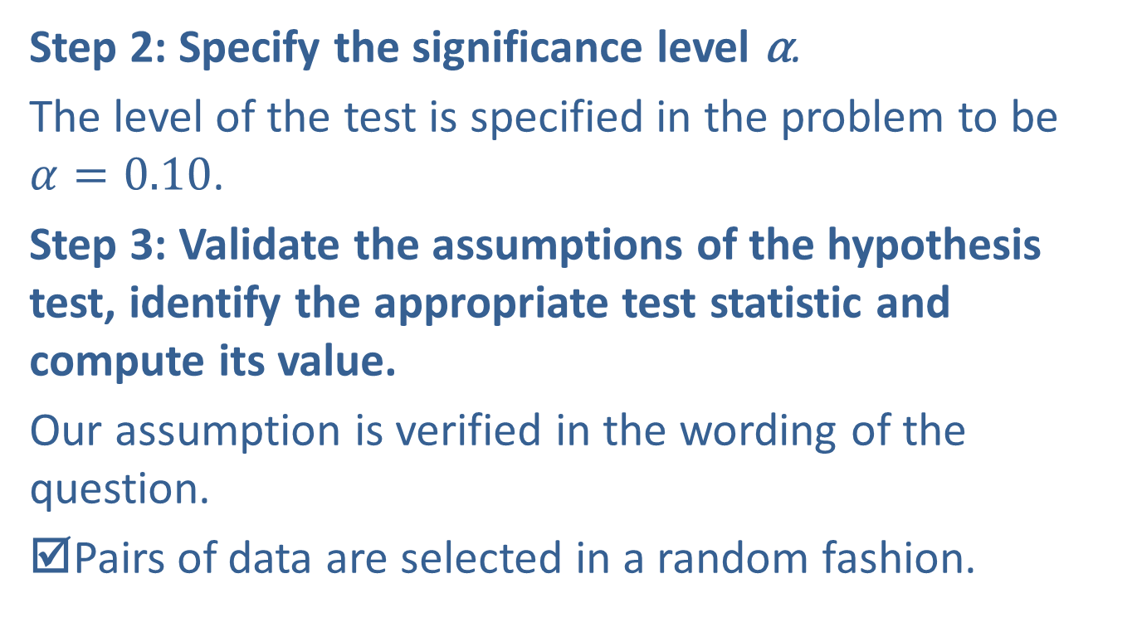
Example 17.1.2: Testing a Population Median with the Sign Test (cont.)
Step 2: Specify the significance level α.
The level of the test is specified in the problem to be
$α=0.10$.
Step 3: Validate the assumptions of the hypothesis test, identify the appropriate test statistic and compute its value.
Our assumption is verified in the wording of the question.
☑Pairs of data are selected in a random fashion.

Slide 42

Example 17.1.2: Testing a Population Median with the Sign Test (cont.)
Since $n>25$, the test statistic is given by
Assuming the null hypothesis is true, z has an approximately standard normal distribution.
Negative signs will occur if the median price of a home in Durham, North Carolina is less than the median home price for the United States.

Slide 43
Example 17.1.2: Testing a Population Median with the Sign Test (cont.)
Thirty-five of the sampled homes had an actual sale price less than the median home price for the United states. Thus, there will be 35 negative signs.
Positive signs will occur if the median price of a home in Durham, North Carolina is greater than the median home price for the United States. Fifteen of the sampled homes had an actual sale price greater than the median home price for the United States. Thus, there will be 15 positive signs.

Slide 44

Example 17.1.2: Testing a Population Median with the Sign Test (cont.)
Since $X=$ the number of times the less frequent sign occurs, $X=15$, and the calculated value of the test statistic is

Slide 45
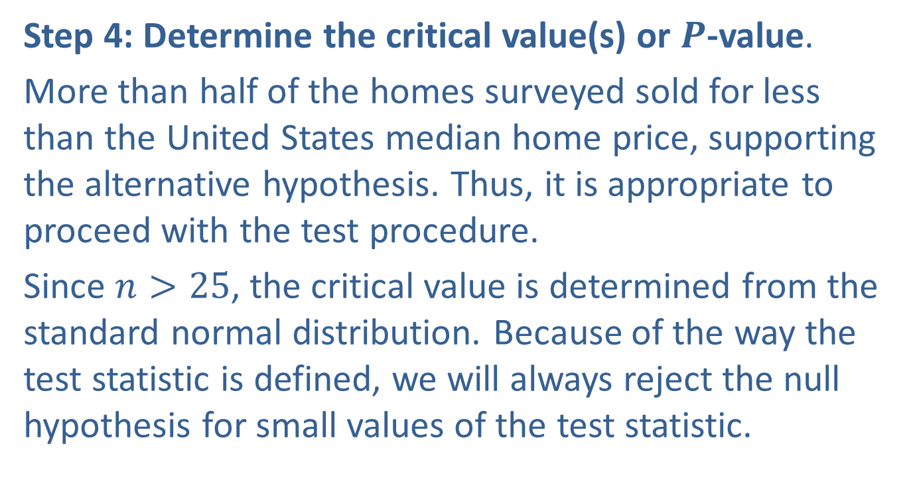
Example 17.1.2: Testing a Population Median with the Sign Test (cont.)
Step 4: Determine the critical value(s) or $P$-value.
More than half of the homes surveyed sold for less than the United States median home price, supporting the alternative hypothesis. Thus, it is appropriate to proceed with the test procedure.
Since $n>25$, the critical value is determined from the standard normal distribution. Because of the way the test statistic is defined, we will always reject the null hypothesis for small values of the test statistic.

Slide 46
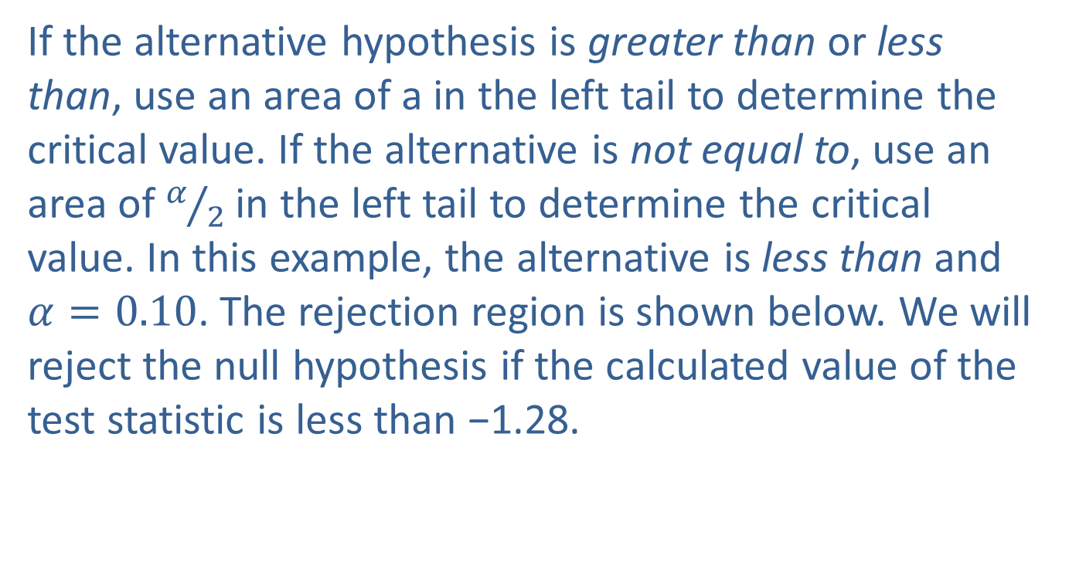
Example 17.1.2: Testing a Population Median with the Sign Test (cont.)
If the alternative hypothesis is greater than or less than, use an area of a in the left tail to determine the critical value. If the alternative is not equal to, use an area of $α/2$ in the left tail to determine the critical value. In this example, the alternative is less than and $α=0.10$. The rejection region is shown below. We will reject the null hypothesis if the calculated value of the test statistic is less than −1.28.

Slide 47
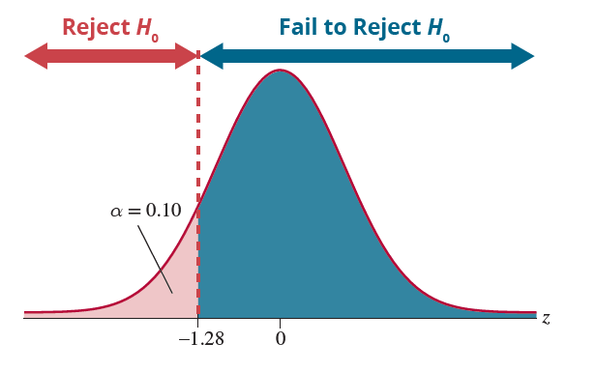
Example 17.1.2: Testing a Population Median with the Sign Test (cont.)

Slide 48
Note
A dashed vertical line on the rejection region diagram indicates that the critical value is not part of the rejection region and a solid vertical line means it is part of the rejection region.

Slide 49
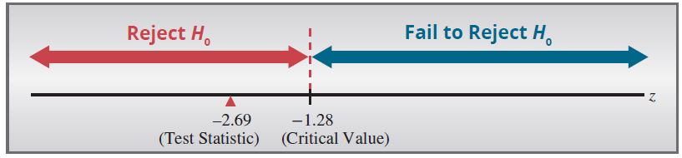
Example 17.1.2: Testing a Population Median with the Sign Test (cont.)
Step 5: Choose between the null and alternative hypotheses.
As shown, the value of the test statistic falls in the rejection region (−2.69 is less than −1.28).

Slide 50
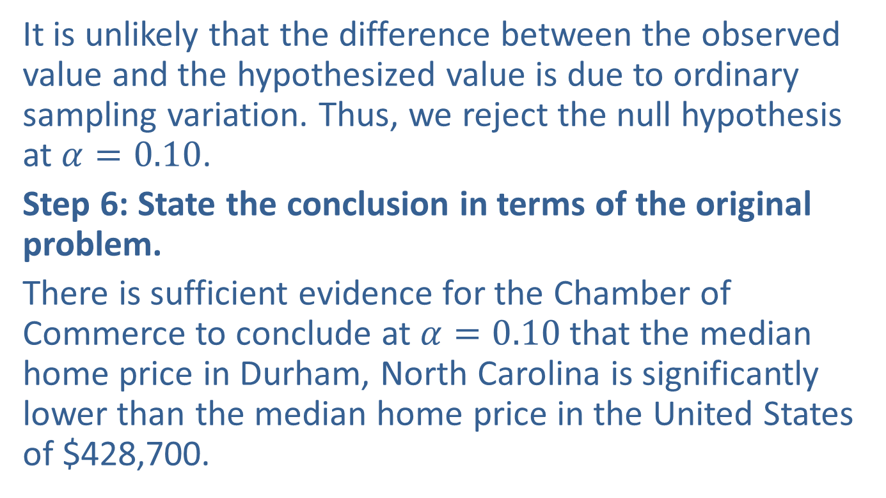
Example 17.1.2: Testing a Population Median with the Sign Test (cont.)
It is unlikely that the difference between the observed value and the hypothesized value is due to ordinary sampling variation. Thus, we reject the null hypothesis at $α=0.10$.
Step 6: State the conclusion in terms of the original problem.
There is sufficient evidence for the Chamber of Commerce to conclude at $α=0.10$that the median home price in Durham, North Carolina is significantly lower than the median home price in the United States of $428,700.

