Slide 1
Section 16.3
The Chi-Square Test for Association

Slide 2
The Chi-Square Test for Association
Our interest sometimes extends beyond one variable to summarizing the relationship between two qualitative variables. For example, a radio executive might be interested in knowing if the marital status of an individual affects that person’s preference for music. Here the qualitative variables of interest are marital status, which could take on values such as single, married, divorced, or widowed, and preference for music, which could take on the values Classical, Jazz, Easy Listening, Rock, Rap, and Country.

Slide 3
The Chi-Square Test for Association (cont.)
Other examples of relationships between two qualitative variables which might be of interest are age and political preference, education level and job performance, income level and occupation, etc. When we are interested in this type of relationship, we often make use of a contingency table.

Slide 4
Definition: Contingency Table (or Two-Way Frequency Table)
A contingency table organizes data on two characteristics simultaneously. Each cell in a contingency table contains either a count or a proportion which represents the number of observations falling into that cell. It is important to note that contingency tables are composed of two variables which each satisfy the properties of the multinomial distribution.

Slide 5
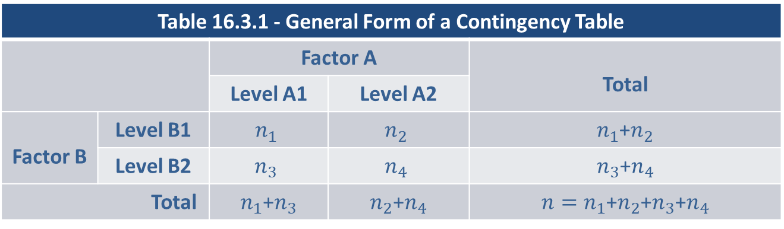
The Chi-Square Test for Association (cont.)
Table 16.3.1 shows the general form of a contingency table.
As an example, consider the following survey on job satisfaction based on income level.
Table 16.3.1 - General Form of a Contingency Table
 |  | Factor A |  | Total
 |  | Level A1 | Level A2
Factor B | Level B1 | $$n_{1}$$ | $$n_{2}$$ | $n_{1}$+$n_{2}$
 | Level B2 | $$n_{3}$$ | $$n_{4}$$ | $n_{3}$+$n_{4}$
Total |  | $n_{1}$+$n_{3}$ | $n_{2}$+$n_{4}$ | $n=n_{1}$+$n_{2}$+$n_{3}$+$n_{4}$

Slide 6
The Chi-Square Test for Association (cont.)
For the survey, 14,999 respondents at various income levels were asked if they were satisfied or dissatisfied with their jobs. For those who responded, the contingency table shown in Table 16.3.2 resulted.
Table 16.3.2 - Level of Job Satisfaction
Income | Satisfied | Dissatisfied | Total
High ($88,000+) | 762 | 475 | 1237
Medium ($45,000 to $87,999) | 3840 | 2606 | 6446
Low (Below $45,000) | 4080 | 3236 | 7316
Total | 8682 | 6317 | 14,999

Slide 7
The Chi-Square Test for Association (cont.)
Notice that the column totals and the row totals both sum to the number of respondents in the survey, 14,999. This means that each respondent was allowed to choose only one category. This is necessary if the table is to satisfy the conditions of a multinomial distribution. If the survey is designed such that respondents are allowed to choose more than one category, the following analysis will not apply.

Slide 8
The Chi-Square Test for Association (cont.)
Suppose we are interested in knowing if there is some relationship between income and job satisfaction. Another way of thinking about the same problem is to ask if job satisfaction is dependent on income level. Rephrasing the question in this manner is important because a formal definition of dependence was developed in Chapter 6. We will use this definition in the development of the hypothesis test. Further, stating that two variables are dependent implies that they are related.

Slide 9
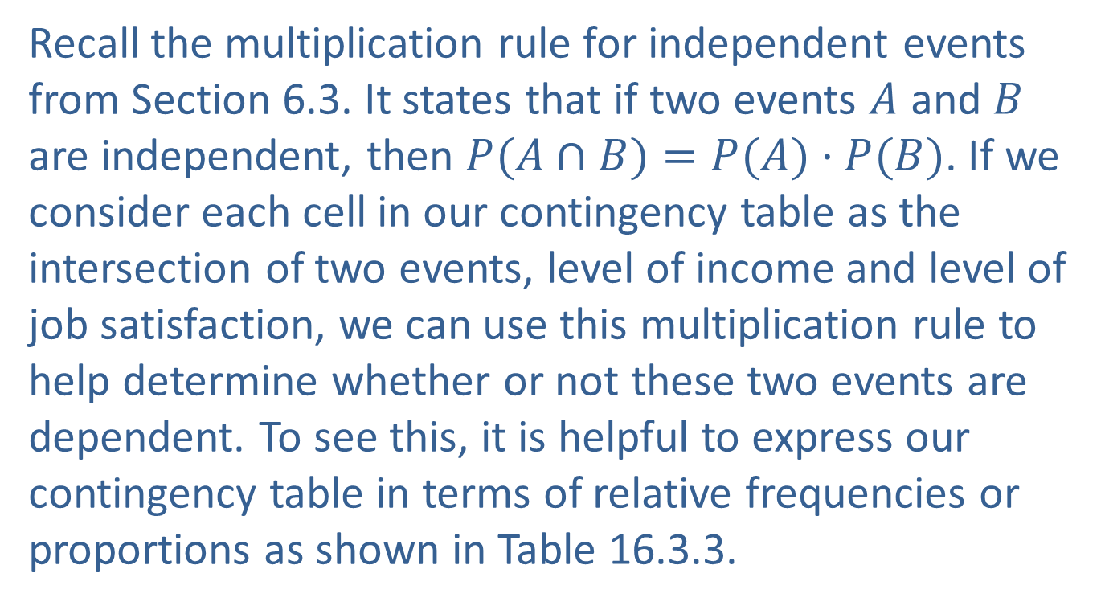
The Chi-Square Test for Association (cont.)
Recall the multiplication rule for independent events from Section 6.3. It states that if two events $A$ and $B$ are independent, then $P(A∩B)=P(A)·P(B)$. If we consider each cell in our contingency table as the intersection of two events, level of income and level of job satisfaction, we can use this multiplication rule to help determine whether or not these two events are dependent. To see this, it is helpful to express our contingency table in terms of relative frequencies or proportions as shown in Table 16.3.3.

Slide 10
The Chi-Square Test for Association (cont.)
Table 16.3.3 - Level of Job Satisfaction (Proportions)
Income | Satisfied | Dissatisfied | Total
High | 0.0508 | 0.0317 | 0.0825
Medium | 0.2560 | 0.1737 | 0.4298
Low | 0.2720 | 0.2157 | 0.4878
Total | 0.5788 | 0.4212 | 1.0000
Let the subscript S represent being Satisfied, D represent Dissatisfied, income level 1 is High, income level 2 is Medium, and income level 3 is Low. The relative frequencies were determined in the following manner.

Slide 11
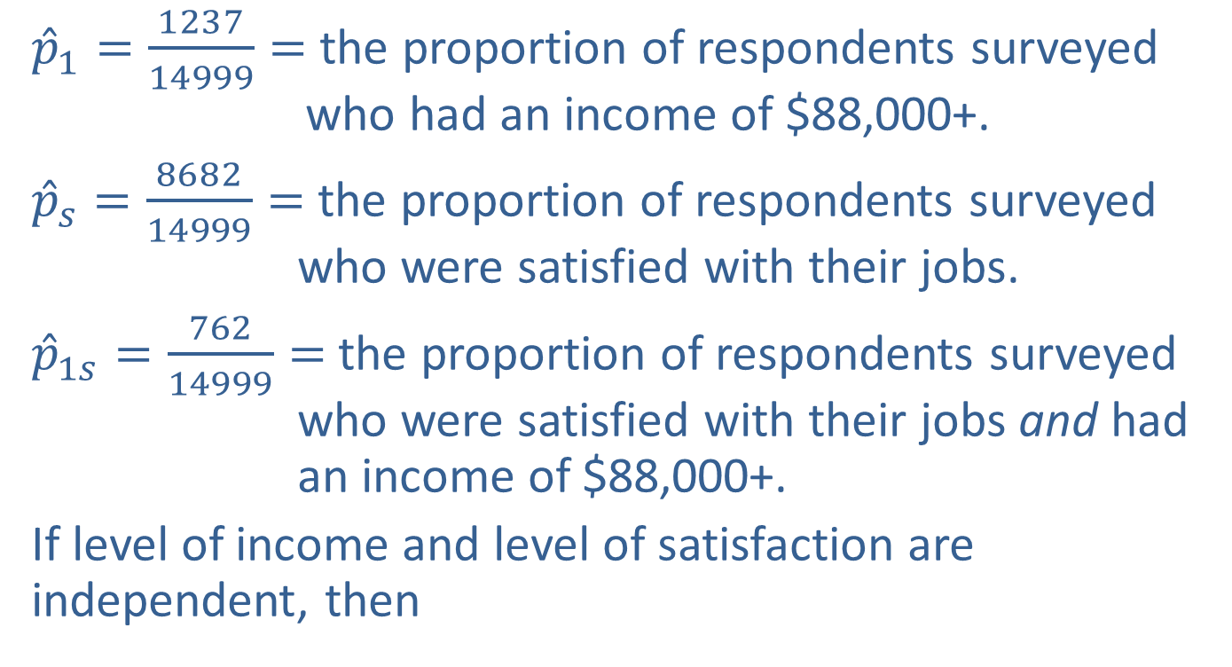
The Chi-Square Test for Association (cont.)
${\hat{p}}_{1}=\frac{1237}{14999}=$ the proportion of respondents surveyed who had an income of $88,000+.
${\hat{p}}_{s}=\frac{8682}{14999}=$ the proportion of respondents surveyed who were satisfied with their jobs.
${\hat{p}}_{1s}=\frac{762}{14999}=$ the proportion of respondents surveyed who were satisfied with their jobs and had an income of $88,000+.
If level of income and level of satisfaction are independent, then

Slide 12
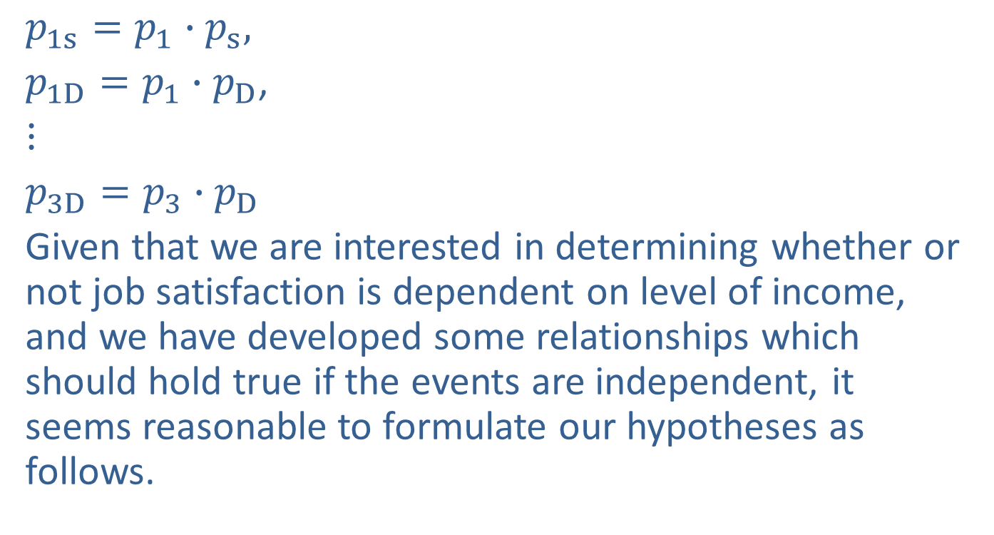
The Chi-Square Test for Association (cont.)
$p_{1s}=p_{1}∙p_{s},$
$p_{1D}=p_{1}∙p_{D}$,
$⋮$
$p_{3D}=p_{3}∙p_{D}$
Given that we are interested in determining whether or not job satisfaction is dependent on level of income, and we have developed some relationships which should hold true if the events are independent, it seems reasonable to formulate our hypotheses as follows.

Slide 13
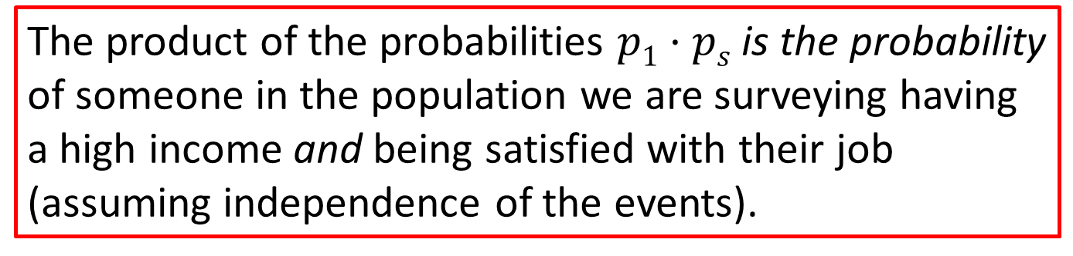
Note
The product of the probabilities $p1·ps$is the probability of someone in the population we are surveying having a high income and being satisfied with their job (assuming independence of the events).

Slide 14
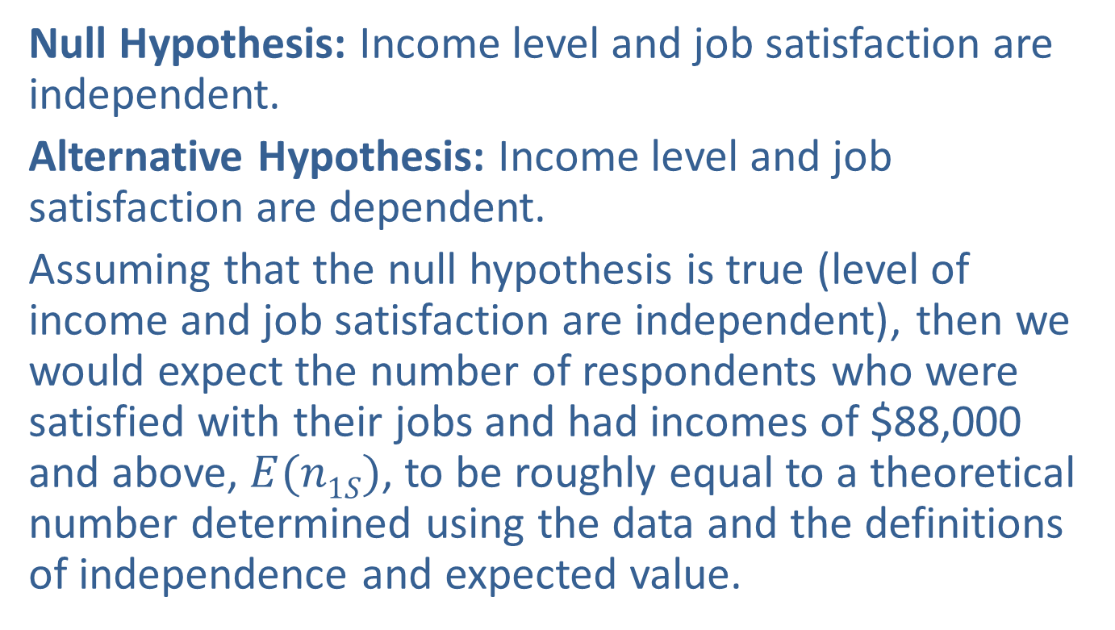
The Chi-Square Test for Association (cont.)
Null Hypothesis: Income level and job satisfaction are independent.
Alternative Hypothesis: Income level and job satisfaction are dependent.
Assuming that the null hypothesis is true (level of income and job satisfaction are independent), then we would expect the number of respondents who were satisfied with their jobs and had incomes of $88,000 and above, $E(n1S)$, to be roughly equal to a theoretical number determined using the data and the definitions of independence and expected value.

Slide 15
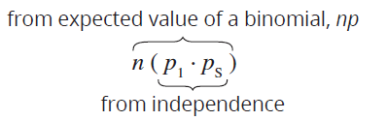

The Chi-Square Test for Association (cont.)
Using the idea of independence and the notion of expected value we would expect $n·p1·ps$to be the number of people in the high income and satisfied category.

Slide 16
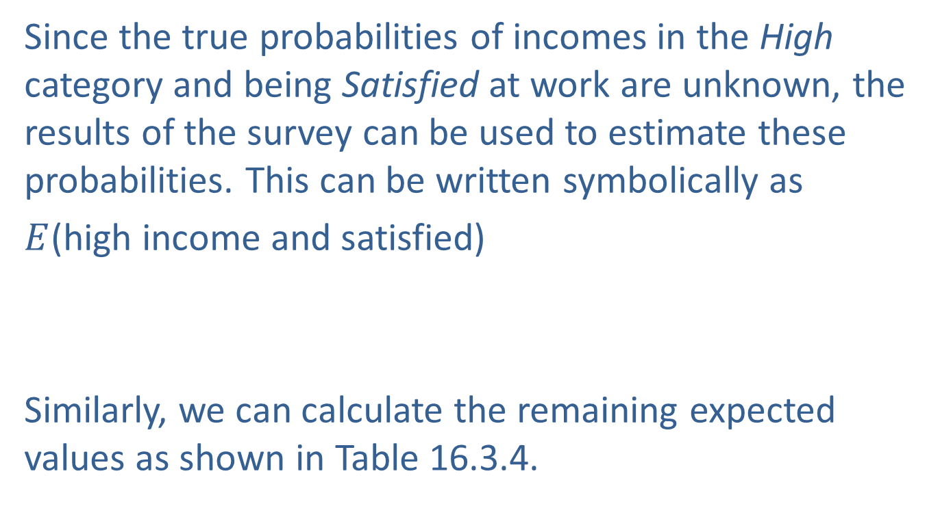
The Chi-Square Test for Association (cont.)
Since the true probabilities of incomes in the High category and being Satisfied at work are unknown, the results of the survey can be used to estimate these probabilities. This can be written symbolically as
$E$(high income and satisfied)
Similarly, we can calculate the remaining expected values as shown in Table 16.3.4.

Slide 17
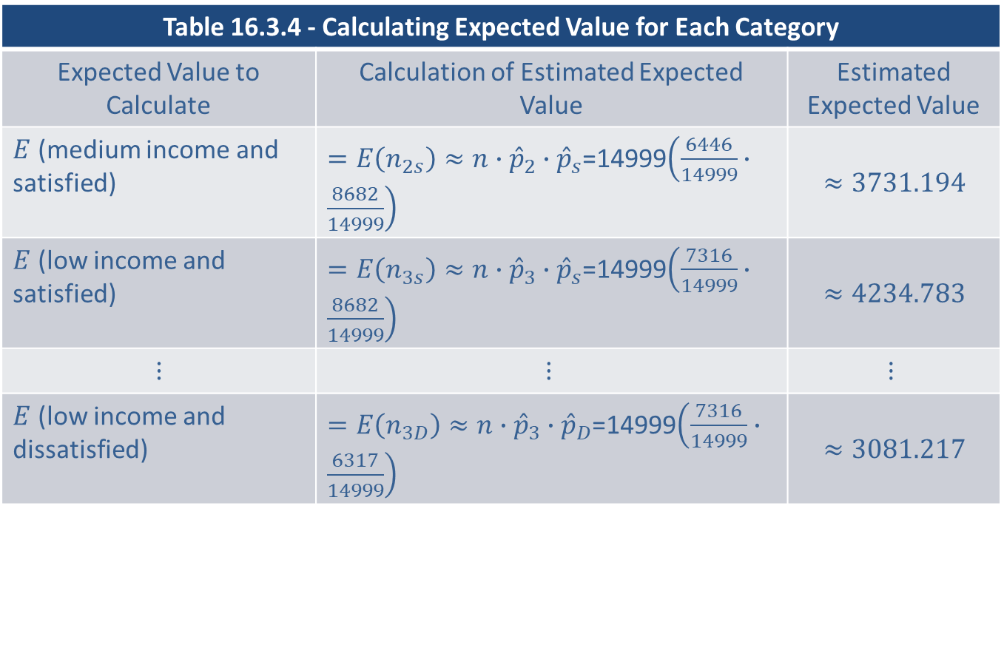
The Chi-Square Test for Association (cont.)
Table 16.3.4 - Calculating Expected Value for Each Category
Expected Value to Calculate | Calculation of Estimated Expected Value | Estimated Expected Value
$E$ (medium income and satisfied) | $=E\left(n_{2s}\right)≈n∙{\hat{p}}_{2}∙{\hat{p}}_{s}$=14999$\left(\frac{6446}{14999}∙\frac{8682}{14999}\right)$ | $$≈3731.194$$
$E$ (low income and satisfied) | $=E\left(n_{3s}\right)≈n∙{\hat{p}}_{3}∙{\hat{p}}_{s}$=14999$\left(\frac{7316}{14999}∙\frac{8682}{14999}\right)$ | $$≈4234.783$$
$$⋮$$ | $$⋮$$ | $$⋮$$
$E$ (low income and dissatisfied) | $=E\left(n_{3D}\right)≈n∙{\hat{p}}_{3}∙{\hat{p}}_{D}$=14999$\left(\frac{7316}{14999}∙\frac{6317}{14999}\right)$ | $$≈3081.217$$

Slide 18
The Chi-Square Test for Association (cont.)
Table 16.3.5 displays observed values and expected values for each cell.
Table 16.3.5 - Actual versus Expected Number of Respondents
Income | Satisfied |  | Dissatisfied
 | Observed | Expected | Observed | Expected
High | 762 | 716.023 | 475 | 520.977
Medium | 3840 | 3731.194 | 2606 | 2714.806
Low | 4080 | 4234.783 | 3236 | 3081.217

Slide 19
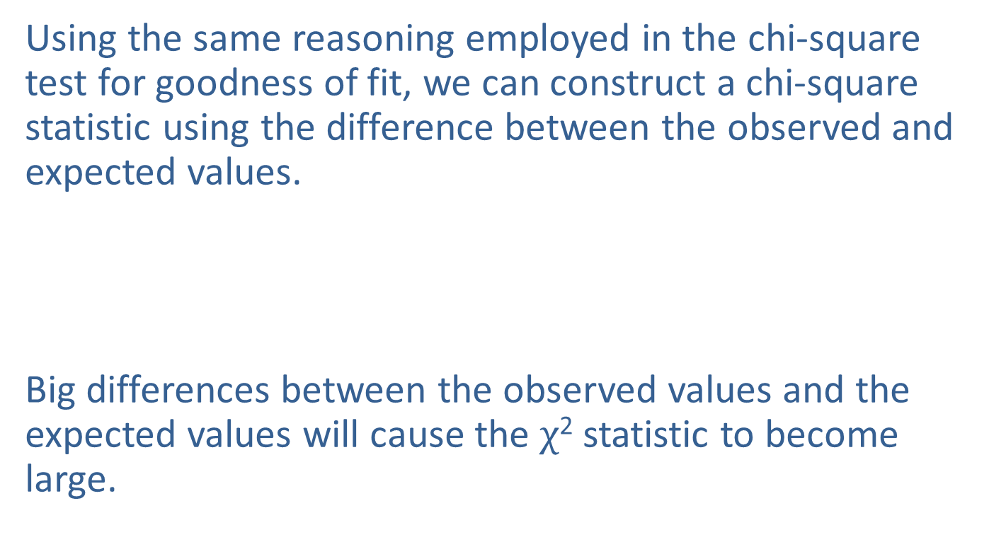
The Chi-Square Test for Association (cont.)
Using the same reasoning employed in the chi-square test for goodness of fit, we can construct a chi-square statistic using the difference between the observed and expected values.
Big differences between the observed values and the expected values will cause the $χ$² statistic to become large.

Slide 20
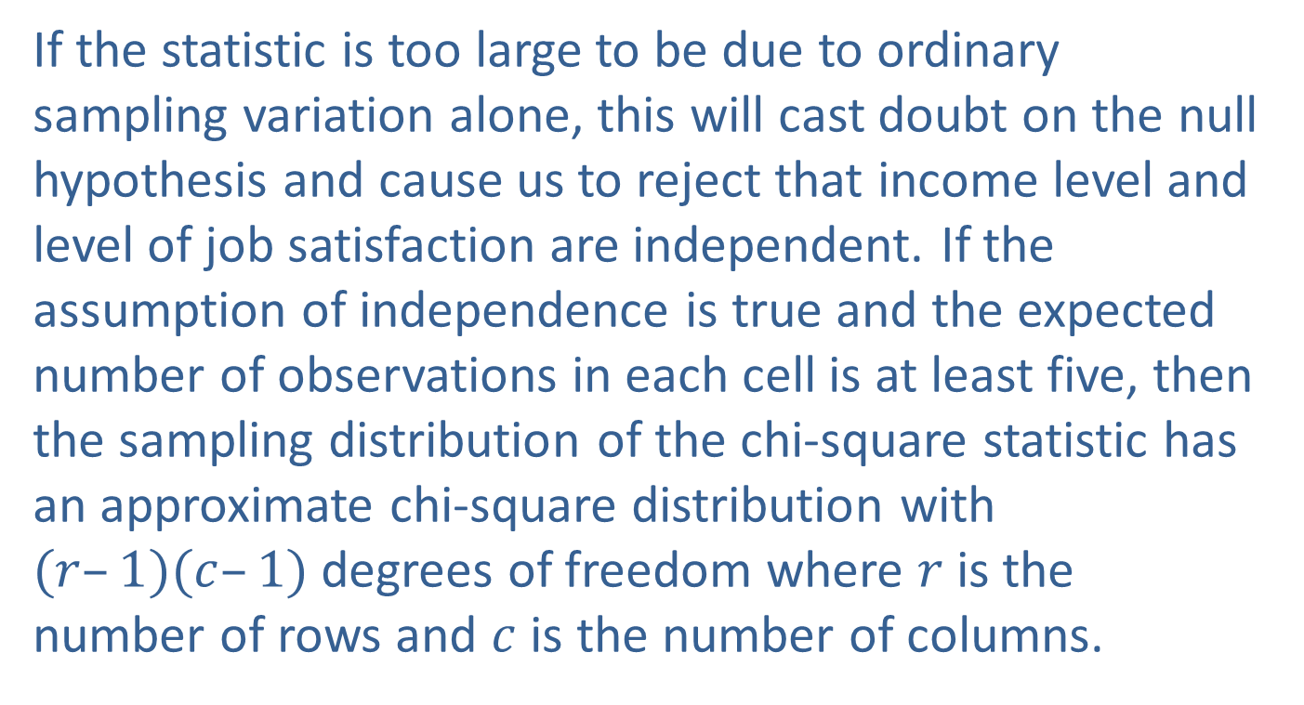
The Chi-Square Test for Association (cont.)
If the statistic is too large to be due to ordinary sampling variation alone, this will cast doubt on the null hypothesis and cause us to reject that income level and level of job satisfaction are independent. If the assumption of independence is true and the expected number of observations in each cell is at least five, then the sampling distribution of the chi-square statistic has an approximate chi-square distribution with $(r–1)(c–1)$degrees of freedom where $r$ is the number of rows and $c$ is the number of columns.

Slide 21

The Chi-Square Test for Association (cont.)
If we choose $α=0.01$, we will reject the null hypothesis if the chi-square test statistic is larger than the chi-square critical value of 9.210 which is ${\text{χ}}_{0.01}^{2}$ with $(3 – 1)(2 – 1)=2$degrees of freedom, or if the observed $P$-value is less than 0.01.

Slide 22
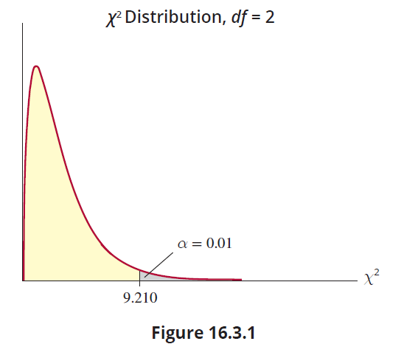
The Chi-Square Test for Association (cont.)

Slide 23
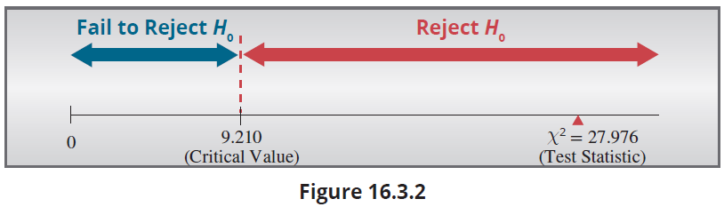
The Chi-Square Test for Association (cont.)
For our data, the chi-square test statistic is given by

Slide 24
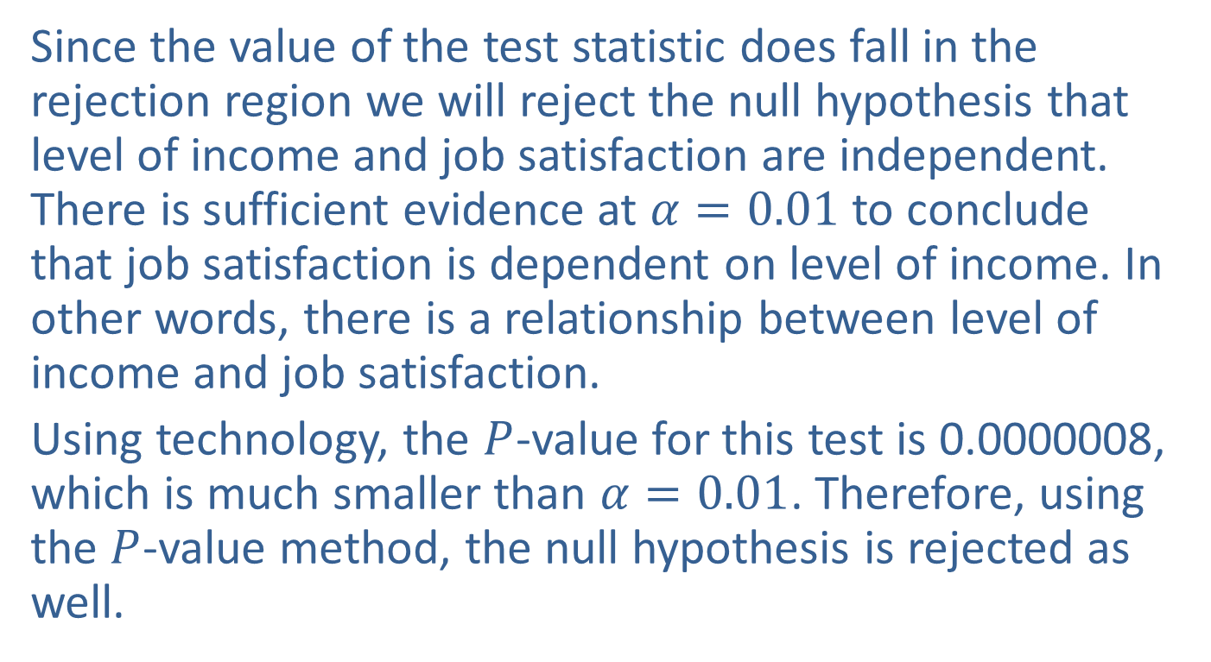
The Chi-Square Test for Association (cont.)
Since the value of the test statistic does fall in the rejection region we will reject the null hypothesis that level of income and job satisfaction are independent. There is sufficient evidence at $α=0.01$to conclude that job satisfaction is dependent on level of income. In other words, there is a relationship between level of income and job satisfaction.
Using technology, the $P$-value for this test is 0.0000008, which is much smaller than $α=0.01$. Therefore, using the $P$-value method, the null hypothesis is rejected as well.

Slide 25

The Chi-Square Test for Association (cont.)
A summary of the chi-square test for association follows. It is important to note that $n$ should be large enough so that the expected cell count (number of observations) in each cell will be equal to five or more.

Slide 26
Note
We recommend the use of technology when performing a chi-square test for association, but if calculations are done manually, be sure to carry at least six decimal places in all calculations for accuracy.

Slide 27
Procedure: Chi-Square Test for Association
Assumptions:
The conditions for a multinomial random variable are met for both variables.
The expected value of n_{i} is at least 5 for each category.
Hypotheses:
H₀: The two qualitative variables are independent (not related).
H_{a}: The two qualitative variables are dependent (related).

Slide 28
Procedure: Chi-Square Test for Association (cont.)
Test Statistic:
where r = the number of rows, c = the number of
columns.

Slide 29
Note
An alternate way to calculate the expected cell frequencies is given by

Slide 30
Procedure: Chi-Square Test for Association (cont.)
where n is the total number of
observations and and are estimates of the true population proportions, p_{i} and p_{j}, calculated as follows:

Slide 31
Procedure: Chi-Square Test for Association (cont.)
If the null hypothesis is true and n is large enough so that the expected number of observations in each cell is at least 5, then the test statistic has an approximate chi-square distribution with (r − 1)(c − 1) degrees of freedom.
Rejection Region:
Reject H₀ if with (r − 1)(c − 1) degrees of freedom.

Slide 32
Procedure: Chi-Square Test for Association (cont.)
P-value:
The P-value is the probability of observing a value as extreme or more extreme than the value of the test statistic, given a chi-square distribution with (r − 1)(c − 1) degrees of freedom.
If the computed P-value is less than α, reject the null hypothesis in favor of the alternative.
If the computed P-value is greater than or equal to α, fail to reject the null hypothesis.

Slide 33
The Chi-Square Test for Association (cont.)
Recall that the chi-square test for association between two variables is always a one-sided test because of the way we construct the test statistic. We will reject the null hypothesis for large values of the test statistic.

Slide 34
Example 16.3.1: Detecting an Association Between Qualitative Variables
Consider a particular question from the Quinnipiac University poll. The Quinnipiac University poll is often used as a barometer of public opinion regarding matters of public concern.
The question: Would you support or oppose raising the national minimum wage?
For those who responded to the question, the results of the poll are presented in the table below.

Slide 35
Example 16.3.1: Detecting an Association Between Qualitative Variables (cont.)
Based on the data can we conclude that support for raising the national minimum wage is dependent on political affiliation or is political affiliation independent of support for raising the minimum wage?
Support for Raising the National Minimum Wage
Political Affiliation | Yes | No | Total
Republican | 208 | 193 | 401
Democrat | 387 | 30 | 416
Independent | 476 | 193 | 669
Total | 1071 | 416 | 1487

Slide 36
Example 16.3.1: Detecting an Association Between Qualitative Variables (cont.)
Solution
Step 1: Determine the population parameter to be used and develop the null and alternative hypotheses.
For this example, we are interested in the proportion of the respondents who fall into each of the Support for National Minimum Wage and Political Affiliation categories.

Slide 37
Example 16.3.1: Detecting an Association Between Qualitative Variables (cont.)
The resulting hypotheses are as follows:
H₀: Support for raising the national minimum wage and political affiliation are independent (not related).
H_{a}: Support for raising the national minimum wage and political affiliation are dependent (related).
Step 2: Specify the significance level α.
We must specify the level of the test ourselves since we are not given one in the problem. Let’s choose α = 0.10.

Slide 38
Example 16.3.1: Detecting an Association Between Qualitative Variables (cont.)
Step 3: Validate the assumptions of the hypothesis testing model, identify the appropriate test statistic and compute its value.
Each respondent was not allowed to respond to more than one category (multinomial random variables).
The expected cell count for each category is greater than 5.

Slide 39
Example 16.3.1: Detecting an Association Between Qualitative Variables (cont.)
We can use the chi-square test for association. Our test statistic is the chi-square test statistic with (3 − 1)(2 − 1) = 2 degrees of freedom. The formula for the test statistic is given as follows.

Slide 40
Example 16.3.1: Detecting an Association Between Qualitative Variables (cont.)
The table below gives the actual responses in each category versus the expected responses in each category.
Raising the National Minimum Wage
 | Yes |  | No
Political Affiliation | Actual | Expected | Actual | Expected
Republican | 208 | 288.82 | 193 | 112.18
Democrat | 387 | 299.62 | 30 | 116.38
Independent | 476 | 481.84 | 193 | 187.16

Slide 41
Example 16.3.1: Detecting an Association Between Qualitative Variables (cont.)
Based on these results the test statistic is calculated as follows.

Slide 42
Example 16.3.1: Detecting an Association Between Qualitative Variables (cont.)
Step 4: Determine the critical value(s) or P-value.
Since the level of the test is α = 0.10 and we will reject the null hypothesis for large values of the test statistic, the chi-square critical value is Values of the test statistic larger than 4.605 would indicate that the apparent dependence of the two classifications could not be due to ordinary sampling variation alone.

Slide 43
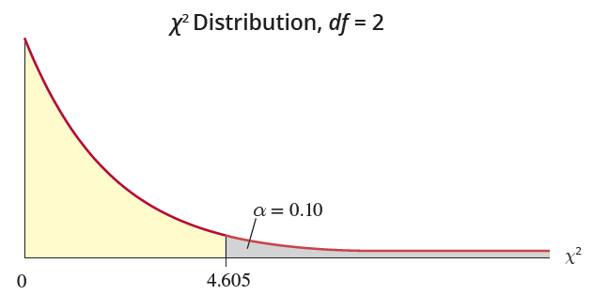
Example 16.3.1: Detecting an Association Between Qualitative Variables (cont.)
Using technology we obtain a test statistic of 170.467 (slightly different from our calculated value due to our intermediate rounding), and find that the P-value is essentially zero.

Slide 44
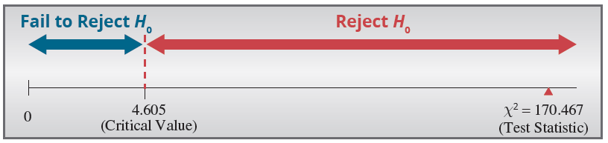
Example 16.3.1: Detecting an Association Between Qualitative Variables (cont.)
Step 5: Choose between the null and alternative hypotheses.
Since the test statistic falls in the rejection region, the null hypothesis should be rejected.
Since the P-value, which is approximately 0, is less than α = 0.10, we also reject H₀ using the P-value method.

Slide 45
Example 16.3.1: Detecting an Association Between Qualitative Variables (cont.)
Step 6: State the conclusion in terms of the original problem.
There is evidence at the 0.10 level to conclude that support for raising the national minimum wage and political affiliation are dependent. The difference in support is too great to believe it to be attributed to ordinary sampling variation alone.

