Slide 1
Section 16.2
The Chi-Square Test for Goodness of Fit

Slide 2
The Chi-Square Test for Goodness of Fit
An owner of a grocery market chain suspects that there has been a change in the shopping pattern of his customers. He has always believed that his stores are equally busy regardless of the day of the week, and he has geared his weekly advertised specials accordingly.
If the shopping pattern has changed and some days are in fact busier shopping days than others, he estimates that this could be costing him thousands of dollars in lost sales due to improperly scheduled advertisements. He decides to use statistical inference to test his theory.

Slide 3
The Chi-Square Test for Goodness of Fit (cont.)
He randomly samples 105 customers from his customer database and asks them which day of the week they go grocery shopping. The results of the survey are listed in Table 16.2.1. Based on this data, what criteria can the grocer use to decide if some days of the week are preferred for grocery shopping over others?
Table 16.2.1 - Customer Shopping Data
Monday | Tuesday | Wednesday | Thursday | Friday | Saturday | Sunday
10 | 15 | 14 | 16 | 11 | 20 | 19

Slide 4
The Chi-Square Test for Goodness of Fit (cont.)
In 1900, Karl Pearson developed the chi-square test for goodness of fit. The test statistic for the chi-square goodness of fit is a summary measure which compares the actual percentage of observations which fall into a particular category with the expected percentage for that category.

Slide 5
Definition: Chi-Square Test for Goodness of Fit
The chi-square goodness-of-fit test is a hypothesis test used to determine if an observed frequency distribution follows a specified distribution. It accomplishes this by comparing observed frequencies to expected frequencies based on the specified distribution.

Slide 6
The Chi-Square Test for Goodness of Fit (cont.)
In order to use the chi-square test for goodness of fit for inference, our experiment must satisfy some basic conditions. First, we must be able to assume that the underlying distribution of the number of shoppers shopping on the various days of the week has a multinomial probability distribution.

Slide 7
Definition: Multinomial Probability Distribution
The multinomial probability distribution is an extension of the binomial probability distribution to more than two possible outcomes on each trial, each with a constant probability of occurring from trial to trial.

Slide 8
Properties: Properties of a Multinomial Experiment
The experiment consists of n independent, identical trials.
There are k possible outcomes for each trial.
The probability of the k outcomes, p₁, p₂, ..., p_{k} are constant from trial to trial.
The random variables of interest are the counts for each of the k possible outcomes, n₁, n₂, ..., n_{k}.

Slide 9
The Chi-Square Test for Goodness of Fit (cont.)
The grocer’s survey of the number of shoppers shopping on the various days of the week seems to satisfy the conditions of a multinomial experiment. Since the customers were randomly selected and each of them was asked the same question, there were 105 independent, identical trials. The true proportions of shoppers shopping on each day of the week are unknown and constant from trial to trial. The proportion of shoppers shopping on each day of the week form a probability distribution whose probabilities sum to one.

Slide 10
The Chi-Square Test for Goodness of Fit (cont.)
Using the procedure outlined in Section 11.1 for testing a hypothesis, we must first define the hypothesis to be tested. Our grocer might formulate his hypothesis as follows.
Null Hypothesis: The proportion of shoppers does not vary by day of the week.
Alternative Hypothesis: The proportion of shoppers does vary by day of the week.
In this situation the proportion is the obvious measure of choice. However, there are several proportions of interest.

Slide 11
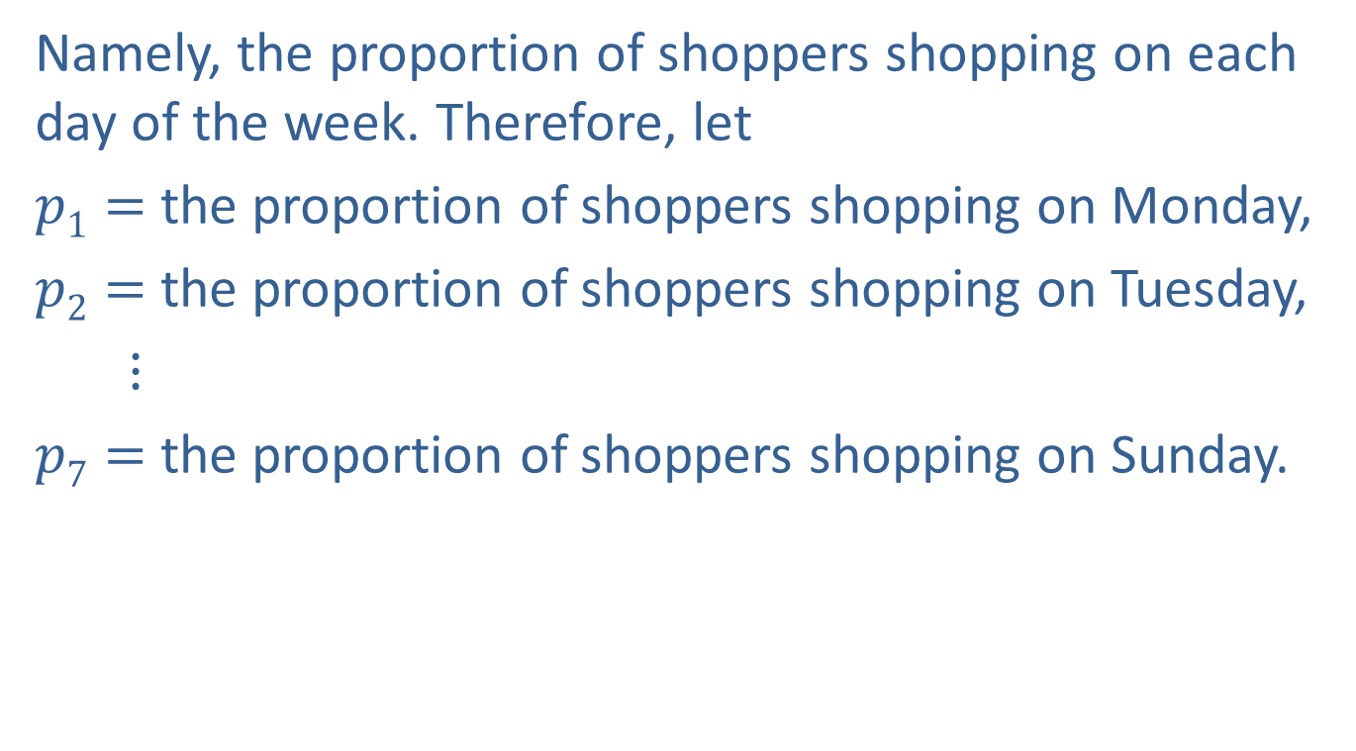
The Chi-Square Test for Goodness of Fit (cont.)
Namely, the proportion of shoppers shopping on each day of the week. Therefore, let
$p1=$the proportion of shoppers shopping on Monday,
$p2=$the proportion of shoppers shopping on Tuesday,
$⋮$
$p7=$the proportion of shoppers shopping on Sunday.

Slide 12
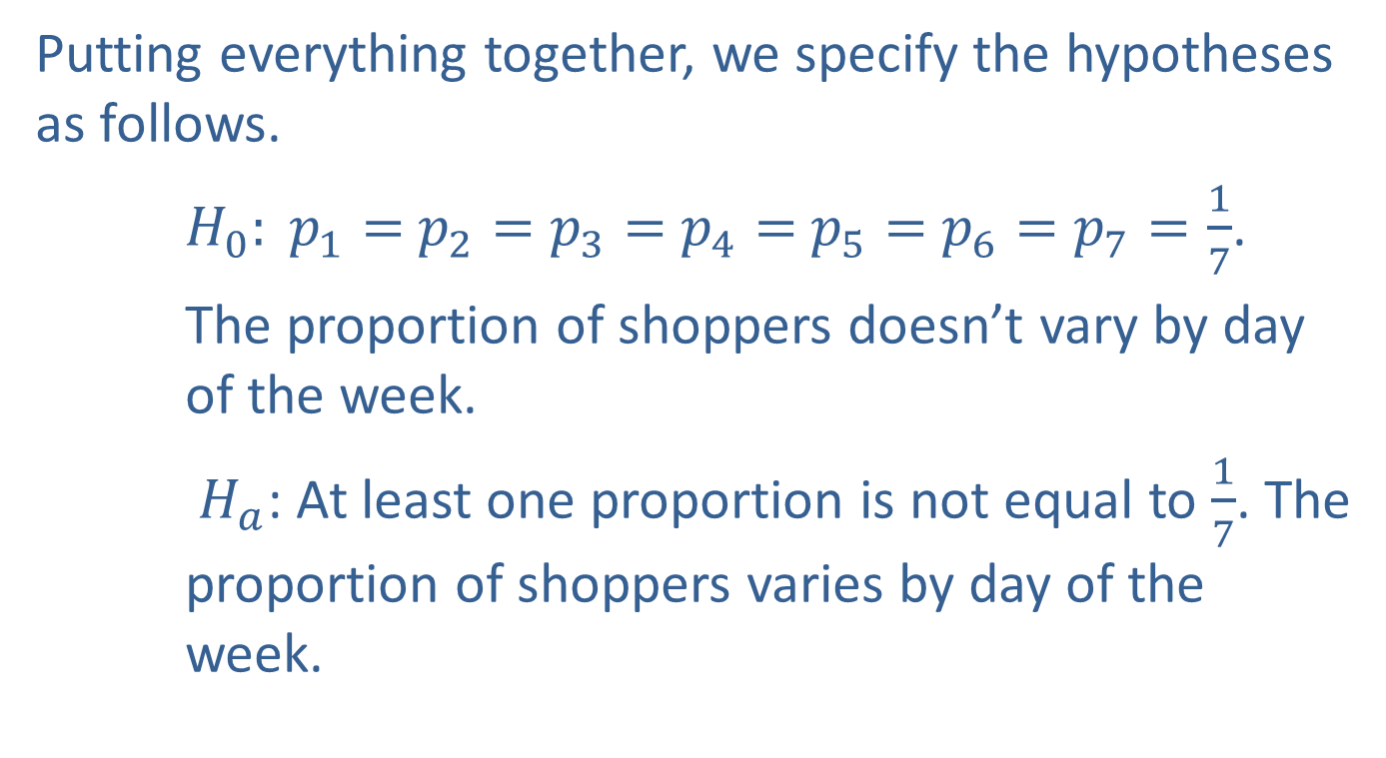
The Chi-Square Test for Goodness of Fit (cont.)
Putting everything together, we specify the hypotheses as follows.
$H_{0}: p_{1}=$ $p_{2}=$ $p_{3}=$ $p_{4}=$ $p_{5}=$ $p_{6}=$ $p_{7}=\frac{1}{7}$.
The proportion of shoppers doesn’t vary by day of the week.
$H_{a}$: At least one proportion is not equal to $\frac{1}{7}$. The proportion of shoppers varies by day of the week.

Slide 13
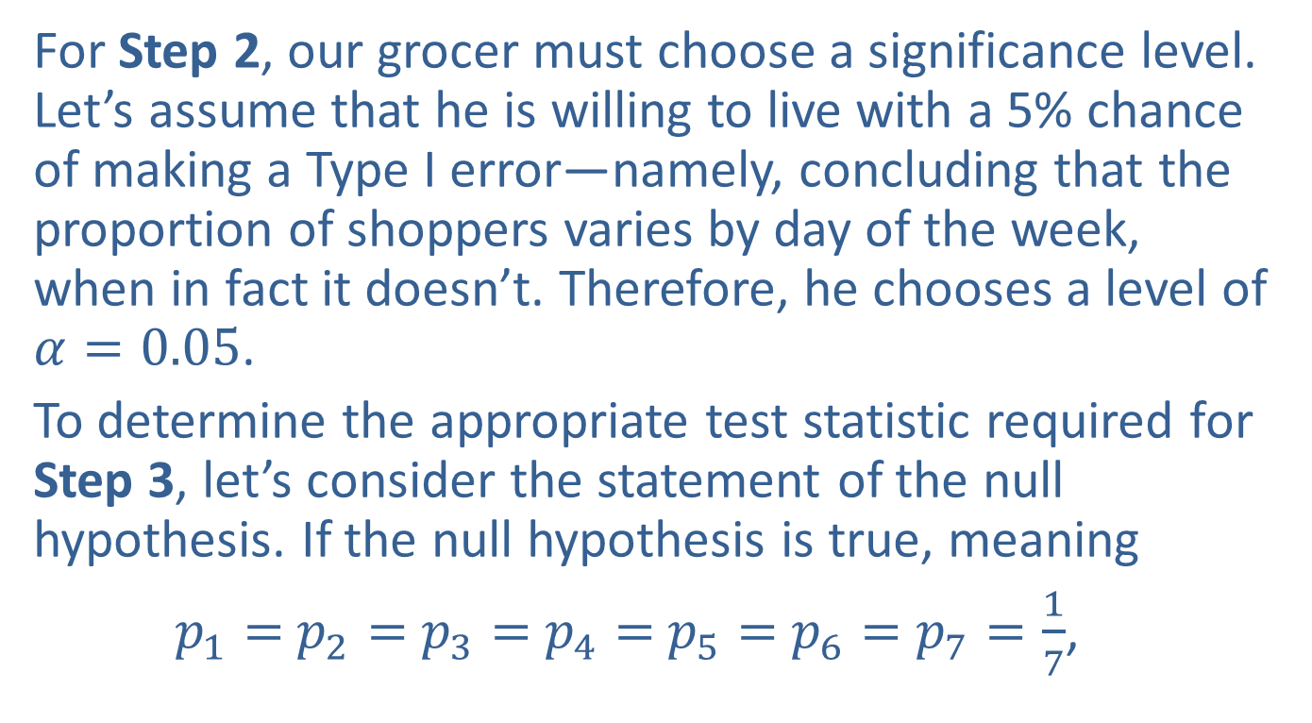
The Chi-Square Test for Goodness of Fit (cont.)
For Step 2, our grocer must choose a significance level. Let’s assume that he is willing to live with a 5% chance of making a Type I error—namely, concluding that the proportion of shoppers varies by day of the week, when in fact it doesn’t. Therefore, he chooses a level of $α=0.05$.
To determine the appropriate test statistic required for Step 3, let’s consider the statement of the null hypothesis. If the null hypothesis is true, meaning
$p_{1}=$ $p_{2}=$ $p_{3}=$ $p_{4}=$ $p_{5}=$ $p_{6}=$ $p_{7}=\frac{1}{7}$,

Slide 14
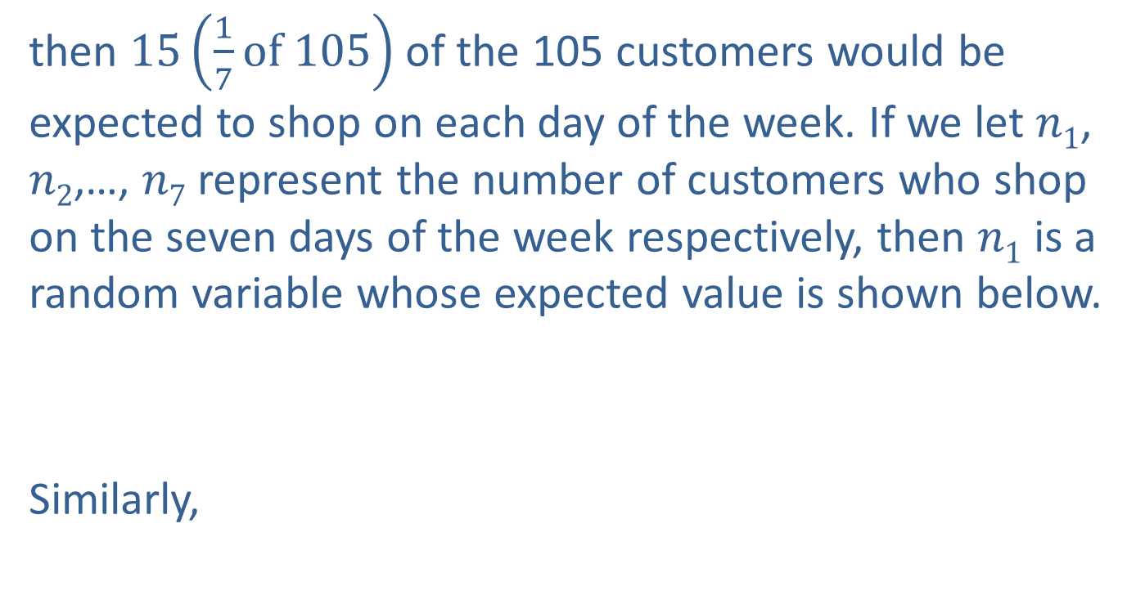
The Chi-Square Test for Goodness of Fit (cont.)
then $15\left(\frac{1}{7}of 105\right)$ of the 105 customers would be expected to shop on each day of the week. If we let $n1$, $n2$,…, $n7$ represent the number of customers who shop on the seven days of the week respectively, then $n1$ is a random variable whose expected value is shown below.
Similarly,

Slide 15
The Chi-Square Test for Goodness of Fit (cont.)
To test the hypothesis, we need to measure how close reality is (the actual proportion of shoppers each day) to what is stated in the null hypothesis (the proportion of shoppers is the same each day). This measure will become a test statistic. The test statistic will be developed as part of a criterion which will be used to make a choice between the null and alternative hypothesis.

Slide 16
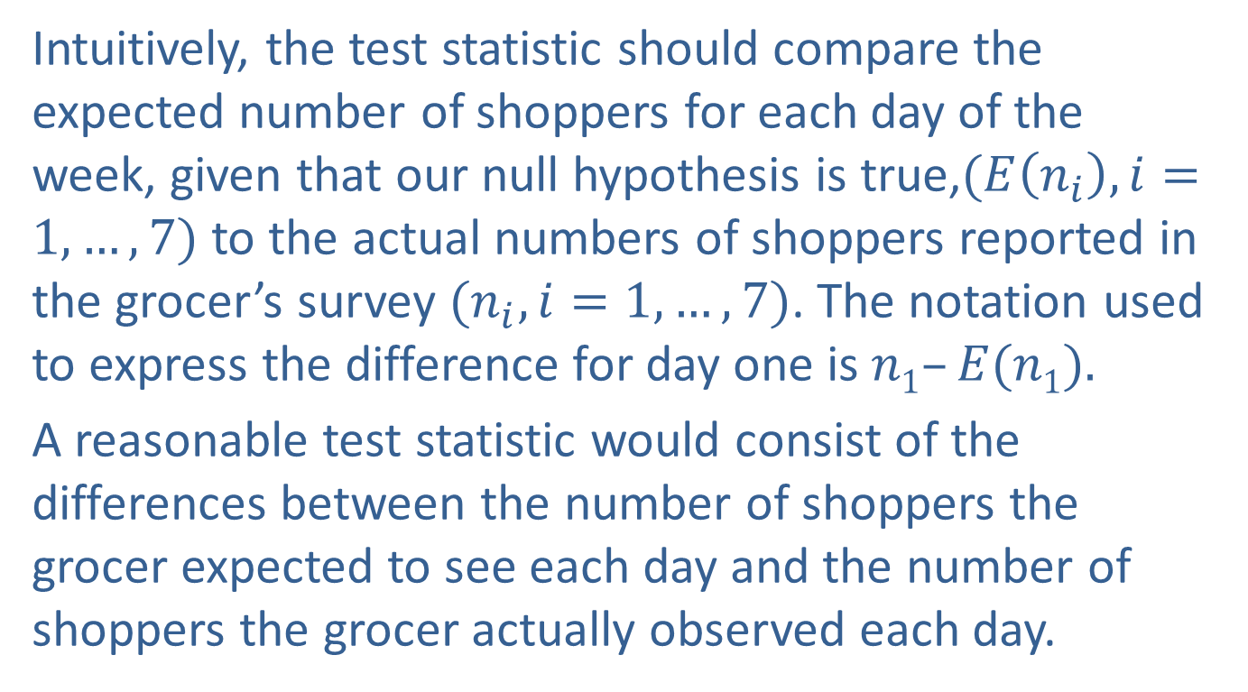
The Chi-Square Test for Goodness of Fit (cont.)
Intuitively, the test statistic should compare the expected number of shoppers for each day of the week, given that our null hypothesis is true,$(E\left(n_{i}\right), i=1,…,7)$ to the actual numbers of shoppers reported in the grocer’s survey $(n_{i}, i=1,…,7)$. The notation used to express the difference for day one is $n1–E(n1).$
A reasonable test statistic would consist of the differences between the number of shoppers the grocer expected to see each day and the number of shoppers the grocer actually observed each day.

Slide 17
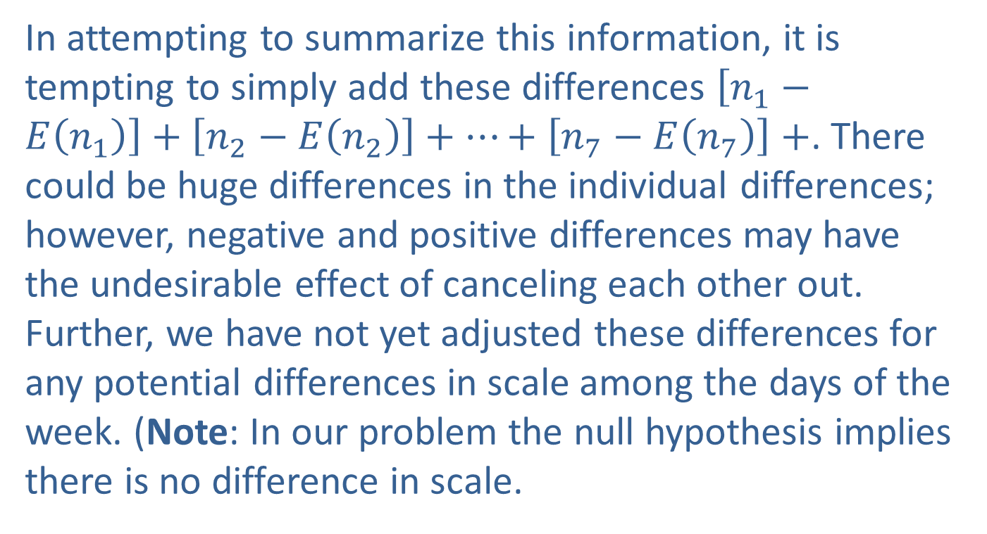
The Chi-Square Test for Goodness of Fit (cont.)
In attempting to summarize this information, it is tempting to simply add these differences $\left[n_{1}−E\left(n_{1}\right)\right]+\left[n_{2}−E\left(n_{2}\right)\right]+…+\left[n_{7}−E\left(n_{7}\right)\right]+$. There could be huge differences in the individual differences; however, negative and positive differences may have the undesirable effect of canceling each other out. Further, we have not yet adjusted these differences for any potential differences in scale among the days of the week. (Note: In our problem the null hypothesis implies there is no difference in scale.

Slide 18
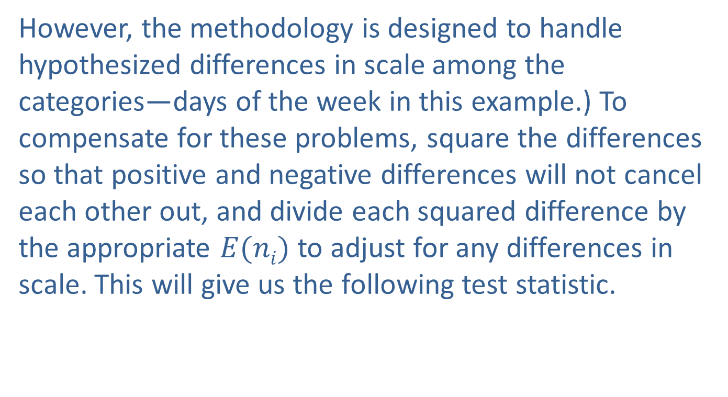
The Chi-Square Test for Goodness of Fit (cont.)
However, the methodology is designed to handle hypothesized differences in scale among the categories—days of the week in this example.) To compensate for these problems, square the differences so that positive and negative differences will not cancel each other out, and divide each squared difference by the appropriate $E(ni)$ to adjust for any differences in scale. This will give us the following test statistic.

Slide 19
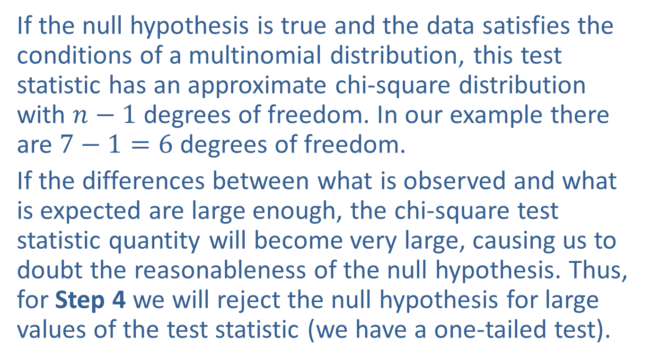
The Chi-Square Test for Goodness of Fit (cont.)
If the null hypothesis is true and the data satisfies the conditions of a multinomial distribution, this test statistic has an approximate chi-square distribution with $n−1$ degrees of freedom. In our example there are $7−1=6$degrees of freedom.
If the differences between what is observed and what is expected are large enough, the chi-square test statistic quantity will become very large, causing us to doubt the reasonableness of the null hypothesis. Thus, for Step 4 we will reject the null hypothesis for large values of the test statistic (we have a one-tailed test).

Slide 20
The Chi-Square Test for Goodness of Fit (cont.)
How large must the value of χ² be in order to conclude the null is not reasonable? We must have a criterion. The critical value for a chi-square distribution at a level of significance of 0.05 with 6 degrees of freedom is 12.592. Thus, if the null hypothesis is true, a test statistic larger than 12.592 will occur only 5% of the time due to sampling variation. Values larger than 12.592 are relatively rare (occur 5% of the time or less) if the null hypothesis is true. Hence, if we observe a value of the test statistic that is larger than 12.592 we will reject the null hypothesis.

Slide 21
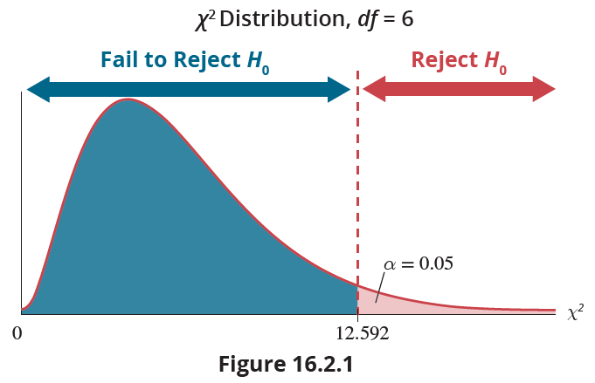
The Chi-Square Test for Goodness of Fit (cont.)
This rejection region is drawn in Figure 16.2.1.

Slide 22
The Chi-Square Test for Goodness of Fit (cont.)
The resulting value of the test statistic is as follows.
Notice that the value of the test statistic does not fall in the rejection region since 5.6 is less than 12.592 as shown in Figure 16.2.2.

Slide 23
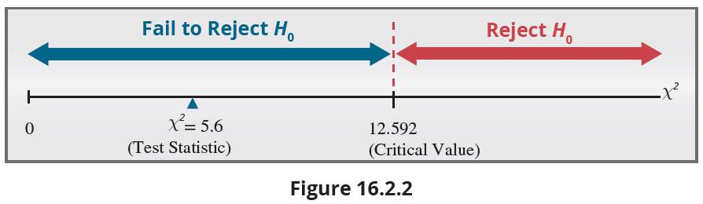

The Chi-Square Test for Goodness of Fit (cont.)
The exact $P$-value for the test statistic of 5.6 can be found using technology. The $P$-value is 0.4695, which is greater than 0.05. Thus, for Step 5, we conclude that the data does not provide enough evidence to reject the null hypothesis.

Slide 24
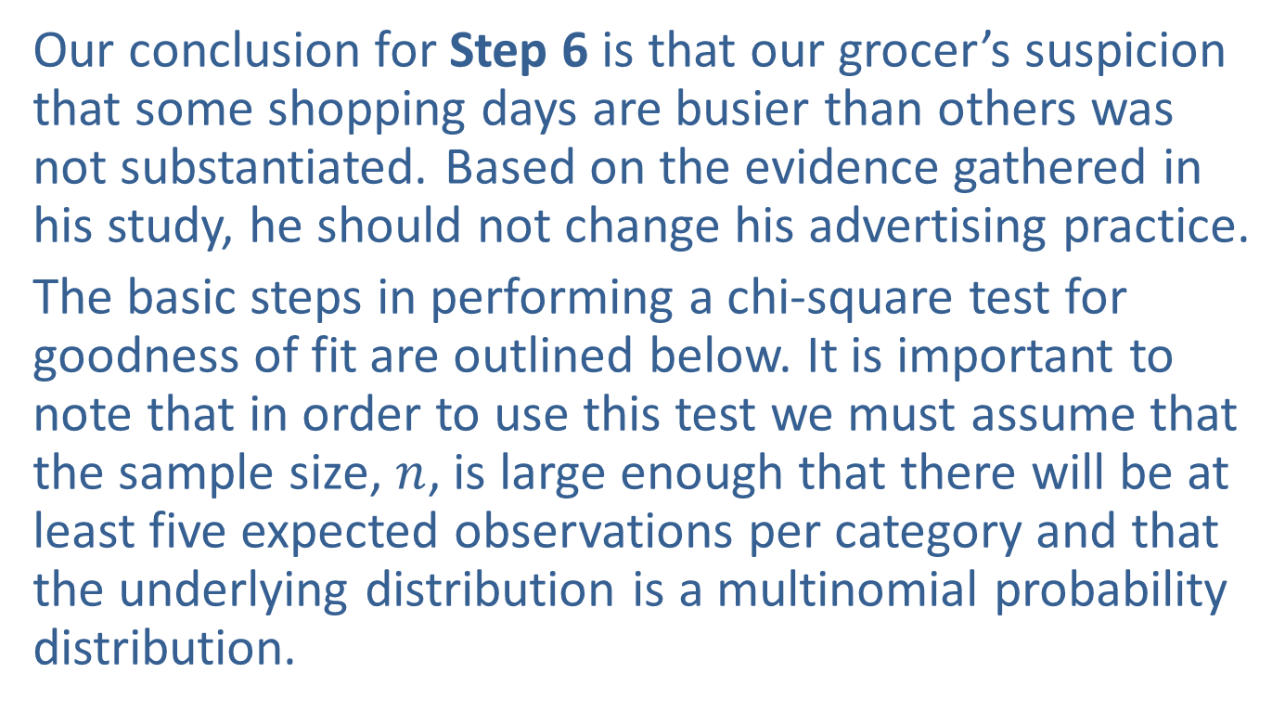
The Chi-Square Test for Goodness of Fit (cont.)
Our conclusion for Step 6 is that our grocer’s suspicion that some shopping days are busier than others was not substantiated. Based on the evidence gathered in his study, he should not change his advertising practice.
The basic steps in performing a chi-square test for goodness of fit are outlined below. It is important to note that in order to use this test we must assume that the sample size, $n$, is large enough that there will be at least five expected observations per category and that the underlying distribution is a multinomial probability distribution.

Slide 25
Procedure: Chi-Square Test for Goodness of Fit
Assumptions:
The conditions for a multinomial random variable are met.
The expected value of n_{i} is at least 5 for each category.
Hypotheses:
H₀: The population follows the specified distribution.
H_{a}: The population does not follow the specified distribution.

Slide 26
Procedure: Chi-Square Test for Goodness of Fit (cont.)
Test Statistic:
where n_{i} is the actual number of observations in each category, and E(n_{i}) is the expected number of observations for each category given that the null hypothesis is true.
Given the assumptions are met, the test statistic has a chi-square distribution with k − 1 degrees of freedom.

Slide 27
Procedure: Chi-Square Test for Goodness of Fit (cont.)
Rejection Region:
Reject H₀ if with k − 1 degrees of freedom.
P-value:
The P-value is the probability of observing a value as extreme or more extreme than the value of the test statistic, given a chi-square distribution with k − 1 degrees of freedom.

Slide 28
Procedure: Chi-Square Test for Goodness of Fit (cont.)
If the computed P-value is less than α, reject the null hypothesis in favor of the alternative.
If the computed P-value is greater than or equal to α, fail to reject the null hypothesis.

Slide 29
Example 16.2.1: Detecting a Change in Side Effects (A Qualitative Variable)
SeQuix has been developed for treating kidney disease. It has been found to have the following side effects in patients when taken over a two-month period.
A competitor has developed a new drug for treating kidney disease. The competitor hopes the new drug will not have as severe blood pressure side effects as SeQuix.
SeQuix
Side Effect | Percent
At least a 5% increase in systolic blood pressure | 50
Less than a 5% change in systolic blood pressure | 40
At least a 5% decrease in systolic blood pressure | 10

Slide 30
Example 16.2.1: Detecting a Change in Side Effects (A Qualitative Variable) (cont.)
Two hundred and fifty patients are treated with the new drug and their blood pressures are monitored over a two-month period. The following results are observed.
Can the researchers conclude that there is a difference in systolic blood pressure side effects between SeQuix and the new drug?
New Drug
Side Effect | Number of Patients
At least a 5% increase in systolic blood pressure | 100
Less than a 5% change in systolic blood pressure | 120
At least a 5% decrease in systolic blood pressure | 30

Slide 31
Example 16.2.1: Detecting a Change in Side Effects (A Qualitative Variable) (cont.)
Solution
Step 1: Determine the population parameter to be used and develop the null and alternative hypotheses.
Null Hypothesis: There is no difference in blood pressure side effects between the two drugs.
Alternative Hypothesis: There is a difference in blood pressure side effects between the two drugs.

Slide 32
Example 16.2.1: Detecting a Change in Side Effects (A Qualitative Variable) (cont.)
The variable to be analyzed is Side Effect, which has three possible values: at least a 5% increase in systolic blood pressure, less than a 5% change in systolic blood pressure, and at least a 5% decrease in systolic blood pressure. Further, our interest is in the proportion (or percent) of the patients who fall into each of the blood pressure side effect categories:

Slide 33
Example 16.2.1: Detecting a Change in Side Effects (A Qualitative Variable) (cont.)
p₁ = the proportion of patients with at least a 5% increase in blood pressure,
p₂ = the proportion of patients with less than a 5% change in blood pressure,
p₃ = the proportion of patients with at least a 5% decrease in blood pressure.
The chi-square test for goodness of fit is always a one-sided test because of the way the test statistic is constructed. We will reject the null hypothesis in favor of the alternative hypothesis for large values of the test statistic.

Slide 34
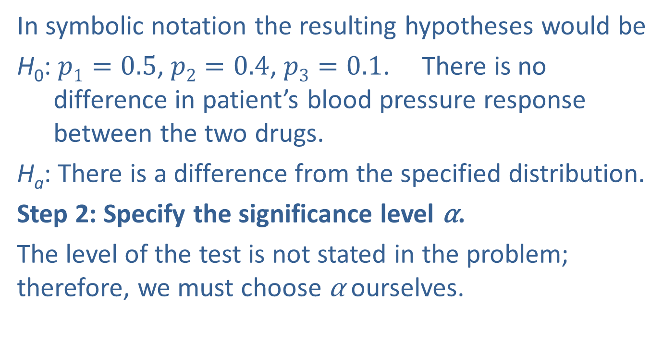
Example 16.2.1: Detecting a Change in Side Effects (A Qualitative Variable) (cont.)
In symbolic notation the resulting hypotheses would be
H₀: $p1=0.5$, $p2=0.4$, $p3=0.1$. There is no difference in patient’s blood pressure response between the two drugs.
H_{a}: There is a difference from the specified distribution.
Step 2: Specify the significance level α.
The level of the test is not stated in the problem; therefore, we must choose α ourselves.

Slide 35
Example 16.2.1: Detecting a Change in Side Effects (A Qualitative Variable) (cont.)
Let’s assume that the researchers are very concerned about making a Type I error (believing that there is a difference in systolic blood pressure side effects between the two drugs when in fact there is not). Although the choice of α is arbitrary, a reasonable choice might be α = 0.01.

Slide 36
Example 16.2.1: Detecting a Change in Side Effects (A Qualitative Variable) (cont.)
Step 3: Validate the assumptions of the hypothesis testing model, identify the appropriate test statistic and compute its value.
The number of patients falling into a particular category of blood pressure response satisfies the properties of a multinomial experiment.
The expected number of observations in each category is at least five.

Slide 37
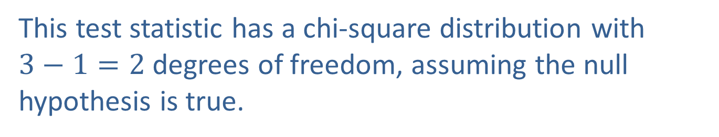
Example 16.2.1: Detecting a Change in Side Effects (A Qualitative Variable) (cont.)
Consequently, the chi-square test for goodness of fit can be used to make inferences concerning the difference in proportions. The chi-square test statistic is
This test statistic has a chi-square distribution with $3−1=2$degrees of freedom, assuming the null hypothesis is true.

Slide 38
Example 16.2.1: Detecting a Change in Side Effects (A Qualitative Variable) (cont.)
Since 250 patients were sampled,
E(n₁) = 250 ⋅ 0.5 = 125,
E(n₂) = 250 ⋅ 0.4 = 100, and
E(n₃) = 250 ⋅ 0.1 = 25.
Thus,

Slide 39
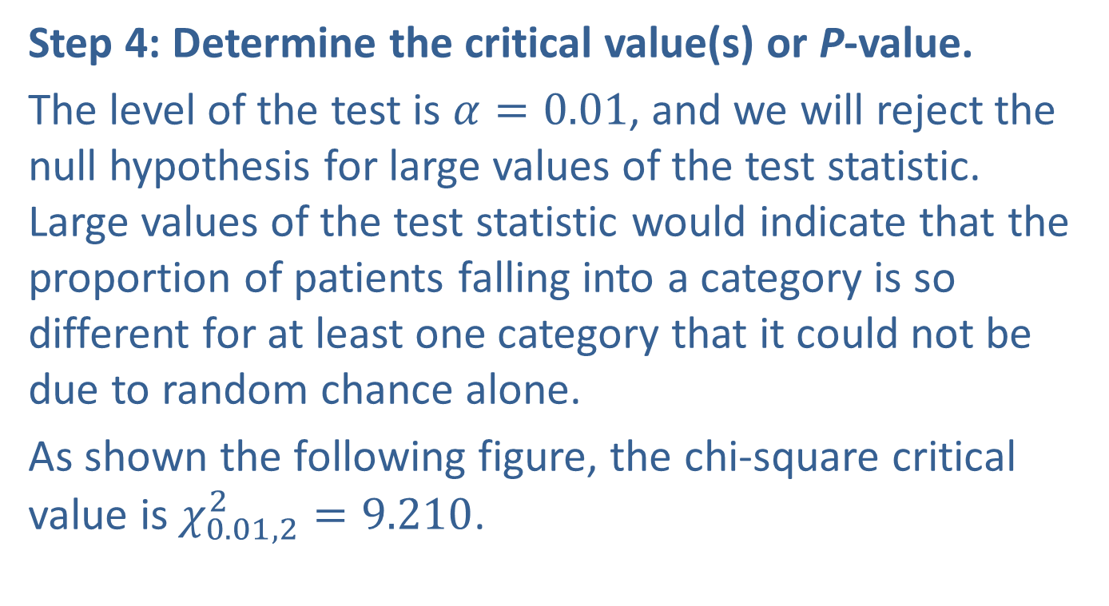
Example 16.2.1: Detecting a Change in Side Effects (A Qualitative Variable) (cont.)
Step 4: Determine the critical value(s) or P-value.
The level of the test is $α=0.01$, and we will reject the null hypothesis for large values of the test statistic. Large values of the test statistic would indicate that the proportion of patients falling into a category is so different for at least one category that it could not be due to random chance alone.
As shown the following figure, the chi-square critical value is $χ_{0.01,2}^{2}=9.210$.

Slide 40
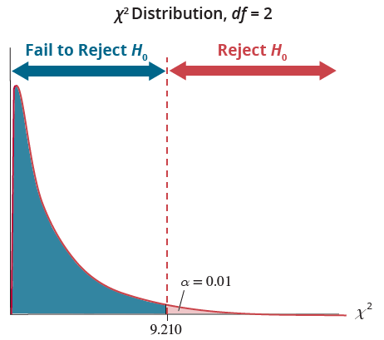
Example 16.2.1: Detecting a Change in Side Effects (A Qualitative Variable) (cont.)
Any value of the test statistic larger than the critical value will be considered too large to be due to ordinary sampling variation.

Slide 41
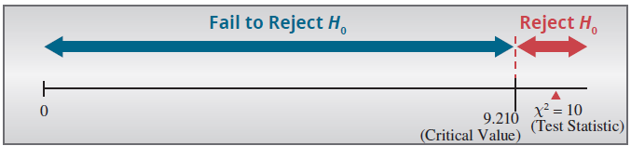
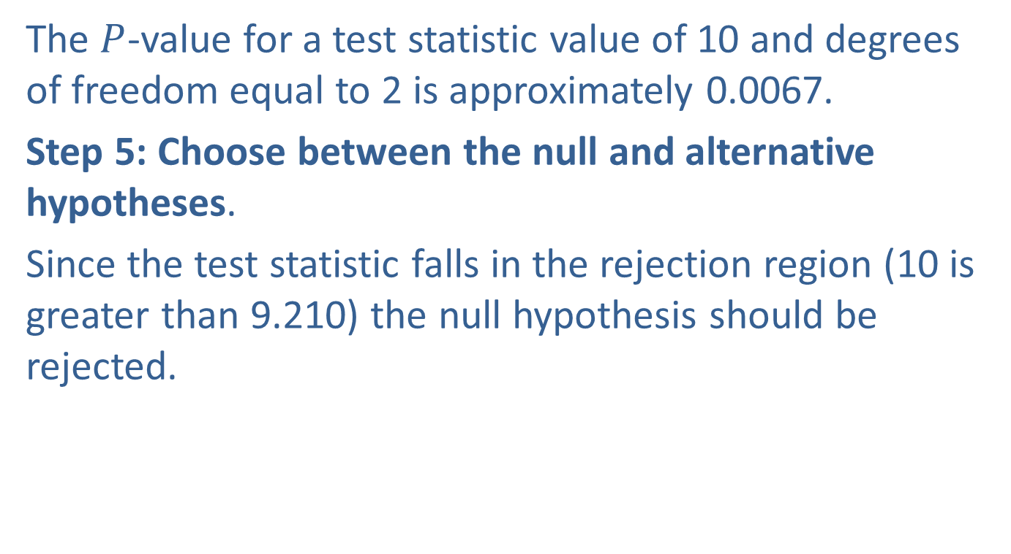
Example 16.2.1: Detecting a Change in Side Effects (A Qualitative Variable) (cont.)
The $P$-value for a test statistic value of 10 and degrees of freedom equal to 2 is approximately 0.0067.
Step 5: Choose between the null and alternative hypotheses.
Since the test statistic falls in the rejection region (10 is greater than 9.210) the null hypothesis should be rejected.

Slide 42
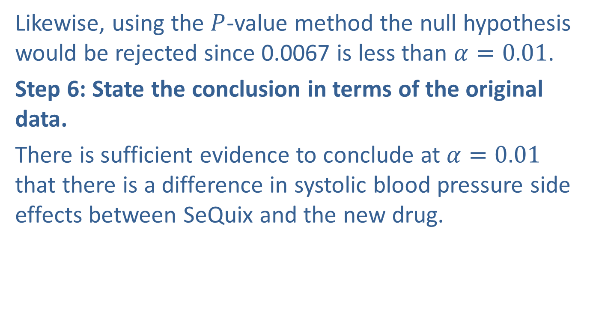
Example 16.2.1: Detecting a Change in Side Effects (A Qualitative Variable) (cont.)
Likewise, using the $P$-value method the null hypothesis would be rejected since 0.0067 is less than $α=0.01$.
Step 6: State the conclusion in terms of the original data.
There is sufficient evidence to conclude at $α=0.01$ that there is a difference in systolic blood pressure side effects between SeQuix and the new drug.

Slide 43
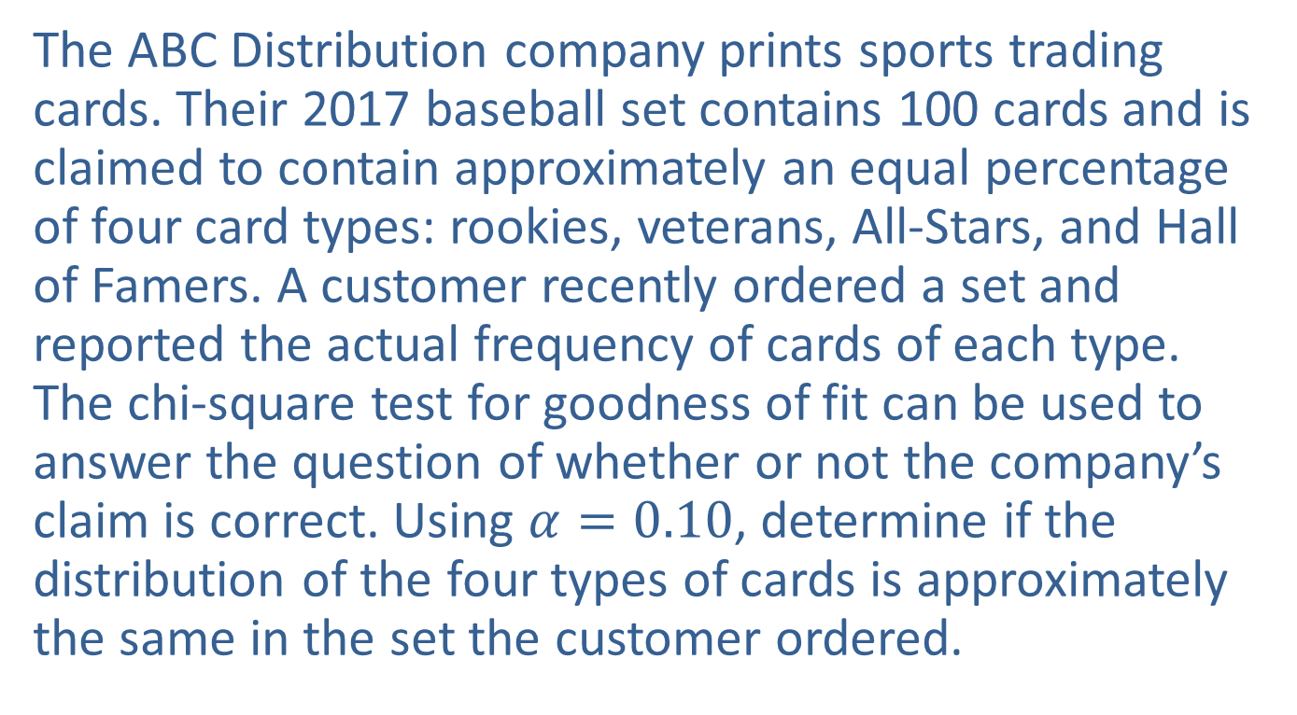
Example 16.2.2: Testing for Equal Percentages of Card Types
The ABC Distribution company prints sports trading cards. Their 2017 baseball set contains 100 cards and is claimed to contain approximately an equal percentage of four card types: rookies, veterans, All-Stars, and Hall of Famers. A customer recently ordered a set and reported the actual frequency of cards of each type. The chi-square test for goodness of fit can be used to answer the question of whether or not the company’s claim is correct. Using $α=0.10$, determine if the distribution of the four types of cards is approximately the same in the set the customer ordered.

Slide 44
Example 16.2.2: Testing for Equal Percentages of Card Types (cont.)
(Since there are 100 cards in the set, the claim of an equal distribution of the four types would result in 25 cards of each type.)
Baseball Cards
Card Type | Claim Frequency | Actual Frequency
Rookie | 25 | 23
Veteran | 25 | 28
All-Star | 25 | 27
Hall of Famer | 25 | 22

Slide 45
Example 16.2.2: Testing for Equal Percentages of Card Types (cont.)
Solution
Step 1: Determine the population parameter to be used and develop the null and alternative hypotheses.
Null hypothesis: The proportion of the four card types in the set is the same.
Alternative hypothesis: The proportion of the four card types in the set is not the same.
Here we are interested in the proportion of each of the types of cards.

Slide 46
Example 16.2.2: Testing for Equal Percentages of Card Types (cont.)
p₁ = the proportion of rookie cards in the set
p₂ = the proportion of veteran cards in the set
p₃ = the proportion of All-Star cards in the set
p₄ = the proportion of Hall of Famer cards in the set
In symbolic notation, the resulting hypotheses would be
H₀: p₁ = p₂ = p₃ = p₄ = 0.25. The proportion of the four card types in the set is the same.
H_{a}: There is a difference from the specified distribution.

Slide 47
Example 16.2.2: Testing for Equal Percentages of Card Types (cont.)
Step 2: Specify the significance level α.
The level of the test is specified in the statement of the problem as α = 0.10.
Step 3: Validate the assumptions of the hypothesis testing model, identify the appropriate test statistic and compute its value.
The number of cards of each type of baseball card satisfies the properties of a multinomial probability distribution.
The expected number of observations in each category is at least 5.

Slide 48
Example 16.2.2: Testing for Equal Percentages of Card Types (cont.)
Thus, we can use the chi-square test for goodness of fit.
The chi-square test statistic is given by,
This test statistic has an approximate chi-square distribution with (4 − 1) = 3 degrees of freedom, assuming the null hypothesis is true.
Our test statistic would be calculated as

Slide 49
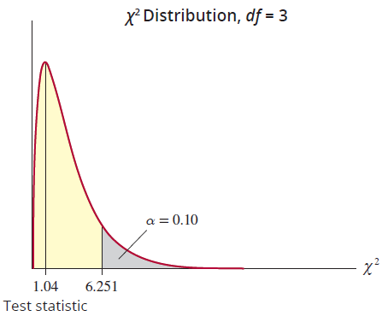
Example 16.2.2: Testing for Equal Percentages of Card Types (cont.)
Step 4: Determine the critical value(s) or P-value.

Slide 50
Example 16.2.2: Testing for Equal Percentages of Card Types (cont.)
Since the level of the test is α = 0.10 and we reject the null hypothesis for large values of the test statistic, the chi-square critical value is
Using technology, the P-value for the test statistic of 1.04 with degrees of freedom equal to 3 is 0.7916.
Step 5: Choose between the null and alternative hypotheses.
If the null hypothesis is true, the test statistic will be larger than the critical value 6.251 only 10% of the time. Since is not larger than 6.251, we fail to reject H₀.

Slide 51
Example 16.2.2: Testing for Equal Percentages of Card Types (cont.)
The P-value is much larger than α = 0.10, so we fail to reject the null hypothesis.
Step 6: State the conclusion in terms of the original problem.
At the 0.10 level, there is insufficient evidence to conclude that the distribution of the card types in the set differs from the company claim that the proportion of each card type is approximately equal.

