Slide 1
Section 16.1
The Chi-Square Distribution

Slide 2
The Chi-Square Distribution
In Section 11.6, we briefly discussed the chi-square distribution in the context of developing a hypothesis testing procedure for testing claims about a population variance. But the chi-square distribution has much broader applications. Before discussing these applications, let’s review a few of the basics about the chi-square distribution.

Slide 3
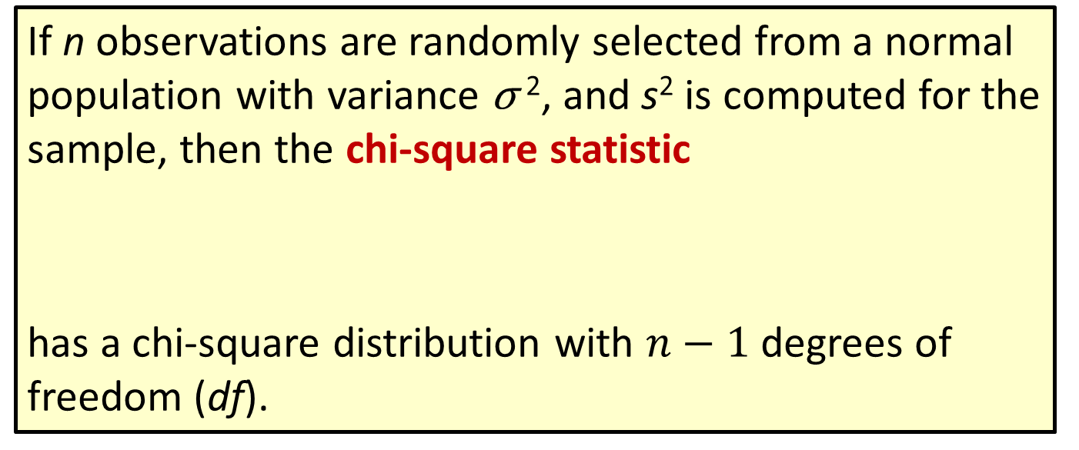
Formula: Chi-Square Statistic
If n observations are randomly selected from a normal population with variance σ ², and s² is computed for the sample, then the chi-square statistic
has a chi-square distribution with $n−1$ degrees of freedom (df).

Slide 4
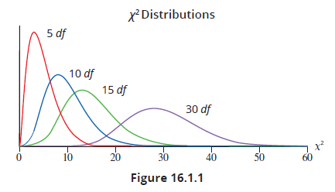

The Chi-Square Distribution (cont.)
A chi-square distribution is a continuous distribution. Unlike the normal distribution and the $t$-distribution, the chi-square distribution is not symmetric. In fact, for small values of $n$ and therefore small values of $df$, it is very skewed, as you can see from Figure 16.1.1.

Slide 5
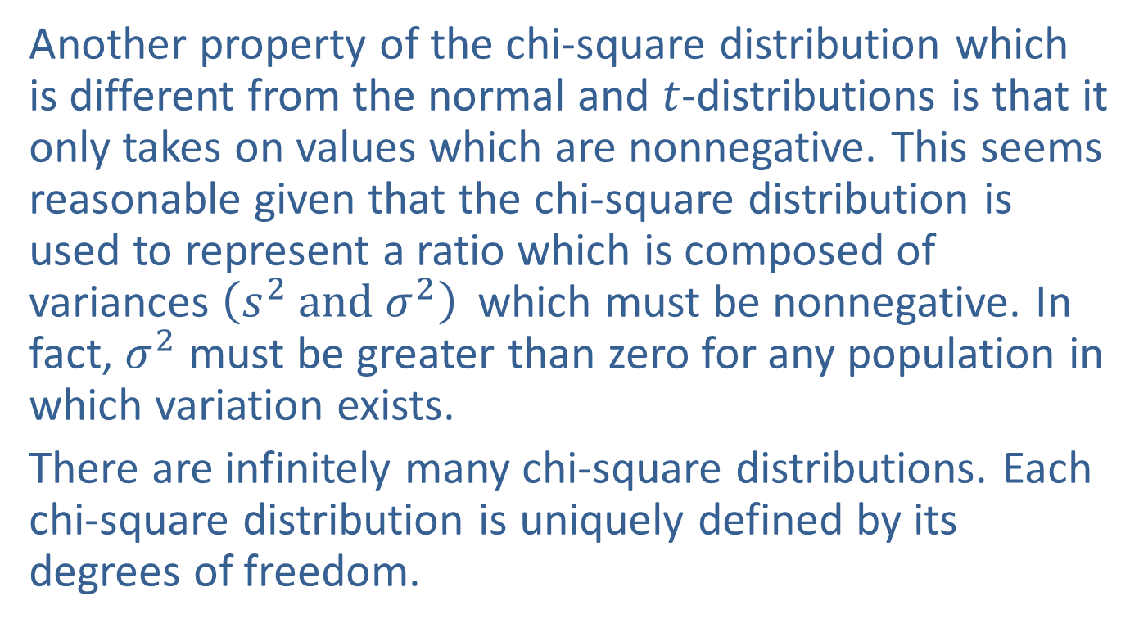
The Chi-Square Distribution (cont.)
Another property of the chi-square distribution which is different from the normal and $t$-distributions is that it only takes on values which are nonnegative. This seems reasonable given that the chi-square distribution is used to represent a ratio which is composed of variances ${\left(s^{2} and σ^{2}\right) }^{ }$which must be nonnegative. In fact, $σ^{2}$ must be greater than zero for any population in which variation exists.
There are infinitely many chi-square distributions. Each chi-square distribution is uniquely defined by its degrees of freedom.

Slide 6
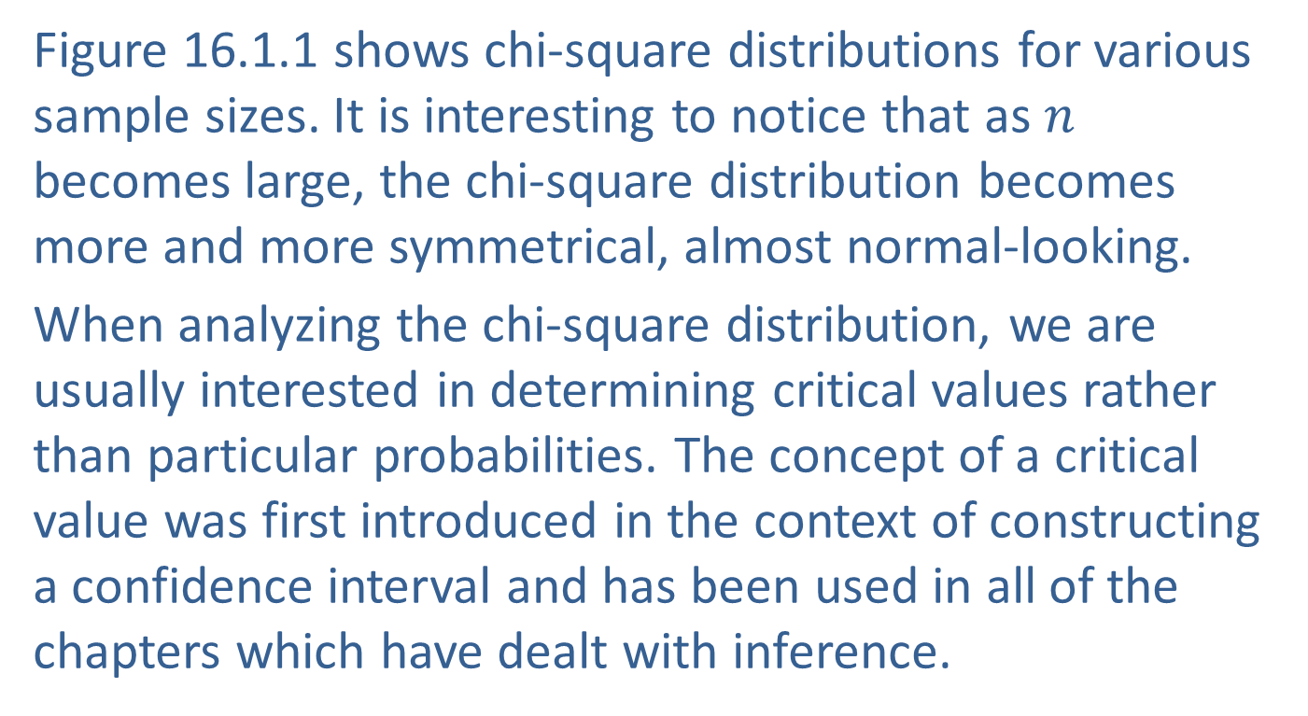
The Chi-Square Distribution (cont.)
Figure 16.1.1 shows chi-square distributions for various sample sizes. It is interesting to notice that as $n$ becomes large, the chi-square distribution becomes more and more symmetrical, almost normal-looking.
When analyzing the chi-square distribution, we are usually interested in determining critical values rather than particular probabilities. The concept of a critical value was first introduced in the context of constructing a confidence interval and has been used in all of the chapters which have dealt with inference.

Slide 7
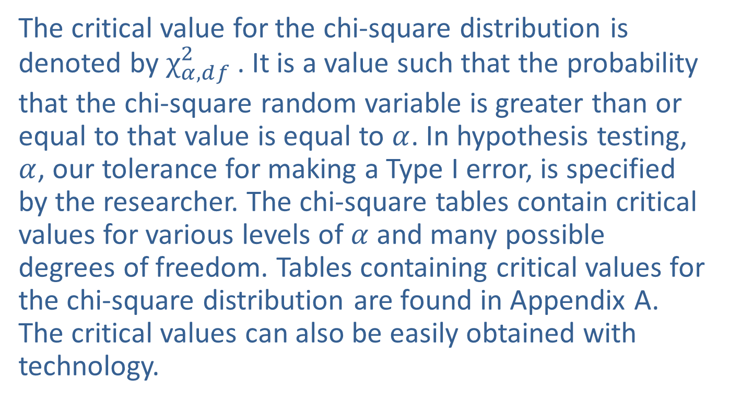
The Chi-Square Distribution (cont.)
The critical value for the chi-square distribution is denoted by ${χ_{α,ⅆf}^{2}}_{ }^{ }$. It is a value such that the probability that the chi-square random variable is greater than or equal to that value is equal to $α$. In hypothesis testing, $α$, our tolerance for making a Type I error, is specified by the researcher. The chi-square tables contain critical values for various levels of $α$ and many possible degrees of freedom. Tables containing critical values for the chi-square distribution are found in Appendix A. The critical values can also be easily obtained with technology.

Slide 8
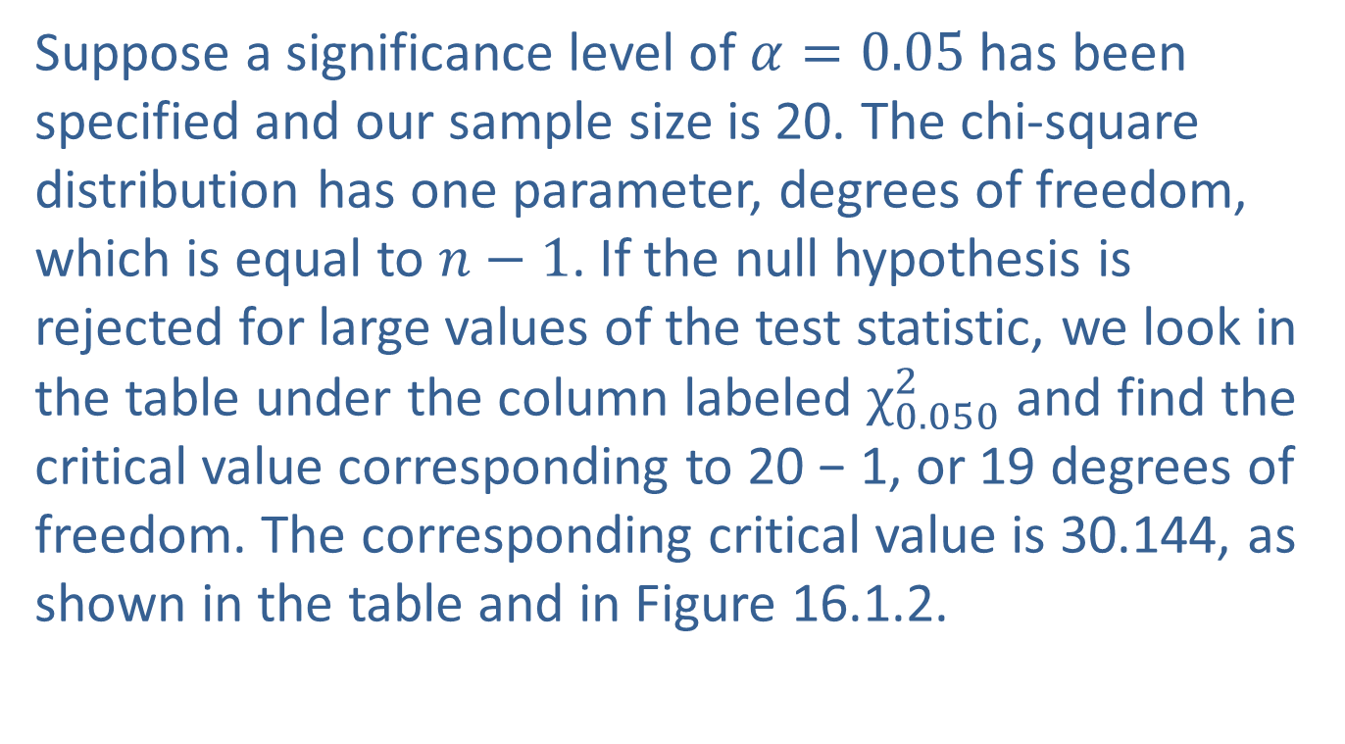
Determining Chi-Square Critical Values
Suppose a significance level of $α=0.05$has been specified and our sample size is 20. The chi-square distribution has one parameter, degrees of freedom, which is equal to $n−1$. If the null hypothesis is rejected for large values of the test statistic, we look in the table under the column labeled $χ_{0.050}^{2}$ and find the critical value corresponding to 20 − 1, or 19 degrees of freedom. The corresponding critical value is 30.144, as shown in the table and in Figure 16.1.2.

Slide 9
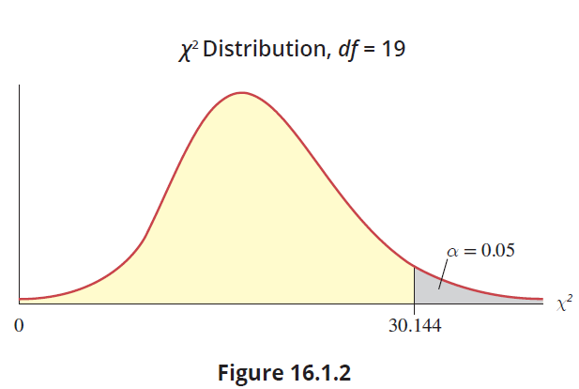
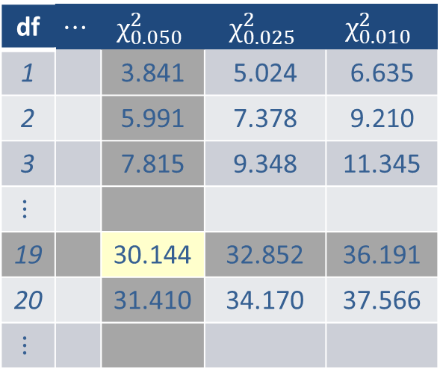
Determining Chi-Square Critical Values (cont.)
df | $$⋯$$ | $$χ_{0.050}^{2}$$ | $$χ_{0.025}^{2}$$ | $$χ_{0.010}^{2}$$
1 |  | 3.841 | 5.024 | 6.635
2 |  | 5.991 | 7.378 | 9.210
3 |  | 7.815 | 9.348 | 11.345
$$⋮$$
19 |  | 30.144 | 32.852 | 36.191
20 |  | 31.410 | 34.170 | 37.566
$$⋮$$

Slide 10
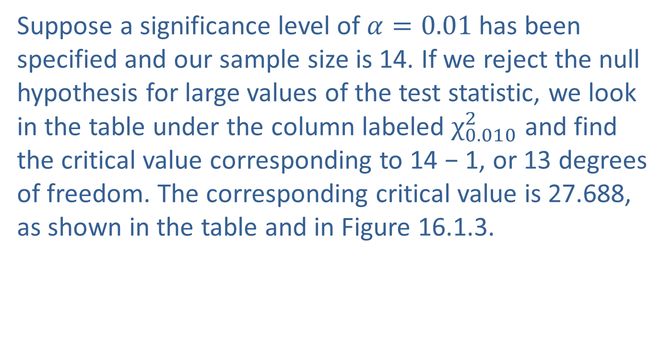
Determining Chi-Square Critical Values (cont.)
Suppose a significance level of $α=0.01$has been specified and our sample size is 14. If we reject the null hypothesis for large values of the test statistic, we look in the table under the column labeled $χ_{0.010}^{2}$ and find the critical value corresponding to 14 − 1, or 13 degrees of freedom. The corresponding critical value is 27.688, as shown in the table and in Figure 16.1.3.

Slide 11
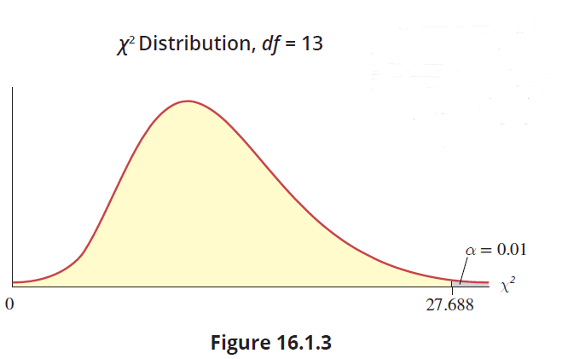
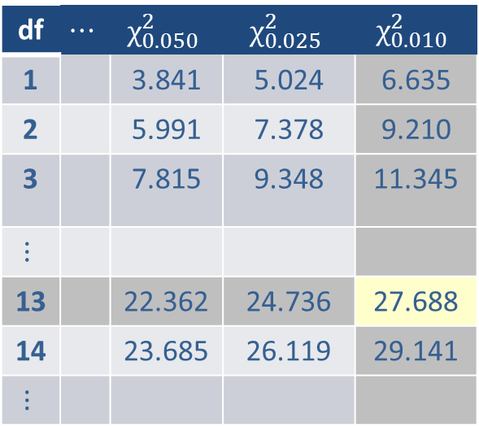
Determining Chi-Square Critical Values (cont.)
df | $$⋯$$ | $$χ_{0.050}^{2}$$ | $$χ_{0.025}^{2}$$ | $$χ_{0.010}^{2}$$
1 |  | 3.841 | 5.024 | 6.635
2 |  | 5.991 | 7.378 | 9.210
3 |  | 7.815 | 9.348 | 11.345
$$⋮$$
13 |  | 22.362 | 24.736 | 27.688
14 |  | 23.685 | 26.119 | 29.141
$$⋮$$

Slide 12
Determining Chi-Square Critical Values (cont.)
The analysis in the remainder of the chapter deals with comparing the actual number of observations falling into a particular category with the number of observations that is expected to fall in that category, based on our hypothesis. In certain circumstances this type of formulation can be evaluated with a chi-square distribution.

