Slide 1
Section 15.4
Two-Way ANOVA: The Factorial Design

Slide 2
Two-Way ANOVA: The Factorial Design
The randomized block test presented in the previous section is one example of a two-way ANOVA. There were two independent factors considered in the analysis, namely the block (the different weight classes) and the treatment (diets), and each level of the treatment occurred with each level of the block. However, there was only one factor which was truly of interest to our experimenter, the treatment (diets).

Slide 3
Two-Way ANOVA: The Factorial Design (cont.)
The techniques discussed for the randomized block design can be extended to the situation where there are two factors of interest. The main features of the factorial design are:
In a factorial design, you have two or more independent variables (factors) that are varied simultaneously, and both are of interest to the researcher. In our examples, we will not have more than two independent variables.

Slide 4
Two-Way ANOVA: The Factorial Design (cont.)
Each level or combination of levels of these factors constitutes a “cell” in the design.
Multiple observations or measurements are typically taken for each cell in the design. This is one of the significant differences in the factorial design compared to the randomized block design.
The data structure resembles a table with rows and columns, where each cell usually contains multiple data points corresponding to a specific combination of factor levels.

Slide 5
Two-Way ANOVA: The Factorial Design (cont.)
There is a method of determining if there is interaction between the independent variables. Interaction is when the effect of one independent variable (factor) on the dependent variable is influenced by the level of another independent variable.
Factorial experiments can provide valuable information by enabling the interaction between the two variables to be estimated. An example of two variables which interact is shown in Figure 15.4.1. This figure is called an interaction plot, which is a plot of the means for each level of the factors.

Slide 6
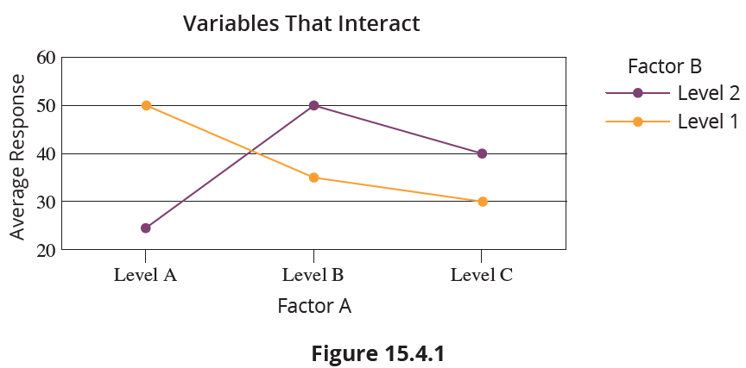
Two-Way ANOVA: The Factorial Design (cont.)
An example of two variables which do not interact is shown in Figure 15.4.2.

Slide 7
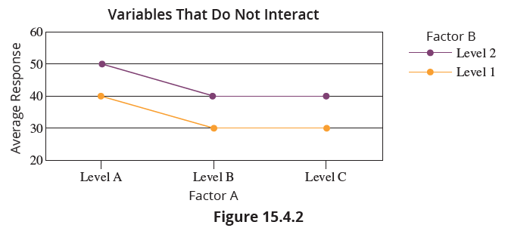
Two-Way ANOVA: The Factorial Design (cont.)

Slide 8
Two-Way ANOVA: The Factorial Design (cont.)
A director of personnel might be interested in relating average salary to two factors: age and experience. In order for the director of personnel to evaluate the relationship of average salary to age and experience, he chooses the following experimental design. He selects four different age groups and three different experience levels, and observes two salaries for each of the possible combinations of age and experience. The resulting data is displayed in Table 15.4.1.

Slide 9
Two-Way ANOVA: The Factorial Design (cont.)
Table 15.4.1 - Salaries (Thousands of Dollars)
Years of Experience | Age
 | 25 – 34 | 35 – 44 | 45 – 54 | 55 – 64
0 – 4 | 52 57 | 55 65 | 64 66 | 67 73
5 – 9 | 64 66 | 65 75 | 72 78 | 79 81
10 – 14 | 69 71 | 70 80 | 83 87 | 81 89
Factor A
Factor B

Slide 10
Two-Way ANOVA: The Factorial Design (cont.)
Again, this type of design is called a two-way analysis of variance because it involves two classifications. It is also called a complete factorial experiment since there is at least one observation for every possible combination of age and salary. An interaction graph for the salary data is shown in Figure 15.4.3. Based on this graph, there appears to be slight interaction between age and experience when age is between 45 and 54 years and years of experience is between 10-14 years.

Slide 11
Two-Way ANOVA: The Factorial Design (cont.)
There are three effects on average salary that will interest the personnel director. The first is the effect that the interaction between age and experience has on average salary, called the main effect for interaction. The second is the effect that experience has on average salary, called the main effect for experience (Factor A). The third is the effect that age has on average salary, called the main effect for age (Factor B).

Slide 12
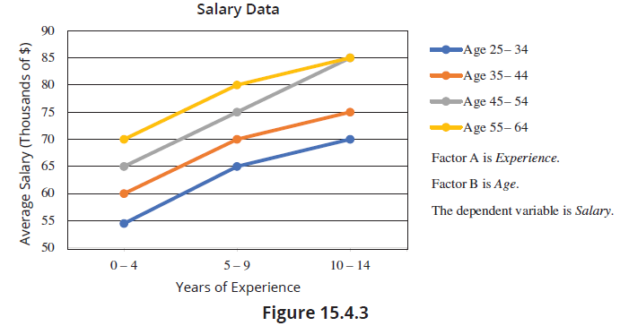
Two-Way ANOVA: The Factorial Design (cont.)

Slide 13
Two-Way ANOVA: The Factorial Design (cont.)
The test procedure is somewhat different than those we have discussed previously because of the potential presence of interaction between the two variables. Of primary importance is determining whether or not there is any interaction between the two variables. If there is interaction, we will not be able to separate out the effects that age and experience have on average salary, and the hypothesis testing procedure is halted.

Slide 14
Two-Way ANOVA: The Factorial Design (cont.)
If there is not interaction, then it is possible to proceed with the hypothesis testing procedure and determine the effect that age has on average salary and the effect that experience has on average salary.
To develop the test procedure for the two-way ANOVA we again rely on the concepts presented in Section 15.1.

Slide 15
Two-Way ANOVA: The Factorial Design (cont.)
The variation among the sample observations, represented by the total sum of squares, can be broken down into four pieces: the sum of squares for Factor A (SSA), the sum of squares for Factor B (SSB), the sum of squares for interaction (SSAB), and the sum of squares for error, SSE. Thus,
Sum of Squares Total Sum of Squares = SSA + SSB + SSAB + SSE
Degrees of n −1 = a −1 + b −1 + (a−1)(b−1) + ab(r−1) Freedom

Slide 16
Two-Way ANOVA: The Factorial Design (cont.)
where
n is the total number of observations,
a is the number of levels of Factor A,
b is the number of levels of Factor B, and
r is the number of observations in the combinations of levels of Factor A and Factor B (i.e., the number of observations in each cell).
The assumptions for the tests in a two-way ANOVA are as follows.

Slide 17
Assumptions
The sample measurements in each cell are random samples that are independent of each other.
The measurements in each cell come from a population that is approximately normally distributed (assumed).
The populations have approximately equal variances (assumed).
All the cells have an equal number of measurements (a balanced design).

Slide 18
Two-Way ANOVA: The Factorial Design (cont.)
The test statistics for a two-way ANOVA for a factorial design are derived by dividing the sums of squares by the appropriate degrees of freedom to produce mean squares, and then dividing each of the respective mean squares by the mean square for error. The test procedures for interaction and main effects are outlined below.

Slide 19
Note
To test for interaction between the factors you must have at least 2 observations per cell (r ≥ 2).

Slide 20
Procedure: Test for Interaction between Factors
Hypotheses:
H₀: There is no interaction between Factor A and Factor B.
H_{a}: There is interaction between Factor A and Factor B.
Test Statistic:

Slide 21
Procedure: Test for Interaction between Factors (cont.)
Rejection Region:
Reject the null hypothesis if F > F_{α} with (a − 1)(b − 1) numerator degrees of freedom and ab(r − 1) denominator degrees of freedom.
P-value:
(The P-value should be available from the output of an ANOVA test performed using technology.)
If the computed P-value is less than α, reject the null hypothesis in favor of the alternative.

Slide 22
Procedure: Test for Interaction between Factors (cont.)
If the computed P-value is greater than or equal to α, fail to reject the null hypothesis.
Note: If the null hypothesis is rejected, then interaction exists. If interaction exists, do not proceed with the main effects tests for Factor A and Factor B.

Slide 23
Procedure: Test for Main Effects for Factor A
Hypotheses:
H₀: Factor A has no effect on average response.
H_{a}: Factor A has an effect on average response.
Test Statistic:

Slide 24
Procedure: Test for Main Effects for Factor A (cont.)
Rejection Region:
Reject the null hypothesis if F > F_{α} with (a − 1) numerator degrees of freedom and ab(r − 1) denominator degrees of freedom.
P-value:
If the computed P-value is less than α, reject the null hypothesis in favor of the alternative.
If the computed P-value is greater than or equal to α, fail to reject the null hypothesis.

Slide 25
Procedure: Test for Main Effects for Factor B
Hypotheses:
H₀: Factor B has no effect on average response.
H_{a}: Factor B has an effect on average response.
Test Statistic:

Slide 26
Procedure: Test for Main Effects for Factor B (cont.)
Rejection Region:
Reject the null hypothesis if F > F_{α} with (b − 1) numerator degrees of freedom and ab(r − 1) denominator degrees of freedom.
P-value:
If the computed P-value is less than α, reject the null hypothesis in favor of the alternative.
If the computed P-value is greater than or equal to α, fail to reject the null hypothesis.

Slide 27
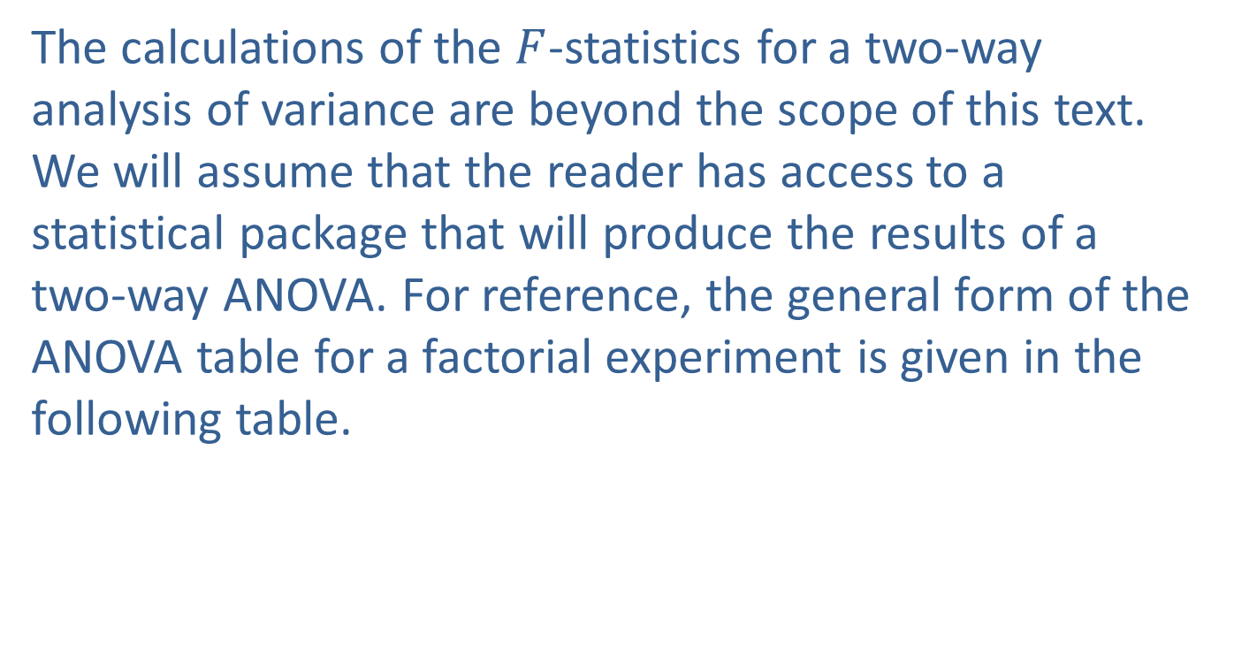
Two-Way ANOVA: The Factorial Design (cont.)
The calculations of the $F$-statistics for a two-way analysis of variance are beyond the scope of this text. We will assume that the reader has access to a statistical package that will produce the results of a two-way ANOVA. For reference, the general form of the ANOVA table for a factorial experiment is given in the following table.

Slide 28
Two-Way ANOVA: The Factorial Design (cont.)
Table 15.4.2 - ANOVA Summary Table for a Factorial Experiment
Source of Variation | SS | df | MS | F
Factor A (organized by rows) | SSA | a − 1 | MSA
Factor B (organized by rows) | SSB | b − 1 | MSB
Interaction | SSAB | (a − 1)(b − 1) | MSAB
Error | SSE | ab(r − 1) | MSE
Total | Total SS | N −1

Slide 29
Two-Way ANOVA: The Factorial Design (cont.)
Before proceeding with the ANOVA test we must verify that the assumptions are met. We know that the ANOVA procedure is robust against departures from the normality and equal variance assumptions. For this example, we do not have sufficient repeated observations for each combination of factors to be able to verify the normality and equal variance assumptions are met. It is highly recommended that as many observations as the budget and time allows be collected for each combination of factors in a factorial experiment.

Slide 30
Two-Way ANOVA: The Factorial Design (cont.)
We will demonstrate the ANOVA procedure for this simplified factorial experiment.
Cell measurements are independent random samples
Cell measurements come from a population that is approximately normally distributed (assumed).
The populations have approximately equal variances (assumed).
All the cells have an equal number of measurements.

Slide 31
Note
When using Excel or Minitab to perform a two-way ANOVA, it is important to pay close attention to how the data is organized so that you can identify the factors on the summary output and accurately interpret the results.

Slide 32
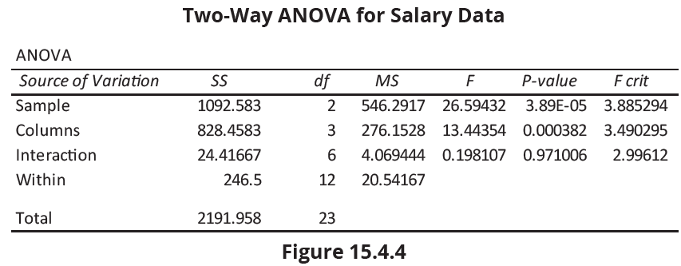
Two-Way ANOVA: The Factorial Design (cont.)
The results of the two-way ANOVA for the personnel director’s salary data are given in Figure 15.4.4.

Slide 33
Two-Way ANOVA: The Factorial Design (cont.)
In the ANOVA table, the row labeled “Sample” corresponds to Experience (Factor A) since the three experience levels were organized by rows in the original data table. The row of the output labeled “Columns” corresponds to Age (Factor B) since the age groups are organized by column. The row labeled “Interaction” corresponds to the interaction between experience and age, and “Within” corresponds to the variation within the sample observations, or error.

Slide 34
Two-Way ANOVA: The Factorial Design (cont.)
The personnel director must first decide if there is interaction between age and experience. The appropriate test statistic for testing for interaction, which is the mean square of the interaction term divided by the mean square for error, is given by

Slide 35
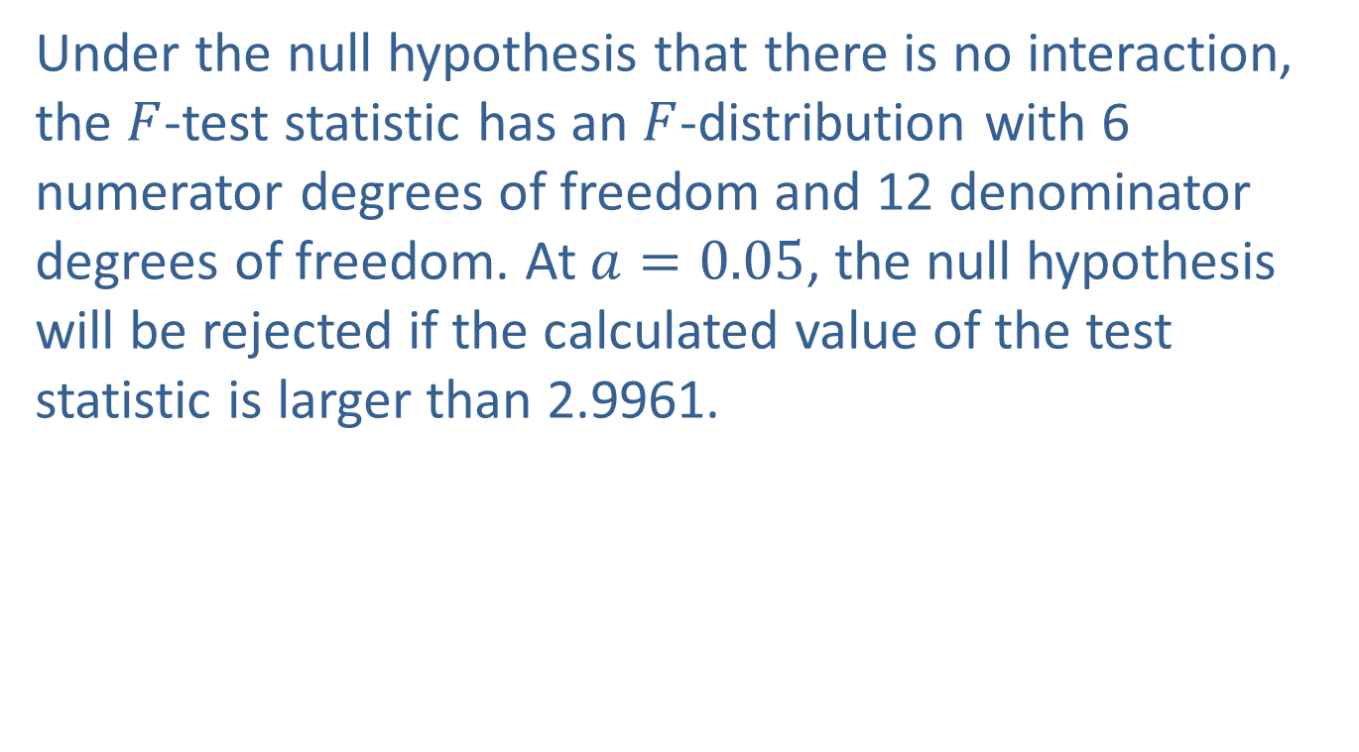
Two-Way ANOVA: The Factorial Design (cont.)
Under the null hypothesis that there is no interaction, the $F$-test statistic has an $F$-distribution with 6 numerator degrees of freedom and 12 denominator degrees of freedom. At $a=0.05$, the null hypothesis will be rejected if the calculated value of the test statistic is larger than 2.9961.

Slide 36
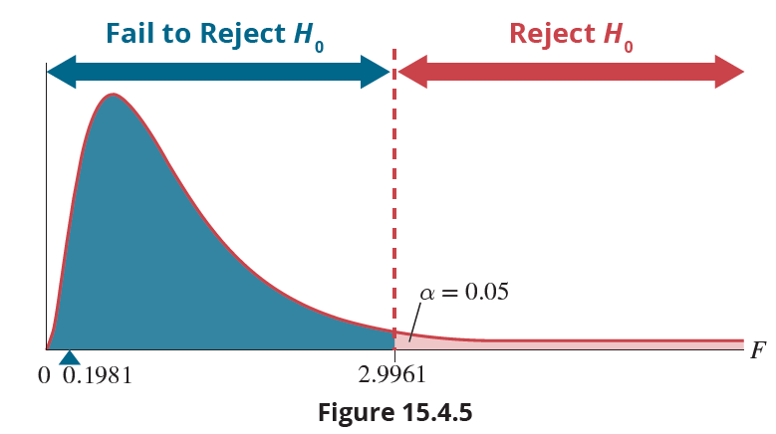
Two-Way ANOVA: The Factorial Design (cont.)
F-Distribution numerator df = 6, denominator df = 12

Slide 37
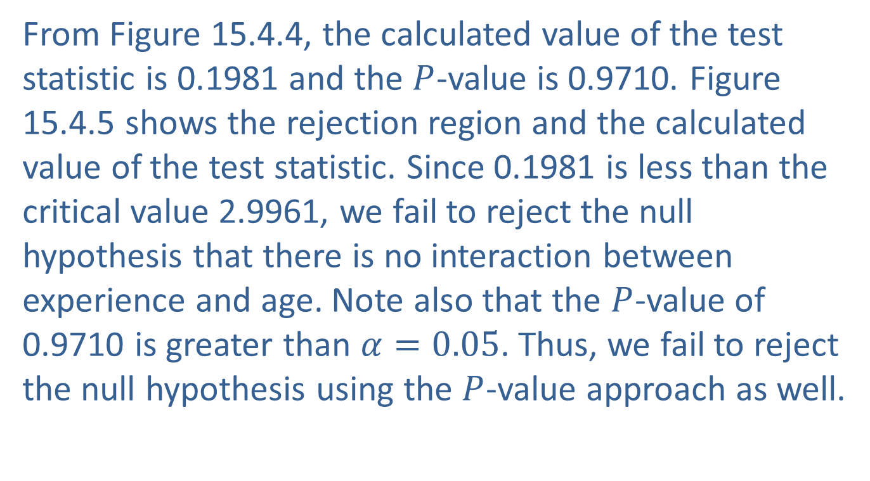
Two-Way ANOVA: The Factorial Design (cont.)
From Figure 15.4.4, the calculated value of the test statistic is 0.1981 and the $P$-value is 0.9710. Figure 15.4.5 shows the rejection region and the calculated value of the test statistic. Since 0.1981 is less than the critical value 2.9961, we fail to reject the null hypothesis that there is no interaction between experience and age. Note also that the $P$-value of 0.9710 is greater than $α=0.05$. Thus, we fail to reject the null hypothesis using the $P$-value approach as well.

Slide 38
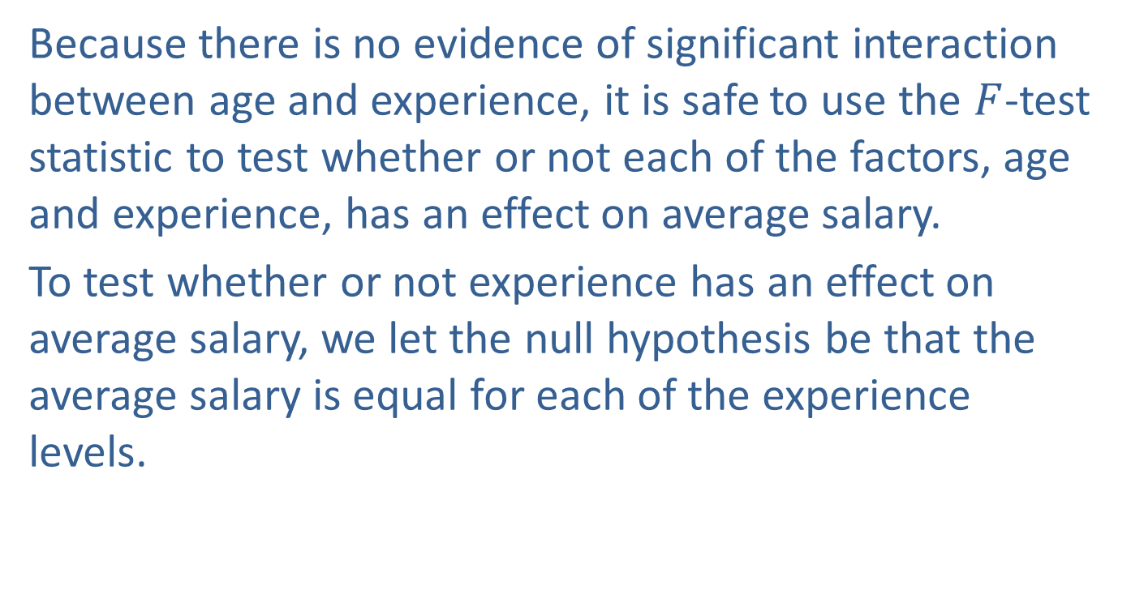
Two-Way ANOVA: The Factorial Design (cont.)
Because there is no evidence of significant interaction between age and experience, it is safe to use the $F$-test statistic to test whether or not each of the factors, age and experience, has an effect on average salary.
To test whether or not experience has an effect on average salary, we let the null hypothesis be that the average salary is equal for each of the experience levels.

Slide 39
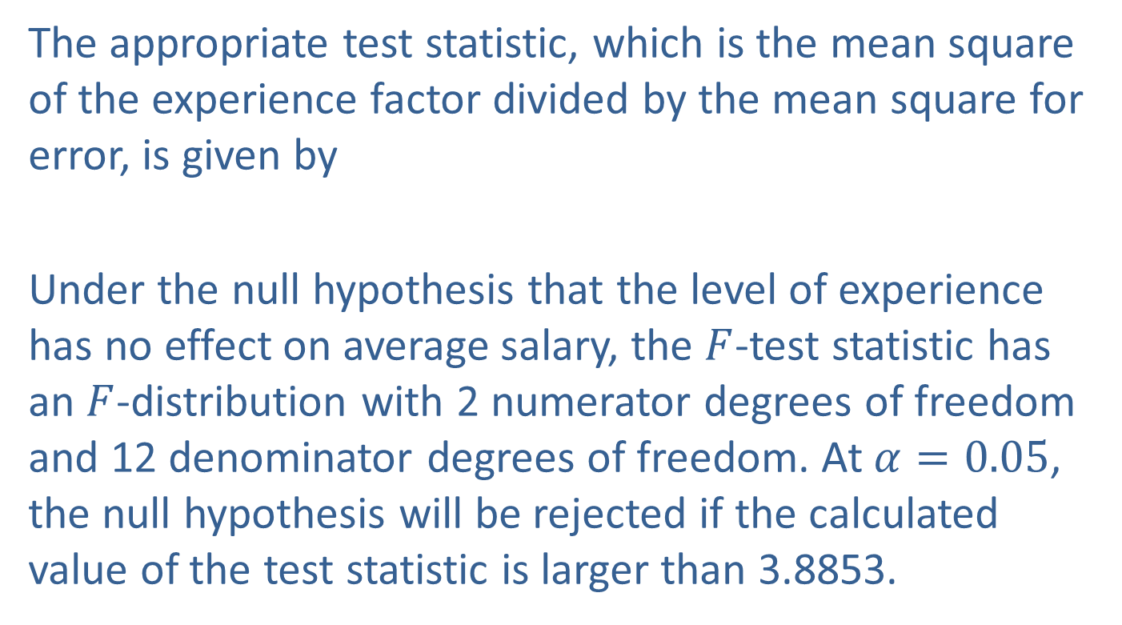
Two-Way ANOVA: The Factorial Design (cont.)
The appropriate test statistic, which is the mean square of the experience factor divided by the mean square for error, is given by
Under the null hypothesis that the level of experience has no effect on average salary, the $F$-test statistic has an $F$-distribution with 2 numerator degrees of freedom and 12 denominator degrees of freedom. At $α=0.05$, the null hypothesis will be rejected if the calculated value of the test statistic is larger than 3.8853.

Slide 40
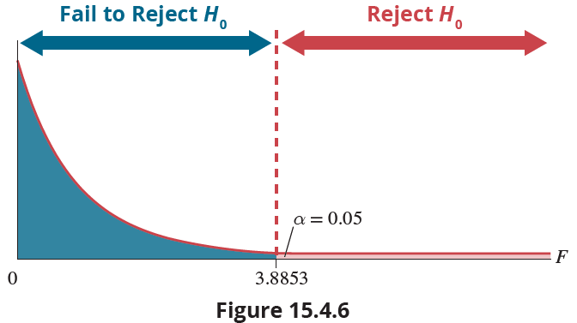
Two-Way ANOVA: The Factorial Design (cont.)
F-Distribution numerator df = 2, denominator df = 12

Slide 41
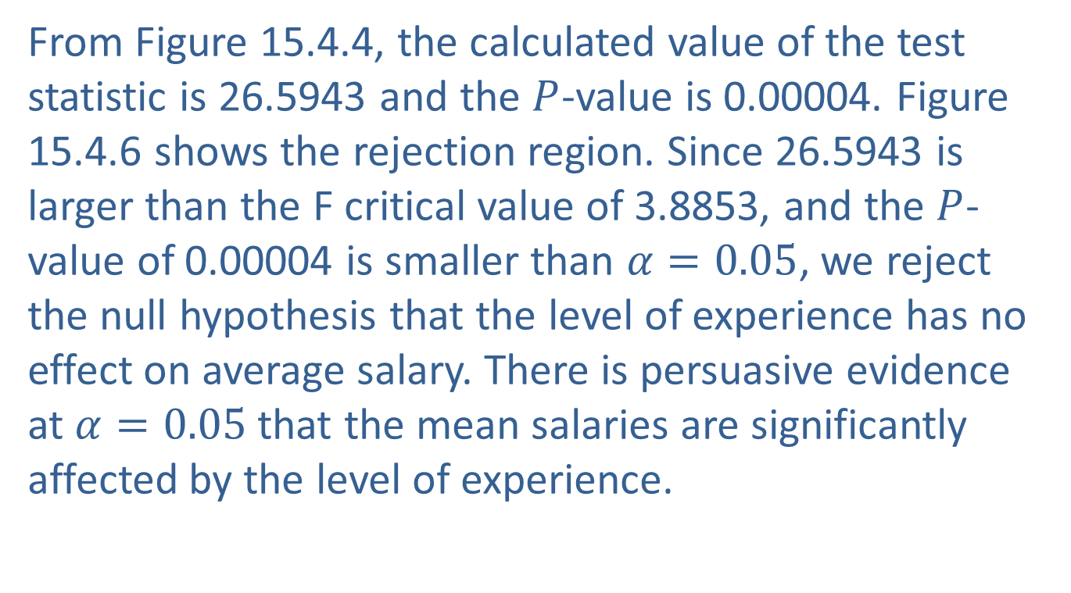
Two-Way ANOVA: The Factorial Design (cont.)
From Figure 15.4.4, the calculated value of the test statistic is 26.5943 and the $P$-value is 0.00004. Figure 15.4.6 shows the rejection region. Since 26.5943 is larger than the F critical value of 3.8853, and the $P$-value of 0.00004 is smaller than $α=0.05$, we reject the null hypothesis that the level of experience has no effect on average salary. There is persuasive evidence at $α=0.05$that the mean salaries are significantly affected by the level of experience.

Slide 42
Two-Way ANOVA: The Factorial Design (cont.)
To test whether or not age has an effect on average salary, we let the null hypothesis be that the average salary is equal for each of the age levels. The appropriate test statistic, which is the mean square of the age factor divided by the mean square for error, is given by

Slide 43
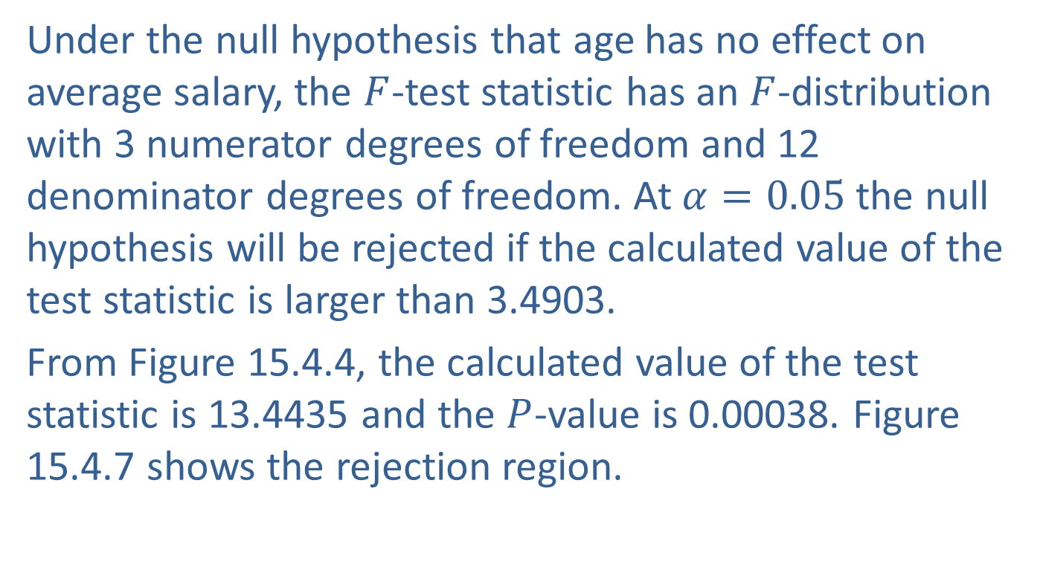
Two-Way ANOVA: The Factorial Design (cont.)
Under the null hypothesis that age has no effect on average salary, the $F$-test statistic has an $F$-distribution with 3 numerator degrees of freedom and 12 denominator degrees of freedom. At $α=0.05$ the null hypothesis will be rejected if the calculated value of the test statistic is larger than 3.4903.
From Figure 15.4.4, the calculated value of the test statistic is 13.4435 and the $P$-value is 0.00038. Figure 15.4.7 shows the rejection region.

Slide 44
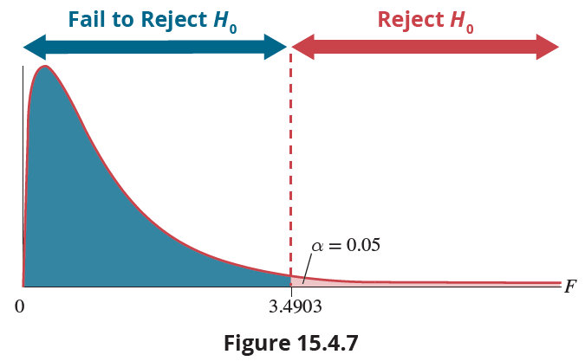
Two-Way ANOVA: The Factorial Design (cont.)
F-Distribution numerator df = 3, denominator df = 12

Slide 45

Two-Way ANOVA: The Factorial Design (cont.)
Since 13.4435 is larger than 3.4903 and the $P$-value is less than $α=0.05$, we reject the null hypothesis that age has no effect on average salary. There is persuasive evidence at $α=0.05$ that the mean salaries are significantly affected by age.

Slide 46
Two-Way ANOVA: The Factorial Design (cont.)
When using the two-way ANOVA, it is important to remember that the assumptions of normality, equal variances, and independent random samples should be satisfied in order for the test to produce meaningful results. As noted previously, the ANOVA test is robust with regards to the normality and equal variance assumptions.
An important concept in statistics related to ANOVA is the design of experiments (DOE).

Slide 47
Two-Way ANOVA: The Factorial Design (cont.)
It is much easier to analyze a properly designed experiment as opposed to a poorly designed one. If you are planning on collecting data, you should involve a statistician at the onset, not just employ them to do the analysis once the data has been collected. Experimental design allows you to estimate the effects of several variables simultaneously, thus resulting in a more efficient collection of data that will be much easier to analyze. Design of experiments is a very extensive field of study for which entire books and courses have been developed, but is beyond the scope of this book.

