Slide 1
Section 15.3
Two-Way ANOVA: The Randomized Block Design

Slide 2
Two-Way ANOVA: The Randomized Block Design
In two-way ANOVA (analysis of variance), there are two independent variables that are being analyzed to determine their effects on a dependent variable. These two independent variables are often referred to as factors, which are called treatments and blocks. Treatments represent the main variable (factor) in the study.

Slide 3
Two-Way ANOVA: The Randomized Block Design (cont.)
Researchers may be interested in the effects of both independent variables but are frequently interested in only one of them (treatments) and use the randomized block design to eliminate a `nuisance’ variable—a variable that creates unwanted variation in the dependent variable. By including a blocking variable in the model, you can statistically account for their effects, which allows you to isolate and assess the main effects of the treatments more accurately.

Slide 4
Two-Way ANOVA: The Randomized Block Design (cont.)
The characteristic used for blocking can be either a categorical or continuous variable depending on the nature of the experiment. For example, in a clinical trial, patients may be blocked based on age, gender, disease severity, or other factors that are known to influence the response to treatment. In an agricultural experiment, plants may be blocked based on soil type, planting density, or other environmental factors.

Slide 5
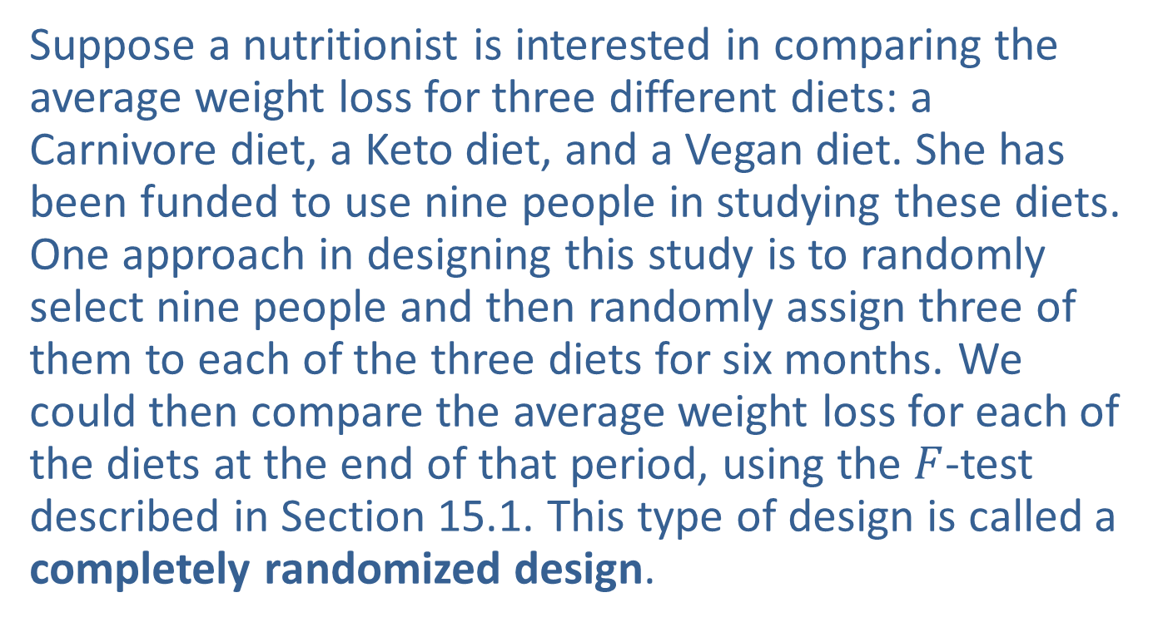
Two-Way ANOVA: The Randomized Block Design (cont.)
Suppose a nutritionist is interested in comparing the average weight loss for three different diets: a Carnivore diet, a Keto diet, and a Vegan diet. She has been funded to use nine people in studying these diets. One approach in designing this study is to randomly select nine people and then randomly assign three of them to each of the three diets for six months. We could then compare the average weight loss for each of the diets at the end of that period, using the $F$-test described in Section 15.1. This type of design is called a completely randomized design.

Slide 6
Two-Way ANOVA: The Randomized Block Design (cont.)
Although this may be a perfectly reasonable approach, it does have some shortcomings in the form of confounding variables. For example, what if all of the people selected to try the Carnivore diet are at least 100 pounds overweight, whereas all of the people selected to try the Vegan diet are only 10 pounds overweight? Certainly, how overweight a person currently is will have an effect on how much weight a person is able to lose, regardless of the diet. Controlling for this “nuisance” factor will improve our experimental design.

Slide 7
Two-Way ANOVA: The Randomized Block Design (cont.)
Controlling for the “nuisance” factor is frequently the point of the two-way ANOVA design. What can be done to reduce the effect of this factor which affects weight loss, but which is not directly related to how well the diets work? One approach would be to divide our study participants into several weight bands called blocks: those people who are more than 100 pounds overweight, those people who are between 51 and 100 pounds overweight, and those people who are between 0 and 50 pounds overweight.

Slide 8
Two-Way ANOVA: The Randomized Block Design (cont.)
Then randomly select people, three from each of the weight bands, to try each of the diets. And finally compare the average weight loss of each of the diets for individuals in each of the three weight bands.
This design is an extension of the paired difference design for comparing two means, which we discussed in Chapter 12. Although the effect that current weight has on the amount of weight loss has not been eliminated, it has probably been greatly reduced by this blocking.

Slide 9
Two-Way ANOVA: The Randomized Block Design (cont.)
As with the paired difference design, we give up degrees of freedom when we block. Thus, we must be sure that the reduction in variation among sample observations is enough to compensate for the loss of degrees of freedom. This type of design is an example of a randomized block design.
In a randomized block design, we select experimental units within blocks which categorize experimental units so that they are as much alike as possible.

Slide 10
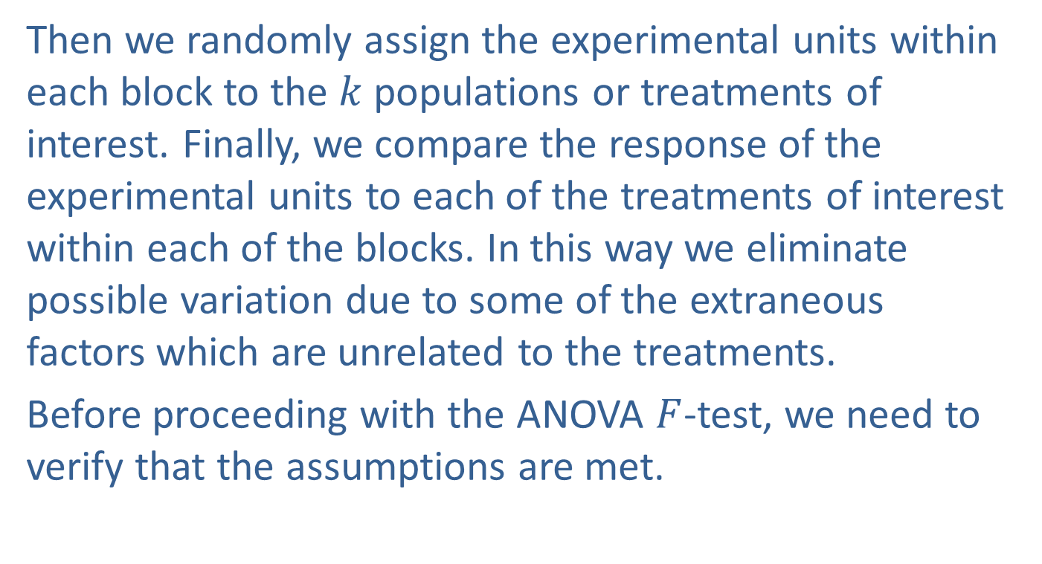
Two-Way ANOVA: The Randomized Block Design (cont.)
Then we randomly assign the experimental units within each block to the $k$populations or treatments of interest. Finally, we compare the response of the experimental units to each of the treatments of interest within each of the blocks. In this way we eliminate possible variation due to some of the extraneous factors which are unrelated to the treatments.
Before proceeding with the ANOVA $F$-test, we need to verify that the assumptions are met.

Slide 11
Two-Way ANOVA: The Randomized Block Design (cont.)
Recall from Section 15.1 that the ANOVA procedure is robust against departures from the normality and equal variance assumptions. For this example, we do not have repeated observations for each combination of treatment and block to be able to verify the normality and equal variance assumptions. The nutritionist should actually collect more data in each cell of the table to verify those assumptions, and to provide additional degrees of freedom for the test. We will demonstrate the ANOVA procedure for this simplified randomized block example nonetheless.

Slide 12
Two-Way ANOVA: The Randomized Block Design (cont.)
Table 15.3.1 – Completely Randomized Block Design
 |  | Treatment
Blocks |  | Carnivore Diet | Keto Diet | Vegan Diet
 | >100 lbs overweight | 25 | 15 | 10
 | 51-100 lbs overweight | 45 | 25 | 15
 | 0-50 lbs overweight | 30 | 20 | 15
Treatments are assigned at random within blocks and the sample measurements in each cell (treatment and block combination) are random samples that are independent of each other.

Slide 13
Two-Way ANOVA: The Randomized Block Design (cont.)
The measurements in each cell come from a population that is approximately normally distributed (assumed).
The populations have approximately equal variances (assumed).
All the cells have an equal number of measurements (a balanced design).
Don’t let the blocking distract from the intent of the experiment. Our interest is still in comparing the treatment means. For the nutritionist, the treatments of interest are the diets.

Slide 14
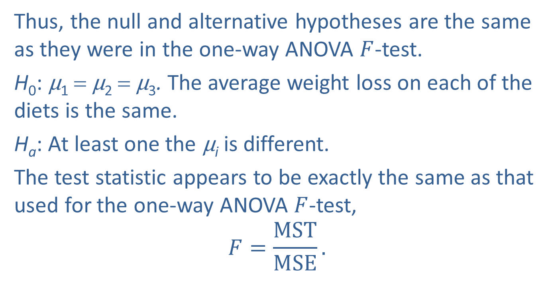
Two-Way ANOVA: The Randomized Block Design (cont.)
Thus, the null and alternative hypotheses are the same as they were in the one-way ANOVA $F$-test.
H₀: μ₁ = μ₂ = μ₃. The average weight loss on each of the diets is the same.
H_{a}: At least one the μ_{i} is different.
The test statistic appears to be exactly the same as that used for the one-way ANOVA $F$-test,
$$F=\frac{MST}{MSE}.$$

Slide 15
Two-Way ANOVA: The Randomized Block Design (cont.)
However, the denominator of the 𝐹-statistic is calculated differently because it takes into account the fact that we were able to eliminate some of the variation between our sample responses by blocking the experimental units. The total sum of squares (Total SS) and the degrees of freedom which we discussed in Section 15.1 can be broken down further as follows.
Sum of Squares: Total SS = SSTreatment + SSBlock + SSError
Degrees of Freedom: N − 1 = k − 1 + b − 1 + (b−1)(k−1)
where

Slide 16
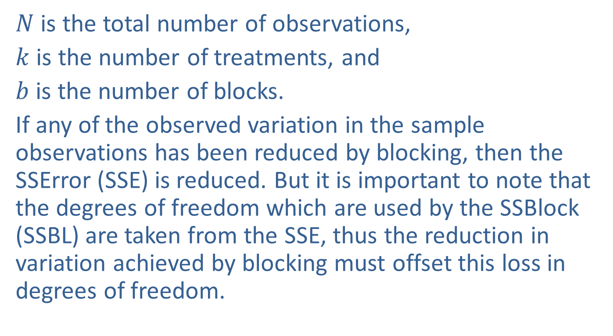
Two-Way ANOVA: The Randomized Block Design (cont.)
$N$ is the total number of observations,
$k$ is the number of treatments, and
$b$ is the number of blocks.
If any of the observed variation in the sample observations has been reduced by blocking, then the SSError (SSE) is reduced. But it is important to note that the degrees of freedom which are used by the SSBlock (SSBL) are taken from the SSE, thus the reduction in variation achieved by blocking must offset this loss in degrees of freedom.

Slide 17
Two-Way ANOVA: The Randomized Block Design (cont.)
If we have been successful at significantly reducing variation by blocking and there is a difference among the sample means, we will be more likely to detect it. The test procedure for the randomized block design is outlined here.

Slide 18
Procedure: Two-Way ANOVA: Randomized Block Design
Assumptions:
Treatments are assigned at random within blocks and the sample measurements in each cell are random samples that are independent of each other.
The measurements in each cell come from a population that is approximately normally distributed (assumed).

Slide 19
Procedure: Two-Way ANOVA: Randomized Block Design (cont.)
The populations have approximately equal variances (assumed).
All the cells have an equal number of measurements.
Hypotheses:
H₀: μ₁ = μ₂ = … = μ_{k} . The k treatment means are equal. H_{a}: At least one of the μ_{i} is different.

Slide 20
Procedure: Two-Way ANOVA: Randomized Block Design (cont.)
Test Statistic:
where SSE = Total SS − SST − SSBL.

Slide 21
Procedure: Two-Way ANOVA: Randomized Block Design (cont.)
Rejection Region:
H₀ will be rejected for large values of In
particular, we will reject H₀ if F > F_{α} with (k − 1) numerator degrees of freedom and (k − 1)(b − 1) denominator degrees of freedom.

Slide 22
Procedure: Two-Way ANOVA: Randomized Block Design (cont.)
P-value:
(The P-value should be available from the output of an ANOVA test performed using technology.)
If the computed P-value is less than α, reject the null hypothesis in favor of the alternative.
If the computed P-value is greater than or equal to α, fail to reject the null hypothesis.

Slide 23
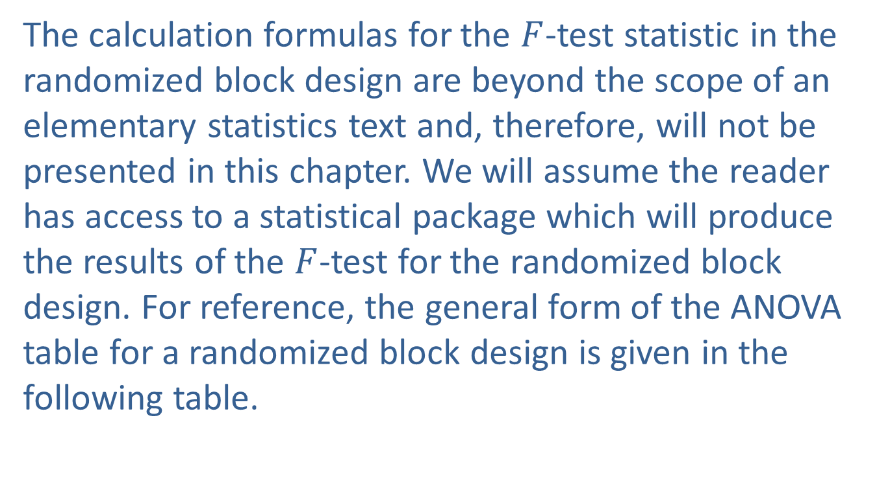
Two-Way ANOVA: The Randomized Block Design (cont.)
The calculation formulas for the $F$-test statistic in the randomized block design are beyond the scope of an elementary statistics text and, therefore, will not be presented in this chapter. We will assume the reader has access to a statistical package which will produce the results of the $F$-test for the randomized block design. For reference, the general form of the ANOVA table for a randomized block design is given in the following table.

Slide 24
Two-Way ANOVA: The Randomized Block Design (cont.)
Table 15.3.2 - ANOVA Summary Table for a Randomized Block Design
Source of Variation | SS | df | MS | F
Treatment | SST | k − 1 | MST
Block | SSBL | b − 1 | MSBL
Error | SSE | (k − 1) (b − 1) | MSE
Total | Total SS | N −1

Slide 25
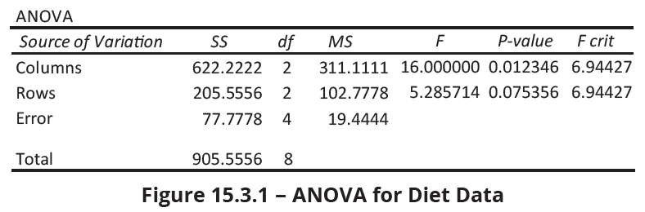
Two-Way ANOVA: The Randomized Block Design (cont.)
The results of the nutritionist’s test are given in Figure 15.3.1.

Slide 26
Note
When using statistical software programs like Excel and Minitab to perform a two-way ANOVA, it is important to pay attention to how the data is organized so that you can identify treatments and blocks on the summary output and accurately interpret the results.

Slide 27
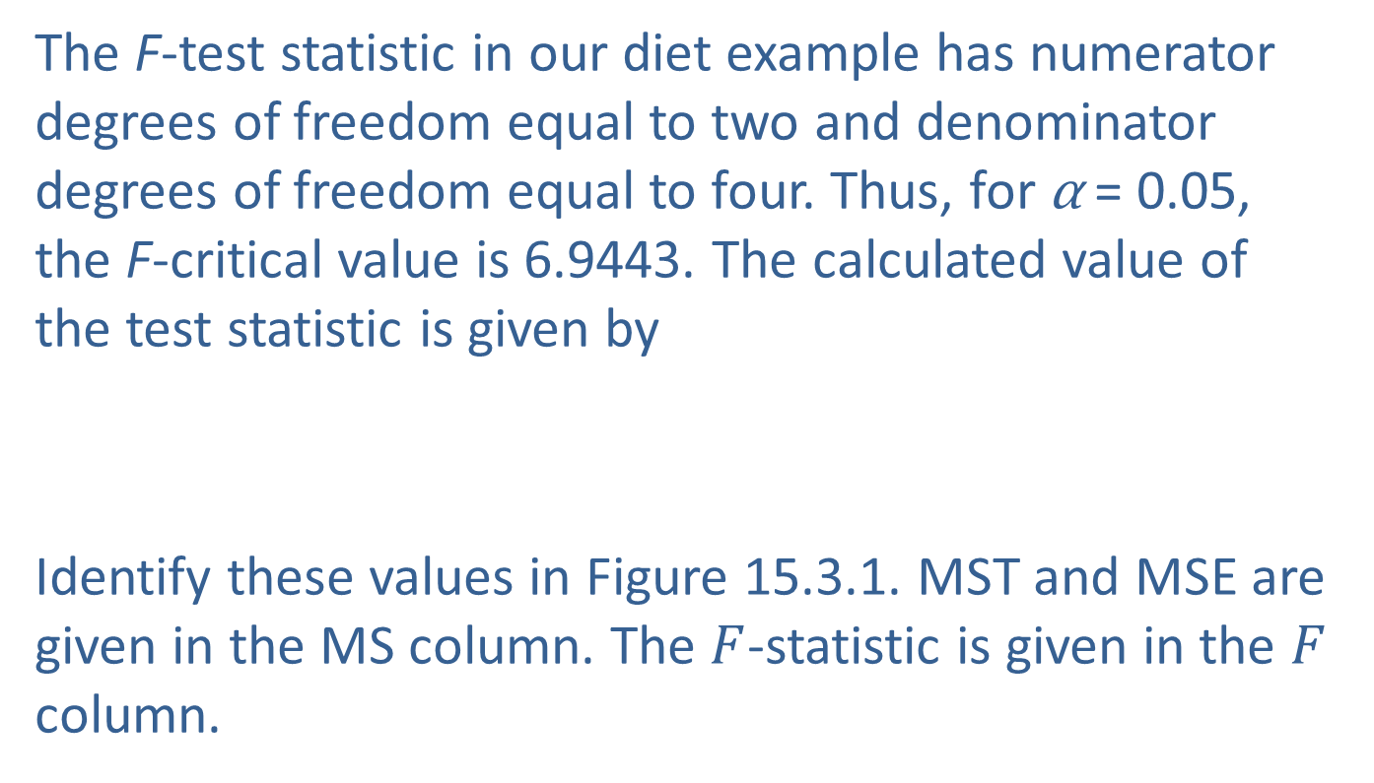
Two-Way ANOVA: The Randomized Block Design (cont.)
The F-test statistic in our diet example has numerator degrees of freedom equal to two and denominator degrees of freedom equal to four. Thus, for α = 0.05, the F-critical value is 6.9443. The calculated value of the test statistic is given by
Identify these values in Figure 15.3.1. MST and MSE are given in the MS column. The $F$-statistic is given in the $F$ column.

Slide 28
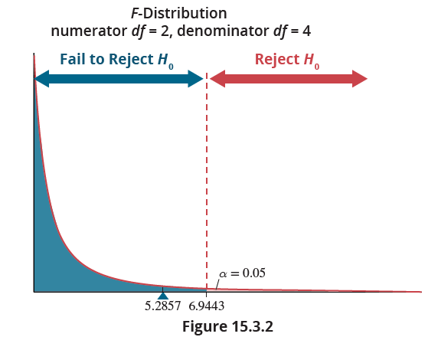
Two-Way ANOVA: The Randomized Block Design (cont.)

Slide 29
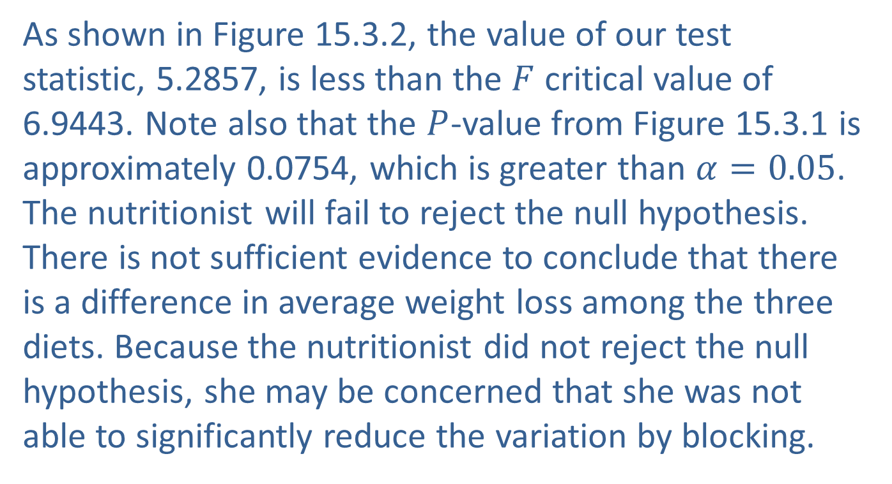
Two-Way ANOVA: The Randomized Block Design (cont.)
As shown in Figure 15.3.2, the value of our test statistic, 5.2857, is less than the $F$ critical value of 6.9443. Note also that the $P$-value from Figure 15.3.1 is approximately 0.0754, which is greater than $α=0.05$. The nutritionist will fail to reject the null hypothesis. There is not sufficient evidence to conclude that there is a difference in average weight loss among the three diets. Because the nutritionist did not reject the null hypothesis, she may be concerned that she was not able to significantly reduce the variation by blocking.

Slide 30
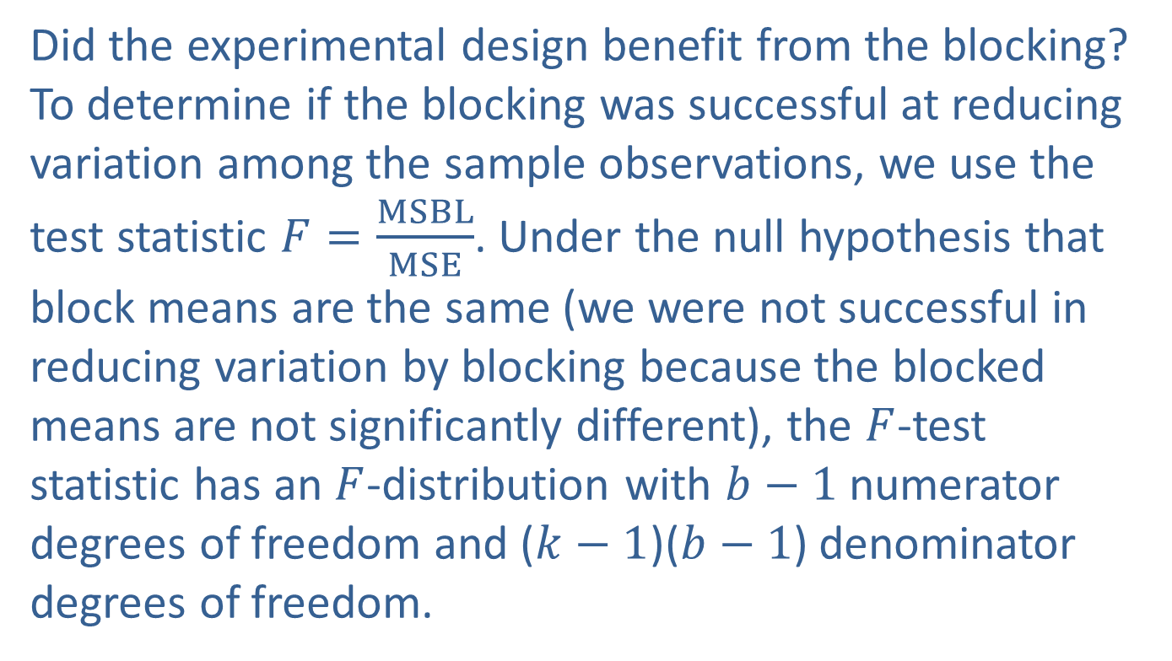
Evaluating the Effect of Blocking on the Experimental Design
Did the experimental design benefit from the blocking? To determine if the blocking was successful at reducing variation among the sample observations, we use the test statistic $F=\frac{MSBL}{MSE}$. Under the null hypothesis that block means are the same (we were not successful in reducing variation by blocking because the blocked means are not significantly different), the $F$-test statistic has an $F$-distribution with $b−1$ numerator degrees of freedom and ($k−1$)($b−1$) denominator degrees of freedom.

Slide 31
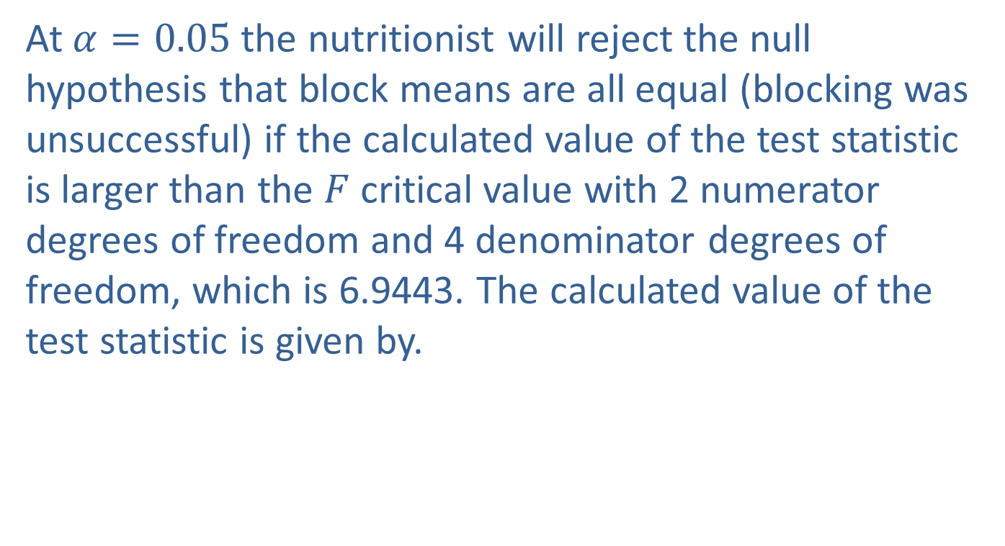
Evaluating the Effect of Blocking on the Experimental Design (cont.)
At $α=0.05$the nutritionist will reject the null hypothesis that block means are all equal (blocking was unsuccessful) if the calculated value of the test statistic is larger than the $F$ critical value with 2 numerator degrees of freedom and 4 denominator degrees of freedom, which is 6.9443. The calculated value of the test statistic is given by.

Slide 32
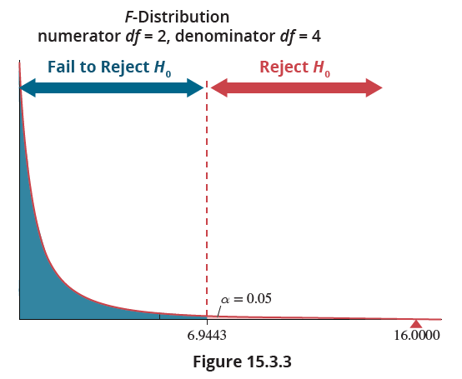
Evaluating the Effect of Blocking on the Experimental Design (cont.)

Slide 33
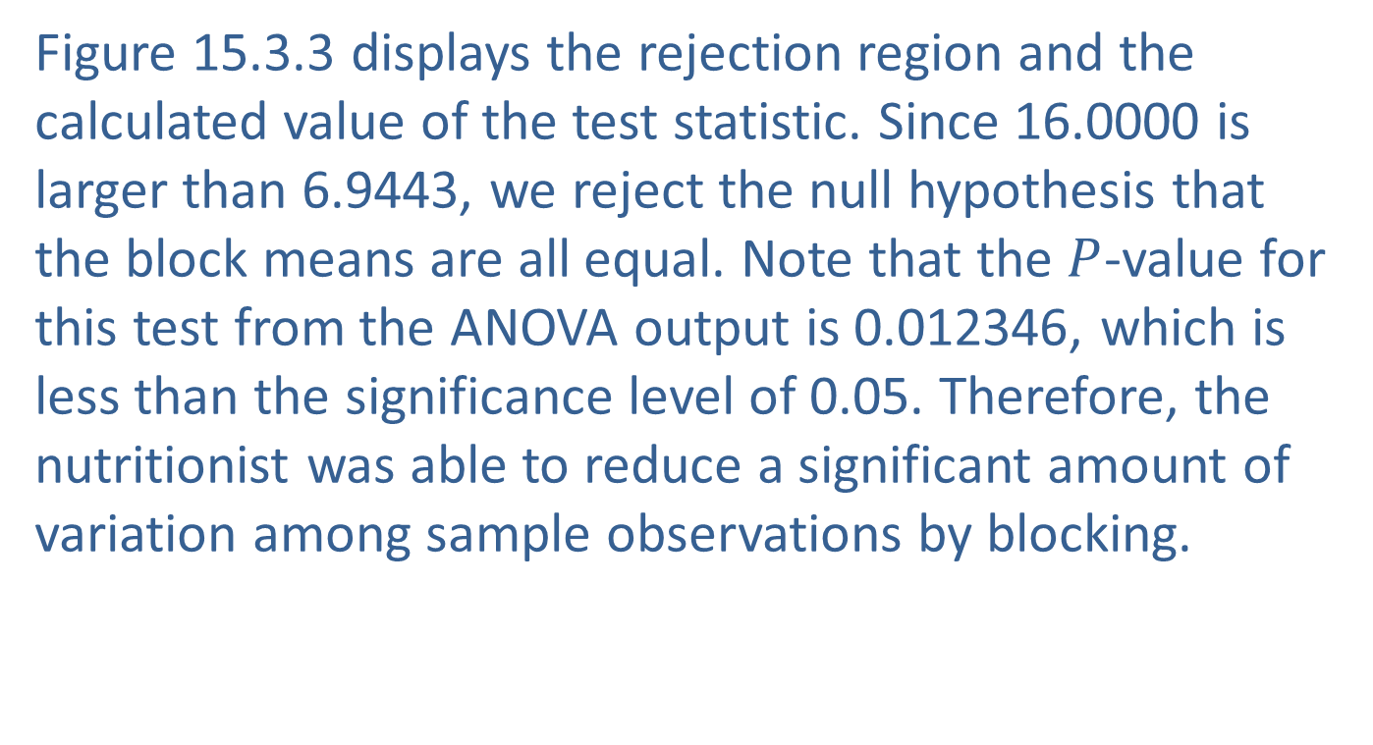
Evaluating the Effect of Blocking on the Experimental Design (cont.)
Figure 15.3.3 displays the rejection region and the calculated value of the test statistic. Since 16.0000 is larger than 6.9443, we reject the null hypothesis that the block means are all equal. Note that the $P$-value for this test from the ANOVA output is 0.012346, which is less than the significance level of 0.05. Therefore, the nutritionist was able to reduce a significant amount of variation among sample observations by blocking.

