Slide 1
Section 15.2
Multiple Comparison Procedures

Slide 2
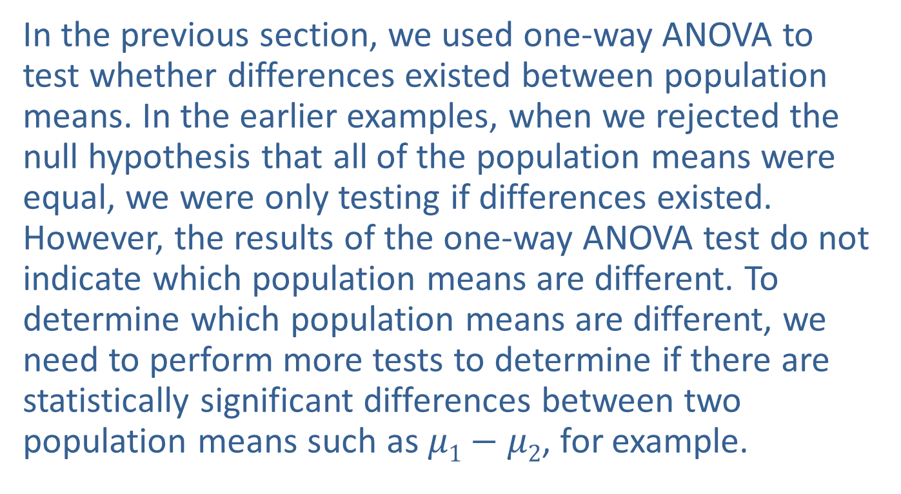
Multiple Comparison Procedures
In the previous section, we used one-way ANOVA to test whether differences existed between population means. In the earlier examples, when we rejected the null hypothesis that all of the population means were equal, we were only testing if differences existed. However, the results of the one-way ANOVA test do not indicate which population means are different. To determine which population means are different, we need to perform more tests to determine if there are statistically significant differences between two population means such as $μ1−μ2$, for example.

Slide 3
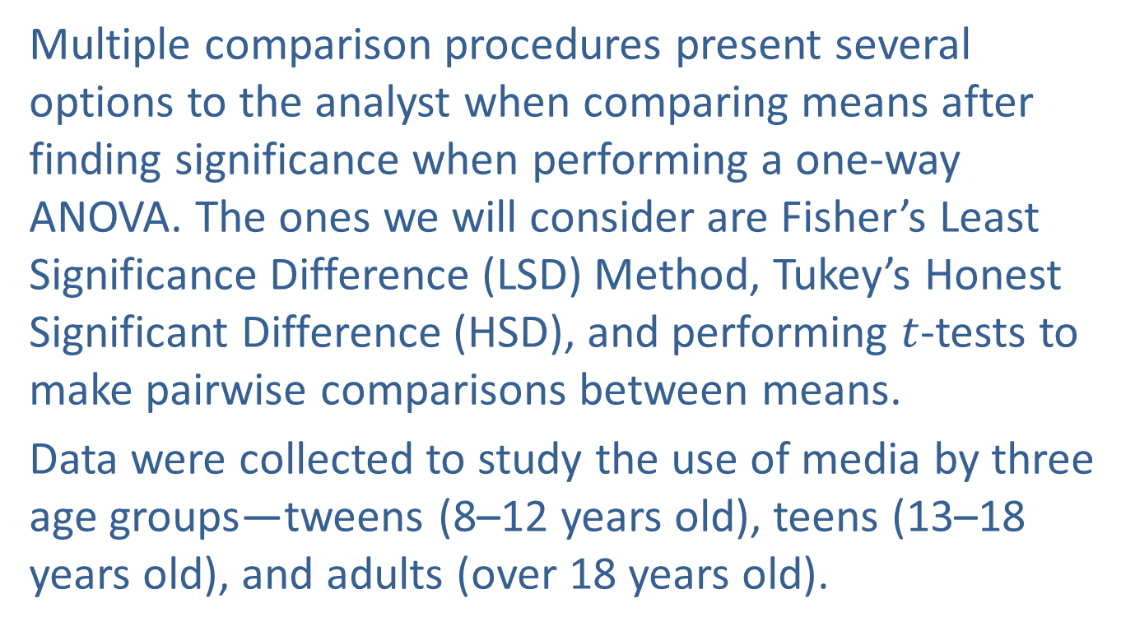
Multiple Comparison Procedures (cont.)
Multiple comparison procedures present several options to the analyst when comparing means after finding significance when performing a one-way ANOVA. The ones we will consider are Fisher’s Least Significance Difference (LSD) Method, Tukey’s Honest Significant Difference (HSD), and performing $t$-tests to make pairwise comparisons between means.
Data were collected to study the use of media by three age groups—tweens (8–12 years old), teens (13–18 years old), and adults (over 18 years old).

Slide 4
Multiple Comparison Procedures (cont.)
A sample of 50 participants in each age group was asked how frequently they engaged in activities such as time spent on cell phones, watching online videos, watching television, and playing mobile games. The table below presents some summary statistics from the data collected showing the sample size, the sample mean time spent on devices, and the sample standard deviation of the data by age group.

Slide 5
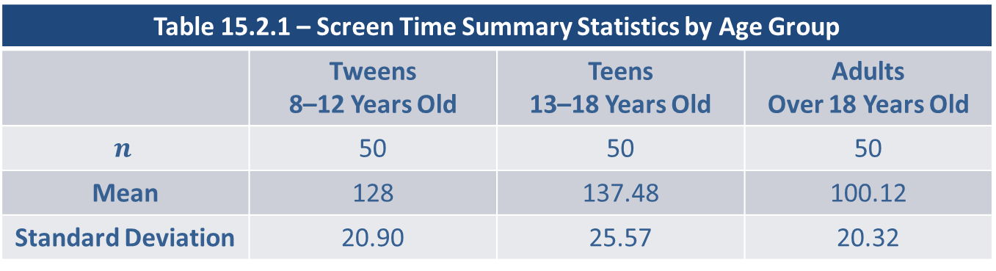
Multiple Comparison Procedures (cont.)
Test to determine if there is a significant difference between average time spent on devices among the three age groups.
Table 15.2.1 – Screen Time Summary Statistics by Age Group
 | Tweens 8–12 Years Old | Teens 13–18 Years Old | Adults Over 18 Years Old
$$n$$ | 50 | 50 | 50
Mean | 128 | 137.48 | 100.12
Standard Deviation | 20.90 | 25.57 | 20.32

Slide 6
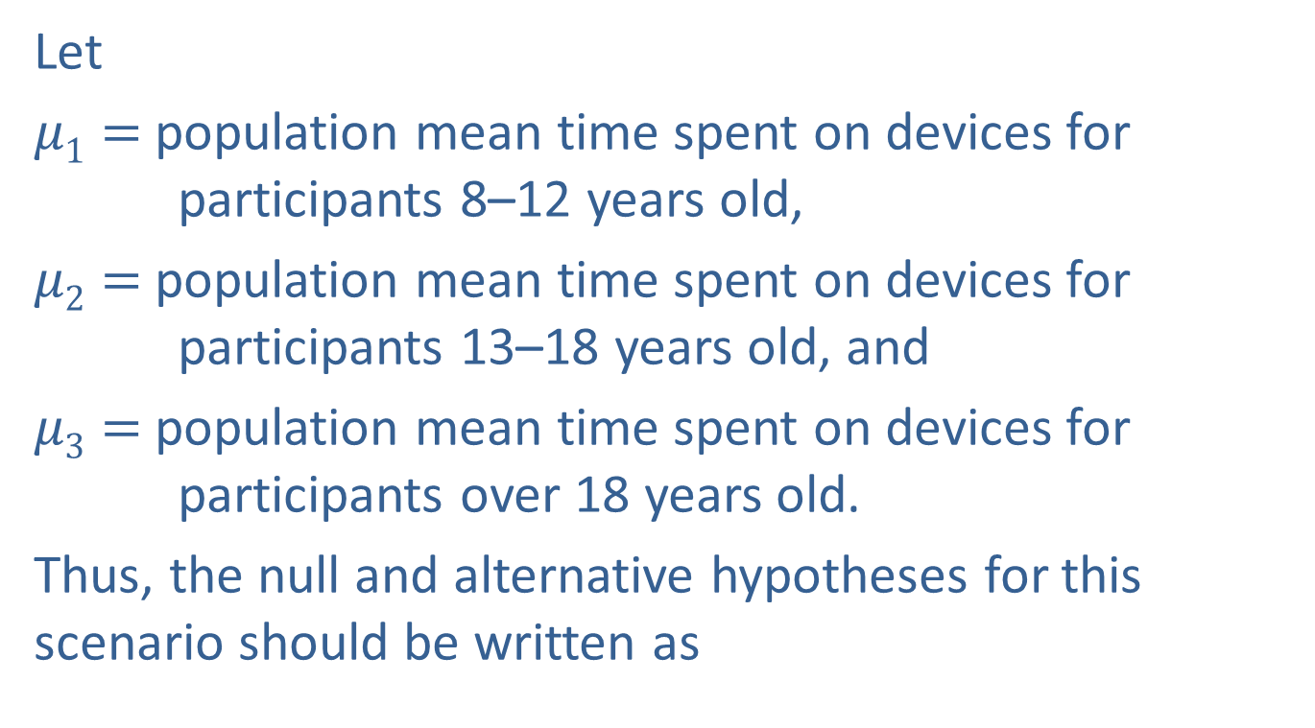
Multiple Comparison Procedures (cont.)
Let
$μ1=$ population mean time spent on devices for participants 8–12 years old,
$μ2=$ population mean time spent on devices for participants 13–18 years old, and
$μ3=$ population mean time spent on devices for participants over 18 years old.
Thus, the null and alternative hypotheses for this scenario should be written as

Slide 7
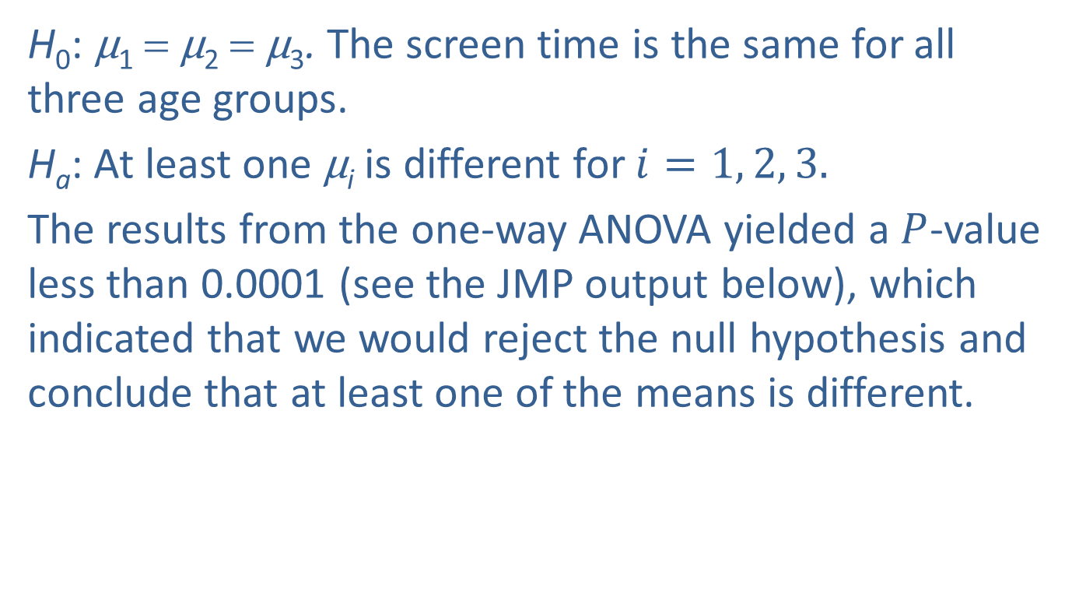
Multiple Comparison Procedures (cont.)
H₀: μ₁ = μ₂ = μ₃. The screen time is the same for all three age groups.
H_{a}: At least one μ_{i} is different for $i=1, 2, 3.$
The results from the one-way ANOVA yielded a $P$-value less than 0.0001 (see the JMP output below), which indicated that we would reject the null hypothesis and conclude that at least one of the means is different.

Slide 8
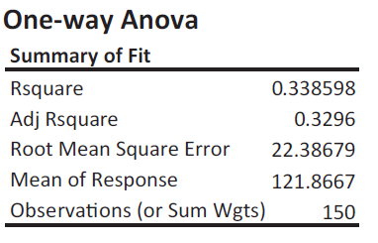
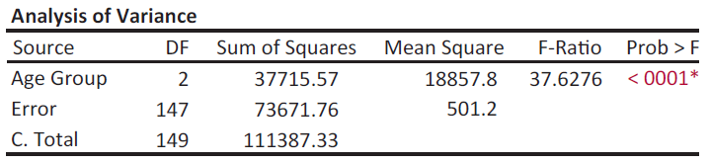
Multiple Comparison Procedures (cont.)

Slide 9
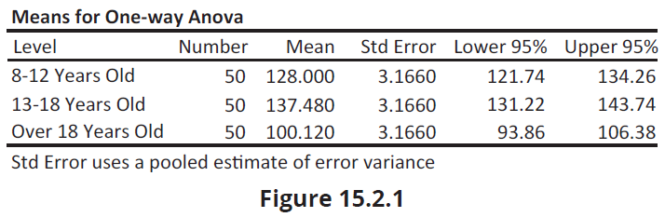

Multiple Comparison Procedures (cont.)
We can now answer the natural question, Which of these means is different? One method that was introduced in Chapter 12 would be the two-sample $t$-test. Using a series of two-sample $t$-tests, we would have the following hypotheses.

Slide 10
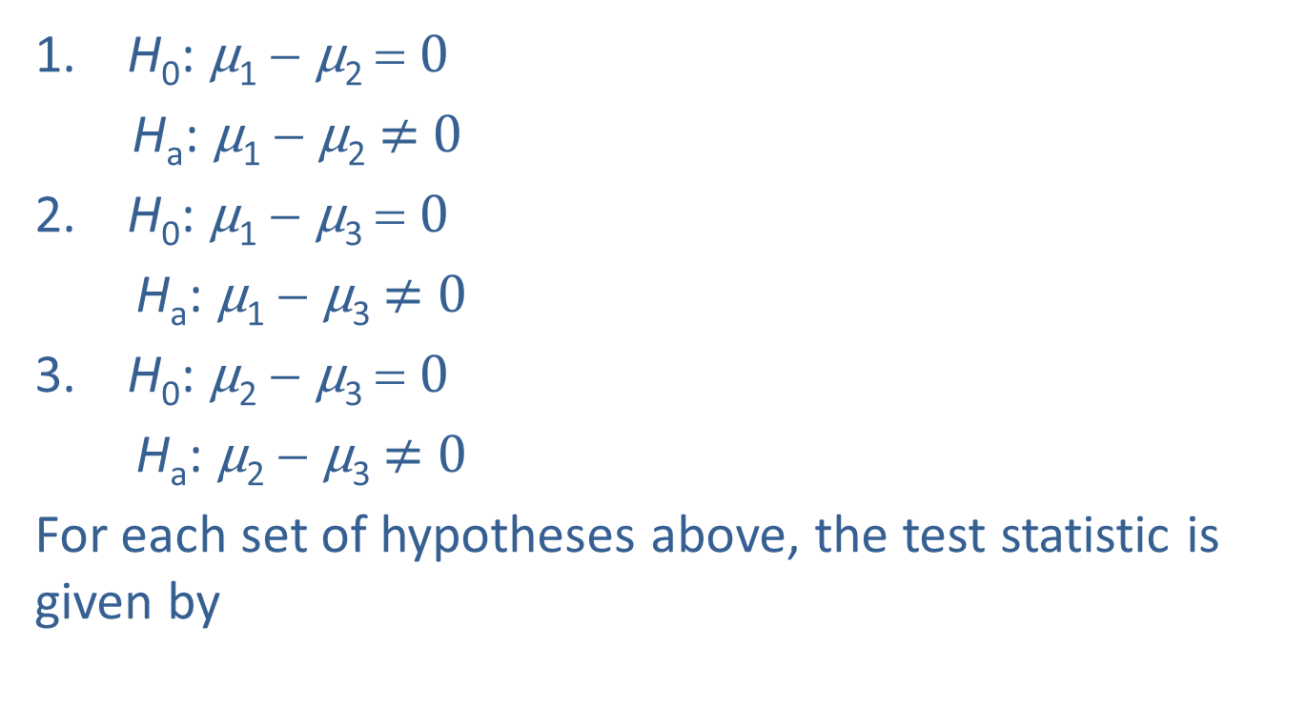
Multiple Comparison Procedures (cont.)
H₀: μ₁ − μ₂ = 0
H_{a}: μ₁ − μ₂ $≠$ 0
H₀: μ₁ − μ₃ = 0
H_{a}: μ₁ − μ₃ $≠$ 0
H₀: μ₂ − μ₃ = 0
H_{a}: μ₂ − μ₃ $≠$ 0
For each set of hypotheses above, the test statistic is given by

Slide 11
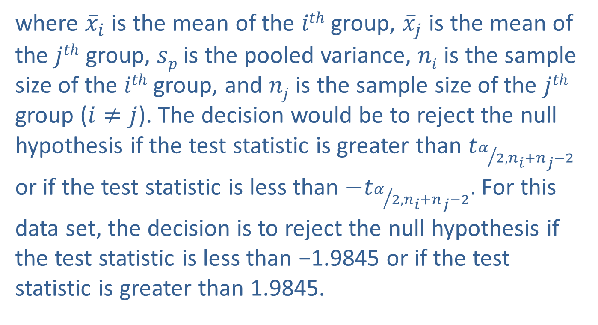
Multiple Comparison Procedures (cont.)
where ${\overline{x}}_{i}$ is the mean of the $ith$ group, ${\overline{x}}_{j}$ is the mean of the $jth$ group, $sp$is the pooled variance, $ni$ is the sample size of the $ith$ group, and $nj$ is the sample size of the $jth$ group ($i≠j$). The decision would be to reject the null hypothesis if the test statistic is greater than $t_{α/{2,n_{i}+n_{j}−2}}$ or if the test statistic is less than ${−t}_{α/{2,n_{i}+n_{j}−2}}.$ For this data set, the decision is to reject the null hypothesis if the test statistic is less than −1.9845 or if the test statistic is greater than 1.9845.

Slide 12
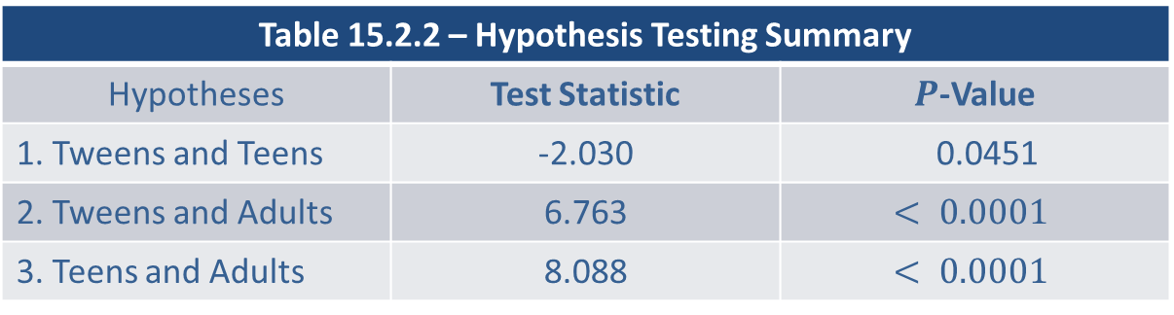

Multiple Comparison Procedures (cont.)
The test statistics for each set of hypotheses numbered above along with their respective $P$-values are presented in the table below.
Table 15.2.2 – Hypothesis Testing Summary
Hypotheses | Test Statistic | $P$-Value
1. Tweens and Teens | -2.030 | 0.0451
2. Tweens and Adults | 6.763 | $$< 0.0001$$
3. Teens and Adults | 8.088 | $$< 0.0001$$

Slide 13
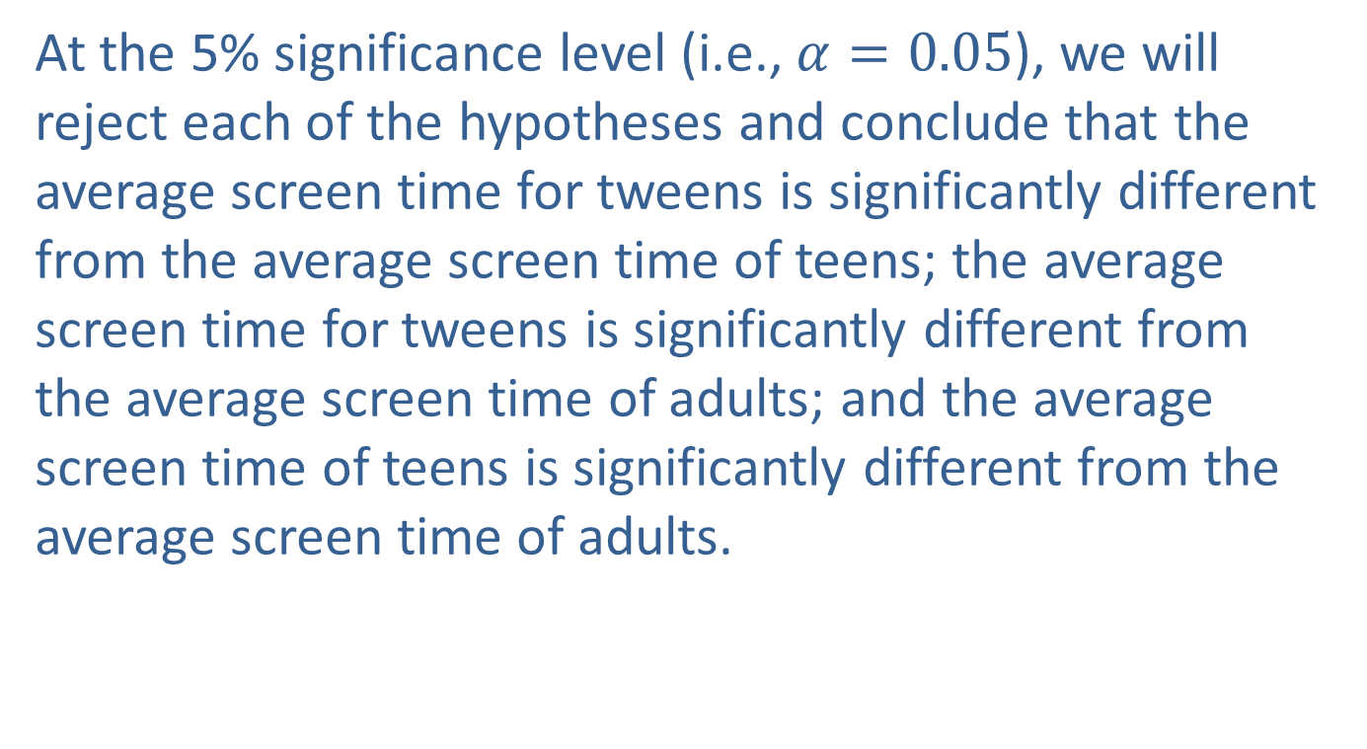
Multiple Comparison Procedures (cont.)
At the 5% significance level (i.e., $α=0.05$), we will reject each of the hypotheses and conclude that the average screen time for tweens is significantly different from the average screen time of teens; the average screen time for tweens is significantly different from the average screen time of adults; and the average screen time of teens is significantly different from the average screen time of adults.

Slide 14
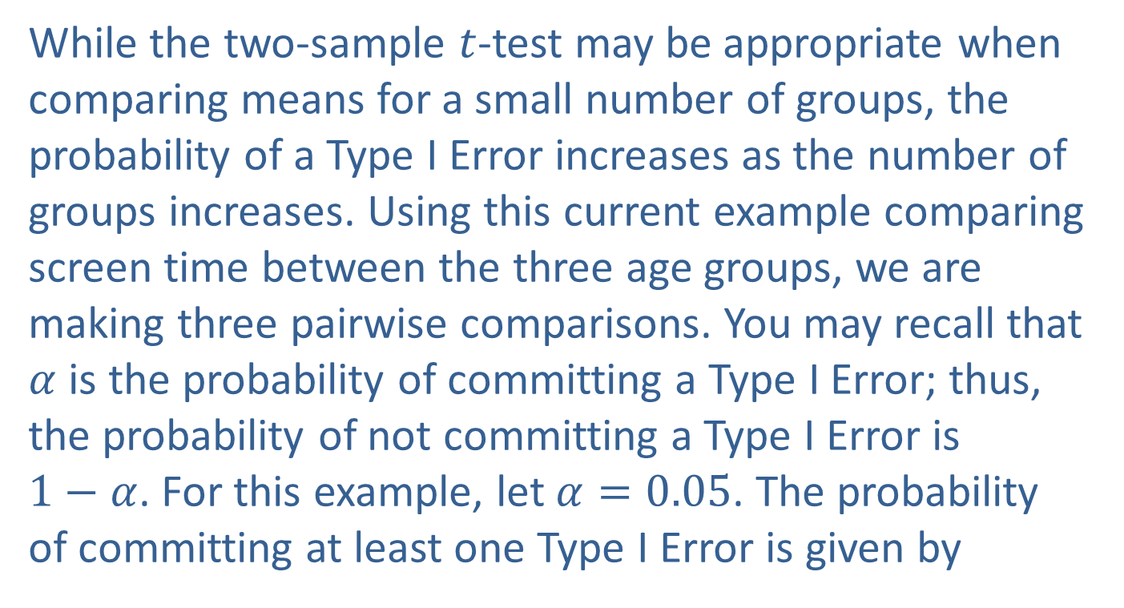
Multiple Comparison Procedures (cont.)
While the two-sample $t$-test may be appropriate when comparing means for a small number of groups, the probability of a Type I Error increases as the number of groups increases. Using this current example comparing screen time between the three age groups, we are making three pairwise comparisons. You may recall that $α$ is the probability of committing a Type I Error; thus, the probability of not committing a Type I Error is $1−α$. For this example, let $α=0.05$. The probability of committing at least one Type I Error is given by

Slide 15
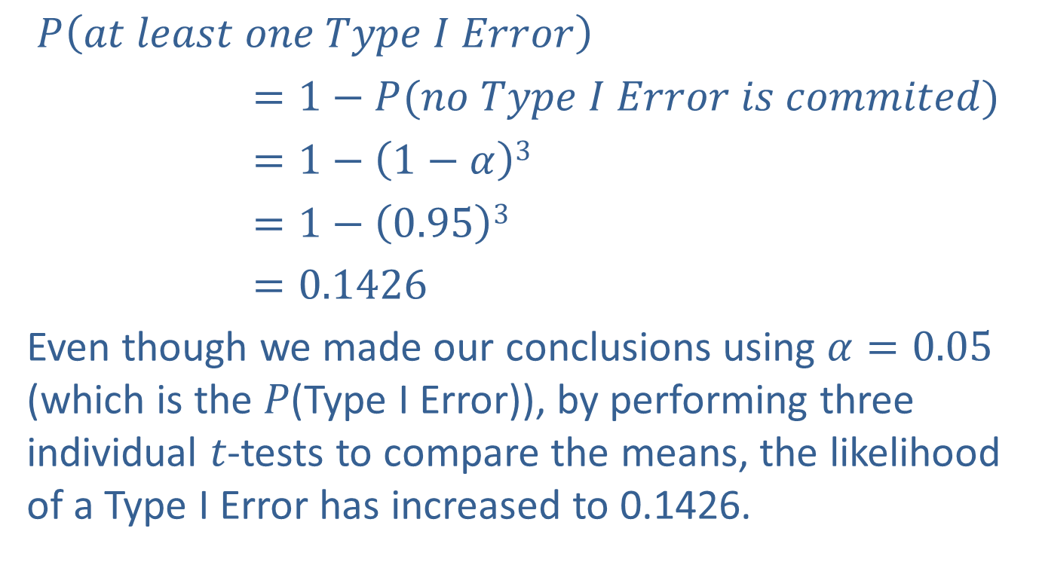
Multiple Comparison Procedures (cont.)
$P\left(at least one Type I Error\right)$
$=1−P(no Type I Error is commited)$
$=1−\left(1−α\right)3$
$=1−\left(0.95\right)3$
$=0.1426$
Even though we made our conclusions using $α=0.05$ (which is the 𝑃(Type I Error)), by performing three individual 𝑡-tests to compare the means, the likelihood of a Type I Error has increased to 0.1426.

Slide 16

Multiple Comparison Procedures (cont.)
The solution to comparing the means when performing ANOVA is to use a multiple comparison procedure so that the likelihood of a Type I Error remains fixed at the $α$ level of significance.

Slide 17
Fisher’s Least Significant Difference (LSD) Method
The first multiple comparison procedure that we will discuss is Fisher’s Least Significant Difference (LSD) method. Fisher’s LSD is a least significant difference method that allows you to compare the difference between two means to a value similar to the margin of error. Suppose we want to compare the population means of three groups, say Tweens, Teens, and Adults which are the three groups.

Slide 18
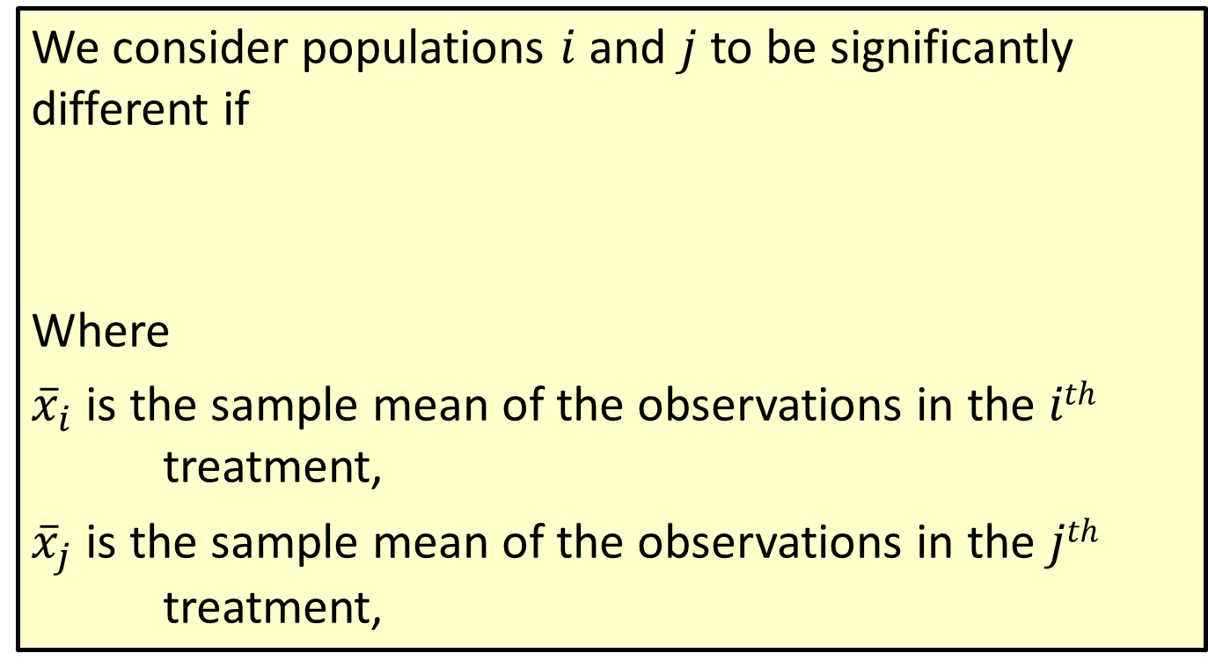
Formula: Fisher’s Least Significant Difference Method
We consider populations $i$ and $j$ to be significantly different if
Where
${\overline{x}}_{i}$ is the sample mean of the observations in the $ith$ treatment,
${\overline{x}}_{j}$ is the sample mean of the observations in the $jth$ treatment,

Slide 19
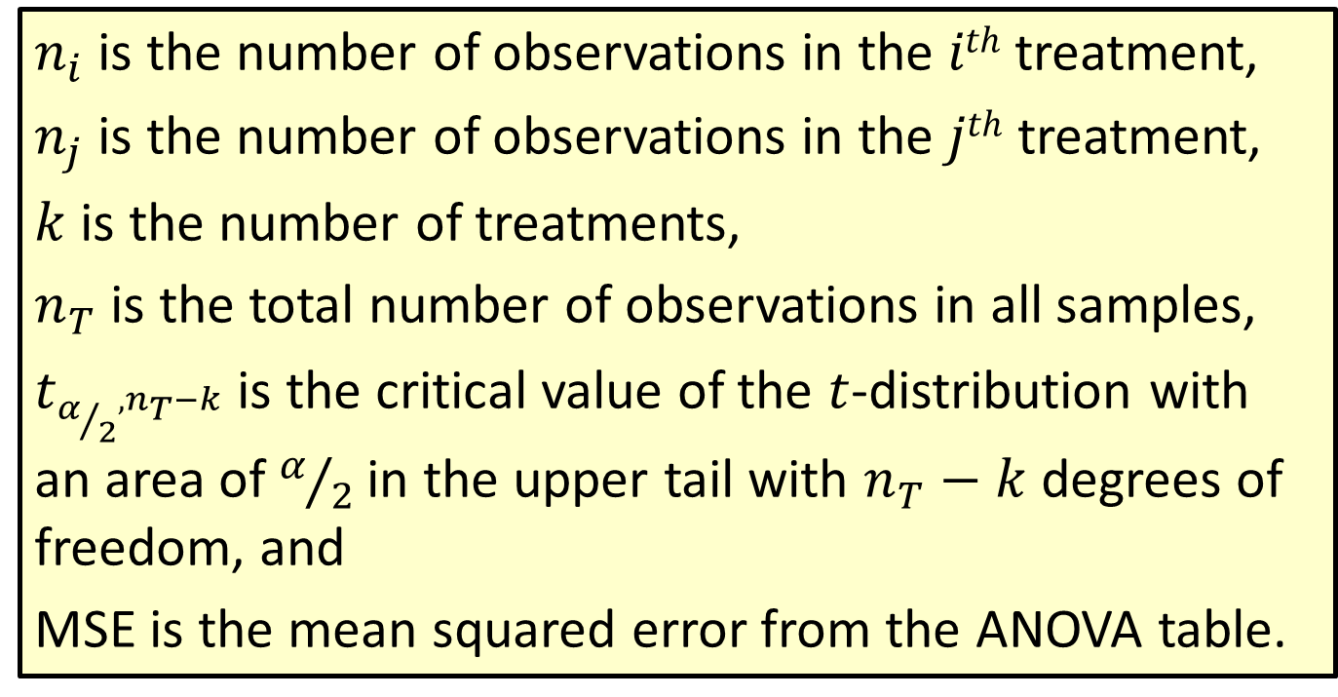
Formula: Fisher’s Least Significant Difference Method (cont.)
$n_{i}$ is the number of observations in the $ith$ treatment,
$n_{j}$ is the number of observations in the$jth$ treatment,
$k$ is the number of treatments,
$n_{T}$ is the total number of observations in all samples,
$t_{{α/2}^{,n_{T}−k}}$ is the critical value of the $t$-distribution with an area of $α/2$ in the upper tail with $n_{T}−k$degrees of freedom, and
MSE is the mean squared error from the ANOVA table.

Slide 20
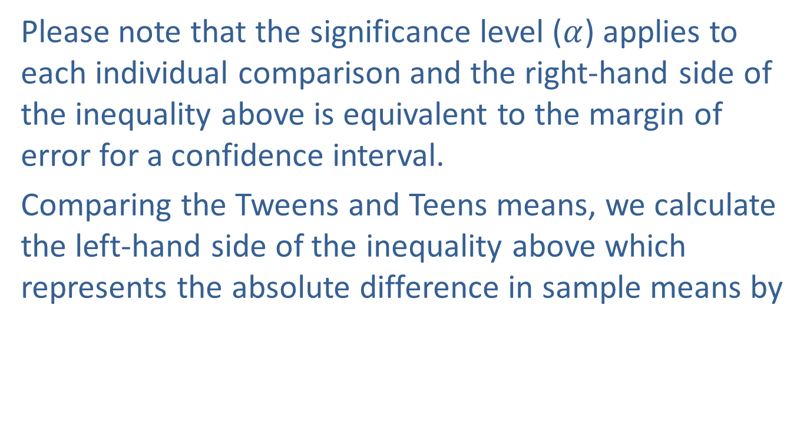
Fisher’s Least Significant Difference (LSD) Method (cont.)
Please note that the significance level ($α$) applies to each individual comparison and the right-hand side of the inequality above is equivalent to the margin of error for a confidence interval.
Comparing the Tweens and Teens means, we calculate the left-hand side of the inequality above which represents the absolute difference in sample means by

Slide 21
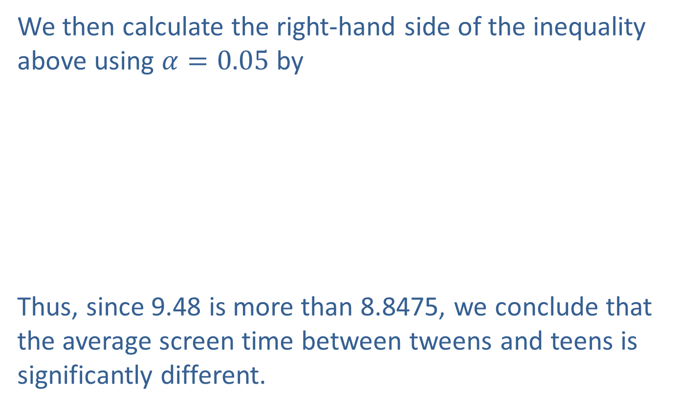
Fisher’s Least Significant Difference (LSD) Method (cont.)
We then calculate the right-hand side of the inequality above using $α=0.05$ by
Thus, since 9.48 is more than 8.8475, we conclude that the average screen time between tweens and teens is significantly different.

Slide 22
Fisher’s Least Significant Difference (LSD) Method (cont.)
Similarly, when comparing Tweens to Adults, we calculate an absolute value of their differences to be
and when comparing Teens to Adults, we get
Since both of these absolute differences are larger than 8.8475, we conclude that the average screen time between tweens and adults is significantly different, and that the average screen time between teens and adults is significantly different.

Slide 23

Fisher’s Least Significant Difference (LSD) Method (cont.)
Another approach to using Fisher’s LSD Method is to calculate a 100($1−α$)% confidence interval for the difference between two population means $μi−μj$.

Slide 24
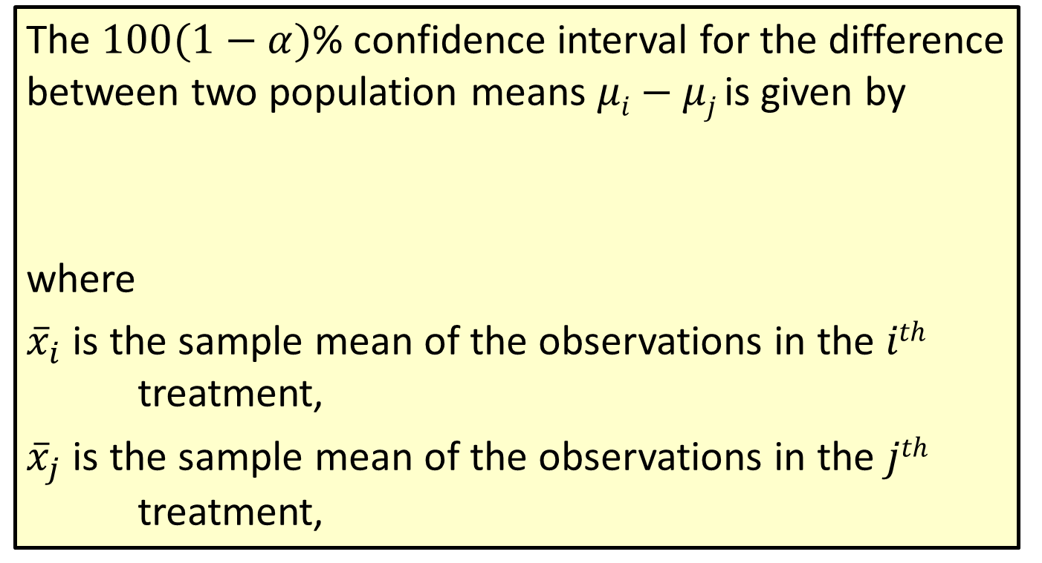
Formula: Fisher’s LSD Method, Confidence Interval Approach
The $100(1−α)$% confidence interval for the difference between two population means $μi−μj$is given by
where
${\overline{x}}_{i}$ is the sample mean of the observations in the $ith$ treatment,
${\overline{x}}_{j}$ is the sample mean of the observations in the $jth$ treatment,

Slide 25
Formula: Fisher’s LSD Method, Confidence Interval Approach (cont.)
$n_{i}$ is the number of observations in the $ith$ treatment,
$n_{j}$ is the number of observations in the$jth$ treatment,
$k$ is the number of treatments,
$n_{T}$ is the total number of observations in all samples,
$t_{{α/2}^{,n_{T}−k}}$ is the critical value of the $t$-distribution with an area of $α/2$ in the upper tail with $n_{T}−k$degrees of freedom, and
MSE is the mean squared error from the ANOVA table.

Slide 26
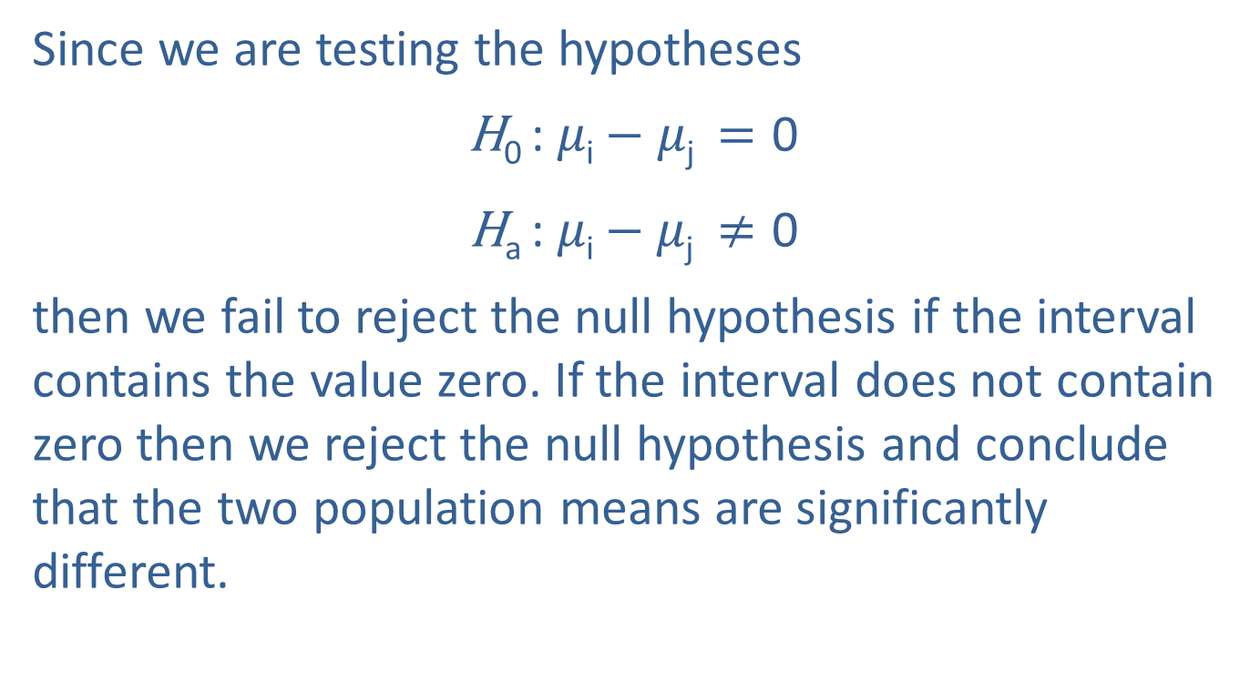
Fisher’s Least Significant Difference (LSD) Method (cont.)
Since we are testing the hypotheses
$$\text{H}\text{0 }\text{: }μ\text{i}−μ\text{j} =\text{0}$$
$$\text{H}\text{a}\text{ : }μ\text{i}−μ\text{j} ≠\text{0}$$
then we fail to reject the null hypothesis if the interval contains the value zero. If the interval does not contain zero then we reject the null hypothesis and conclude that the two population means are significantly different.

Slide 27
Fisher’s Least Significant Difference (LSD) Method (cont.)
Similar to the example above, let’s compare Tweens and Teens.

Slide 28
Fisher’s Least Significant Difference (LSD) Method (cont.)
Since the interval above does not contain zero, we reject the null hypothesis and conclude that the average screen time between tweens and teens is significantly different.
When comparing Tweens to Adults, we calculate the 95% confidence interval for the mean differences as

Slide 29
Fisher’s Least Significant Difference (LSD) Method (cont.)
and when comparing Teens to Adults, we get

Slide 30
Fisher’s Least Significant Difference (LSD) Method (cont.)
Since neither of the last two intervals contain zero, we conclude that the average screen time between tweens and adults is significantly different, and that the average screen time between teens and adults is also significantly different.

Slide 31
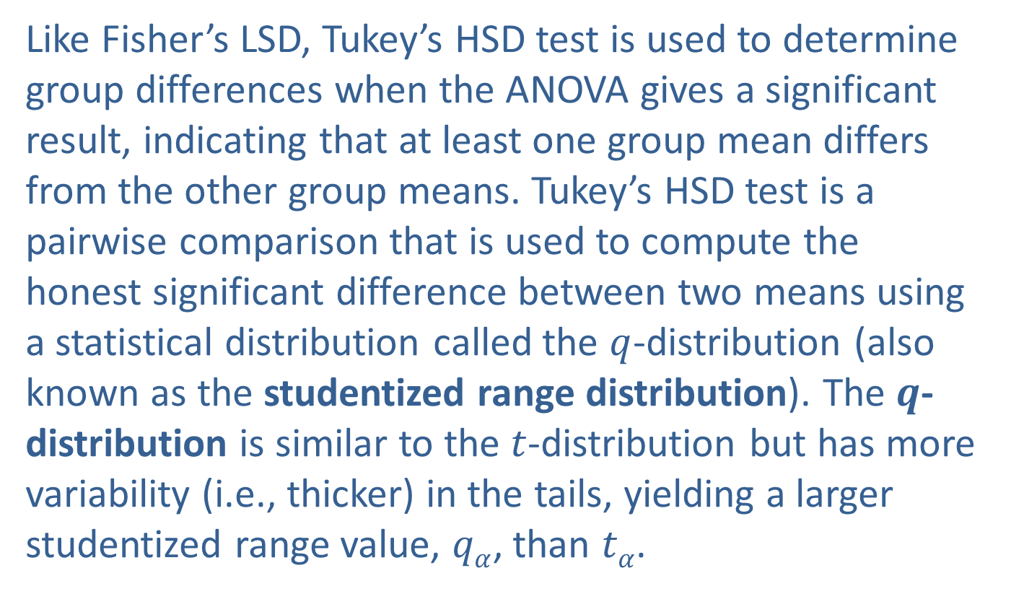
Tukey’s Honest Significant Difference (HSD) Method
Like Fisher’s LSD, Tukey’s HSD test is used to determine group differences when the ANOVA gives a significant result, indicating that at least one group mean differs from the other group means. Tukey’s HSD test is a pairwise comparison that is used to compute the honest significant difference between two means using a statistical distribution called the $q$-distribution (also known as the studentized range distribution). The $q$-distribution is similar to the $t$-distribution but has more variability (i.e., thicker) in the tails, yielding a larger studentized range value, $qα$, than $tα$.

Slide 32
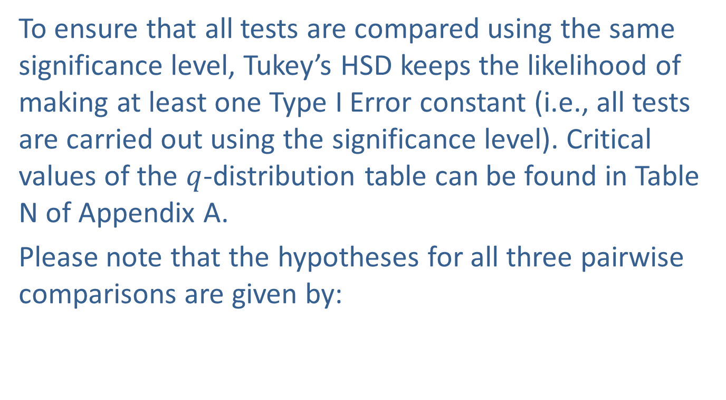
Tukey’s Honest Significant Difference (HSD) Method (cont.)
To ensure that all tests are compared using the same significance level, Tukey’s HSD keeps the likelihood of making at least one Type I Error constant (i.e., all tests are carried out using the significance level). Critical values of the $q$-distribution table can be found in Table N of Appendix A.
Please note that the hypotheses for all three pairwise comparisons are given by:

Slide 33
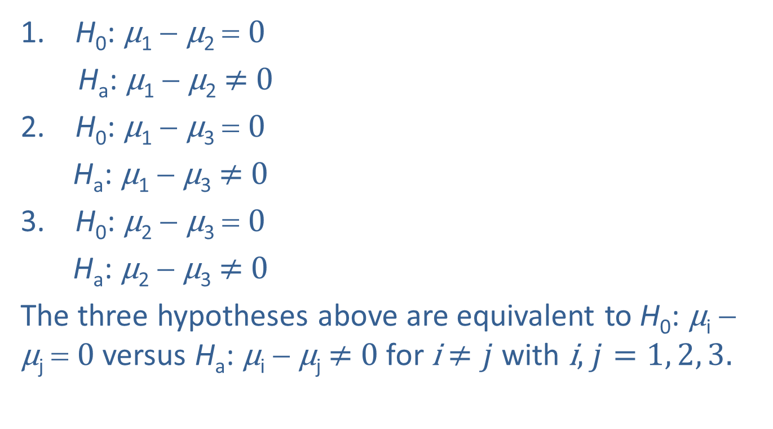
Tukey’s Honest Significant Difference (HSD) Method (cont.)
H₀: μ₁ − μ₂ = 0
H_{a}: μ₁ − μ₂ $≠$ 0
H₀: μ₁ − μ₃ = 0
H_{a}: μ₁ − μ₃ $≠$ 0
H₀: μ₂ − μ₃ = 0
H_{a}: μ₂ − μ₃ $≠$ 0
The three hypotheses above are equivalent to H₀: μ_{i} − μ_{j} = 0 versus H_{a}: μ_{i} − μ_{j} $≠$ 0 for i $≠j$ with i, $j=1, 2, 3.$

Slide 34
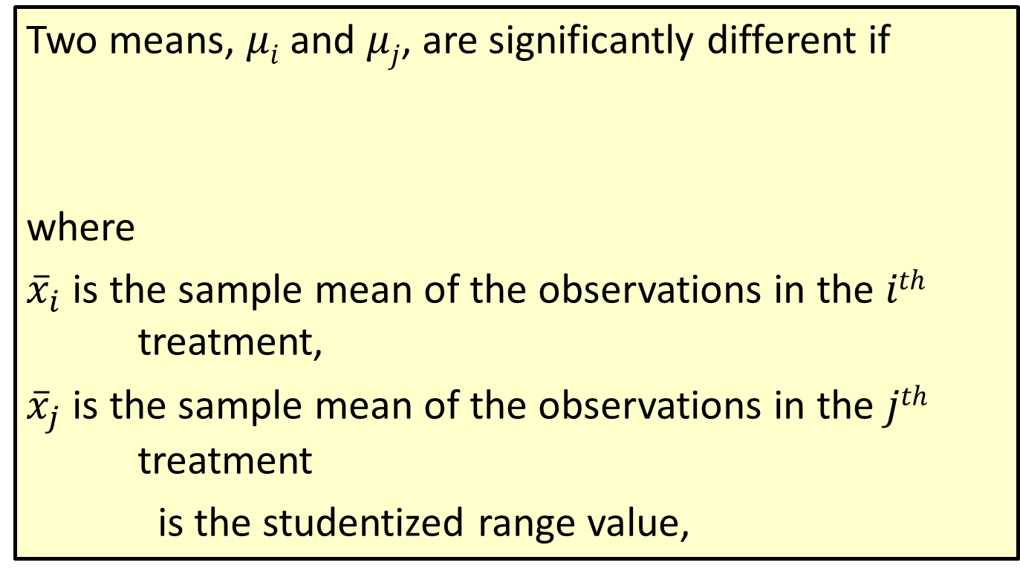
Formula: Tukey’s Honest Significant Difference Method
Two means, $μi$ and $μj$, are significantly different if
where
${\overline{x}}_{i}$ is the sample mean of the observations in the $ith$ treatment,
${\overline{x}}_{j}$ is the sample mean of the observations in the $jth$ treatment
is the studentized range value,

Slide 35
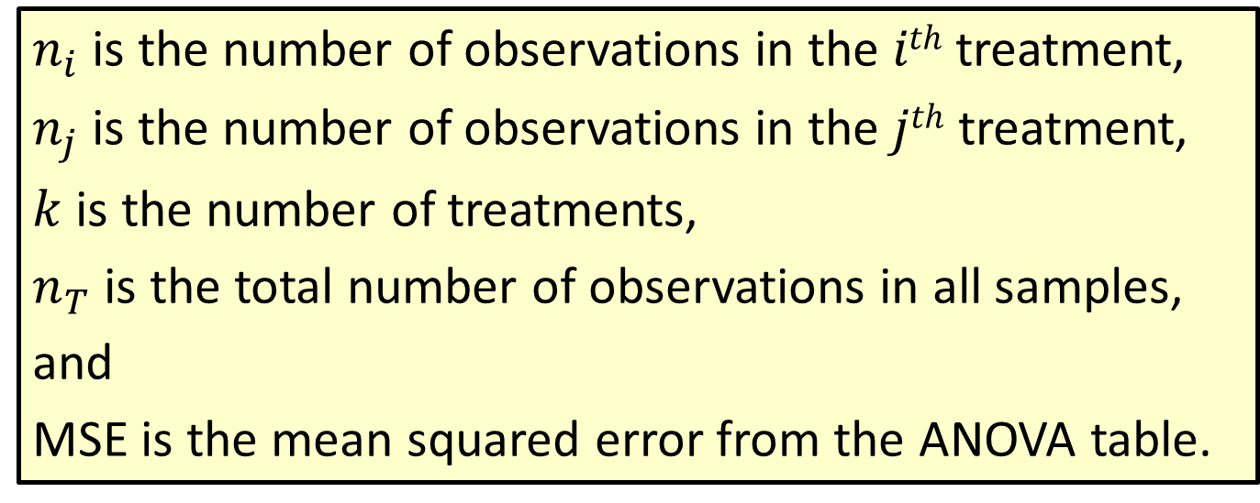
Formula: Tukey’s Honest Significant Difference Method (cont.)
$n_{i}$ is the number of observations in the $ith$ treatment,
$n_{j}$ is the number of observations in the$jth$ treatment,
$k$ is the number of treatments,
$n_{T}$ is the total number of observations in all samples,
and
MSE is the mean squared error from the ANOVA table.

Slide 36

Formula: Tukey’s HSD Method, Confidence Interval Approach
The $100(1−α)$% confidence interval for the difference between two population means $μi−μj$given by
or
where

Slide 37
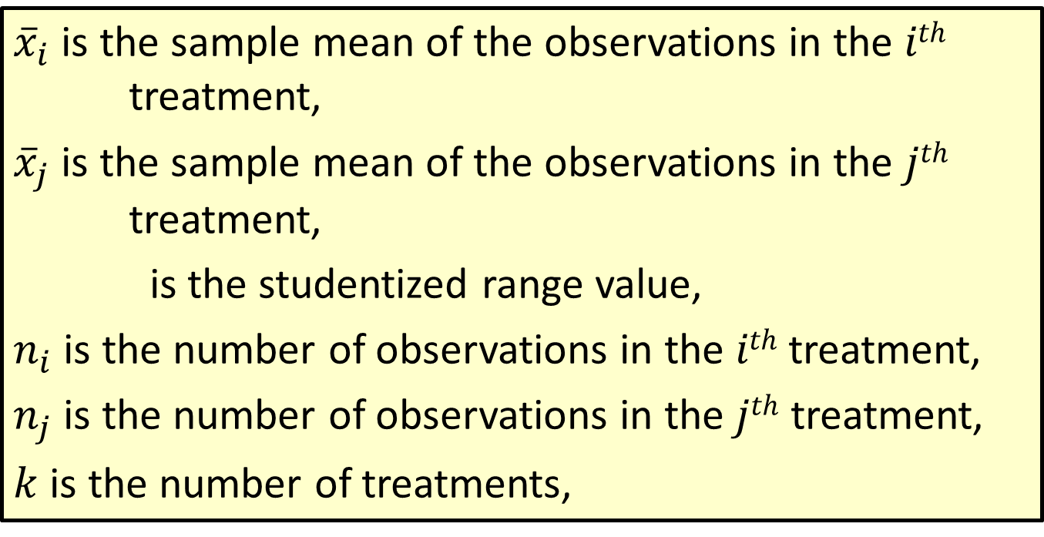
Formula: Tukey’s HSD Method, Confidence Interval Approach (cont.)
${\overline{x}}_{i}$ is the sample mean of the observations in the $ith$ treatment,
${\overline{x}}_{j}$ is the sample mean of the observations in the $jth$ treatment,
is the studentized range value,
$n_{i}$ is the number of observations in the $ith$ treatment,
$n_{j}$ is the number of observations in the$jth$ treatment,
$k$ is the number of treatments,

Slide 38
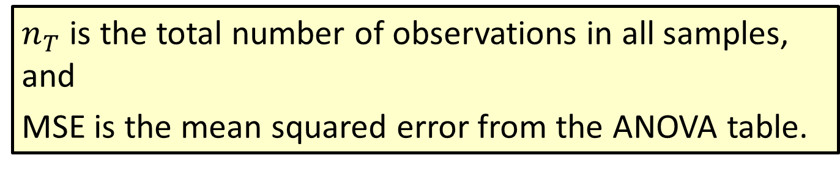
Formula: Tukey’s HSD Method, Confidence Interval Approach (cont.)
$n_{T}$ is the total number of observations in all samples, and
MSE is the mean squared error from the ANOVA table.

Slide 39
Tukey’s Honest Significant Difference (HSD) Method (cont.)
To illustrate the use of Tukey’s HSD, we will use the Screen Time by Age Group data with which we performed a one-way ANOVA to compare average screen time between tweens, teens, and adults. The table below contains the summary statistics of the data which is a duplicate of the table at the beginning of this section.

Slide 40
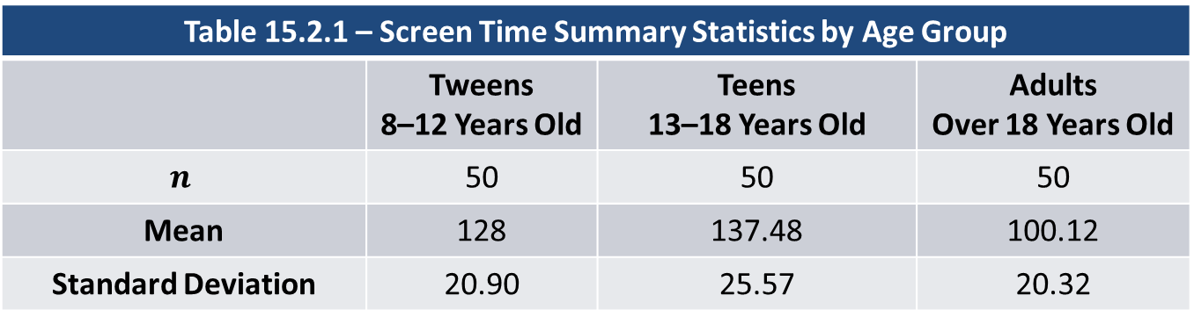
Tukey’s Honest Significant Difference (HSD) Method (cont.)
Table 15.2.1 – Screen Time Summary Statistics by Age Group
 | Tweens 8–12 Years Old | Teens 13–18 Years Old | Adults Over 18 Years Old
$$n$$ | 50 | 50 | 50
Mean | 128 | 137.48 | 100.12
Standard Deviation | 20.90 | 25.57 | 20.32
Using the confidence interval approach for Tukey’s HSD for the first hypothesis above, a 95% confidence interval for the mean differences between Tweens and Teens is given by

Slide 41
Tukey’s Honest Significant Difference (HSD) Method (cont.)

Slide 42
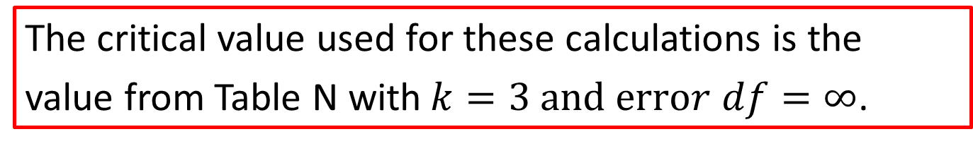
Note
The critical value used for these calculations is the
value from Table N with$k=3 and error df=∞$.

Slide 43
Tukey’s Honest Significant Difference (HSD) Method (cont.)
Since the interval above includes zero, we fail to reject the null hypothesis and conclude that there is not enough evidence to indicate that the amount of screen time for tweens is different from that of teens.
Note that the MSE is the mean squared error which comes from the ANOVA.
Similarly, comparing the average screen time for Tweens and Adults using Tukey’s HSD, a 95% confidence interval is given by

Slide 44
Tukey’s Honest Significant Difference (HSD) Method (cont.)
Since the interval does not include zero, we reject the null hypothesis and conclude that the average screen time between tweens and adults is significantly different.

Slide 45
Tukey’s Honest Significant Difference (HSD) Method (cont.)
Lastly, when comparing Teens and Adults using Tukey’s HSD, a 95% confidence interval yields the following.
Again, the interval does not contain zero, thus we reject the null hypothesis and conclude that the average screen time between teens and adults is significantly different.

Slide 46
Tukey’s Honest Significant Difference (HSD) Method (cont.)
If we examine the “Connecting Letters Report” in the JMP output in the figure below, we can see that tweens and teens have the same letter (A) and adults have the letter B. As stated in the output, the levels that are not connected by the same letter are significantly different. Thus, the average screen times between tweens and teens are not significantly different, but the average screen time between tweens and adults are significantly different. Also, the average screen times between teens and adults are significantly different.

Slide 47
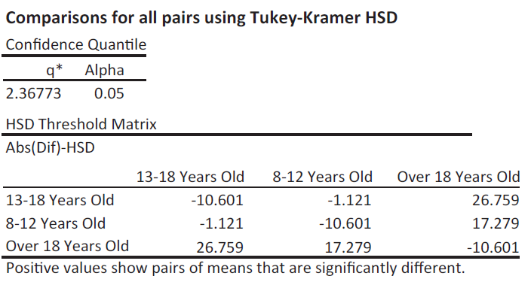
Tukey’s Honest Significant Difference (HSD) Method (cont.)
This was supported in the calculations presented above.

Slide 48
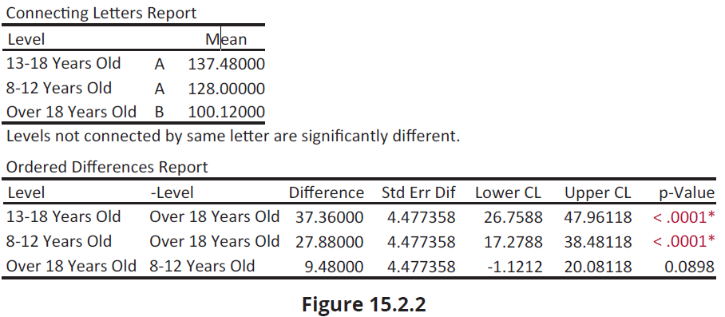
Tukey’s Honest Significant Difference (HSD) Method (cont.)

Slide 49
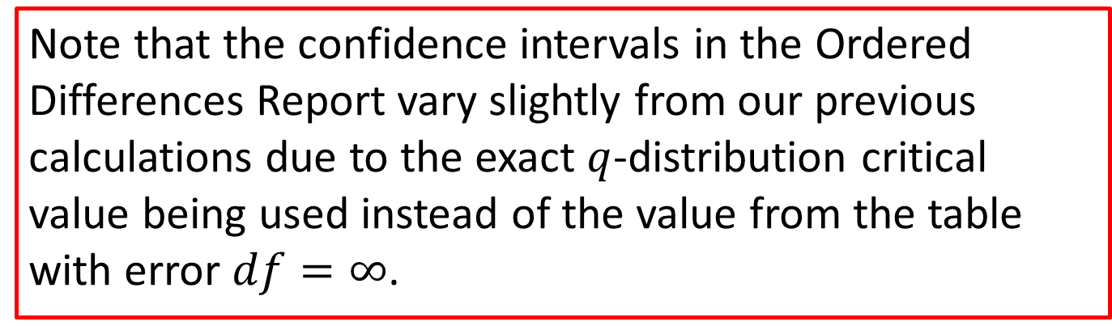
Note
Note that the confidence intervals in the Ordered Differences Report vary slightly from our previous calculations due to the exact $q$-distribution critical value being used instead of the value from the table with error $df=∞$.

Slide 50
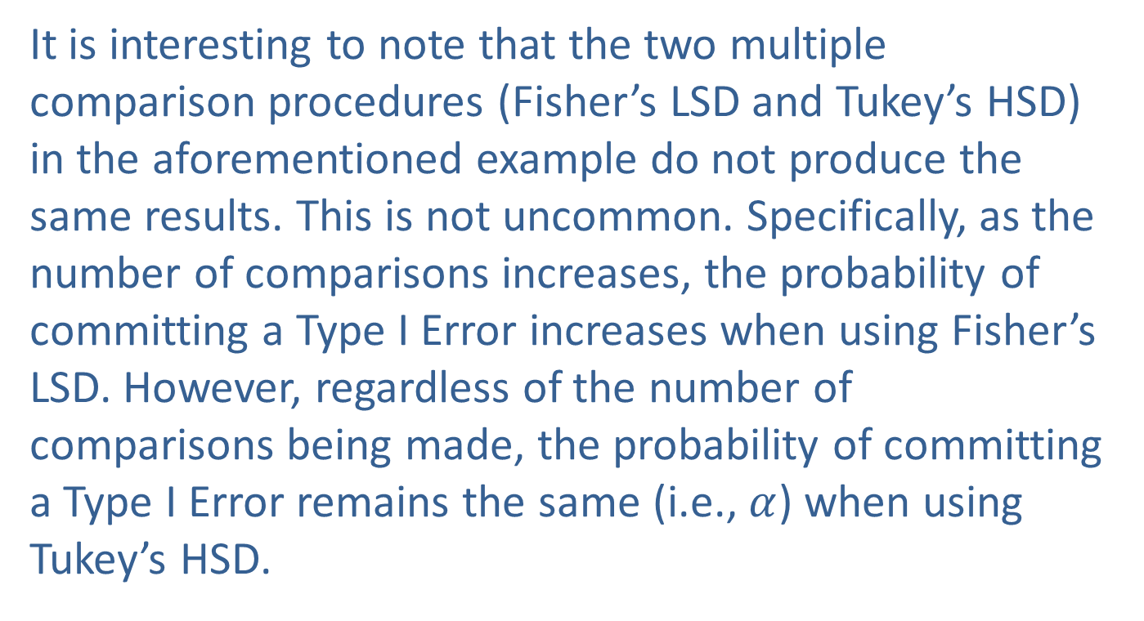
Tukey’s Honest Significant Difference (HSD) Method (cont.)
It is interesting to note that the two multiple comparison procedures (Fisher’s LSD and Tukey’s HSD) in the aforementioned example do not produce the same results. This is not uncommon. Specifically, as the number of comparisons increases, the probability of committing a Type I Error increases when using Fisher’s LSD. However, regardless of the number of comparisons being made, the probability of committing a Type I Error remains the same (i.e., $α$) when using Tukey’s HSD.

