Slide 1
Section 15.1
One-Way ANOVA

Slide 2
One-Way ANOVA
Before we discuss a particular experimental design, lets discuss a method of comparing more than two means. In comparing population means a natural question arises: Is there a significant difference between the means? A preliminary answer to this question can be obtained by drawing a random sample from each of the populations of interest and computing the sample mean. The larger the differences between the sample means, the more likely it would seem that there is a difference among the population means.

Slide 3
One-Way ANOVA (cont.)
How large is large enough to conclude a difference? Since samples have been drawn from each of the populations, we must decide whether or not the observed differences between the sample means are simply due to random variation among the sample observations or to a real difference in the means.

Slide 4
Definition: Experimental Units
Individuals or objects on which the experiment is performed are called experimental units.

Slide 5
Definition: Treatment
An experimental condition applied to the units is called a treatment.

Slide 6
One-Way ANOVA (cont.)
An agricultural researcher is interested in knowing whether or not the average yield of his tomato plants is different for three different types of fertilizer: Fertilizer A, which is rich in phosphate, Fertilizer B, which is rich in nitrogen, and Fertilizer C, which is a mixture of A and B. He controls the soil factor, precipitation factor, and sunlight availability by planting the same species of tomato plant in a field that has a consistent soil type.

Slide 7
One-Way ANOVA (cont.)
He randomly selects several tomato plants which have been grown with each of the fertilizers and computes the summary measures for yield which result in the box plots in Figure 15.1.1. He finds that the sample average yield for plants treated with Fertilizer A is 17 pounds per plant, the sample average yield for plants treated with Fertilizer B is 20 pounds, and the sample average yield for Fertilizer C is 18 pounds. Is the difference in sample averages large enough to conclude that the average yield for the tomato plants is different between the three fertilizers?

Slide 8
Note
The tomato plants are called experimental units and the fertilizer is the treatment.

Slide 9
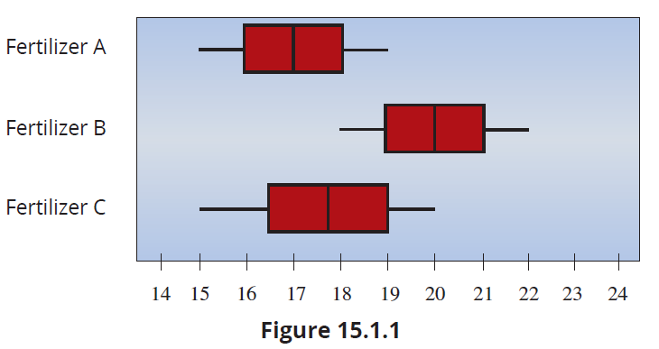
One-Way ANOVA (cont.)

Slide 10
One-Way ANOVA (cont.)
The box plots in Figure 15.1.1 can give some insight into this question. The box plot for Fertilizer A is centered around 17 pounds, has a range of 4 pounds, and a majority of the yields are between 16 and 18 pounds. The box plot for Fertilizer B is centered around 20 pounds, has a range of 4 pounds, and the majority of the observed yields are between 19 and 21 pounds. The box plot for Fertilizer C is centered around 18 pounds, has a range of 5 pounds, and the majority of the observed yields are between 16.5 and 19 pounds.

Slide 11
One-Way ANOVA (cont.)
Although there are a few observed yields that are the same for all the fertilizers, the majority of the observed yields are higher for Fertilizer B than for Fertilizers A and C. Thus, it seems unlikely that the difference we have observed in the sample average yields is due to sample variation. Another way of expressing this concept is that the difference between the sample average yields is large when compared with the variability within the observed yields for each sample. It seems that there is a difference in average yields between the fertilizers.

Slide 12
One-Way ANOVA (cont.)
In fact, it appears that Fertilizer B has higher yields than Fertilizer A or C.
Although box plots can provide a sense of whether or not there is a difference among the means, they cannot help us evaluate how likely it is that the observed difference is due to ordinary sampling variation. The following sections will develop measures which will help assess how likely it is that the observed differences among the sample means are due to sampling variation.

Slide 13
One-Way ANOVA (cont.)
In the realm of statistical analysis, the concept of breaking apart total variation into different components is not new. We previously employed a similar method when studying regression analysis, where we divided the total variation in the dependent variable into two parts: SSR and SSE. Similarly, when exploring differences in means, we will use a similar approach.

Slide 14
One-Way ANOVA (cont.)
We will begin by examining the total variation in the data and breaking it down into two components—the sum of squares for treatments, SST, which accounts for the variation that can be attributed to the treatments, and the sum of squares for error, SSE, which represents the unexplained variation.
When conducting a one-way ANOVA analysis, the agricultural researcher is trying to determine if there is a statistically significant difference between the mean yield of each fertilizer treatment.

Slide 15
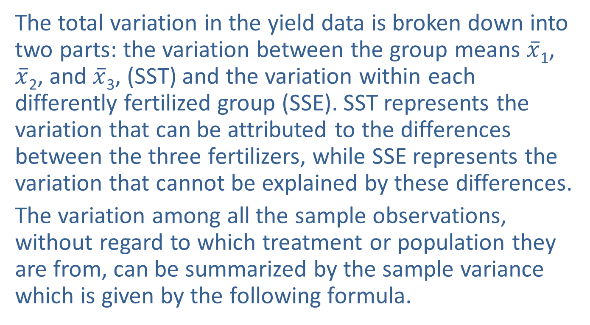
One-Way ANOVA (cont.)
The total variation in the yield data is broken down into two parts: the variation between the group means $\overline{x}$₁, $\overline{x}$₂, and $\overline{x}$₃, (SST) and the variation within each differently fertilized group (SSE). SST represents the variation that can be attributed to the differences between the three fertilizers, while SSE represents the variation that cannot be explained by these differences.
The variation among all the sample observations, without regard to which treatment or population they are from, can be summarized by the sample variance which is given by the following formula.

Slide 16
Formula: Sample Variance
where
is the sample mean of all of the observations, and is called the grand mean,
n_{j} is the number of observations in the j^{th} treatment, x_{ij} is the i^{th} data value from the j^{th} sample,
k is the number of treatments, and
N is the total number of observations in all samples.

Slide 17

One-Way ANOVA (cont.)
The numerator of $s$² is called the total sum of squares since it describes the total variation among all of the sample observations. The denominator of $s$² gives the degrees of freedom associated with the total sum of squares, $N−1$.

Slide 18
Formula: Total Sum of Squares
Total Sum of Squares

Slide 19
One-Way ANOVA (cont.)
The total variation in the sample measurements can be partially attributed to the treatments from which they came and partially attributed to random variation inherent in sampling. Thus, the total sum of squares can be divided into two components. The first component measures the variation which can be attributed to the treatments and is called the sum of squares for treatments or SST.

Slide 20
Formula: Sum of Squares for Treatments
The mathematical expression for the sum of squares for treatments is given by
where
n_{j} is the number of observations in the j^{th} treatment,
is the sample mean of the observations in the j^{th} treatment, and
is the grand mean.

Slide 21
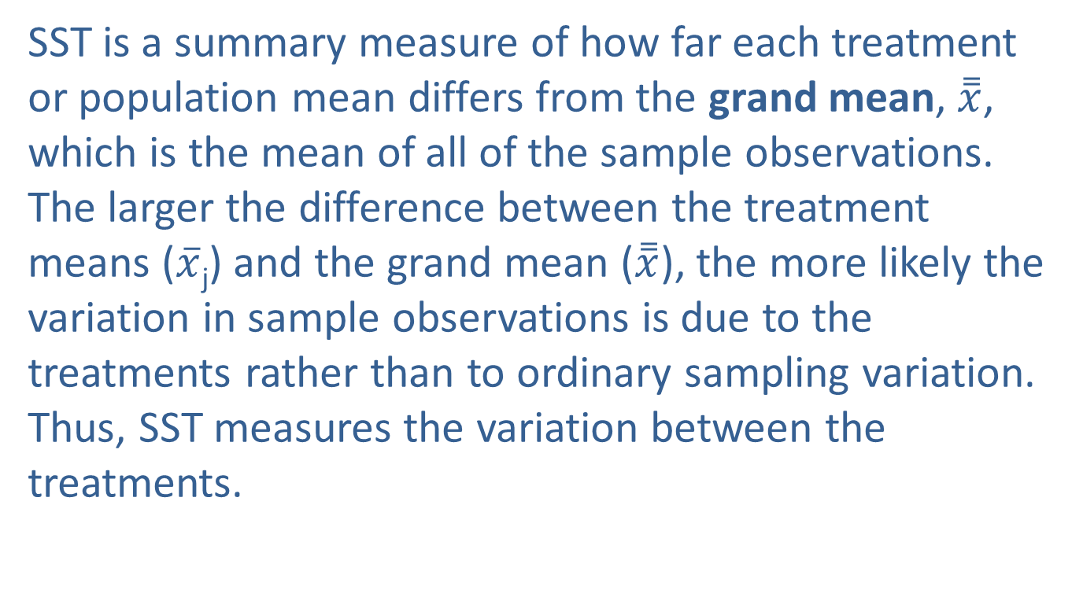
One-Way ANOVA (cont.)
SST is a summary measure of how far each treatment or population mean differs from the grand mean, $\overset{̿}{x}$, which is the mean of all of the sample observations. The larger the difference between the treatment means ($\overline{x}$_{j}) and the grand mean ($\overset{̿}{x}$), the more likely the variation in sample observations is due to the treatments rather than to ordinary sampling variation. Thus, SST measures the variation between the treatments.

Slide 22
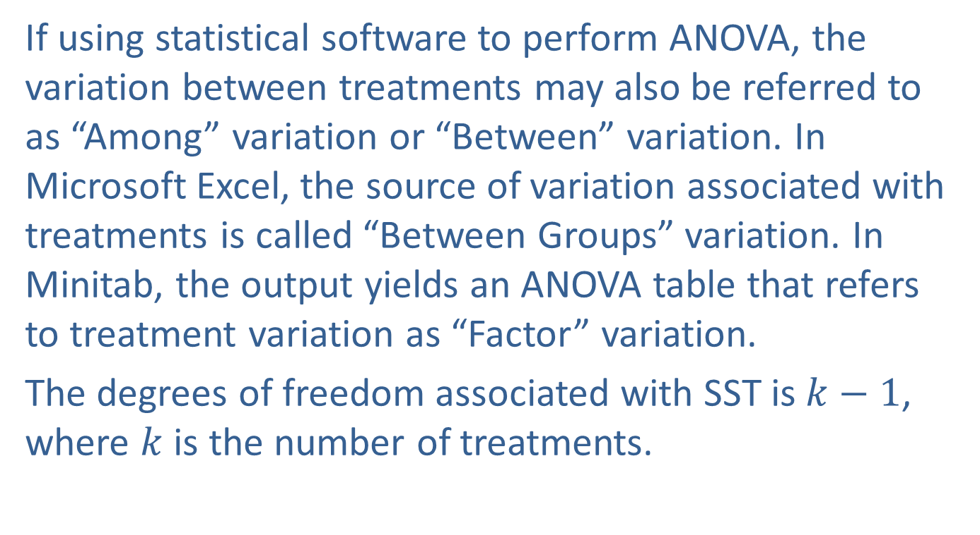
One-Way ANOVA (cont.)
If using statistical software to perform ANOVA, the variation between treatments may also be referred to as “Among” variation or “Between” variation. In Microsoft Excel, the source of variation associated with treatments is called “Between Groups” variation. In Minitab, the output yields an ANOVA table that refers to treatment variation as “Factor” variation.
The degrees of freedom associated with SST is $k−1$, where $k$ is the number of treatments.

Slide 23
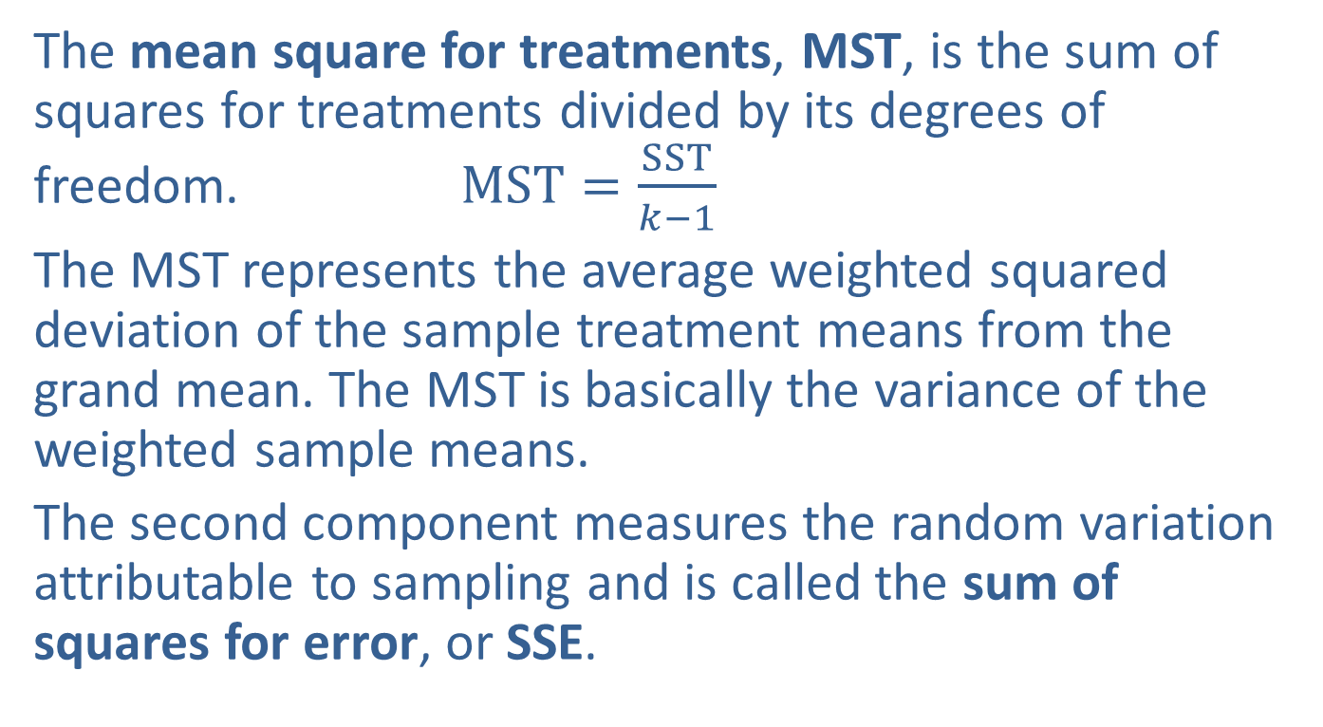
One-Way ANOVA (cont.)
The mean square for treatments, MST, is the sum of squares for treatments divided by its degrees of freedom. $MST=\frac{SST}{k−1}$
The MST represents the average weighted squared deviation of the sample treatment means from the grand mean. The MST is basically the variance of the weighted sample means.
The second component measures the random variation attributable to sampling and is called the sum of squares for error, or SSE.

Slide 24
Formula: Sum of Squares for Error
The mathematical expression for the sum of squares for error is given by the following formula.

Slide 25
One-Way ANOVA (cont.)
The SSE is a summary measure of how much of the total variation in the sample data is not explained by SST. The previous expression is a direct calculation of SSE which shows that the SSE summarizes how much the sample observations within each treatment vary from the treatment mean. In other words, SSE is a measure of the variation within the treatments. In practice, it is much easier to calculate SSE as the total variation in the sample minus the variation explained by the treatments, SST.

Slide 26
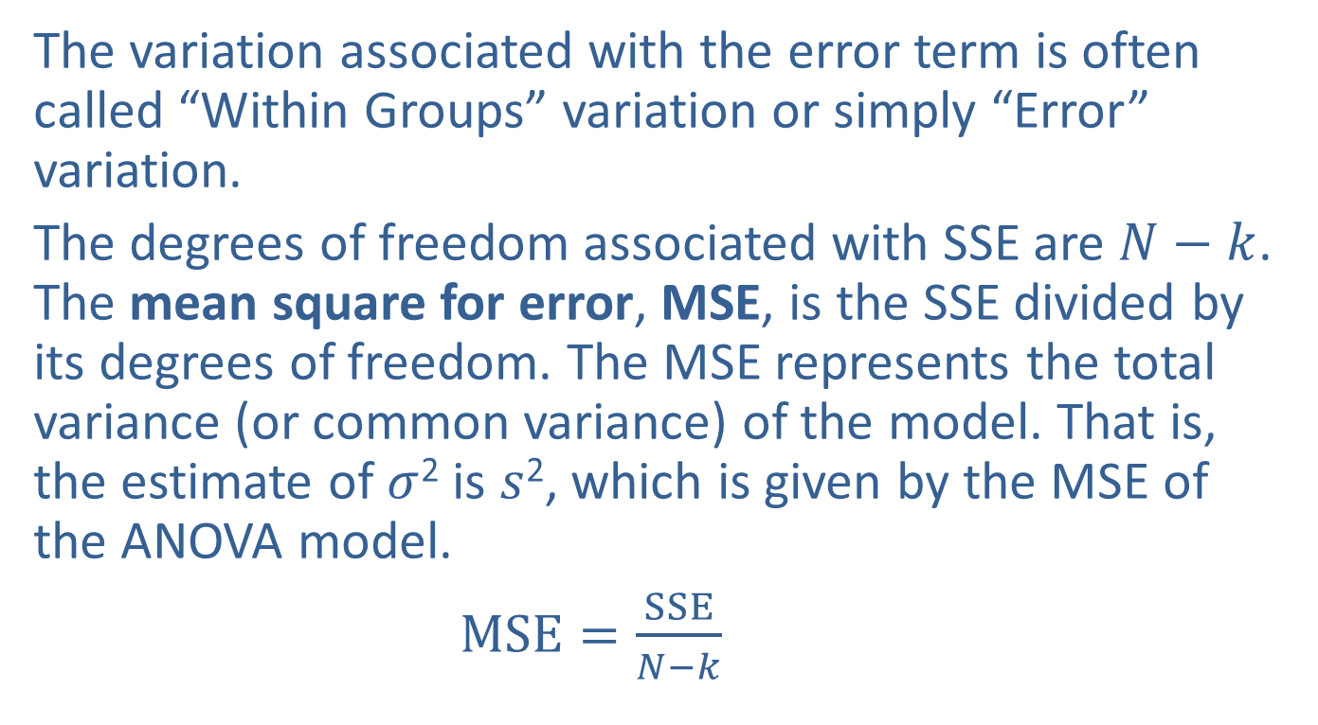
One-Way ANOVA (cont.)
The variation associated with the error term is often called “Within Groups” variation or simply “Error” variation.
The degrees of freedom associated with SSE are $N−k$. The mean square for error, MSE, is the SSE divided by its degrees of freedom. The MSE represents the total variance (or common variance) of the model. That is, the estimate of $σ$² is $s$², which is given by the MSE of the ANOVA model.
$MSE=\frac{SSE}{N−k}$

Slide 27
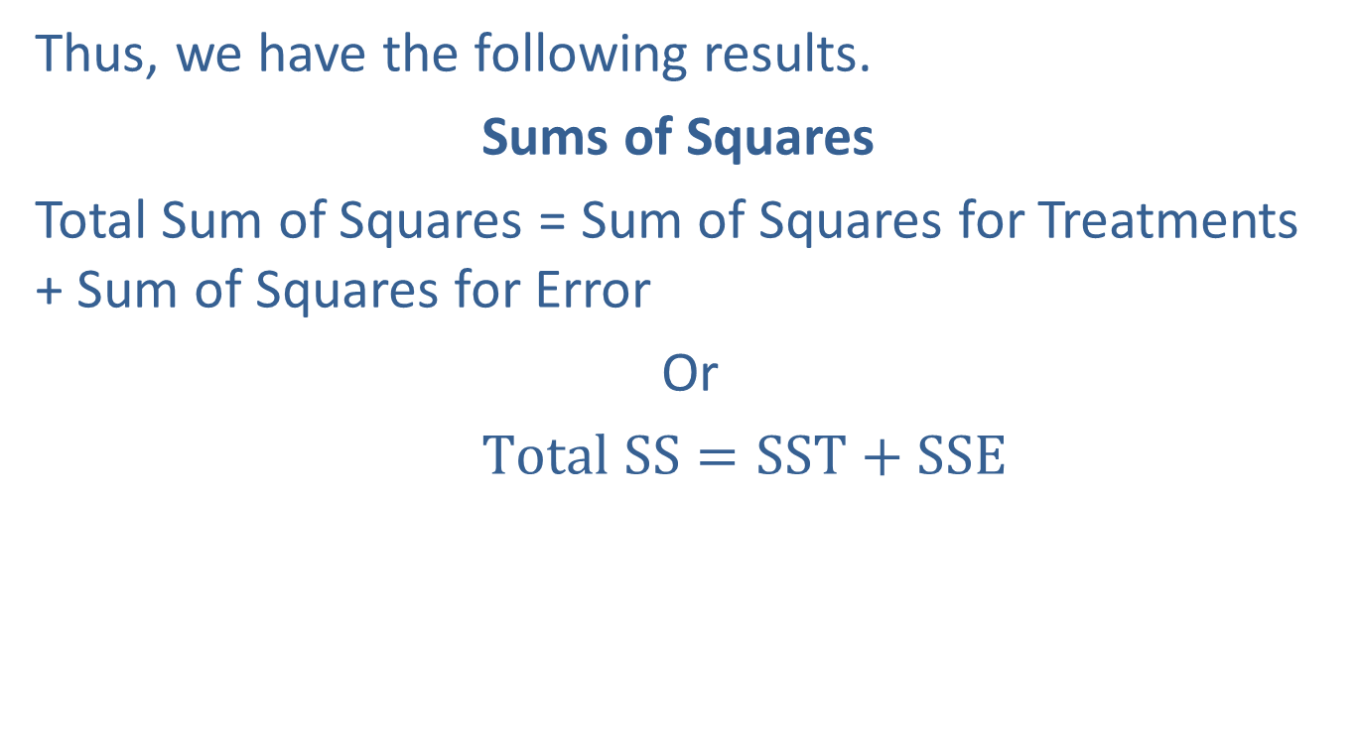
One-Way ANOVA (cont.)
Thus, we have the following results.
Sums of Squares
Total Sum of Squares = Sum of Squares for Treatments + Sum of Squares for Error
Or
$Total SS=SST+SSE$

Slide 28
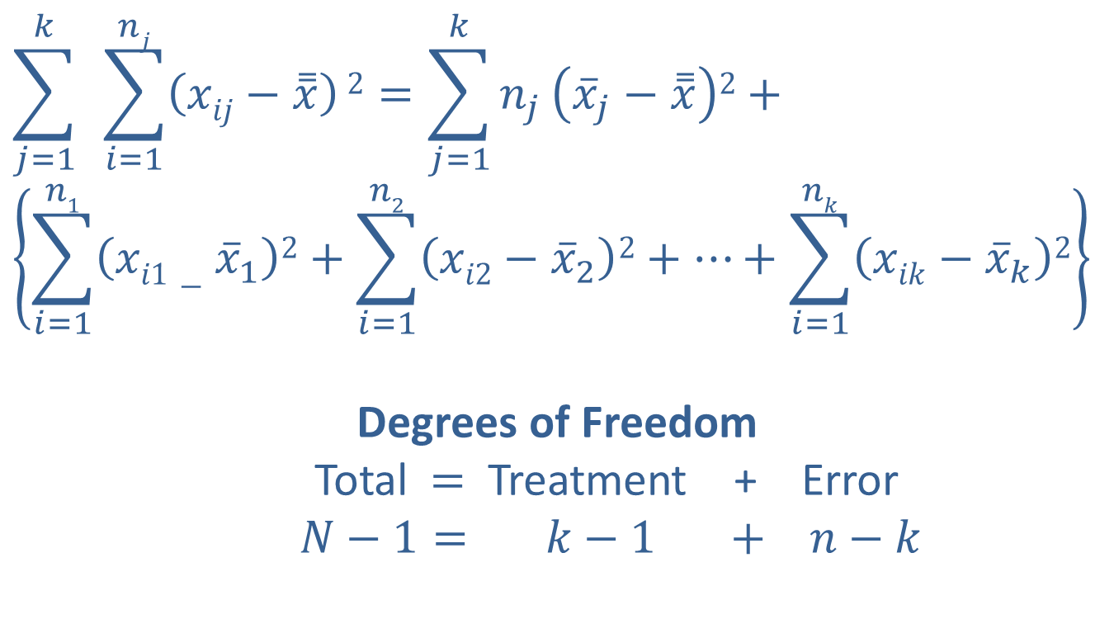
One-Way ANOVA (cont.)
$$\sum_{j=1}^{k}{ }\sum_{i=1}^{nj}{\left(xij−\overset{̿}{x}\right)}2=\sum_{j=1}^{k}{n_{j}}\left({\overline{x}}_{j}−\overset{̿}{x}\right)2+$$
$$\left\{\sum_{i=1}^{n1}{\left(xi1−{\overline{x}}_{1}\right)2+\sum_{i=1}^{n2}{\left(xi2−{\overline{x}}_{2}\right)2+…+\sum_{i=1}^{nk}{\left(xik−{\overline{x}}_{k}\right)2}}}\right\}$$
Degrees of Freedom
Total $=$ Treatment + Error
$N−1= k−1 + n−k$

Slide 29
One-Way ANOVA (cont.)
As you might expect, these measures of variability are the fundamental pieces which will be used to develop a hypothesis test for determining whether or not there is a significant difference among the population means. This is precisely the reason that the test which we will use to make this decision is often called an Analysis of Variance, or ANOVA. The expressions are complicated. Fortunately, most statistical analysis programs will compute these quantities.

Slide 30
One-Way ANOVA (cont.)
When the agricultural researcher evaluated the sample data to determine if there was a difference in average yield between the three fertilizers, there were two overriding factors which contributed to the analysis. The first factor which he considered was whether or not there was a difference between the sample average yields for the fertilizers, which is summarized by SST. The second factor he considered was whether or not that difference was larger than the differences among the observed yields for the samples from each of the fertilizers, which is summarized by SSE.

Slide 31
One-Way ANOVA (cont.)
These sources of variation can be generalized to the situation of comparing many population means, and they will be the basis for answering the question of whether or not we can conclude that there is a difference among the population means.

Slide 32
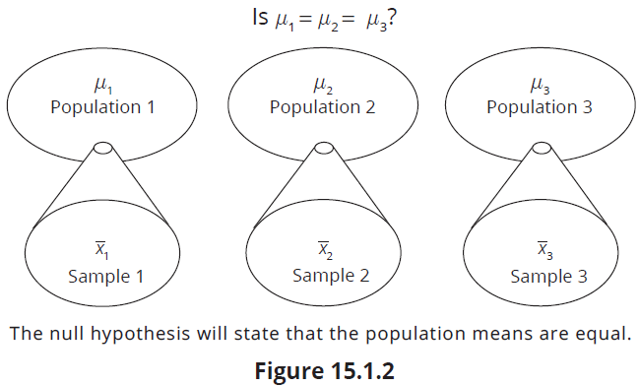
One-Way ANOVA (cont.)

Slide 33
Formula: ANOVA Formulas
Grand Mean:
Sum of Squares for Treatments:
Mean Square for Treatments:

Slide 34
Formula: ANOVA Formulas (cont.)
Sum of Squares for Error:
Mean Square for Error:
Total Sum of Squares:
Total Sum of Squares

Slide 35
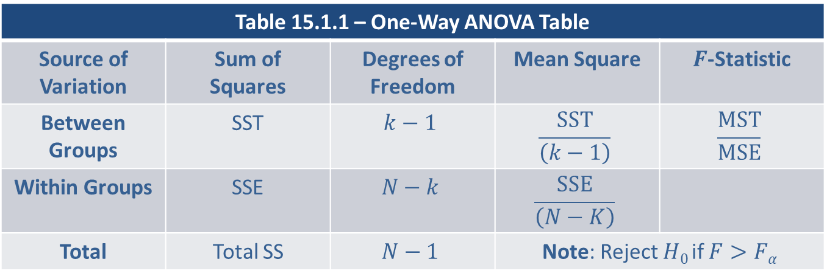

One-Way ANOVA (cont.)
Having calculated the sum of squares for each element for analysis of variance, the data can be summarized in the following table. This is the table often used when performing the one-way ANOVA $F$-test.
Table 15.1.1 – One-Way ANOVA Table
Source of Variation | Sum of Squares | Degrees of Freedom | Mean Square | $F$-Statistic
Between Groups | SST | $$k−1$$ | $$\frac{SST}{\left(k−1\right)}$$ | $$\frac{MST}{MSE}$$
Within Groups | SSE | $$N−k$$ | $$\frac{SSE}{\left(N−K\right)}$$
Total | Total SS | $$N−1$$ | Note: Reject $H0$ if $F>Fα$

Slide 36
Note
The lesson “Name that Distribution” provides practice in recognizing distributions of histograms of sample data drawn from various distributions including the normal distribution.

Slide 37
Assumptions of the Test
Before proceeding with a description of the hypothesis testing procedure for determining whether or not there is a significant difference among several population means, it is important to point out the assumptions upon which the test is based. If the data does not appear to conform to these assumptions, the hypothesis testing procedures described in the subsequent sections will not be valid inferential techniques.

Slide 38
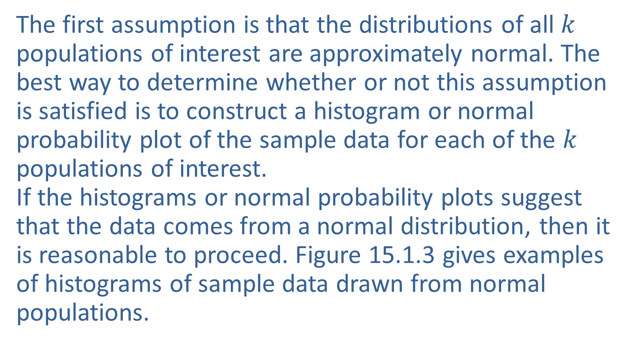
Assumptions of the Test (cont.)
The first assumption is that the distributions of all $k$ populations of interest are approximately normal. The best way to determine whether or not this assumption is satisfied is to construct a histogram or normal probability plot of the sample data for each of the $k$ populations of interest.
If the histograms or normal probability plots suggest that the data comes from a normal distribution, then it is reasonable to proceed. Figure 15.1.3 gives examples of histograms of sample data drawn from normal populations.

Slide 39
Assumptions of the Test (cont.)
If one or more of the populations have a distribution that is definitely not normal, then the Kruskal-Wallis test described in Section 17.6 should be used (a nonparametric test). The ANOVA test has been shown
to be very robust even with significant departures from normality.

Slide 40
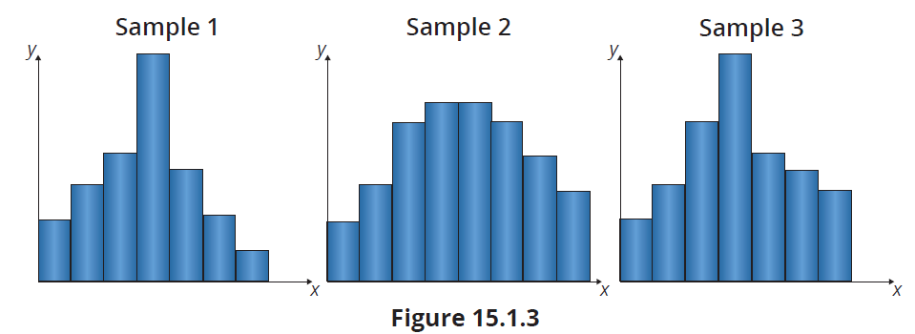
Assumptions of the Test (cont.)

Slide 41
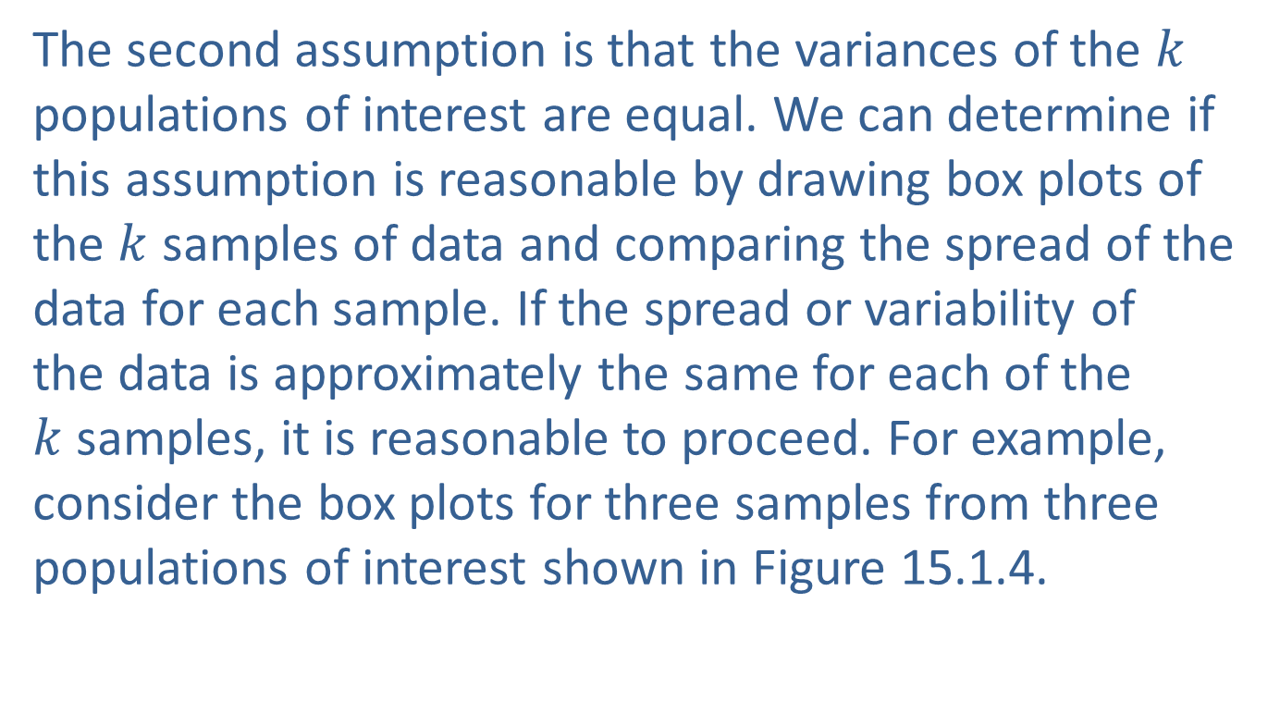
Assumptions of the Test (cont.)
The second assumption is that the variances of the $k$ populations of interest are equal. We can determine if this assumption is reasonable by drawing box plots of the $k$ samples of data and comparing the spread of the data for each sample. If the spread or variability of
the data is approximately the same for each of the $k$samples, it is reasonable to proceed. For example, consider the box plots for three samples from three populations of interest shown in Figure 15.1.4.

Slide 42
Assumptions of the Test (cont.)
Although the spread of the box plots is not exactly the same for each of the samples, they are similar enough that it is likely that the observed difference in spread is due to sample variation, and it is safe to proceed. There is a hypothesis test which can be used to determine if there is a significant difference among the variances,
but that testing procedure is beyond the scope of this textbook.

Slide 43
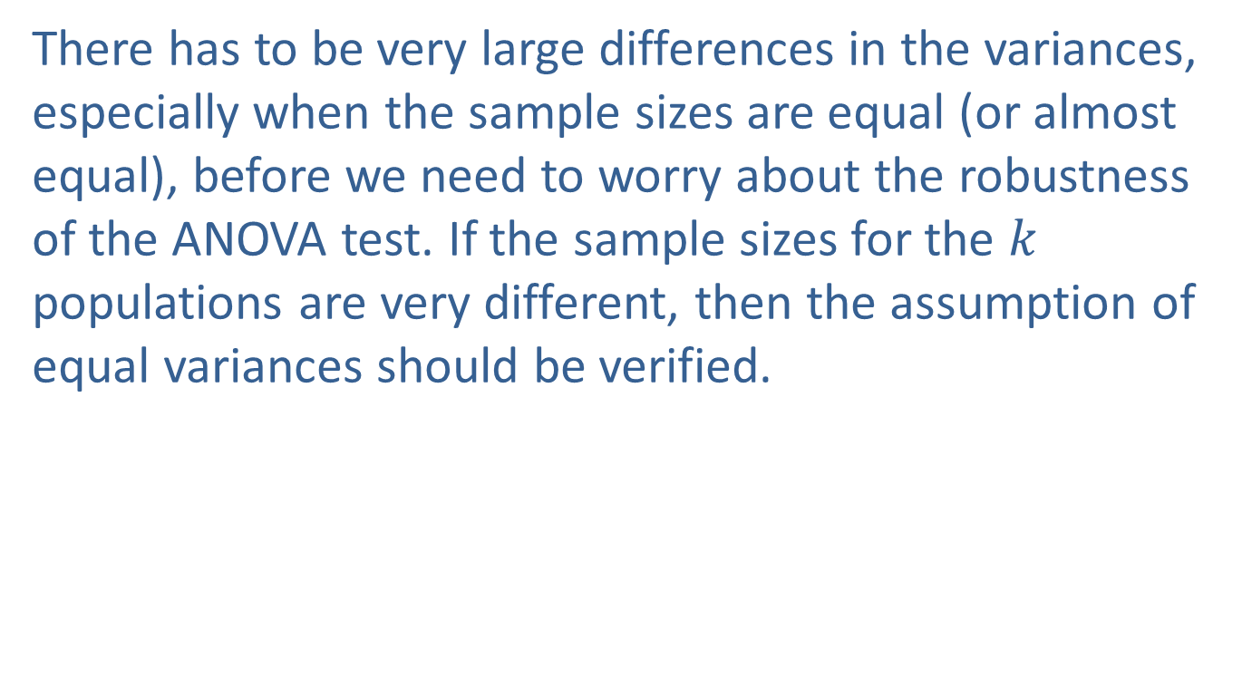
Assumptions of the Test (cont.)
There has to be very large differences in the variances, especially when the sample sizes are equal (or almost equal), before we need to worry about the robustness of the ANOVA test. If the sample sizes for the $k$ populations are very different, then the assumption of
equal variances should be verified.

Slide 44
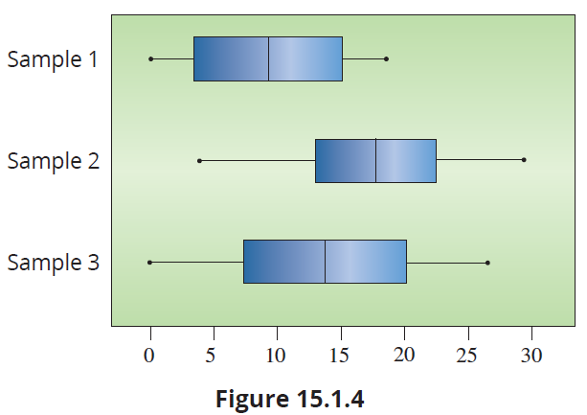
Assumptions of the Test (cont.)

Slide 45
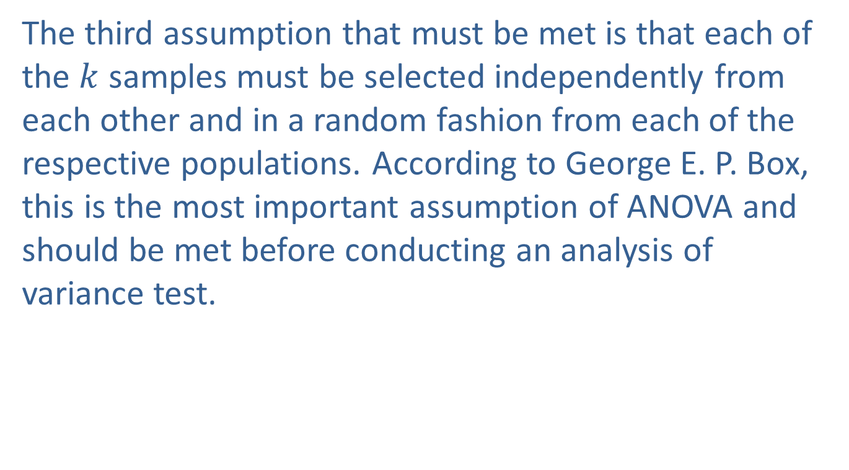
Assumptions of the Test (cont.)
The third assumption that must be met is that each of the $k$ samples must be selected independently from each other and in a random fashion from each of the respective populations. According to George E. P. Box, this is the most important assumption of ANOVA and should be met before conducting an analysis of variance test.

Slide 46
Note
There is a simple “rule of thumb’ that you can use to check the variance assumption. If the largest standard deviation is no more than twice the smallest, then the presumption is that the assumption holds.

Slide 47
Assumptions: ANOVA Assumptions
In order for an analysis of variance to be valid, the following three assumptions must hold.
The sample observations are randomly selected and the samples are independent of one another.
The distributions of all k populations of interest are approximately normal.
The variances of the k populations are equal.

Slide 48
The F-Test
To this point we have set forth most of the analytical tools required to determine the appropriate measure for deciding whether or not there is a difference among population means. We developed MST, a measure for summarizing the variability among the sample means, and MSE, a measure for summarizing the variability within the samples themselves. If the variability among the sample means is much larger than the variability within the sample observations, this will cause us to doubt the hypothesis that the population means are the same.

Slide 49
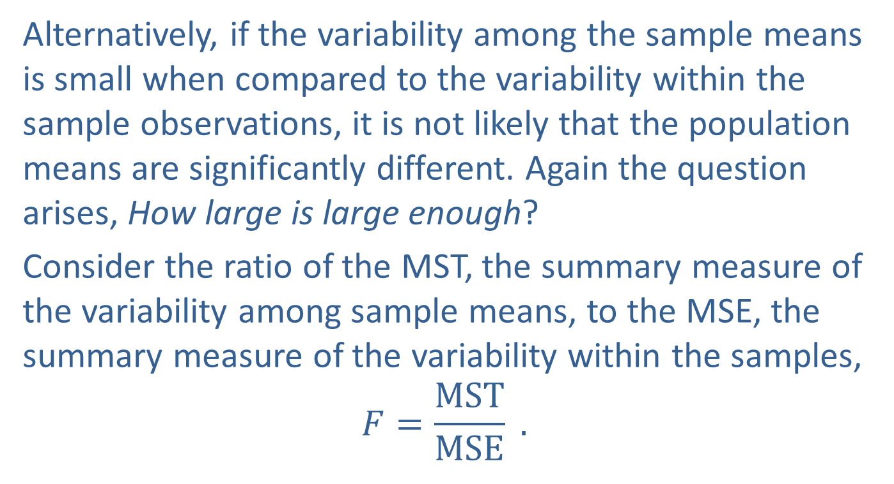
The F-Test (cont.)
Alternatively, if the variability among the sample means is small when compared to the variability within the sample observations, it is not likely that the population means are significantly different. Again the question arises, How large is large enough?
Consider the ratio of the MST, the summary measure of the variability among sample means, to the MSE, the summary measure of the variability within the samples,
$$F=\frac{MST}{MSE} .$$

Slide 50
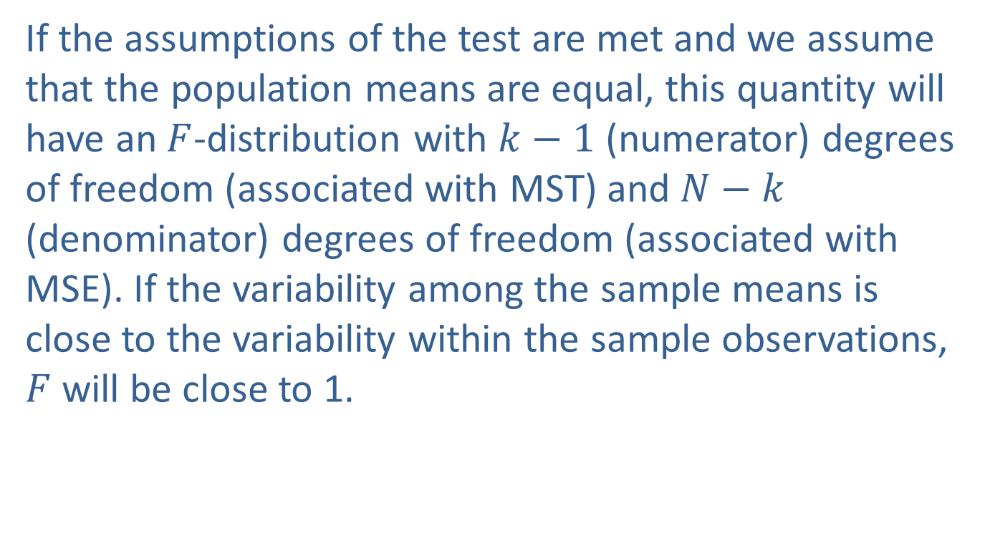
The F-Test (cont.)
If the assumptions of the test are met and we assume that the population means are equal, this quantity will have an $F$-distribution with $k−1$ (numerator) degrees of freedom (associated with MST) and $N−k$ (denominator) degrees of freedom (associated with MSE). If the variability among the sample means is close to the variability within the sample observations, $F$ will be close to 1.

Slide 51
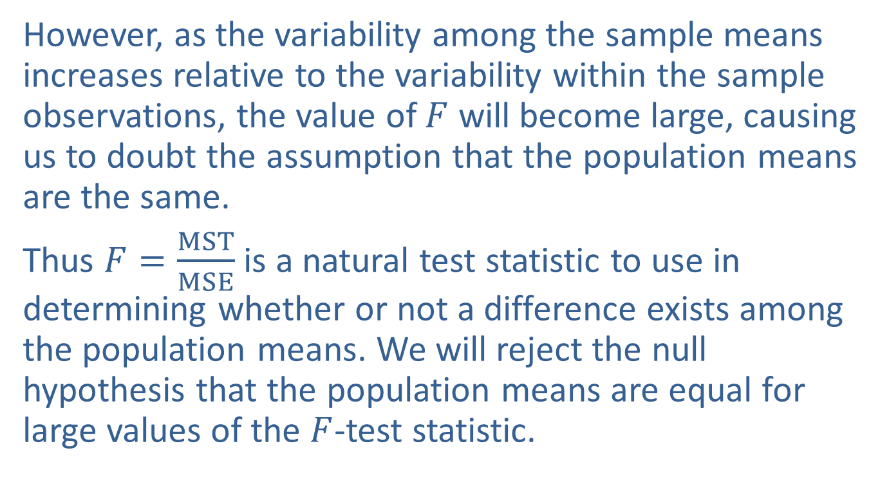
The F-Test (cont.)
However, as the variability among the sample means increases relative to the variability within the sample observations, the value of $F$ will become large, causing us to doubt the assumption that the population means are the same.
Thus $F=\frac{MST}{MSE}$ is a natural test statistic to use in determining whether or not a difference exists among the population means. We will reject the null hypothesis that the population means are equal for large values of the $F$-test statistic.

Slide 52

The F-Test (cont.)
This is why the test for differences among population means is often referred to as the $F$-test. A summary of the $F$-test is given below.

Slide 53
Procedure: ANOVA F-Test
Assumptions:
The observations from each sample are randomly selected and the samples are independent of one another.
The distributions of the k populations of interest are approximately normally distributed.
The variances of the k populations are equal.

Slide 54
Procedure: ANOVA F-Test (cont.)
Hypotheses:
H₀: μ₁ = μ₂ = … = μ_{k}. The k population means are equal. H_{a}: At least one μ_{i} is different.
Test Statistic:

Slide 55
Procedure: ANOVA F-Test (cont.)
Rejection Region:
H₀ will be rejected for large values of In
particular, we will reject H₀ if F > F_{α} with (k − 1)
numerator degrees of freedom and (N − k) denominator degrees of freedom.

Slide 56
Procedure: ANOVA F-Test (cont.)
P-value:
The P-value should be available from the output of an ANOVA test performed using technology. The ANOVA test will always be a right-tailed test since large values of the test statistic cause us to reject equality of the population means.
If the computed P-value is less than α, reject the null hypothesis in favor of the alternative.
If the computed P-value is greater than or equal to α, fail to reject the null hypothesis.

Slide 57
Note
Like developing and analyzing multiple regression models, learning to use statistical software packages to perform ANOVA is critical for real-world problem solving. All statistical analysis software, including Excel, perform ANOVA.

Slide 58
Example 15.1.1: Using a One-Way ANOVA to Compare Selling Prices
You have just been promoted to sales manager of a company manufacturing robots used to assemble automobiles. Although your sales force is given a suggested price at which to sell the robots, they have considerable leeway in negotiating the final price. Past sales records indicate that sometimes there is a large difference in the sales price of identical robots which different sales representatives are able to negotiate.

Slide 59
Example 15.1.1: Using a One-Way ANOVA to Compare Selling Prices (cont.)
You are interested in knowing if this difference is significant, possibly because of a more effective negotiating strategy or exceptional interpersonal skills, or whether this observed difference in sales price is just due to random variation. You decide to randomly select four sales over the last year for each of your three sales representatives and observe the actual selling price of the robot. The table below shows the amounts at which the robots sold in thousands of dollars.

Slide 60
Example 15.1.1: Using a One-Way ANOVA to Compare Selling Prices (cont.)
Selling Prices (Thousands of Dollars)
 | Salesperson 1 | Salesperson 2 | Salesperson 3
 | 110 | 111 | 61
 | 114 | 96 | 83
 | 130 | 114 | 120
 | 72 | 150 | 115
Total | 426 | 471 | 379
Average | 106.50 | 117.75 | 94.75
Standard Deviation | 24.570 | 22.897 | 27.837

Slide 61
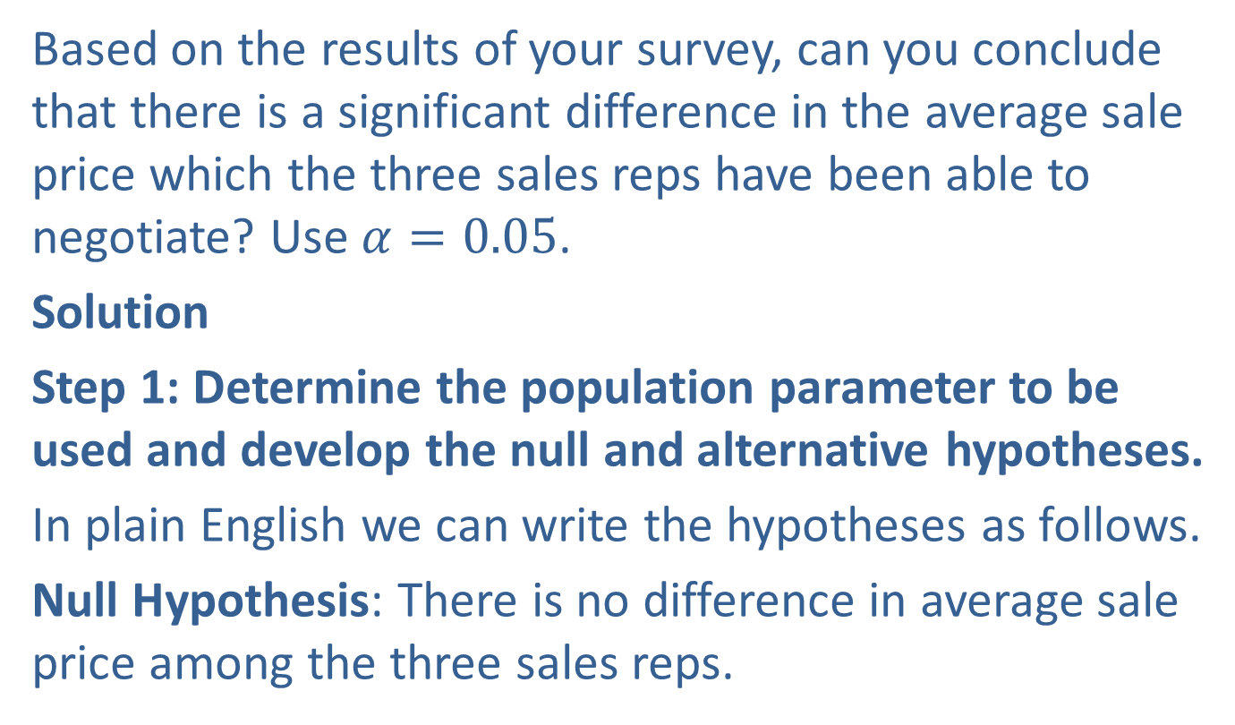
Example 15.1.1: Using a One-Way ANOVA to Compare Selling Prices (cont.)
Based on the results of your survey, can you conclude that there is a significant difference in the average sale price which the three sales reps have been able to negotiate? Use $α=0.05$.
Solution
Step 1: Determine the population parameter to be used and develop the null and alternative hypotheses.
In plain English we can write the hypotheses as follows.
Null Hypothesis: There is no difference in average sale price among the three sales reps.

Slide 62
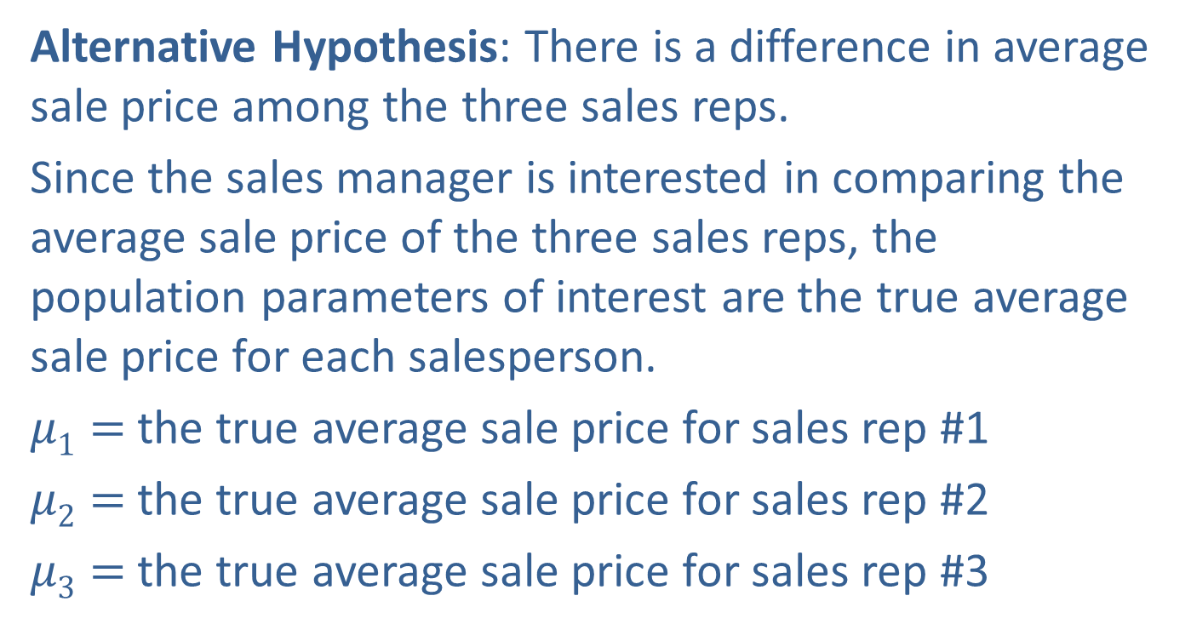
Example 15.1.1: Using a One-Way ANOVA to Compare Selling Prices (cont.)
Alternative Hypothesis: There is a difference in average sale price among the three sales reps.
Since the sales manager is interested in comparing the average sale price of the three sales reps, the population parameters of interest are the true average sale price for each salesperson.
$μ1=$the true average sale price for sales rep #1
$μ2=$the true average sale price for sales rep #2
$μ3=$the true average sale price for sales rep #3

Slide 63
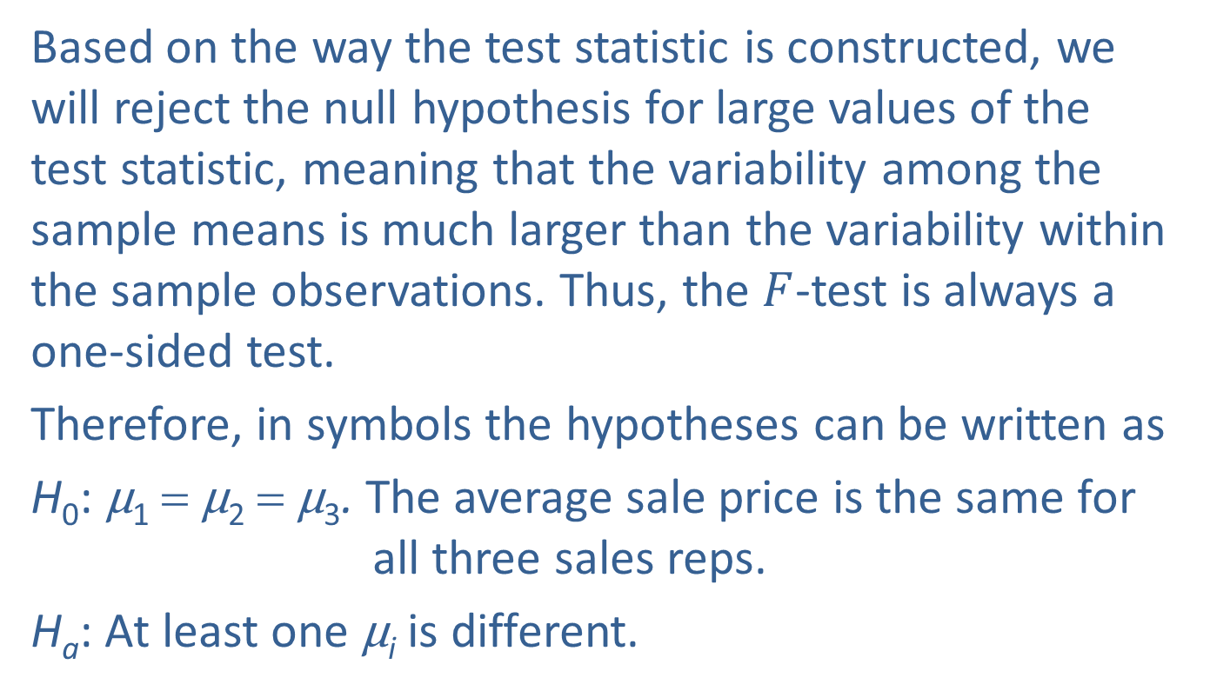
Example 15.1.1: Using a One-Way ANOVA to Compare Selling Prices (cont.)
Based on the way the test statistic is constructed, we will reject the null hypothesis for large values of the test statistic, meaning that the variability among the sample means is much larger than the variability within the sample observations. Thus, the $F$-test is always a one-sided test.
Therefore, in symbols the hypotheses can be written as
H₀: μ₁ = μ₂ = μ₃. The average sale price is the same for all three sales reps.
H_{a}: At least one μ_{i} is different.

Slide 64
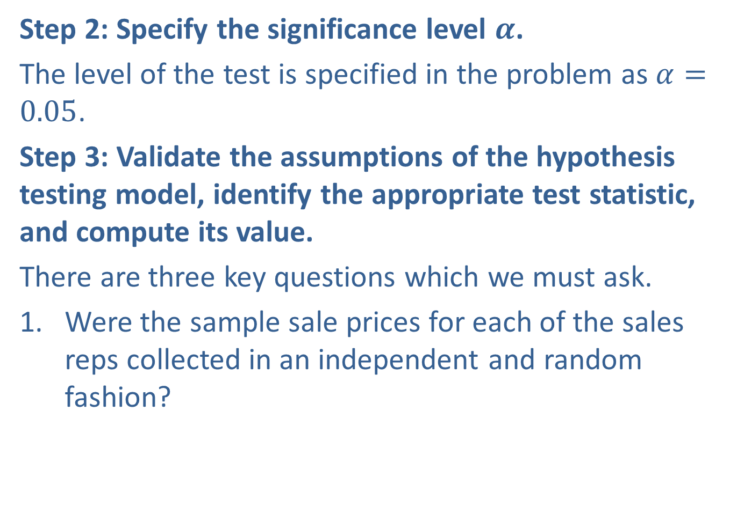
Example 15.1.1: Using a One-Way ANOVA to Compare Selling Prices (cont.)
Step 2: Specify the significance level $α$.
The level of the test is specified in the problem as $α=0.05$.
Step 3: Validate the assumptions of the hypothesis testing model, identify the appropriate test statistic, and compute its value.
There are three key questions which we must ask.
Were the sample sale prices for each of the sales reps collected in an independent and random fashion?

Slide 65
Example 15.1.1: Using a One-Way ANOVA to Compare Selling Prices (cont.)
Are the sale prices for each of the sales reps normally distributed?
Do the sale prices for each of the sales reps have essentially the same variance?
Based on prior studies and normal probability plots of each salesperson’s sales (only the plot for Salesperson 1 is shown), you have reason to believe that the sale prices of the robots for each of the sales reps has an approximately normal distribution.

Slide 66
Example 15.1.1: Using a One-Way ANOVA to Compare Selling Prices (cont.)
The standard deviation of the selling prices for each salesperson, shown at the bottom of the table, are reasonably similar. Therefore, we can assume that the variances of the three distributions are approximately equal. Also, you used random sampling to collect your data.
Independent random samples for each salesperson
The distribution of selling prices is approximately normally distributed for each salesperson.

Slide 67
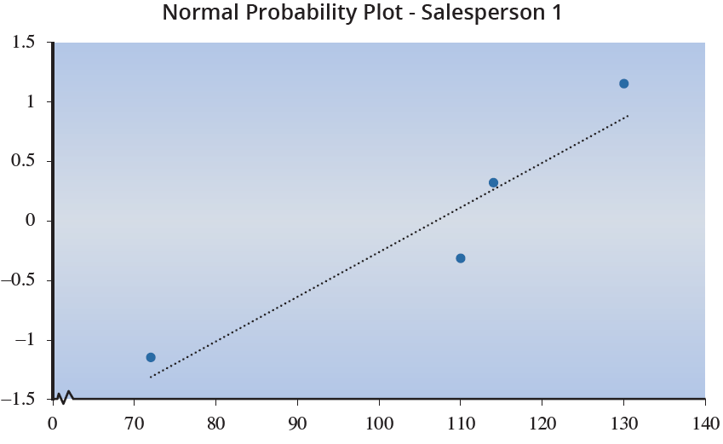
Example 15.1.1: Using a One-Way ANOVA to Compare Selling Prices (cont.)
The variances in selling price for each salesperson are approximately equal.

Slide 68
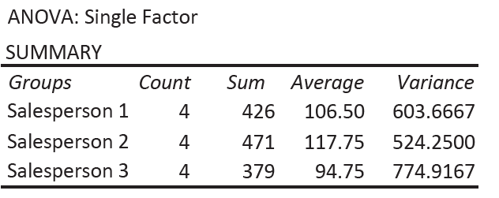
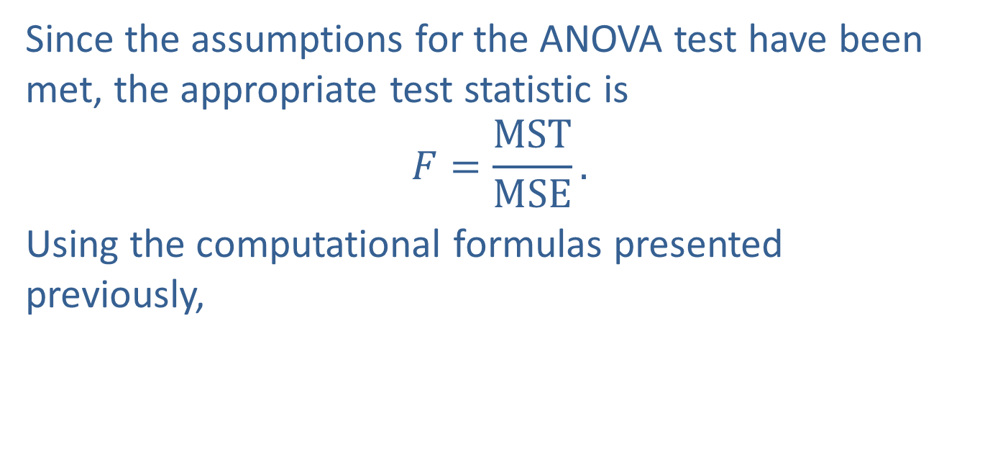
Example 15.1.1: Using a One-Way ANOVA to Compare Selling Prices (cont.)
Since the assumptions for the ANOVA test have been met, the appropriate test statistic is
$$F=\frac{MST}{MSE}.$$
Using the computational formulas presented previously,

Slide 69
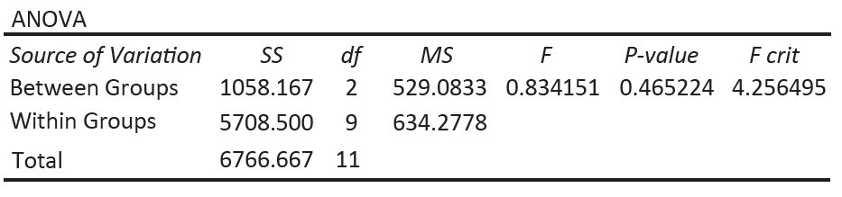

Example 15.1.1: Using a One-Way ANOVA to Compare Selling Prices (cont.)
The resulting value of the test statistic is
$F=\frac{MST}{MSE}≈\frac{529.083}{634.278}≈0.8342.$
MST is “Between Groups” in the output, and MSE is “Within Groups” in the output under the column MS.

Slide 70
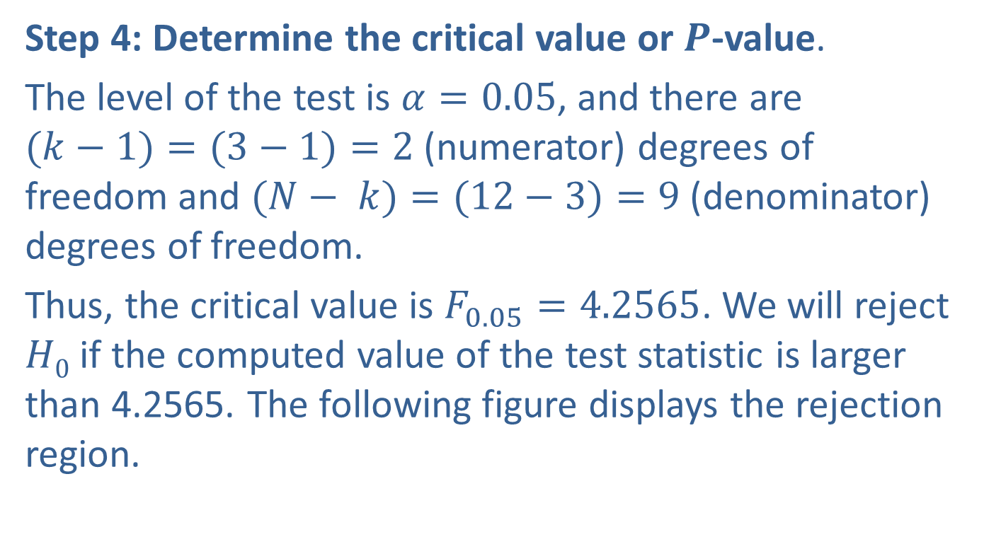
Example 15.1.1: Using a One-Way ANOVA to Compare Selling Prices (cont.)
Step 4: Determine the critical value or $P$-value.
The level of the test is $α=0.05$, and there are $(k−1)=(3−1)=2$(numerator) degrees of freedom and $(N− k)=(12−3)=9$(denominator) degrees of freedom.
Thus, the critical value is $F_{0.05}=4.2565$. We will reject $H0$ if the computed value of the test statistic is larger than 4.2565. The following figure displays the rejection region.

Slide 71
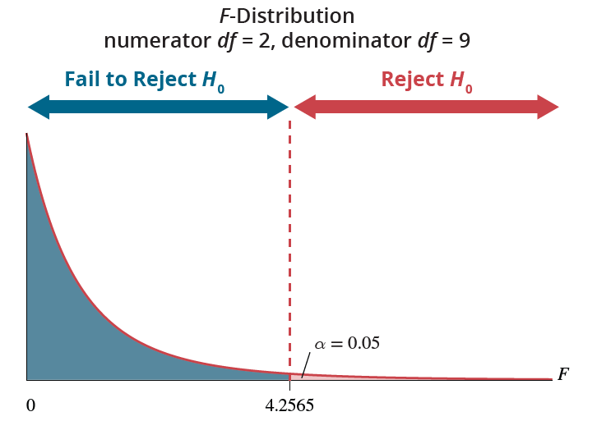

Example 15.1.1: Using a One-Way ANOVA to Compare Selling Prices (cont.)
The $P$-value can be obtained through technology,

Slide 72
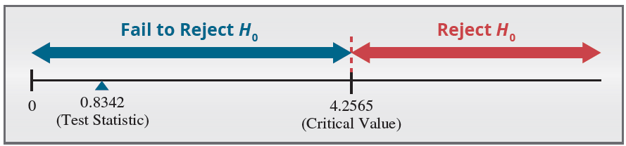
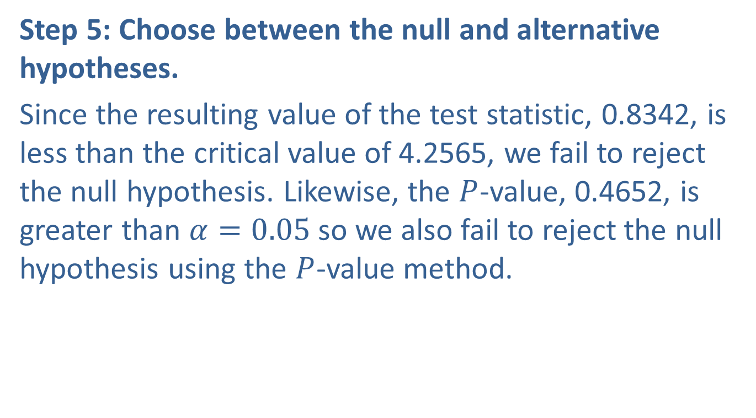
Example 15.1.1: Using a One-Way ANOVA to Compare Selling Prices (cont.)
Step 5: Choose between the null and alternative hypotheses.
Since the resulting value of the test statistic, 0.8342, is less than the critical value of 4.2565, we fail to reject the null hypothesis. Likewise, the $P$-value, 0.4652, is greater than $α=0.05$ so we also fail to reject the null hypothesis using the $P$-value method.

Slide 73
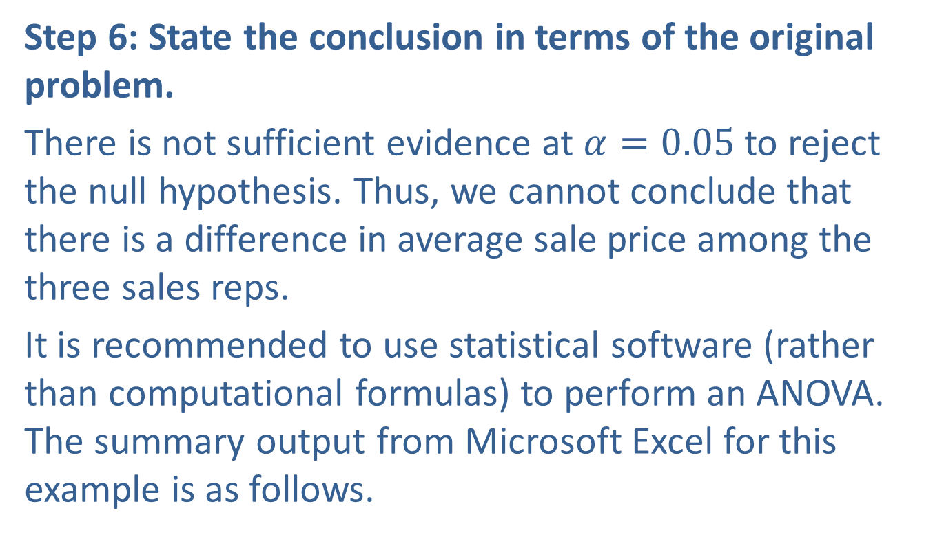
Example 15.1.1: Using a One-Way ANOVA to Compare Selling Prices (cont.)
Step 6: State the conclusion in terms of the original problem.
There is not sufficient evidence at $α=0.05$to reject the null hypothesis. Thus, we cannot conclude that there is a difference in average sale price among the three sales reps.
It is recommended to use statistical software (rather than computational formulas) to perform an ANOVA. The summary output from Microsoft Excel for this example is as follows.

Slide 74
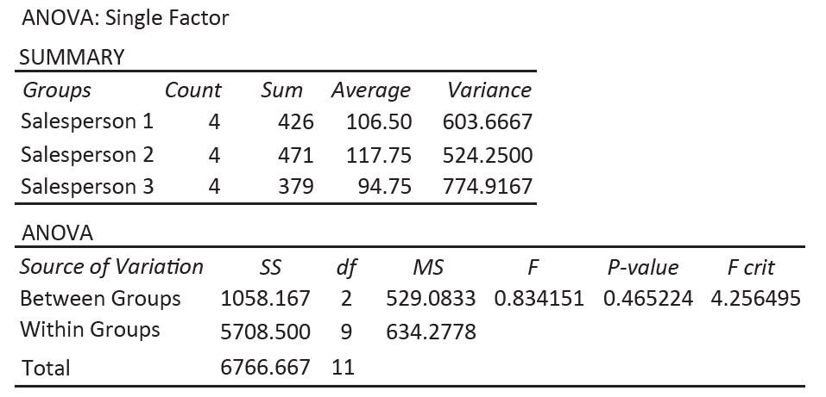
Example 15.1.1: Using a One-Way ANOVA to Compare Selling Prices (cont.)

Slide 75
Example 15.1.1: Using a One-Way ANOVA to Compare Selling Prices (cont.)
If the null hypothesis that all population means are equal is rejected, the ANOVA procedure does not tell you which means are not equal. There are procedures, called multiple comparison procedures, that allow us to determine which means are different. Some of the more popular multiple comparisons procedures are the Fisher method and the Tukey method. These procedures will be discussed in the next section.

Slide 76
The Completely Randomized Design
The ANOVA procedure described in 15.1 is a commonly used method for testing differences in means between two or more groups. It can be applied to both experimental and non-experimental designs, although the most well-established experimental design that utilizes ANOVA is the completely randomized design. This design involves randomly assigning subjects to different treatment groups, allowing for causal inferences to be made about the effects of different treatments.

Slide 77
The Completely Randomized Design (cont.)
In contrast, non-experimental ANOVA may be limited in its ability to draw such inferences. If there are potentially confounding factors that need to be considered in the experiment you may be able to use the experimental designs in sections 15.3 and 15.4.
Data derived from experimental designs is often deemed more valuable than that from observational studies. This is due to the superior degree of control experimental designs offer, as well as their potential to determine cause-and-effect links between variables.

Slide 78
The Completely Randomized Design (cont.)
The practice of randomly assigning participants to various conditions in experimental designs ensures that observed differences in results can be attributed to the variable being manipulated, rather than to unrelated confounding factors.

